Slide 1

A staged plan to refine FVS
FIA calibration, a localized density limit, and a CONUS-wide single variant
Update for the USDA Forest Service FVS team
A. Weiskittel and collaborators | Center for Research on Sustainable Forests | 14 June 2026

Slide 2
One plan, three steps: near-term to long-term
1
Calibrate via FIA modifiers
2
Refine the maximum SDI
3
One CONUS variant
Layer FIA-derived calibration modifiers (mortality, growth, density limit) onto the existing FVS engine. The basis of fvs-modern.
Replace the species-weighted maximum with a localized, FIA-derived one, jointly calibrated with mortality, to improve long-term density and self-thinning.
Refit the component equations as a single trait-aware CONUS variant covering all species, retiring the 20 separate regional variants.
Mortality, crown, HT-DBH calibrated for all 25 variants; growth in progress
Validated in analysis; not yet in production config
Equations banked; injection prototyped, not merged
Each step stands alone and improves FVS; together they modernize it end to end

Slide 3
Step 1
Calibrate the FVS engine with FIA-derived modifiers
Deployable on the existing engine today; the basis of fvs-modern

Slide 4
FIA calibration modifiers on the existing engine
STEP 1
What it is. Keep the FVS engine and species tables, and layer FIA-derived calibration on top: mortality, growth, and density-limit modifiers (MORTMULT, BAIMULT, SDIMAX) fit to FIA remeasurement. No new equations to certify; it improves accuracy with the engine as-is.
Clean Northeast benchmark, FIA remeasurement (year-0 reproduces observed state exactly):
-0.6%
+12 to 13%
calibrated basal area bias
native NE and ACD bias
University of Maine | Center for Research on Sustainable Forests
Early Northeast result is encouraging; being re-verified, and growth calibration is in progress

Slide 5
Step 2
Refine the maximum SDI for better long-term predictions
The density limit governs self-thinning over a rotation

Slide 6
Species-weighted maximum is biased; a localized one predicts better
STEP 2
+28%
0.02
~85%
species-weighted bias
vs FIA-derived maximum
its bias-corrected R-squared
(near-zero plot skill)
better self-thinning prediction,
localized vs species-weighted
Maximum SDI is not observable, so the test is predictive: relative density from the localized maximum predicts observed self-thinning about 85 percent better, in every region (82,130 plots)
Set the density limit from a localized, FIA-derived maximum, not species-weighted constants

Slide 7
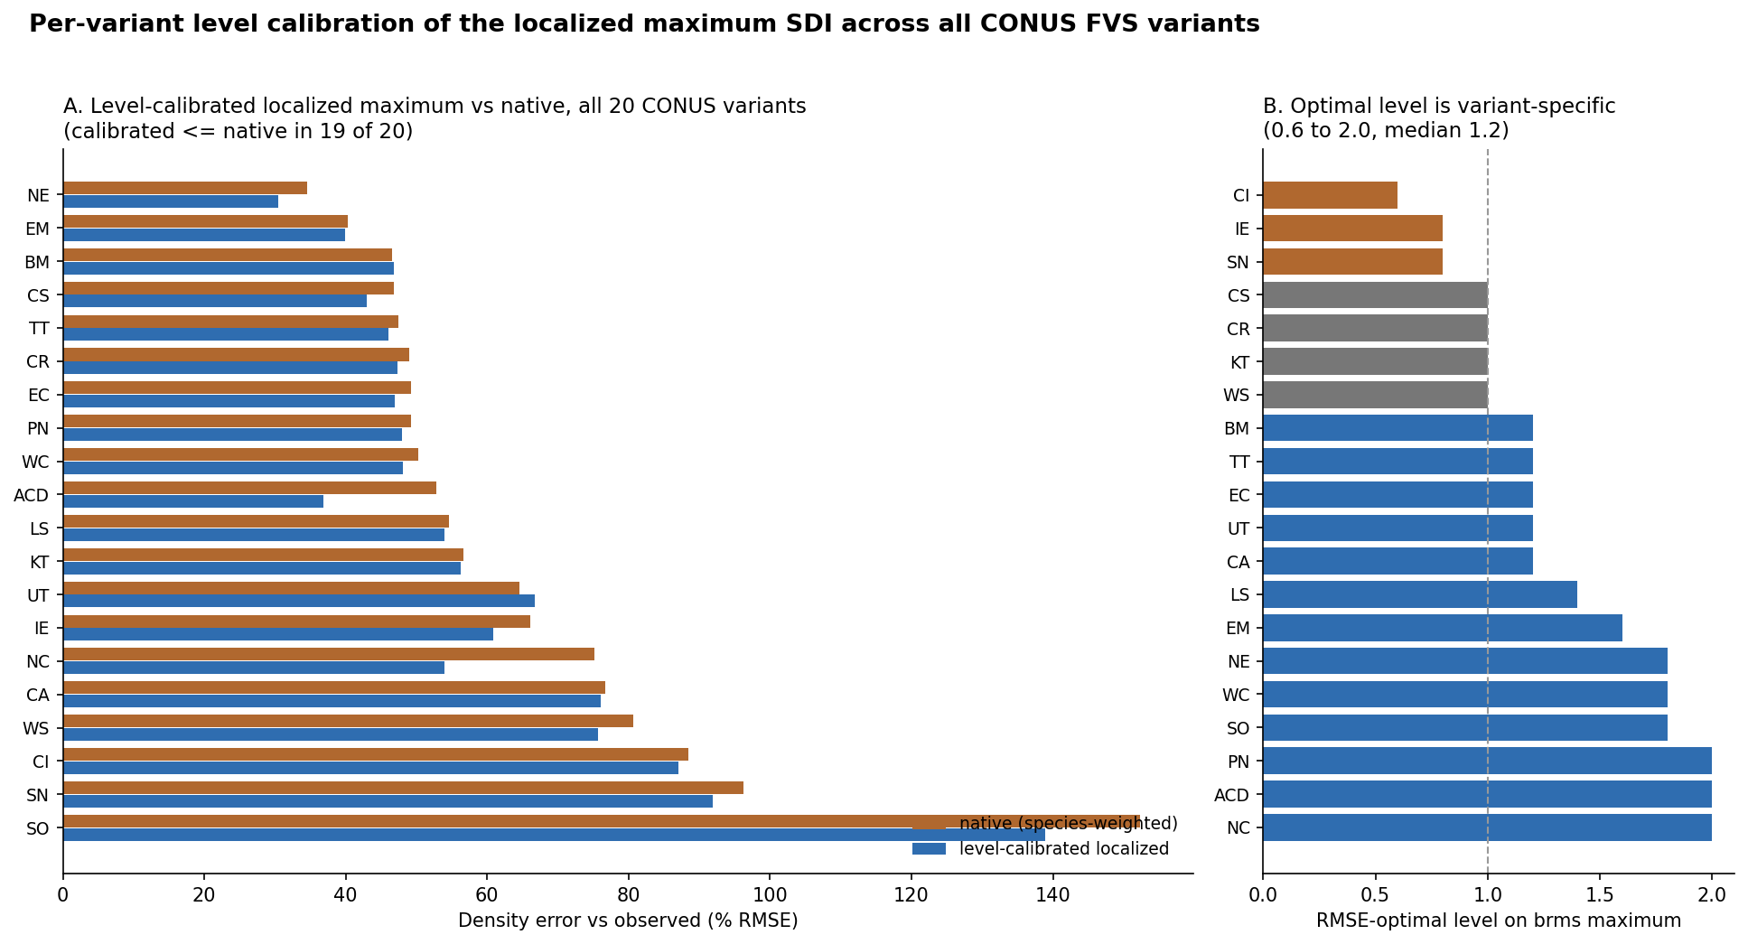
Confirmed across all 20 CONUS variants in the engine
STEP 2
Each variant needs its own level (0.6 to 2.0, median 1.2); the level tracks its native bias, so it is calibrated jointly with mortality, not dropped in uniformly
A level-calibrated localized maximum matches or beats native in 19 of 20 variants

Slide 8
Step 3
Refit the component equations as one CONUS variant
Move away from 20 separately maintained regional variants

Slide 9
One trait-aware set, built on two axes
STEP 3
Species-dependent
(per-species fit)
Species-independent
(trait-driven, species-free)
Tree-level
Growth, height-diameter, crown, survival, ingrowth fit per species
Same components from a trait and climate form; covers rare species
Stand-level
Composition-driven density and basal area
Density and basal area on the localized maximum SDI (Step 2)
A per-species shrinkage blend joins the two columns: known species keep their fit, rare species fall back to traits
One variant, all species, with calibrated uncertainty

Slide 10
Early evidence: competitive, and strong on rare species
STEP 3
0.091
0.097
0.118
our species-dependent
RMSE (cm/yr)
Greg Johnson
species-specific RMSE
our species-free,
zero Douglas-fir data
Douglas-fir diameter growth: competitive with a species-specific model, and within about 22 percent predicting a species it has never seen, exactly the rare-species case regional variants do not cover
The trait leg covers the species the regional variants cannot

Slide 11
Status and where your input would help
Step 1 — FIA modifiers
Mortality, crown, height-diameter calibrated for all 25 variants; growth multipliers still being completed
Step 2 — Maximum SDI
Validated in analysis as a better self-thinning predictor; not yet in production config; adopt jointly with mortality
Step 3 — CONUS variant
Equations fit and banked; engine injection prototyped, not merged
We would value FVS-team guidance on: the maximum-SDI source and SDI convention, the engine integration path for the CONUS equations, and the benchmark protocol to match.
Three steps, each improving FVS, with a clear path to one modern CONUS variant

Slide 12
Discussion
Detailed technical report and data available on request
aaron.weiskittel@maine.edu

