Slide 1

Toward CONUS-wide FVS component equations
and a localized, data-derived maximum stand density index
Briefing for the USDA Forest Service FVS team
A. Weiskittel and collaborators | Center for Research on Sustainable Forests | 14 June 2026

Slide 2
Why one CONUS variant
20 regional variants
Rare species thinly served
National analyses are awkward
Different functional forms and species coverage, separately maintained, hard to keep current
Per-species fits leave uncommon species with weak or no support
Carbon, fuels, and climate work need one consistent engine across regions
University of Maine | Center for Research on Sustainable Forests
A unified, trait-aware set keeps every species supported and national analyses consistent

Slide 3
Two design axes organize the equations
Species-dependent
(per-species fit)
Species-independent
(trait-driven, species-free)
Tree-level
DG, HG, HT-DBH, crown base, crown ratio, survival, ingrowth fit per species
Same components from a trait and climate form; covers rare and unsampled species
Stand-level
Composition-driven density and basal area behavior
Density and basal area driven by a localized, data-derived maximum SDI
A per-species shrinkage blend (w = n / (n + k)) joins the two columns
Well-sampled species keep their own fit; rare species fall back to the trait form

Slide 4
Where it stands
Tree-level: built
Diameter and height growth, height-diameter, crown base, crown ratio, survival, ingrowth. Three carry a validated refit (annualized crown and crown base, senescence).
Stand-level: prototyped
Age-independent, annualized density, basal area, and top height, in the spirit of Garcia's state-space approach. Not yet wired as a constraint layer.
Integration: in progress
Engine driven today through multipliers and the SDIMAX keyword; injecting the trait-driven equations as the engine's growth functions is the largest remaining task.
Components built and validated; engine injection is the make-or-break remaining work

Slide 5
Clean benchmark: unified beats the regional variants on basal area
Northeast FIA remeasurement, year-0 reproducing observed stand state exactly
-0.6%
+12 to 13%
density
Unified basal area bias
Native NE and ACD bias
the only weakness,
traced to maximum SDI
University of Maine | Center for Research on Sustainable Forests
On the integral that matters most, the unified equations already beat the regional variants

Slide 6
Versus Greg Johnson's CONUS equations (Douglas-fir diameter growth)
0.091
0.097
0.118
Our species-dependent
RMSE (cm/yr)
Greg species-specific
RMSE (cm/yr)
Our species-free,
zero Douglas-fir data
Predicting Douglas-fir from traits alone, having never seen one, lands within about 22 percent of a model fit on 156,000 Douglas-fir observations
University of Maine | Center for Research on Sustainable Forests
Competitive where Greg has data; the trait leg covers the rare species his system cannot

Slide 7
Maximum stand density index
The density limit is one of the most consequential single numbers in any long-term projection

Slide 8
The FVS species-weighted maximum is biased and uninformative
+28%
0.02
not observable
biased high vs an
FIA-derived maximum
bias-corrected R-squared
(near-zero plot skill)
the maximum is latent;
the test must be predictive
Per-species maxima are conservative pure-stand bounds; basal-area-weighting them across a mixed stand overstates the achievable maximum and carries no location signal
Species-weighting predicts the real maximum worse than simply using the overall mean

Slide 9
The non-circular test: does it predict observed self-thinning
Relative density drives self-thinning, so the better maximum is the one whose relative density better predicts observed density loss. 82,130 remeasured plots, deviance explained:
Region
FVS species-weighted
Localized (FIA)
All
0.058
0.107
East
0.072
0.124
West
0.034
0.057
about 85 percent better, in every region
On the only criterion that is not circular, the localized maximum wins everywhere

Slide 10
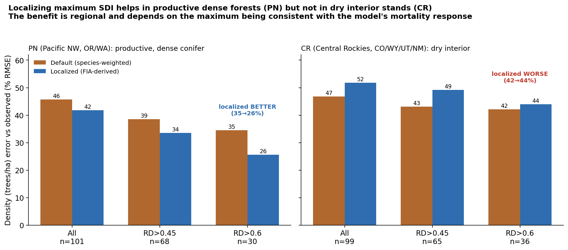
But inside FVS the benefit is regional
Localizing helps dense Pacific Northwest stands and hurts dry interior Central Rockies

Slide 11
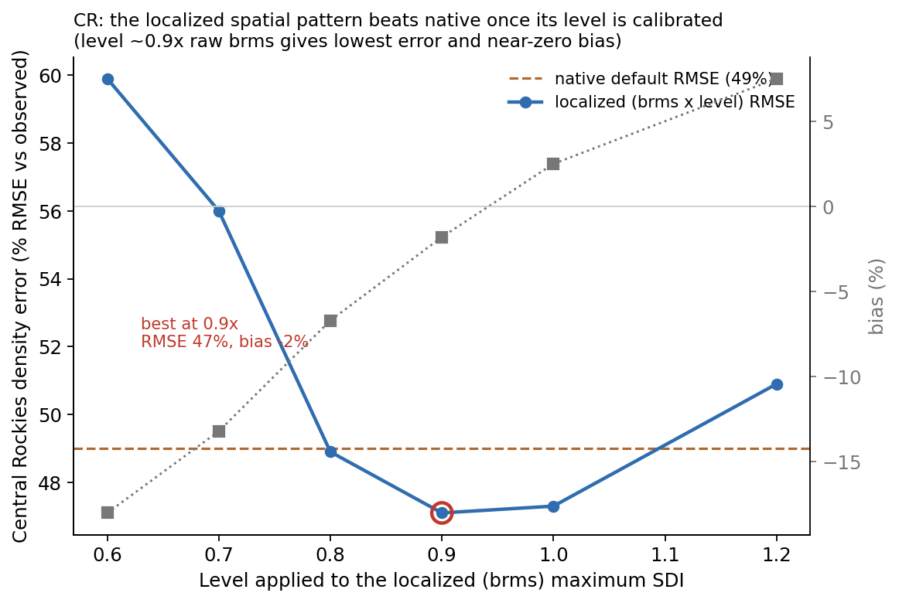
Why: pattern is good, the level needs calibration
•
The FIA maximum carries a spatial pattern and a level
•
A free fit of self-thinning is invariant to the level, so the value is in the pattern
•
In the engine the mortality response is fixed, so the level decides where each stand sits
•
At about 0.9x the raw value, CR beats native with near-zero bias
Adopt the localized spatial pattern; calibrate its level jointly with the mortality response

Slide 12
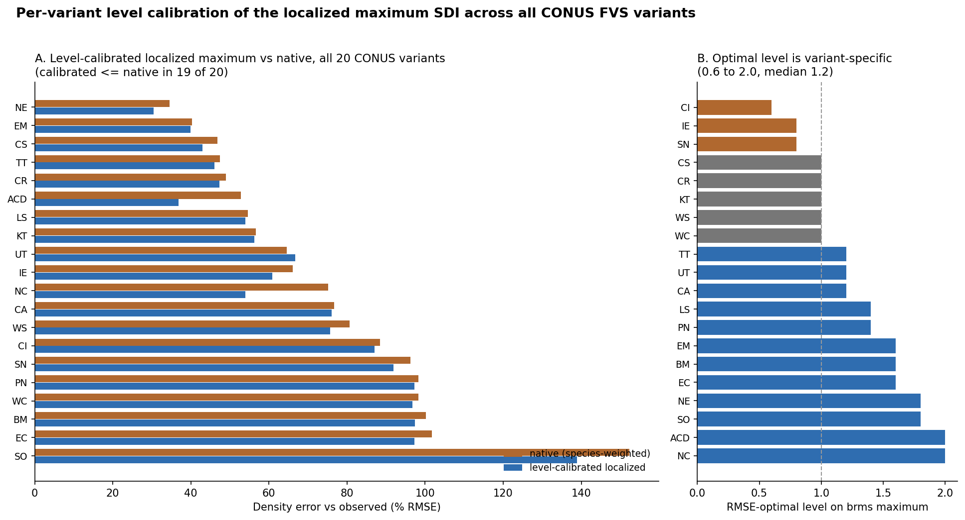
Across all 20 CONUS variants: calibrated localized beats native in 19
Optimal level spans 0.6 to 2.0 (median 1.2): no single global level works, each variant needs its own
A level-calibrated localized maximum matches or beats native in 19 of 20 variants

Slide 13
Where the density limit matters most (7.25 million plots)
Strength of the self-thinning signal varies about four-fold by region
Weakest: dry interior West Utah 0.04, Central Idaho 0.05, Central Rockies 0.06
drought and disturbance dominate mortality
Strongest: moist East, South, PNW Southern 0.14, Blue Mountains 0.12, Pacific NW 0.10, Northeast 0.10
self-thinning is the primary control
Same axis as the projection result: localizing the maximum pays off most where self-thinning governs stand dynamics
Get the maximum right first in the East, South, and moist West

Slide 14
Recommendations for the FVS team
1
Treat maximum SDI as a localized, data-derived stand attribute from the FIA surface, not a species-weighted constant
2
Adopt the spatial pattern and calibrate its level jointly with the density-dependent mortality response
3
Do not ship it as a drop-in SDIMAX override on a native variant without per-region revalidation
4
Guidance welcome on benchmark design, the engine integration path, and the SDI convention to match
Localize the maximum, calibrate the level, and validate by region

Slide 15
Discussion
Companion documents: the maximum-SDI technical report and the CONUS equations briefing
aaron.weiskittel@maine.edu

