Slide 1

The “Shiva runtime environment”
Advancing the programmability of the Linux process address space
Ryan “elfmaster” O’Neill: ryan@bitlackeys.org

Slide 2
What is Shiva exactly?
A weird machine for loading modules into the address space
A custom runtime linker
Fast In-process debugging and instrumentation
A rich API for program transformation, tracing, and debugging.
Think “LKM’s (Loadable kernel modules) but for userland processes”.
A programmable debugging engine that does NOT require the ptrace system call

Slide 3
What can Shiva be used for?
Building debuggers and tracers
Designing process Security modules
  Anti-exploitation, Sandboxing, Process hardening
In-memory fuzzing harnesses
Software profiling
Virus detection engines
Hot-patching code and data
Userland-Rootkit detection & disinfection
Extremely fast instrumentation, hooking, and process injection of all types (Without the use of SYS_ptrace).

Slide 4
From a blackhat perspective
Shiva can be used to crack software
Design powerful in-process rootkits
Modular virus infection

Slide 5
How does Shiva run?
Shiva is a weird machine
Shiva loads the module (ET_REL) from the “/opt/shiva/modules” directory
1. Shiva can be invoked directly as an executable
  Shiva works as a userland-exec to load and map the target executable into its own process address space (See grugqs work on ul_exec: https://grugq.github.io/docs/ul_exec.txt)
  i.e. ./shiva /bin/test_prog
2. Shiva can be invoked indirectly as a runtime interpreter (i.e. the program declares shiva as its dynamic linker)
  The kernel loads the target executable and loads Shiva as the interpreter
  Good for writing modules that are linked at every single execution
  i.e. /bin/test_prog

Slide 6
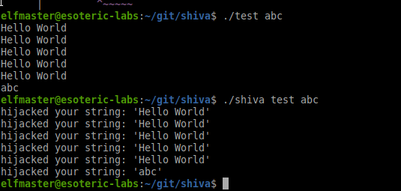
Shiva ran directly on program ./test
Shiva is loading a module: pltgot_hook.o
This module hooks the PLT function ‘puts’ and modifies the string output

Slide 7
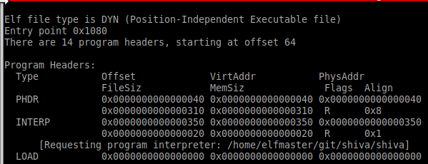
Shiva interpreter path
The INTERP segment contains the path to ‘shiva’ instead of “ld-linux.so”.

Slide 8
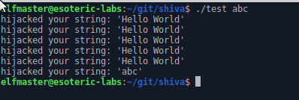
Shiva running as the interpreter for ./test

Slide 9
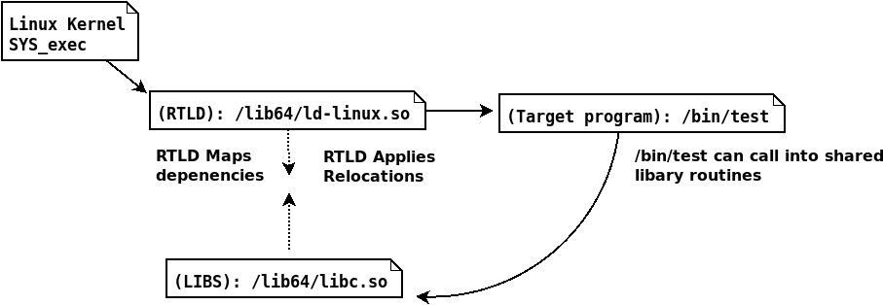
Process execution flow of a normal dynamically linked ELF

Slide 10
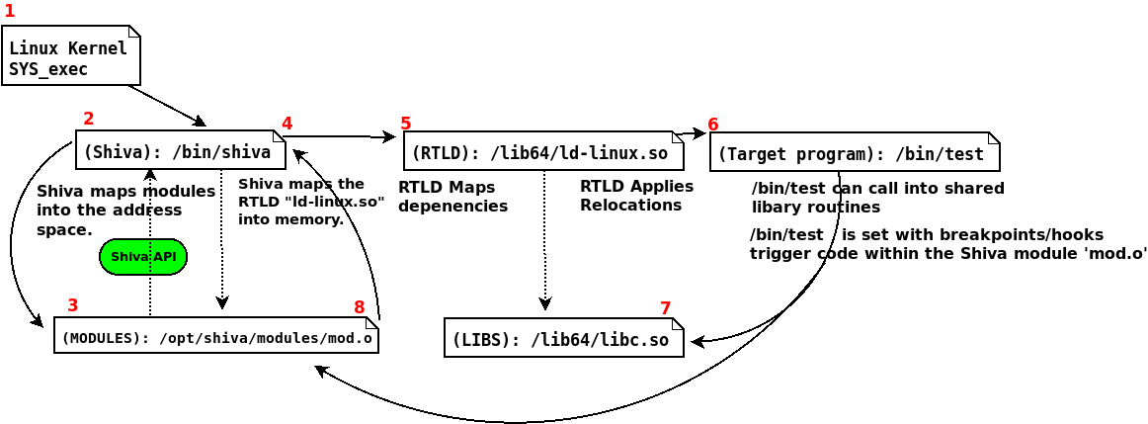
Process execution flow with Shiva as an interpreter.

Slide 11
Understanding Shiva modules
Shiva modules are loaded from: “/opt/shiva/modules”
Similar to LKM (Loadable kernel module):
  Shiva modules are ELF relocatable object
  Shiva modules must have an initialization routine
  int shakti_main(shiva_ctx_t *ctx)

Slide 12
Shiva Module: context struct
The context struct “shiva_ctx_t”
Passed into the modules init function
Contains:
  Register state
  Process-state
  Thread-state
  Control flow data
  Signal data
  Shiva-Trace API specific data structures
  Full access to elfobj_t of target executable

Slide 13
Shiva modules: Linking
Shiva modules use the Shiva_trace API for program instrumentation
Modules are written in C and have access to:
  musl-libc
  libelfmaster
  Libudis86
  Shiva-Trace API
Shiva loader handles loading and linking of modules
The module is an ELF ET_REL (relocatable object file)
Sections are mapped appropriately into memory segments

Slide 14
Shiva modules execute in-process
Shiva modules are executed in-process.
In-process means:
  The Shiva runtime engine is in the same process as the target program
  The module also executes within the same process address space
Instrumentation and hooking is extremely fast
Module has an initialization function
Module init function sets hooks and breakpoints within the target program
Handler functions are callbacks to these hooks and breakpoints

Slide 15
Understanding Shiva modules: gcc code models
Shiva modules are currently compiled with GCC and must be compiled with a large code model (i.e.
gcc -c -mcmodel=large)
A large code model is necessary to handle module relocation offsets that exceed 4GB
On 64bit system: The Shiva executable, the Shiva module, and the target executable will be mapped to addresses that are vastly far apart
In some instances we can and must use a small code model for modules (More on this later)

Slide 16
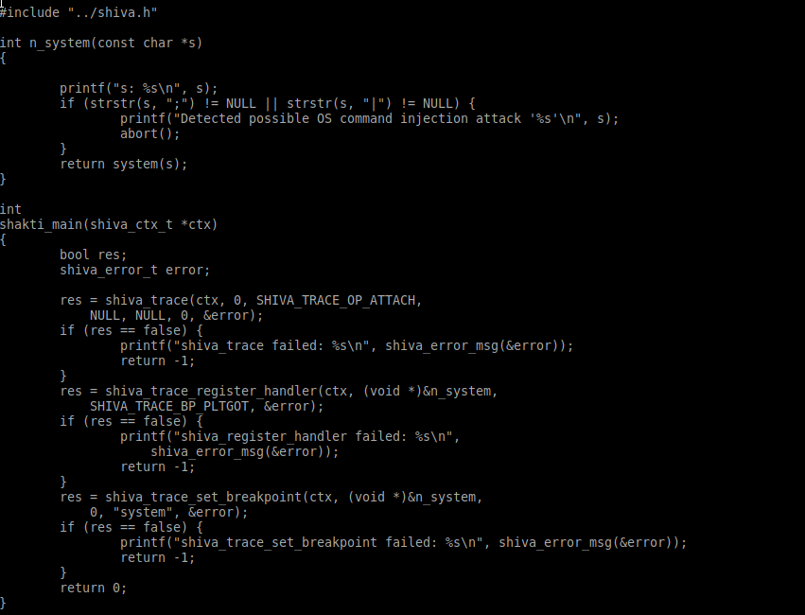
A security module. Prevent command injection via system function

Slide 17
The Shiva API (shiva_trace)
Shiva modules are written in C
The Shiva_trace API can: access, read, transform and instrument the process image.
Rich API for process transformation
Excellent for writing debuggers, tracers, security modules, etc.
In very early development phase

Slide 18
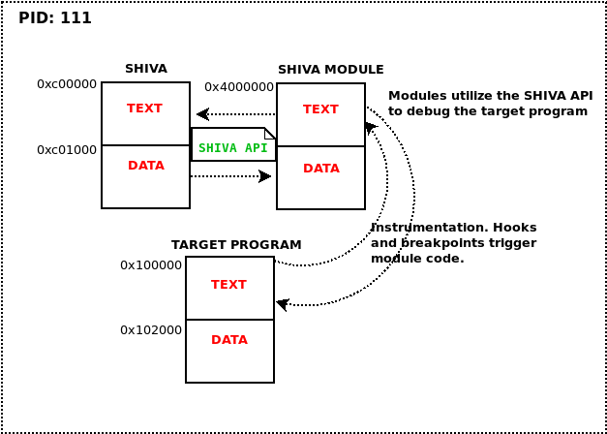
Shiva debugging model

Slide 19
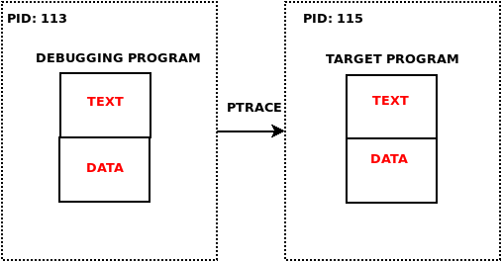
PTRACE Debugging model

Slide 20
Shiva-Trace vs. PTRACE
The Shiva-Trace API does not rely on the PTRACE system call
Shiva-Trace is effective against hardened binaries and anti-debugging
Shiva-Trace is implemented as an “in-process” programmable runtime engine.
PTRACE on the other hand, executes from a separate process context.
PTRACE: Slow. And is useless against many Linux anti-debugging techniques.
PTRACE operations send a SIGSTOP to the target process.
PTRACE is a system call and requires a context switch, whereas Shiva_trace is implemented purely in userland and less expensive.

Slide 21
Shiva Trace p3.
shiva_trace can cleverly instrument the target program at runtime
shiva_trace uses the terminology “Hooks” and “Breakpoints” interchangeably.
Many breakpoints are really just various types of hooks
shiva_trace can defeat anti-debugging techniques
Powerful for debugging hostile binaries

Slide 22
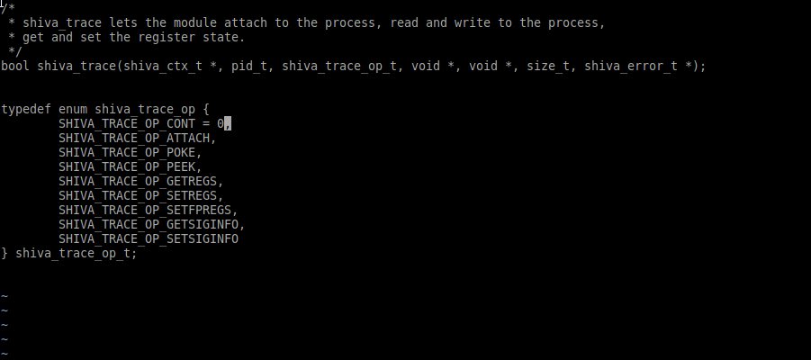
Shiva API basics: shiva_trace()

Slide 23
Shiva-Trace API - Breakpoints
Breakpoints are registered to a handler function
Similar to Linux Kprobes, but for userland
Multiple breakpoints can be set for a single handler
Some breakpoints are hooks
Some breakpoints are signal driven
A complex series of in-process trampolines

Slide 24
Shiva breakpoints and signals
We do not use PTRACE to catch signals
Our debugging module exists within the same PID as the program it’s debugging
Signal driven breakpoints (i.e. int3) register a handler internally with sigaction()
Shiva internally hooks signal() and sigaction() in the target program to prevent the target from overwriting breakpoint handlers

Slide 25
A look at all Shiva breakpoint types
typedef enum shiva_trace_bp_type {
SHIVA_TRACE_BP_JMP = 0,
SHIVA_TRACE_BP_CALL,
SHIVA_TRACE_BP_INT3,
SHIVA_TRACE_BP_SEGV,
SHIVA_TRACE_BP_SIGILL,
SHIVA_TRACE_BP_TRAMPOLINE,
SHIVA_TRACE_BP_PLTGOT
} shiva_trace_bp_type_t;

Slide 26
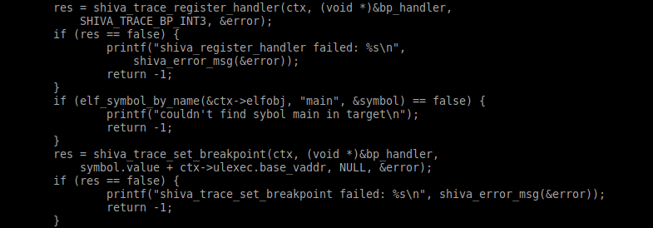
Setting hooks and breakpoints
Breakpoints/hooks are registered to a handler function

Slide 27
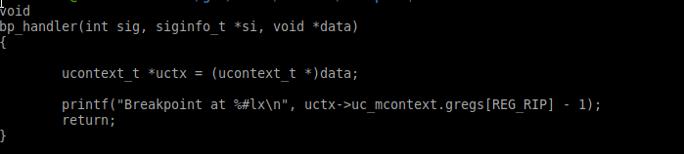
Basic handler function

Slide 28
SHIVA_TRACE_BP_JMP
Breakpoint type: Control flow hook
Set on 5 byte jmp instructions
The jmp offset is replaced by an offset to your registered handler function
When done, the handler jumps back to the original target.
SHIVA_TRACE_LONGJMP_RETURN macro: rewinds the stack and jmp’s to the original offset
Defeats breakpoint detection with anti-debugging

Slide 29
SHIVA_TRACE_BP_CALL
Breakpoint type: Control flow hook
Set on 5 byte immediate call instructions
Original call target is replaced with offset to registered handler
The registered handler returns after calling the original function (If desired)
Extremely fast way to build a function tracer: (See modules/examples/func_tracer.c)
Only works when executing Shiva directly (Not as an interpreter) due to required small-code model.
Defeats breakpoint detection

Slide 30
SHIVA_TRACE_BP_TRAMPOLINE
Breakpoint type: Control flow hook
This type of breakpoint inserts a trampoline on the entry point of the function
  movq $target_addr, %rax
  jmp *%rax
Excellent for hooking any function locally or globally within the address space
Trampoline function restores the original code bytes before calling the original function
Not currently thread-safe. Memcpy’s that place and restore hooks are not atomic operations
Works well in a large code model whereas call hooks do not.

Slide 31
SHIVA_TRACE_BP_PLTGOT
Hook any shared library function within the PLT/GOT
Modifies the .got.plt[entry] of the given symbol
Was tricky to implement. The RTLD wants to patch over our GOT patch. (i.e. with DT_BINDNOW)
Very low overhead, and thread safe
Handler is usually a hook-replacement function for the function being hooked
A single handler can also be used for multiple PLTGOT hooks. (i.e. Any PLT call triggers the same handler)

Slide 32
SHIVA_TRACE_BP_INT3
Breakpoint type: Signal driven
Traditional int3 breakpoint uses 0xcc opcode
Causes kernel to deliver SIGTRAP
The breakpoint handler is essentially a signal handler
Uses struct ucontext to get register state in this case, as any signal handler would
If the target program already had a SIGTRAP handler: ours replaces it, and optionally can invoke the original handler

Slide 33
SHIVA_TRACE_BP_SIGILL
Breakpoint type: Signal driven
This breakpoint inserts a two byte ud2 (undefined instruction) to trigger SIGILL. “\x0f\x0b\”
Breakpoint is registered to your signal handler function
Can be helpful against hardened binaries that perform anti-debugging on standard breakpoints

Slide 34
SHIVA_TRACE_BP_SEGV
Breakpoint type: Signal driven
Breakpoint code:
  push <invalid_offset>(%rip)
Shiva_trace API inserts an instruction with an invalid offset or address
Causes an invalid memory dereference, and thus a SIGSEGV
The handler function is a signal handler that catches the SEGV, and executes your custom code

Slide 35
Reading and writing to process memory
The shiva_trace() API call
SHIVA_TRACE_OP_PEEK
  Allows the module to read anywhere in process memory
SHIVA_TRACE_OP_POKE
  Allows the module to write anywhere in process memory (Except to the Shiva code itself)

Slide 36
Getting and setting register state
The shiva_trace API call
SHIVA_TRACE_OP_GETREGS
  Get the current register values
SHIVA_TRACE_OP_SETREGS
  Set the register values

Slide 37
In-process debugging tools with Shiva
When running Shiva directly it can be used for creating powerful debugging tools
“In-process” debugging technology is extremely fast
Less context switching, more in-process trampolines
modules/examples/func_tracer.c is a module for function tracing
Sets a SHIVA_TRACE_BP_CALL hook on every immediate call
Registered handler function simply prints each function name being called

Slide 38
Shiva module: func_tracer.o
func_tracer.c
Only 84 lines of code
Much faster than tracers that are written using PTRACE
Benchmarks demonstrating performance:
Command ./test:
  Real 0m0.052s
Tracing ./test with Shiva:
  Real 0m0.155s
Tracing ./test with /bin/ltrace
  Real 0m3.582

Slide 39
Control flow integrity: ret2PLT protection
modules/examples/plt_cfi.c
Only 109 lines of code
Forward edge / Backward edge CFI
Sets a SHIVA_TRACE_BP_PLTGOT hook on every PLT call
shiva_trace_set_breakpoint() installs hooks/breakpoints and stores CFI data in breakpoint struct
Every PLT call is redirected to our modules handler:
int plt_handler(void *arg)

Slide 40
Ret2plt handler function
int plt_handler(void *arg)
Checks the return address
Prevents arbitrary calls to the PLT
A ret2PLT attack will fail against this

Slide 41
Mitigate OS command injection
modules/examples/os_inject.o
Only 48 lines of code
SHIVA_TRACE_BP_PLTGOT hook on system() function
Replaced with secure function n_system()
n_system() sanitizes the command string

Slide 42
Crack software
./crackme
Shiva module to crack serial number validator
modules/examples/crackme_bypass.o
Redirects: int check_serial(char *serial)
To a modified version of the function
Uses a SHIVA_TRACE_BP_TRAMPOLINE breakpoint

Slide 43
Shiva for debugging hardened binaries
There is a long history of anti-debugging techniques
PTRACE system call is easily foiled
PTRACE fails on PaX hardened binaries
  mprotect restrictions prevent ptrace(PTRACE_POKETEXT, …);
Shiva maps the hostile/hardened program into it’s own address space
In-process debugging can be very effective for Reverse engineering tough problems

Slide 44
Tracing a hardened binary
modules/examples/func_tracer.o
Capable of tracing binaries with anti-debugging
test_antidebug.c: Simple anti-debugging techniques
  ptrace(PTRACE_TRACEME, 0, 0, 0, 0);
  prctl(PR_SET_DUMPABLE, 0, 0, 0, 0);

Slide 45
Shiva works on stripped ELF binaries
Corrupted meta-data
Missing symbol tables
Missing section header table
Shiva uses libelfmaster:https://github.com/elfmaster/libelfmaster
Forensic reconstruction of stripped binaries:
  Symbol table reconstruction
  Section header table reconstruction

Slide 46
Tracing a stripped binary
ltrace fails to get any tracing info:
  Requires section headers and symbol tables
Our Shiva module for function tracing succeeds
  Forensically reconstructs section and symbol data

Slide 47
Current limitations
Shiva doesn’t work on ELF’s with -fcf-protection
Shiva can load only one module at a time
Shiva only works with x86_64 ET_DYN binaries
  Will add support for x86_64 ET_EXEC
Running Shiva as an interpreter requires a large code model for all modules
  Some Shiva features require a small code model (i.e. SHIVA_TRACE_BP_CALL breakpoints

Slide 48
Future plans
Open source the technology
Continue to develop and expand the usability and functionality
shiva-gcc wrapper for modules
Design a suite of security modules for process hardening
Handle loading multiple modules

Slide 49
Related works
Linux kprobe instrumentation
  http://phrack.org/issues/67/6.html
Preloading the linker for fun and profit
  https://tmpout.sh/2/6.html
Embedded ELF debugging (by Mayhem & ERESI)
  http://phrack.org/issues/63/9.html
Userland exec implementation (By the Grugq: )
  https://grugq.github.io/docs/ul_exec.txt

Slide 50
Questions?
Ryan@bitlackeys.org
Bitlackeys.org
https://github.com/elfmaster/shiva

Slide 51
Questions?

