Slide 1
Proposal of Final Project
Authors Maarten Bieshaar
Richard Borkowski
Sijia Li
Andreas Stavropolous

Slide 2
Scene
First view: Camera in the center of the campus is located on the ground.
In front of the main entrance.
A helicopter flies to the camera.
Helicopter picks the camera up.
The camera begins to fly around.
The helicopter lands on a table which is located somewhere in the main yard.
With wine glass, ancient Greek temple and Tour Eiffel.

Slide 3
Effects
Rotation of the rotors of the helicopter
Blur and reflection/ global illuminiation
Fog (only near ground)
Sky-dome
Light refraction with transparent object (glass)

Slide 4
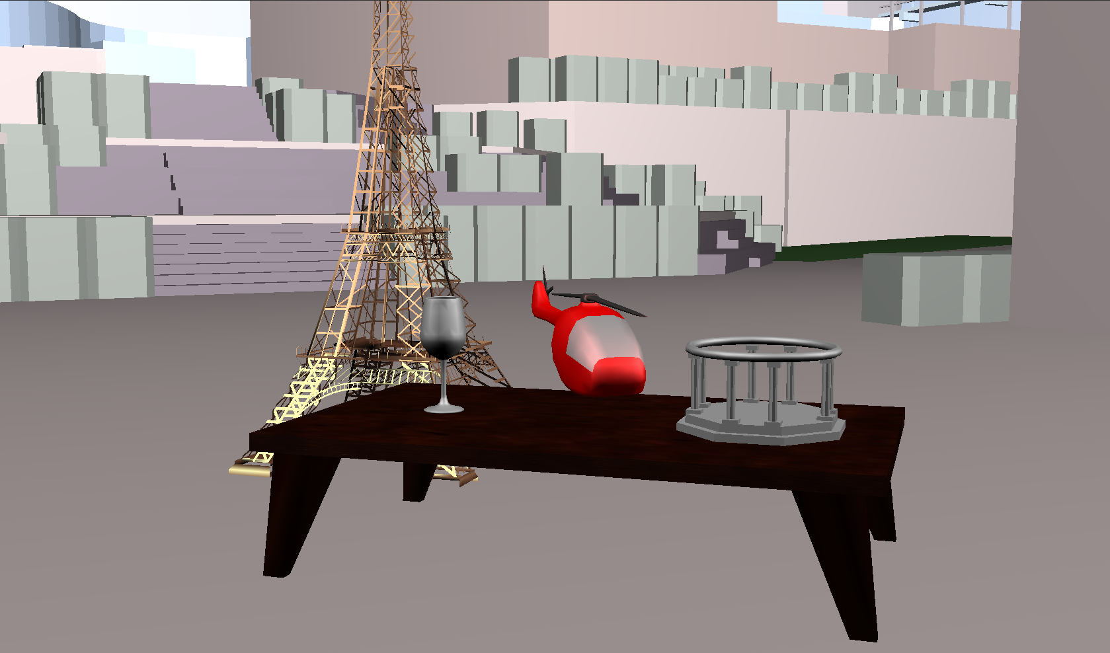
Screenshot of scene

