Slide 1


Advanced Rendering ST 2013
Prof. Gitta Domik, Dipl. Inform. Stephan Arens
Project ExtraBees
Authors
Maarten Bieshaar
Richard Borkowski
Sijia Li
Andreas Stavropoulos

Slide 2
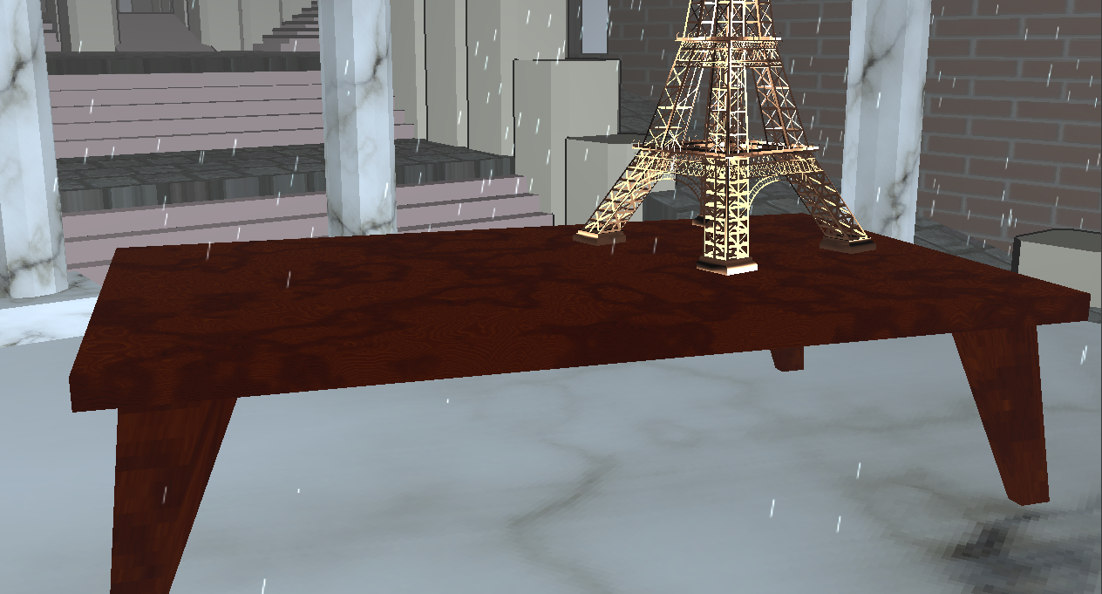
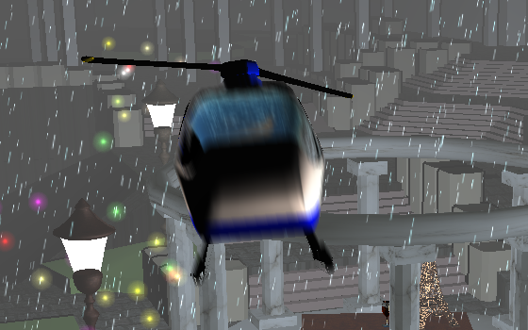
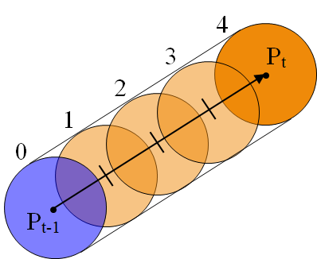
Table, Particle System, Shader, Post Processing
Maarten
basic scene graph programming
table with Mahagony wood texture and normal map
CPU based particle system
basic framework
supports simple physics
renders particles as point sprites
rain, fire and fireflies as realization of particle system
shader manager
avoid overhead by integration of shader in state machine
shader programming
distance fog
toon shader with colors
post processing
motion blur
taken from Stupid OpenGL Shader Tricks
by Simon Green

Slide 3
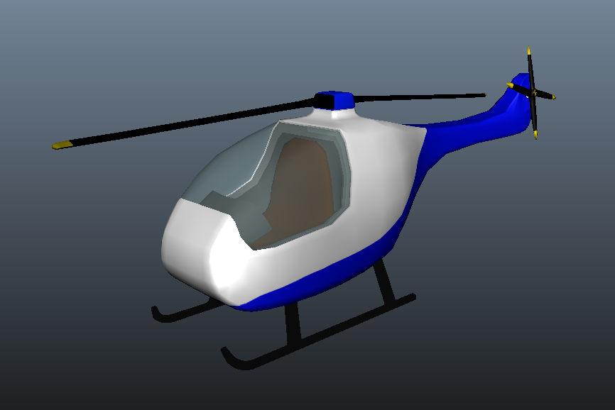

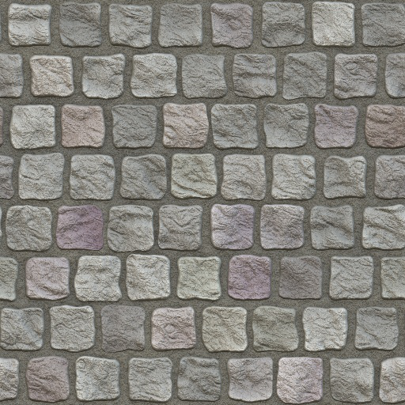
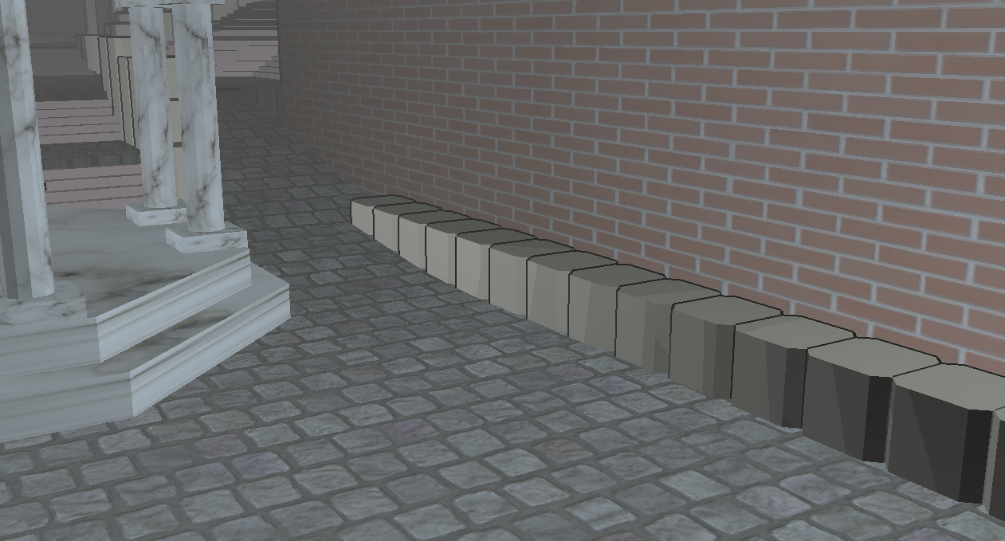
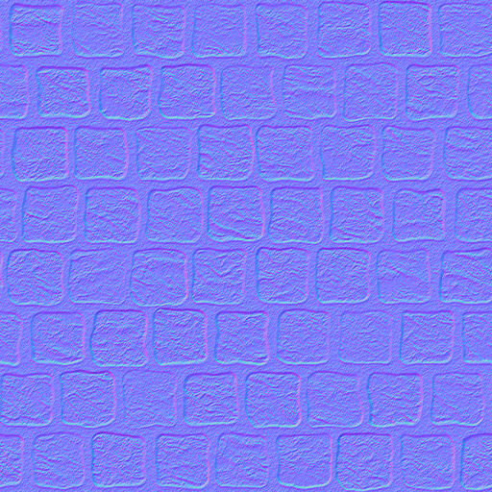
Helicopter, Animation
Richard
Basic scene graph programming and positioning of the scene, animation, texturing
Helicopter model (~2500 polygons)
Helicopter and camera paths are realized with bezier paths (7 paths with 4 to 10 control points)
in the video: window with reflection via dynamic cubemap
Used particle system to create flame effect.
Emitter in form of an ellipsoid
Normal Mapping
Two textures per Object
Second texture contains normals based on the first color texture
Shader uses the second texture to get the new normal vector for basic phong shading equation

Slide 4
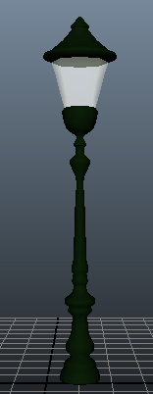
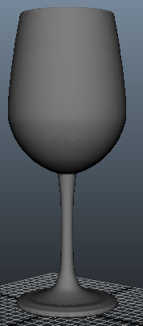
Glass and Lamps
Sijia
Glass Model by Maya
Lamp Model by Maya
Combine some Models to overview the performance in Maya
Dynamic CubeMap Reflection on Glass
Second Camera Path by Bezier Curve
Some configuration stuffs on Fireflies

Slide 5
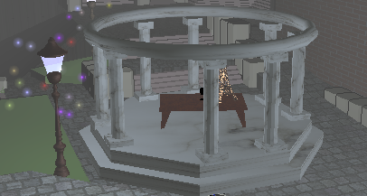
Temple, Firefly effect
Andreas
Temple
Modeled with maya
comprised of polygon cubes and cylinder
textured so it is look like made of marble
Firefly effect
Used particle system to create this effect
Particles are moving around the lamps in our scene in various colors and random movement variations
Particles have various colors and they give the impression of glowing

Slide 6
Summary
Programming
Scenegraph Maarten, Richard Shadermanager Maarten Particle system Maarten Dynamic cube-mapping Maarten, Richard, Sijia
Modelling
Table Maarten Helicopter Richard Glass, Lamp Sijia Temple Andreas
Animation Helicopter Richard Bezier-Curves Richard, Sijia Particle effects Rain Maarten Flame Richard Fireflies Andreas, Maarten
Shader Fog, Motion Blur, ColorToon Maarten Normal-mapping Richard

Slide 7
Advanced Rendering ST2013
Prof. Gitta Domik, Dipl. Inform. Stephan Arens
Thank you for listening!

