Slide 1
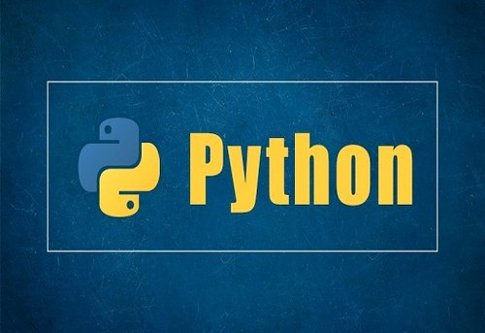
PREPARED BY:
NIRALA LAMICHHANE

Slide 2
What is if...else statement in Python?
Decision making is required when we want to execute a code only if a certain condition is satisfied
Syntax of if...else
if test expression:
Body of if
else:
Body of else
The if..else statement evaluates test expression and will execute the body of if only when the test condition is True.
If the condition is False, the body of else is executed. Indentation is used to separate the blocks.

Slide 3
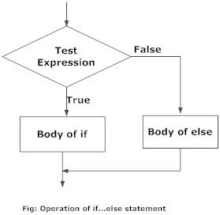
Python if..else Flowchart

Slide 4
Example: Python if...else Statement
# Program checks if the number is positive or negative
# And displays an appropriate message
num = 3
# Try these two variations as well.
# num = -5
# num = 0
if num >= 0:
print("Positive or Zero")
else:
print("Negative number")

Slide 5
Syntax of if...elif...else
if test expression:
Body of if
elif test expression:
Body of elif
else:
Body of else
The elif is short for else if. It allows us to check for multiple expressions.
If the condition for if is False, it checks the condition of the next elif block and so on.
If all the conditions are False, the body of else is executed.
Only one block among the several if...elif...else blocks is executed according to the condition.
The if block can have only one else block. But it can have multiple elif blocks.

Slide 6
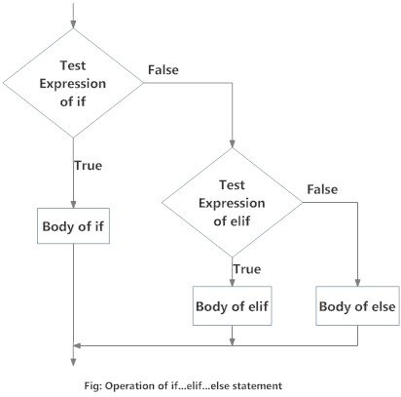
Flowchart of if...elif...else

Slide 7
Example:
''In this program, we check if the number is positive or negative or zero and display an appropriate message''
num = 3.4
# Try these two variations as well:
# num = 0
# num = -4.5
if num > 0:
print("Positive number")
elif num == 0:
print("Zero")
else:
print("Negative number")

Slide 8
Nested if Example:
'''In this program, we input a number check if the number is positive or negative or zero and display an appropriate message This time we use nested if statement'''
num = float(input("Enter a number: "))
if num >= 0:
if num == 0:
print("Zero")
else:
print("Positive number")
else:
print("Negative number")

Slide 9
What is while loop in Python?
The while loop in Python is used to iterate over a block of code as long as the test expression (condition) is true.
We generally use this loop when we don't know the number of times to iterate beforehand.
Syntax of while Loop
while test_expression:
Body of while
In the while loop, test expression is checked first. The body of the loop is entered only if the test_expression evaluates to True. After one iteration, the test expression is checked again. This process continues until the test_expression evaluates to False.

Slide 10
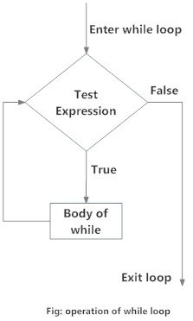
Flowchart of while Loop

Slide 11
Example: Python while Loop
# Program to add natural
# numbers up to
# sum = 1+2+3+...+n
n = 10
# initialize sum and counter
sum = 0
i = 1
while i <= n:
sum = sum + i
i = i+1 # update counter
# print the sum
print("The sum is", sum)

Slide 12
While loop with else
'''Example to illustrate the use of else statement with the while loop'''
counter = 0
while counter < 3:
print("Inside loop")
counter = counter + 1
else:
print("Inside else")

Slide 13
What is for loop in Python?
The for loop in Python is used to iterate over a sequence (list, tuple, string) or other iterable objects. Iterating over a sequence is called traversal.
Syntax of for Loop
for val in sequence:
Body of for
Here, val is the variable that takes the value of the item inside the sequence on each iteration.
Loop continues until we reach the last item in the sequence.

Slide 14
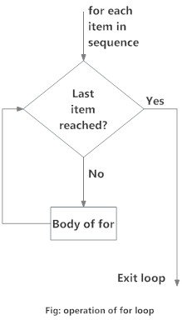
Flowchart of for Loop

Slide 15
Example:
# Program to find the sum of all numbers stored in a list
# List of numbers
numbers = [6, 5, 3, 8, 4, 2, 5, 4, 11]
# variable to store the sum
sum = 0
# iterate over the list
for val in numbers:
sum = sum+val
print("The sum is", sum)

Slide 16
The range() function
We can generate a sequence of numbers using range() function. range(10) will generate numbers from 0 to 9 (10 numbers).
We can also define the start, stop and step size as range(start, stop,step_size). step_size defaults to 1 if not provided.
Some examples:
print(list(range(10)))
print(list(range(2, 8)))
print(list(range(2, 20, 3)))

Slide 17
# Program to iterate through a list using indexing
genre = ['pop', 'rock', 'jazz']
# iterate over the list using index
for i in range(len(genre)):
print("I like", genre[i])

Slide 18
Nested For Loop:
for i in range(2):
print(" outer loop", i)
for j in range(3):
print(" inner loop", j)
print(" END")

Slide 19
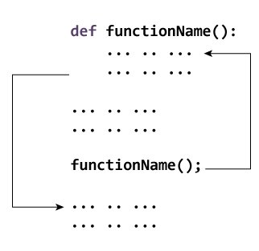
What is a function in Python?
In Python, a function is a group of related statements that performs a specific task.
Functions help break our program into smaller and modular chunks.
Syntax of Function
def function_name(parameters):
"""docstring"""
statement(s)

Slide 20
def greet(name):
"""This function greets to the person passed in as a parameter"""
print("Hello, ", name , ". Good morning!")
How to call a function in python?
Once we have defined a function, we can call it from another function, program or even the Python prompt. To call a function we simply type the function name with appropriate parameters.
>>> greet('Nirala')
Hello, Nirala. Good morning!

Slide 21
The return statement
The return statement is used to exit a function and go back to the place from where it was called.
Syntax of return
return [expression_list]

Slide 22
Scope of variables
Scope of a variable is the portion of a program where the variable is recognized. Parameters and variables defined inside a function are not visible from outside the function. Hence, they have a local scope.
Here is an example to illustrate the scope of a variable inside a function
def my_func():
x = 10
print("Value inside function:",x)
x = 20
my_func()
print("Value outside function:",x)
Output:
Value inside function: 10
Value outside function: 20

Slide 23
Errors
We can make certain mistakes while writing a program that lead to errors when we try to run it. A python program terminates as soon as it encounters an unhandled error. These errors can be broadly classified into two classes:
Syntax errors
Logical errors (Exceptions)
Python Syntax Errors
Error caused by not following the proper structure (syntax) of the language is called syntax error or parsing error.
Let's look at one example:
>>> if a < 3
File "<interactive input>", line 1
if a < 3
^
SyntaxError: invalid syntax

Slide 24
Python Logical Errors (Exceptions)
Errors that occur at runtime (after passing the syntax test) are called exceptions or logical errors.
For instance, they occur when we try to open a file(for reading) that does not exist (FileNotFoundError), try to divide a number by zero (ZeroDivisionError), or try to import a module that does not exist (ImportError).
Example:
numerator =10
denominator =0
print(numerator/denominator )

Slide 25
Exceptions Handling
Exception handling is the process of responding to exceptions in a custom way during the execution of a program.
try:
#code that may cause exception
Except:
#code to run when the exception occurs

Slide 26
Example:
try:
num=int(input("enter a numerator"))
den=int(input("enter a denominator"))
result=num/den
print(result)
except:
print(" denominator cannot be zero.please try again")

