Slide 1
E-Tourism
Project Member Name-
Anil Rode
Suraj Sawant
Sushant Padale
Project Guide-
Prof. Ravindra V. Kerkar

Slide 2
Introduction
The sum of the phenomena and relationship arising from the travel and stay of on residents
Its provide reservation Facility to there customer
Maximize travel policy compliance all areas including best fares,allowances and approval

Slide 3
OBJECTIVE
The objective of the project is to develop a system that automates the processes and activities of a travel and tourism agency.
The purpose is to design a system using which one can perform all operations related to traveling and sight-seeing.

Slide 4
PROPOSED SYSTEM
The proposed system is a web based application and maintains a centralized repository of all related information.
The system allows one to easily access the relevant information and make necessary travel arrangements.
Users can decide about places they want to visit and make bookings online for travel and accommodation.

Slide 5
E-Tourism Platforms and Tools
Online travel agencies (OTAs) and booking platforms
Travel comparison websites
Mobile apps for travel planning and navigation
Virtual reality (VR) and augmented reality (AR) in tourism

Slide 6
Benefits of E-Tourism for User
Convenience and accessibility
Personalization and customized travel experiences
Cost savings and deals through online bookings
Access to reviews and recommendations from other User

Slide 7
Benefits of E-Tourism for Admin
Expanded reach and global exposure
Direct communication with customers
Data analytics and customer insights
Efficient inventory and resource management

Slide 8
Challenges in E-Tourism
Digital divide and accessibility issues
Cybersecurity and data privacy concerns
Maintaining a balance between technology and human touch
Competition and market saturation in the online travel industry

Slide 9
Future of E-Tourism
Predictions for the future of e-tourism
Emerging technologies and their potential impact on the travel industry
Opportunities for innovation and growth

Slide 10
Modules
1. Administrator module –
This module provides administrator related functionality. Administrator manages all information and has access rights to add, delete, edit and view the data related to places, travels, routes, bookings, Enquiries etc.
2. User(Traveler) module - User can register your self for booking.
3. Guest user- Guest user can visit the website and view the all content of website. Guest user can also Enquiry.

Slide 11
Hardware & Software Configuration
Operating System:Linux Mint 21
Front End : PHP,HTML,CSS,JavaScript
Back End : MY-SQL
Editor Tool : Visual Studio
Web Browser : Google Chrome, Firefox
Intel Core i3
Processor RAM : 4GB or above

Slide 12
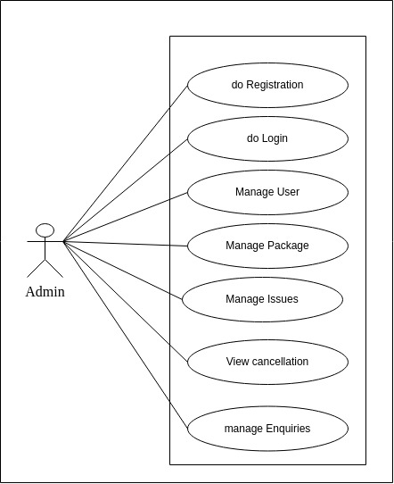
Use Case Diagram(Admin)

Slide 13
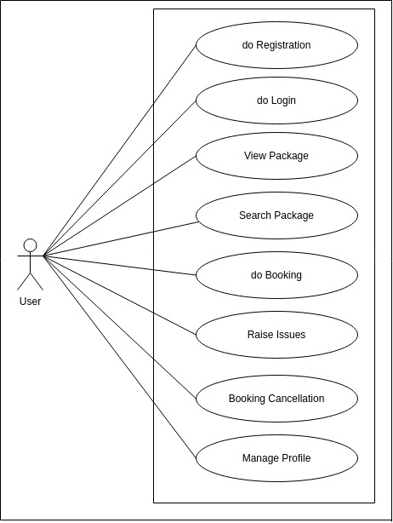
Use Case Diagram(User)

Slide 14
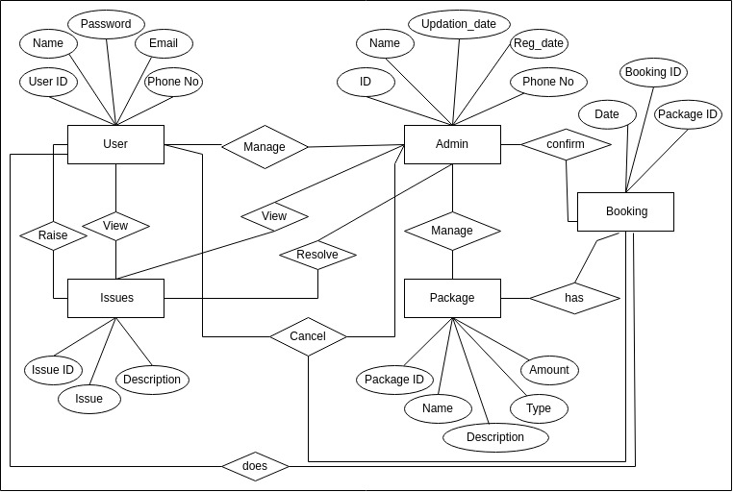
E-R Diagram

Slide 15
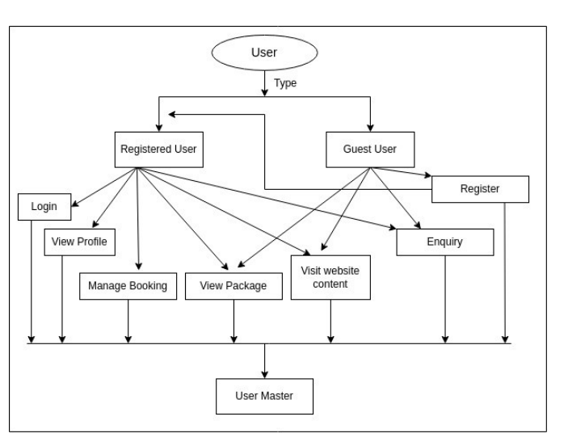
DFD User Diagram

Slide 16
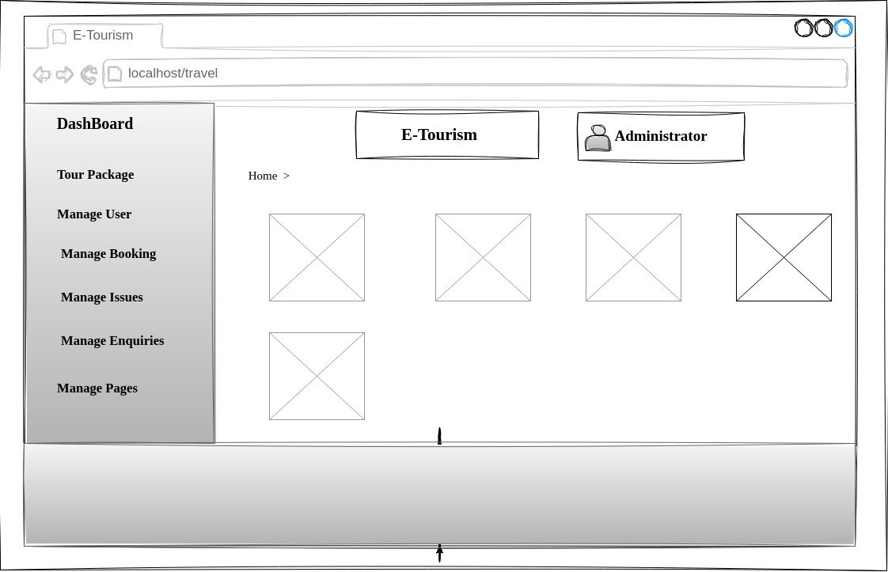
Wireframe Dashboard

Slide 17
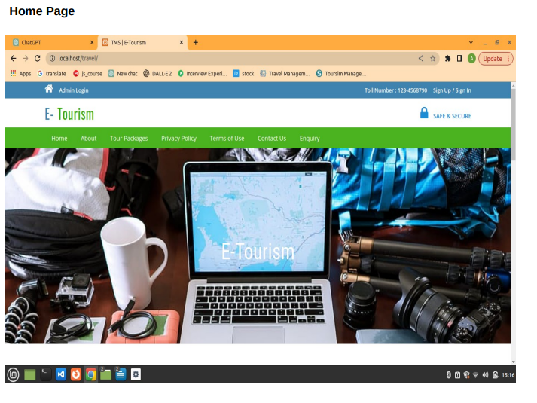

Slide 18
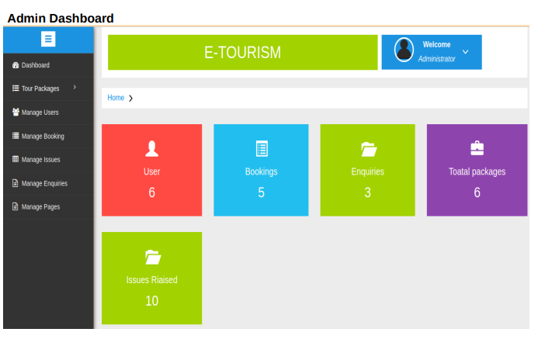

Slide 19
Conclusion
Fast Processing and Immediate result with high security.
Minimizing human effort and cost efficient database
Navigation through the site is easy.
User-friendly interface

Slide 20
Thank You

