Slide 1




SMART INDIA HACKATHON 2026
  Problem Statement ID – SIH26093
  Problem Statement – AI-Based Real-Time Stress & Trauma Assessment
  Theme – MedTech / BioTech / HealthTech
  PS Category – Software
  Team ID – TBA
  Team Name (Registered on portal) – ALT F4

Slide 2





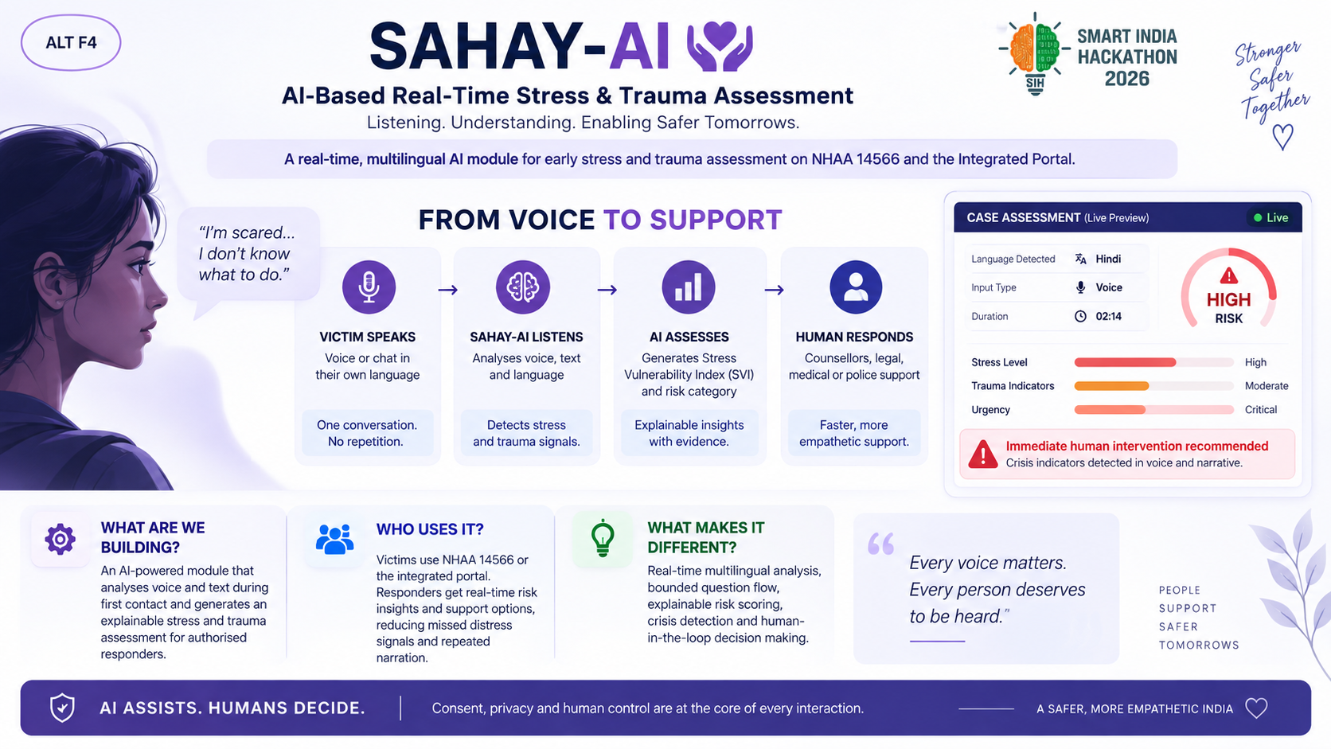
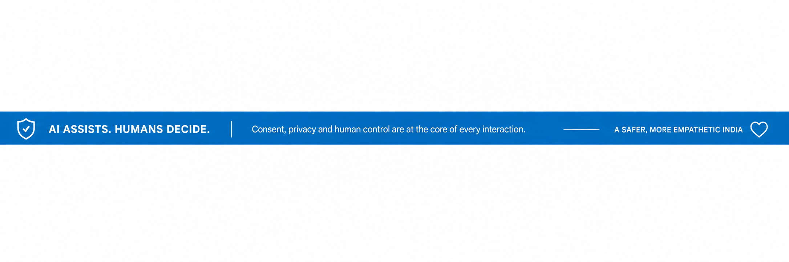
ALT F4
SAHAY-AI
AI - Based Real-Time Stress & Trauma Assessment
Listening. Understanding. Enabling Safer Tomorrows.
A real-time, multilngual AI module for early stress and trauma assessment on NHAA 14566 and the integrated portal
I’m scared...
I don't know
what to do
FROM VOICE TO SUPPORT
VICITM SPEAKS
Voice or chat in
their own language
SAHAY-AI LISTENS
Analyses, voice, text and language
AI ASSESSES
Generates Stress Vulnerability Index
(SVI)
HUMAN RESPONSE
Consellors, legal, medical, police support
One conversation.
No repetition
Detects stress and trauma signals
Explaniable insights
with evidence
Faster, more
empathetic support.
@SIH Idea submission- Template

Slide 3
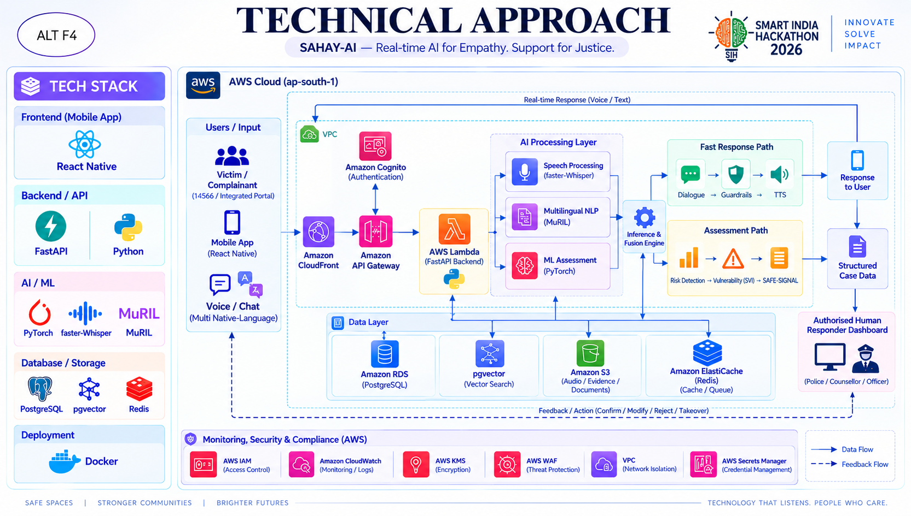
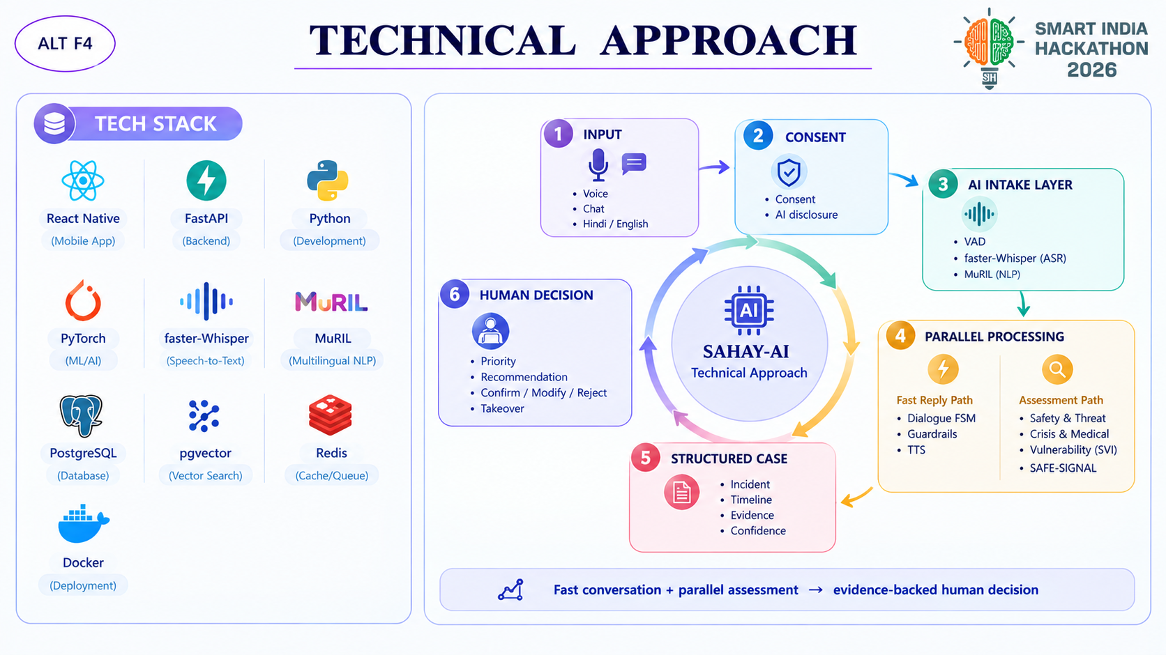
TECHNICAL APPROACH
ALT F4
@SIH Idea submission- Template

Slide 4
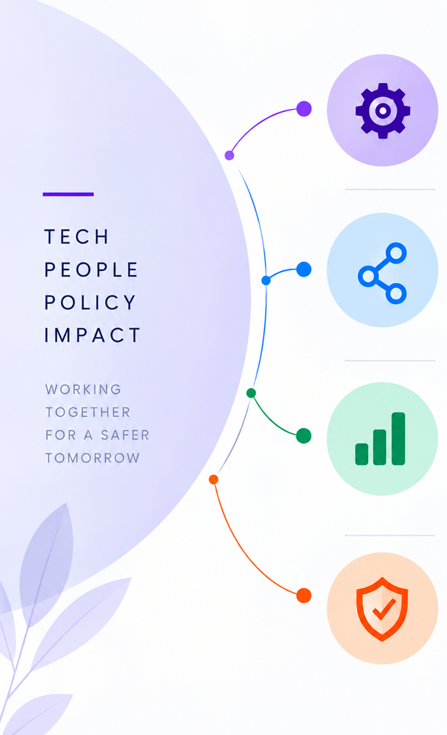
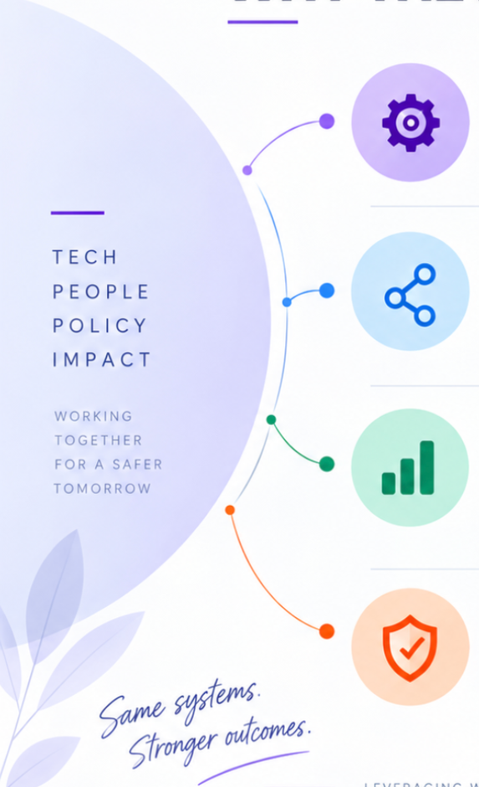
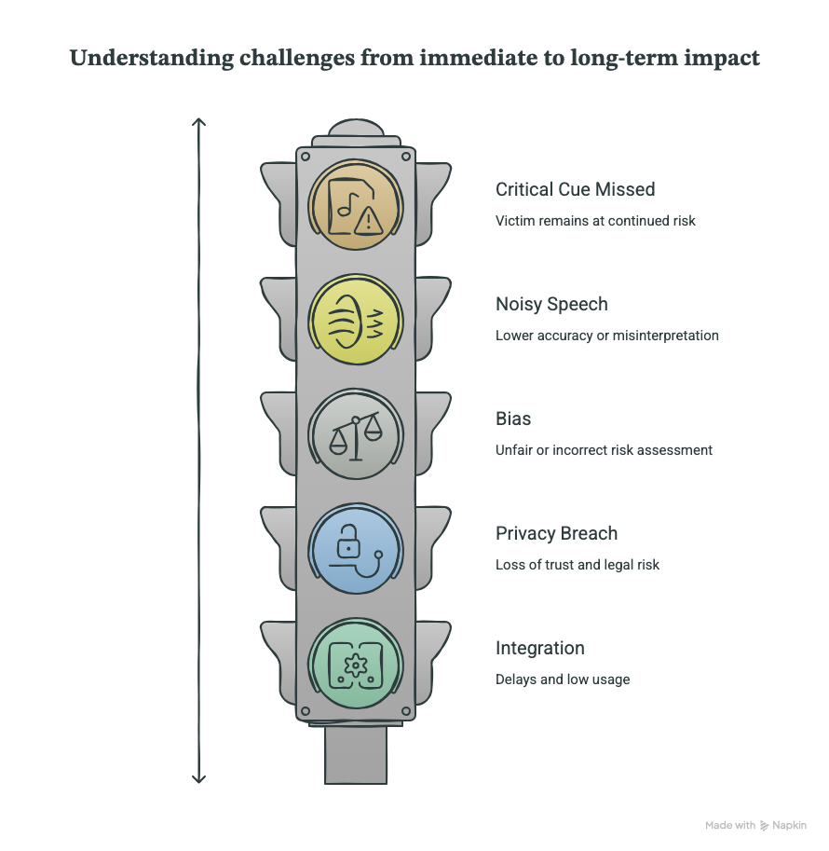
ALT F4
FEASIBILITY AND VIABILITY
Built for Real-World Impact at Scale
WHY THE IDEA IS FEASIBLE
WHY THE IDEA IS VIABILE
Proven Technology
CRITICAL CUE MISSED
Multilingual ASR, transformer-based NLP and
rule-based safety checks are available
as modular components.
High-recall crisis rules trigger escalation and immediate human takeover when critical distress signals are detected.
Noisy / Code-Mixed Speech
Operational Fit
ASR confidence checks, text fallback, and human assessment handle noisy, accented, and mixed-language inputs.
Adapter APIs connect approved channels
to the responder dashboard without
replacing existing authority or procedures.
Bias / False Certainty
Calibrated SVI, evidence-based scoring, uncertainty indicators, and human override reduce biased or unreliable assessments.
Viabilty
A service-based architecture supports languages
and model upgrades while scaling across users,
regions and support resources.
Privacy / Confidentiality Breach
Consent, data minimisation, encryption, RBAC, retention controls, and audit logs protect sensitive case data.
Privacy by Design
Integration / Staff Adoption:
Consent, data minimisation, encryption,
role-based access, retention controls and
audit logs are built in from the start.
Adapter APIs, sandbox testing, responder training, and clear override controls enable smooth workflow adoption.
@SIH Idea submission- Template

Slide 5
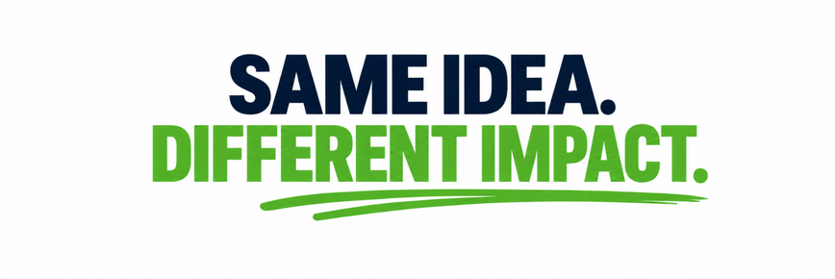
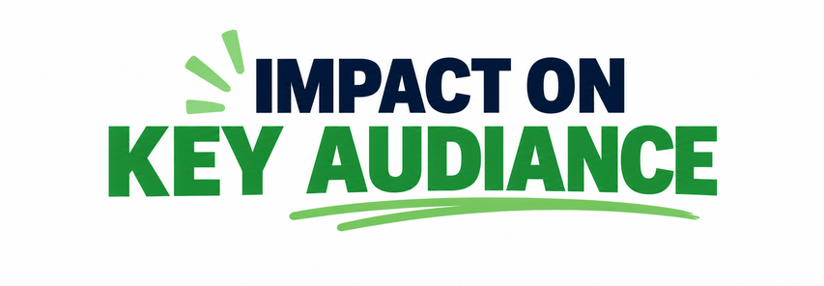
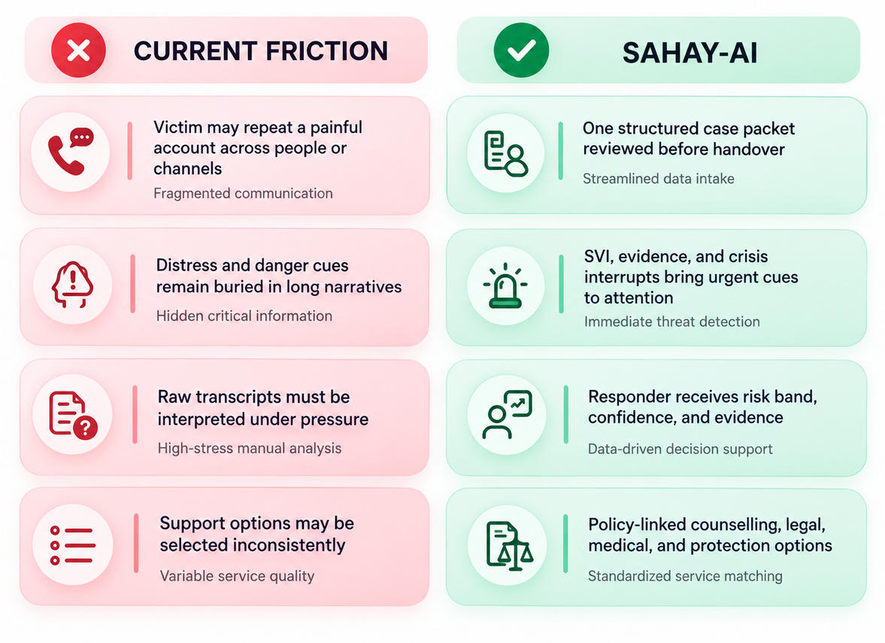
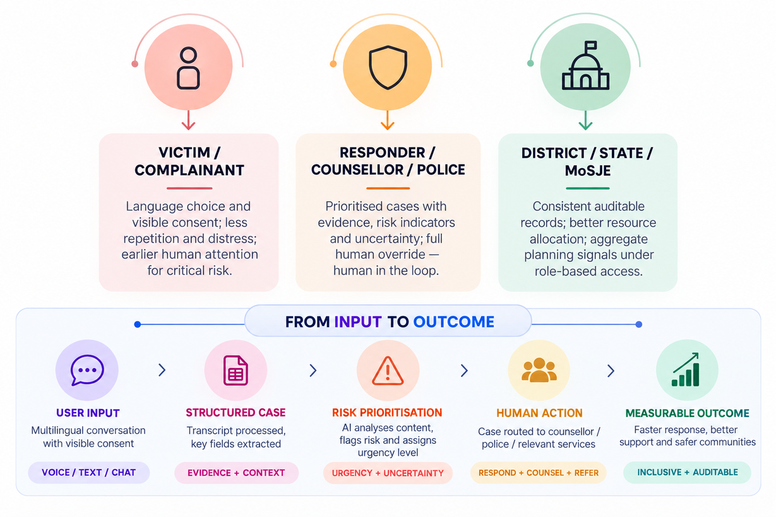
ALT F4
IMPACT AND BENEFITS
Safer people, Faster responsible, Smater administration
Research Paper about the AI Model :
https://drive.google.com/file/d/1pg7v9idXMvwG45T0eTxJUNVCLzW4_er9/view?usp=sharing
@SIH Idea submission- Template

Slide 6
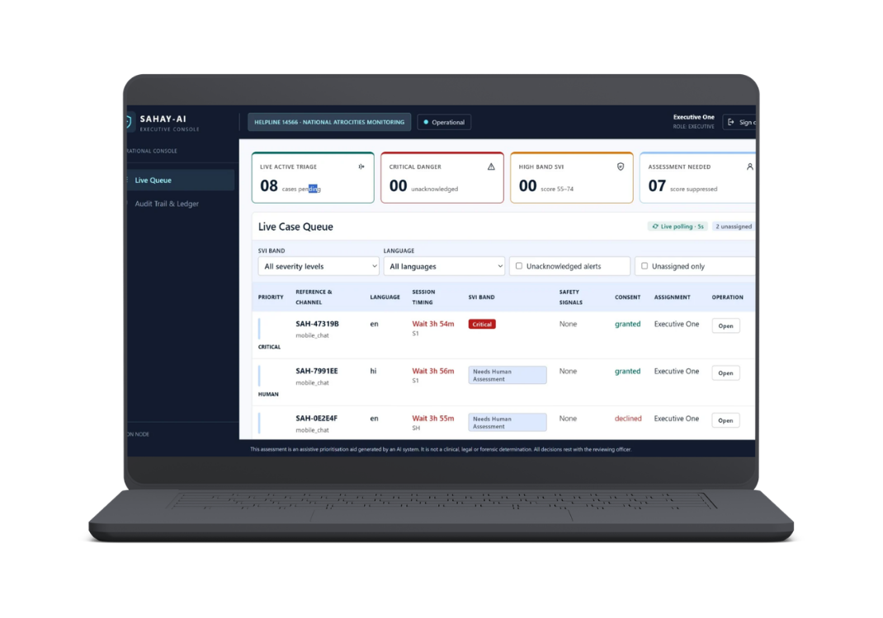
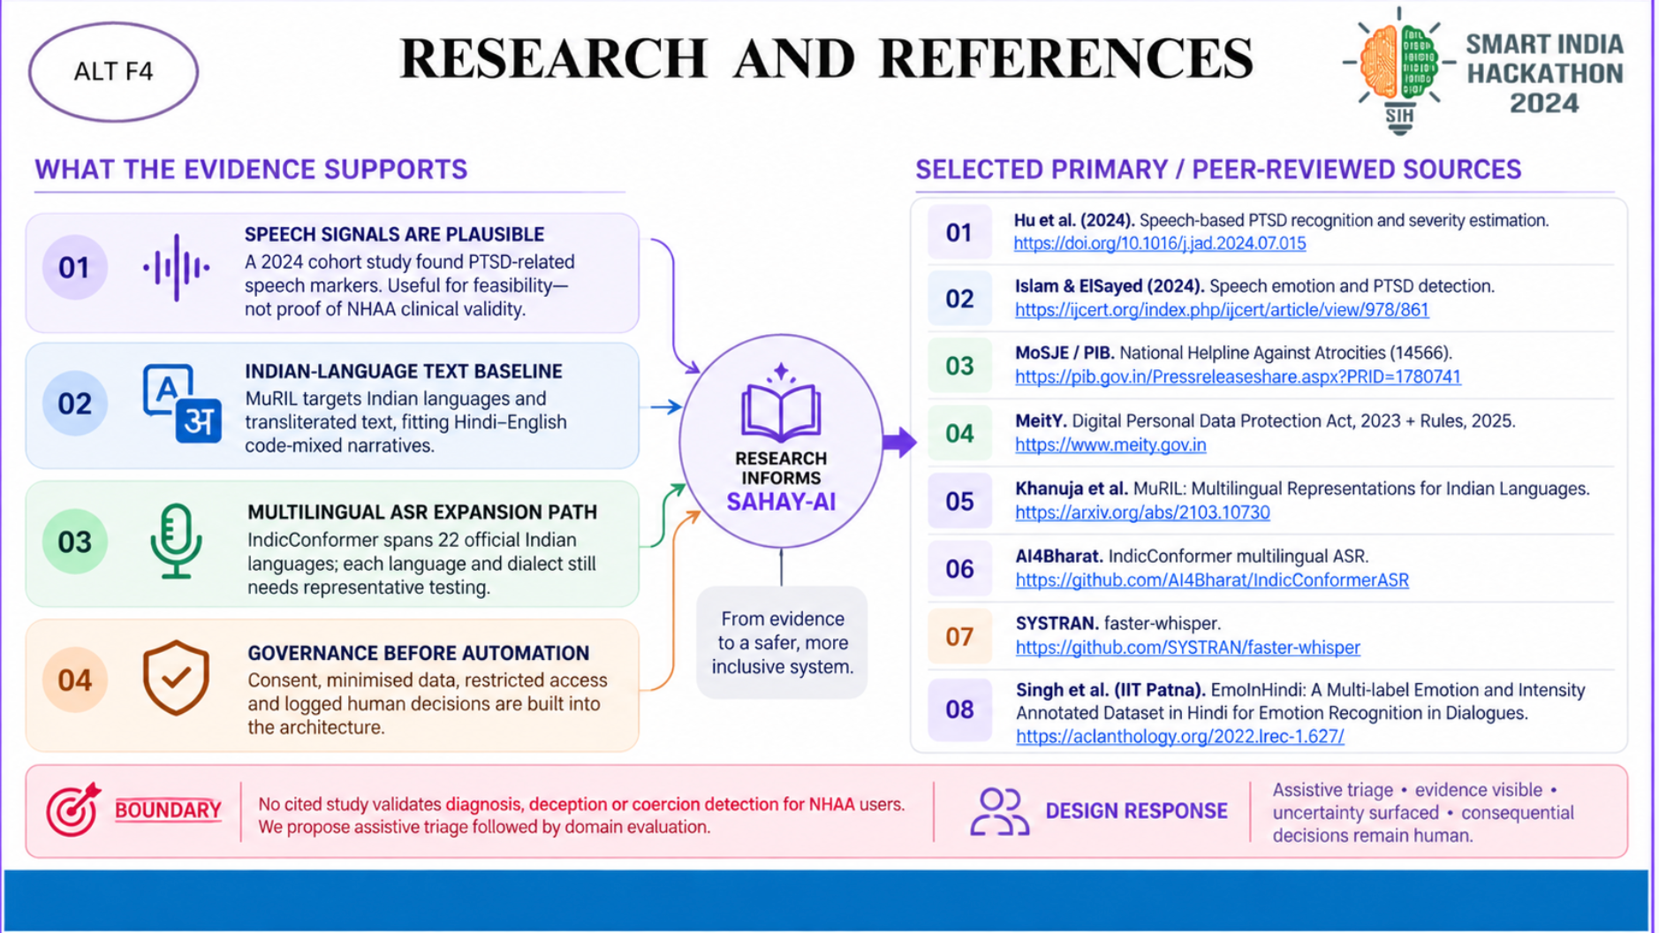
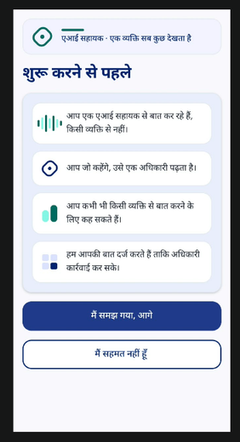
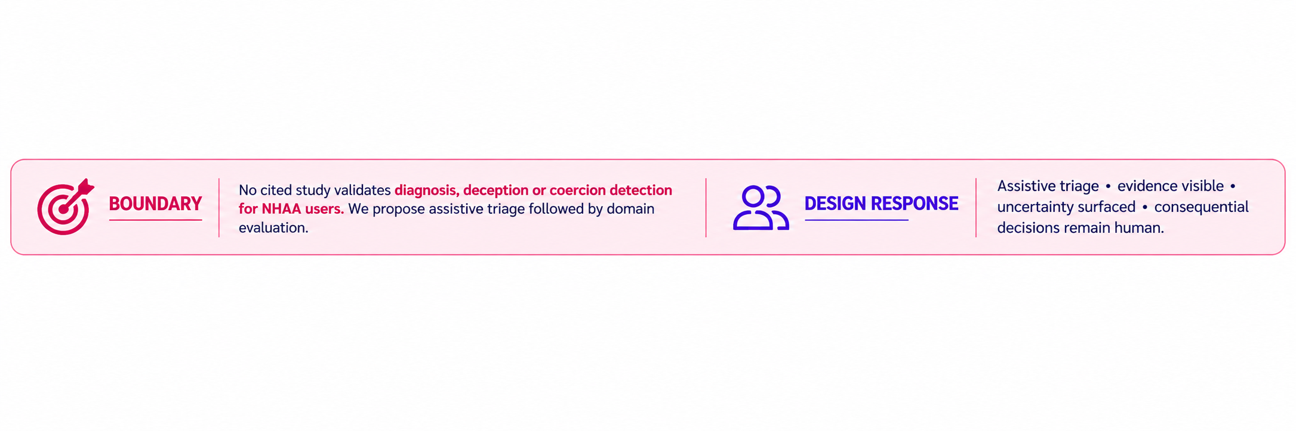
ALT F4
RESEARCH AND REFERENCES
https://doi.org/10.1016/j.jad.2024.07.015
https://www.ijcert.org/index.php/ijcert/article/view/978/861
https://pib.gov.in/Pressreleaseshare.aspx?PRID=1780741
https://www.meity.gov.in
https://arxiv.org/abs/2103.10730
https://github.com/AI4Bharat/IndicConformerASR
https://github.com/SYSTRAN/faster-whisper
https://aclanthology.org/2022.lrec-1.627/
@SIH Idea submission- Template

