Slide 1
GATK
21.09.29 JunKi Yoo

Slide 2
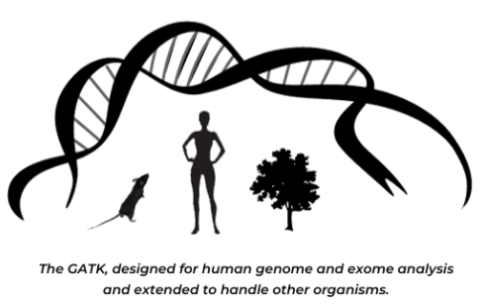
What is GATK?
Mainly, A toolkit for identifying SNPs and Indels in germline DNA sequencing data.
Also can be used for identifying SNPs and Indels in RNAseq data, and somatic variants in cancer genome sequencing data. (Updated GATK)
Basic & essential tool for human genomics
SNP
Insertion
Deletion
Reference | AATTGC
Sample | AATTCC
Reference | AATT--GC
Sample | AATTCTGC
Reference | AATTGC
Sample | AAT-GC
Notes:
goal of germline DNA sequencing : identifying germline mutation. germline mutation: DNA mutation inherited from parents. Common in whole cells of body.
SNP Indels are based on reference sequence. Reference sequence is a standard sequence assembled by scientists.
Typically the error rate is assessed by comparison of results across different platforms with multiple replicates

Slide 3

Why do we need GATK?
After Illumina DNA sequencing, we get FASTQ file (raw data)
Only with FASTQ file,
Hard to know which sequence is variant (non-reference).
Duplicate reads / Overlapping reads.
There are sequencing errors made by sequencing machine
→ Hard to progress genomic analysis.
Read (sequence) ID (Automatically attached by sequencing machine)
Sequence obtained by sequencing machine
Sequence quality (same length with sequence)
Notes:
2: We need overlapping reads, because Human genome is very large that there will be a significant number of sequencing errors Even though sequencing machine is highly accurate. So overlapping reads are needed to distinguish between sequencing errors and true SNPs. But we don’t need the whole information of reads for genomic analysis. We need processed / integrated data.
Illumina: one of commonly used sequencing platform
symbol

Slide 4
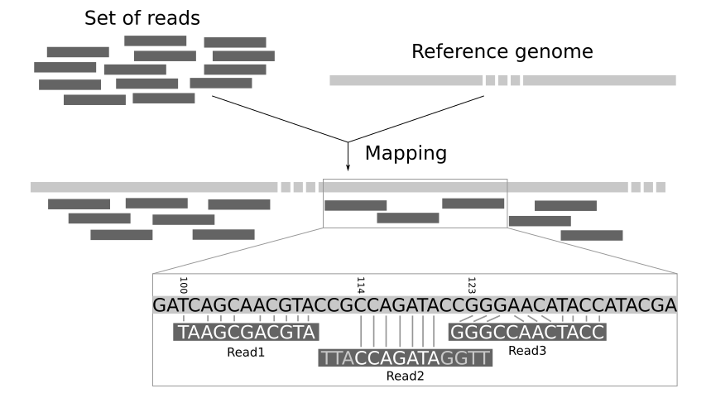
Read Mapping (alignment)
FASTQ file from sequencing
External FASTA file
Notes:
Before I explain GATK, I will explain what are reads and what is mapping (or alignment)
compare reads data from sequencing machine (fastq file) & reference genome
aligning: identifying most probable position where reads are from. (like puzzle game)

Slide 5
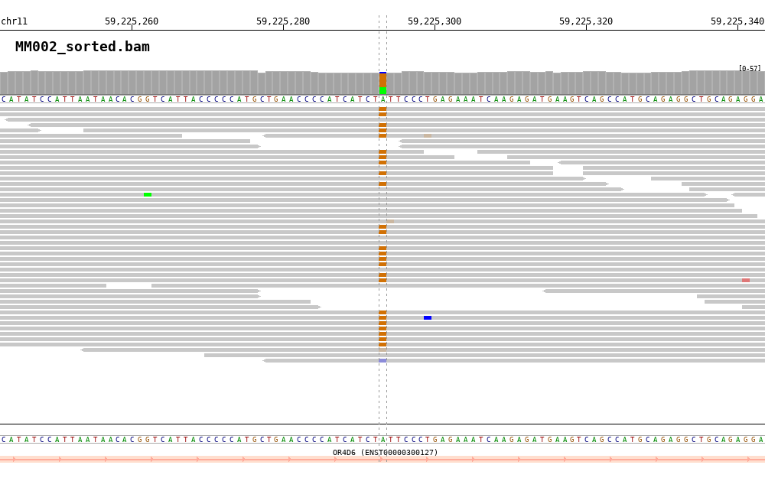
Visualization of overlapping reads
Brown boxes are real variants (A > G).
Half of the reads are colored
→Heterozygous (A|G)
Error
Notes:
it is impossible to check all position one by one, because human genome length is 3 billion base pair.
This is why we need overlapping reads and need further processing steps.

Slide 6
What GATK Includes?
Initial read mapping
(Global alignment)
GATK is a ‘Toolkit’. Current GATK version (v. 4.2.2.0) includes 342 tools. (Tool Documentation Index – GATK (broadinstitute.org)
To identify SNPs & Indels in germline DNA sequencing data, proper tools must be chosen.
Tools for 4 steps (5 steps in GATK v. 3)
GATK v.3
Local Realignment
GATK v.4
Base Quality Score
Recalibration (BQSR)
SNP&Indel Discovery
(Calling)
Variant Quality Score
Recalibration (VQSR)

Slide 7
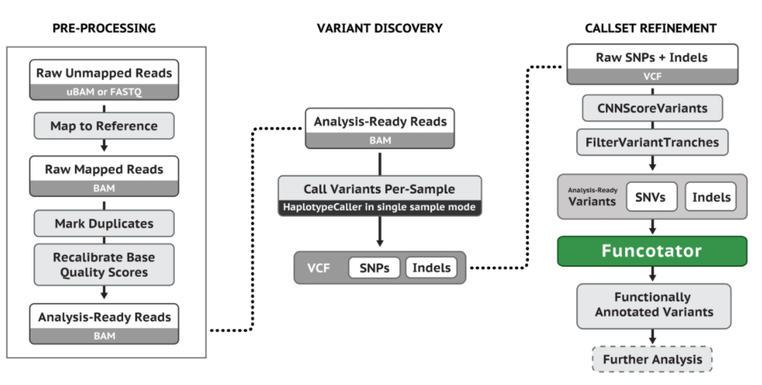
Best Practices workflow
Workflow for Germline variant calling (single sample)
Best Practices Workflows – GATK (broadinstitute.org)
Notes:
sequential process -> explain each process step by step.

Slide 8
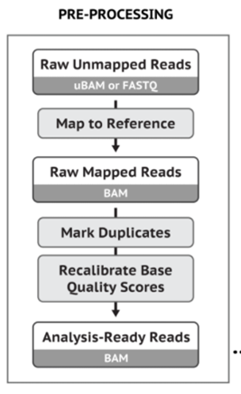
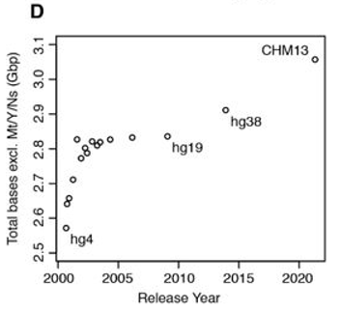
1. Initial read mapping (Global alignment)
No position information of each reads in raw unmapped sequencing data.
Non-GATK process
→ Instead, use BWA tool (popular short-read aligner)
Reference genome FASTA file is required
(hg19, hg38)
Nurk et al. (2021), The complete sequence of a human genome, bioRXiv doi: 10.1101/2021.05.26.445798
Notes:
Non GATK process according to GATK paper
Reference genome is a nucleic acid sequence database, assembled by scientists as a representative example of genome in one idealized individual organism. (it’s like a map for puzzle)
hg19 or hg38 is commonly used reference genome.

Slide 9
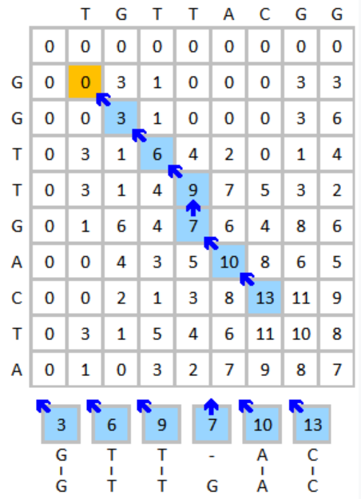
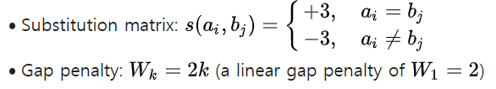
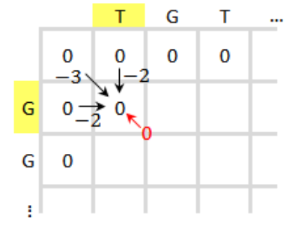
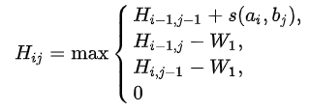
1-1. Initial mapping Algorithm
Ref
Global alignment
BWA-MEM is based on Smith-Waterman algorithm
Following
Choose the highest value for each cell.
Start with the highest value, and then go backward
Read
Notes:
briefly explain.

Slide 10
2. Local Realignment (Only in GATK v. 3)
Step after initial mapping in GATK v.3, but dropped out in GATK v. 4
Local realignment step refines initial mapping (global alignment).
Initial mapping algorithms map each read independently, which can lead to False negative Indels.
Other steps in pipeline may cover the dropout of this step.
Notes:
alignment - What is local realignment and what is the problem it solves? - Bioinformatics Stack Exchange
considering read independently -> hard to distinguish simple coverage loss (sequencing fail) and real indel, especially near ends of reads.
So initial mapping algorithm tend to prefer outputting SNPs rather than indel . (we say mismatches are cheaper than indel)
No official announcement why dropped out. but there were many guess that updated haplotypecaller can cover what local realignment did.

Slide 11
2-1 Local Realignment Algorithm
How do we identify where realignment is needed?
Known sites (e.g. dbSNP, 1000 Genomes)
Indels seen in original alignments (Double checking)
Sites where evidence suggests a hidden indel (Entropy calculation identifies ‘messy areas’)

Slide 12
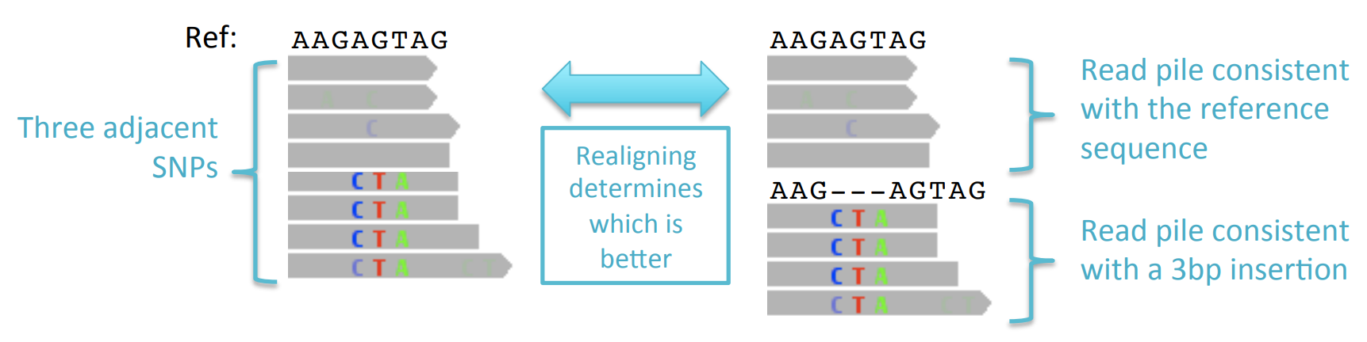
2-1 Local Realignment Algorithm
Find the best alternate sequence that, together with the reference genome, best fits the reads in a pile. (= consider reads together)
Score for alternate sequence: Total sum of quality scores of mismatching bases
If alternate sequence is sufficiently better than the original alignment -> accept the alternate one.

Slide 13
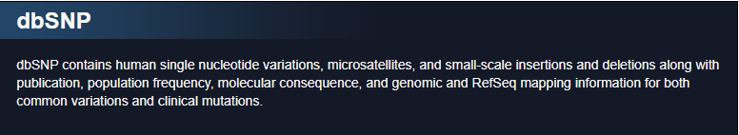
3. Base Quality Score Recalibration (BQSR)
After removing duplicate reads (=non-informative reads)
Base quality scores from FASTQ file are recalculated.
Machine-learning based calculation, considering already known variants & adjacent bases
External data (ex. dbsnp vcf file)
Notes:
Base Quality Score Recalibration (BQSR) – GATK (broadinstitute.org)
base recalibrator builds a model based on input data & known variants.
adjacent base: repeating sequence such as AAAA : the quality goes down following the sequence.

Slide 14
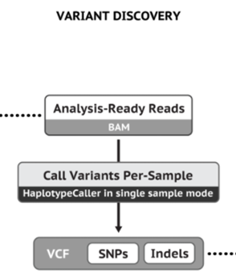
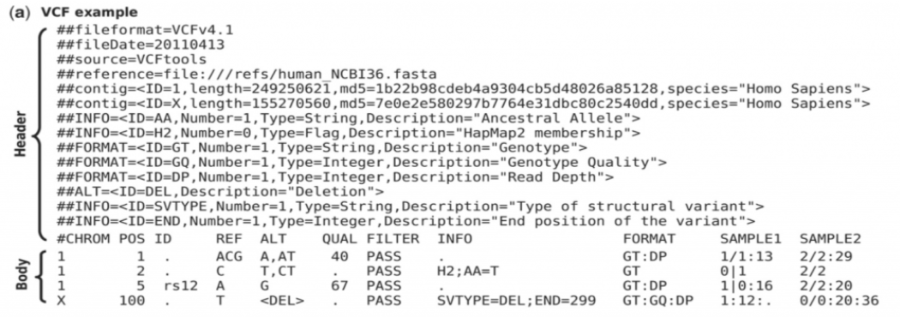
4. SNP & Indel discovery (calling)
Making Summarized variant file using HaplotypeCaller
Output file is VCF format
Notes:
Haplotype caller: GATK tool.

Slide 15
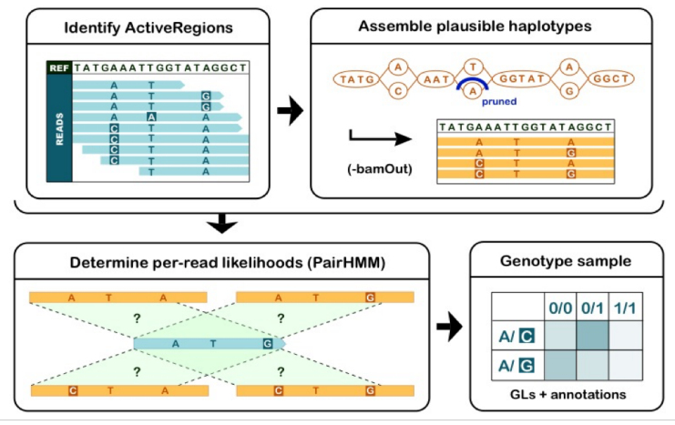
4-1. HaplotypeCaller Algorithm
1. Identify Active Regions
Active Regions are Regions of genome that vary significantly from the reference.
2. re-assembling reads
Re-assembling reads into candidate haplotypes using de-Bruijin-like graphs.
Notes:
whether each variant if maternal or paternal.
pair hmm: hmm for sequence alignment (conditional probability)

Slide 16
4-1. HaplotypeCaller Algorithm
3. Pair-HMM
Using state transition probabilities derived from the read base qualities
4. Genotype Assignment
Calling raw variants for each sample by applying read-haplotype likelihood to Bayesian model
Notes:
whether each variant if maternal or paternal.
pair hmm: hmm for sequence alignment (conditional probability)
read haplotype likelihood: result from pair HMM step. likelihood that each read was derived from each haplotype

Slide 17
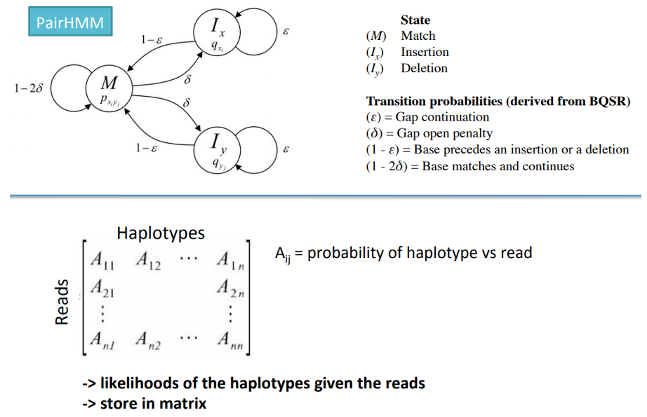

Slide 18
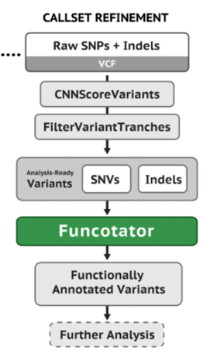
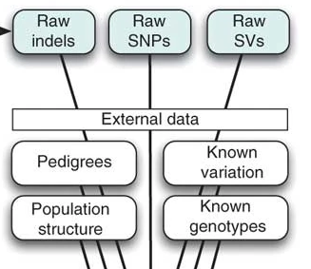
5. Variant Quality Score Recalibration (VQSR)
Refining callset (Filtering variant calls)
Uses External data
Technical covariates, Known sites of variation, Known individual genotypes, Linkage disequilibrium, Population structure
Employs bayes Gaussian Mixture Model
Notes:
Do not be confused with BQSR. this step is refining initial callset & making final callset.
All the external information integrated with raw vcf

Slide 19
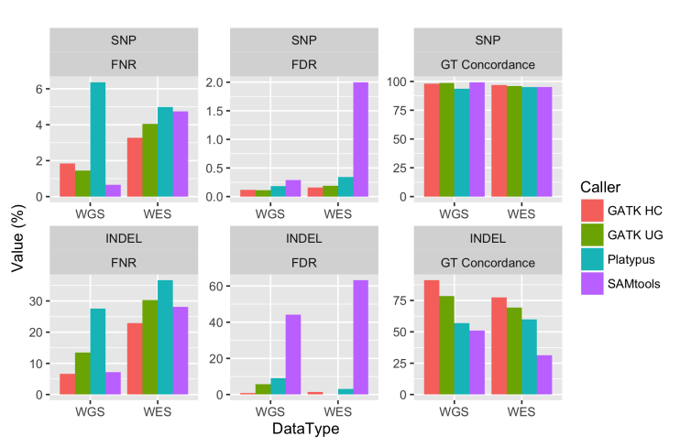
Variant Caller Comparison
Sensitivity plotted as FNR (lower → better)
Specificity plotted as FDR
(lower → better)
Notes:
For indel: GATK HC much better performance than other caller.

Slide 20
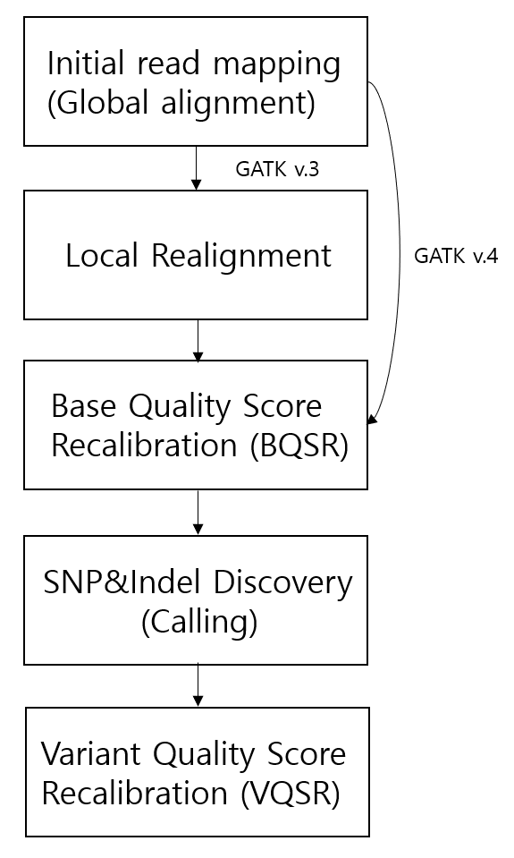
Conclusion
raw sequencing data (FASTQ)
GATK is a toolkit for identifying variants (SNP & Indel) from raw sequencing data
Convert FASTQ → Analysis ready VCF
4 (or 5) steps in this process.
Analysis ready VCF

