Slide 1
Learn CI/CD Fundamentals
The lession is proprietary to:
Advent Technology solutions & Staffing Services
www.https://adventts.com
An Overview of What is GIT & how to git ... !!

Slide 2
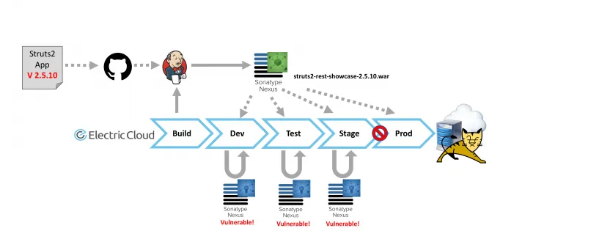
How Code is transferred to Prod?

Slide 3
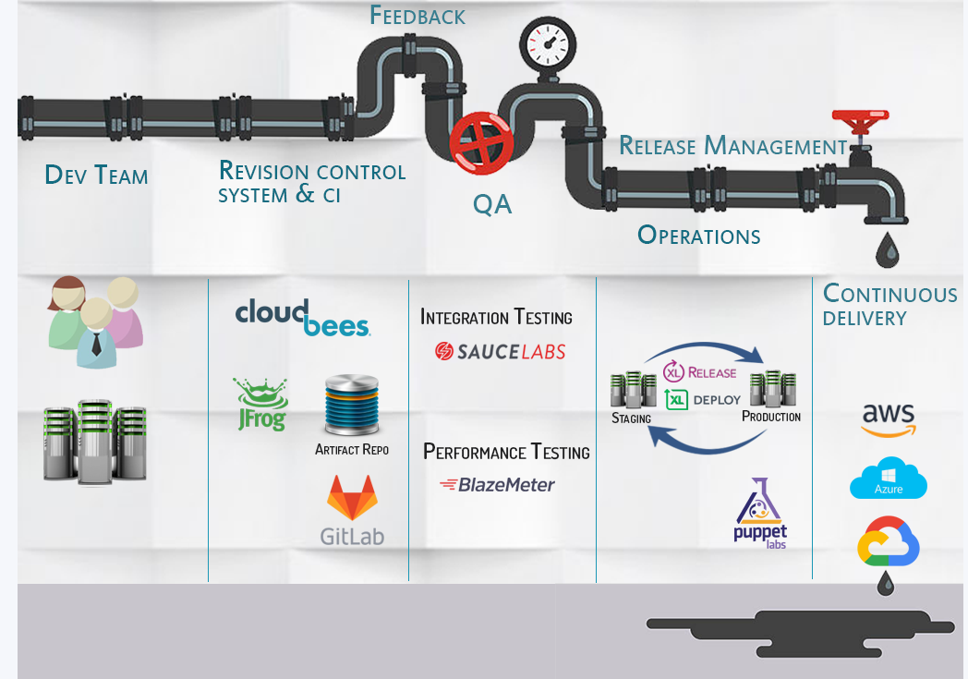
CI/CD Architecture !!

Slide 4
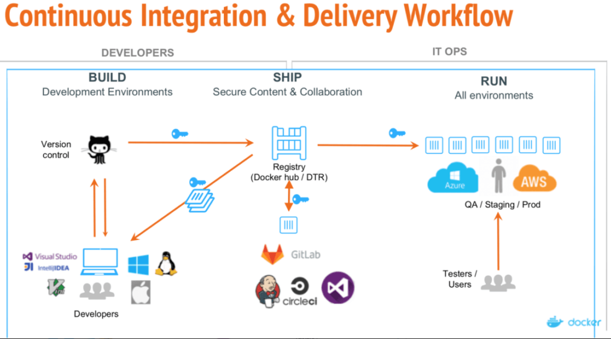
How the work is completed !!

Slide 5
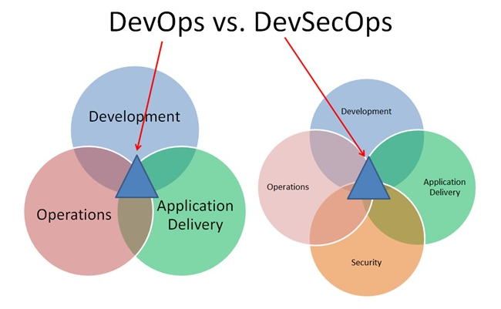
DEVOPS or DEVSECOPS ?

Slide 6
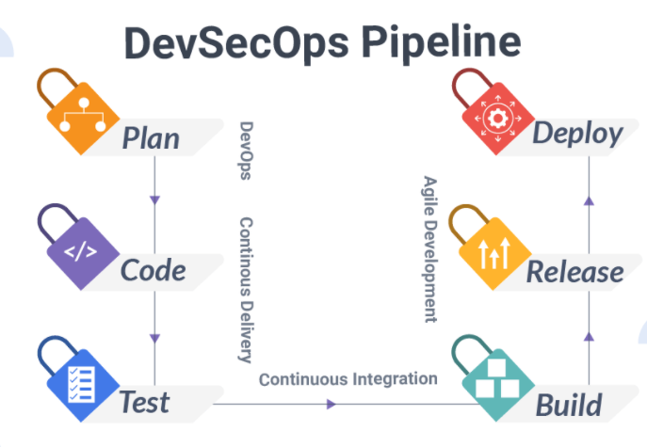
PIPELINE environment

Slide 7
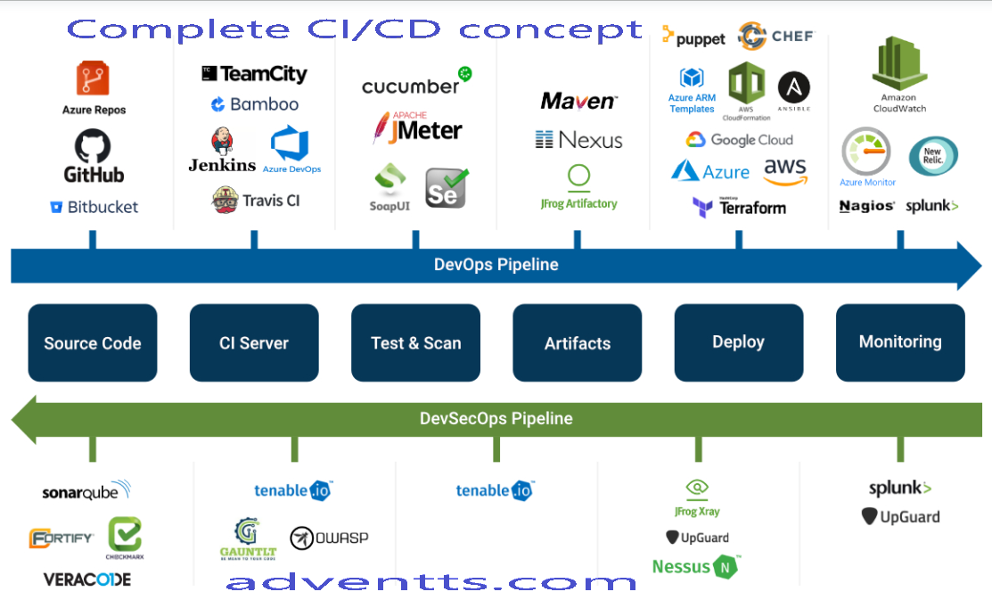
Total concept is here !!

Slide 8
What is GIT
GIT is a technology which is used to manage “Version Control System”
VCS basically tracks the history of project works in a distributed work system
AGILE is a distributed work system

Slide 9
What can be done ?
You can find out:
  Which changes were made?
  Who made the changes?
  When were the changes made?
  Why were changes needed?

Slide 10
Why GIT ?
more than 70 percent of developers use Git, making it the most-used VCS in the world. Git is commonly used for both open source and commercial software development, with significant benefits for individuals, teams and businesses.
Git lets developers see the entire timeline of their changes, decisions, and progression of any project in one place. From the moment they access the history of a project, the developer has all the context they need to understand it and start contributing.
Developers work in every time zone. With a DVCS like Git, collaboration can happen any time while maintaining source code integrity. Using branches, developers can safely propose changes to production code.
Businesses using Git can break down communication barriers between teams and keep them focused on doing their best work. Plus, Git makes it possible to align experts across a business to collaborate on major projects.

Slide 11
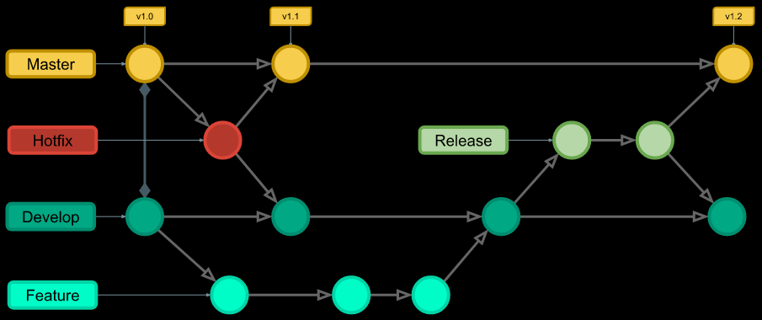
Diagram -- GIT (high level)

Slide 12
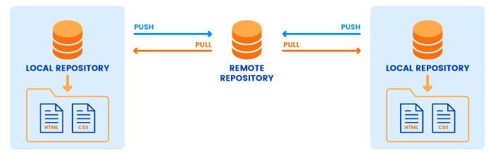
GIT/Docker for code transfer to/from Cloud!!

Slide 13
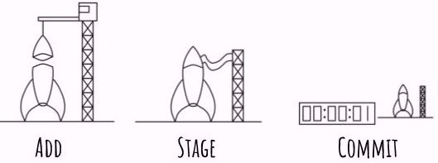
Work in GIT

Slide 14
Master- This is production code - simple as that
Hot Fix- Need to fix production?
Develop- The code just before Deployment/ production
Feature- This is the closest to normal git branching as you will get in git flow (later)
Release- This is one of the greatest built-in features of the git flow pattern -- (still remeber the word -- Release ! in AGILE)

Slide 15
Want to learn GIT?
How hard to learn GIT?
well, anything you start at the beginning, is hard ......
Only command line?
Not only commandline, it has some graphical interface too

Slide 16
Commands to remember
Git add: This command simply tells git to start tracking a particular file or folder.
Git Stage: This is a command that allows you to track or add what you want to store in the eventual commit.
Git commit: This is where the snapshot of your code really happens, like the count down timer to go - everything is packed and ready. Anything that is staged gets added here and it creates a snapshot in time of your project.

Slide 17
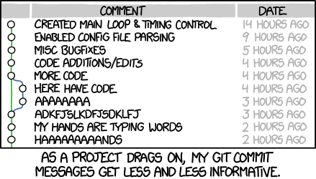
GIT Commit example

Slide 18
Set up GIT
MAC or Windows??
On Windows you have a lot of options when it comes to git from command line to graphical user interface - it really depends on what you are looking for
https://git-scm.com/download/win
and download your version (32/64) and then follow step by step, Not hard at all

Slide 19
command line - setup git
git config --global user.name "Your Name Here"
git config --global user.name adventts
git config --list
  adventts

Slide 20
Tracking a folder
git init : This is the magical command that tells git to start tracking a folder. Regardless of git client this step is almost always the same. First you’ll need a folder, typically a black one, but if you’re starting to use git on a project where you didn’t have any source control on you can also use it there.
Thats it ! now you can use this folder as a version control folder.

Slide 21
Staging a file to upload
git add: Simply tells git to stage a file, but it has two options
git add . : this command adds all of the changed file to the stage
git add -i: this command allows you to select files to upload to stage, but not all

Slide 22
put in the stage now
git status: this command helps you to see which files are now ready for to go to stage area
git commit: this is the final step of the cycle making your changes logged into the source control
git commit -m “This is the first commit”

Slide 23
git push- send file to remote
git push
What is remote: well, remote is a simple remote computer somewhere that can accept your code pushes.
bitbucket / github/ gitlab
bitbucket or gitlab are private cloud
github is opensource.

Slide 24
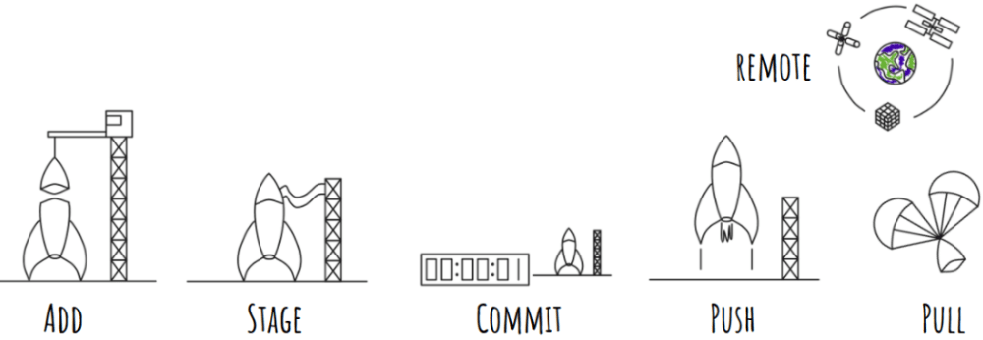
The big picture

Slide 25
git remote add
git remote add [shortname typically “origin”] your url
url is your remote location of either
  bitbucket or gitlab or github

Slide 26
git pull ?
git pull : this command simply asks git to connect to the remote locaton and return the changes that it might have that you dont know about .. (if done by others ..)
git pull
$ git remote -v
origin https://github.com/....... (fetch)
origin https://github.com/....... (push)
Note: this means that, you can work on these repos

Slide 27
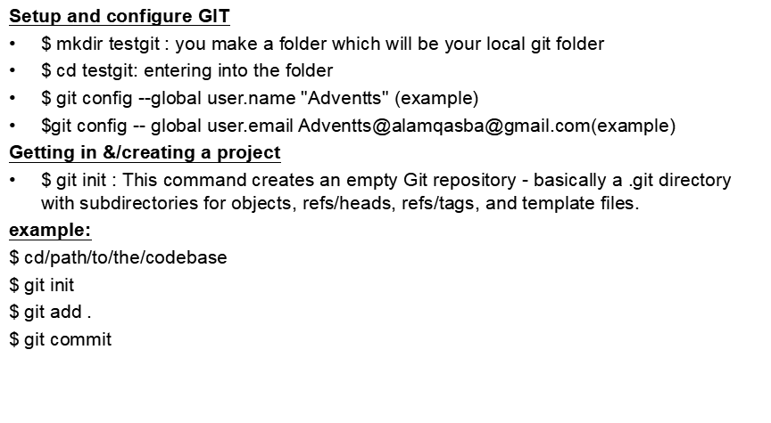
commands you need ...1

Slide 28
...2
$ git-clone - Clone a repository into a new directory
example:
*** Clone from upstream: (examples)
$ git clone git://git.kernel.org/pub/scm/.../linux.git my-linux
OR
$ git clone https://github.com/shafiruma/RepTraining.git
Note: At this point, you should have a bona fide Git repository on your local machine, and a checkout or working copy of all of its files in front of you.
Check the status of your branch
$ git status
On branch master
Your branch is up-to-date with 'origin/master'.
nothing to commit, working directory clean

Slide 29
...3
Let’s say you add a new file to your project, a simple README file. If the file didn’t exist before, and you run git status, you see your untracked file like so:
$ echo 'My Project' > README
$ git status
On branch master
Your branch is up-to-date with 'origin/master'.
Untracked files:
(use "git add <file>..." to include in what will be committed)
README
nothing added to commit but untracked files present (use "git add" to track)

Slide 30
...4
Tracking New Files
In order to begin tracking a new file, you use the command git add. To begin tracking the README file, you can run this:
$ git add README
If you run your status command again, you can see that your README file is now tracked and staged to be committed:
$ git status
On branch master
Your branch is up-to-date with 'origin/master'.
Changes to be committed:
(use "git restore --staged <file>..." to unstage)
new file: README

Slide 31
Committing Your Changes
Now that your staging area is set up the way you want it, you can commit your changes. Remember that anything that is still unstaged — any files you have created or modified that you haven’t run git add on since you edited them — won’t go into this commit. They will stay as modified files on your disk. In this case, let’s say that the last time you ran git status, you saw that everything was staged, so you’re ready to commit your changes. The simplest way to commit is to type git commit:
$ git commit
result displayed: (example)
Changes to be committed:
# new file: README

