Slide 1
Adversarial Personalized Ranking

Slide 2
Table of content
Matrix Factorization - Bayesian Personalized Ranking
Adversarial Personalized Ranking
Experiments
Conclusion

Slide 3
Table of content
Matrix Factorization - Bayesian Personalized Ranking
Adversarial Personalized Ranking
Experiments
Conclusion

Slide 4
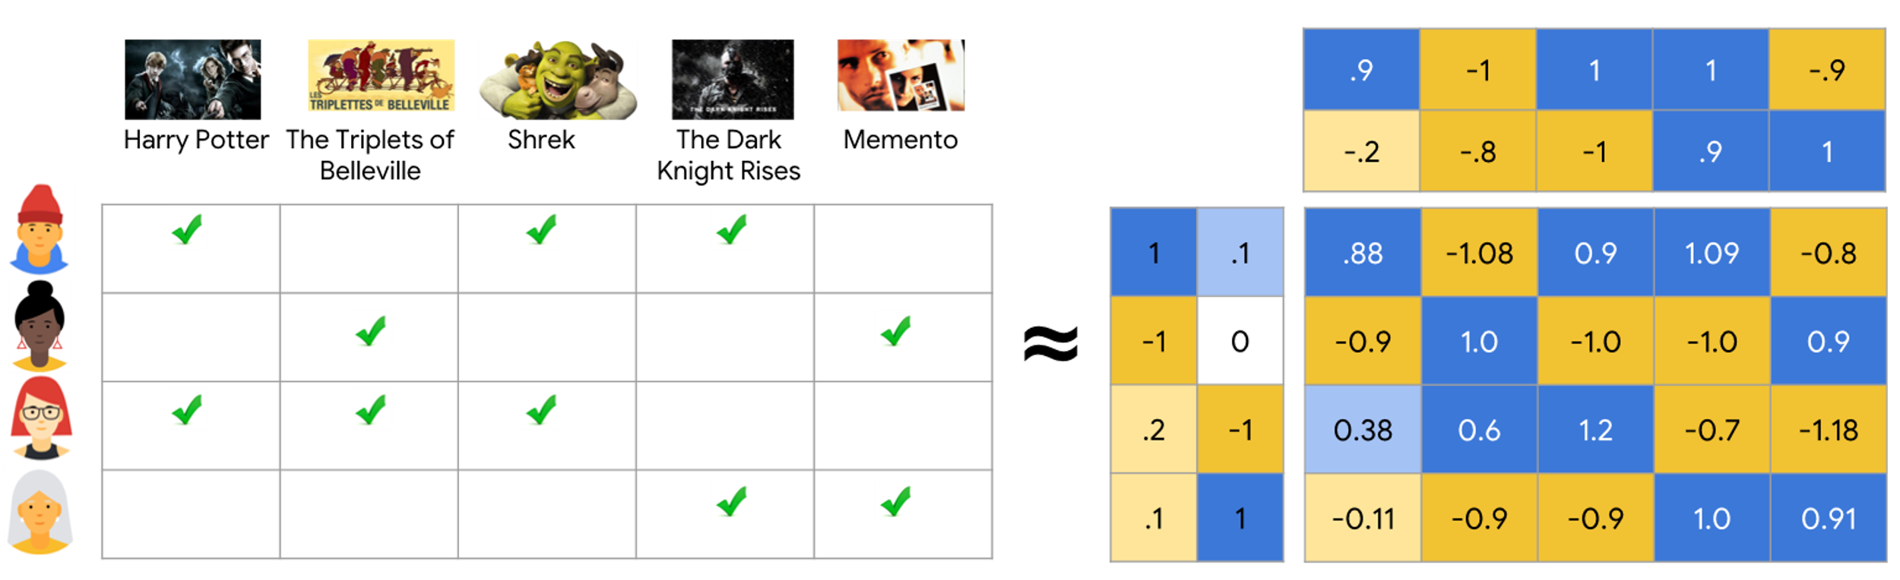
1. MF - BPR
Matrix Factorization:
Represent each user and item as an embedding vector, that can estimate user's preference on an item as inner product.
Given user u and item i, their embedding vector are p_{u} and q_{i} . The predicted output of the model is:
y_{ui} = p_{u}^{T}q_{i}

Slide 5

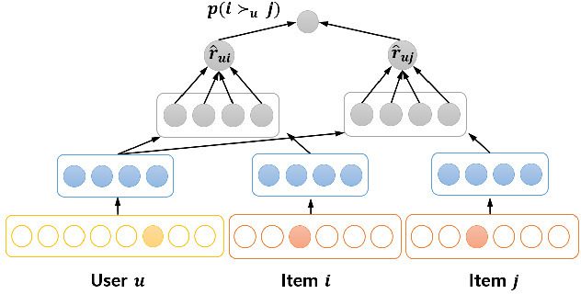
1. MF-BPR
Bayesian Personalized Ranking
Maximize the distance between positively and negatively rated items.
Given the training dataset 𝐷 composed by positive and negative for each user, and the triple items (𝑢, 𝑖, 𝑗) (user 𝑢, a positive item 𝑖 and negative item 𝑗), the BPR objective function is defined as:

Slide 6
Table of content
Matrix Factorization - Bayesian Personalized Ranking
Adversarial Personalized Ranking
Experiments
Conclusion

Slide 7
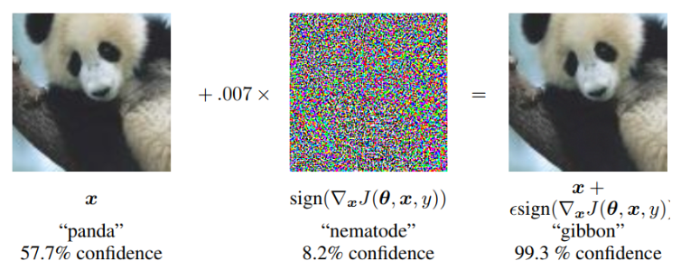
2. Adversarial Personalization Ranking
Idea of Adversarial Attack:
Adding a small vector perturbation can change the prediction of a classification model.

Slide 8
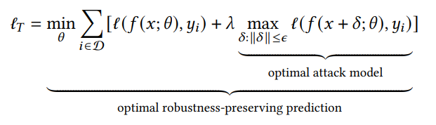
2. Adversarial Personalization Ranking
Idea of Adversarial Training:
Including adversarial samples in training of a model makes it more robust.
The objective function of the model adversarial trained is:
Adversarial training provides better generalization performance.
Notes:
The goal of adversarial training is to build a robust model from ground-up on a training set augmented with adversarial examples. Adversarial regularization is one of the mostly investigated techniques for adversarial training, which utilizes an approximation of the worst-case loss function, i.e., max𝛿: ∥𝛿 ∥≤𝜖 ℓ(𝑓 (𝑥 + 𝛿; 𝜃), 𝑦𝑖), as the regularizer.
As it can be noted, the inner maximization finds the strongest attack against the prediction model that is subject to adversarial perturbation. The outer minimization estimates the strongest defensive against a given attack by giving up a level of accuracy due to the regularization. The parameter 0 < 𝜆 < 1 controls the trade-off between accuracy (on clean data) and robustness (on perturbed data).

Slide 9
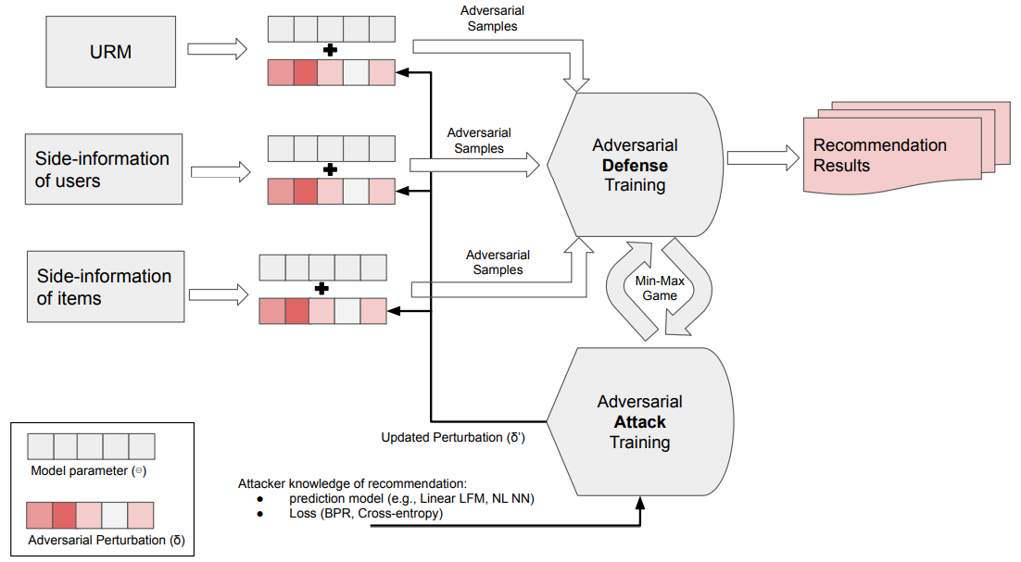
2. Adversarial Personalization Ranking

Slide 10
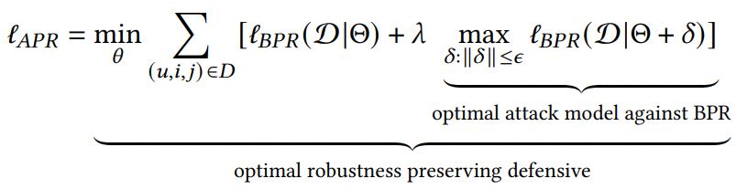
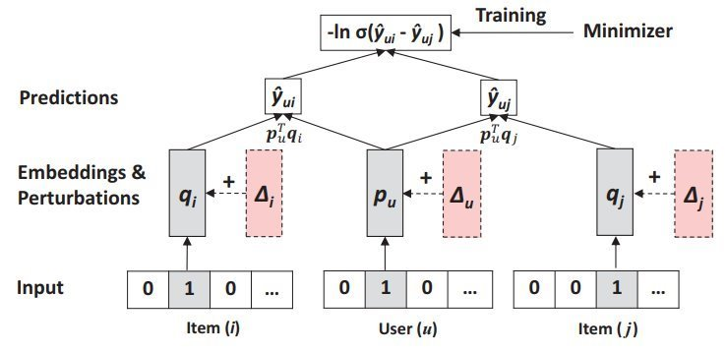
2. Adversarial Personalization Ranking
Adversarial training of MF-BPR can be formulated as:

Slide 11


2. Adversarial Personalization Ranking
Adversarial Perturbation:
Constructing adversarial perturbations can be formulated as maximizing:
To maximize the approximated linear function, we only need to move towards the gradient direction of the objective function:
Then we have the solution:

Slide 12

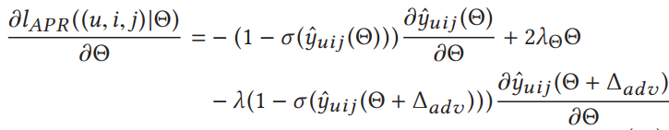

2. Adversarial Personalization Ranking
Learning Model Parameter:
The local objective function to minimize for a training instance (u,i, j) is as follows:
Regard perturbation parameter as constant, the local objective function to minimize for a training instance (u,i, j) is as follows:
Then we can obtain the SGD update rule for the parameter

Slide 13
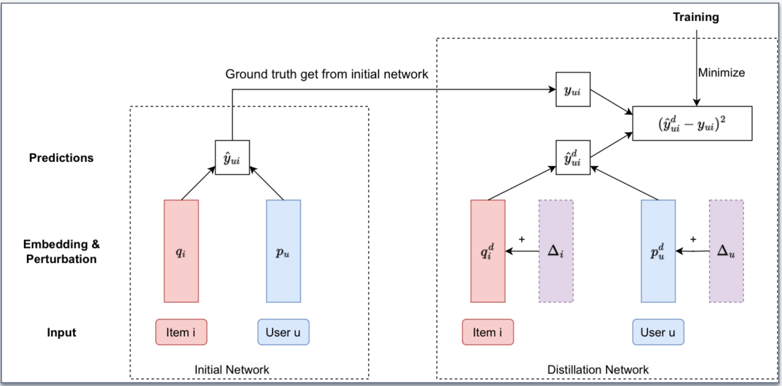
Proposed: Distillation model
Combination of Robust Optimization method and Distillation method
- Distillation model predict the label that the initial model generate.

Slide 14
Table of content
Matrix Factorization - Bayesian Personalized Ranking
Adversarial Personalized Ranking
Experiments
Conclusion

Slide 15
3. Experiments
Dataset
Yelp: Yelp Challenge Data of user rating on business.
Book-croosing: book rating in 4 weeks from Book-Croosing Community.
Parameter
Dataset | No. Interaction | No. Item | No. User | Sparsity
Yelp | 730,790 | 25,815 | 25,677 | 99.89%
Book-crossing | 62,657 | 14,684 | 1,295 | 99.99%
parameter | value
lambda | 1
Learning rate | 0.05
Batch size | 512
epoch | 2000
embedding size | 64

Slide 16
3. Experiments
Scenarios
Impact of adding random and adversarial noise to RecSys.
Performance of MF-BPR and APR.
Criteria:
Hit Ratio (HR): is a recall-based metric, measuring whether the testing item is in the top-K list.
Normalized Discounted Cumulative Gain (NDCG): is position-sensitive, which assigns higher score to hits at higher positions.
Area under the ROC Curve (AUC): the probability that the model ranks a random positive example more highly than a random negative example
Notes:
To evaluate the efficiency of defense method, we performed different experiments scenarios
For both metrics, larger values indicate better performance.

Slide 17
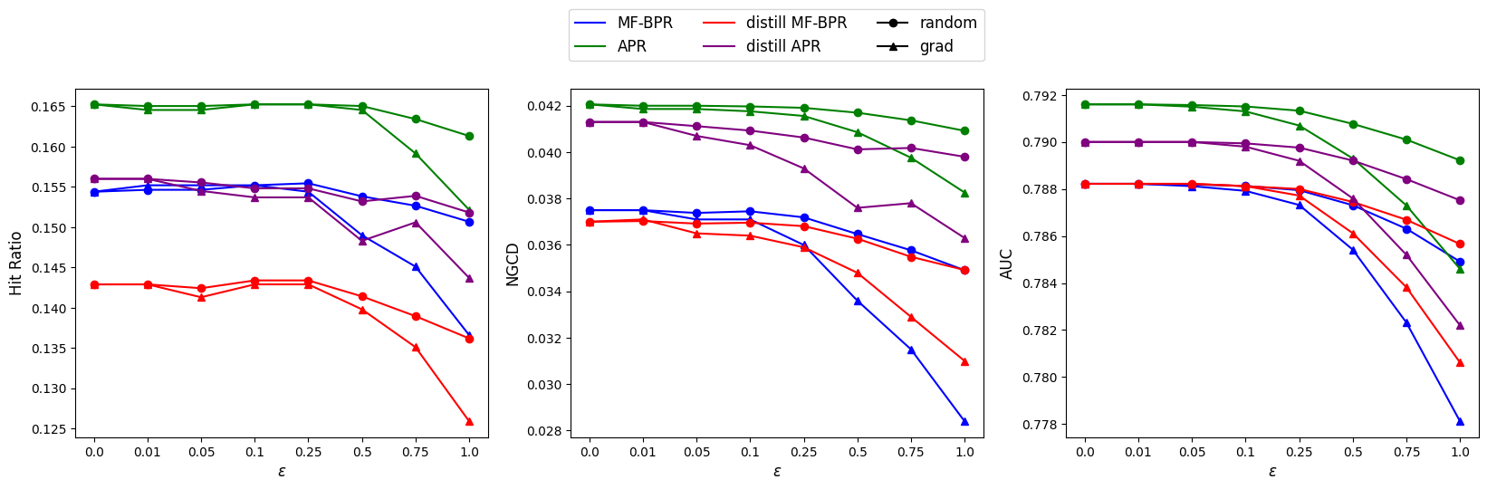
3. Experiments
Impact of adding random and adversarial noise
Performance of the models on Book-crossing dataset decreased by
adding perturbation.
Notes:
In this experiments, we implemented 3 models: MF-BPR, APR and distillation version on a small dataset Book-Crossing. Beside that, we trained separately noise model: random noise and adversarial noise. We set up many values of noise magnitude ε to evaluate the impact of perturbation attack to the models.
we found that adversarial perturbation is more harmful than the random.
The improvement of distillation model is not significant, we will ignore it in the next slides.

Slide 18
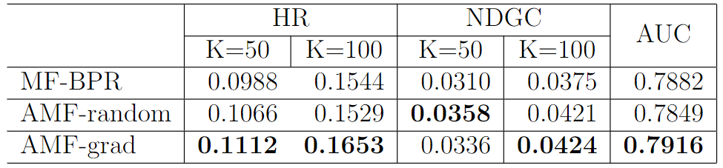
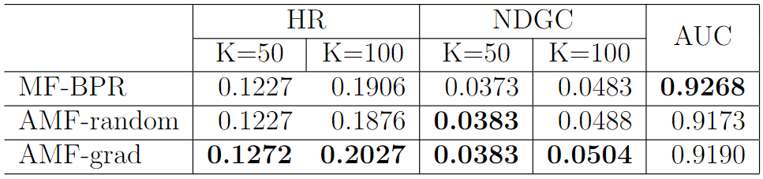
3. Experiments
Performance of MF-BPR and APR
Book-Crossing
Yelp
Notes:
Obviously, adversarial perturbation improve the results in almost criteria, included in important two are HR and NDGC.

Slide 19
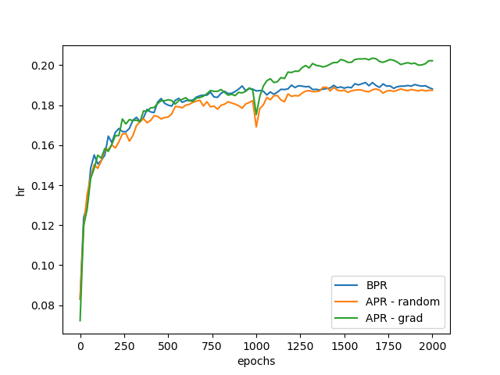
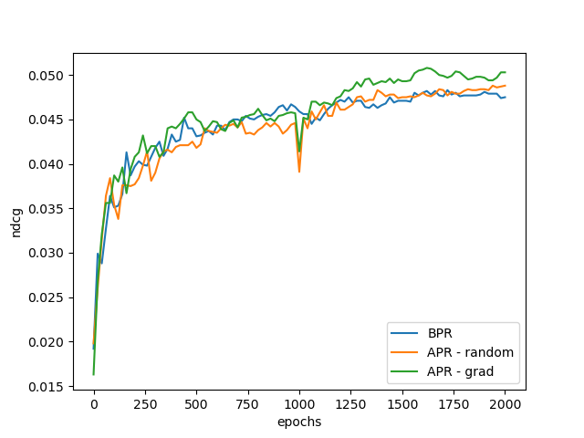
3. Experiments
Performance of MF-BPR and APR (on Yelp)
Notes:
On the other hand, we visual the top-100 HR and NDCG in the training process of each model.
In large dataset Yelp, they grow epoch by epoch and reach the optimal at last.
.

Slide 20
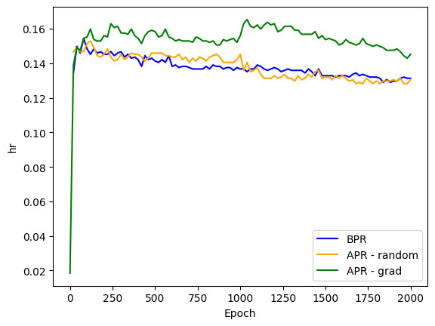
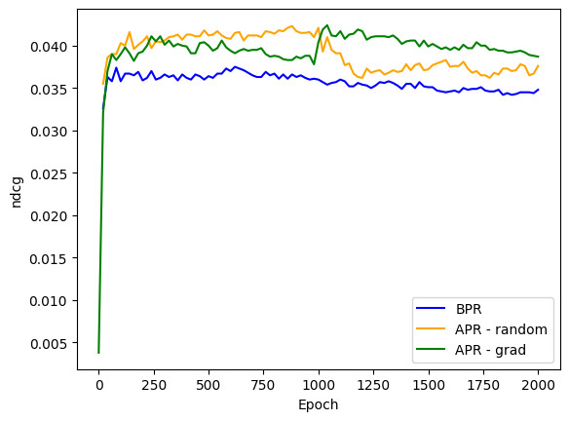
3. Experiments
Performance of MF-BPR and APR (on Book-Crossing)
Notes:
In small dataset Book-crossing, all model quickly achive optimal and the after epoches seem to be not better.
It's seems like the overfiting occurs.

Slide 21
Table of content
Matrix Factorization - Bayesian Personalized Ranking
Adversarial Personalized Ranking
Experiments
Conclusion

Slide 22
4. Conclusion
Study Matrix Factorization- Bayesian Personalization Ranking, how perturbation degrade the performance of RecSys and Defense by Adversarial Personalization Ranking.
Experiments show that:
Adversarial perturbation is more dangerous than random.
Distillation method is not efficient as Robust optimization.

Slide 23
THANK FOR WATCHING

