Slide 1
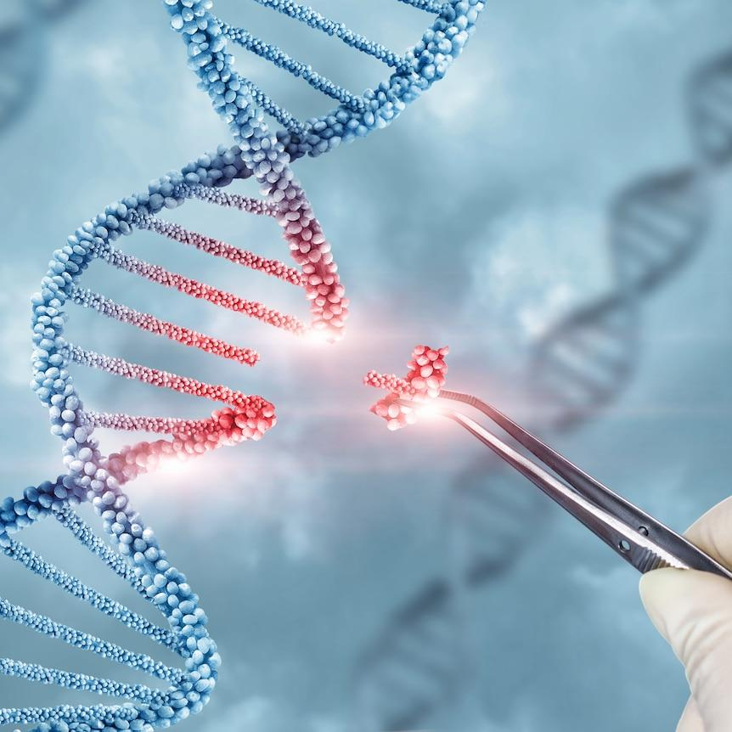
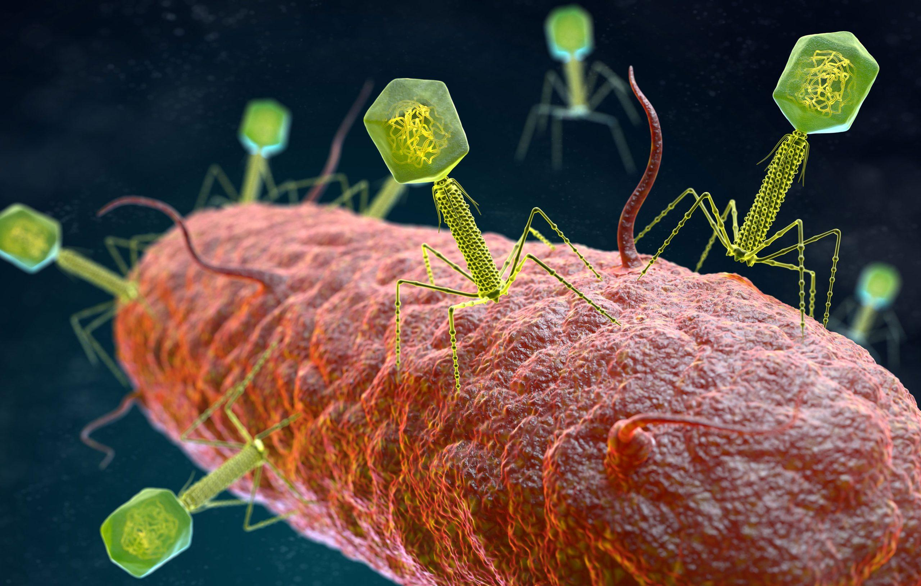


CRISPR-Cas9 The Molecular Scissors That Changed Biology A beginner's exploration of one of the biotechnology's most transformative innovations.
ADVIKAA SINHA
Undergraduate Biotechnology STUDENT

Slide 2
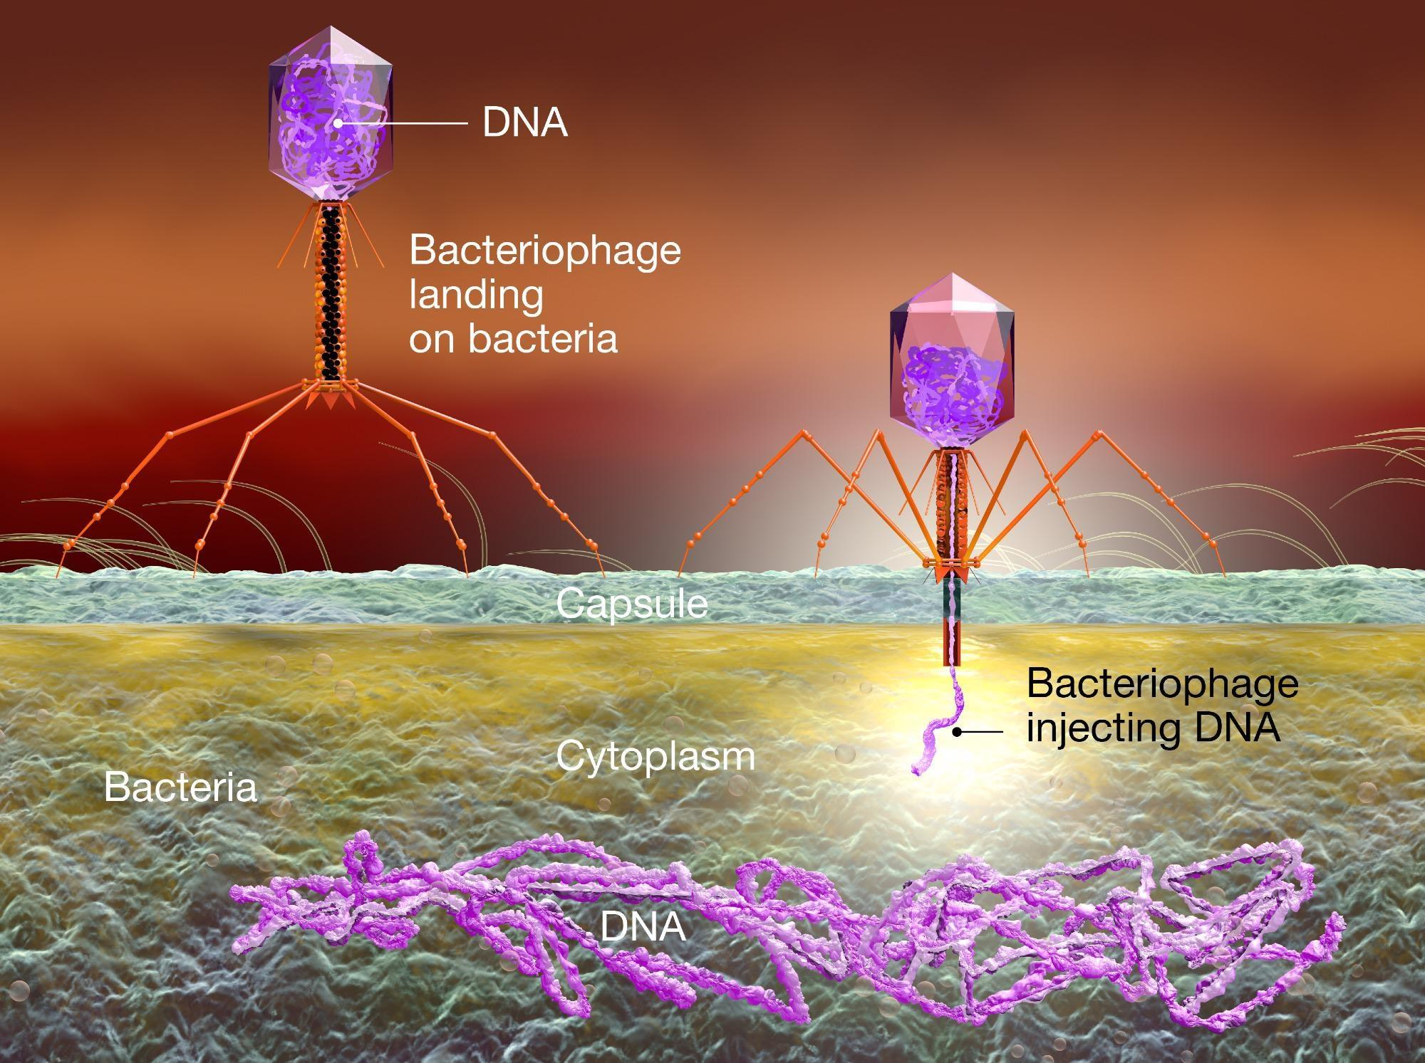
WHAT IS CRISPR-Cas9?
Definition
CRISPR-Cas9 is a revolutionary gene-editing technology that allows scientists to make precise changes to DNA. It acts like molecular scissors, enabling researchers to add, remove, or modify specific genes with remarkable accuracy.
Did You Know?
In 2020, Emmanuelle Charpentier and Jennifer Doudna received the Nobel Prize in Chemistry for developing CRISPR-Cas9 gene-editing technology.
Brief History
CRISPR was first discovered as part of the natural immune system of bacteria. Bacteria use CRISPR sequences and the Cas9 protein to recognize and destroy the DNA of invading viruses, protecting themselves from infection. Scientists later adapted this natural defense mechanism into a powerful tool for gene editing.

Slide 3
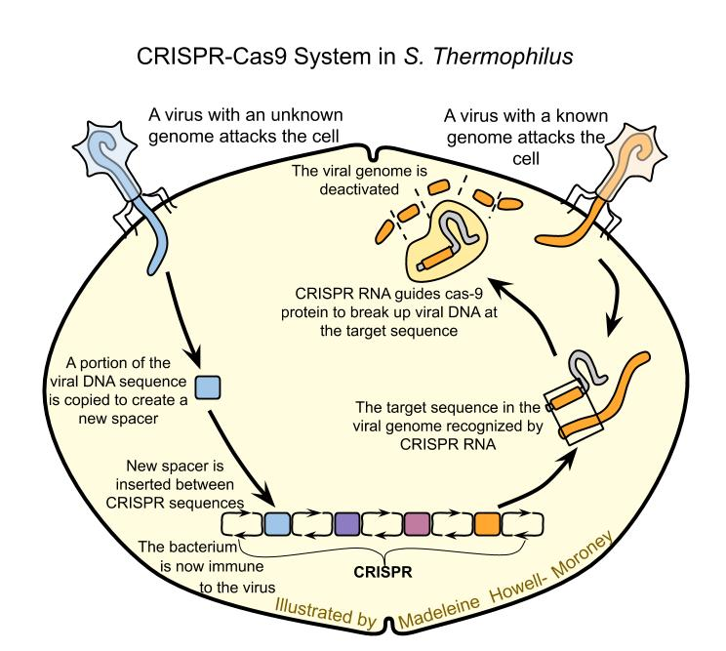
Why is it Revolutionary?
Enables highly precise and targeted DNA editing.
Faster, simpler, and more cost-effective than older gene-editing techniques.
Has transformed research in genetics, medicine, agriculture, and biotechnology.
Offers potential treatments for genetic disorders, cancer, and infectious diseases.
Accelerates scientific discoveries and the development of personalized medicine.
💡 Student Insight: Learning that CRISPR originated from a bacterial defense system completely changed how I think about nature-inspired innovations.

Slide 4
How Does CRISPR-Cas9 Work?
CRISPR-Cas9 edits DNA through a simple three-step process:
Step 1: Guide RNA (gRNA) Finds the Target
A specially designed Guide RNA (gRNA) recognizes and binds to a specific DNA sequence that scientists want to edit. The gRNA acts like a GPS, directing the Cas9 protein to the exact location in the genome.
Step 2: Cas9 Cuts the DNA
Once the target sequence is located, the Cas9 protein acts as molecular scissors and creates a precise double-strand break in the DNA. This cut is the first step in making a genetic change.
Step 3: The Cell Repairs the DNA
After the DNA is cut, the cell activates its natural repair mechanisms. Scientists can use these repair pathways to achieve different outcomes:
Non-Homologous End Joining (NHEJ): A quick repair process that often introduces small insertions or deletions, effectively turning a gene off (gene knockout).
Homology-Directed Repair (HDR): Uses a DNA template to accurately repair or replace the damaged sequence, allowing scientists to correct mutations or insert new genetic information.
💡Student Insight: The three-step workflow made gene editing much easier to understand than I initially expected.

Slide 5
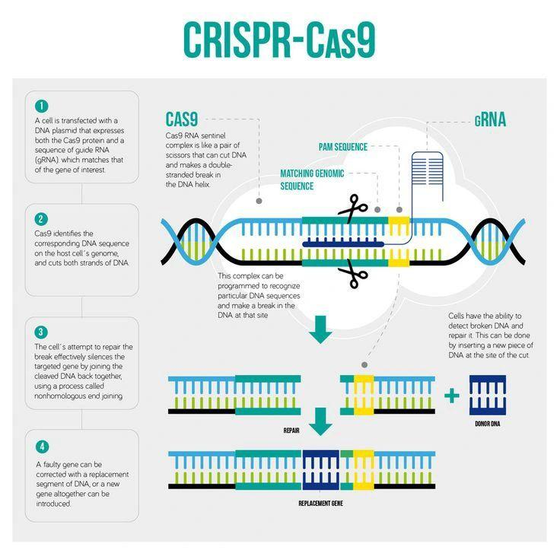
CRISPR Workflow
Guide RNA (gRNA)
↓
Recognizes Target DNA
↓
Cas9 Protein Binds
↓
DNA is Cut
↓
Cell Repairs DNA
↙ ↘
NHEJ HDR
(Gene (Gene
Knockout) Correction

Slide 6
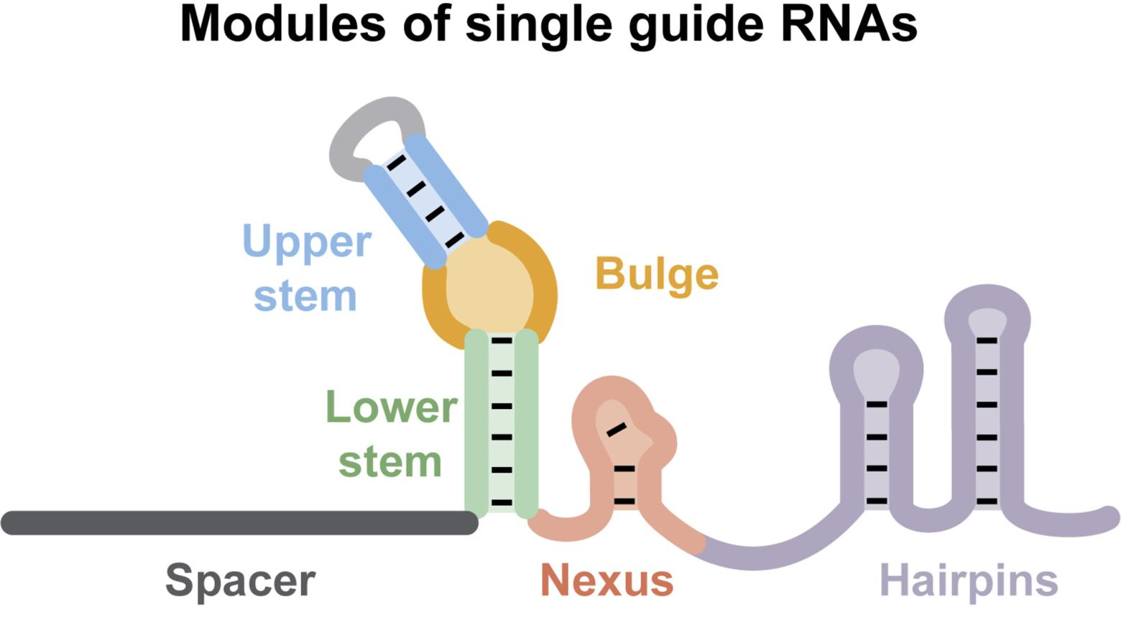
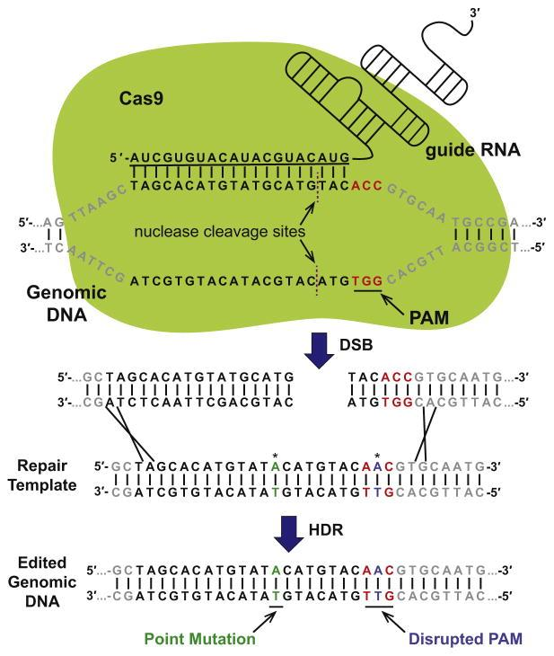
Components of CRISPR-Cas9
CRISPR-Cas9 consists of four key components that work together to edit DNA with high precision.
1. Guide RNA (gRNA)
The guide RNA is a short RNA molecule designed to match a specific DNA sequence. It directs the Cas9 protein to the exact location where the DNA needs to be edited.
2. Cas9 Protein
Cas9 is an enzyme that acts as molecular scissors. Once guided by the gRNA, it cuts both strands of the target DNA, initiating the editing process.
3. Target DNA
This is the specific DNA sequence selected for editing. Scientists can remove, replace, or modify genes depending on the desired outcome.
4. PAM Sequence
The Protospacer Adjacent Motif (PAM) is a short DNA sequence located next to the target site. Cas9 can only bind and cut DNA if a PAM sequence is present, ensuring greater specificity.

Slide 7
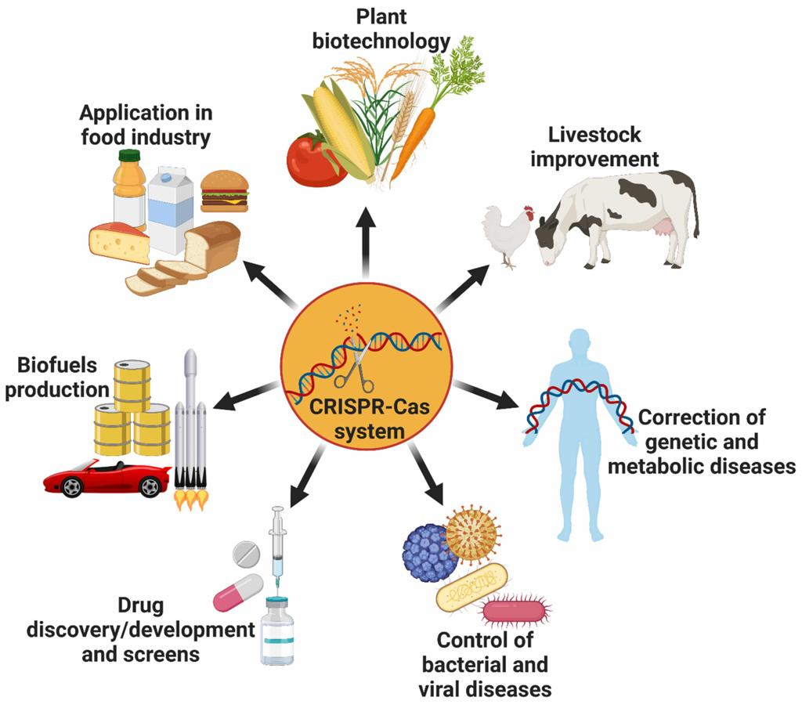
Applications of CRISPR-Cas9
CRISPR-Cas9 has transformed biotechnology and is being used across multiple fields.
🦠 Disease Research
Developing disease models for research.
Understanding how genes influence health and disease.
Studying viral infections and immune responses.
💊 Drug Discovery
Identifying new drug targets.
Testing drug effectiveness more efficiently.
Accelerating the development of new medicines.
🧪 Synthetic Biology
Engineering microorganisms for industrial applications.
Producing biofuels and pharmaceuticals.
Designing organisms with useful biological functions.

Slide 8
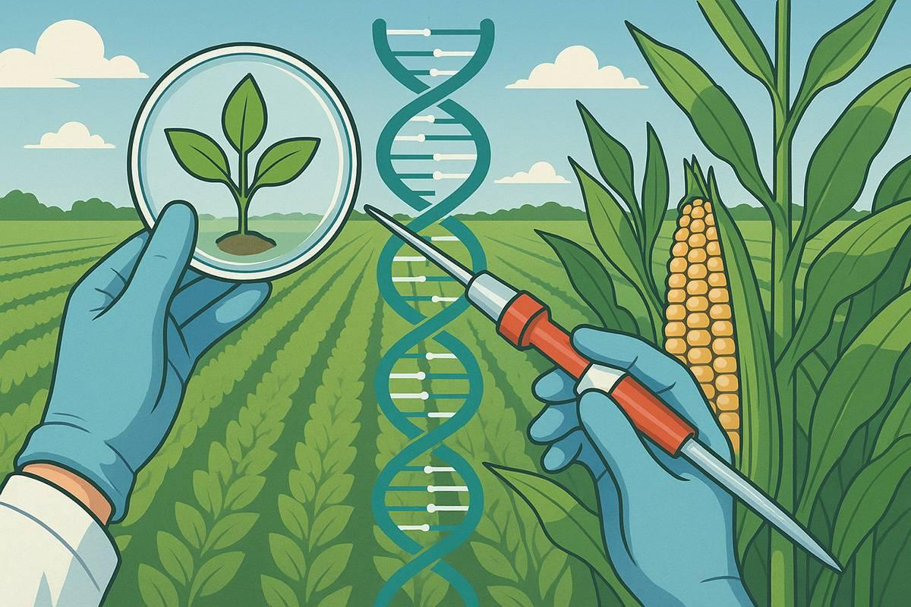
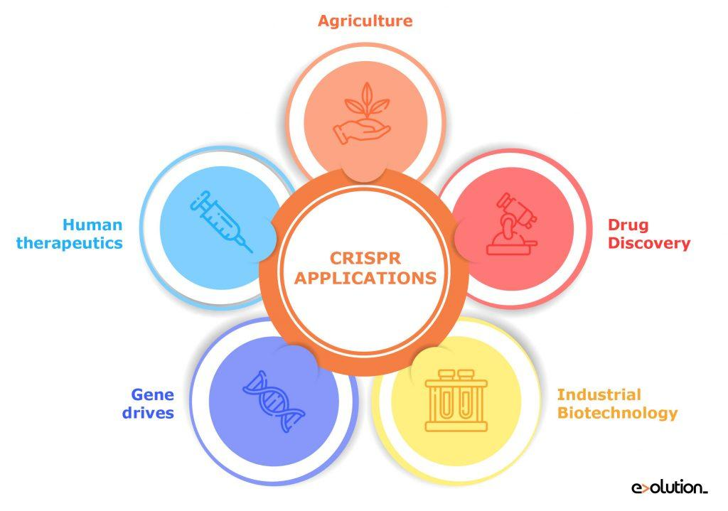
🧬 Medicine
Developing treatments for genetic disorders such as sickle cell disease.
Advancing cancer immunotherapy.
Exploring therapies for rare inherited diseases.
🌱 Agriculture
Creating pest- and disease-resistant crops.
Improving drought tolerance.
Enhancing crop yield and nutritional quality.
🦠 Disease Research
Developing disease models for research.
Understanding how genes influence health and disease.
Studying viral infections and immune responses.
💡 Student Insight: I was surprised to learn that CRISPR has applications far beyond medicine, including agriculture and environmental biotechnology.

Slide 9
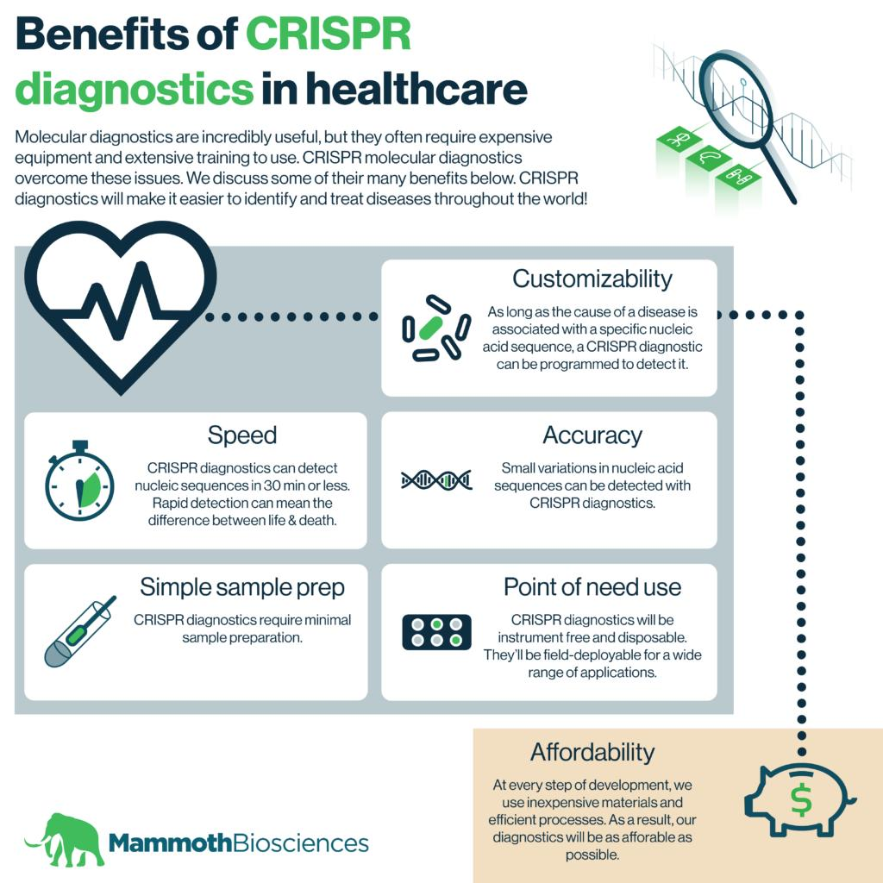
Advantages of CRISPR-Cas9
CRISPR-Cas9 has become one of the most widely used gene-editing technologies because of its many advantages.
High Precision
Targets specific DNA sequences with remarkable accuracy, reducing unintended changes.
Faster than Traditional Methods
Gene editing can be completed in a fraction of the time required by older techniques.
Cost-Effective
CRISPR is relatively inexpensive, allowing more laboratories and researchers to use the technology.
Wide Range of Applications
Useful in medicine, agriculture, environmental science, and basic biological research.
Easy to Design
Scientists can quickly create guide RNAs to target different genes.

Slide 10
Challenges & Ethical Issues
Although CRISPR offers enormous potential, several scientific and ethical challenges remain.
Off-Target Effects
Cas9 may occasionally cut unintended DNA sequences, leading to unwanted genetic changes.
Delivery Challenges
Delivering CRISPR components safely and efficiently into the correct cells remains a major hurdle.
Human Embryo Editing
Editing embryos raises concerns about inherited genetic changes and the possibility of "designer babies."
Accessibility
Advanced gene-editing therapies may be expensive, limiting access for many patients worldwide.
Ethical Responsibility
Scientists and policymakers must ensure CRISPR is used safely, responsibly, and for the benefit of society.

Slide 11
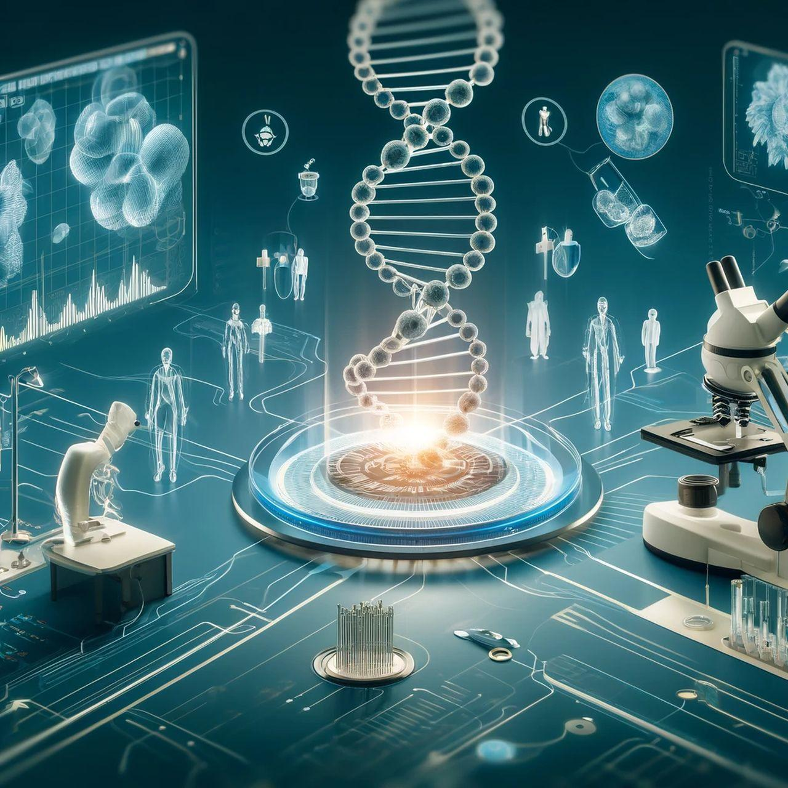
The Future of CRISPR
CRISPR continues to evolve and has the potential to reshape healthcare, agriculture, and biotechnology.
Gene Therapy
Developing long-term treatments for inherited genetic disorders.
Personalized Medicine
Creating treatments tailored to an individual's genetic makeup.
Disease Prevention
Correcting harmful genetic mutations before they cause disease.
Climate-Resilient Crops
Engineering crops that can withstand drought, pests, and changing environmental conditions.
Ongoing Research
Scientists are improving CRISPR's precision, reducing off-target effects, and developing next-generation gene-editing technologies such as base editing and prime editing.
💡Student Insight: Exploring the future of CRISPR made me excited about the possibilities of personalized medicine and gene therapy.

Slide 12
Key Takeaways
What We Learned
✅ CRISPR-Cas9 is a revolutionary gene-editing technology that enables precise DNA modification.
✅ It originated from the natural immune system of bacteria.
✅ The technology works through three simple steps: targeting DNA, cutting DNA, and repairing DNA.
✅ CRISPR has wide-ranging applications in medicine, agriculture, disease research, drug discovery, and synthetic biology.
✅ While the technology offers tremendous potential, ethical considerations and responsible use remain essential.
Final Thought
As a first-year biotechnology student, learning about CRISPR-Cas9 has deepened my interest in genetics and molecular biology. Creating this presentation helped me understand how a natural bacterial defense mechanism became one of the most powerful tools in modern science. I'm excited to continue exploring biotechnology and sharing what I learn along the way.

Slide 13
References
National Human Genome Research Institute
Broad Institute
Nature
National Institutes of Health
Think About It 🤔
If CRISPR could cure inherited diseases before birth, should it also be used to enhance traits like intelligence or athletic ability?

