Slide 1
Section G
SapphireLib Development

Slide 2
SapphireLib: Why We Need New Drive Software
Identify the Problem
The problem
The "library" is the layer of code between the robot's sensors and its motors: it is what turns "drive to the goal" into the right voltage on every wheel, 100 times a second. Last season we used two libraries written by other teams and neither fit us.
What happened last season | What it cost us
Started on EZ-Template, which only drives by distance and angle | Every autonomous was a chain of "drive 24, turn 90". One slip and everything after it was off.
Switched to LemLib halfway through the season, in a rush | We could not get its tracking wheel offsets calibrated, so the robot's idea of where it was drifted.
Neither library supports our new drivetrain (page D-41) | A mecanum drive with two extra center wheels has six motors that must be mixed. Both libraries assume a tank drive.
When a match went wrong we had no record of why | We guessed. Fixes were based on what we thought we saw.
Criteria: what the software must do
Drive our robot: tank drives and holonomic drives, including the six-motor "asterisk" layout.
Know where it is: track the robot's position on the field with whatever sensors are mounted.
Go where it is told: drive to a point, to a point facing a direction, and along a path.
Tune itself: find its own control settings, so a rebuilt robot is ready in minutes, not days.
Explain itself: record what happened in a match so decisions come from data.
Constraints: the limits we work inside
Constraint | Why it matters
Runs on the V5 Brain with PROS 4.2.2 | Fixed processor speed and memory. No extra computers are legal on the robot.
One programmer | Everything must be testable without the robot, because the robot is usually being built.
The team has one or two field walls, not a full field | Calibration and testing cannot assume a full 12 ft field.
Must last two seasons | Nothing in the library may be specific to this year's game.
All code is ours to explain | Judges and teammates must be able to ask "why" about any line.
Sources: LemLib, github.com/LemLib/LemLib and lemlib.readthedocs.io; EZ-Template, ez-robotics.github.io/EZ-Template; 96671H 2025-26 notebook (Stratagem V2.0 code).
CP
Cody Paschal
06/01/26
G-1

Slide 3
SapphireLib: What Our Robot Asks of the Software
Identify the Problem
Before researching solutions we listed what this season's robot physically needs, then turned each need into a software requirement. This is the list every later decision in this section is checked against.
What the robot has or must do | What the software therefore needs | How we will measure it
Mecanum drive with two straight center wheels ("asterisk"), six motors | A wheel mixer for 4 corners + 2 centers, driving, strafing and turning at once | All six motors share the load in a straight drive and in a turn
Drivers want "forward" to always mean away from them | Field-centric control using the inertial sensor | Robot drives the same direction whichever way it faces
Autonomous must end where the next motion expects | Position tracking (odometry) that can be corrected mid-routine | Under 1 in from the true position at the end of a routine
A lift, a claw and an intake, but only 12 buttons | A macro system: one button can mean different things in different states | Every control reachable without letting go of the sticks
Motors overheat in long matches | Notice heat and compensate before the robot drifts | A strafe stays straight with one hot motor
Robot is rebuilt several times a season | Automatic tuning and calibration | New chassis tuned in one practice, not a week
Failures must be explained | A log on the SD card and a tool to read it | Every match leaves a file we can replay
Why this page exists: when we score options in a decision matrix later, the criteria and their weights come from this table, not from what is easiest to program.
What "holonomic" means
A tank drive can only go forward, backward and turn. A holonomic drive can also slide sideways (strafe) without turning, and can do all three at once. Our drive base testing (Section D) chose a mecanum drive with two extra straight wheels in the middle for pushing power. Seen from above the six wheels look like an asterisk (*), so that is what we call it.
Sources: 96671H notebook, Section D (drive base testing); VEX V5RC 2026-27 Game Manual; PROS docs, pros.cs.purdue.edu/v5.
CP
Cody Paschal
06/03/26
G-2

Slide 4
SapphireLib: Existing Libraries
Research
We started by studying the libraries other teams publish, to learn what a good one contains and to decide whether one of them could be adapted. For each we read the documentation and the source code.
Library | Drive types | Position tracking | Tuning tools | What we learned from it
LemLib | Tank only | Tracking wheels + inertial sensor | None built in | The moveToPoint(x, y) style of command, the "boomerang" curve, clear code comments
EZ-Template | Tank only | Added recently; built around distance and angle | On-screen PID tuner, auton selector | Every motion needs an exit condition and a timeout; a brain-screen tuner saves hours
OkapiLib | Tank, X-drive, mecanum | Basic | None | Holonomic "chassis models"; but it is no longer maintained for the current PROS
JAR-Template | Tank and holonomic | Tracking wheels | None | Holonomic odometry is practical in VEX; but it is for VEXcode, not PROS
What none of them had
A holonomic drive with extra center wheels. Every library assumes four corner wheels at most.
One library with position tracking, holonomic driving, self-tuning and match logging together. Teams combine two or three libraries, and the pieces do not share information.
A way to test without the robot. Each library can only be tried by downloading to a real robot.
Reflection
Reading the source changed our plan. We had assumed a library was mostly "the math". In both LemLib and EZ-Template, the math is a small part: most of the code handles things going wrong (a sensor unplugged, a motion that never finishes, two tasks touching the same value). We added "what happens when something fails" as a question to ask of every feature we write.
Sources: LemLib, github.com/LemLib/LemLib and lemlib.readthedocs.io; EZ-Template, ez-robotics.github.io/EZ-Template; OkapiLib, okapilib.github.io/OkapiLib; JAR-Template (GitHub).
CP
Cody Paschal
06/05/26
G-3

Slide 5
SapphireLib: Where Each Technique Comes From
Research
Almost nothing in a drive library is new. The skill is choosing well-proven techniques and fitting them together. This table lists every outside idea SapphireLib builds on and where it is used, so credit is given where the idea appears.
Source | What we took from it | Used in
EZ-Template | Exit conditions and timeouts on every motion; brain-screen tuner | Motions, Brain GUI
LemLib | moveToPoint / moveToPose command style; boomerang; comment style | Motions
5225A PiLons position tracking paper | The arc method for tracking wheels | Odometry
Purdue SIGBots Wiki | Using the inertial sensor for heading; PID basics | Odometry, PID
Game Manual 0 (FTC) | Mecanum wheel mixing and field-centric driving | Chassis
Coulter 1992 (Carnegie Mellon) | Pure pursuit path following | Path following
Astrom and Murray, Feedback Systems | PID theory, pole placement, phase margin | PID, Auto-Tune
WPILib (FRC) system identification | The kS / kV / kA motor model | Auto-Tune
Thrun, Burgard and Fox, Probabilistic Robotics | Monte Carlo localization | Localization
PROS and LVGL documentation | Tasks, devices, SD card, the brain screen | Everything
How we used sources
We read the idea, then wrote our own code for it. No file in SapphireLib is copied from another library.
Where two sources disagreed (for example, three tracking wheels against two plus an inertial sensor) we treated it as a design choice and made a decision matrix.
Each page that uses a source names it in the red box at the bottom of that page.
Sources: LemLib, github.com/LemLib/LemLib and lemlib.readthedocs.io; EZ-Template, ez-robotics.github.io/EZ-Template; 5225A E-Bots PiLons, "Introduction to Position Tracking" (2018), thepilons.ca/wp-content/uploads/2018/10/Tracking.pdf; Purdue SIGBots Wiki, Odometry, wiki.purduesigbots.com/software/odometry; Game Manual 0, Mecanum Drive, gm0.org/en/latest/docs/software/tutorials/mecanum-drive.html; R. C. Coulter, "Implementation of the Pure Pursuit Path Tracking Algorithm," CMU-RI-TR-92-01 (1992); K. Astrom and R. Murray, Feedback Systems (Princeton, 2008), fbswiki.org; WPILib docs, docs.wpilib.org; S. Thrun et al., Probabilistic Robotics (MIT Press, 2005); PROS docs, pros.cs.purdue.edu/v5; LVGL 9.2 docs, docs.lvgl.io/9.2.
CP
Cody Paschal
06/05/26
G-4

Slide 6
SapphireLib: Three Ways Forward
Brainstorm and Pick Best Solution
From the research we saw three realistic approaches. We wrote down what each would look like in practice before scoring them.
 | A. Keep last year's code on LemLib | B. Go back to EZ-Template | C. Write our own: SapphireLib
What we would do | Keep Stratagem V2.0 and add a holonomic layer inside LemLib's code | Use EZ-Template's drive and add holonomic control and odometry to it | Start from an empty PROS project and write every part
First drive | Same day | Same day | Two to three weeks
Asterisk drive | We edit someone else's tank-drive code | We edit someone else's tank-drive code | Designed in from the first line
When it breaks at a tournament | Debug thousands of lines we did not write | Debug thousands of lines we did not write | We wrote it, so we know where to look
Tools (tuning, logging) | Add separately | Tuner exists; logging added separately | Built to share data with each other
Biggest risk | Library updates overwrite our edits | Odometry is not its strength | One programmer; nothing works until a lot works
How the approaches differ
A and B are fast today and slow later: the robot drives immediately, but every feature the robot needs that the library lacks has to be forced into code designed for a different drivetrain. C is slow today and fast later: nothing drives for weeks, but each feature is built for our robot and for testing on a laptop.
What would change our mind: if the season started in two weeks, A wins. Because we started in June with the whole summer ahead and the robot not yet built, time to first drive matters less than usual. That is why "works on day one" gets a middle weight, not the top weight, on the next page.
Sources: LemLib, github.com/LemLib/LemLib and lemlib.readthedocs.io; EZ-Template, ez-robotics.github.io/EZ-Template; 96671H 2025-26 notebook (Stratagem V2.0 code).
CP
Cody Paschal
06/08/26
G-5

Slide 7
SapphireLib: Library Decision Matrix
Brainstorm and Pick Best Solution
Each approach is scored from 1 (poor) to 5 (excellent) on each criterion. The score is multiplied by the criterion's weight (1 to 5, from how much our robot depends on it, page G-2). The number in brackets is the weighted score. Green is the best in a row, red the worst.
Criteria | Weight | A. Keep LemLib | B. EZ-Template | C. SapphireLib
Supports the six-motor asterisk drive | 5 | 1 (5) | 1 (5) | 5 (25)
Any mix of tracking sensors, easy to calibrate | 4 | 3 (12) | 2 (8) | 5 (20)
We can explain and fix every line | 4 | 2 (8) | 2 (8) | 5 (20)
Tuning and logging tools built in | 3 | 2 (6) | 3 (9) | 5 (15)
Works on day one | 3 | 5 (15) | 5 (15) | 1 (3)
Low risk with one programmer | 2 | 4 (8) | 4 (8) | 2 (4)
Weighted total |  | 54 | 53 | 87
Why each score
Asterisk drive: A and B are tank-only, so both score 1. This is the highest weight because without it the robot from Section D cannot drive at all.
Sensor mix: LemLib requires tracking wheels (3). EZ-Template's tracking is newer and less flexible (2).
Explain every line: we scored ourselves honestly at 2 for both outside libraries after last season, when we could not find why LemLib's offsets would not calibrate.
Day one and risk: the outside libraries win clearly. Writing our own is a real risk and scores 1 and 2.
Decision: write our own library, SapphireLib. It scores highest because the two criteria our robot depends on most cannot be met by the others. Decided by Cody Paschal (programmer). To manage the risk we will (1) build in phases so the robot can drive after phase 1, and (2) keep Stratagem V2.0 working as a fallback until SapphireLib has driven an autonomous.
Sources: LemLib, github.com/LemLib/LemLib and lemlib.readthedocs.io; EZ-Template, ez-robotics.github.io/EZ-Template; criteria from page G-1 and G-2.
CP
Cody Paschal
06/10/26
G-6

Slide 8
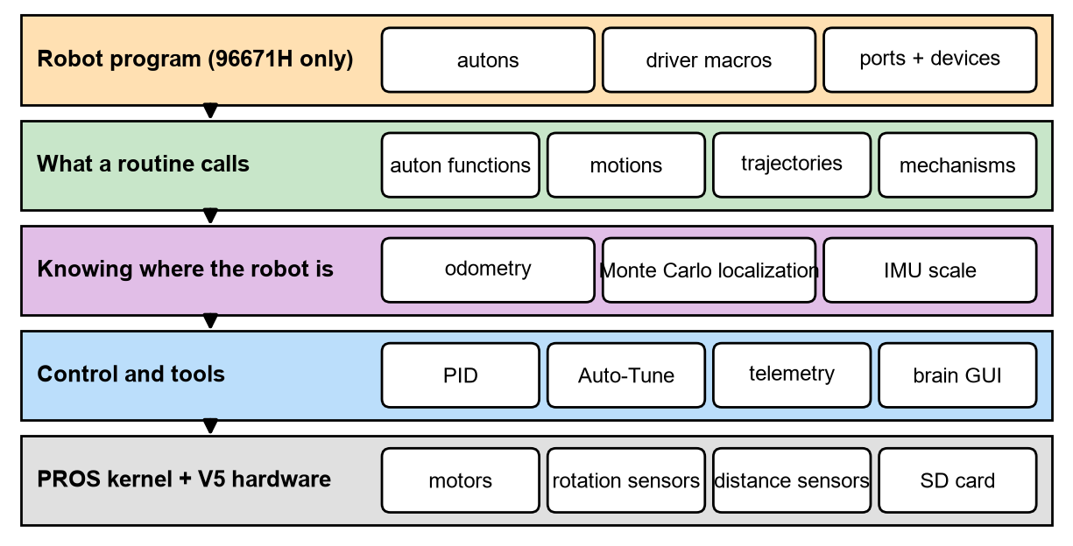
SapphireLib: Designing the Library Before Writing It
CAD/Design and Prototype
A library is designed like a mechanism: parts with clear jobs that connect in known ways. Before any code we drew the layers below. Each layer only talks to the one beneath it, so a part can be rebuilt without touching the rest.
SapphireLib's layers. The top layer is our robot; everything below it works on any V5 robot.
Sources: K. Astrom and R. Murray, Feedback Systems (Princeton, 2008), fbswiki.org; LemLib, github.com/LemLib/LemLib and lemlib.readthedocs.io (project layout); PROS docs, pros.cs.purdue.edu/v5.
CP
Cody Paschal
06/11/26
G-7

Slide 9
SapphireLib: Designing the Library Before Writing It (continued)
CAD/Design and Prototype
Design rules we set
Tell it what sensors exist, it picks the math. No tracking wheels, one, or two: the same library.
Math is separate from hardware. Every calculation is a plain function that takes numbers and returns numbers. That lets us test it on a laptop with no robot (page G-17).
Nothing may freeze the robot. Every wait has a timeout. Every motion reports whether it finished or gave up.
Tools are optional. A team that does not want our screen or logger never has to turn them on.
Phases
Phase | What it delivers | Robot can then...
1. Chassis control | PID, tank and holonomic drives, driver control | Drive straight and turn to an angle
2. Odometry | Position tracking with any sensor mix | Know where it is
3. Motions | Move to point, move to pose, follow a path | Run a full autonomous
4. Tools | Brain screen, tuners, SD card logging | Be tuned and debugged quickly
5. Mechanisms | Lifts, pistons, controller macros | Run the whole robot on one library
Phase 1 comes first on purpose: the robot can drive in practice before position tracking exists.
Sources: K. Astrom and R. Murray, Feedback Systems (Princeton, 2008), fbswiki.org; LemLib, github.com/LemLib/LemLib and lemlib.readthedocs.io (project layout); PROS docs, pros.cs.purdue.edu/v5.
CP
Cody Paschal
06/12/26
G-8

Slide 10
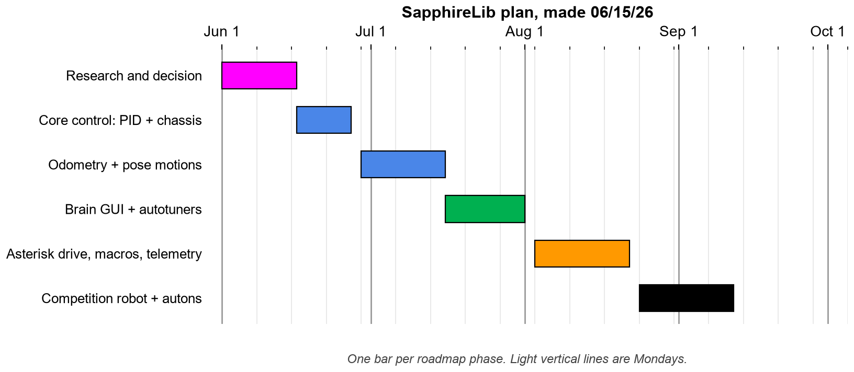
SapphireLib: SapphireLib Plan
Monthly Gantt Charts
Overall goal
Have SapphireLib driving the competition robot in autonomous by mid-September, before our first tournament.
Sub-goals
June: finish research and the decision (done), then the PID controller and both drive types.
Late June to mid-July: odometry for every sensor combination, then the pose motions.
Late July: the brain screen and an automatic tuner, so the build team can tune without the programmer.
August: driver macros and SD card logging.
Late August to mid-September: move everything onto the competition robot.
Top priorities
Phases 1 to 3 (drive, track, move). If these slip, the fallback is last year's Stratagem code for the first tournament.
Extra goals
If we are ahead: a way to correct position drift during a match using distance sensors. Research only for now.
Reasons for gaps
The same person programs and helps with drive base testing (Section D), so programming days in June and July are the days the test drive bases are not being run.
See page G-42 for progress against this plan part way through, and page G-82 for the final chart.
Sources: 96671H notebook, page A-4 (How to Read Gantt Charts); SapphireLib docs/ROADMAP.md.
CP
Cody Paschal
06/15/26
G-9

Slide 11
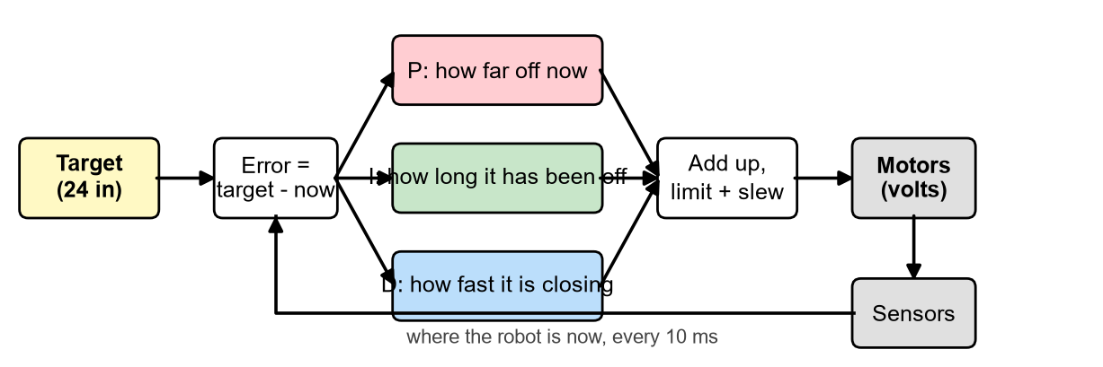
SapphireLib: How a PID Controller Works
Research
Every motion the robot makes on its own comes down to one question, asked 100 times a second: "how many volts should the motors get right now?" A PID controller answers it. Cruise control in a car is the everyday example: it compares the speed you set to the speed you are going and adjusts the engine.
The loop: compare target to reality, combine three reactions, send volts, measure again.
Part | In plain words | What it fixes | Too much of it causes
P (proportional) | Push harder the farther away you are | Gets the robot moving toward the target | Overshooting and bouncing back
I (integral) | If you have been a little off for a while, push more | The last small error friction leaves behind | A big overshoot after being blocked ("windup")
D (derivative) | If you are closing in fast, ease off | Overshoot: it is the brake | Jitter from sensor noise
What we decided to add to the textbook version
Reading EZ-Template, LemLib and the control textbook showed four known weaknesses of a basic PID. We chose to build a fix for each into ours from the start, then test that each one earns its place (next three pages).
Weakness | Our addition
Integral keeps growing while the robot is stuck | Anti-windup: stop adding to I while the output is already at its limit
Changing the target makes D spike | Option to take D from the measurement instead of the error
0 to 12 V instantly slips the wheels | Slew limit: cap how fast the output may change
Gains only work at one loop speed | Gains are per second, not per loop
Sources: Purdue SIGBots Wiki, PID Controller, wiki.purduesigbots.com/software/control-algorithms/pid-controller; K. Astrom and R. Murray, Feedback Systems (Princeton, 2008), fbswiki.org, ch. 10 (PID Control); L. Llamas, "The PID Controller," luisllamas.es; EZ-Template, ez-robotics.github.io/EZ-Template (PID tuning guide).
CP
Cody Paschal
06/16/26
G-10

Slide 12
SapphireLib: Our PID Code
Programming
This is the heart of the controller, trimmed to its key lines. Green text after // is a comment: a note to the reader that the robot ignores. Every motion, the lift and the heading hold all run through this one function.
double PID::step(double target, double measurement, double dtS) {
const double error = target - measurement; // how far off are we?
// I: add up error over TIME (dtS = seconds since last loop), so kI is "per second"
const double integralDelta = error * dtS;
integral_ += integralDelta;
// D: how fast the error is changing, per second. Optionally from the measurement,
// so that changing the target does not look like a sudden huge change
double derivative = (config_.derivativeOnMeasurement ? -(measurement - prevMeasurement_)
: (error - prevError_)) / dtS;
double output = config_.gains.kP * error + config_.gains.kI * integral_
+ config_.gains.kD * derivative;
// anti-windup: already past the limit and still pushing the same way?
// Then undo this loop's integration. It could only come back later as overshoot
if (std::fabs(output) > config_.outputLimit && (output > 0.0) == (integralDelta > 0.0)) {
integral_ -= integralDelta;
output = config_.gains.kP * error + config_.gains.kI * integral_
+ config_.gains.kD * derivative;
}
// slew: the output may only change by so much per loop (no 0 V to 12 V jumps)
output = prevOutput_ + std::clamp(output - prevOutput_, -config_.slewRate, config_.slewRate);
return std::clamp(output, -config_.outputLimit, config_.outputLimit); // a motor has 12 V
}
How this code was developed
Version 1 (June) was the textbook: three lines for P, I and D added per loop.
Version 2 added the output limit and the slew limit, because a jump from 0 V to 12 V in one loop slips the wheels.
Version 3 changed I and D to be per second. This came from a bug found later while building the automatic tuner (page G-39): gains worked out by a formula were wrong by exactly the loop time, with kI 100 times too large and kD 100 times too small at a 10 ms loop. Making the gains per second fixed it for good.
Version 4 added the "observer": after each step the controller can hand its numbers to the SD card logger.
Why one PID for everything: a fix made here reaches every mechanism at once, and one set of tests (next pages) covers them all.
Sources: Purdue SIGBots Wiki, PID Controller, wiki.purduesigbots.com/software/control-algorithms/pid-controller; K. Astrom and R. Murray, Feedback Systems (Princeton, 2008), fbswiki.org, sec. 10.4 (Integrator Windup); SapphireLib src/sapphirelib/control/pid.cpp.
CP
Cody Paschal
06/18/26
G-11

Slide 13
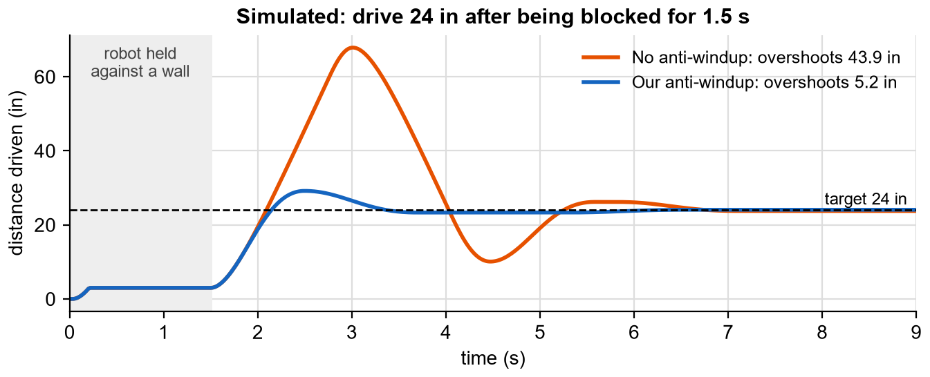
SapphireLib: PID Test 1: Anti-Windup
Test
Question
Does our anti-windup rule actually stop the overshoot that happens after the robot is blocked?
Procedure (repeatable)
Tool: the library's PID running against the simulated forward axis of our drive (the motor model measured by Auto-Tune: 1.0 V friction, 0.20 V per in/s, 0.045 V per in/s^2, 30 ms delay).
Target: drive 24 in. For the first 1.5 s a wall at 3 in stops the robot, as if pinned by an opponent. Then the wall is removed.
Gains: kP 0.9, kI 1.5, kD 0.06. Loop: 10 ms. Run for 9 s.
Run twice: once with anti-windup off, once with it on. Nothing else changes.
Measure: the farthest the robot goes past 24 in (overshoot).
 | Anti-windup off | Anti-windup on
Overshoot past the 24 in target | 43.9 in | 5.2 in
Time after release to stay within 0.5 in | 5.1 s | 4.2 s
What we saw
While held against the wall the "off" controller kept adding to its integral for 1.5 s. When released it drove far past the target before that stored-up push drained away. In a match that is a robot driving through the goal it was meant to stop at. With anti-windup on, the overshoot shrank by about 88%.
Decision from this test: anti-windup is turned on automatically whenever an output limit is set, which is every controller on our robot. Decided by Cody Paschal from the data above.
Reflection: the remaining 5.2 in overshoot comes from the integral gathered in the first instant after release. It pushed us toward controllers that need no I term at all, which the Auto-Tune work later delivered.
Sources: K. Astrom and R. Murray, Feedback Systems (Princeton, 2008), fbswiki.org, sec. 10.4; SapphireLib simulator (tools/analyzer/js/model.js), run by notebook/build/experiments.js.
CP
Cody Paschal
06/19/26
G-12

Slide 14
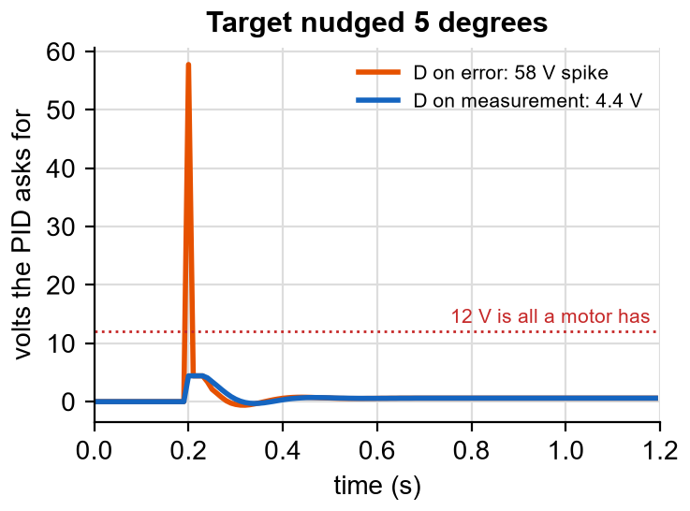
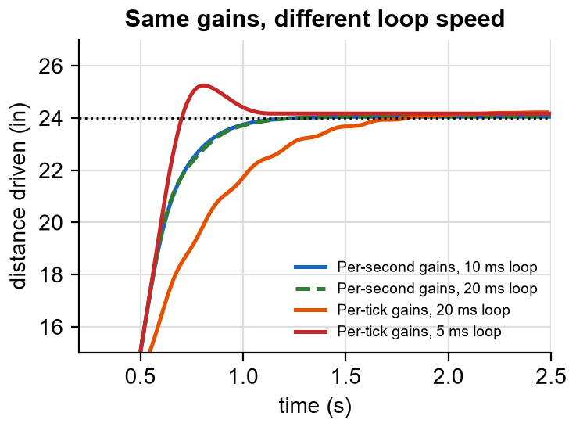
SapphireLib: PID Tests 2 and 3: Derivative Kick and Loop Speed
Test
Test 2: changing the target
Procedure: heading-hold controller on the simulated turn axis. At 0.2 s the target heading is nudged by 5 degrees, as when the driver taps the turn stick. Run once with D taken from the error, once from the measurement. Measure the largest voltage asked for.
Result: D on error asked for 58 V, almost five times what a motor has. D on measurement asked for 4.4 V. The robot ends at the same heading either way.
Test 3: changing the loop speed
Procedure: one set of gains (kP 4.25, kI 0.8, kD 0.68), 24 in drive. Run at a 10 ms loop and a 20 ms loop with our per-second gains. Then run how an ordinary per-loop PID tuned at 10 ms behaves at 20 ms and at 5 ms. Measure settle time and overshoot.
Sources: K. Astrom and R. Murray, Feedback Systems (Princeton, 2008), fbswiki.org, sec. 10.5 (Implementation: derivative action, setpoint weighting); Purdue SIGBots Wiki, PID Controller, wiki.purduesigbots.com/software/control-algorithms/pid-controller; SapphireLib simulator, run by notebook/build/experiments.js.
CP
Cody Paschal
06/22/26
G-13

Slide 15
SapphireLib: PID Tests 2 and 3: Derivative Kick and Loop Speed (continued)
Test
Controller and loop speed | Settles within 0.5 in after | Overshoot
Per-second gains, 10 ms loop | 0.92 s | 0.05 in
Per-second gains, 20 ms loop | 0.94 s | 0.06 in
Per-tick gains, 20 ms loop | 1.42 s | 0.21 in
Per-tick gains, 5 ms loop | 0.98 s | 1.25 in
What the data says
With per-second gains, doubling the loop time changed the settle time by 0.02 s. The gains survive.
With per-loop gains the same robot overshoots 1.25 in at 5 ms and takes 1.42 s to settle at 20 ms. A tuning done at one loop speed is wrong at another.
Decisions (Cody Paschal): (1) Controllers whose target moves while running (driver heading hold) use D on measurement. (2) All gains are per second. This matters to us because the driver loop runs at a different speed than the autonomous loop, and both share controllers.
Sources: K. Astrom and R. Murray, Feedback Systems (Princeton, 2008), fbswiki.org, sec. 10.5 (Implementation: derivative action, setpoint weighting); Purdue SIGBots Wiki, PID Controller, wiki.purduesigbots.com/software/control-algorithms/pid-controller; SapphireLib simulator, run by notebook/build/experiments.js.
CP
Cody Paschal
06/24/26
G-14

Slide 16
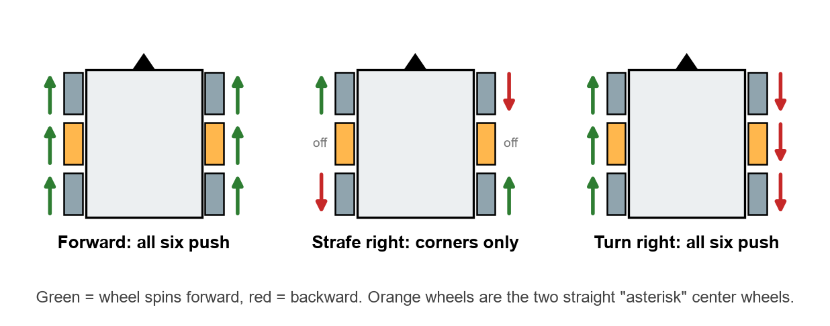
SapphireLib: Driving Six Wheels: the Holonomic Mixer
Programming
The driver gives three wishes at once: go forward, slide sideways, and turn. The "mixer" turns those three wishes into a voltage for each wheel (shown simplified below). Mecanum wheels have angled rollers, so spinning the corners in different directions makes the robot slide sideways.
// mix the three wishes into the four corner wheels
frontLeft = throttle + strafe + turn;
frontRight = throttle - strafe - turn;
backLeft = throttle - strafe + turn;
backRight = throttle + strafe - turn;
// if any wheel was asked for more than 12 V, shrink all four by the same amount,
// so the robot still moves in the direction asked, just slower
const double biggest = std::max({fabs(frontLeft), fabs(frontRight), fabs(backLeft), fabs(backRight)});
if (biggest > 12.0) { scale all four by 12.0 / biggest; }
// the two straight center wheels cannot push sideways. Work backward from the four
// corners to find how much "forward" and "turn" was asked, and give them only that
const double throttleVolts = (frontLeft + frontRight + backLeft + backRight) / 4.0;
const double turnVolts = (frontLeft - frontRight + backLeft - backRight) / 4.0;
middleLeft = throttleVolts + turnVolts;
middleRight = throttleVolts - turnVolts;
Design choices
One mixer for mecanum and X-drive. Both use the same plus and minus pattern, so the library supports either with the same code, including the X-drive and mecanum test bases from Section D.
Center wheels are worked out from the corners, not from the sticks. Whatever asked for the motion (driver, autonomous, the tuner), the center wheels react the same way. This removed a whole class of "works in driver, not in auton" bugs.
Shrink together, never clip one wheel. Clipping one wheel at 12 V changes the direction of travel.
Sources: Game Manual 0, Mecanum Drive, gm0.org/en/latest/docs/software/tutorials/mecanum-drive.html; OkapiLib X-drive model, okapilib.github.io/OkapiLib; SapphireLib src/sapphirelib/chassis/holonomic_drivetrain.cpp.
CP
Cody Paschal
06/26/26
G-15

Slide 17
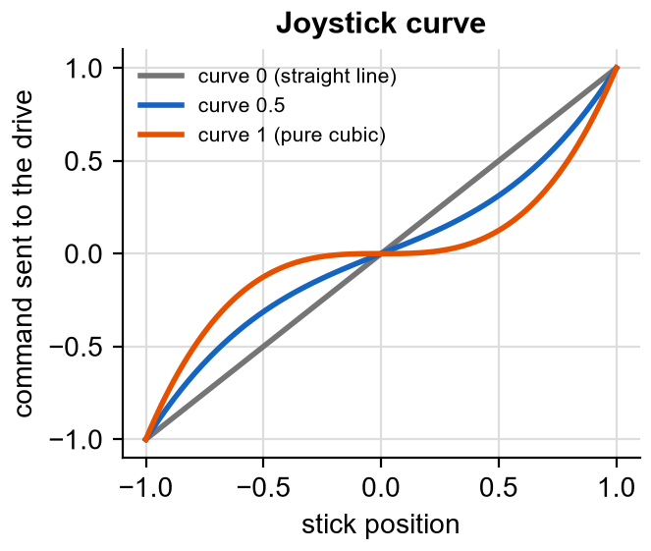
SapphireLib: Field-Centric Driving and the Joystick Curve
Programming
Joystick curve
A straight-line stick makes small, careful movements hard: a tiny push already moves the robot quickly. The curve blends a straight line with a cubic (x times x times x), so the first half of the stick gives fine control and the top end still reaches full speed.
return curve * x * x * x + (1.0 - curve) * x;
The driver picks the blend. A deadband ignores the one or two counts a stick reads at rest.
Field-centric ("headless") driving
With a robot that can slide in any direction, "forward on the stick" is confusing once the robot has turned around. In field-centric mode, pushing the stick away from the driver always moves the robot away from the driver. The inertial sensor tells us how far the robot has turned, and we rotate the stick by that angle:
// rotate the driver's stick by how far the robot has turned since "forward" was set
const double headingRad = (robotHeading - fieldForwardHeading) * (kPi / 180.0);
const double robotThrottle = throttle * cos(headingRad) + strafe * sin(headingRad);
const double robotStrafe = -throttle * sin(headingRad) + strafe * cos(headingRad);
holonomic(robotThrottle, robotStrafe, turn); // then mix as on the previous page
Problems this solves for the drivers
Situation | Problem | What the library provides
Robot has spun around | "Forward" on the stick now drives toward the driver | Field-centric mode
Lining up on a goal | A straight-line stick is too sensitive near the center | The curve; the driver chooses how much
Autonomous ended at an angle | "Forward" would point wherever autonomous left the robot | resetFieldHeading() re-zeroes "forward"
Stick not perfectly centered | Robot creeps when nobody is touching it | Deadband
Reflection: the rotation is four lines of math. The rest of this page exists because a driver feature is only finished when it handles the awkward moments of a match: after a spin, after autonomous, and with a worn controller.
Sources: Game Manual 0, Mecanum Drive, gm0.org/en/latest/docs/software/tutorials/mecanum-drive.html (field-centric control); EZ-Template, ez-robotics.github.io/EZ-Template (joystick curves); SapphireLib src/sapphirelib/control/joystick_curve.cpp.
CP
Cody Paschal
06/29/26
G-16

Slide 18
SapphireLib: Testing Code Without a Robot
Test
The problem
The robot was being designed and rebuilt all summer, and a bug that only shows up on the robot can take a whole practice to find. We needed to test the library on a laptop.
Our method: desktop unit tests
Because every calculation is a plain function (design rule 2, page G-7), we can call it on a laptop with numbers we choose and check the answer against one worked out by hand. Each check is a "unit test". They run in seconds, and they run again automatically every time the code changes.
Area | Example of what a test checks | Why it matters
PID | Integral does not grow while the output is at its limit | Page G-12
Angles | 350 degrees to 10 degrees is a 20 degree turn, not 340 | Robot turns the short way
Odometry | Spinning in place moves the pose by zero | Wheel offsets are applied correctly
Path following | The lookahead point is on the path, ahead of the robot | Robot does not drive backward along a path
Tuner | Recovers known motor values from simulated data with noise | Auto-Tune can be trusted
Localization | Same random seed gives exactly the same result | Tests are repeatable
Telemetry | Log text matches the file format byte for byte | Old logs stay readable
Test group | Count
Desktop C++ test files, one per module | 48
Simulator test files (JavaScript) | 10
Run automatically on every code change | Yes (GitHub Actions)
What unit tests cannot do
They prove the math does what we intended. They cannot prove we intended the right thing, or that the real robot behaves like our model of it. For that we use the simulator (page G-60) and then the robot itself.
Reflection: writing a test takes about as long as writing the function, which felt slow at first. It is also the only way one programmer can keep changing a library this size without breaking what already worked. From here on, each page that says "desktop test" means this.
Sources: GitHub Actions docs, docs.github.com/actions; LemLib, github.com/LemLib/LemLib and lemlib.readthedocs.io (CI layout); SapphireLib tests/ folder and .github/workflows/build.yml.
CP
Cody Paschal
06/30/26
G-17

Slide 19
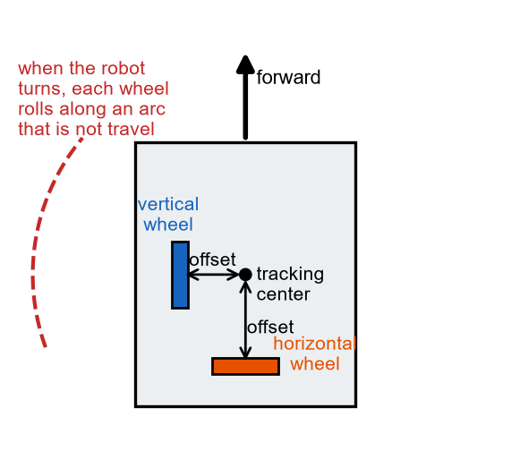
SapphireLib: How Odometry Works
Research
Odometry is how the robot knows where it is. It is dead reckoning, the way a ship navigated before GPS: start from a known spot, and keep adding up every small movement.
The sensors
Tracking wheels: small unpowered wheels on rotation sensors that roll along the floor. One faces forward (vertical), one sideways (horizontal).
Inertial sensor (IMU): reports which way the robot is facing.
Every 10 ms
Read how far each wheel rolled.
Subtract the part that came from the robot turning (the arc).
Rotate what is left by the heading, and add it to the position.
The arc problem
A tracking wheel is never exactly at the center of the robot. When the robot spins in place it has not travelled anywhere, but an off-center wheel rolls along a circle. The 5225A PiLons paper gives the fix: that false rolling equals the wheel's distance from the center (its offset) times the angle turned. Subtract it and only real travel remains.
Two ways to get the heading
Method | How | Trade-off
PiLons (2018) | Two parallel wheels; heading from the difference between them | Three wheels total. Heading error grows with wheel error.
SIGBots Wiki | The inertial sensor reports heading directly | One fewer wheel. IMU drifts slowly over a match.
What we learned: odometry only ever adds. Any error (a wheel that slips, a bump from another robot) stays in the position for the rest of the match. That weakness is why this section later adds a second system to check odometry against the field walls.
Sources: 5225A E-Bots PiLons, "Introduction to Position Tracking" (2018), thepilons.ca/wp-content/uploads/2018/10/Tracking.pdf; Purdue SIGBots Wiki, Odometry, wiki.purduesigbots.com/software/odometry; LemLib, github.com/LemLib/LemLib and lemlib.readthedocs.io (tracking wheel setup).
CP
Cody Paschal
07/02/26
G-18

Slide 20
SapphireLib: Which Sensors for Odometry
Brainstorm and Pick Best Solution
The research gave four ways to build odometry. We compared them for our robot, then made a second decision about what the library should support.
Option | Sensors | How it tracks
1. Three wheels | 2 vertical + 1 horizontal tracking wheel | Heading from the two vertical wheels (PiLons)
2. Two wheels + IMU | 1 vertical + 1 horizontal + inertial sensor | Heading from the IMU, both directions from wheels
3. One wheel + IMU | 1 vertical + inertial sensor | Forward only; assumes the robot never slides sideways
4. Drive motors + IMU | Encoders inside the drive motors + inertial sensor | No extra parts; wheel slip counts as travel
Criteria | Weight | 3 wheels | 2 wheels + IMU | 1 wheel + IMU | Motors + IMU
Tracks sideways sliding (needed for holonomic) | 5 | 5 (25) | 5 (25) | 1 (5) | 1 (5)
Not fooled by drive wheel slip | 4 | 5 (20) | 5 (20) | 4 (16) | 1 (4)
Heading accuracy | 4 | 3 (12) | 5 (20) | 5 (20) | 5 (20)
Space it takes inside the robot | 3 | 1 (3) | 3 (9) | 4 (12) | 5 (15)
Ports and parts used | 2 | 2 (4) | 3 (6) | 4 (8) | 5 (10)
Weighted total |  | 64 | 80 | 61 | 54
Reasoning
Our drive slides sideways on purpose, so options 3 and 4 score 1 on the top criterion: they cannot see a strafe.
Mecanum rollers slip constantly, so motor encoders (option 4) are a poor measure of real travel.
Three wheels would need space inside the chassis that the lift and intake are using.
Decision 1 (robot): two tracking wheels plus the inertial sensor. Decided by Cody Paschal; the pods themselves are documented on the Odometry Pods pages.
Decision 2 (library): support all of options 2, 3 and 4 with the same code. The test drive bases in Section D had no tracking wheels at all, and a future tank robot will not need a horizontal wheel. The library picks the math from whichever sensors it is given.
Sources: 5225A E-Bots PiLons, "Introduction to Position Tracking" (2018), thepilons.ca/wp-content/uploads/2018/10/Tracking.pdf; Purdue SIGBots Wiki, Odometry, wiki.purduesigbots.com/software/odometry; VEX Rotation Sensor, vexrobotics.com/276-6050.html; VEX Inertial Sensor, vexrobotics.com/276-4855.html.
CP
Cody Paschal
07/03/26
G-19

Slide 21
SapphireLib: Odometry Code
Programming
The whole of odometry's math is this one function. It runs every 10 ms on its own background task, so the position keeps updating no matter what the rest of the program is doing.
PoseDelta computeOdometryDelta(double lastHeadingDeg, double headingDeg,
double verticalDeltaIn, double horizontalDeltaIn,
double verticalOffsetIn, double horizontalOffsetIn) {
const double dThetaDeg = wrapDegrees180(headingDeg - lastHeadingDeg); // how far we turned
const double dThetaRad = dThetaDeg * kDegToRad;
// remove each wheel's arc from turning, leaving its real movement
const double localForwardIn = verticalDeltaIn - verticalOffsetIn * dThetaRad;
const double localLateralIn = horizontalDeltaIn - horizontalOffsetIn * dThetaRad;
// rotate the robot's own movement onto the field, using the average heading
// over the update (the robot was turning while it moved)
const double avgHeadingRad = (lastHeadingDeg + dThetaDeg / 2.0) * kDegToRad;
return PoseDelta{
.dxIn = localForwardIn * sin(avgHeadingRad) + localLateralIn * cos(avgHeadingRad),
.dyIn = localForwardIn * cos(avgHeadingRad) - localLateralIn * sin(avgHeadingRad),
};
}
One function, four sensor setups
Sensors on the robot | What the function is given
IMU + drive motor encoders | Motor encoders as the vertical wheel; horizontal = 0
IMU + vertical tracking wheel | The vertical wheel; horizontal = 0
IMU + horizontal tracking wheel | Motor encoders as vertical; the horizontal wheel
IMU + both wheels (our robot) | Both wheels
Things that went wrong and what we changed
An unplugged rotation sensor moved the pose about 515,000 in. A disconnected sensor reports a huge error value. The wheel now holds its last good reading until the sensor answers again.
One bad inertial sensor reading made the heading "not a number" for the rest of the program. Bad readings are now skipped.
Setting the start pose ignored the heading. A routine that started facing 270 degrees had its whole field rotated. Setting the pose now also sets the heading everywhere it is read.
Sources: 5225A E-Bots PiLons, "Introduction to Position Tracking" (2018), thepilons.ca/wp-content/uploads/2018/10/Tracking.pdf (arc method); Purdue SIGBots Wiki, Odometry, wiki.purduesigbots.com/software/odometry; SapphireLib src/sapphirelib/odom/odometry_math.cpp.
CP
Cody Paschal
07/06/26
G-20

Slide 22
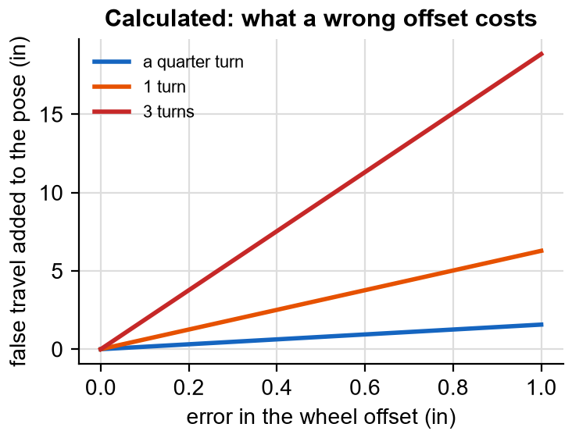
SapphireLib: Calibrating Tracking Wheel Offsets
Test
Why this test
Last season we could not get LemLib's offsets right by measuring with a ruler. Before trusting our own odometry we worked out how much a wrong offset costs, then designed a way to measure it without a ruler.
Calculation: false travel = offset error x angle turned (in radians). The chart shows it for three amounts of turning.
A ruler measurement to the middle of a wheel inside a chassis is easily 0.25 in off. A routine with three full turns then carries 4.7 in of error that never happened.
Our calibration procedure (repeatable)
Place the robot on the tiles. On the brain screen, Odom tab, press Calibrate Offsets.
The robot spins in place. It has not travelled, so everything a wheel rolled is arc.
Offset = distance the wheel rolled / angle turned. The screen shows both offsets.
Copy them into the robot's config file. Repeat after any change to the pods.
double calibrateTrackingWheelOffsetIn(double wheelDistanceIn, double rotatedRadians) {
return wheelDistanceIn / rotatedRadians;
}
Simulator test of the result
Setup | Odometry while the robot spins 3 s in place | Pass?
Wheels mounted as the offsets say | Position stays still | Yes
Vertical wheel on the opposite side | Position moves with every turn | No
Traceable change: this test caught a real mistake. Our documentation said a positive vertical offset meant "right of center". The math treats positive as left. A hand-measured right-side wheel would have added about 11 in of false travel per quarter turn. The spin calibration always gave the right sign, so we fixed the documentation and added a permanent test that pins both signs.
Sources: 5225A E-Bots PiLons, "Introduction to Position Tracking" (2018), thepilons.ca/wp-content/uploads/2018/10/Tracking.pdf; LemLib, github.com/LemLib/LemLib and lemlib.readthedocs.io (tracking wheel offsets); SapphireLib tests/odom/odometry_math_test.cpp and tools/sim/test/sim.test.js.
CP
Cody Paschal
07/08/26
G-21

Slide 23
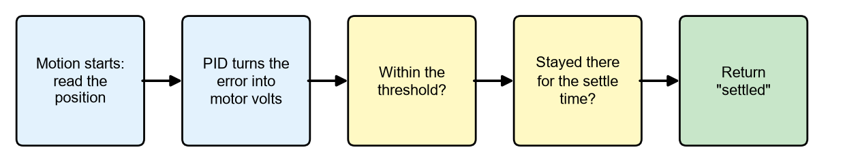
SapphireLib: Motions and Knowing When to Stop
Programming
A motion is a command like "drive to this point". The hard part is not starting it but deciding when it is done. Stop too early and the robot is short. Never stop and the whole autonomous freezes on one command.
Every motion runs this loop every 10 ms. If the timeout runs out first, it returns "timed out".
Motion | What it does | Finished when
driveDistance(24) | Straight line by distance, holding its heading | Within 1 in for 200 ms
turnToHeading(90) | Spin to face a field direction | Within 2 degrees for 200 ms
moveToPoint(x, y) | Go to a spot on the field | Within 1 in of the point
moveToPose(x, y, heading) | Go to a spot and end facing a direction | Within 1 in and 2 degrees
followPath(points) | Follow a curved route (next page) | Within 1 in of the last point
// a routine can ask each motion how it ended, and react
if (!drivetrain.moveToPoint(24, 48).settled()) {
return; // we hit something or got stuck: stop here instead of scoring in the wrong place
}
How testing shaped this
Motions used to return nothing. A routine could not tell "arrived" from "ran out of time against a wall", and carried on blindly. Every motion now returns a result: settled, timed out or interrupted.
Leaving the exit settings empty meant a threshold of 0 in. No robot can be 0 in from a target, so every motion ran to its timeout. The defaults are now 1 in and 2 degrees.
A motion running when autonomous ended kept driving into driver control. Every motion now watches for the match mode changing and stops itself.
Reflection: all three were found by running routines in the simulator and reading the log, not by inspection. Each is the kind of failure that costs a match and looks like "the robot just did something weird".
Sources: EZ-Template, ez-robotics.github.io/EZ-Template (exit conditions); LemLib, github.com/LemLib/LemLib and lemlib.readthedocs.io (moveToPoint, moveToPose); SapphireLib src/sapphirelib/motion/exit_tracker.cpp.
CP
Cody Paschal
07/10/26
G-22

Slide 24
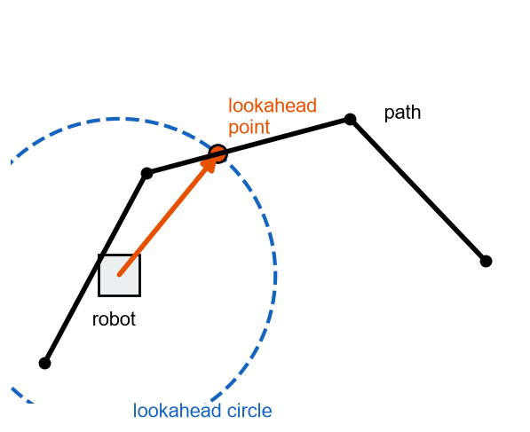
SapphireLib: Pure Pursuit and Boomerang
Research
Pure pursuit: following a path
Coulter (Carnegie Mellon, 1992) describes it like driving a car: you do not stare at the road under your bumper, you look some distance ahead and steer toward that.
Draw a circle around the robot. Its radius is the lookahead.
Find where the circle crosses the path, ahead of the robot.
Drive toward that point. Repeat every 10 ms.
Finding the crossing is a quadratic equation, the same one from algebra class: a line (the path segment) meets a circle (the lookahead). Our code solves it for each segment and keeps the crossing farthest along the path.
Sources: R. C. Coulter, "Implementation of the Pure Pursuit Path Tracking Algorithm," CMU-RI-TR-92-01 (1992), ri.cmu.edu; Purdue SIGBots Wiki, Basic Pure Pursuit, wiki.purduesigbots.com; LemLib, github.com/LemLib/LemLib and lemlib.readthedocs.io (boomerang controller, lateral motion docs).
CP
Cody Paschal
07/13/26
G-23

Slide 25
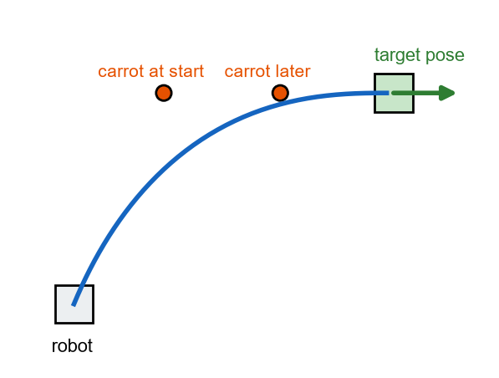
SapphireLib: Pure Pursuit and Boomerang (continued)
Research
Boomerang: arriving facing the right way
A tank drive cannot slide sideways, so to arrive facing a direction it must curve in. LemLib's boomerang aims at a "carrot" placed behind the target. As the robot gets closer the carrot slides onto the target, bending the path into a smooth hook.
carrot = target - (direction of final heading) x lead x distance left. Our lead is 0.6.
What changes for a holonomic drive
Our robot can slide sideways while it turns, so it does not need the carrot. Its moveToPose drives straight at the point and turns to the final heading at the same time. The library keeps boomerang for tank drives, so both drive types have a moveToPose.
Setting | Small value | Large value
Lookahead distance | Hugs the path, but steers constantly and can wobble | Smooth, but cuts corners
Boomerang lead | Nearly straight in; may arrive at the wrong angle | Wide hook; needs more room
Both settings are trade-offs with no "correct" answer in the papers, so we tested them (next two pages).
Sources: R. C. Coulter, "Implementation of the Pure Pursuit Path Tracking Algorithm," CMU-RI-TR-92-01 (1992), ri.cmu.edu; Purdue SIGBots Wiki, Basic Pure Pursuit, wiki.purduesigbots.com; LemLib, github.com/LemLib/LemLib and lemlib.readthedocs.io (boomerang controller, lateral motion docs).
CP
Cody Paschal
07/14/26
G-24

Slide 26
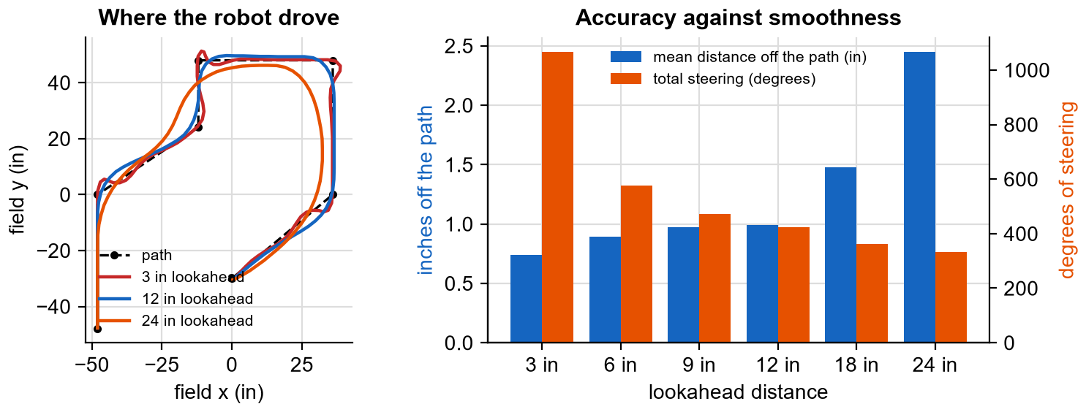
SapphireLib: Choosing the Lookahead Distance
Test
Question
What lookahead distance follows a path most accurately without constant steering?
Procedure (repeatable)
Simulator, our robot's measured drive model, perfect sensors (so only the path follower is being tested).
One S-shaped path of 7 points across the field, about 230 in long, at up to 9 V.
Run followPath() with lookahead 3, 6, 9, 12, 18 and 24 in. Nothing else changes.
Measure every 10 ms: distance from the robot to the nearest point of the path. Also total the change in the robot's direction of travel ("steering"), and the time to finish.
Lookahead | Mean off path | Worst off path | Total steering | Time
3 in | 0.74 in | 3.46 in | 1067 deg | 9.6 s
6 in | 0.89 in | 3.61 in | 576 deg | 8.6 s
9 in | 0.97 in | 3.46 in | 472 deg | 8.3 s
12 in | 0.99 in | 3.27 in | 423 deg | 8.1 s
18 in | 1.48 in | 5.62 in | 363 deg | 7.6 s
24 in | 2.45 in | 9.12 in | 332 deg | 7.3 s
Analysis
At 3 in the robot stays close to the line but steers 1067 degrees in total, more than twice the path's own turning: it is wobbling. At 24 in it is smooth and fast but cuts corners by up to 9.1 in, enough to clip a field element. Between 9 and 12 in the error is about 1 in and the steering has levelled off.
Decision (Cody Paschal): default lookahead of 10 to 12 in for our robot. Each path may set its own, so a route through a tight gap can use 6 in and a long open run 18 in.
Sources: R. C. Coulter, "Implementation of the Pure Pursuit Path Tracking Algorithm," CMU-RI-TR-92-01 (1992); Purdue SIGBots Wiki, Basic Pure Pursuit; SapphireLib simulator (tools/sim), run by notebook/build/experiments.js.
CP
Cody Paschal
07/16/26
G-25

Slide 27
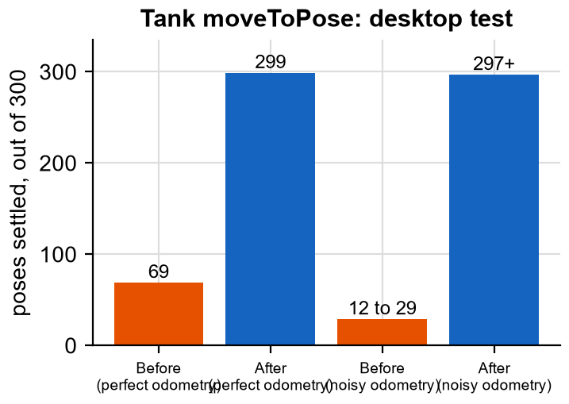
SapphireLib: Fixing Boomerang on a Tank Drive
Test
What we noticed
In simulated tests the tank moveToPose sometimes arrived at the right spot facing the wrong way, or backed into the target. Trying a handful of poses by hand was not enough to see a pattern, so we tested hundreds.
Procedure
Desktop test. A simulated tank robot at the field center.
300 random target poses (position and final heading).
A pose "settles" if the robot ends within 1 in and 2 degrees before the timeout.
Repeated with noise added to the odometry.
 | Settled, perfect odometry | Settled, noisy odometry
Before the fix | 69 of 300 (23%) | 12 to 29 of 300
After the fix | 299 of 300 (99.7%) | 297 or more of 300
What the failures had in common
The controller chose "forward or reverse" again every loop. When the carrot swung past 90 degrees it flipped, and the robot backed in facing the wrong way.
It steered at the carrot right to the end. Within an inch, the direction to the carrot is mostly sensor noise.
Nothing ever turned it to the final heading that its own exit condition required.
The changes, each tied to a failure above
Direction is chosen once at the start.
Within 3 in of the target it heads for the point itself, not the carrot.
It then turns in place to the final heading.
Reflection: 23% is a number we would never have guessed from watching a few runs that looked fine. Testing in bulk with random inputs is now our standard for any motion. Limitation: this fix has been tested on a simulated tank only, because our robot this season is holonomic.
Sources: LemLib, github.com/LemLib/LemLib and lemlib.readthedocs.io (boomerang controller); SapphireLib tests/motion/boomerang_math_test.cpp.
CP
Cody Paschal
07/17/26
G-26

Slide 28
SapphireLib: Motion Bug Log
Test
We keep one table of every motion bug: how it was found, what was wrong and what changed. It shows that each change to the motion code came from a test result, not a guess.
Found by | What the test showed | Cause | Change
Simulator: square laps | followPath() on a lap ended instantly | A lap ends where it starts, so "near the last point" was true on the first loop | Also wait until pursuit reaches the last segment
Desktop test: 500 random paths | Lookahead jumped to the lap's last side | The last side runs beside the first, inside the circle | Stop searching at the first miss after a hit
Simulator: holonomic moves | Robot rotated during moveToPoint() | Turn command was zero, so nothing held the heading | Hold the starting heading with the turn PID
Simulator: blocked path | Robot chased a blocked path for the rest of autonomous | Pursuit only ended by reaching the end | Timeout on the pursuit phase (10 s default)
Simulator: far from the path | Robot drove straight to the last point, skipping the route | No part of the path was inside the lookahead circle | Go back to the nearest point of the path
Code review + desktop test | driveDistance() jumped the pose backward | It zeroed the motor encoders odometry was also reading | Measure from wherever the encoders are
Desktop test: empty path | Crash | Asked for the last point of an empty list | Return "aborted"
Checking the fixes did not change anything else
For each fix we kept a copy of the old code inside the test and ran old and new side by side on hundreds of cases. On every case that used to work, the new code sends the same motor commands at the same times. Only the broken cases changed.
Reflection on the first three phases (planned for 07/15): chassis control, odometry and the motions were written and passing their tests later than planned (see page G-42), mostly because of the time spent on the bugs above. We judged that worth it: each of these would have been far harder to find on a robot at a tournament. The cost is that tools (phase 4) start later than the Gantt chart on page G-9 planned.
Sources: R. C. Coulter, "Implementation of the Pure Pursuit Path Tracking Algorithm," CMU-RI-TR-92-01 (1992); LemLib, github.com/LemLib/LemLib and lemlib.readthedocs.io; SapphireLib tests/motion/pure_pursuit_math_test.cpp, exit_tracker_test.cpp and tools/sim/test/sim.test.js.
CP
Cody Paschal
07/20/26
G-27

Slide 29
SapphireLib: A Screen for the Robot
Brainstorm and Pick Best Solution
The problem
Phase 4 of the plan is tools. Until now, changing any number (a PID gain, which autonomous to run) meant editing code and downloading it again, about a minute each time and only the programmer could do it. The V5 Brain has a 480 x 240 touch screen we were not using.
Three approaches
 | A. PROS text screen (LLEMU) | B. Controller screen only | C. Our own tabbed touch screen
What it is | Eight lines of text and three buttons on the brain | Three lines of text on the controller, driven by its buttons | Pages with buttons and drawings, built on the LVGL graphics library that ships with PROS
Good | Almost no code | Driver can use it from the field | Anything can be shown; touch buttons; a field map
Bad | Marked as outdated by PROS, and it did not display for us on PROS 4 | Three short lines; drops text sent faster than every 50 ms | Most work; LVGL has rules that are easy to break
Criteria | Weight | A. Text screen | B. Controller | C. Tabbed screen
Change settings by touch, no re-download | 5 | 2 (10) | 1 (5) | 5 (25)
Readable at a glance in the pits | 4 | 3 (12) | 2 (8) | 5 (20)
Supported by the current PROS | 4 | 1 (4) | 5 (20) | 5 (20)
Can draw pictures (field map) | 3 | 1 (3) | 1 (3) | 5 (15)
Little work to build | 2 | 5 (10) | 4 (8) | 2 (4)
Weighted total |  | 39 | 44 | 84
Decision (Cody Paschal): build our own tabbed screen (C). The deciding criterion is the top one: the whole reason for a screen is to let anyone on the team tune and select without a laptop. We keep the controller screen (B) as well, for the three lines the driver needs during a match.
Why tabs
Our screens in past seasons used tabs and they were the easiest for the whole team to use, so we kept the idea: a row of tabs along the top, one page per job.
Sources: PROS docs, pros.cs.purdue.edu/v5 (LLEMU, LVGL); LVGL 9.2 docs, docs.lvgl.io/9.2; EZ-Template, ez-robotics.github.io/EZ-Template (auton selector and PID tuner); 96671H 2025-26 notebook.
CP
Cody Paschal
07/22/26
G-28

Slide 30
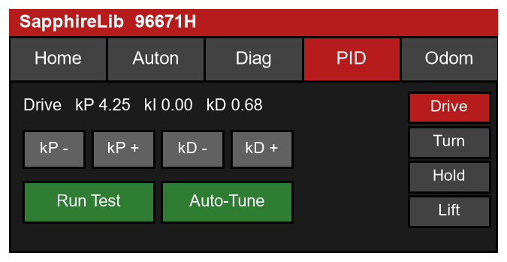
SapphireLib: Building the Brain Screen
Programming
Layout
A header with the team name, a row of tabs, and one page under them. The sketch shows the PID tab: the controller list is a fixed column on the right.
Layout sketch of the PID tab (480 x 240 pixels).
Tab | What it shows | Why we wanted it
Home | Battery, match status, heading, SD card state | Catch a dead battery or missing card in the pits
Auton | List of routines; tap one to select it | Choose autonomous without a laptop
Diag | Every motor and sensor: plugged in or not | A loose cable shows up before the match
PID | Gains with + and - buttons, Run Test, Auto-Tune | Tune on the robot, see the effect at once
Odom | Live x, y, heading and a dot on a field map | Check position tracking by pushing the robot
How a page is written
Every tab is a "Page" with three parts. Adding a tab of our own uses exactly the same three parts as the built-in ones, so the screen can grow with the robot.
class OdometryPage : public Page {
const char* title() override { return "Odom"; } // the text on the tab
void build(lv_obj_t* parent) override; // create the labels and buttons, once
void update() override; // refresh the numbers, many times a second
};
gui.addPage(odometryPage); // built-in and custom pages: added the same way
The rule that shaped the design
LVGL is not "thread-safe": if two parts of the program touch the screen at the same instant, it can crash or draw garbage. A tuning run takes several seconds and cannot freeze the screen, so it has to run in the background. Our rule: background work only ever writes plain numbers; only update() turns numbers into text on the screen. An early draft of the tuner broke this rule by setting a label directly from the background task. It was caught by re-reading the rule against the code before it was ever downloaded.
The screen is opt-in: a team using SapphireLib that wants its own screen, or none, simply never creates it.
Sources: LVGL 9.2 docs, docs.lvgl.io/9.2 (tabview, timers, threading); PROS docs, pros.cs.purdue.edu/v5 (LVGL in PROS 4); EZ-Template, ez-robotics.github.io/EZ-Template; SapphireLib src/sapphirelib/gui/.
CP
Cody Paschal
07/24/26
G-29

Slide 31
SapphireLib: Brain Screen on the Real Brain
Test
Procedure
The screen was the first part of SapphireLib tested on real hardware. Each version was downloaded to the brain on the test chassis and used with a finger the way it would be in the pits: switch tabs, press every button, push the robot around while watching the Odom tab. We recorded what was hard to use and changed it.
What we observed on the brain | Measured or noted | Change made
Tabs were hard to hit with a finger | Tab bar was 28 pixels tall | Raised to 31, still missed; raised to 43 pixels, which works
Scrolling a list by dragging was "incredibly hard" | The touch panel does not report a drag smoothly | No page needs dragging: the PID selector became a fixed column of buttons
The whole screen felt laggy | All five pages refreshed every tick, even hidden ones | Only the visible tab refreshes
Still redrawing when nothing changed | Setting a label to the same text still forces a redraw | Compare first; only write a label when its text changed
Heading line on the map could be drawn wrong | Code review: the line was reading memory that had already been reused | The line's points are now kept by the page for as long as it exists
Bottom of the field map was cut off | Map was 15 pixels taller than the page area | Map shrunk to 150 pixels; scrolling turned off
Result
After these changes the screen is confirmed working on the real brain: tabs switch on the first touch and the Odom page follows the robot as it is pushed.
What this taught us
Qualitative data counts. "Hard to hit" is not a number, but it was the most useful finding on this page, and it only appears when a person uses the real thing.
Desktop tests and the robot find different bugs. Unit tests checked the map math and passed. None of the six problems above could have been found on a laptop.
One of the six was a real memory bug, not a looks problem. It worked "most of the time", which is the most dangerous kind.
Next: the PID tab has + and - buttons, but tuning by hand is slow and depends on the tuner's experience. The next pages are our three attempts at making the robot tune itself.
Sources: LVGL 9.2 docs, docs.lvgl.io/9.2 (label, line, scrolling); PROS docs, pros.cs.purdue.edu/v5; SapphireLib docs/ROADMAP.md (Phase 4 notes) and src/sapphirelib/gui/.
CP
Cody Paschal
07/27/26
G-30

Slide 32
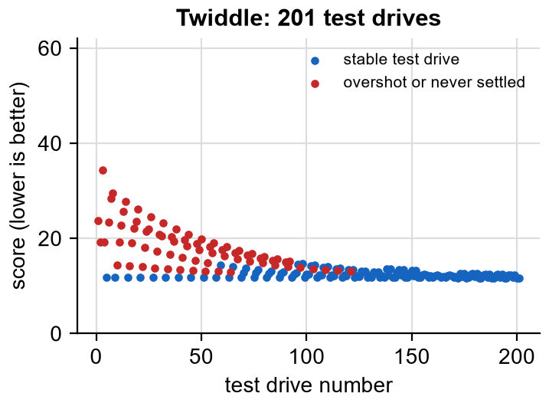
SapphireLib: Autotuner Prototype 1: Twiddle
CAD/Design and Prototype
Why an autotuner
A PID needs three numbers (gains). Finding them by hand means: change one, run the robot, watch, repeat, for every controller on the robot, again after every rebuild. Criterion 4 on page G-1 says the software should do this itself. We prototyped three ways.
How Twiddle works
Twiddle is "try it and see", automated. It is taught in Sebastian Thrun's robotics course.
Nudge one gain up. Run a test drive and score it.
Better? Keep it and take a bigger nudge next time.
Worse? Try nudging down instead. Still worse? Put it back and nudge smaller.
Move to the next gain. Repeat until the nudges are tiny.
Test (simulator)
Procedure: simulated forward axis of our drive. Each trial is a 24 in drive, scored by total error over 3 s plus a penalty for overshoot. Start from kP 0.3, kI 0, kD 0. Stop when the nudges add up to under 0.02 or after 200 trials.
Sources: S. Thrun, "Artificial Intelligence for Robotics" (Udacity), lesson on PID control (Twiddle); EZ-Template, ez-robotics.github.io/EZ-Template (manual PID tuning guide); SapphireLib simulator, run by notebook/build/experiments.js.
CP
Cody Paschal
07/29/26
G-31

Slide 33
SapphireLib: Autotuner Prototype 1: Twiddle (continued)
CAD/Design and Prototype
Measured | Result
Test drives used | 201 (stopped at the limit)
Robot time that would take | About 10 minutes of driving, plus resetting the robot each time
Trials that overshot badly or never settled | 72 of 201
Gains it ended on | kP 0.60, kI 0.00, kD 0.029
24 in drive with those gains | Settles in 1.0 s, overshoot 0.0 in
6 in drive with those gains | Stops 1.35 in short and never gets closer
What we learned
It works, slowly. But the red points on the chart are trials where the robot overshot or shook. On a real robot those are runs into a wall.
It only learns the one test it is scored on. Gains tuned on a 24 in drive were too gentle to finish a 6 in drive.
It tells us nothing about the robot. Tuning the turn controller means starting again from zero.
Decision: do not ship Twiddle. Keep its idea of scoring a test drive, and look for a method that measures the robot instead of searching blindly. Decided by Cody Paschal.
Sources: S. Thrun, "Artificial Intelligence for Robotics" (Udacity), lesson on PID control (Twiddle); EZ-Template, ez-robotics.github.io/EZ-Template (manual PID tuning guide); SapphireLib simulator, run by notebook/build/experiments.js.
CP
Cody Paschal
07/31/26
G-32

Slide 34
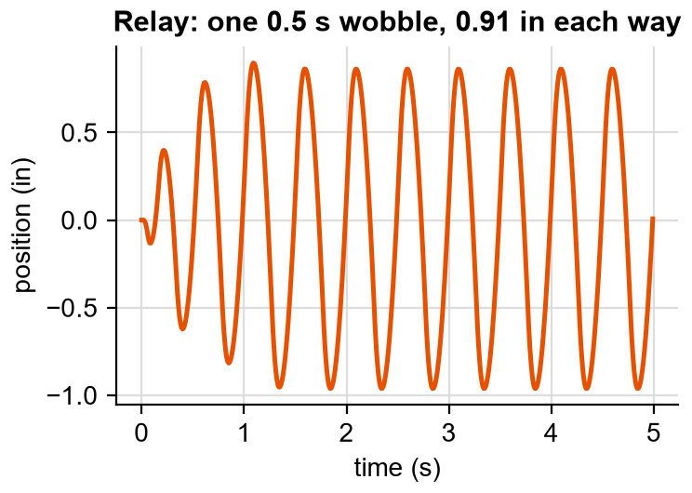
SapphireLib: Autotuner Prototype 2: Relay (Ziegler-Nichols)
CAD/Design and Prototype
The idea
Astrom and Hagglund (1984) showed a way to tune from a single experiment. Instead of a PID, use a "relay": full push one way until the robot crosses the target, then full push the other way. The robot settles into a steady wobble. How fast it wobbles and how far tell you how the system behaves, and the Ziegler-Nichols rules (1942) turn those two numbers into gains.
Our prototype
Switch the drive between +6 V and -6 V each time it crosses the start line.
Wait for the wobble to become steady.
Measure its period (Tu) and its size.
Ku = 4 x 6 V / (pi x size). Then kP = 0.6 Ku, kI = 1.2 Ku / Tu, kD = 0.075 Ku Tu.
Sources: K. Astrom and T. Hagglund, "Automatic tuning of simple regulators with specifications on phase and amplitude margins," Automatica 20(5), 1984; J. Ziegler and N. Nichols, "Optimum settings for automatic controllers," Trans. ASME 64, 1942; K. Astrom and R. Murray, Feedback Systems (Princeton, 2008), fbswiki.org.
CP
Cody Paschal
08/03/26
G-33

Slide 35
SapphireLib: Autotuner Prototype 2: Relay (Ziegler-Nichols) (continued)
CAD/Design and Prototype
Test (simulator)
Measured | Result
Test drives used | 1 wobble run, about 8 s
Wobble | Period 0.50 s, 0.91 in each way
Gains | kP 5.03, kI 20.1, kD 0.314
24 in drive with those gains | Settles in 1.28 s, overshoot 2.6 in
6 in drive with those gains | Settles in 0.89 s, overshoot 1.9 in
What we learned
Big improvement in effort: one 8 s run replaces hundreds of trials, and the wobble is small and safe.
But it overshoots at every distance. On a 6 in drive the overshoot is 1.9 in, a third of the move. Ziegler-Nichols was designed for chemical plants, where a quick response matters more than overshoot. A robot stopping at a goal needs the opposite.
It measures one speed of wobble only and assumes a smooth wave. A drivetrain has friction and gear slop, so the real wave is not smooth.
One set of gains per mechanism. The turn controller in autonomous and the heading hold in driver control need different behaviour from the same motors, and the relay can only give one answer.
Reflection: we used this version for over three weeks and every result still needed fine tuning by hand. That is the evidence that sent us back to research. The useful lesson was that one short experiment can replace a search. The missing piece was getting more than two numbers out of it.
Sources: K. Astrom and T. Hagglund, "Automatic tuning of simple regulators with specifications on phase and amplitude margins," Automatica 20(5), 1984; J. Ziegler and N. Nichols, "Optimum settings for automatic controllers," Trans. ASME 64, 1942; K. Astrom and R. Murray, Feedback Systems (Princeton, 2008), fbswiki.org.
CP
Cody Paschal
08/04/26
G-34

Slide 36
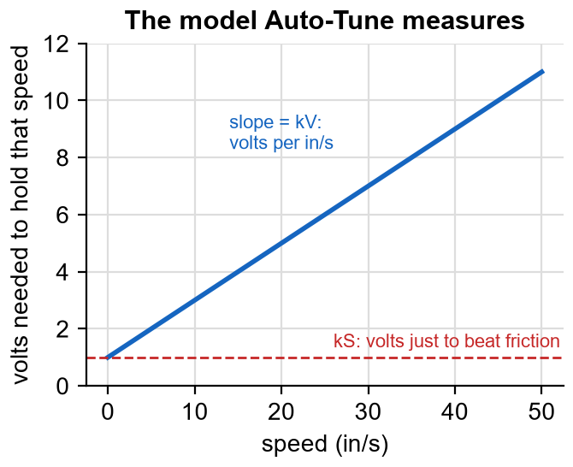
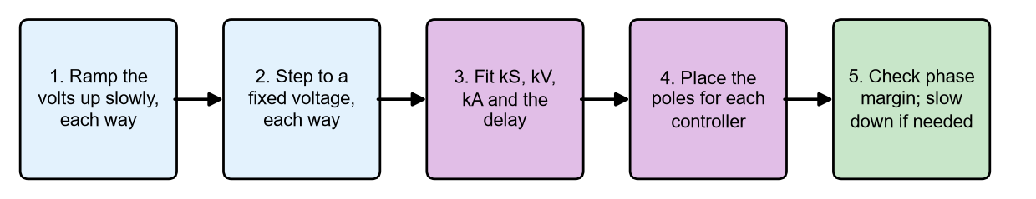
SapphireLib: Autotuner Prototype 3: Measure a Model
CAD/Design and Prototype
The idea
FRC teams tune with "system identification" (WPILib's SysId): first measure a simple model of the mechanism, then calculate the gains from the model. The model answers "how many volts does it take?" with three numbers:
Volts = kS + kV x speed + kA x acceleration
kS: volts just to overcome friction.
kV: extra volts for each in/s of speed.
kA: extra volts for each in/s^2 of speeding up.
Once these are known, we know how the robot will respond to any voltage, and can choose gains by calculation instead of by trial.
One press of Auto-Tune runs these five steps for each axis: forward, strafe and turn.
Sources: WPILib docs, Introduction to System Identification and Introduction to DC Motor Feedforward, docs.wpilib.org; K. Astrom and R. Murray, Feedback Systems (Princeton, 2008), fbswiki.org, ch. 2 (System Modeling) and ch. 7 (Output Feedback); SapphireLib tests/tuning/characterization_math_test.cpp.
CP
Cody Paschal
08/06/26
G-35

Slide 37
SapphireLib: Autotuner Prototype 3: Measure a Model (continued)
CAD/Design and Prototype
Two problems we had to solve
Noise. The obvious way to find acceleration is to take the change in speed, which is the change in position, twice over. Each step multiplies sensor noise, and noisy acceleration makes kA come out too small. We instead fit the exact equation of how speed changes from one moment to a later one, which never needs acceleration.
Delay. A command takes time to reach the wheels (about 30 ms in our model). Fitting delayed data as if it were instant makes friction look bigger and kA smaller. We measure the delay by comparing how long a step takes to reach half speed against what a delay-free model predicts, then fit again with the commands shifted.
Test of the measuring step (desktop)
We simulated an axis with known kS, kV, kA and delay, added sensor noise, and asked the code to recover the numbers. It does, to within the test's tolerance, and refuses to give an answer when the data is bad (a reversed sensor, too little travel), leaving the old gains in place.
What changed from prototype 2: the same idea of one short experiment, but it now yields a full description of the axis instead of two numbers. One measurement of the turn axis can design the autonomous turn controller and the driver heading hold, each for its own job.
Sources: WPILib docs, Introduction to System Identification and Introduction to DC Motor Feedforward, docs.wpilib.org; K. Astrom and R. Murray, Feedback Systems (Princeton, 2008), fbswiki.org, ch. 2 (System Modeling) and ch. 7 (Output Feedback); SapphireLib tests/tuning/characterization_math_test.cpp.
CP
Cody Paschal
08/07/26
G-36

Slide 38
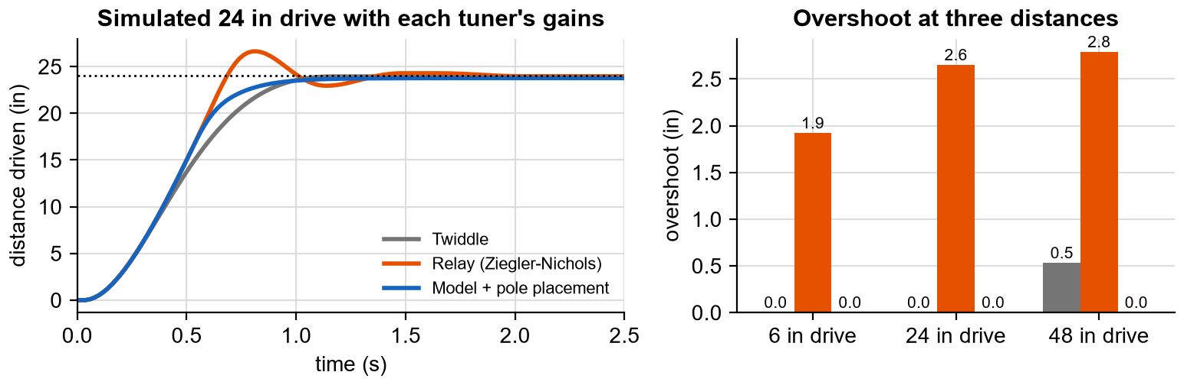
SapphireLib: Comparing the Three Autotuners
Test
Procedure (repeatable)
To compare fairly, all three methods were run again on the same simulated forward axis (1.0 V friction, 0.20 V per in/s, 0.045 V per in/s^2, 30 ms delay, 12 V limit, 10 ms loop).
Each method produced its gains with no hand adjustment.
Each set of gains then drove 6, 24 and 48 in. Measured: time until it stays within 0.5 in, and overshoot.
Tuner | Test drives needed | Gains (kP / kI / kD) | 6 in drive | 24 in drive | 48 in drive
Twiddle | 201 | 0.60 / 0.0 / 0.029 | never, +0.0 in | 1.00 s, +0.0 in | never, +0.5 in
Relay | 1 | 5.03 / 20.1 / 0.314 | 0.89 s, +1.9 in | 1.28 s, +2.6 in | 1.74 s, +2.8 in
Model | 4 short runs | 4.25 / 0.0 / 0.675 | 0.55 s, +0.0 in | 1.00 s, +0.0 in | 1.46 s, +0.0 in
Sources: WPILib docs, Introduction to System Identification and Introduction to DC Motor Feedforward, docs.wpilib.org; Astrom and Hagglund 1984; Ziegler and Nichols 1942; S. Thrun (Twiddle); SapphireLib simulator, run by notebook/build/experiments.js.
CP
Cody Paschal
08/10/26
G-37

Slide 39
SapphireLib: Comparing the Three Autotuners (continued)
Test
Each drive cell shows settle time, then overshoot. The model-based gains are the only set with no overshoot at all three distances.
Criteria | Weight | Twiddle | Relay | Model
Good gains at any distance | 5 | 2 (10) | 3 (15) | 5 (25)
Safe while tuning (no wild runs) | 4 | 1 (4) | 4 (16) | 4 (16)
One measurement tunes every controller | 4 | 1 (4) | 1 (4) | 5 (20)
Little robot time | 3 | 1 (3) | 5 (15) | 4 (12)
Simple to understand | 2 | 5 (10) | 3 (6) | 2 (4)
Weighted total |  | 31 | 56 | 77
Decision (Cody Paschal): model-based Auto-Tune replaces the relay tuner. The evidence is the table: zero overshoot at all three distances from four short runs. Its one weak score, being harder to understand, is why the next page explains the gain calculation step by step.
Reflection: three prototypes, each built on what the last one taught: Twiddle showed that scoring a drive works but searching is unsafe; the relay showed one experiment is enough but two numbers are not; the model keeps the single experiment and gets the full picture.
Sources: WPILib docs, Introduction to System Identification and Introduction to DC Motor Feedforward, docs.wpilib.org; Astrom and Hagglund 1984; Ziegler and Nichols 1942; S. Thrun (Twiddle); SapphireLib simulator, run by notebook/build/experiments.js.
CP
Cody Paschal
08/12/26
G-38

Slide 40
SapphireLib: Auto-Tune: From Model to Gains
Programming
With kS, kV and kA measured, choosing gains becomes a calculation called pole placement. We decide how the robot should behave, and solve for the gains that make it so. We describe "how it should behave" with two numbers a person can picture:
We choose | Meaning | Our drive controller
Settle time | How long until the robot is at the target and staying there | 0.6 s
Damping | 1.0 = as fast as possible with no overshoot; lower = faster but overshoots | 1.0
Minimum phase margin | A safety margin against delay making it shake (see below) | 50 degrees
// omega = how "fast" the response is. A faster settle time needs a bigger omega.
// zeta = damping (1.0 = no overshoot)
PIDGains placePoles(const MotorFeedforward& model, double omega, double zeta) {
return PIDGains{
.kP = model.kA * omega * omega, // heavier robot (bigger kA) -> more push
.kI = 0.0, // not needed: kS already handles friction
// the brake, minus the braking the motors already do themselves (kV)
.kD = std::fmax(0.0, 2.0 * zeta * omega * model.kA - model.kV),
};
}
// delay is what the textbook formula ignores. If the measured delay leaves too little
// safety margin, slow the design down until it is safe, and report that we did
double omega = unitSettle / spec.settleTimeS;
if (phaseMarginDeg(model, placePoles(model, omega, zeta), delayS) < spec.minPhaseMarginDeg) {
omega = slowestOmegaThatMeetsTheMargin(model, zeta, delayS, spec);
}
Sources: K. Astrom and R. Murray, Feedback Systems (Princeton, 2008), fbswiki.org, ch. 7 (pole placement) and ch. 10 (phase margin); WPILib docs, Introduction to System Identification and Introduction to DC Motor Feedforward, docs.wpilib.org; SapphireLib src/sapphirelib/tuning/gain_design.cpp.
CP
Cody Paschal
08/14/26
G-39

Slide 41
SapphireLib: Auto-Tune: From Model to Gains (continued)
Programming
Why there is no I term
The integral exists to remove the small error friction leaves. Our model already knows the friction (kS), so the controller can add it directly. That removes integral windup (page G-12) at its source.
Phase margin in plain words
Steering a boat with a slow rudder: react too strongly and by the time the boat responds you have over-corrected, and it weaves. Phase margin measures how close a controller is to weaving because of delay. For the simulated drive the design came out at 57 degrees, above our 50 degree minimum.
What Auto-Tune does on our robot
Axis measured once | Controllers designed from it
Forward | Drive, path tracking (forward)
Strafe | Path tracking (sideways)
Turn | Autonomous turn, driver heading hold, path tracking (turn): three different settle times
Status: the gains our robot runs today came from this Auto-Tune. This is also where the per-second gain bug was found: the formula's gains were right, but the old per-loop PID applied them 100 times too strongly in I and 100 times too weakly in D.
Sources: K. Astrom and R. Murray, Feedback Systems (Princeton, 2008), fbswiki.org, ch. 7 (pole placement) and ch. 10 (phase margin); WPILib docs, Introduction to System Identification and Introduction to DC Motor Feedforward, docs.wpilib.org; SapphireLib src/sapphirelib/tuning/gain_design.cpp.
CP
Cody Paschal
08/17/26
G-40

Slide 42
SapphireLib: Auto-Tune for the Lift
Programming
What is different about a lift
The drive model assumes that with no voltage, the robot sits still. A lift does not: gravity pulls it down all the time. So the lift's model has a fourth number, kG, the volts needed just to hold the lift up.
Volts = kS x (direction) + kG + kV x speed + kA x acceleration
How we separate gravity from friction
Both kS and kG are "volts before anything moves", so one experiment cannot tell them apart. The trick: friction always fights the motion, so it flips sign when the lift changes direction. Gravity always pulls down. By running the lift up and down, the difference between the two directions reveals which is which.
Going up | Going down | So
Motors fight friction AND gravity | Gravity helps; motors fight friction only | Half the difference in volts is gravity; the average is friction
Two kinds of mechanism
Type | Gravity term | Example
Elevator (moves straight up) | Constant: kG | Our cascade lift
Arm (swings) | kG x cos(angle): most when level, zero when straight up | A four-bar or wrist
Safety built into the run
The lift moves only between two limits we set, and is braked between each part of the test.
A Stop button on the screen ends a run at once. So does disabling the robot.
New gains are applied only if the whole run succeeded. A failed run leaves everything as it was.
Tuning the lift never moves the drive, and the other way round.
Result
The measured kG goes straight into the lift as "gravity feedforward": the lift always gets its holding voltage, and the PID only has to handle the movement. The lift holds its height without an I term slowly winding up.
// the lift's control, each loop: PID for the movement + a constant to cancel gravity
volts = pid.update(targetHeight, currentHeight, dt) + gravityVolts;
Reflection: writing the lift version was quick because it reuses the drive version's experiment and fit with one more term. That is the pay-off from prototype 3: a model can be extended, a search or a wobble cannot.
Sources: WPILib docs, Introduction to System Identification and Introduction to DC Motor Feedforward, docs.wpilib.org (elevator and arm feedforward); K. Astrom and R. Murray, Feedback Systems (Princeton, 2008), fbswiki.org; SapphireLib src/sapphirelib/tuning/ and tests/tuning/characterization_runner_test.cpp.
CP
Cody Paschal
08/18/26
G-41

Slide 43
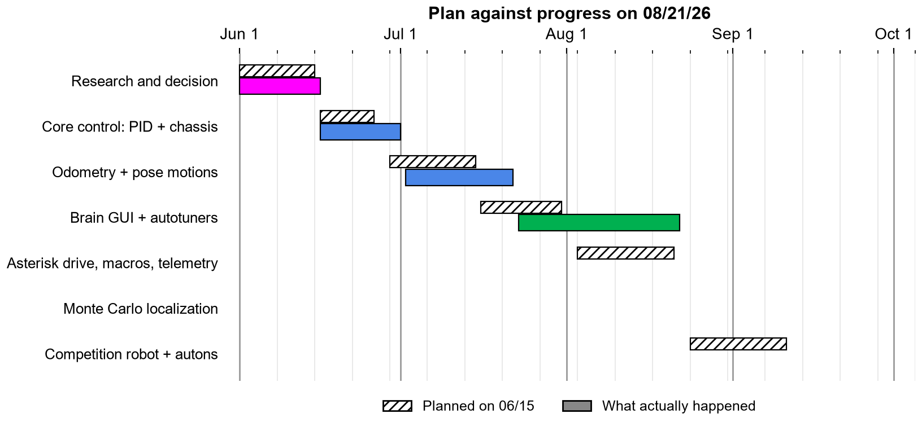
SapphireLib: SapphireLib Progress Check
Monthly Gantt Charts
Original goal
SapphireLib driving the competition robot in autonomous by mid-September.
Accomplished
Research and the decision to write our own library.
Phase 1: PID controller, tank and holonomic drives, field-centric control.
Phase 2: odometry for all four sensor setups, with offset calibration.
Phase 3: moveToPoint, moveToPose, followPath, each returning a result.
Phase 4 (part): the brain screen, working on the real brain, and three autotuner prototypes.
Sources: 96671H notebook, page A-4 (How to Read Gantt Charts); SapphireLib docs/ROADMAP.md.
CP
Cody Paschal
08/20/26
G-42

Slide 44
SapphireLib: SapphireLib Progress Check (continued)
Monthly Gantt Charts
Partially complete
Automatic tuning: the model-based method is chosen and tested in simulation; the lift version is being added.
Pending
Driver macros, SD card logging, and moving everything to the competition robot.
Analysis and reasoning
Each solid bar starts later and runs longer than its hatched plan. Two causes. First, the motion bugs on page G-27 took time we had not planned for. Second, the autotuner took three prototypes instead of one: the relay tuner alone was in use for over three weeks before we accepted it was not good enough. We chose to spend that time because tuning is repeated after every rebuild all season, so a tuner that needs hand-fixing costs more in total than building a better one once.
Future plans
The plan had the competition robot port starting in late August. That now moves back. The asterisk drive changes, macros and logging come next because the competition robot cannot be driven without them. The "extra goal" from page G-9, correcting drift with distance sensors, is kept, because the bump test on page G-55 shows odometry alone will not be accurate enough.
Sources: 96671H notebook, page A-4 (How to Read Gantt Charts); SapphireLib docs/ROADMAP.md.
CP
Cody Paschal
08/21/26
G-43

Slide 45
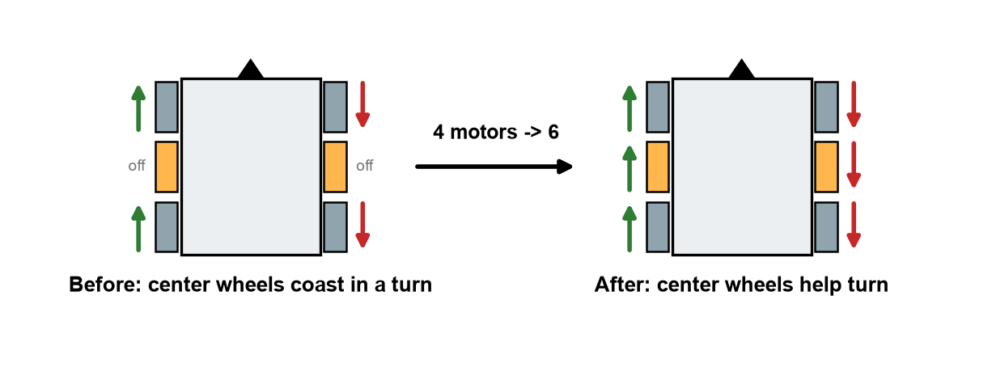
SapphireLib: Asterisk Drive: Using All Six Motors
Programming
What testing showed
We checked what voltage the mixer sends each of the six motors for each kind of motion. For a turn in place, the two center motors were sent 0 V. Four motors were turning the robot while two were being dragged.
Why it happened
The first mixer gave the center wheels only the "forward" part of the command. A pure turn has zero forward part, so they got zero. That looked reasonable when written: a straight wheel cannot help a robot slide sideways, so we had assumed it could not help a turn either.
Sources: Game Manual 0, Mecanum Drive, gm0.org/en/latest/docs/software/tutorials/mecanum-drive.html (mecanum kinematics); 96671H notebook, Section D (asterisk drive testing); SapphireLib src/sapphirelib/chassis/holonomic_drivetrain.cpp.
CP
Cody Paschal
08/24/26
G-44

Slide 46
SapphireLib: Asterisk Drive: Using All Six Motors (continued)
Programming
Why that assumption was wrong
In a turn about the center of the robot, a wheel on the left side travels straight backward and a wheel on the right side straight forward. That is exactly the direction a straight center wheel rolls. They are the best-placed wheels on the robot for turning.
// before: center wheels got the forward part only
middleLeft = throttleVolts;
middleRight = throttleVolts;
// after: they also get the turn part, left and right opposite
middleLeft = throttleVolts + asterisk.turnContribution * turnVolts;
middleRight = throttleVolts - asterisk.turnContribution * turnVolts;
 | Before | After
Motors working in a turn | 4 of 6 | 6 of 6
Center wheels during a turn | Dragged sideways across the tile | Driven in the direction they roll
Straight-line heading correction | Corners only | All six
turnContribution is a setting (default 1.0). Setting it to 0 gives the old behaviour, so the change can be switched off to compare.
Traceable change: the check of the mixer's output (center motors at 0 V in turns) led to the mixer change above. Decided by Cody Paschal.
Sources: Game Manual 0, Mecanum Drive, gm0.org/en/latest/docs/software/tutorials/mecanum-drive.html (mecanum kinematics); 96671H notebook, Section D (asterisk drive testing); SapphireLib src/sapphirelib/chassis/holonomic_drivetrain.cpp.
CP
Cody Paschal
08/26/26
G-45

Slide 47
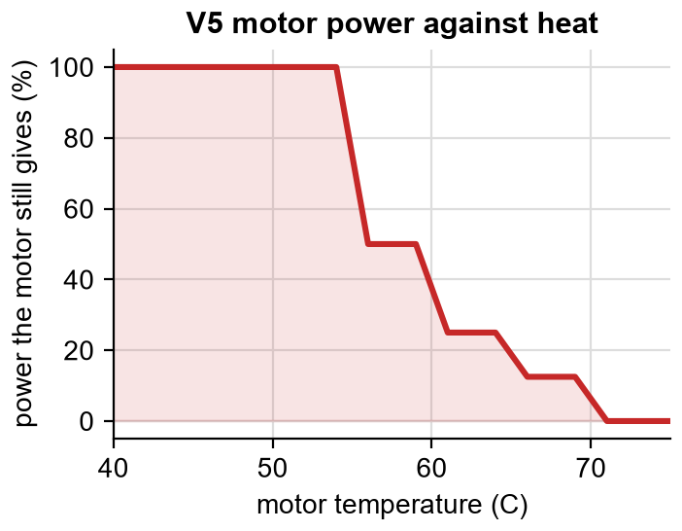
SapphireLib: Heat: Keeping a Strafe Straight
Programming
The problem
A V5 motor protects itself as it heats up by cutting its own power: to about half at 55 C and to nothing at 70 C. It does not tell the program it has done so.
On a tank drive that just means "slower". On a mecanum drive it is worse. A strafe works because the four corners cancel each other's forward and backward push exactly. If one corner is weaker, they no longer cancel, and the robot creeps forward or backward and twists while it strafes.
Our solution: the center wheels cancel the drift
The two straight center wheels face exactly the direction of that unwanted creep. So:
Twice a second, read each corner motor's temperature and estimate what fraction of its power it still has (the curve above).
Every loop, multiply each corner's commanded volts by its shortfall. That is the push that is missing.
Add up the missing push in the forward direction and the turning direction, and give that to the center wheels, which can supply both.
Sources: VEX V5 Smart Motor (11W), vexrobotics.com/276-4840.html; VEX Library, kb.vex.com; Game Manual 0, Mecanum Drive, gm0.org/en/latest/docs/software/tutorials/mecanum-drive.html; SapphireLib src/sapphirelib/chassis/thermal_math.cpp and tests/chassis/thermal_math_test.cpp.
CP
Cody Paschal
08/28/26
G-46

Slide 48
SapphireLib: Heat: Keeping a Strafe Straight (continued)
Programming
// each corner's missing push = what we asked for x the fraction heat has taken away
missing[i] = commandedVolts[i] * (1.0 - thermalPowerFraction(tempC[i]));
// the center wheels can push forward/back and can turn. Project the missing push onto those
forwardFix = (missing[FL] + missing[FR] + missing[BL] + missing[BR]) / 4.0;
turnFix = (missing[FL] - missing[FR] + missing[BL] - missing[BR]) / 4.0;
Design decisions
Choice | Why
Per corner, never an average | Two hot corners on the same diagonal double the drift; one on each diagonal cancel. An average cannot tell these apart. A desktop test checks exactly this case.
Act before the drift happens (feedforward) | A separate loop on the tracking wheel catches drift after it starts. This one prevents the part we can predict.
Fade out as the center motors heat up | Otherwise fixing a 4-motor overheat creates a 6-motor overheat.
A cap on the correction | A bad temperature reading can never command a large voltage.
Limit we accept: nothing mounted straight can push sideways. A strafe on hot corners holds its line but is still slower. Status: the math is tested on the desktop; the simulator does not model heat, so this is the least-tested feature in this section and is on our list for a long practice match.
Sources: VEX V5 Smart Motor (11W), vexrobotics.com/276-4840.html; VEX Library, kb.vex.com; Game Manual 0, Mecanum Drive, gm0.org/en/latest/docs/software/tutorials/mecanum-drive.html; SapphireLib src/sapphirelib/chassis/thermal_math.cpp and tests/chassis/thermal_math_test.cpp.
CP
Cody Paschal
08/31/26
G-47

Slide 49
SapphireLib: Heading Hold and Drift Correction
Programming
Heading hold: the turn stick steers a direction
In the first driver code, the turn stick set how fast the robot spins. When a robot hit ours, it stayed at whatever angle it was knocked to and the driver had to notice and fix it. We changed what the stick means: it now moves a target heading, and the turn PID holds the robot on that heading all the time.
 | Stick = turn speed (before) | Stick = target heading (after)
Let go of the stick | Robot coasts on a little | Robot is pointed somewhere definite
Hit by another robot | Stays knocked off line | Turns itself back
One hot motor in a strafe | Robot twists as it slides | Twist is corrected
Three details that made it usable
Problem found | Cause | Fix
Robot slowly rotated with no hands on the controller | A resting stick reads a count or two, and a held heading adds that up all match | Deadband on the stick
Robot kept turning after the stick was released | The target ran far ahead of the robot, which then had to catch up | Cap on how far the target may lead the robot
Robot spun at the start of driver control | The held heading was from before autonomous | After any gap over 0.25 s, re-adopt the current heading and reset the PID
Drift correction: a bug in our own fix
The center wheels also correct forward creep during a strafe, measured by the vertical tracking wheel. The first version treated any forward motion during a strafe as drift. Testing showed it fighting the driver:
What the robot was doing | What the first version did | What it should do
Driving a diagonal on purpose | Fought the forward part | Nothing: that motion was asked for
Turning while strafing | Read the tracking wheel's arc (0.06 in per degree) as drift | Remove the arc first
// drift = what the wheel rolled - what turning explains - what the driver asked for
driftIn = verticalWheelDeltaIn - verticalOffsetIn * rotationRad - commandedForwardIn;
Reflection: the wheel offset that odometry subtracts (page G-20) mattered here too. The same physical fact, "an off-center wheel rolls when the robot turns", had to be handled in two places. We now ask of every new feature that reads a tracking wheel: is the robot turning?
Sources: Game Manual 0, Mecanum Drive, gm0.org/en/latest/docs/software/tutorials/mecanum-drive.html (field-centric control); K. Astrom and R. Murray, Feedback Systems (Princeton, 2008), fbswiki.org, ch. 10; SapphireLib src/sapphirelib/control/heading_hold.cpp, chassis/drift_math.cpp and their tests.
CP
Cody Paschal
09/01/26
G-48

Slide 50
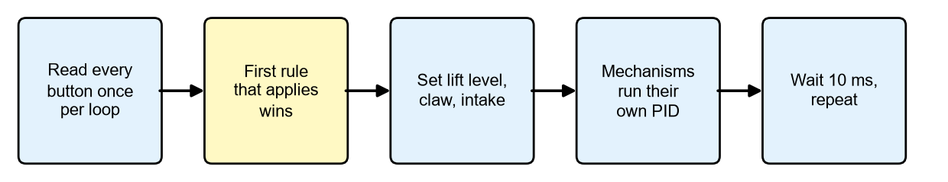
SapphireLib: Driver Macros
Programming
The problem
This game needs a lift, a claw, an intake and several pistons to work in sequence, but each must still be controllable on its own, and the controller has 12 buttons. Some buttons must mean different things at different times: our outtake button is also the score button, depending on whether the claw is deployed.
The macro loop. Every output is worked out fresh from the robot's state each time round.
Approaches we considered
Approach | How it works | Why we did or did not use it
Command framework (FRC style) | Each action is an object; a scheduler decides what runs | Powerful, but adds rules to learn and hides the order things happen in
One task per mechanism | Lift, claw and intake each run their own loop | They must talk to each other constantly; timing bugs
One loop with a priority list (chosen) | A single function; the first rule that applies wins | The robot's priorities are readable top to bottom in one place
Sources: PROS docs, pros.cs.purdue.edu/v5 (controller API); WPILib command-based programming, docs.wpilib.org; EZ-Template, ez-robotics.github.io/EZ-Template; SapphireLib docs/MACROS.md.
CP
Cody Paschal
09/03/26
G-49

Slide 51
SapphireLib: Driver Macros (continued)
Programming
master.update(); // read every button once, at the top of the loop
if (scoring.running()) { // 1. a scoring sequence in progress wins
scoring.update(now);
} else if (master.pressed(Button::a) && lift.level() > 0) {
scoring.start(now); // 2. A = "dip, release, stow" on its own
} else {
if (master.pressed(Button::l1)) lift.up(); // 3. otherwise the buttons mean the usual things
if (master.pressed(Button::r1)) claw.toggle(now);
}
Building blocks the library provides
Block | Replaces this hand-written code
Controller | Detecting a new press, a hold, a long press, two buttons together
PositionMechanism | A lift or arm: PID + gravity, rest at the bottom, stop if the sensor unplugs
Piston | A pneumatic that knows how long it has been open ("wait 400 ms after deploying")
Roller | An intake that notices a jam and reverses briefly
Sequence | Timed steps that do not freeze driver control while they run
A bug this fixed: PROS's own "new press" check only updates when a button is read. Our old two-button shortcut (B + DOWN) only worked if the buttons were pressed in one order. Reading every button once per loop and comparing with the last loop removes the problem. Decided by Cody Paschal.
Sources: PROS docs, pros.cs.purdue.edu/v5 (controller API); WPILib command-based programming, docs.wpilib.org; EZ-Template, ez-robotics.github.io/EZ-Template; SapphireLib docs/MACROS.md.
CP
Cody Paschal
09/04/26
G-50

Slide 52
SapphireLib: Proving the Macro Rewrite Changed Nothing
Test
The risk
The robot already had hand-written lift and scoring code that worked. Replacing it with the new building blocks could quietly change how the robot behaves, and the drivers had practised on the old behaviour.
Procedure: old and new side by side
For each piece, a copy of the old code was kept inside a desktop test. The test feeds the same inputs to the old and new code for a very large number of loops and fails if their outputs ever differ. The inputs are random but come from a fixed seed, so the test is repeatable.
Piece | Compared against | How much | Result
Lift control | The old hand-written lift loop | 1.2 million simulated loops, including sensor dropouts | Identical, bit for bit
Scoring sequence | The old phase machine | 10,000 random sequences of driver presses | Identical, step for step
Button presses | A copy of PROS's own press logic | 400,000 random loops | Identical
Controller screen | The old screen code | Every write compared | Identical
Motion exit logic | The old loop inside each motion | Old and new drivetrain code replayed in a simulator harness | Every motor command unchanged
Why "bit for bit"
Close is not good enough here. If the new lift code gave 6.001 V where the old gave 6.000 V, the lift would still work, but we would no longer know whether a later problem came from the rewrite. Requiring an exact match means any future difference in behaviour is something we chose.
What the new blocks add on top of matching
The B + DOWN shortcut now works whichever button is pressed first (the old order bug, previous page).
A lift at the bottom can rest at 0 V on its hard stop instead of pushing into it for the whole match.
A sequence changes at most one step per loop, so every step runs at least once and none can be skipped.
If the lift's sensor stops answering, the lift brakes instead of driving on a bad reading.
Reflection: this is the software version of test-fitting a new part before removing the old one. It took longer than the rewrite itself. Limit: these are desktop tests. They prove the logic matches, not that the real lift feels the same, which the drivers check in practice.
Sources: PROS docs, pros.cs.purdue.edu/v5; SapphireLib tests/mechanism/position_control_test.cpp, tests/util/sequence_test.cpp, tests/input/ and tests/motion/exit_tracker_test.cpp.
CP
Cody Paschal
09/07/26
G-51

Slide 53
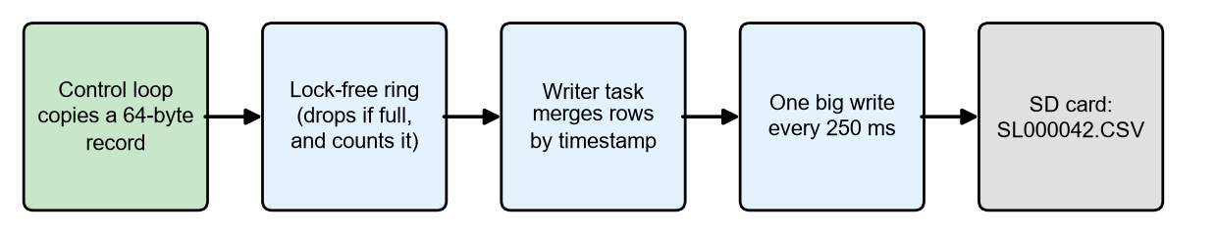
SapphireLib: Recording What Happened: SD Card Telemetry
Identify the Problem
The problem
When something fails in a match (a motion stops short, the lift fades in the last 30 seconds) we could only guess at the cause. Criterion 5 on page G-1 asks the software to explain itself. We need a recording of what the robot was doing, from inside the robot.
Criteria and constraints
Requirement | Why
Logging must never slow down the code it records | A logger that makes the PID loop late causes the problems it is meant to find
Record every PID step, the pose, and every motor | These are the three places problems start
Survive the card being pulled or filling up | Cards get bumped in matches
Readable without special software | Anyone on the team should be able to open a log
What PROS and the V5 limit, and our answer to each
Limit we found | Design answer
Every write to the SD card is slow (a full sync) | Collect rows in memory; write one big chunk every 250 ms
PROS deletes tasks when the match mode changes | No locks anywhere a control loop runs, so a deleted task cannot leave one locked
The brain has no clock or date | Files are numbered: SL000001, SL000002, ...
PROS cannot create folders | Use the "sl" folder if it exists, otherwise the card's top level
Two tasks using the card at once can corrupt it | One lock for the card, held only by slow background tasks
The fast side (left) never waits for the slow side (right).
The key design choice: drop and count
If the memory buffer is full, a new row is dropped rather than making the control loop wait, and the number dropped is written into the file. A gap we can see in the data is better than a robot that stutters.
Decision (Cody Paschal): logging starts by itself whenever the robot is plugged into field control, and from a button on the Home tab otherwise. Every match is recorded without anyone remembering to press anything.
Sources: PROS docs, pros.cs.purdue.edu/v5 (filesystem, tasks, competition control); LemLib, github.com/LemLib/LemLib and lemlib.readthedocs.io (logging); SapphireLib docs/TELEMETRY_FORMAT.md and src/sapphirelib/telemetry/.
CP
Cody Paschal
09/09/26
G-52

Slide 54
SapphireLib: Reading the Logs: the Analyzer and the Tuning Loop
Programming
A log nobody reads is worth nothing
A 2 minute match produces thousands of rows. We built a companion tool, the telemetry analyzer, that runs in a web browser with nothing to install: drop the SD card's files onto the page.
What the analyzer does | Example
Lists what went wrong, most serious first, each with its time | "Lift motor reached 55 C at 1:12 and lost half its power"
Replays the match from above | The robot's path, its targets, and the lift's height beside it
Charts any recorded value against time | Battery voltage against drive current
Tunes from the log | Re-fits the Auto-Tune model from ordinary driving and proposes gains
Findings the analyzer looks for
Motors: overheating (and which power step it reached), unplugging, stalling.
Mechanisms: stuck short of a target at full power.
Motions: timed out, and whether the robot was still pushing when they did.
Electrical: battery sag, a controller dropping out, a sensor unplugged.
The logger itself: rows dropped, SD faults.
Closing the loop: TUNE.CFG
Finding a better gain is only half of it. Getting it onto the robot used to mean editing code and rebuilding. Now the tools write a small text file, TUNE.CFG, to the SD card, and the robot reads it when it starts.
Sources: PROS docs, pros.cs.purdue.edu/v5; WPILib DataLog and AdvantageScope (log replay tools in FRC), docs.wpilib.org; SapphireLib tools/analyzer/README.md and docs/TUNING.md.
CP
Cody Paschal
09/11/26
G-53

Slide 55
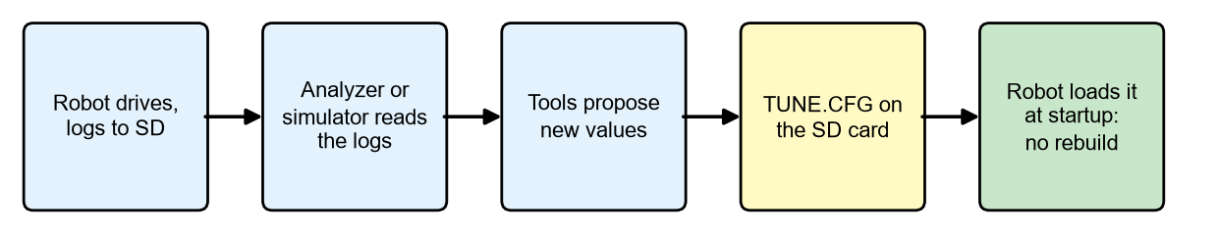
SapphireLib: Reading the Logs: the Analyzer and the Tuning Loop (continued)
Programming
format=1
rev=8
note=PID refinement: Turn
pid.turn=0.442,0,0.0849 # kP,kI,kD
model.turn=0.6,0.045,0.00992 # kS,kV,kA
mcl.periodMs=33
mcl.filter.motionNoise.perInch=0.07
Every line is checked against the allowed names and ranges. One bad line rejects the whole file and the robot uses the values in its code, so a typo can never half-apply.
The file's revision number is shown on the Home tab and stamped into every log, so we always know which settings a match was played with.
Reflection: telemetry changed how we work more than any other feature. Every "Test" page after this one that mentions a log (for example SL000029) is quoting a file recorded by this system.
Sources: PROS docs, pros.cs.purdue.edu/v5; WPILib DataLog and AdvantageScope (log replay tools in FRC), docs.wpilib.org; SapphireLib tools/analyzer/README.md and docs/TUNING.md.
CP
Cody Paschal
09/14/26
G-54

Slide 56
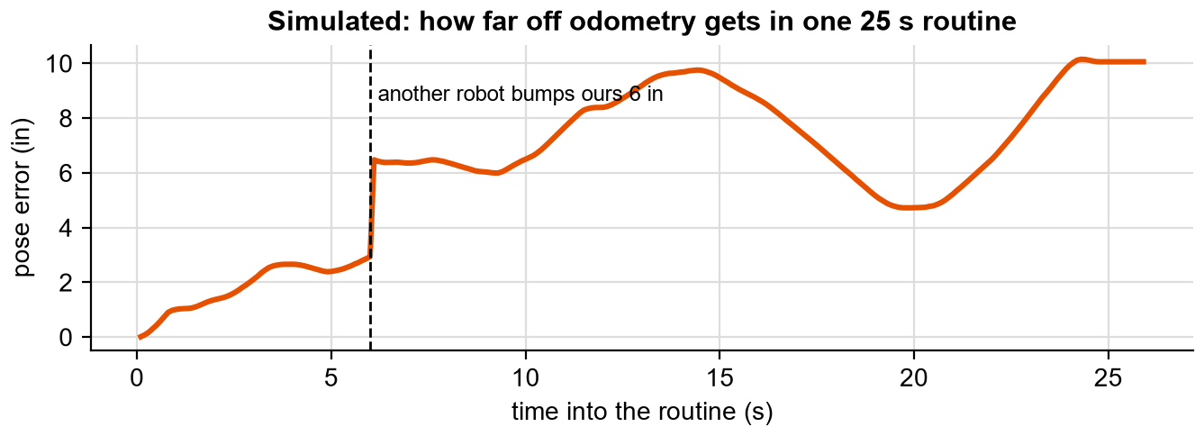
SapphireLib: Odometry Drifts
Identify the Problem
The problem
Odometry only ever adds movements together (page G-20). Nothing in it can notice that it has become wrong. Three things make it wrong in every match:
Cause | Size | Effect
Tracking wheels read slightly long or short | A percent or two | Error grows with every inch driven
The inertial sensor drifts | A fraction of a degree per minute | Every later movement is added in a slightly wrong direction
Another robot bumps ours, or a wheel lifts | Inches, instantly | The wheels never see it, so the error is permanent
How big is it? (simulator test)
Procedure: simulator, the Field tour routine (25 s, drives a lap of the field). Tracking wheels set 3% off with 2% slip and the inertial sensor drifting 3 degrees per minute ("worn" settings). At 6 s the robot is shoved 6 in sideways, as in a collision. Measured every 100 ms: distance between where odometry says the robot is and where it really is.
Sources: Purdue SIGBots Wiki, Odometry, wiki.purduesigbots.com/software/odometry; S. Thrun, W. Burgard and D. Fox, Probabilistic Robotics (MIT Press, 2005), ch. 8; SapphireLib simulator, run by notebook/build/experiments.js; tests/localization/particle_filter_test.cpp.
CP
Cody Paschal
09/15/26
G-55

Slide 57
SapphireLib: Odometry Drifts (continued)
Identify the Problem
Measured | Odometry alone
Largest error before the bump (first 6 s) | 2.9 in
Largest error in the routine | 10.2 in
Error at the end of the routine | 10.1 in
Our criterion (page G-2) | Under 1 in
Even with good wheels and no bump, the same routine ends 1.6 in off on average (5 runs). A desktop test of a longer case (80 s of laps with a 4% wheel error) ended 28.8 in off.
Why it matters
The first motion of an autonomous is accurate. The tenth can be inches off, and a claw 2 in from where the program thinks it is misses the Pin. Our criterion needs something that can look at the field and correct the position during the routine.
Constraint carried from page G-1: only legal V5 sensors, the V5 Brain's processor, and a practice area with one or two field walls.
Sources: Purdue SIGBots Wiki, Odometry, wiki.purduesigbots.com/software/odometry; S. Thrun, W. Burgard and D. Fox, Probabilistic Robotics (MIT Press, 2005), ch. 8; SapphireLib simulator, run by notebook/build/experiments.js; tests/localization/particle_filter_test.cpp.
CP
Cody Paschal
09/17/26
G-56

Slide 58
SapphireLib: Four Ways to Correct the Position
Brainstorm and Pick Best Solution
 | A. Wall resets | B. GPS sensor | C. Kalman filter | D. Monte Carlo localization (MCL)
How it works | At planned moments, press against or measure to a wall and overwrite x or y | A camera reads coded strips on the field walls and reports position | Blend odometry with distance sensor readings, weighted by trust in each | Keep hundreds of guesses of where the robot is; keep the ones the sensors agree with
Strength | Simple and exact at that moment | Reports position directly | Cheap; well known | Many guesses at once; shrugs off a blocked sensor
Weakness | Only fixes at the planned spots; costs time | Must see the strip, and must be a full tile from the walls | One guess only: a reading off another robot needs extra logic to reject | Heaviest on the processor; many settings
Criteria | Weight | A. Wall reset | B. GPS | C. Kalman | D. MCL
Corrects anywhere on the field, including near walls | 5 | 2 (10) | 1 (5) | 4 (20) | 5 (25)
Recovers from a big bump | 4 | 2 (8) | 4 (16) | 2 (8) | 5 (20)
Copes when another robot blocks a sensor | 4 | 3 (12) | 2 (8) | 2 (8) | 5 (20)
Usable on our 1 to 2 wall practice area | 3 | 5 (15) | 2 (6) | 3 (9) | 3 (9)
Light on the brain's processor | 3 | 5 (15) | 5 (15) | 4 (12) | 2 (6)
Few extra parts and ports | 2 | 4 (8) | 2 (4) | 3 (6) | 3 (6)
Weighted total |  | 68 | 54 | 63 | 86
Reasoning behind the key scores
GPS scores 1 on the top criterion. We considered it seriously. It can only localize while it can see the code strip, and it has to be a full tile away from the wall to work. Our robot scores and loads against the walls, exactly where the GPS goes blind.
Wall resets score 2 on bumps: a bump is only fixed at the next planned reset, which may be after the miss.
Kalman scores 2 on blocked sensors: it believes one position, so a distance reading off another robot drags that position unless we add separate rejection logic.
MCL scores 2 on processor load. This is its real cost and the risk we take on (tested on page G-64).
Decision (Cody Paschal): Monte Carlo localization on four distance sensors, one facing each way. It is the only option that scores well on the three highest-weighted criteria. We also keep wall resets (A) as a one-line command for routines, because they are exact and cost nothing to offer.
Sources: F. Dellaert, D. Fox, W. Burgard and S. Thrun, "Monte Carlo Localization for Mobile Robots," IEEE ICRA 1999; S. Thrun, W. Burgard and D. Fox, Probabilistic Robotics (MIT Press, 2005), ch. 8; VEX V5 GPS Sensor, vexrobotics.com/276-7405.html; VEX V5 Distance Sensor, vexrobotics.com/276-4852.html; R. Kalman, "A New Approach to Linear Filtering and Prediction Problems," 1960; 2654E Echo, MCL explanation video (YouTube).
CP
Cody Paschal
09/18/26
G-57

Slide 59
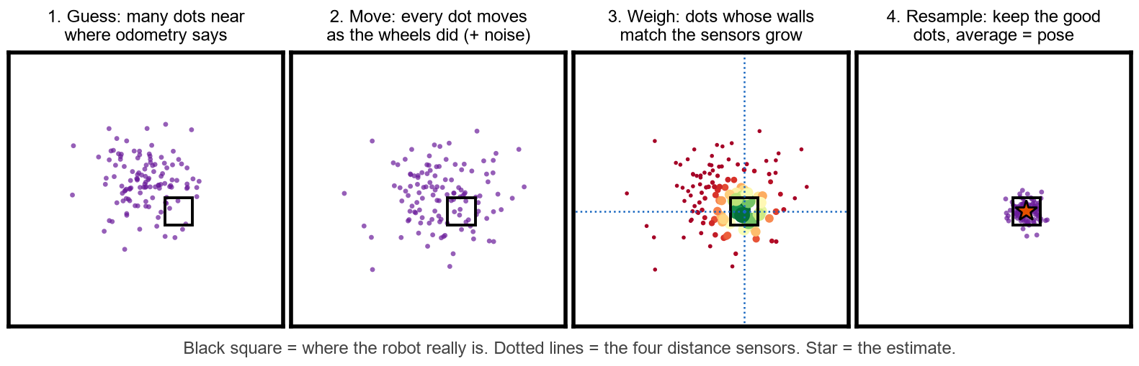
SapphireLib: How Monte Carlo Localization Works
Research
MCL comes from Dellaert, Fox, Burgard and Thrun (1999). The name is from the Monte Carlo casino: it works by making many random guesses. Each guess is called a particle: one possible position of the robot.
An everyday comparison
You wake up in a dark room you know well. You are not sure exactly where you are standing. You reach out: a wall 2 ft to your left, a wall 6 ft ahead. Only a few spots in the room match both. MCL does the same with four distance sensors and a map of the field walls, 20 times a second.
The sensor we use
V5 Distance Sensor | Value | What it means for the design
Range | 20 mm to 2000 mm (about 78 in) | A reading past 78 in is ignored
Accuracy | About 15 mm under 200 mm; about 5% beyond | Far readings are trusted less than near ones
Update rate | About 30 times a second | No point running the localizer much faster
Sees | The nearest thing in a cone, not a thin line | Caused a real bug later (page G-75)
Our design choices
Particles hold x and y only. Heading comes from the inertial sensor, which is far better at heading than distance sensors are. Fewer unknowns means fewer particles needed.
MCL advises, odometry drives. MCL runs beside odometry and nudges odometry's position. Every motion still reads one position from one place, so nothing else in the library had to change.
An "outlier" allowance. Each reading has a chance of being something the map cannot explain (another robot). Such a reading stops telling the particles apart instead of dragging them all to a wrong spot.
Repeatable randomness. The random numbers come from a seed, so the same test gives the same particles every run, on the robot and on a laptop.
Sources: F. Dellaert, D. Fox, W. Burgard and S. Thrun, "Monte Carlo Localization for Mobile Robots," IEEE ICRA 1999; S. Thrun, W. Burgard and D. Fox, Probabilistic Robotics (MIT Press, 2005), ch. 8; M. Arulampalam et al., "A Tutorial on Particle Filters," IEEE Trans. Signal Processing 50(2), 2002; VEX V5 Distance Sensor, vexrobotics.com/276-4852.html; 2654E Echo, MCL explanation video (YouTube).
CP
Cody Paschal
09/21/26
G-58

Slide 60
SapphireLib: The Particle Filter Code
Programming
These are the two core steps, trimmed. "Predict" moves every particle the way odometry says the robot moved. "Weigh" scores each particle by how well the walls it would see match what the sensors actually read.
// PREDICT: move every particle by what odometry measured, plus a little random noise.
// The noise is what lets the cloud spread out to cover odometry's possible error.
void ParticleFilter::predict(double dxIn, double dyIn, double turnedDeg) {
const double sigmaIn = noise.baseIn + noise.perInch * std::hypot(dxIn, dyIn)
+ noise.perDegreeIn * std::fabs(turnedDeg); // moved more -> less sure
for (Particle& p : particles_) {
p.xIn += dxIn + sigmaIn * rng_.fastGaussian();
p.yIn += dyIn + sigmaIn * rng_.fastGaussian();
}
}
// WEIGH: for each particle, for each sensor: "if the robot were HERE, how far away
// would this sensor see a wall?" Compare that with the real reading.
for (std::size_t i = 0; i < particles_.size(); ++i) {
double logLikelihood = map_.contains(p.xIn, p.yIn) ? 0.0 : kOutsideLogPenalty; // off the field?
for (const std::size_t s : usedSensors_) {
double expectedIn = casters_[s].castIn(p.xIn + ray.xIn, p.yIn + ray.yIn); // distance to wall
logLikelihood += scorers_[s].logLikelihood(expectedIn); // good match = high
}
logWeights_[i] += logLikelihood; // added as logarithms: four tiny numbers multiplied
} // together would round to zero
Then: resample and estimate
Particles with low weight are dropped and high-weight ones are copied, but only once the weights have become lopsided (fewer than half the particles doing useful work). The estimate is the weighted average.
Two changes from the textbook, both found in the simulator
Textbook behaviour | What we saw | Our change
Recovery (scattering fresh particles) triggers when the average match gets worse | It fired constantly: a far wall always matches worse than a near one, so just driving toward and away from walls looked like "getting worse" | Measure the match as a fraction of a perfect match for that reading
Recovery runs whenever the match dips | Ordinary driving dips a little all the time | A trigger level: ordinary driving stays above 0.9, a 7 in shove drops it under 0.6
Desktop test results: after 80 s of laps on deliberately bad odometry (4% wheel error, 1.5 degree heading bias, slow creep), odometry was 28.8 in off and MCL 0.13 in. After an 8 in bump, the filter found the robot again in 4 updates with recovery on, and never did with it off while standing still.
Sources: S. Thrun, W. Burgard and D. Fox, Probabilistic Robotics (MIT Press, 2005), ch. 8 (sec. 8.3, augmented MCL); F. Dellaert, D. Fox, W. Burgard and S. Thrun, "Monte Carlo Localization for Mobile Robots," IEEE ICRA 1999; Arulampalam et al. 2002; D. Blackman and S. Vigna, xoshiro generators, prng.di.unimi.it; SapphireLib src/sapphirelib/localization/particle_filter.cpp.
CP
Cody Paschal
09/23/26
G-59

Slide 61
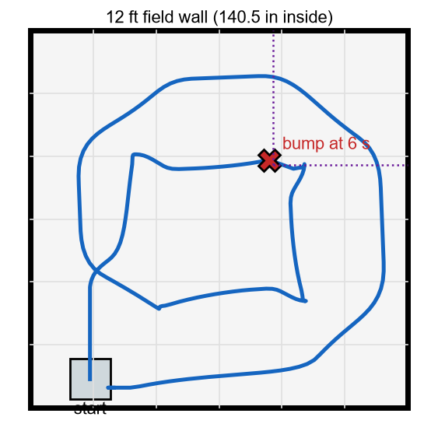
SapphireLib: Prototype: the Simulator
CAD/Design and Prototype
Why a simulator
The competition robot was still being built, and MCL has dozens of settings. Trying them one download at a time on a robot that did not exist yet was not possible. We built the test bench first: a simulator that runs in a web browser.
What it is
A top-down field with a robot that drives using the library's own math, copied line for line into JavaScript.
The robot's drive is the model Auto-Tune measures.
The "world" can be made worse on purpose: worn wheels, sensor noise, a bump, a defender robot.
It draws the particles, the sensor beams, and both positions (true and believed).
The Field tour test route (true path).
How we know the copy matches the robot code
The JavaScript copy is held to the same test values as the C++: a filter run from the same random seed must land on the same particles to nine decimal places. If someone changes one side, the test fails until the other side matches.
Sources: F. Dellaert, D. Fox, W. Burgard and S. Thrun, "Monte Carlo Localization for Mobile Robots," IEEE ICRA 1999; S. Thrun, W. Burgard and D. Fox, Probabilistic Robotics (MIT Press, 2005), ch. 8; WPILib robot simulation, docs.wpilib.org; SapphireLib tools/sim/README.md and tools/sim/test/mcl.test.js.
CP
Cody Paschal
09/25/26
G-60

Slide 62
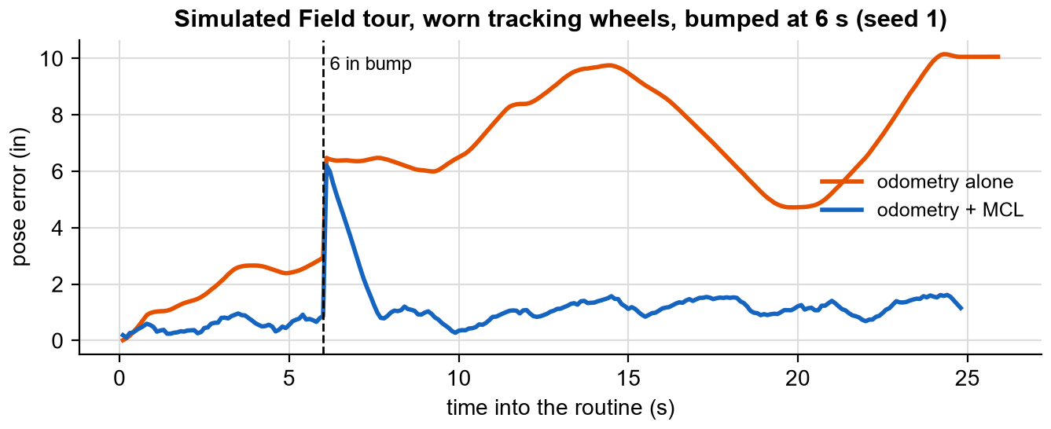
SapphireLib: Prototype: the Simulator (continued)
CAD/Design and Prototype
First results
Same run as page G-55 | Odometry alone | Odometry + MCL
Largest error | 10.2 in | 6.2 in (at the bump)
Error at the end | 10.1 in | 1.2 in
A bug only the simulator could show
Before the routine tells odometry where the robot starts, odometry believes it is at (0, 0). A localizer allowed to correct at that moment briefly locked onto a spot more than 30 in away that happened to match the walls. Change: the localizer now waits until the start position has been set before it may correct anything.
Reflection: the simulator is a prototype in the true sense. It let us try ideas in seconds and throw most of them away. Its limit is stated on its own front page: it shows what the robot will do only as far as the simulated world matches the real one. Every number from it in this notebook is labelled "simulated".
Sources: F. Dellaert, D. Fox, W. Burgard and S. Thrun, "Monte Carlo Localization for Mobile Robots," IEEE ICRA 1999; S. Thrun, W. Burgard and D. Fox, Probabilistic Robotics (MIT Press, 2005), ch. 8; WPILib robot simulation, docs.wpilib.org; SapphireLib tools/sim/README.md and tools/sim/test/mcl.test.js.
CP
Cody Paschal
09/28/26
G-61

Slide 63
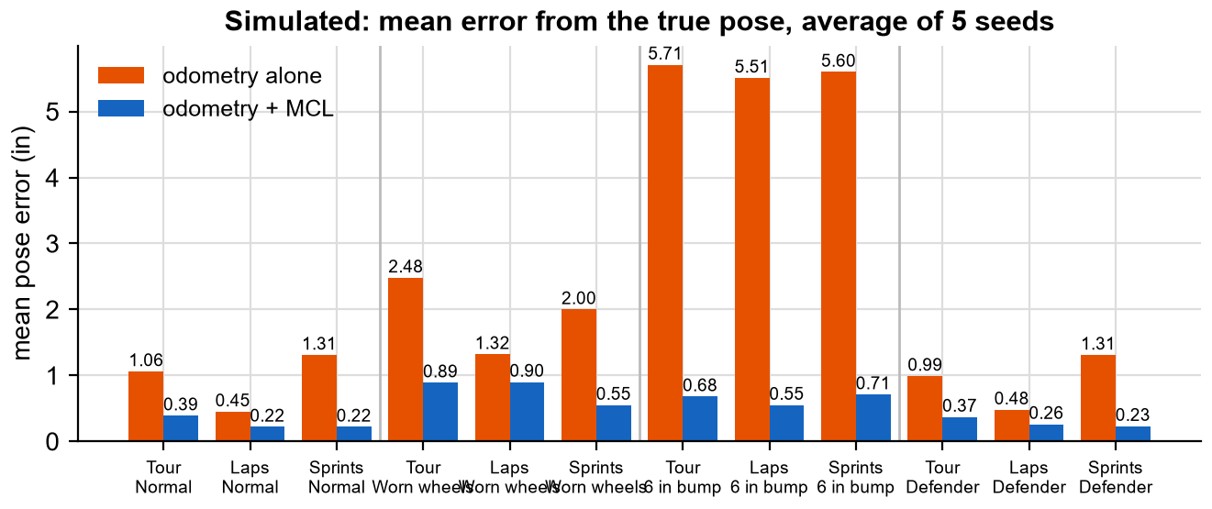
SapphireLib: MCL Against Odometry Alone
Test
Question
Does MCL keep the position more accurate than odometry alone, in the conditions a match actually has?
Procedure (repeatable)
Routines: Field tour (25 s), Square laps (24 s), Sprints (22 s).
Conditions: Normal (wheels 1% off, 0.5% slip, IMU drift 0.5 deg/min). Worn wheels (3%, 2%, 3 deg/min). A 6 in bump at 6 s. A defender robot patrolling and blocking sensors.
Each combination run with correction off and on, for random seeds 1 to 5: 120 runs.
Measured every 10 ms: distance from the position the motions use to the true position. Reported: the mean over the run, averaged over the 5 seeds.
Sources: F. Dellaert, D. Fox, W. Burgard and S. Thrun, "Monte Carlo Localization for Mobile Robots," IEEE ICRA 1999; S. Thrun, W. Burgard and D. Fox, Probabilistic Robotics (MIT Press, 2005), ch. 8; SapphireLib simulator (tools/sim), run by notebook/build/experiments.js; tools/sim/test/sim.test.js.
CP
Cody Paschal
09/29/26
G-62

Slide 64
SapphireLib: MCL Against Odometry Alone (continued)
Test
Condition | Routine | Odometry alone: mean / end (in) | With MCL: mean / end (in) | Mean error cut by
Normal | Tour | 1.06 / 1.65 | 0.39 / 0.28 | 63%
Normal | Laps | 0.45 / 0.15 | 0.22 / 0.26 | 51%
Normal | Sprints | 1.31 / 2.54 | 0.22 / 0.15 | 83%
Worn wheels | Tour | 2.48 / 2.92 | 0.89 / 0.76 | 64%
Worn wheels | Laps | 1.32 / 0.89 | 0.90 / 1.36 | 32%
Worn wheels | Sprints | 2.00 / 3.20 | 0.55 / 0.15 | 72%
6 in bump | Tour | 5.71 / 8.82 | 0.68 / 0.27 | 88%
6 in bump | Laps | 5.51 / 7.36 | 0.55 / 0.22 | 90%
6 in bump | Sprints | 5.60 / 8.38 | 0.71 / 0.10 | 87%
Defender | Tour | 0.99 / 1.49 | 0.37 / 0.19 | 63%
Defender | Laps | 0.48 / 0.21 | 0.26 / 0.26 | 46%
Defender | Sprints | 1.31 / 2.54 | 0.23 / 0.13 | 82%
Analysis
MCL lowered the mean error in all 12 combinations, by 32% to 90%.
The biggest gain is after a bump: odometry stays about 5.6 in off for the rest of the routine; MCL averages under 0.75 in.
The smallest gain is Laps with worn wheels. On a closed lap, odometry's errors partly cancel by the time it returns to the start, so there is less to fix. This is also why we report the mean, not only the end.
A defender blocking sensors made almost no difference, which is the "outlier allowance" doing its job.
Decision (Cody Paschal): MCL meets the under-1-in criterion in simulation in every condition, so it goes onto the robot. Limit: this is simulated data. The real sensors, walls and tiles still have to agree (page G-78).
Sources: F. Dellaert, D. Fox, W. Burgard and S. Thrun, "Monte Carlo Localization for Mobile Robots," IEEE ICRA 1999; S. Thrun, W. Burgard and D. Fox, Probabilistic Robotics (MIT Press, 2005), ch. 8; SapphireLib simulator (tools/sim), run by notebook/build/experiments.js; tools/sim/test/sim.test.js.
CP
Cody Paschal
10/01/26
G-63

Slide 65
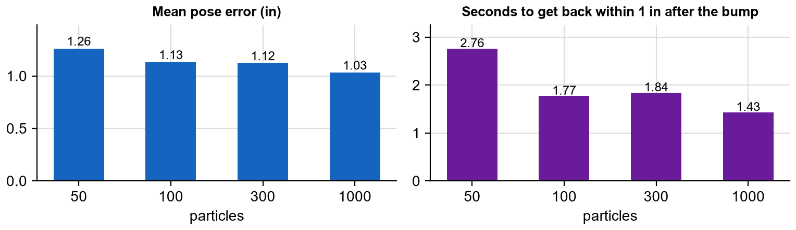
SapphireLib: How Many Particles?
Test
Why this test
The decision matrix flagged MCL's cost on the processor as its weak point. More particles should mean a better estimate but more work for the brain, which also has to run the drive, the lift and the logger.
Test 1: accuracy against particle count (simulator)
Procedure: Field tour, worn wheels, 6 in bump at 6 s, seeds 1 to 5. The particle count is the only thing changed: 50, 100, 300, 1000. Measured: mean error, and seconds after the bump until the error is back under 1 in.
Test 2: cost on the brain
Procedure: the update was timed by counting processor instructions in an emulator of the brain's chip (ARM Cortex-A9), before and after we replaced slow math with lookup tables.
Sources: G. Marsaglia and W. Tsang, "The Ziggurat Method for Generating Random Variables," J. Statistical Software 5(8), 2000, jstatsoft.org; QEMU emulator, qemu.org; SapphireLib docs/TOOLS.md and simulator.
CP
Cody Paschal
10/02/26
G-64

Slide 66
SapphireLib: How Many Particles? (continued)
Test
Particles | Time per update, first version | Time per update, with tables | Share of the brain at 20 updates/s
300 | 1.1 to 2.1 ms | 0.34 to 0.76 ms | 0.7 to 1.5%
1000 | 3.5 to 6.5 ms | 1.1 to 2.4 ms | 2.1 to 4.8%
3000 | 10 to 19 ms | 3.2 to 7.1 ms | 6 to 14%
What made it about 3 times faster
Random noise from a pre-computed table (the "ziggurat" method) instead of logarithms and square roots.
The sensor score from a lookup table instead of an exponential per particle per sensor.
All of one sensor's wall distances worked out together, with no division per particle.
Analysis
From 100 to 1000 particles the mean error only moves from 1.13 to 1.03 in. Sensor noise, not particle count, sets the accuracy.
Recovery after a bump does improve: 2.76 s at 50 particles, 1.43 s at 1000.
With the tables, 1000 particles cost about what 300 did before.
Decision (Cody Paschal): the library default stays at 300 particles, which is under 1.5% of the brain, and the count is a setting in TUNE.CFG so it can be raised for faster bump recovery without a rebuild. The processor risk from the decision matrix is closed.
Sources: G. Marsaglia and W. Tsang, "The Ziggurat Method for Generating Random Variables," J. Statistical Software 5(8), 2000, jstatsoft.org; QEMU emulator, qemu.org; SapphireLib docs/TOOLS.md and simulator.
CP
Cody Paschal
10/06/26
G-65

Slide 67
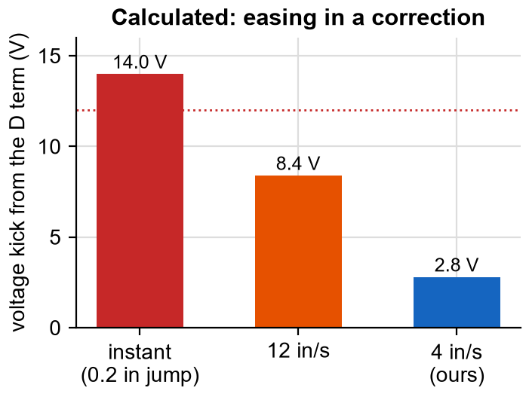
SapphireLib: Applying a Correction Without Jerking the Robot
Programming
The problem
When MCL decides odometry is 2 in off, the obvious thing is to move odometry's position by 2 in. But a motion is running at that moment, and its PID is watching that position. A sudden 2 in jump looks to the D term like the robot moving at enormous speed.
Calculation: an Auto-Tuned drive has a D gain of about 0.7 V per in/s. A jump of only 0.2 in inside one 10 ms loop looks like 20 in/s, which is a 14 V kick: more than a motor's whole range.
Our answer: corrections "ease in". Odometry's position slides toward MCL's at a capped speed.
// each 10 ms, move the position toward the correction, but no more than maxStepIn
PoseDelta correctionStep(double remainingXIn, double remainingYIn, double maxStepIn) {
const double remainingIn = std::hypot(remainingXIn, remainingYIn);
if (remainingIn <= maxStepIn) return {remainingXIn, remainingYIn}; // close: finish it
const double scale = maxStepIn / remainingIn; // far: one capped step
return {remainingXIn * scale, remainingYIn * scale};
}
Sources: S. Thrun, W. Burgard and D. Fox, Probabilistic Robotics (MIT Press, 2005), ch. 8; K. Astrom and R. Murray, Feedback Systems (Princeton, 2008), fbswiki.org, ch. 10 (derivative action); SapphireLib src/sapphirelib/odom/odometry_math.cpp and src/robot/tune.cpp.
CP
Cody Paschal
10/08/26
G-66

Slide 68
SapphireLib: Applying a Correction Without Jerking the Robot (continued)
Programming
When MCL is allowed to correct at all
Rule | Why
The particle cloud must be tight (within 3 in) | A spread-out cloud means MCL is not sure
At least two sensors must agree with the map | One sensor alone can be fooled by a robot or game piece
Not while spinning fast | Readings are smeared and slightly old during a fast turn
Only after the start position is set | The simulator bug on page G-60
Iteration: the cap changed after a real run
Version | Cap | Evidence | Result
Library default | 4 in/s | Calculation above: at most a 2.8 V nudge | Smooth, but slow to apply a big correction
Our robot now | 18 in/s | Robot log SL000021: odometry ran 10 in behind the localizer on a drive to the goal, and the robot hit the goal at full power still thinking it was short | Correction keeps up on a fast approach
Traceable change: the 4 in/s cap came from a calculation; the move to 18 in/s on our robot came from a logged run where the calculation's answer was too cautious. The library keeps 4 as its default and each robot sets its own. This trade-off (smooth against quick) is still being tuned.
Sources: S. Thrun, W. Burgard and D. Fox, Probabilistic Robotics (MIT Press, 2005), ch. 8; K. Astrom and R. Murray, Feedback Systems (Princeton, 2008), fbswiki.org, ch. 10 (derivative action); SapphireLib src/sapphirelib/odom/odometry_math.cpp and src/robot/tune.cpp.
CP
Cody Paschal
10/09/26
G-67

Slide 69
SapphireLib: Finding Where the Sensors Really Are
CAD/Design and Prototype
The problem
MCL compares each sensor's reading with the map. To do that it must know exactly where each sensor sits on the robot. Any error there goes straight into the position. With four sensors tucked inside the chassis, a ruler is not accurate enough, the same lesson as the tracking wheel offsets.
Three versions, each from what the last one could not do
Version | How it works | Tested accuracy (simulated) | What sent us to the next version
1. Full field | Robot spins one turn each way at the middle of a field; a fit finds the start position and every sensor's offset against the four walls | Within about 0.1 in along each beam | We do not have a full field. It could never be run at our practice area.
2. One wall or a corner | Spin near a wall or in a corner. The sensors' spacing is held from the configured values; everything else is found | Within about 0.05 in of where the spacing puts it | The spacing itself is still taken from a tape measure
3. A box of known size | Spin inside a box (or between two walls) whose inside size is known, which pins the spacing as well | Every sensor within 0.11 in; about 0.03 in typical in a 40 in box | Current version
The fit, in plain words
The robot collects hundreds of readings while it spins. The program then asks: "what sensor positions would make all of these readings line up with straight walls?" It adjusts the positions a little at a time until they fit best (the Levenberg-Marquardt method). Readings that are far from any wall, such as a chair or a person walking past, are given no say at all (Tukey's biweight).
What testing in random rooms taught us
Finding from the stress tests | Change
Trusting each reading by its measured distance pushed every offset out by about 0.08 in | Trust is based on the predicted distance
A gentler outlier rule let furniture drag the answer into a compromise | The strict rule from the first pass
From one wall, the fit's other walls settled on a cabinet's face | A wall more than 3 degrees out of square is left out
A flat object across the room passed for a field wall and moved every sensor 4 in | The spacing may change by 3 in at most
A 20 in box cannot work: the robot cannot spin in it | Recommended box is 34 to 56 in
Reflection: version 1 was correct and useless to us. We had designed for the field in the game manual, not for the room we actually practise in. That constraint is on page G-1; we had not applied it. Versions 2 and 3 exist because we went back to it. Decided by Cody Paschal.
Sources: D. Marquardt, "An Algorithm for Least-Squares Estimation of Nonlinear Parameters," J. SIAM 11(2), 1963; A. Beaton and J. Tukey, "The Fitting of Power Series," Technometrics 16(2), 1974; VEX V5 Distance Sensor, vexrobotics.com/276-4852.html; SapphireLib docs/LOCALIZATION.md.
CP
Cody Paschal
10/12/26
G-68

Slide 70
SapphireLib: Moving to the Competition Robot
Robot Iterations
What changed
Until now SapphireLib ran on the test chassis and in the simulator. With the competition robot built (Section H), the whole program was moved onto it. This is where the layered design from page G-7 was tested for real: only the top layer should need to change.
Part of the program | Changed for the new robot? | What changed
Library (drive, odometry, motions, MCL, tools) | No | Nothing rewritten. New features were added beside it (orbit mode, Home tab buttons)
Ports | Yes | One file, config.hpp: every port written once
Devices | Yes | Three-motor lift, pneumatic claw, extender, side piston
Macros | Yes | New controls for the new mechanisms
Tuning | Re-run | Auto-Tune run again; offsets and sensor mounts re-calibrated
A new-chassis checklist
Because every calibration depends on the one before it, we wrote the order down so a rebuild is repeatable:
Sources: PROS docs, pros.cs.purdue.edu/v5 (device configuration); LemLib, github.com/LemLib/LemLib and lemlib.readthedocs.io (chassis configuration); 96671H notebook, Section H; SapphireLib docs/NEW_CHASSIS.md.
CP
Cody Paschal
10/14/26
G-69

Slide 71
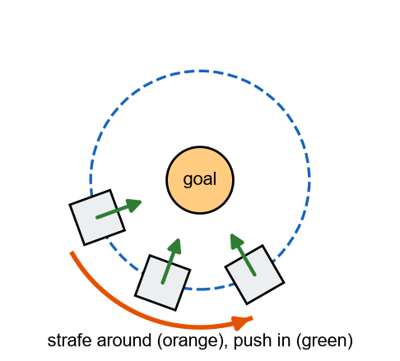
SapphireLib: Moving to the Competition Robot (continued)
Robot Iterations
1. Inertial sensor scale (spin a known number of turns).
2. Tracking wheel diameters, then their offsets (spin in place).
3. Auto-Tune each axis, then the lift.
4. Distance sensor mounts (spin in the box).
5. Localizer settings, from the robot's own logs.
New driver mode: orbit
With a drive that can slide sideways we added a mode for defending a goal. The robot locks onto a pivot point (the goal) and the stick moves it around that point while it keeps facing in.
What makes ours different from circling by hand: the robot strafes along the true circle while the center wheels push it toward the goal, so it stays pinned against it and is hard to shove off.
Reflection: the port changed the robot's own files and rewrote no library file. That is the first real evidence for the decision on page G-6 and the layers on page G-7: code written for one specific robot would have been rewritten here.
Sources: PROS docs, pros.cs.purdue.edu/v5 (device configuration); LemLib, github.com/LemLib/LemLib and lemlib.readthedocs.io (chassis configuration); 96671H notebook, Section H; SapphireLib docs/NEW_CHASSIS.md.
CP
Cody Paschal
10/16/26
G-70

Slide 72
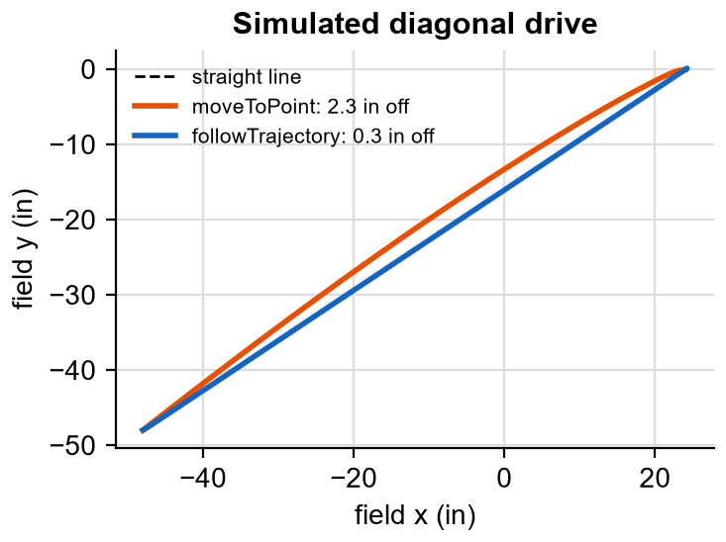
SapphireLib: Trajectories: Planning the Whole Drive
Programming
What testing showed
moveToPoint aims at the target and lets the PID push. On a diagonal, a holonomic drive's forward and sideways directions are not equally strong, so the robot does not travel in a straight line: it bends.
Procedure (simulator): drive from (-48, -48) to (24, 0), an 86 in diagonal, with perfect sensors. Once with moveToPoint, once with a planned trajectory. Measured every 10 ms: distance from the straight line.
 | moveToPoint | Trajectory
Worst off the line | 2.28 in | 0.30 in
Mean off the line | 1.35 in | 0.06 in
End error | 0.39 in | 0.03 in
Time | 3.33 s | 3.72 s
How a trajectory is different
A trajectory is planned before the robot moves: where it should be, how fast, and facing which way, at every instant. The robot then follows that plan.
The path is a smooth curve through the waypoints (a cubic spline), so there are no sudden corners.
The speed is the fastest the measured motor model allows. The volts needed for forward, sideways and turning must add up to no more than the voltage budget, because that sum is what the hardest-working wheel sees. This is what slows the plan on diagonals and in turns, automatically.
Following uses feedforward (the volts the model says this speed needs) plus a small PID on each axis to remove what is left.
If the robot is blocked, the plan pauses and waits for it, instead of running ahead.
Trade-off
The trajectory is 0.4 s slower on this drive (3.72 s against 3.33 s), because it will not ask the wheels for more than they can give. In return it is 8 times closer to the line. For driving between field elements with a few inches to spare, we accept the time.
Decision (Cody Paschal): keep both. moveToPoint for short, simple moves; trajectories for long or curved routes and anywhere the route passes close to something. Trajectories can also branch part-way on a sensor reading without stopping. Status: trajectories have been driven on the robot.
Sources: WPILib docs, Trajectory Generation and Following, docs.wpilib.org; R. C. Coulter, "Implementation of the Pure Pursuit Path Tracking Algorithm," CMU-RI-TR-92-01 (1992); K. Astrom and R. Murray, Feedback Systems (Princeton, 2008), fbswiki.org (feedforward design); SapphireLib docs/TRAJECTORIES.md; simulator, run by notebook/build/experiments.js.
CP
Cody Paschal
10/19/26
G-71

Slide 73
SapphireLib: How Should We Write Autonomous Routines?
Brainstorm and Pick Best Solution
The problem
The library can now drive accurately. The question became how a person tells it what to do. We built one approach, used a second, and replaced both with a third.
 | A. Teach mode | B. Library calls directly | C. Short auton functions
What it is | Drive the route once by hand while the robot records position and buttons; replay it as the autonomous | Write each motion with the drivetrain's full commands and settings | One short word per motion, with sensible defaults: drive(24); turnTo(90);
Good | No code to write; fast first result | Total control | Reads like the plan on the whiteboard; a number is easy to change
Bad | The routine is a recording, not text. To change one stop you re-drive the whole thing. No way to read what it will do | Long lines; easy to mis-set an option; slow to edit between matches | A layer of our own to maintain
Criteria | Weight | A. Teach mode | B. Direct calls | C. Auton functions
We can trust what it will do (readable) | 5 | 1 (5) | 4 (20) | 5 (25)
Quick to adjust at a tournament | 5 | 1 (5) | 3 (15) | 5 (25)
Mechanisms timed to the drive | 4 | 4 (16) | 2 (8) | 5 (20)
Fast to make the first routine | 3 | 5 (15) | 2 (6) | 4 (12)
Little library code to maintain | 2 | 1 (2) | 5 (10) | 4 (8)
Weighted total |  | 43 | 59 | 90
What happened with teach mode
We built teach mode fully: recording, smoothing the recorded drive into a trajectory, and replaying the button presses on the plan's clock. It had unit tests and it worked in them. But it added a large amount of code that was hard to debug, and a recorded routine cannot be read or edited by hand: when it did the wrong thing there was nothing to look at except a file of numbers.
Decision (Cody Paschal): remove teach mode and write routines with short auton functions (C). Teach mode was too complex to trust. An autonomous we cannot read is an autonomous we cannot fix in the pits. The style of C follows RW-Template's workflow, which we researched as an example of routines that stay short.
Reflection: this is the one place in this section where finished, tested code was deleted. The tests proved teach mode did what we designed. They could not tell us the design was wrong for how we work at a tournament. The first two criteria in the matrix were added after using it, and they are now the first thing we ask of any tool: can a person read it and change it quickly?
Sources: RW-Template (GitHub), autonomous workflow; EZ-Template, ez-robotics.github.io/EZ-Template (autonomous routines); LemLib, github.com/LemLib/LemLib and lemlib.readthedocs.io; SapphireLib docs/QUICKSTART.md and docs/ROADMAP.md.
CP
Cody Paschal
10/20/26
G-72

Slide 74
SapphireLib: Auton Functions
Programming
This is part of a real routine from our robot: stack three Pins on a Goal. Each line is one action. Compare it with the whiteboard plan in the comments.
void triplePinPoints() {
setPose(-60.6, -5, 90); // tell the robot where it starts
macros::setLiftLevel(macros::Goal::alliance, 1);
moveToPoint(-50, -5); // 1: straight out from the wall
if (!ontoGoal(kGoalXIn, kGoalYIn)) return; // onto the goal; stop the routine if it failed
scoreOnGoal(); // preload scored at level 1
offGoalTo(-50.8, 0); // 2: back off the goal
if (!ontoPin(-23.55, -23.55)) return; // second Pin; missed it? stop here
macros::setLiftLevel(macros::Goal::alliance, 2);
backTo(-29.8, -18.1);
if (!ontoGoal(kGoalXIn, kGoalYIn)) return;
scoreOnGoal(); // scored at level 2
...
}
What each function gives a routine
Feature | Example | Why we needed it
Speed cap | drive(24, {.maxVolts = 6}) | Creep the last inches into a goal
Chaining | moveToPoint(x, y, {.chain = true}) | Flow into the next motion without stopping
Background motion | runAsync(...); waitUntilNear(x, y, 6); | Raise the lift while still driving
Cancel | cancelMotion() | Stop the drive the moment the claw closes
Forced turn direction | turnTo(180, clockwise) | Keep a back corner from swinging into a wall
Wall reset | resetBack() | Option A from page G-57, as one line
Design rule: stop rather than guess
Every step that can fail returns true or false, and the routine checks it (`if (!ontoPin(...)) return;`). If the robot misses the second Pin, it stops there instead of driving to the goal and "scoring" nothing, or scoring in the wrong place. A stopped robot in a known position is easier for the driver to recover than one that carried on.
Tools that go with it
The simulator runs the same routine with the same function names, so a route can be tried before the robot is free.
The simulator's Paths tab lets us draw a route on the field and writes the C++ for it.
The auton selector remembers the last choice on the SD card and can be changed from the controller while disabled.
Status: routines written this way are what the robot runs today. In the simulator the Triple Pin routine finishes inside 14.5 s with each Pin within 0.75 in of the goal's middle.
Sources: RW-Template (GitHub); EZ-Template, ez-robotics.github.io/EZ-Template; LemLib, github.com/LemLib/LemLib and lemlib.readthedocs.io (async motions, waitUntil); SapphireLib docs/QUICKSTART.md, src/robot/autons.cpp and tools/sim/test/sim.test.js.
CP
Cody Paschal
10/22/26
G-73

Slide 75
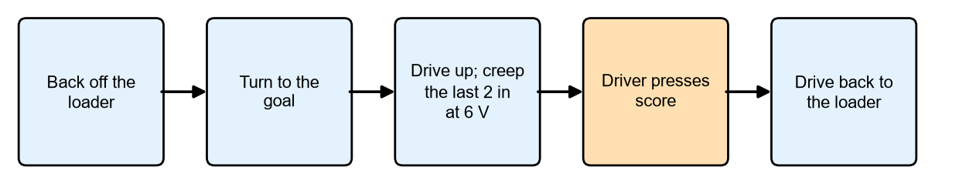
SapphireLib: First Runs on the Robot: What the Logs Showed
Test
The test
The "auto cycle" is a driver-assist: one button and the robot shuttles between the loader and the goal by itself while the driver works the lift and claw. It was the first routine run repeatedly on the competition robot with the SD logger recording.
One auto cycle. Touching a drive stick cancels it at any point.
Procedure
Run the cycle from the right-hand loader. After each run, pull the SD card and open the log in the analyzer. Each row below is one finding, the log it came from, and the change it led to.
Log | What the log showed | Cause | Change
SL000028 | Turns stopped 5.5 degrees short at 1.5 V. Moves stopped 1 in off sideways at 2.2 V. Each then waited out its 3 s timeout | Close to the target the PID asks for less voltage than it takes to start the robot moving | A minimum push per direction until first inside the threshold: 1 V forward, 4 V strafe, 2.5 V turn
SL000029 | Strafing at a 3 V minimum only crept | The center wheels drag sideways | Strafe minimum raised to 4 V
SL000030 | Creeping into the goal, the robot twisted 6 degrees and stayed there | 1.5 V was too little to turn back | The minimum returns if the error grows past twice the threshold
SL000028 | The drive braked about twice as hard as designed from 17 in out | Tracking wheel readings changed only every other loop, so the D term read double, then zero | Rotation sensors set to report every 5 ms
SL000028 | Localizer moved the robot 3.7 in toward the wall at the loader | The front sensor saw the loader's face; the map only had walls | The four loaders added to the map
What this shows
None of these appeared in the simulator. The simulated robot has no sticky friction near zero speed, sensors that update every loop, and no loaders. Each one is a way the real world differs from our model.
All five were found in the first three logged runs. Without the logger, "the robot stops a bit short sometimes" would have been the whole diagnosis.
Each fix went back into the simulator too, so the model is now closer to the robot than it was.
Reflection: this page is why telemetry was built before the robot port. The plan had logging as a "nice to have" tool. It turned out to be how every later decision was made. Decided by Cody Paschal from the logs listed.
Sources: PROS docs, pros.cs.purdue.edu/v5 (Rotation sensor data rate); K. Astrom and R. Murray, Feedback Systems (Princeton, 2008), fbswiki.org (static friction, dead zones); SapphireLib docs/ROADMAP.md (auto cycle notes, logs SL000028 to SL000030) and src/robot/autocycle.cpp.
CP
Cody Paschal
10/23/26
G-74

Slide 76
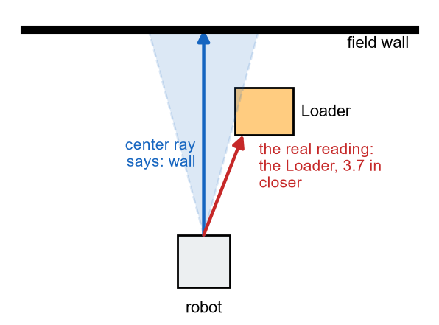
SapphireLib: The Sensor Sees a Cone, Not a Line
Test
What the log showed
After the loaders were added to the map, log SL000035 showed a new miss: approaching a loader, the localizer moved the robot's position and the robot stopped 3.3 in short.
Cause
Our map math treated each distance sensor as a thin line: "what is straight ahead?" The real sensor reads the nearest thing anywhere inside a cone. Beside a loader, the center line passed the loader and hit the wall behind it. The sensor itself saw the loader's corner, 3.7 in nearer. The localizer trusted its line model, decided the reading meant the robot was 3.7 in closer to the wall, and "corrected" a position that had been right.
How we measured the cone
Three logs contained approaches to the loaders. For each reading we knew where the robot was and what the sensor reported, so we could work out how far off-center the loader was when the sensor first picked it up. The readings fit a half-angle of about 15 degrees.
The change
Walls are still read along the center line (a flat wall reads the same across the cone).
Anything added to the map (loaders, goals) is checked across the whole 15 degree cone, and the nearest hit is used.
Faces turned more than 60 degrees away from the beam are left out: the sensor does not get a return from them.
Test | Line model | Cone model
Replay of the SL000035 approach (desktop test) | Picks the spot the localizer wrongly went to | Picks where the robot really was
Cone against many thin rays 0.005 degrees apart | - | Matches
A map with walls only (all earlier tests) | Same result | Same result
Reflection: the cone was in our own research table (page G-58, last row) weeks earlier, and we still modelled a line because it was simpler. The fix was small. Finding it needed a log, a replay and a diagram. We now check each simplification in the model against the sensor's real behaviour before trusting a correction near field elements. Status: in the library and tested on the desktop from the real log. Decided by Cody Paschal.
Sources: VEX V5 Distance Sensor, vexrobotics.com/276-4852.html; S. Thrun, W. Burgard and D. Fox, Probabilistic Robotics (MIT Press, 2005), ch. 8 (sec. 6.3, beam models of range finders); SapphireLib tests/localization/field_map_test.cpp and particle_filter_test.cpp; robot log SL000035.
CP
Cody Paschal
10/26/26
G-75

Slide 77
SapphireLib: autoClaw: Closing at the Right Moment
Test
The problem
autoClaw closes the claw by itself when a distance sensor inside it sees a Pin arrive. The first version closed when the reading dropped to a fixed 125 mm. In practice it grabbed well at one approach speed and missed at others.
Why a fixed distance cannot work
Between the sensor seeing the Pin and the jaws being shut, time passes: the sensor's reading is already about 15 ms old, the program looks once per loop, and the air valve takes about 60 ms to close the jaws. During that time the robot keeps moving. Faster robot, more distance covered, so the Pin is deeper in the claw than planned.
// how far will the Pin travel before the jaws are shut? speed x (valve + loop + reading's age)
const double aheadMs = kClawLeadMs + tickMs + readingAgeMs;
aim.aimMm = readingMm - approachMmPerMs * aheadMs; // where the Pin WILL be
aim.fires = aim.aimMm <= kGrabMm; // close now if that is the grab point
Test (simulator)
Procedure: the claw timing model: a sensor that measures every 33 ms and reports 15 ms late with noise, a 20 ms program loop, a valve with a little variation. 400 grabs at each speed from 4 to 60 in/s for each of three rules. A grab is "caught" if the jaws shut with the Pin inside the grab window.
Sources: VEX V5 Distance Sensor, vexrobotics.com/276-4852.html; PROS docs, pros.cs.purdue.edu/v5 (ADI pneumatics, distance sensor); SapphireLib tools/sim/js/clawtiming.js, tools/sim/claw.html and src/robot/macros.cpp; run by notebook/build/experiments.js.
CP
Cody Paschal
10/28/26
G-76

Slide 78
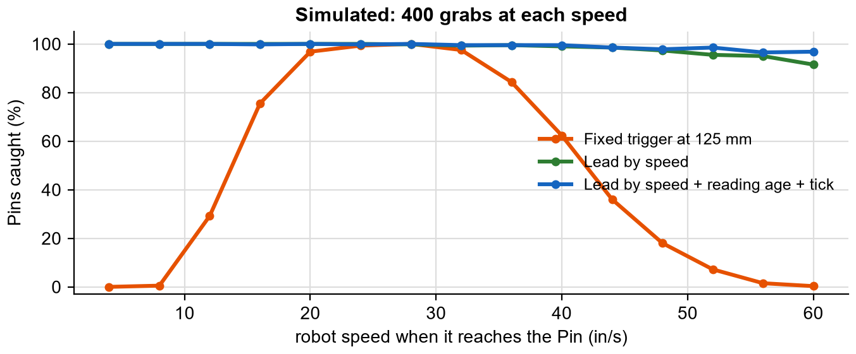
SapphireLib: autoClaw: Closing at the Right Moment (continued)
Test
Rule | Slow (8 in/s) | Medium (28 in/s) | Fast (52 in/s)
Fixed trigger at 125 mm | 0% | 100% | 7%
Lead by speed | 100% | 99% | 95%
Lead by speed + reading age + tick | 100% | 100% | 98%
Analysis
The fixed trigger only works in a band around one speed: too early when slow, too late when fast. Leading by speed fixes both ends. Adding the reading's age and the loop time holds the catch rate a little higher at the top speeds, because a reading that has not changed for a while is older than it looks.
Decision (Cody Paschal): autoClaw leads by speed, reading age and loop time. The robot also shows each grab on the controller and logs it. Honest status: the two constants on the robot (grab point 35 mm, lead 125 ms) are starting values that have not yet been measured from logged grabs. That is the next test.
Sources: VEX V5 Distance Sensor, vexrobotics.com/276-4852.html; PROS docs, pros.cs.purdue.edu/v5 (ADI pneumatics, distance sensor); SapphireLib tools/sim/js/clawtiming.js, tools/sim/claw.html and src/robot/macros.cpp; run by notebook/build/experiments.js.
CP
Cody Paschal
10/30/26
G-77

Slide 79
SapphireLib: Where Localization Stands, and What Comes Next
Test
Honest status
MCL is on the competition robot with its four sensors mounted and calibrated, and it corrects the position. It is not yet good enough to use in a competition. On the robot the corrected position still drifts more than in the simulator, and a wrong correction is worse than no correction. Our competition routines currently turn it off and run on odometry alone.
Feature | Simulated | On the robot | Trusted for competition
Odometry and pose motions | Yes | Yes | Yes
Auto-Tune gains | Yes | Yes | Yes
Trajectories | Yes | Yes | Yes
SD logging and the analyzer | Yes | Yes | Yes
Monte Carlo localization | Yes | Works, drifts too much | Not yet
Thermal compensation | Desktop math only | Not yet verified | Not yet
Why the gap between simulator and robot
The simulator's world is cleaner than the real one. The auto cycle and cone pages each found a difference (sticky friction, the loaders, the cone). Each fix closed part of the gap. What remains is tuning the localizer's settings to the real sensors and tiles.
Research for the next version (simulator, 10/27)
Procedure: each idea was added to the simulator's localizer and compared with today's version on the same recorded paths: 12 random seeds, 10 scenarios (the standard set plus big bumps, worn wheels with bumps, mis-measured sensor mounts, a bad inertial sensor, and short wheels).
Sources: S. Thrun, W. Burgard and D. Fox, Probabilistic Robotics (MIT Press, 2005), ch. 8 (sec. 8.3); S. Lenser and M. Veloso, "Sensor Resetting Localization for Poorly Modelled Mobile Robots," IEEE ICRA 2000; F. Dellaert, D. Fox, W. Burgard and S. Thrun, "Monte Carlo Localization for Mobile Robots," IEEE ICRA 1999; SapphireLib simulator experiments of 10/27/26 and docs/LOCALIZATION.md.
CP
Cody Paschal
11/02/26
G-78

Slide 80
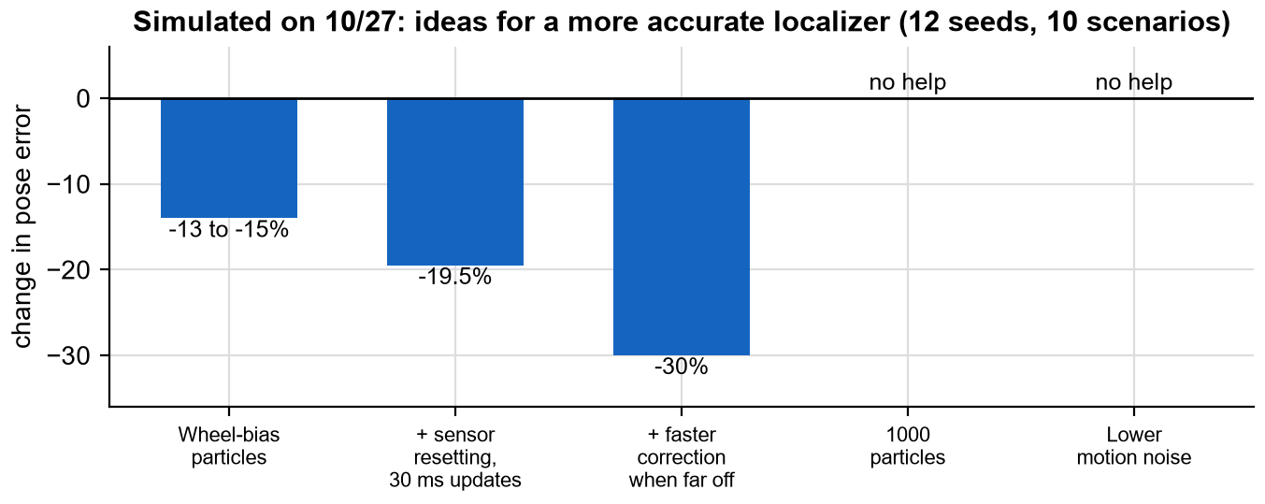
SapphireLib: Where Localization Stands, and What Comes Next (continued)
Test
Wheel-bias particles: each particle also guesses how far off the tracking wheels are, so the filter learns the wheel error instead of fighting it forever. On worn wheels alone the gain was 45%.
Sensor resetting: after a bump, place new particles where the wall readings say the robot is. Recovery in 0.15 to 0.25 s, against 0.5 s.
Faster correction when far off: no larger voltage kicks than today in the simulated closed loop.
Did not help: more particles (as page G-64 predicted), and lower motion noise.
Plan: (1) tune today's settings from the robot's logs using the simulator's Tune tab; (2) add wheel-bias particles, the largest single gain; (3) only then turn corrections on in a competition routine, and compare logged runs with it off and on. Decided by Cody Paschal.
Sources: S. Thrun, W. Burgard and D. Fox, Probabilistic Robotics (MIT Press, 2005), ch. 8 (sec. 8.3); S. Lenser and M. Veloso, "Sensor Resetting Localization for Poorly Modelled Mobile Robots," IEEE ICRA 2000; F. Dellaert, D. Fox, W. Burgard and S. Thrun, "Monte Carlo Localization for Mobile Robots," IEEE ICRA 1999; SapphireLib simulator experiments of 10/27/26 and docs/LOCALIZATION.md.
CP
Cody Paschal
11/03/26
G-79

Slide 81
SapphireLib: Did SapphireLib Solve the Problem?
Team Management
We end this section by going back to the criteria and constraints on page G-1 and checking each against evidence in this section.
Criterion (page G-1) | Met? | Evidence
Drive our robot (tank and holonomic, asterisk) | Yes | Six-motor mixer; all six motors used in turns
Know where it is | Partly | Odometry: yes. Correction during a match: simulated under 1 in, not yet reliable on the robot
Go where it is told | Yes | Point, pose, path and trajectory motions; diagonal within 0.3 in in simulation
Tune itself | Yes | Model-based Auto-Tune: no overshoot at 6, 24 and 48 in; robot runs its gains
Explain itself | Yes | SD logs; five problems found from the first three logged runs
Constraint | Held? | Note
Runs on the V5 Brain with PROS 4.2.2 | Yes | Localizer under 1.5% of the processor
One programmer | Yes | Possible only because of desktop tests and the simulator
One or two field walls | Yes, after a miss | Sensor calibration version 1 needed a full field; versions 2 and 3 do not
Lasts two seasons | So far | Nothing game-specific in the library; the robot port changed no library file
All code is ours to explain | Yes | This section
Sources: REC Foundation Engineering Notebook Rubric; 96671H notebook pages G-1 through this page; SapphireLib docs/ROADMAP.md.
CP
Cody Paschal
11/05/26
G-80

Slide 82
SapphireLib: Did SapphireLib Solve the Problem? (continued)
Team Management
What we would do differently
Build the logger first. It was phase 4. Everything after it went faster and every decision after it has a log number beside it.
Put real hardware in the loop sooner. The simulator found the math bugs. The robot found the physics we had left out: sticky friction, sensor update rates, the sensor's cone.
Decide what "easy to use at a tournament" means before building a tool. Teach mode passed every test and was still the wrong tool.
Plan time for testing, not just writing.
What worked
Prototyping in threes. The autotuner and the sensor calibration each took three versions, and in both the third was only possible because of what the first two showed.
Decision matrices before code. Four of them in this section. The one for the library itself is the reason the robot port took days.
Writing down limits. Each page says whether its data is simulated, from a desktop test, or from the robot.
Next: SapphireLib development continues in the monthly programming entries. The open items are on page G-78.
Sources: REC Foundation Engineering Notebook Rubric; 96671H notebook pages G-1 through this page; SapphireLib docs/ROADMAP.md.
CP
Cody Paschal
11/06/26
G-81

Slide 83
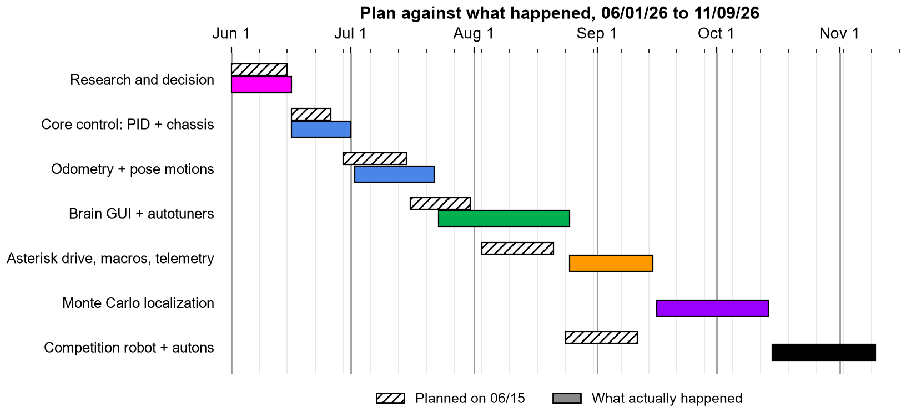
SapphireLib: SapphireLib Final Chart and Analysis
Monthly Gantt Charts
Original goal
SapphireLib driving the competition robot in autonomous by mid-September.
Accomplished
All five planned phases: chassis control, odometry, motions, tools, mechanisms.
The library runs the competition robot in driver control and autonomous.
Beyond the plan: trajectories, the simulator, the telemetry analyzer, TUNE.CFG.
Sources: 96671H notebook, page A-4 (How to Read Gantt Charts); SapphireLib docs/ROADMAP.md.
CP
Cody Paschal
11/09/26
G-82

Slide 84
SapphireLib: SapphireLib Final Chart and Analysis (continued)
Monthly Gantt Charts
Partially complete
Monte Carlo localization: built, simulated and on the robot, but not yet accurate enough to use in matches.
Pending
Measuring autoClaw's two constants from logs. Verifying thermal compensation in a long practice.
Analysis and reasoning
The goal was met about a month late: the competition robot ran on SapphireLib in mid-October, not mid-September. Comparing the hatched plan with the solid bars shows where the time went. Every phase ran long, and one bar (localization) was not in the plan at all. The causes, in order of size: three autotuner prototypes instead of one; localization, which started as an "extra goal" and became necessary once the bump test showed odometry alone would miss our accuracy criterion; and teach mode, which was built and then removed.
The plan's mistake was treating each phase as "write it". Every phase was really "write it, test it, find what is wrong, change it", and the last three took longer than the first. Future plans will give testing its own bar.
Future plans
Tune the localizer from logs, add wheel-bias particles, and re-test (page G-78). These go on the team's monthly Gantt chart under A1 Programming from here on.
Sources: 96671H notebook, page A-4 (How to Read Gantt Charts); SapphireLib docs/ROADMAP.md.
CP
Cody Paschal
11/11/26
G-83

