Slide 1
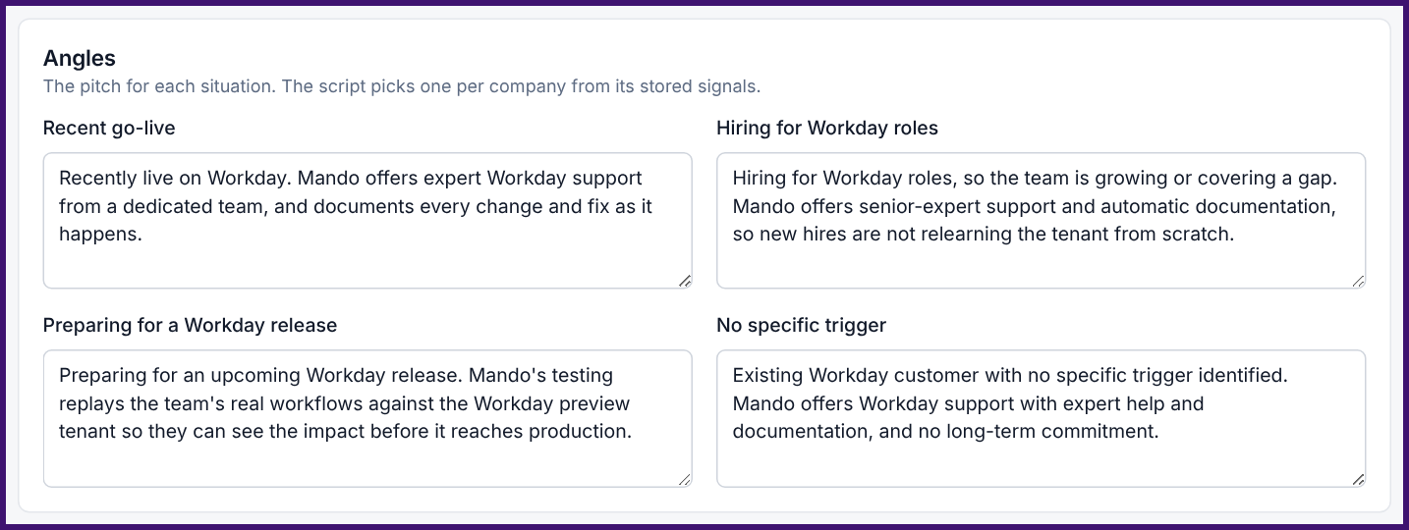
Mando logo
CUBE logo
OUTREACH WORKFLOW
From ranked list to a tailored message in four steps
01
02
Rank
Top-scored Qualified & Maybe companies surface first.
Find Buyers
HR leadership, HR systems & IT contacts with verified email + LinkedIn.
03
04
Draft
AI drafts an email + LinkedIn note using the right angle: go-live, hiring, release or general.
Send & Track
Sending a draft marks the lead Contacted automatically.
Email customization page: the pitch for each situation
Every message is grounded in a public signal, not a generic template.
Notes:
Once a company is ranked, the tool takes it the rest of the way to a message. First, the highest-scoring Qualified and Maybe companies rise to the top. Second, we identify the buyers there, mostly HR leadership, HR systems and IT, and only treat someone as ready once we have a verified email. Third, the tool drafts an email and a LinkedIn note. This is where the Email customization page on the right comes in: we wrote one pitch per situation. If a company just went live on Workday, the message leads with expert support and documentation. If they're hiring Workday roles, it's about new hires not relearning the tenant. If a release is coming, it's about testing. The script picks the angle from the signals we already collected. The same page sets the voice: warm and plain, no hype, one low-pressure ask for a short intro call. Mando can change any of it without touching code. Finally, once a draft is sent, the lead is marked Contacted automatically. So every message is tied to a real reason to reach out, not a generic template.

Slide 2
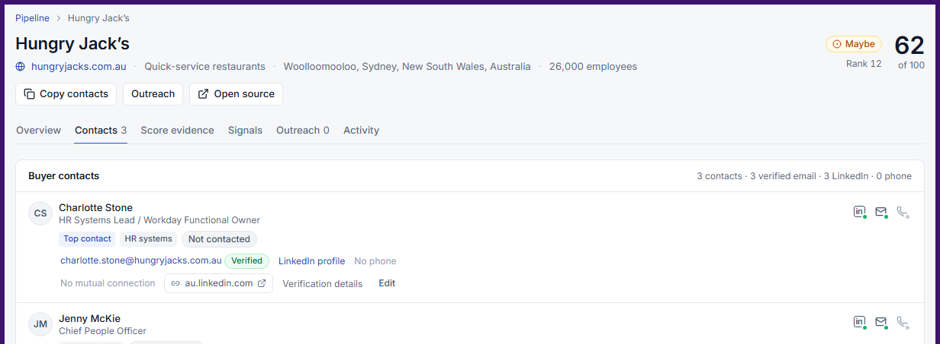
Mando logo
CUBE logo
LEAD STATUS
Every lead has a stage, and every stage has a timestamp
Queued
Contacted
Replied
Demo Booked
default
contacted_at
replied_at
demo_booked_at
Timestamps on each stage let us measure reply rate and time-to-demo.
Queue tabs filter leads by stage: Queued, Contacted, Replied, Demo booked.
Activity tab tracks each company’s rank week over week.
Company record: status shown on every contact
We can see exactly where each lead stalls and follow up.
Notes:
Every lead moves through four stages: Queued, Contacted, Replied and Demo Booked. Each move records a timestamp, so we're not just counting leads, we can see how long it takes to get a reply and how many replies turn into demos. On the company record, every contact shows their own status, so whoever picks up a lead knows instantly whether someone has already reached out. The outreach queue can be filtered by stage, and the Activity tab shows how a company's rank has moved week to week. The point is that we can see exactly where leads stall, whether that's no reply or replies that don't convert, and follow up there.

Slide 3
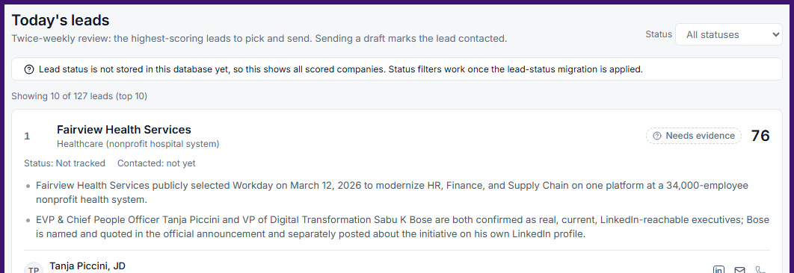
Mando logo
CUBE logo
WHERE WE STAND
Current pipeline vs. the 20 demos / week goal
127
companies scored
146
buyer contacts
21
ready to contact
20 / wk
demo goal (from 2–5)
Turn on status tracking
Apply the lead-status migration so stage counts go live.
01
Send first batch
Reach out to the 21 ready contacts.
02
Today’s leads: twice-weekly top-10 review
Next: report replies and demos booked every week.
Notes:
Here's where the pipeline stands. We've scored and ranked 127 companies and identified 146 buyer contacts. 21 of those are ready to contact today, meaning a verified email at a company that scores high enough. The goal from the start was to take Mando from 2 to 5 qualified demos a week to 20. Today's leads, on the left, is the twice-weekly view the team uses to pick the top 10 and send. Two next steps: first, switch on status tracking in the live database so these stage counts fill in; second, send the first batch to those 21 contacts. From there we'll report replies and demos booked every week. (Confirm the numbers against the live dashboard before presenting.)

