Slide 2

1
2
1
2

Slide 3
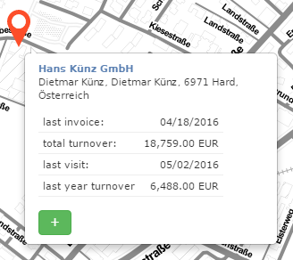
1
2

