Slide 1
Estimation

Slide 2
Estimation
All probability models depend on parameters. E.g., Binomial depends on probability of success π. Normal depends on mean μ, standard deviation σ.
Parameters are properties of the “population” and are typically unknown.
The process of taking a sample of data to make inferences about these parameters is referred to as “estimation”.
There are a number of different estimation methods … we will study two estimation methods: Maximum likelihood (ML) Bayes

Slide 3
Maximum Likelihood
Fisher (1922) invented this general method.
Problem: Unknown model parameters,
Set-up: Write the probability of the data, Y, in terms of the model parameter and the data,
Solution: Choose as your estimate the value of the unknown parameter that makes your data look as likely as possible. Pick that maximizes the probability of the observed data. The estimator is called the maximum likelihood estimator (MLE).

Slide 4
Maximum Likelihood - Example
Data: Y_{i} = 0/1 for i = 1, 2,….n (independent)
Model: ~ Binomial(n,π)
Probability: Let’s fix the number in the sample at n = 20. The resulting model for Z is Binomial with size 20 and success probability π.
The probability distribution function is:
where Z is the variable and π is fixed.
The likelihood function is the same function:
except now π is the variable and Z is fixed.
Notes:
In general, n₁₀|M ~ Bin(M, OR/(OR+1)). So can test Ho: any OR

Slide 5
Maximum Likelihood - Example
Two ways to look at this:
Fix π and look at the probability of different values of Z:
Fix Z and look at the probability under different values of π (this is called the likelihood function):
Z = 3
Z
0 1 2 3 4 5 | 0.122 0.270 0.285 0.190 0.090 0.032
0.01 0.05 0.10 0.20 0.30 0.40 | 0.001 0.060 0.190 0.205 0.072 0.012

Slide 6
Maximum Likelihood - Example
If you observe the data Z = 3 then the likelihood function is shown in the plots below:
P(Z=3) as function of π
log P(Z=3) as function of π

Slide 7
Maximum Likelihood - Example
We can use elementary calculus (an oxymoron?) to find the maximum of the (log) likelihood function:
Not surprisingly, the likelihood in this example is maximized at the observed proportion, 3/20.
Sometimes (e.g. this example) the MLE has a simple closed form. In more complex problems, numerical optimization is used.
Computers can find these maximum values!

Slide 8
Maximum Likelihood - Notation
L(θ) = Likelihood as a function of the unknown parameter, θ.
l(θ) = log(L(θ)), the log-likelihood. Usually more convenient to work with analytically and numerically.
S(θ) = dl(θ)/dθ = the “score”. Set dl(θ)/dθ = 0 and solve for θ to find the MLE.
I(θ) = -d²l(θ)/dθ² = the “information”. If evaluated at the MLE, then -d²l(θ)/dθ² is referred to as the observed information; E(-d²l(θ)/dθ²) is referred to as the expected or Fisher information.
Var(θ) = I⁻¹(θ) (in most cases)

Slide 9
Maximum Likelihood - Example
(note: constant dropped from l(π))

Slide 10
Numerical Optimization
In complex problems it may not be possible to find the MLE analytically; in that case we use numerical optimization to search for the value of θ that maximizes the likelihood
A common problem with maximum likelihood estimation is accidentally finding a local maximum instead of a global one; solution is to try multiple starting values
Likelihood
θ

Slide 11
Comments:
Maximum likelihood estimates (MLEs) are always based on a probability model for the data.
Maximum likelihood is the “best” method of estimation for any situation that you are willing to write down a probability model (so generally does not apply to nonparametric problems).
Maximum likelihood can be used even when there are multiple unknown parameters, in which case θ has several components
The MLE is a “point estimate” (i.e. gives the single most likely value of θ). In lecture 5 we will learn about interval estimates, which describe a range of values which are likely to include the true value of θ. We combine the MLE and Var(θ) to generate these intervals.
The likelihood function lets us compare different models (next).

Slide 12
Model Comparisons
Q: Suppose we have two alternative models for the data; in each case we use maximum likelihood to estimate the parameters. How do we decide which model fits the data “better”?
A: First thought - compare the likelihoods.
Larger likelihood is better, but …
the tradeoff is larger likelihood ⇔ more complex model.
How to choose?
A common approach is to “penalize” the likelihood for more complex models (i.e. more parameters).
The AIC and BIC are two examples of penalized likelihood measures.
The LOD (“log odds”) score can be thought of as a special case (1 parameter) of a penalized likelihood.

Slide 13
Example – LOD scores
Suppose we have a sample of size N gametes in which the number of recombinants (R) and nonrecombinants (N-R) for two loci can be counted. Let θ be the recombination fraction between the two loci. Then the probability of the data can be modeled using the binomial distribution:
The situation of no linkage corresponds to θ = 0.5, so we can express the models as
Model 1: θ = 0.5
Model 2: θ anywhere between 0 and 0.5
Notes:
Model 1 = 0 parameters (to estimate)
Model 2 = 1 parameter

Slide 14
Example – LOD scores
Model 1: The situation of no linkage corresponds to θ = 0.5. If we substitute this into the likelihood equation, we get
This model has 0 (free) parameters.
Model 2: The log-likelihood when θ is unrestricted is
This model has 1 parameter.
Taking the derivative and solving for θ gives
If we substitute this back into the log-likelihood, we get …
Notes:
LOD score is traditionally expressed on the log10 scale

Slide 15
Example – LOD scores
The LOD score is
LOD = (log₁₀ L₂ – log₁₀ L₁)
=
Large values of the LOD score (> 3) are considered evidence of linkage (i.e. the penalty is 3).
(As we will see, this is a pretty big hurdle to overcome.)

Slide 16
Example – LOD scores
E.g. N = 50 and R = 18
= 18/50 = 36%
log₁₀L₁ = -15.0
log₁₀L₂ = -14.2
LOD = -14.2 – (-15.0) = 0.8
⇒ No evidence of linkage; conclude θ = .5

Slide 17
Model Comparisons – AIC, BIC
AIC – Akaike’s Information Criterion
BIC – Bayes Information Criterion
AIC = 2 - 2k
BIC = 2 - klog(n)
k = # parameters
(natural logs now)
Use to compare a series of models. Pick the model with the largest AIC or BIC
Larger model ⇒ larger likelihood (typically)
Therefore, “penalize” the likelihood for each added parameter
AIC tries to find the model that would have the minimum prediction error on a new set of data.
BIC tries to find the model with the highest “posterior probability” given the data
Typically, BIC is more conservative (picks smaller models)

Slide 18
Model Comparisons – AIC, BIC
Example – Recombinants (N=50, R = 18)
log(L1)= -34.66
log(L2) = -32.67
θ = .5 θ arb
AIC -2*34.66 = -69.32 -2*32.67 - 2 = -67.34
BIC -2*34.66 = -69.32 -2*32.67 - log(50) = -69.25
(natural logs now)
AIC ⇒ pick θ = .36
BIC ⇒ pick θ = .36 ( but almost tied)
Notes:
-69.3 -67.34
-69.3 -69.25

Slide 19
Bayes Estimation
Recall Bayes theorem (written in terms of data X and parameter θ):
Notice the change in perspective - θ is now treated as a random variable instead of a fixed number.
P(X|θ) is the likelihood function, as before.
P(θ) is called the prior distribution of θ.
P(θ | X) is called the posterior distribution of θ.
Based on P(θ | X) we can define a number of possible estimators of θ. A commonly used estimate is the maximum a posteriori (MAP) estimate:
We can also use P(θ | X) to define “credible” intervals for θ.
Notes:
Notice that the denominator is just P(X) – constant wrt θ. It serves the purpose of normalizing the distribution of P(θ|X) i.e. making sure it sums/integrates to 1

Slide 20
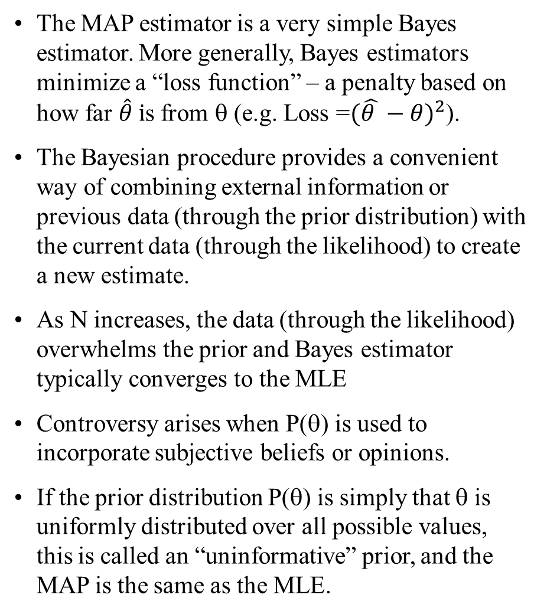
Bayes Estimation
Comments:
The MAP estimator is a very simple Bayes estimator. More generally, Bayes estimators minimize a “loss function” – a penalty based on how far $\hat{θ} i$s from θ (e.g. Loss =${(\hat{θ }−θ)}^{2}$).
The Bayesian procedure provides a convenient way of combining external information or previous data (through the prior distribution) with the current data (through the likelihood) to create a new estimate.
As N increases, the data (through the likelihood) overwhelms the prior and Bayes estimator typically converges to the MLE
Controversy arises when P(θ) is used to incorporate subjective beliefs or opinions.
If the prior distribution P(θ) is simply that θ is uniformly distributed over all possible values, this is called an “uninformative” prior, and the MAP is the same as the MLE.

Slide 21
Bayes Estimation
Example
Suppose a man is known to have transmitted allele A1 to his child at a locus that has only two alleles: A1 and A2. What is his most likely genotype?
Soln. Let X represent the paternal allele in the child and let θ represent the man’s genotype:
X = A1
θ = {A1A1, A1A2, A2A2}
We can write the likelihood function as:
P(X | θ = A1A1) = 1
P(X | θ = A1A2) = .5
P(X | θ = A2A2) = 0
Therefore, the MLE is θ = A1A1.
Notes:
Note that the MLE would be the same regardless of the frequency of the A1 allele in the population.

Slide 22
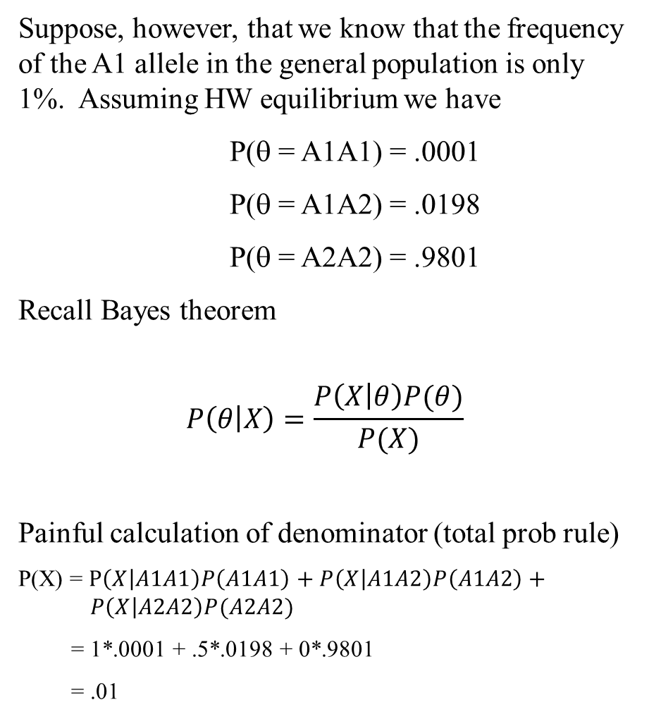
Bayes Estimation
Suppose, however, that we know that the frequency of the A1 allele in the general population is only 1%. Assuming HW equilibrium we have
P(θ = A1A1) = .0001
P(θ = A1A2) = .0198
P(θ = A2A2) = .9801
Recall Bayes theorem
$$P\left(θ | X\right)=\frac{P\left(X | θ\right)P(θ)}{P(X)}$$
Painful calculation of denominator (total prob rule)
P(X) = $P\left(X | A1A1\right)P\left(A1A1\right)+P\left(X | A1A2\right)P\left(A1A2\right)+ P\left(X | A2A2\right)P(A2A2)$
= 1*.0001 + .5*.0198 + 0*.9801
= .01
Notes:
Note: I found the denominator – 0.01 – by just summing .0001 and .0099 and 0.

Slide 23
Bayes Estimation
This leads to the “posterior distribution” ….
P(θ = A1A1 | X) = P(X | θ = A1A1) P(θ = A1A1) / P(X) = 1 * .0001 / .01 = .01
P(θ = A1A2 | X) = P(X | θ = A1A2) P(θ = A1A2) / P(X) = .5 * .0198 / .01 = .99
P(θ = A2A2 | X) = P(X | θ = A2A2) P(θ = A2A2) / P(X)
= 0 * .9801 / .01 = 0
So the Bayesian MAP estimator is θ = A1A2.
Exercise: redo assuming the man has 2 children who both have the A1 paternal allele.
Notes:
Note: I found the denominator – 0.01 – by just summing .0001 and .0099 and 0.

Slide 24
Summary
Maximum likelihood is a method of estimating parameters from data
ML requires you to write a probability model for the data
MLE’s may be found analytically or numerically
(Inverse of the negative of the) second derivative of the log-likelihood gives variance of estimates
Comparison of log-likelihoods allows us to choose between alternative models
Bayesian procedures allow us to incorporate additional information about the parameters in the form of prior data, external information or personal beliefs.

Slide 25
Problem 1
Suppose we are interested in estimating the recombination fraction, θ, from the following experiment. We do a series of crosses: AB/ab x AB/ab and measure the frequency of the various phases in the gametes (assume we can do this). If the recombination fraction is θ then we expect the following probabilities (sorry, I can’t explain these…):
phase probability (*4)
AB 3 - 2θ + θ²
Ab 2θ - θ²
aB 2θ - θ²
ab 1 - 2θ + θ²
Suppose we observe (AB,Ab,aB,aa) = (125,18,20,34). Use maximum likelihood to estimate θ.

Slide 26
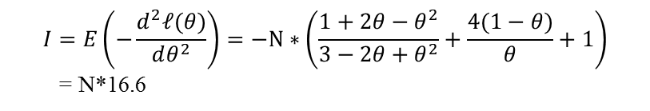
Solution to problem 1
Pr(data | θ) ∝ (3-2θ+θ²)^{AB} (2θ - θ²)^{Ab} (2θ - θ²)^{aB} (1-2θ+θ²)^{ab}
l(θ) = AB log(3-2θ+θ²) + (Ab+aB) log (2θ - θ²) + ab log(1-2θ+θ²)
Numerical solution gives θ = .21
$$I=E\left(−\frac{d^{2}ℓ(θ)}{dθ^{2}}\right)=−N∗\left(\frac{1+2θ−θ^{2}}{3−2θ+θ^{2}}+\frac{4(1−θ)}{θ}+1\right)$$
= N*16.6
Var(θ) = 1/213.6 = .00468

Slide 27
Problem 2
Every human being can be classified into one of four blood groups: O, A, B, AB. Inheritance of these blood groups is controlled by 1 gene with 3 alleles: O, A and B where O is recessive to A and B. Suppose the frequency of these alleles is r, p, and q, respectively (p+q+r=1). If we observe (O,A,B,AB) = (176,182,60,17) use maximum likelihood to estimate r, p and q.

Slide 28
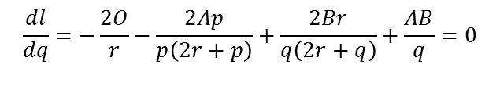
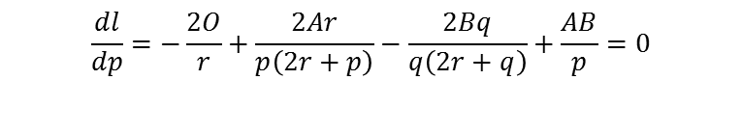
Solution to problem 2
First, we use basic genetics to find the probability of the observed phenotypes in terms of the unknown parameters. Assuming random mating, we have:
Genotype prob. Phenotype prob.
OO r² O r²
AA p²
AO 2pr A p² + 2pr
BB q²
BO 2qr B q² + 2qr
AB 2pq AB 2pq
Pr(data | θ) ∝ (r²)^{O} (p²+2pr)^{A} (q²+2qr)^{B} (2pq)^{AB}
l(p,q,r) = 2Olog(r) + Alog(p²+2pr) + Blog(q²+2qr) + ABlog(p) + ABlog(q)
To estimate p, q and r, we need to maximize l(p,q,r) subject to the constraint p+q+r=1. This constraint makes the problem a bit harder …. one approach is to just put r = 1-p-q in the likelihood so we have just 2 parameters … p and q. Then
$$\frac{dl}{dp}=−\frac{2O}{r}+\frac{2Ar}{p\left(2r+p\right)}−\frac{2Bq}{q\left(2r+q\right)}+\frac{AB}{p}=0$$
$$\frac{dl}{dq}=−\frac{2O}{r}−\frac{2Ap}{p\left(2r+p\right)}+\frac{2Br}{q\left(2r+q\right)}+\frac{AB}{q}=0$$
For (O,A,B,AB) = (176,182,60,17), this gives
p = .264 q = .093 r = .642
Further analysis would take 2nd derivatives to find the information and, therefore, the variances of the estimates.

Slide 29
Problem 3
Suppose we have the following simple pedigree.
1
2
3
4
5
6
Define the phenotype of person i as H_{i} and the genotype as G_{iH} How can we use maximum likelihood to estimate parameters of the penetrance function, Pr(H | G; θ)?

Slide 30
Solution to problem 3
If we knew all the genotypes the problem would be “easy”. We would simply write down the log-likelihood and maximize it numerically or analytically:
If we don’t know the genotypes (only data are the phenotypes), then we must maximize
where H represents the collection of all 6 phenotypes. The general idea is to use the total probability rule to write
Further simplification is achieved by writing
Since the genotype of each individual is determined only by his/her parents
Given the inheritance probabilities (Pr(G_{i}| G_{j},G_{k})) and population frequencies of the genotypes (Pr(G_{i})), we have a fully specified model and can maximize the likelihood using a computer.

Slide 31
Problem 4
Suppose we wish to estimate the recombination fraction for a particular locus. We observe N = 50 and R = 18. Several previously published studies of the recombination fraction in nearby loci (that we believe should have similar recombination fractions) have shown recombination fractions between .22 and .44. We decide to model this prior information as a beta distribution (see http://en.wikipedia.org/wiki/Beta_distribution) with parameters a = 19 and b = 40:
Find the MLE and Bayesian MAP estimators of the recombination fraction. Also find a 95% confidence interval (for the MLE) and a 95% credible interval (for the MAP)

Slide 32
Solution to problem 4
The data follow a binomial distribution with N = 50, R = 18 and the prior information is captured by a beta distribution with parameters a = 19, b = 40:
Working through Bayes theorem, we find …
which is another beta distribution with parameters (a+R) and (N-R+b). The mode of the beta distribution with parameters α and β is (α-1)/(α+β-2) so
Also, we can find the 2.5th and 97.5th percentiles of the posterior distribution (95% credible interval): [.23 - .40]
For comparison the MLE is 18/50 = 0.36 with a 95% confidence interval of [.23 - .49]

