Slide 1
Permutation and Exact Tests
&
False Detection Rate

Slide 2
Exact and Permutation Tests
Computer-intensive methods for hypothesis testing
Permutation Test (randomization test): Used when distribution of the test statistic (under the null hypothesis) is unknown
Exact Test: Used when sample sizes are small, so standard asymptotic (large sample) procedures do not work well
Exact test maintains the Type I error level without any large sample approximations/assumptions

Slide 3
Example - HPV vaccine trial
200 uninfected women are randomly assigned 1:1 to HPV vaccine or placebo (i.e., 100 to each group)
After 1 year subjects are tested for HPV infection (yes/no)
Does the probability of infection differ between the two groups?
What is a useful model for these data?

Slide 4
Example - HPV vaccine trial
Vaccine group: Binomial(100, p_{V})
Placebo group: Binomial(100, p_{P})
Scientific Question:
Is the risk of infection the same or different in the two groups?
Restate in terms of the model:
H₀: p_{v} = p_{p} ("null hypothesis")
vs. H_{a}: p_{v} < p_{p}

Slide 5
Example - HPV vaccine trial
Results:
Vaccine Placebo Total
HPV+ 20 40 60
HPV- 80 60 140
100 100 200
The overall infection rate is 30%, but we observe 20% and 40% for vaccine and placebo, respectively. What if we repeated the experiment … would we see similar results? We know that sample results are variable. Could the difference go the other way? Could a difference this large be due to chance alone?

Slide 6
Example - HPV vaccine trial
We first need a way of summarizing the difference in the infection probabilities between vaccine and placebo groups. A useful summary has these features:
Summarize the differences between the groups in a single number.
Example ⇒ p_{v} - p_{p}
One particular value (say, 0) of the summary corresponds to the null hypothesis being exactly true.
Example ⇒ p_{v} – p_{p} = 0
We expect values near 0 if the null hypothesis is true; we expect values far from 0 if the null hypothesis is false.
But how near is near? How far is far?

Slide 7
Example - HPV vaccine trial
We need to figure out what sort of distribution of values we would see for our summary statistic if the experiment were repeated many times and the null hypothesis were true.
Imagine the following experiment:
• make up a deck of 200 cards
• mark the word “HPV+" on 60 of them
• shuffle and deal two groups of 100
• form a 2 x 2 table from the results
• calculate your summary statistic
• repeat many times
• plot the results
This experiment should give us an idea of what we expect to see if the null hypothesis is true.

Slide 8
Example - HPV vaccine trial
Here is the distribution of differences p_{v} – p_{p} that we might expect to see if the null hypothesis is true:
Summarize the results by reporting what proportion of the simulated results are as “extreme” or more so than the observed result (p value).
only 3/2000 simulated differences were more extreme than the observed difference of -0.2
p = .0015

Slide 9
Example - HPV vaccine trial
Summary:
We have constructed a valid test of the hypothesis, H₀: p_{V} = p_{P}, using a randomization test. There are four steps involved:
1. Pick a model for the data and restate the scientific question in terms of the model (null hypothesis)
2. Choose (any) reasonable summary statistic that quantifies deviations from the null hypothesis
3. Resample data assuming the null hypothesis is true and compute the summary statistic for each resampled data set.
4. Compare the observed value of the summary statistic to the null distribution generated in Step 3.

Slide 10
Permutation Test for Correlation
Assume data are pairs (X_{1i},X_{2i}), i = 1,2,…,n
Ho: ρ = 0
Compute r_{obs} = corr (X₁,X₂)
Mix up the X_{1i} and X_{2i} ; i.e., for each X_{1i} randomly choose X_{2i}′ from all the X₂’s. Compute r_{perm} = corr(X₁,X₂′)
Repeat Step 3 many times and compare r_{obs} to the distribution of r_{perm}
Note: There are n! possible pairings. If n is small, you can enumerate all possible pairings.

Slide 11
Permutation Tests - Summary
Useful when we can do resampling under the null hypothesis
Permutation samples are drawn without replacement
If the sample size is small, you can enumerate all possible permutations, otherwise generate many permutations.
Fewer assumptions than e.g. t-test (i.e., no assumption about skewness or normality of underlying distribution)
Many standard nonparametric methods (e.g., Wilcoxon Rank Sum Test) are permutation tests based on ranks.
Good Reference: Manly (2007). Randomization, Bootstrap and Monte Carlo Methods in Biology. Chapman & Hall/CRC.

Slide 12
Fisher’s Exact Test
Motivation: When a 2 × 2 table contains cells that have fewer than 5 expected observations, the χ² approximation to the distribution of X² is known to be poor. This can lead to incorrect inference since the p-values based on this approximation are not valid.
Solution: Use Fisher’s Exact Test

Slide 13
Fisher’s Exact Test
Example: A retrospective study is done among men aged 50-54 who died over a 1-month period. The investigators tried to include equal numbers of men who died from cardiovascular disease (CVD) and those that did not. Then, asking a close relative, the dietary habits were ascertained.
A calculation of the odds ratio yields:

Slide 14
Fisher’s Exact Test
If we fix all of the margins then any one cell of the table will allow the remaining cells to be filled. Note that a must be greater than 0, less than both n₁ and m₁, and an integer. Thus there are only a relatively few number of possible table configurations if either n₁or m₁ is small (with n₁, n₂, m₁, m₂ fixed).
Under the null hypothesis,
H₀ : OR = 1
we can use the hypergeometric distribution (a probability distribution for discrete rv’s) to compute the probability of any given configuration. Since we have the distribution of a statistic (a) under the null, we can use this to compute p-values. You will never do this by hand ….

Slide 15
Fisher’s Exact Test
Example: (Rosner, p. 370) Cardiovascular disease.
Possible Tables:

Slide 17
Fisher Exact Test Using Stata
Fisher’s exact test.
. cci 5 30 2 23,exact
Proportion
| Exposed Unexposed | Total Exposed
-----------------+------------------------+----------------------
Cases | 5 30 | 35 0.1429
Controls | 2 23 | 25 0.0800
-----------------+------------------------+----------------------
Total | 7 53 | 60 0.1167
| |
| Point estimate | [95% Conf. Interval]
|------------------------+----------------------
Odds ratio | 1.916667 | .2789585 21.62382 (exact)
Attr. frac. ex. | .4782609 | -2.584763 .9537547 (exact)
Attr. frac. pop | .068323 |
+-----------------------------------------------
1-sided Fisher's exact P = 0.3747
2-sided Fisher's exact P = 0.6882
Notes:
Note that two-sided test is not simply double the one sided test because distribution is not symmetric

Slide 18
Fisher Exact Test Using Stata
The usual chi-squared test, for comparison.
. cci 5 30 2 23
Proportion
| Exposed Unexposed | Total Exposed
-----------------+------------------------+----------------
Cases | 5 30 | 35 0.1429
Controls | 2 23 | 25 0.0800
-----------------+------------------------+----------------
Total | 7 53 | 60 0.1167
| |
| Point estimate | [95% Conf. Interval]
|------------------------+----------------
Odds ratio | 1.916667 | .2789585 21.62382 (exact)
Attr. frac. ex. | .4782609 | -2.584763 .9537547 (exact)
Attr. frac. pop | .068323 |
+-----------------------------------------------
chi2(1) = 0.56 Pr>chi2 = 0.4546

Slide 19
False Discovery Rate
For some studies, answering the scientific question of interest may require testing hundred, thousands, or millions of hypotheses. This is especially true of genetics.
E.g. Hedenfalk et al (2001) screened 3226 genes using microarrays to find differential expression between BRCA-1 and BRCA-2 mutation positive tumors.
Issue: If a traditional hypothesis testing approach is taken and we conduct 3226 tests at the 0.05 level, then we expect (up to) 161 false positive findings. Unfortunately, they are not labeled as such!
Traditional Solution (Bonferroni correction): If we conduct each test at an α = .05/3226 = .000015 level then the probability of 1 or more false positive findings will be ~0.05. But, … with such a stringent α level we are likely to miss many true positive results.
New Solution: Don’t try to eliminate false positives … control them

Slide 20
False Discovery Rate
 | Reject null | Fail to reject
Null true | F | m₀-F | m₀
Alternative true | T | m₁-T | m₁
 | S | m-S | m
false positive rate = F/ m₀
false discovery rate = F/S
Idea: Control the false discovery rate (q-value) instead of the false positive rate (p-value)

Slide 21
False Discovery Rate
E.g. Hedenfalk data
Order the 3170 p-values (56 genes were excluded from this analysis): p_{i} , i = 1 … 3170
Pick a p-value cutoff, say α; reject H_{o} for all p_{i} < α.
F will be equal to α*m₀
Q: What is the FDR associated with this choice of α?
FDR = F/S
S = #{p_{i} < α}
F = α * m₀
FDR = q-value = α * m₀ / #{p_{i} < α}
I know S, I know α, what is m₀?

Slide 22
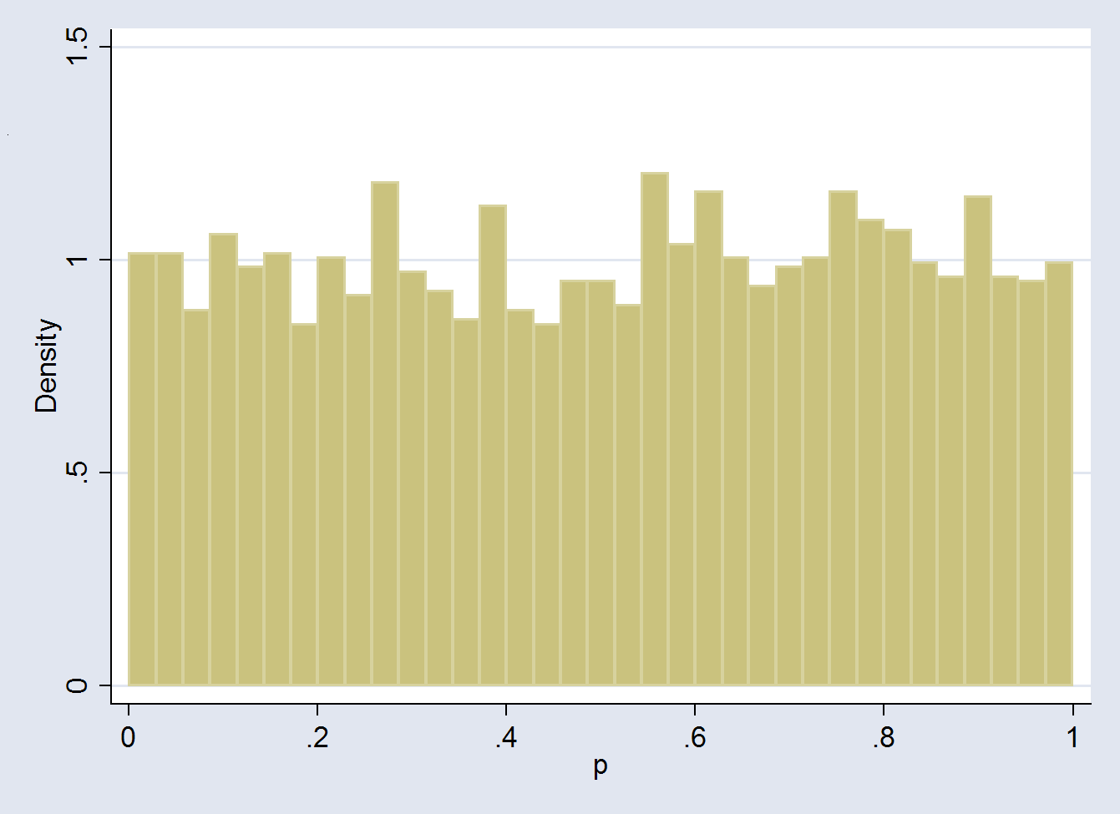
False Discovery Rate
Distribution of 3170 p-values when all null hypotheses are true
Distribution of 3170 p-values from Hedenfalk et al. Height of the line gives estimated proportion of true null hyptheses.
.676
m₀ = 3170*.676 = 2142
Notes:
m0 = 3170*.676 (approx) = 2142

Slide 23
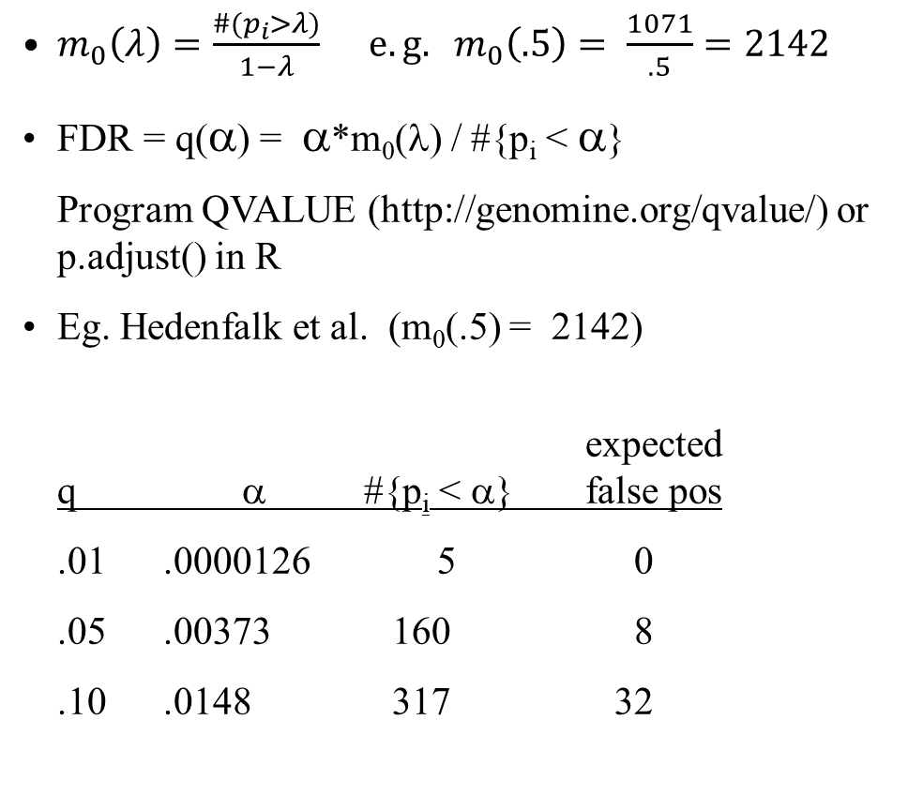
False Discovery Rate
$m_{0}\left(λ\right)=\frac{\#(p_{i}>λ)}{1−λ} e.g. m_{0}\left(.5\right)= \frac{1071}{.5}=2142$
FDR = q(α) = α*m₀(λ) / #{p_{i} < α}
Program QVALUE (http://genomine.org/qvalue/) or p.adjust() in R
Eg. Hedenfalk et al. (m₀(.5) = 2142)
expected
q α #{p_{i} < α} false pos
.01 .0000126 5 0
.05 .00373 160 8
.10 .0148 317 32
No. differentially expressed
Using traditional methods Hedenfalk et al. concluded 9-11 genes were differentially expressed.
Notes:
M0 est is 2142

