Slide 1
Hypothesis Testing

Slide 2
Hypothesis Testing
Motivation
1. Is the chance of getting a cold different when subjects take vitamin C than when they take placebo? (Pauling 1971 data).
2. Suppose that 6 out of 15 students in a grade-school class develop influenza, whereas 20% of grade-school children nationwide develop influenza. Is there evidence of an excessive number of cases in the class?

Slide 3
Hypothesis Testing
Motivation
3. In a study of 25 hypertensive people we find a mean serum-cholesterol level of 220 mg/ml. In the population the mean serum cholesterol is 211 mg/ml with standard deviation of 46 mg/ml.
Is the data consistent with that model?
What if = 230 mg/ml?
What if = 250 mg/ml?
What if the sample was of n=100 instead of 25?

Slide 4
Hypothesis Testing
Define:
μ = population mean serum cholesterol for male hypertensives
Hypothesis:
1. Null Hypothesis: Generally, the hypothesis that the unknown parameter equals a fixed value.
H₀: μ = 211 mg/ml
2. Alternative Hypothesis: contradicts the null hypothesis.
H_{A}: μ ≠ 211 mg/ml

Slide 5
Hypothesis Testing
Decision / Action:
We assume that either H₀ or H_{A} is true. Based on the data we will choose one of these hypotheses.
α = “size”
1 - β = “power”

Slide 6
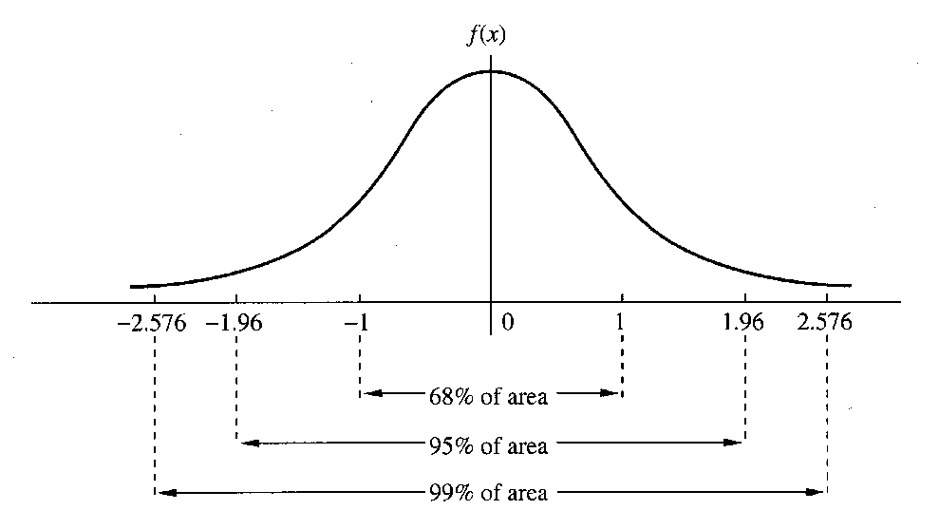
Hypothesis Testing
Let’s fix α, for example, α = 0.05.
0.05 = α = P[ choose H_{A} | H₀ true ]
α = P[ reject H₀ | H₀ true ]
Q: How to construct a procedure that makes this error with only 0.05 probability?
A: Suppose we assume H₀ is true and suppose that, using that assumption, the data should give us a standard normal, Z.
If μ = 0 then |Z| is rarely “large”. A “large” |Z| would make me question whether μ = 0 .

Slide 7
Hypothesis Testing
Therefore, we reject H₀ if |Z| > 1.96.
α = P[reject H₀ | H₀ true] = 0.05
Then if we do find a large value of |Z| we can claim that:
Either H₀ is true and something unusual happened (with probability α)…
or, H₀ is not true.
Given α and H₀ we can construct a test of H₀ with a specified significance level. But remember, we start by assuming that H₀ is true - we haven’t proved it is true. Therefore, we usually say
|Z| > 1.96 then we reject H₀.
|Z| < 1.96 then we fail to reject H₀.

Slide 8
Hypothesis Testing
Cholesterol Example:
Let μ be the mean serum cholesterol level for male hypertensives. We observe
= 220 mg/ml
Also, we are told that for the general population...
μ₀ = mean serum cholesterol level for males = 211 mg/ml
σ = std. dev. of serum cholesterol for males = 46 mg/ml
NULL HYPOTHESIS: mean for male hypertensives is the same as the general male population.
ALTERNATIVE HYPOTHESIS: mean for male hypertensives is different than the mean for the general male population.
H₀ : μ = μ₀ = 211 mg/ml
H_{A} : μ ≠ μ₀ (μ ≠ 211 mg/ml)

Slide 9
Hypothesis Testing
Cholesterol Example:
Test H₀ with significance level α.
Under H₀ we know:
Therefore,
Reject H₀ if > 1.96 gives an α = 0.05 test.
Reject H₀ if

Slide 10
Hypothesis Testing
Cholesterol Example:
TEST: Reject H₀ if
In terms of Z ...
Reject H₀ if Z<-1.96 or Z> 1.96

Slide 12
Hypothesis Testing
p-value:
smallest possible α for which the observed sample would still reject H₀.
probability of obtaining a result as extreme or more extreme than the actual sample (give H₀ true).

Slide 13
Hypothesis Testing
p-value: Cholesterol Example
= 220 mg/ml n = 25 σ = 46 mg/ml
H₀ : μ = 211 mg/ml
H_{A} : μ ≠ 211 mg/ml
p-value is given by:
2 * P[ > 220] = .33

Slide 14
Determination of Statistical Significance for Results from Hypothesis Tests
Either of the following methods can be used to establish whether results from hypothesis tests are statistically significant:
(1) The test statistic Z can be computed and compared with the critical value at an α level of .05. Specifically, if H₀: μ = μ₀ versus H₁: μ ≠ μ₀ are being tested and |Z| > 1.96, then H₀ is rejected and the results are declared statistically significant (i.e., p < .05). Otherwise, H₀ is accepted and the results are declared not statistically significant (i.e., p ≥ .05). We refer to this approach as the critical-value method.
(2) The exact p-value can be computed, and if p < .05, then H₀ is rejected and the results are declared statistically significant . Otherwise, if p ≥ .05 then H₀ is accepted and the results are declared not statistically significant . We will refer to this approach as the p-value method .

Slide 15
Guidelines for Judging the Significance of p-value
If .05 < p < .10, than the results are marginally significant.
If .01 < p < .05, then the results are significant.
If .001 < p < .01, then the results are highly significant.
If p < .001, then the results are very highly significant.
If p > .1, then the results are considered not statistically significant (sometimes denoted by NS).
Significance is not everything!

Slide 16
Hypothesis Testing and Confidence Intervals
Hypothesis Test: Fail to reject H₀ if
Confidence Interval: Plausible values for μ are given by

Slide 17
Hypothesis Testing
“how many sides?”
Depending on the alternative hypothesis a test may have a one-sided alternative or a two-sided alternative. Consider
H₀ : μ = μ₀
We can envision (at least) three possible alternatives
H_{A} : μ ≠ μ₀ (1)
H_{A} : μ < μ₀ (2)
H_{A} : μ > μ₀ (3)
(1) is an example of a “two-sided alternative”
(2) and (3) are examples of “one-sided alternatives”
The distinction impacts
Rejection regions
p-value calculation

Slide 18
Hypothesis Testing
“how many sides?”
Cholesterol Example: Instead of the two-sided alternative considered earlier we may have only been interested in the alternative that hypertensives had a higher serum cholesterol.
H₀ : μ = 211
H_{A} : μ > 211
Given this, an α = 0.05 test would reject when
We put all the probability on “one-side”.
The p-value would be half of the previous,
p-value = P[ > 220]
= .163
When do one vs two sided? If a small or large value would change the direction of your research?

Slide 20
Hypothesis Testing
Through this worked example we have seen the basic components to the statistical test of a scientific hypothesis.
Summary
1. Identify H₀ and H_{A}
2. Identify a test statistic
3. Determine a significance level, α = 0.05, α = 0.01
4. Critical value determines rejection / acceptance region
5. p-value
6. Interpret the result
Other things to note
General idea (compare p-value of test statistic to cutoff) is same for all hypothesis tests
- The test stat and distribution changes for different tests (regression parameters, proportions, etc.)
- Bayesians take a different approach to hypothesis testing

