Slide 1
Sampling Distributions

Slide 2
The most important distinction in statistics
sample
vs
population
When analysing data (or reading the literature), think about whether you want to discuss the sample that you observed or want to make statements that are more generally true
Statistics is the only field that gives us the correct framework to generalise from our sample to the population

Slide 3
The most important distinction in statistics
Example: T cell counts from 40 women with triple negative breast cancer were observed. What can we do with this information?
Option 1: Discuss the 40 women. What was the mean T cell count? What was its variation?
Option 2: Generalise the information about the 40 women to make statements about all women with triple negative breast cancer
These are 2 different approaches to using the same information

Slide 4
Language for making these distinctions
Population
Size N (usually ∞)
Mean = μ
Variance =
Sample
Size n
Sample Mean =
Sample variance =

Slide 5
Generalising the sample to the population
Issue: We can calculate the sample mean and sample variance from our data, but the true mean and true variance are generally unknown
Fortunately, statisticians have learnt some things about how to recover* the true mean and true variance based only on sample means and sample variances
* with high probability

Slide 6
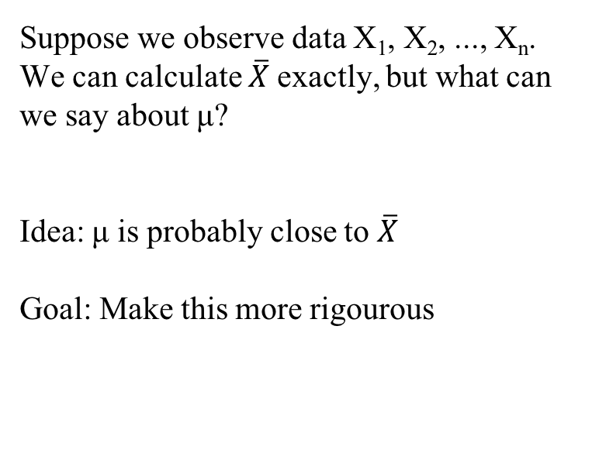
How do sample means behave?
Suppose we observe data X₁, X₂, ..., X_{n}.
We can calculate $\overline{X}$exactly, but what can we say about μ?
Idea: μ is probably close to $\overline{X}$
Goal: Make this more rigourous

Slide 7
Sums of Normal Random Variables
In general, neither the sum nor mean of the data will have the same distribution as the data
Example:
X₁, X₂, X₃ follow F-distributions.
X₁+ X₂+ X₃ does not follow an F-distribution
(X₁+ X₂+ X₃)/3 does not follow an F-distribution
Exception to the rule:
If X₁, X₂, ..., X_{n} are independent and normally distributed with means μ_{i} and σ_{i}²,
X₁+…+X_{n}
follows a normal distribution with mean
μ₁+…+ μ_{n}
and variance
σ₁² +…+ σ_{n}²

Slide 8
Central limit theorem
What can we do instead? Use the central limit theorem!
Central limit theorem:
If X₁, X₂, ..., X_{n} are independent and have the same distribution, and the variance of that distribution is σ², then if n is large,
approximately and under relatively weak conditions.
In general, this applies for n ≥ 30.
As n increases, the normal approximation improves.

Slide 9
Distribution of the Sample Mean
Population of X’s (mean = μ)
sample of size n
sample of size n
sample of size n
sample of size n
sample of size n
μ

Slide 10
Central Limit Theorem - Illustration
Population

Slide 12
Central limit theorem
The central limit theorem allows us to use the sample (X₁…X_{n}) to discuss the population (μ)
We do not need to know the distribution of the data to make statements about the true mean of the population!

Slide 13
Distribution of the Sample Mean
EXAMPLE:
Suppose that for Seattle sixth grade students the mean number of missed school days is 5.4 days with a standard deviation of 2.8 days. What is the probability that a random sample of size 49 (say Ridgecrest’s 6th graders) will have a mean number of missed days greater than 6 days?

Slide 14
Find the probability that a random sample of size 49 from this population will have a mean greater than 6 days.
μ = 5.4 days
σ = 2.8 days
n = 49

Slide 15
Quiz
What is the probability that a random sample (size 49) from this population has a mean between 4 and 6 days?
Recall: μ = 5.4 days, σ = 2.8 days, n = 49

Slide 16
Quiz Solution

Slide 17
Confidence Intervals

Slide 18
Confidence Intervals
Confidence intervals are not just intervals!
“(L, U) is a 100p% confidence interval for a parameter θ”
means that
“For any possible correct value parameter θ, the interval (L, U) contains θ with probability at least p.”
Since we don't know θ, we need to find a way to determine L and U from our data.
Note: Confidence intervals only concern parameters. Prediction intervals (different!) are intervals about random variables.

Slide 19
Confidence Intervals for the mean
Because
we know that
Rearranging gives us that
is a 95% confidence interval for the true mean μ

Slide 20
Confidence Intervals
σ known
If we desire a (1 - α) confidence interval we can derive it based on the statement
That is, we find constants and that have exactly (1 - α) probability between them.
A (1 - α) Confidence Interval for the Population Mean

Slide 21
Confidence Intervals
σ known - EXAMPLE
Suppose gestational times are normally distributed with a standard deviation of 6 days. A sample of 30 second time mothers yield a mean pregnancy length of 279.5 days. Construct a 90% confidence interval for the mean length of second pregnancies based on this sample.

Slide 22
Confidence Intervals
σ² unknown
t Distribution
When σ is unknown we replace it with the estimate, s, and use the t-distribution. The statistic
has a t-distribution with n-1 degrees of freedom.
We can use this distribution to obtain a confidence interval for μ even when σ is not known.
A (1-α) Confidence Interval for the Population Mean when σ is unknown

Slide 23
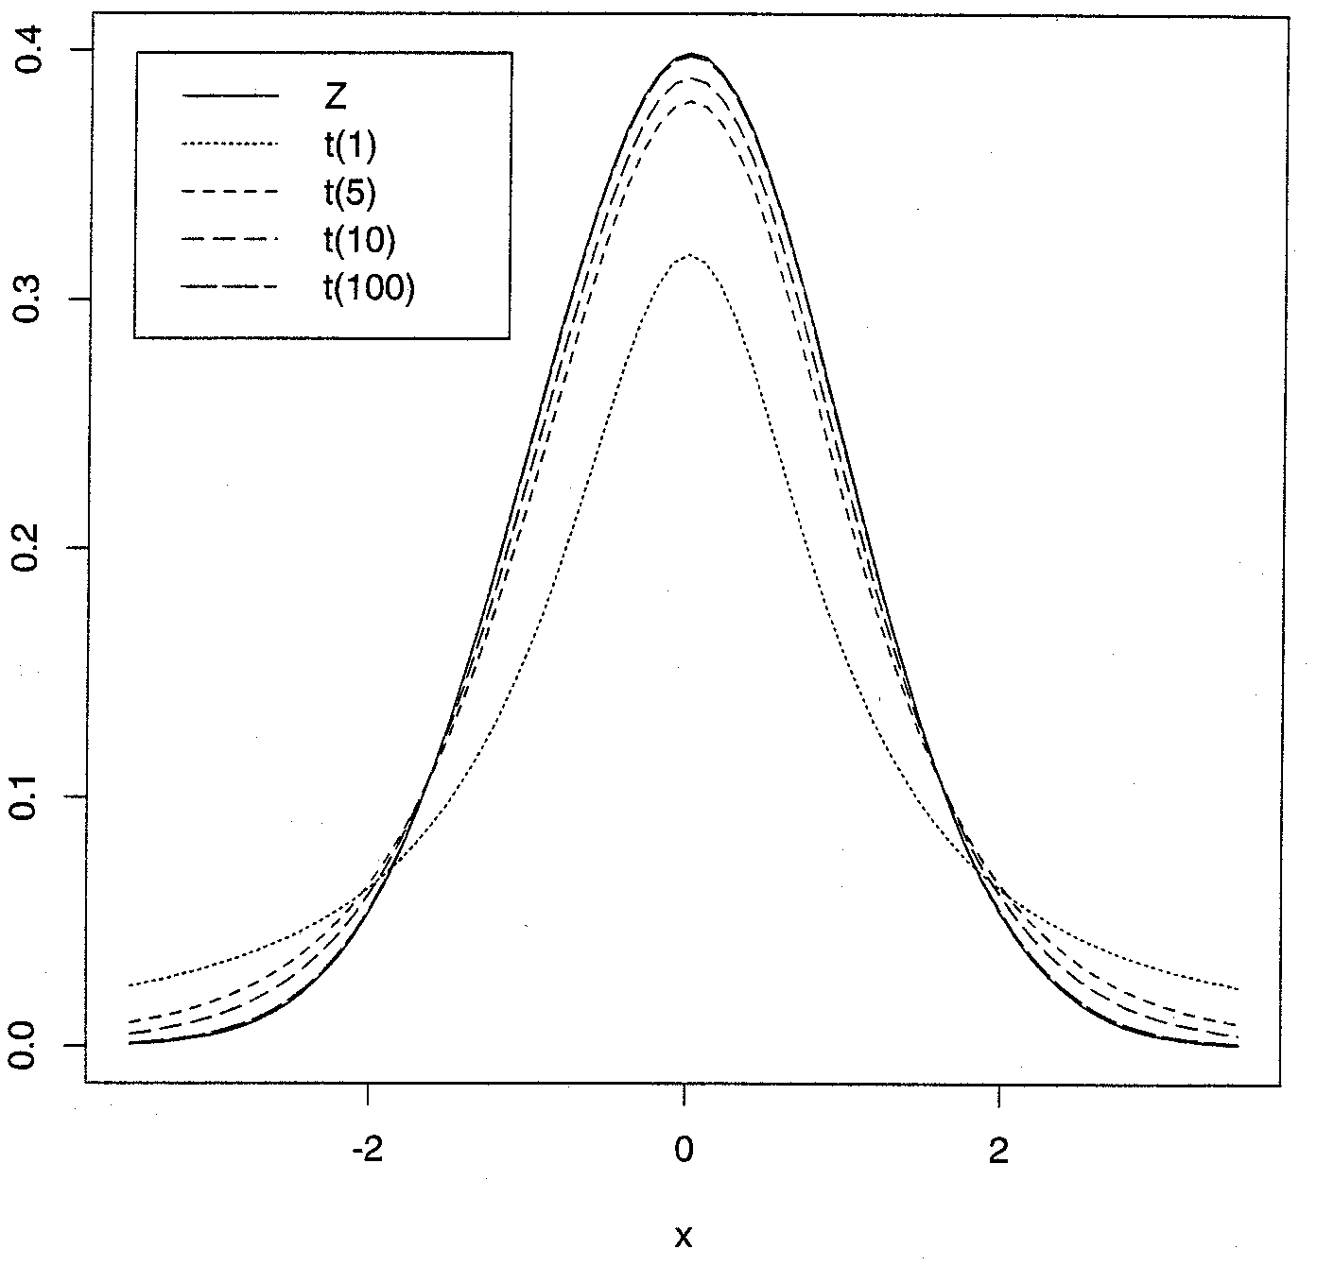
Normal and t distributions

Slide 24
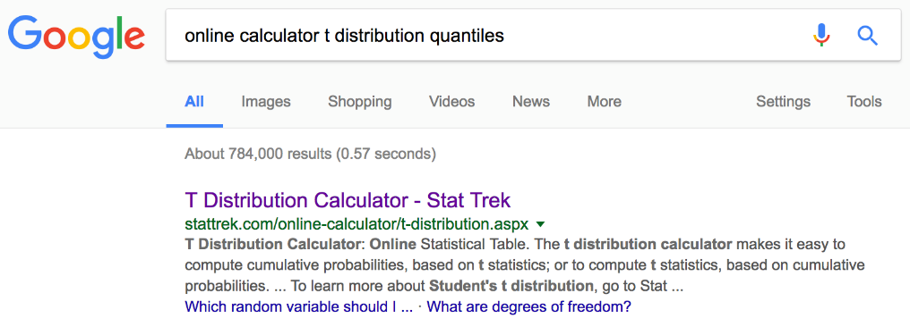
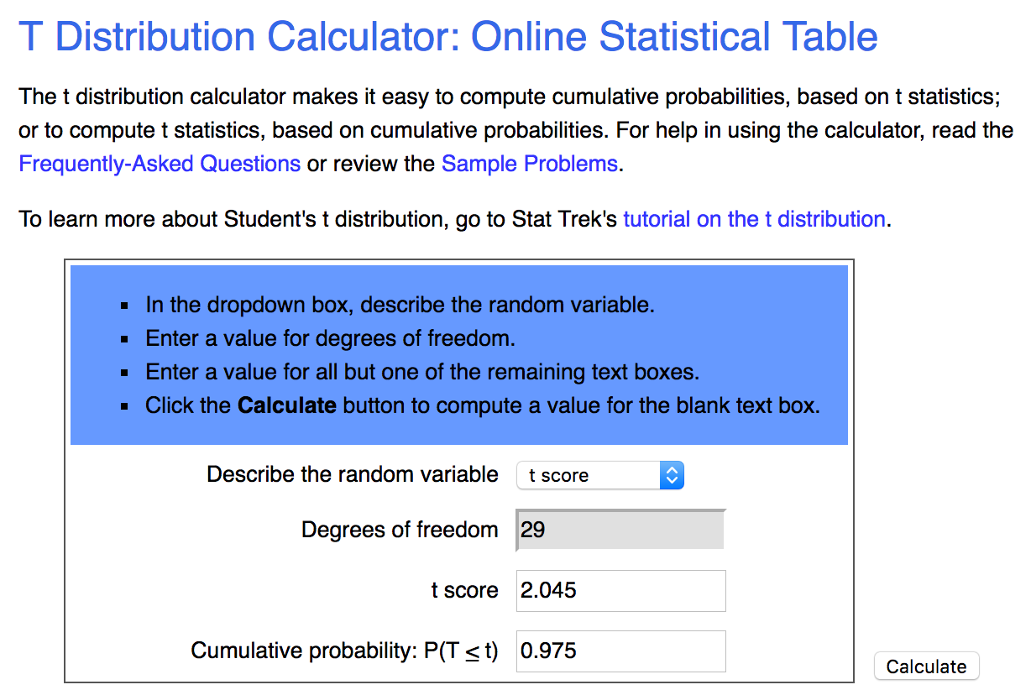
Confidence Intervals - σ² unknown
t Distribution - EXAMPLE
Given our 30 moms with a mean gestation of 279.5 days and a variance of 28.3 days², we can now compute a 95% confidence interval for the mean length of pregnancies for second time mothers:

Slide 25
Confidence Intervals -
sample variance
Q: Can we derive a confidence interval for the sample variance?
A: Yes. We’ll need the Chi-square distribution
Definition: The sum of squared independent standard normal random is a random variable with a Chi-square distribution with n degrees of freedom.
Let Z_{i} be standard normals, N(0,1). Let
X has a χ²(n) distribution

Slide 26
Chi-square Distribution
Properties of χ² (n): Let X ~ χ²(n).
1. X ≥ 0
2. E[X] = n
3. V[X] = 2n
4. n, the parameter of the distribution is called the degrees of freedom.

Slide 27
Chi-square Distribution
Sample Variance
The Chi-square distribution describes the distribution of the sample variance. Recall
and
Now the right side almost looks like
which would be χ²(n).
Since μ is estimated by one degree of freedom is lost leading to …
with n-1 degrees of freedom

Slide 28
Chi-square Distribution
Confidence Interval for σ²
We can use the Chi-square distribution to obtain a (1 - α) confidence interval for the population variance.
Now, inverting this statement yields:
Therefore,
A (1 - α) Confidence Interval for the Population Variance

Slide 29
Chi-square Distribution
Confidence Interval for σ² - example
Suppose for the second time mothers were not happy using the standard deviation of 6 days since it was based on the population of all mothers regardless of parity. The sample variance was 28.3 days². What is a 95% confidence interval for the variance of the length of second pregnancies?

Slide 30
Chi-square Distribution
Confidence Interval for σ² - Solution
Suppose for the second time mothers were not happy using the standard deviation of 6 days since it was based on the population of all mothers regardless of parity. The sample variance was 28.3 days². What is a 95% confidence interval for the variance of the length of second pregnancies?

Slide 31
Summary
General (1 - α) Confidence Intervals.
Confidence intervals are only for parameters!
CI for μ, σ assumed known → Z.
CI for μ, σ unknown → T.
CI for σ² → χ²
↑confidence → wider interval
↑sample size → narrower interval

