Slide 1
Quick review

Slide 2
Review/Quiz
Your friend, who has taken STAT101, claims that they learnt that the central limit theorem says that all data are normally distributed
Is that true?
If not, what is true? What does the central limit theorem tell us?

Slide 3
The Bootstrap
and Jackknife

Slide 4
Bootstrap & Jackknife
Motivation
In scientific research
Interest often focuses upon the estimation of some unknown parameter, θ. The parameter θ can represent for example, mean weight of a certain strain of mice, heritability index, a genetic component of variation, a mutation rate, etc.
Two key questions need to be addressed:
1. How do we estimate θ ?
2. Given an estimator for θ , how do we estimate its precision/accuracy?
We assume Question 1 can be reasonably well specified by the researcher
Question 2, for our purposes, will be addressed via the estimation of the estimator’s standard error

Slide 5
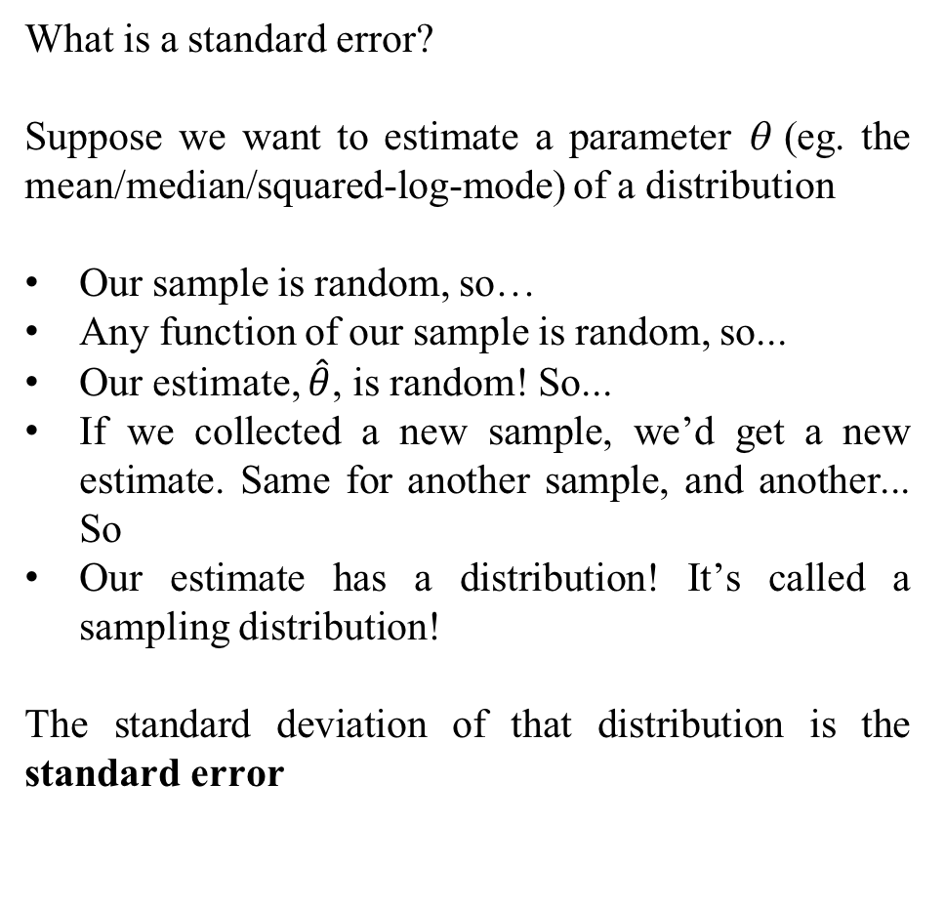
What is a standard error?
Suppose we want to estimate a parameter θ (eg. the mean/median/squared-log-mode) of a distribution
Our sample is random, so…
Any function of our sample is random, so...
Our estimate, $\hat{θ}$, is random! So...
If we collected a new sample, we’d get a new estimate. Same for another sample, and another... So
Our estimate has a distribution! It’s called a sampling distribution!
The standard deviation of that distribution is the standard error

Slide 6
Bootstrap Motivation
Challenges
Answering Question 2, even for relatively simple estimators (e.g., ratios and other non-linear functions of estimators) can be quite challenging
Solutions to most estimators are mathematically intractable or too complicated to develop (with or without advanced training in statistical inference)
However
Great strides in computing in the last 25 years have made these calculations more feasible.
We will investigate how the bootstrap allows us to obtain robust estimates of precision

Slide 7

Bootstrap Estimation
Estimating the precision of the sample mean
The central limit theorem gives us the standard error of $\overline{X}$:
However, the CLT only concerns means -- it does not extend to other estimators. The bootstrap is a more general approach that applies to medians, diversity indices, ratios…

Slide 8
Bootstrap Estimation
Estimating the precision of the sample mean
The central limit theorem gives us the standard error of $\overline{X}$:
However, the CLT only concerns means -- it does not extend to other estimators. The bootstrap is a more general approach that applies to medians, diversity indices, ratios…

Slide 9
Bootstrap Estimation
Estimating the precision of the sample mean
The central limit theorem gives us the standard error of $\overline{X}$:
However, the CLT only concerns means -- it does not extend to other estimators. The bootstrap is a more general approach that applies to medians, diversity indices, ratios…

Slide 10
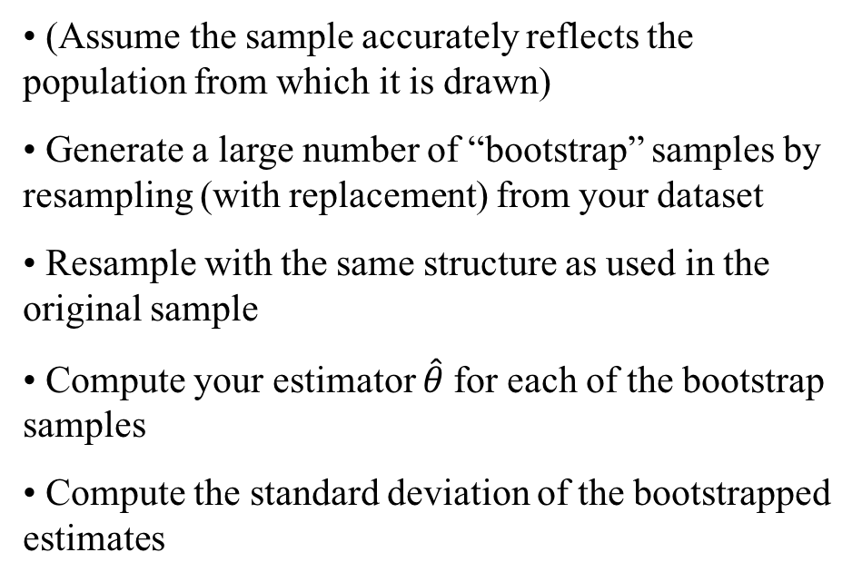
Bootstrap Algorithm
(Assume the sample accurately reflects the population from which it is drawn)
Generate a large number of “bootstrap” samples by resampling (with replacement) from your dataset
Resample with the same structure as used in the original sample
Compute your estimator $\hat{θ}$for each of the bootstrap samples
Compute the standard deviation of the bootstrapped estimates

Slide 11
Bootstrap Estimation Examples
What is the variance of the sample median? No idea!
=> Use the bootstrap!
Bootstrapped estimates of the standard error for sample median
Data Median
Original sample: {1, 5, 8, 3, 7} 5
Bootstrap 1: {1, 7, 1, 3, 7} 3
Bootstrap 2: {7, 3, 8, 8, 3} 7
Bootstrap 3: {7, 3, 8, 8, 3} 7
Bootstrap 4: {3, 5, 5, 1, 5} 5
Bootstrap 5: {1, 1, 5, 1, 8} 1
etc.
Bootstrap B (=1000)

Slide 12
Bootstrap Estimation Examples
Bootstrapped estimates of the standard error for sample median (cont.)
Descriptive statistics for the sample medians from 1000 bootstrap samples
B 1000
Mean 4.964
Standard Deviation 1.914
Median 5
Minimum, Maximum 1, 8
25th, 75th percentile 3, 7
We estimate the standard error for the sample median as 1.914

Slide 13
Bootstrap Estimation Examples
Bootstrapped estimates of the standard error for sample relative risk
r = P[D|Exposed]/P[D|Not exposed]
Cross-classification of Framingham Men by high systolic blood pressure and heart disease
Heart Disease
High Systol BP No Yes
No 915 48
Yes 322 44
The sample estimate of the relative risk is
r = (44/366)/(48/963) = 2.412

Slide 14
Bootstrap Estimation Examples
Bootstrapped estimates of the standard error for the relative risk (cont.)
Descriptive statistics for the sample relative risks
B 100000
Bootstrap mean, r 2.464
Bootstrap Median 2.412
Standard Deviation 0.507
The bootstrap standard error for the estimated relative risk is 0.507

Slide 15
Bootstrap Summary
Advantages
All purpose computer intensive method useful for statistical inference.
Bootstrap estimates of precision do not require knowledge of the theoretical form of an estimator’s standard error, no matter how complicated it is.
Disadvantages
Typically not useful for correlated (dependent) data.
Missing data, censoring, data with outliers are also problematic
Often used incorrectly
Note that there are many different types of bootstraps: we have only discussed one

Slide 16
Quiz
Suppose you are interested in the number of times an experiment works before it fails. Suppose it failed on the first try, then on the sixth try, then on the first try. What is an estimate of the long-run median number of successes before failures, and the standard error in your estimate?
To help, here are 10 bootstrap samples:
{0, 0, 5}, {5, 0, 0}, {5, 0, 5}, {0, 5, 0}, {0, 0, 5},
{5, 5, 0}, {0, 5, 0}, {0, 5, 5}, {0, 5, 5}, {5, 0, 5}

Slide 17
Quiz
Suppose you are interested in the number of times an experiment works before it fails. Suppose it failed on the first try, then on the sixth try, then on the first try. What is an estimate of the long-run median number of successes before failures, and the standard error in your estimate?
To help, here are 10 bootstrap samples:
{0, 0, 5}, {5, 0, 0}, {5, 0, 5}, {0, 5, 0}, {0, 0, 5},
{5, 5, 0}, {0, 5, 0}, {0, 5, 5}, {0, 5, 5}, {5, 0, 5}

Slide 18
Jackknife
Jackknife Estimation
The jackknife (or leave one out) method, invented by Quenouille (1949), is an alternative resampling method to the bootstrap.
The method is based upon sequentially deleting one observation from the dataset, recomputing the estimator, here, , n times. That is, there are exactly n jackknife estimates obtained in a sample of size n.
Like the bootstrap, the jackknife method provides a relatively easy way to estimate the precision of an estimator, θ.
The jackknife is generally less computationally intensive than the bootstrap

Slide 19
Jackknife Algorithm
Jackknifing
For a dataset with n observations, compute n estimates by sequentally omitting each observation from the dataset and estimating on the remaining n – 1 observations.
Using the n jackknife estimates, ,
we estimate the standard error of the estimator as
Unlike the bootstrap, the jackknife standard error estimate will not change for a given sample

Slide 20
Jackknife Summary
Advantages
Useful method for estimating and compensating for bias in an estimator.
Like the bootstrap, the methodology does not require knowledge of the theoretical form of an estimator’s standard error.
Is generally less computationally intensive compared to the bootstrap method.
Disadvantages
The jackknife method is more conservative than the bootstrap method, that is, its estimated standard error tends to be slightly larger.
Performs poorly when the the estimator is not sufficiently smooth, i.e., a non-smooth statistic for which the jackknife performs poorly is the median.

