Slide 1




Forest Fire Detection Using Deep learning
- Adwait Rajendra Chavan
- AICTE Student ID: STU67cf249e249821741628574

Slide 2

Learning Objectives
Learn how forest fire data is collected and used
Understand basic data analysis and cleaning steps
Use ML models like Decision Tree, SVM, and Random Forest
Compare model results and accuracy
Learn how to predict forest fires using features like temperature, wind, and rain.
Understand the problem of forest fire detection and its significance in environmental protection.
Learn data preprocessing techniques using image datasets (e.g., resizing, normalization).
Apply Convolutional Neural Networks (CNNs) for binary image classification (fire vs. no fire).
Evaluate model performance using metrics like accuracy, loss, and validation results.
Gain hands-on experience in deep learning implementation using TensorFlow/Keras.
Interpret model predictions and understand the importance of model generalization.
GOAL
Source :
www.freepik.com/

Slide 3
Tools and Technology used
Python, TensorFlow, Keras
OpenCV for image processing
Google Colab for model training and experimentation
CNN (Convolutional Neural Network) for image classification
Python, Pandas, NumPy for data manipulation
Scikit-learn for building machine learning models
Matplotlib & Seaborn for data visualization
Machine Learning Algorithms: Logistic Regression, KNN, SVM, Random Forest

Slide 4
Methodology
Data Acquisition: Forest Fire dataset (temperature, humidity, wind, rain, area burned)
Preprocessing: Handling missing data, feature scaling, train-test split
Model Training: Supervised ML algorithms applied to predict fire likelihood
Evaluation: Accuracy score and confusion matrix used for model comparison
Data Collection: Forest fire and non-fire images collected and preprocessed.
Model Architecture: Custom CNN with multiple Conv2D, MaxPooling, and Dense layers.
Training & Evaluation: Dataset split into train/test, model trained with accuracy/loss monitored.
Prediction: Model tested on new images to identify fire presence.

Slide 5
Problem Statement:
Forest fires are unpredictable and spread rapidly, threatening ecosystems and human lives.
There’s a need for an early detection system using AI to minimize damage.
Forest fires cause widespread environmental and economic damage.
Traditional detection methods are slow and often reactive.

Slide 6
Solution:
Developed ML models to predict the risk of a forest fire based on environmental factors.
Random Forest showed higher accuracy among all algorithms.
Provides a foundation for real-time predictive systems for fire prevention.
A deep learning-based image classification model that detects forest fires from real-time images.
High accuracy in distinguishing fire from non-fire scenarios.
Can be integrated into surveillance systems for rapid detection.

Slide 7
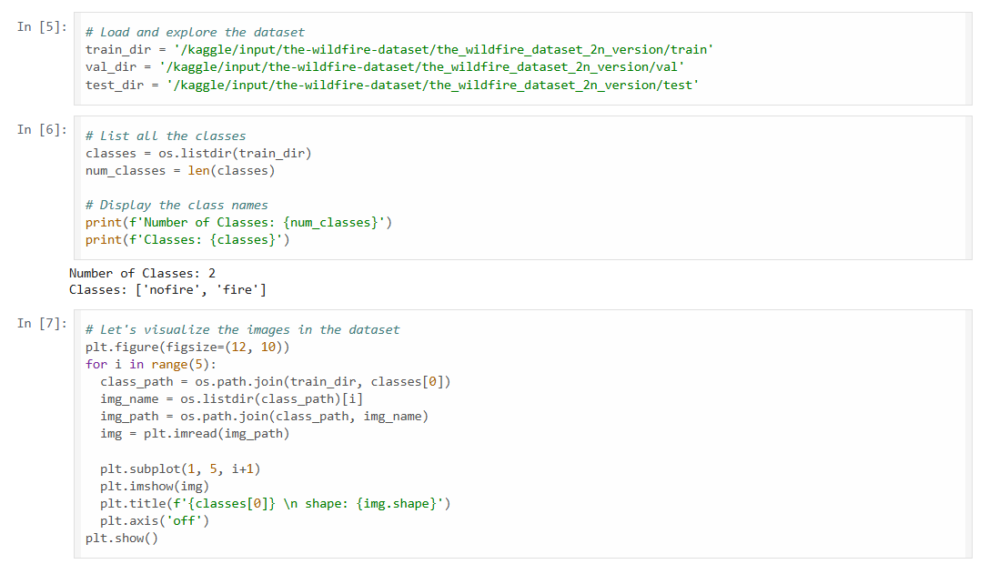
Screenshot of Output:

Slide 8
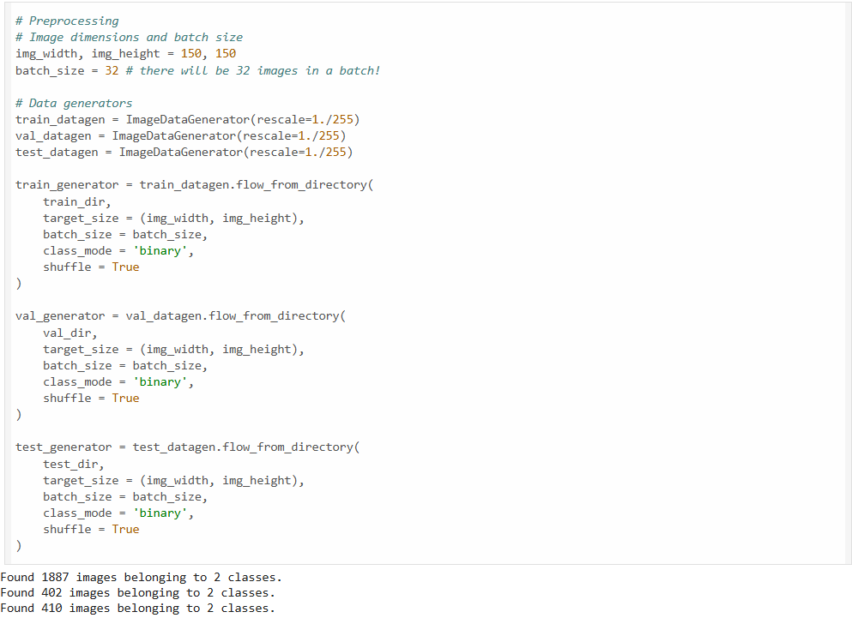
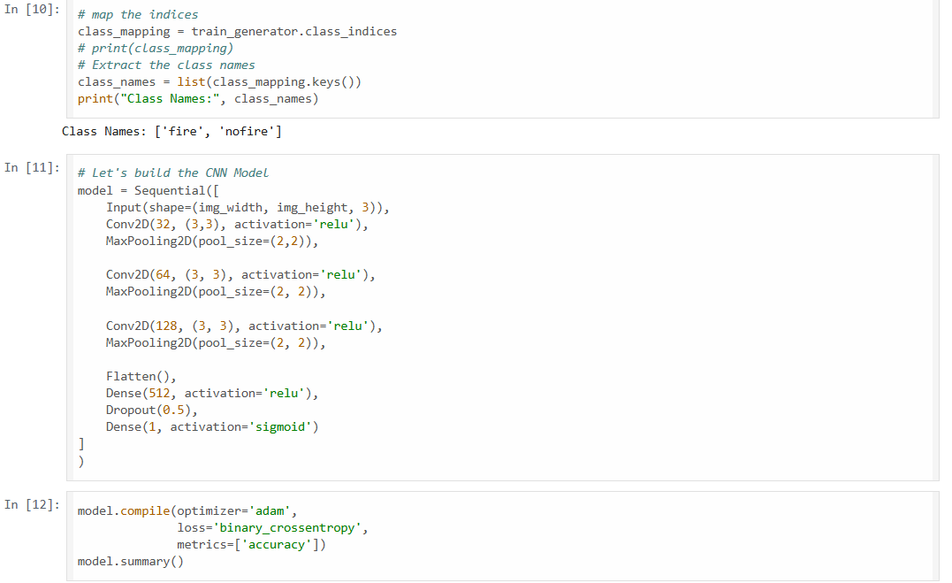
Screenshot of Output:

Slide 9
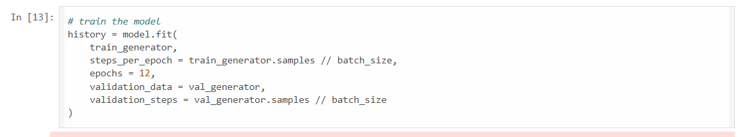
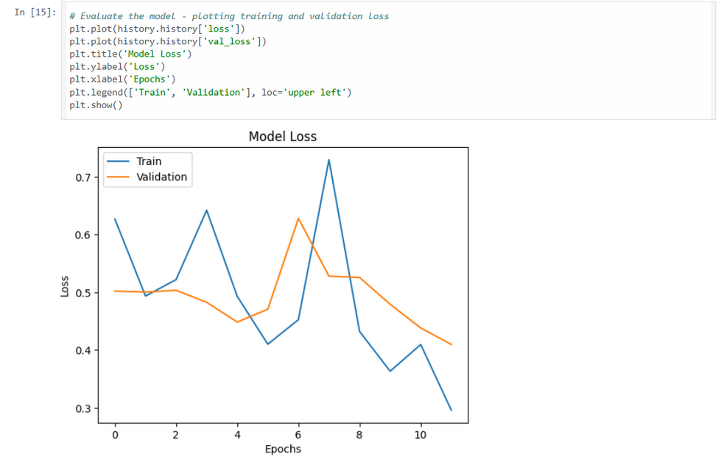
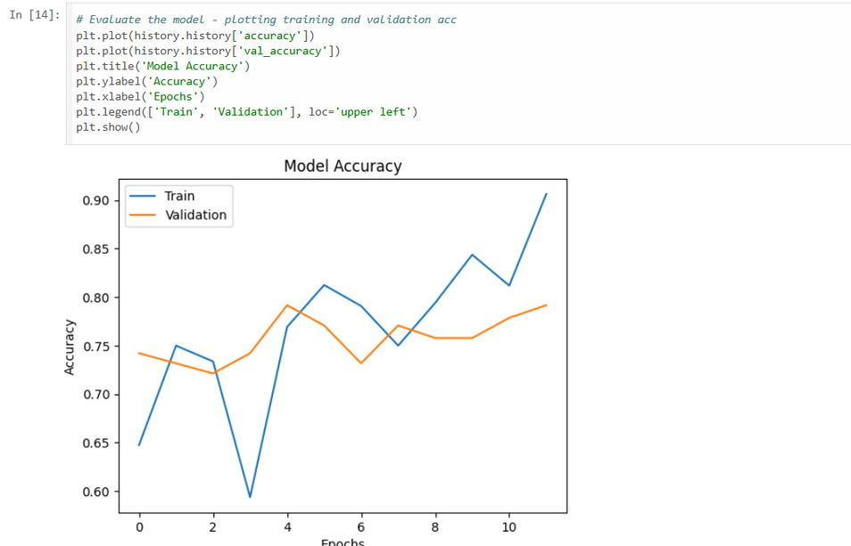
Screenshot of Output:

Slide 10
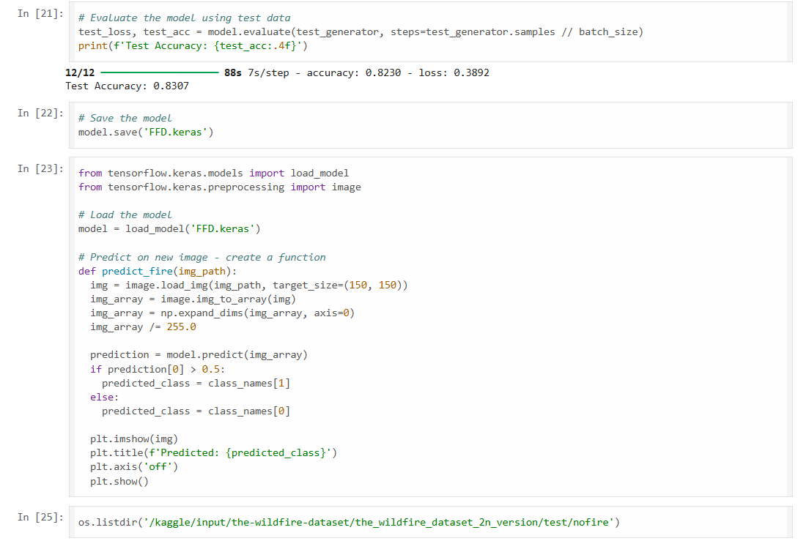
Screenshot of Output:

Slide 11
Conclusion:
Explored Machine Learning (Week 2) and Deep Learning (Week 3) approaches for fire detection.
Week 2: Used algorithms like Random Forest and SVM on environmental data.
Week 3: Implemented CNN for image-based fire classification.
Gained hands-on experience in data preprocessing, model training, and evaluation.
Learned the trade-offs between structured data models and visual data models.
Deep Learning approach offers better scalability for real-time applications.
Future enhancements include deployment with drones, real-time data, and edge computing.

