Slide 1
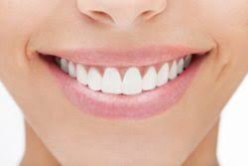
SMILE DENTAL CLINIC
BY: TEAM #2, 200SUCCESS
Adwait Sathe
Gauri Verma
Shwetank Rokhade
Vivek Kulkarni

Slide 2

OVERVIEW
The database is created to manage and address the appointments at a multi-location dental clinic. It will cater and support the following:
Scheduling appointments for patients
Storing information regarding their visit(s)
Managing diagnosis, treatment, and prescription related information
Managing invoice
Tracking information for the visits of the patients
Storing and managing medical details of the patient
Handling equipment and supplies information

Slide 3
MAIN FUNCTIONALITY
Allow CREATION of patient
Schedule appointment for patient
Store dentist details and schedule
Generate invoice on the basis of treatment after each appointment
Handle supplies and equipment information

Slide 4
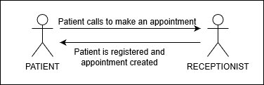
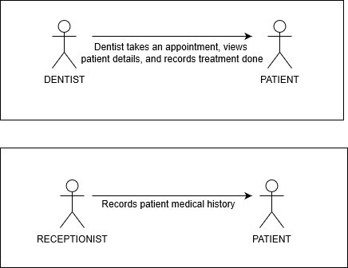
FLOW:

Slide 5
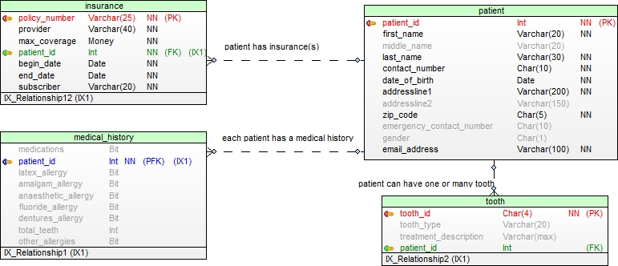
CLUSTER: Appointment

Slide 6
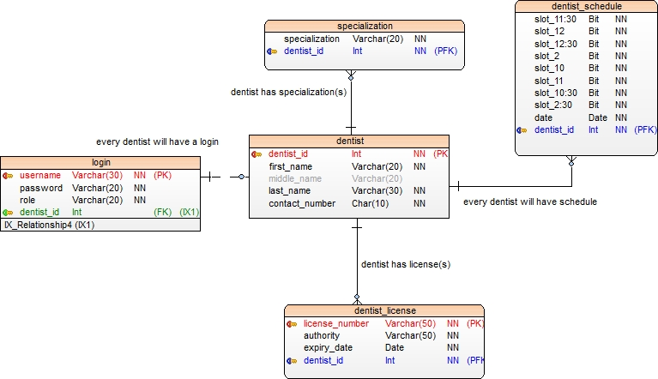
CLUSTER: Provider

Slide 7
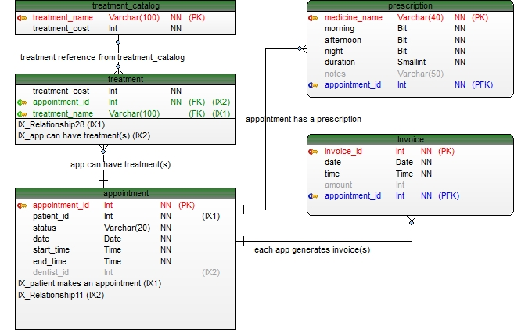
CLUSTER: Receiver

Slide 8
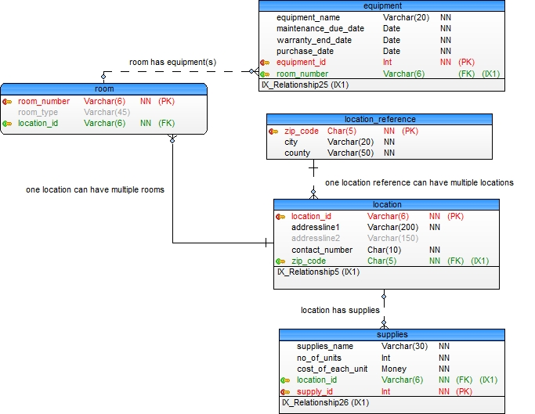
CLUSTER: Location

Slide 9
PROJECT DEMO

Slide 10
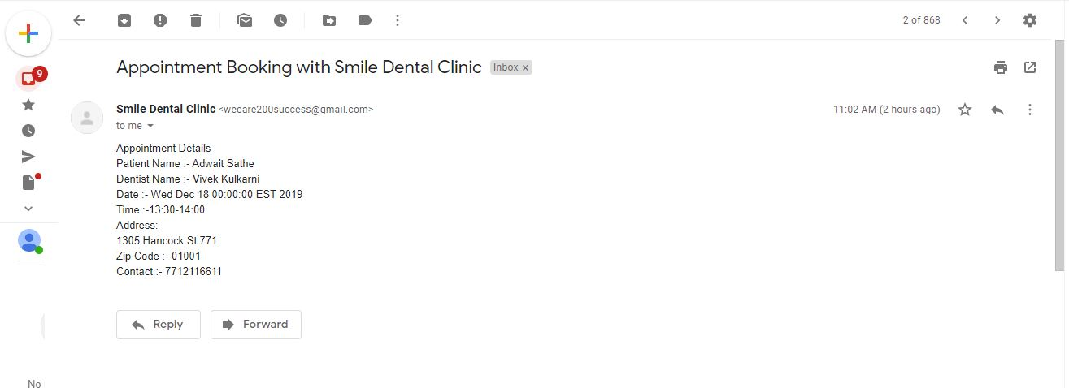
KEY FEATURES
A confirmation E-Mail is sent to the patient after booking of an appointment.

Slide 11
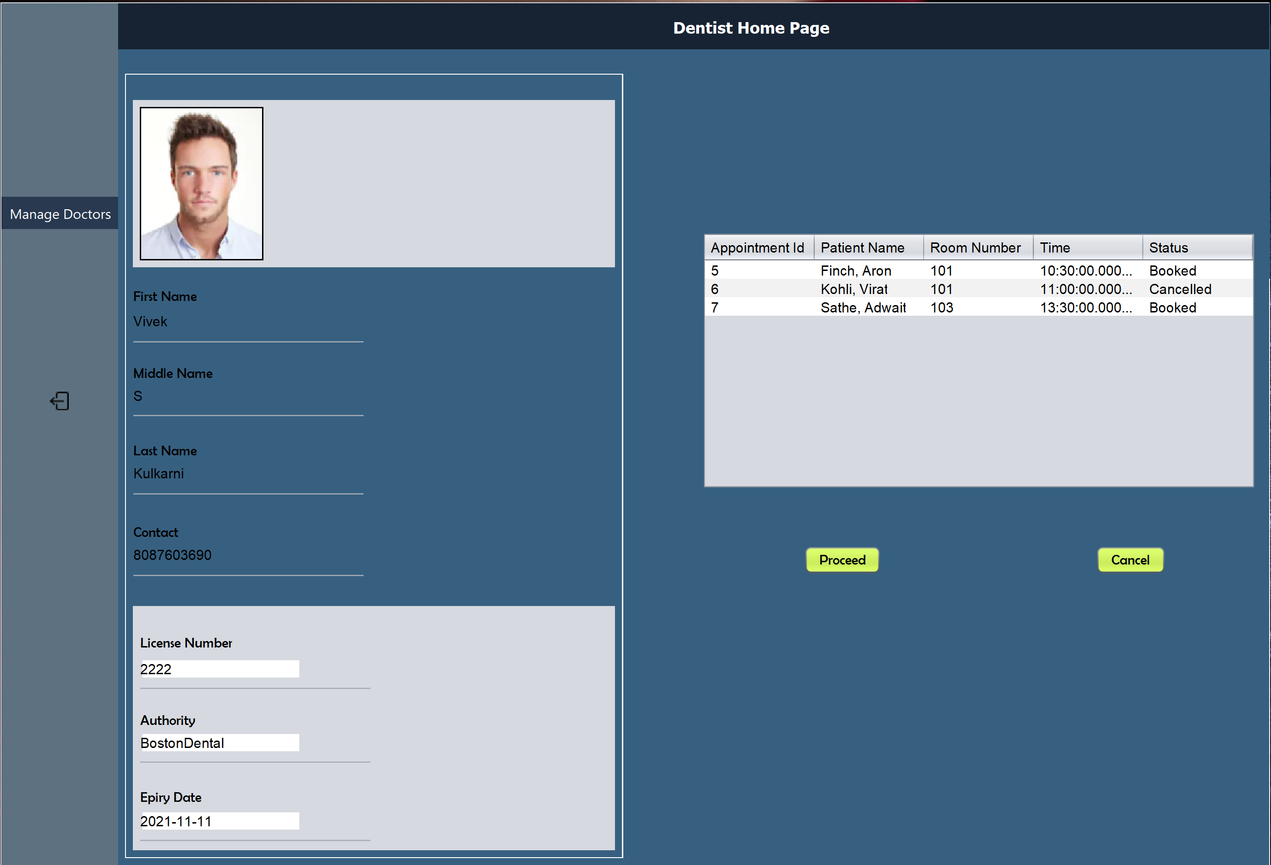
KEY FEATURES
Image fetch and store in SQL DB: Retrieving images from sql column to the view.

Slide 12
KEY FEATURES
SQL Functions, Stored Procedures, Triggers,Views and Soundex
Stored proc to insert Appointment Row
Stored proc to Insert Tooth Row
Stored proc to Send Mail
Stored proc to add invoice
Trigger to handle dentist schedule
Function to get dentist and patient details
Soundex for patient search
Function to find Treatment Count
Bulk insertion of data in location_reference table
Used view to show only required data.

Slide 13
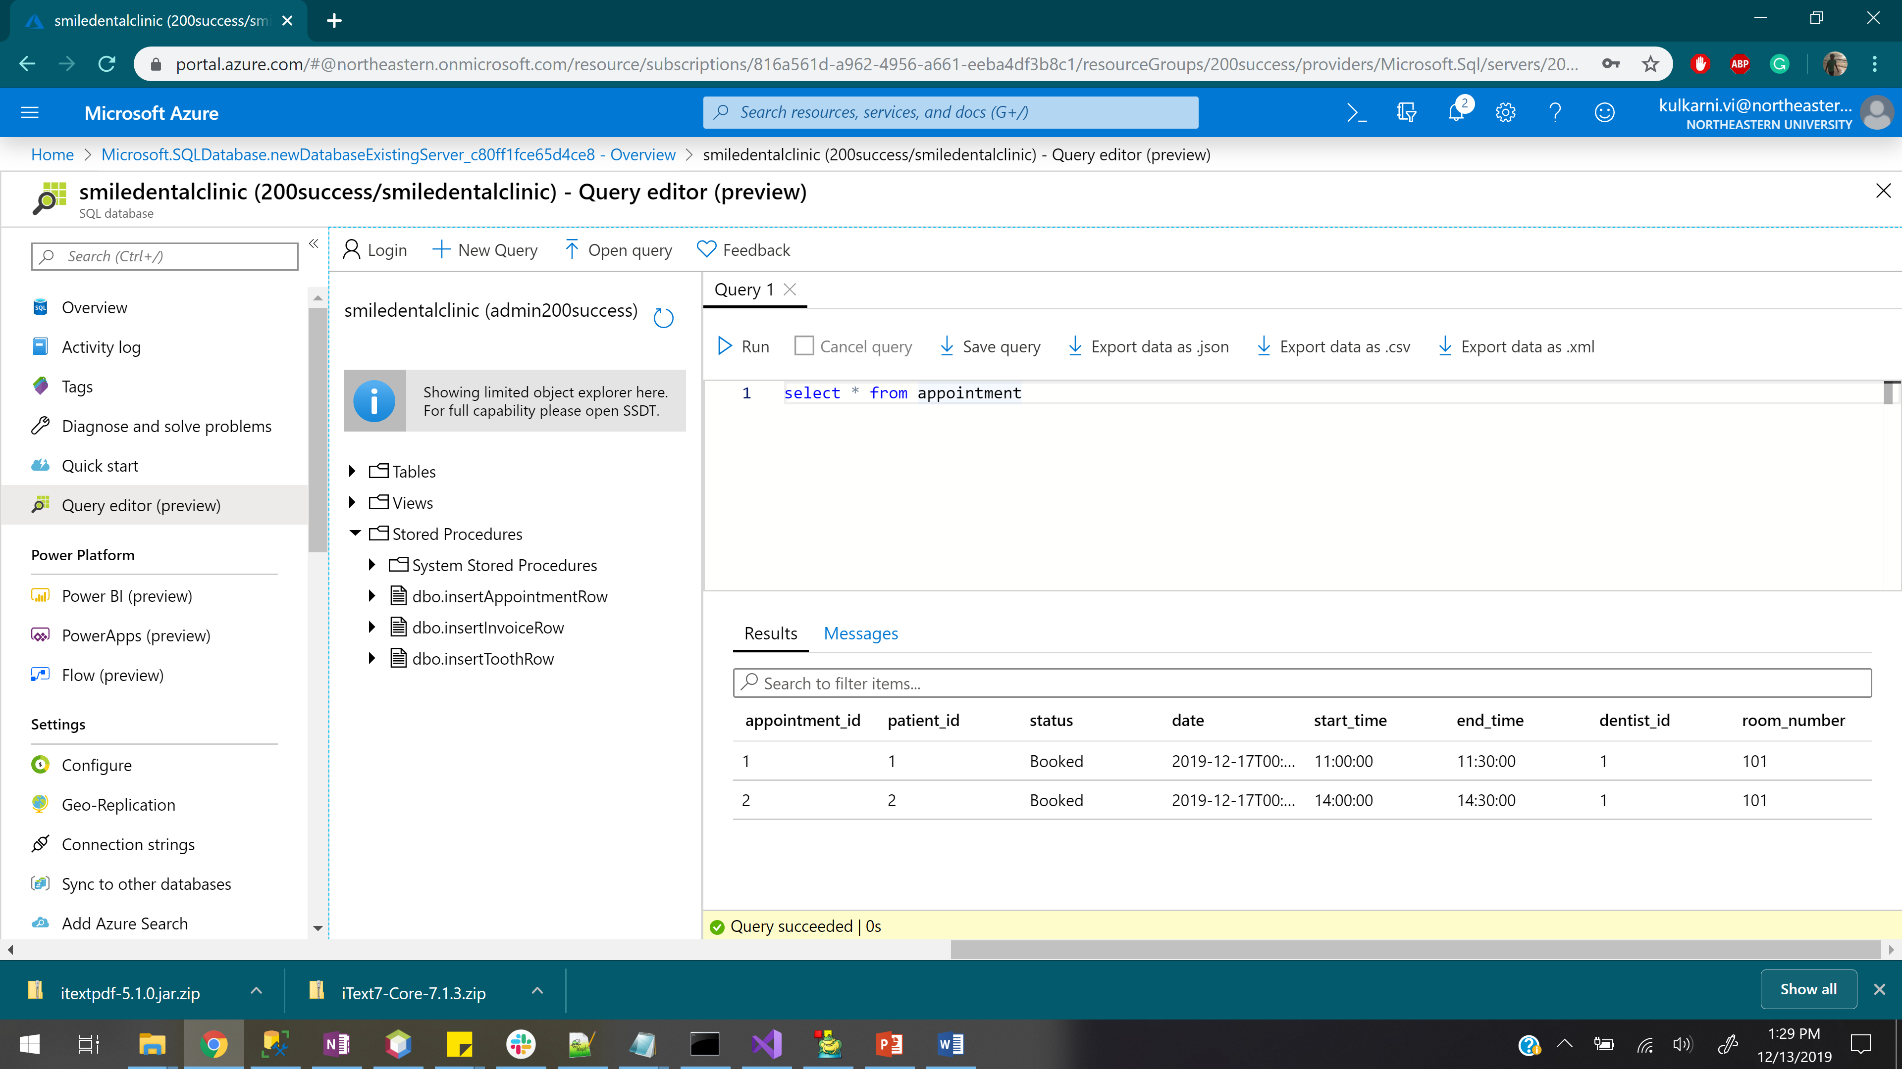
Key Features

Slide 14
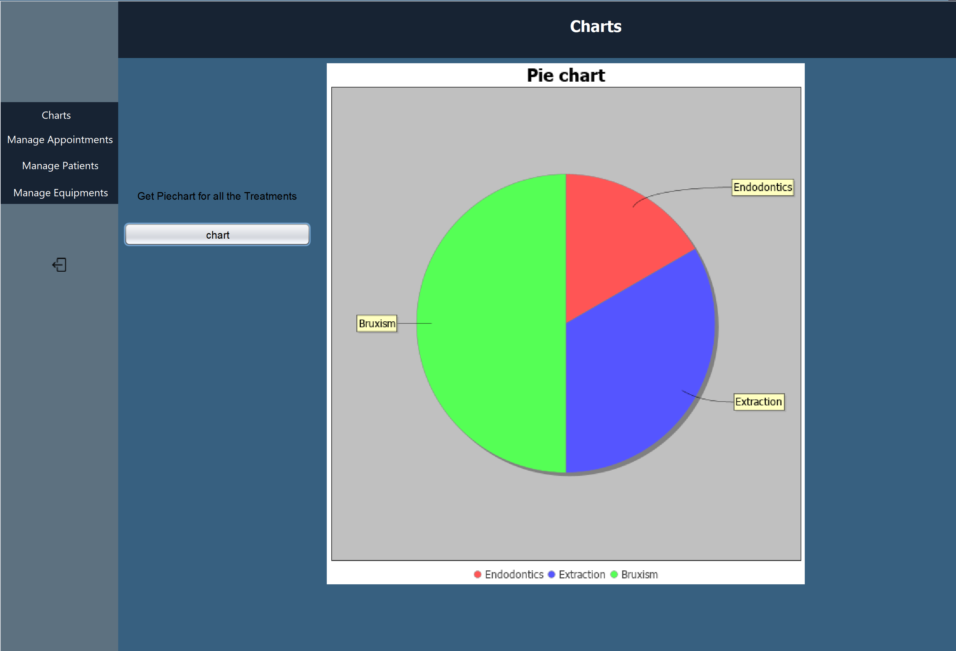
Key Features
Graphs using data from -- table

