Slide 1
Act Net
Activity Based Social Network
Compete, Collaborate and Be Active.
Group 15
Parth Mehta, Adwaith Venkatraman,
Amrita Aurora

Slide 2
Agenda:
Goals
Features of System
Design Overview
Detailed Design - Android Process View
Firefly Tasks
Design Challenges(
Activity Recognition Algorithm – Firefly
Detection of Activities - Firefly
Final Demo Scenario that test all features
Lessons Learnt

Slide 3
Goals
Activity based social network, share data with people around you about activities like running, walking, biking etc.
Motivation for exercise
Find out about other active people and what activities they do, People whom you would never meet otherwise
Act net enables you to find people with similar physical activity and contact them.
Notes:
High-Level Project Goals (1 slide)
What are the chances that two people in the same room play badminton. Would you like to know about that ? Its a really good ice breaker. This is a proximity based social networking service. You get information about people around you.
Keeps you motivate for exercise: in todays world it is very important to remain fit and active physically. And Act net aims to always keep you motivated for exercise all the time.
eeps you motivated for exercise
You get updates and statistics of how much other people exercise.
Its always fun to meet new people with the same activities.
What are the chances that two people in the same room play badminton ?

Slide 4

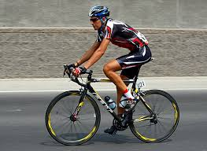
Features of System
1. Activity Recognition:
NAME:Amrita
ACTIVITY:RUNNING
STEPS:2543
TIME:1 HOUR
NAME:Parth
ACTIVITY:CYCLING
TIME:0.5 HOURS
Notes:
Recognize activities like running, cycling, walking

Slide 5
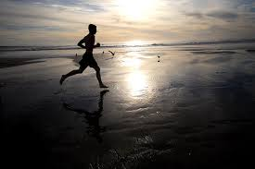
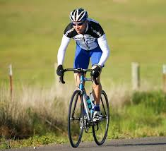
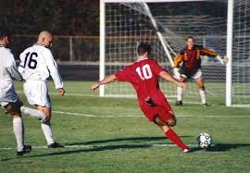
Features of System
2. Exchange statistics of Activities with people.
NAME:XYZ
ACTIVITY:RUNNING
DURATION:3 HOURS
DAY:3/5/2013
NAME:ABC
ACTIVITY:CYCLING
DURATION:1 HOURS
DAY:3/5/2013
NAME:PQR
ACTIVITY:SOCCER
DURATION:2 HOURS
DAY:3/5/2013
Notes:
User story + image showing statistics

Slide 6
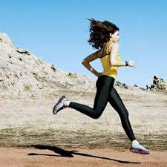

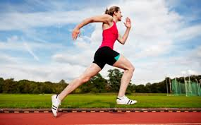
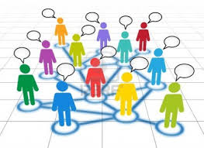
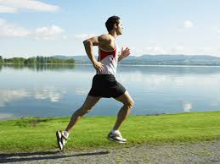
Features of System
3. Contact people with similar interest in the vicinity to get together and do something like running, or play sport together.

Slide 7
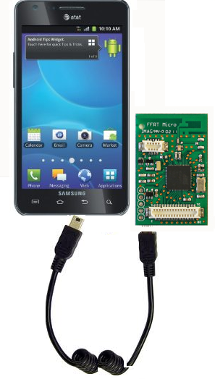
Design Overview(1/4)
Firefly + Android powered phone
Every user carries both of these
Notes:
System Design (~5 slides)
– Block diagrams
– System layering

Slide 8
Design Overview(2/4)
Activity Recognition
Android Activity Recognition API
Biking, Walking, In Car, Tilting, Still
Accelerometer on Firefly
Sitting, Standing, Running, Walking, Number of Steps
Location Based Activity Recognition
Basketball
Notes:
How activity recognition works on andoid. There is a service that runs in the background which gives a confidence of what the activity is being performed.
It classifies the activity into these categories.
We measure the time for which a particular activity was recognized and aggregate the time for each activity.
On Accelerometer on Firefly we see for patterns of the accelerometer readings on the firefly.
Location based activity recognition. Have a beacon at specific locations and aggregate the time spent near the beacon which will mean you doing that activity.

Slide 9
Design Overview(3/4)
Sharing activity data with other users
Activity data is logged on android phone.
Other users are detected in the vicinity by the firefly
Activity data is then exchanged by the firefly
Data from all nearby users is visible on the phone. .
Notes:
Recognizing activities like running, walking and cycling.
Recognizing activities like sports – amount of time spent on locations like basket ball court, tennis court by
Exchanging statistics with other people – when people come in the vicinity exchange data.

Slide 10
Design Overview(4/4)
Contact Users with similar Interests
All nearby users data is visible on phone.
Can trigger a message from the phone which is sent through the firefly to the other phone.
Other user receives a notification in the phone with contact details and activity of interest.

Slide 11
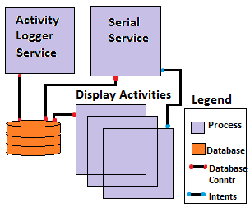
Detailed Design Android Process View

Slide 12
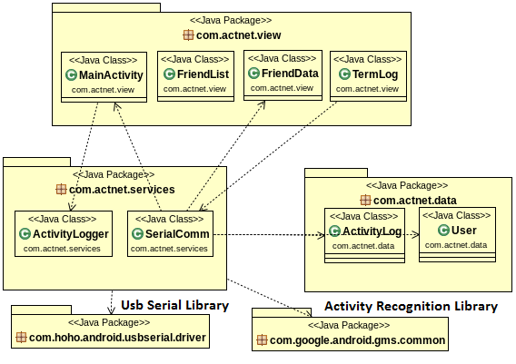
Detailed Design Android Code View

Slide 13
Firefly Tasks
Neighbor Discovery task send a beacon every 4s to find other people in the vicinity and advertises its latest version of data.
Activity Recognition task monitors the accelerometer
and notifies the phone when a new activity is recognized.
Uart task requests data from phone’s database and transmits it to the other node. It also asks for version information update of the nodes data
Retransmit task takes care of retransmissions and connection termination in case the other node is not responding
Rx Packets task received all packets and performs according to protocol. This is the common receive task for all packets. Most important task given 0.7 of CPU time.
API
NanoRK Task
Calls relation
Activity recognition Task
Neighbor discovery
UART Task
Retransmit Task
Rx packets Task
UART communication api
Bmac API
Notes:
Updated

Slide 14
Design Challenges(1/5)
Activity data in Kilo Bytes.
Cannot fit in one packet
Packet loss
Solution
Marshall User data into 10 byte packets
Unmarshall the packets to store.
Sequence numbers, Acks to battle packet loss.
Retransmissions every 4 seconds helps reliability

Slide 15
Design Challenges(2/5)
Nodes are on the move
Need to exchange data when come near each other
Solution
Every node sends a beacon periodically to advertise itself.
When nodes come in radio range they receive each other’s beacon and exchange data using the sequence numbers and Acks.

Slide 16
Design Challenges(3/5)
Lots of nodes want to transfer data at the same time
Who sends first, who receives first.
Solution
Maintain a logical connection between two nodes.
Setup and terminate phase.
Do not entertain requests from other nodes while connections.
Multiple nodes try to setup connection highest MAC address wins.
Fixed after setup until connection terminated.
Connection Oriented Data transfer.

Slide 17
Design Challenges(4/5)
People are constantly logging their activities. My data with other user is stale.
Solution
Version numbers of activity data
Latest version in advertisement packet.
Version of other users data stored locally.
Compare between local version and latest advertized version to send data request.
On a data request, calculate diff of data and transfer only needed data.

Slide 18
Design Challenges(5/5)
People move around. Nodes who are in a connection may go out of range before the data transfer is completed.
Solution
When two nodes are in a connection. There is a timer on the receiver as well as sender side.
If no new packet is not received for 20s the connection is terminated and the receiver is up for new connections.
On the sender side if it does not receive any ACK for 20s it terminates connection.
Ensures correctness in the face of intermittent connectivity.

Slide 19
Activity Recognition Algorithm - Firefly
The vertical axis (Y-axis) readings are plotted as a graph, against time.
Based on the values of peaks and its frequency, the activity can be detected.
The peaks and the frequency were decided upon collecting sufficient samples of data.

Slide 20
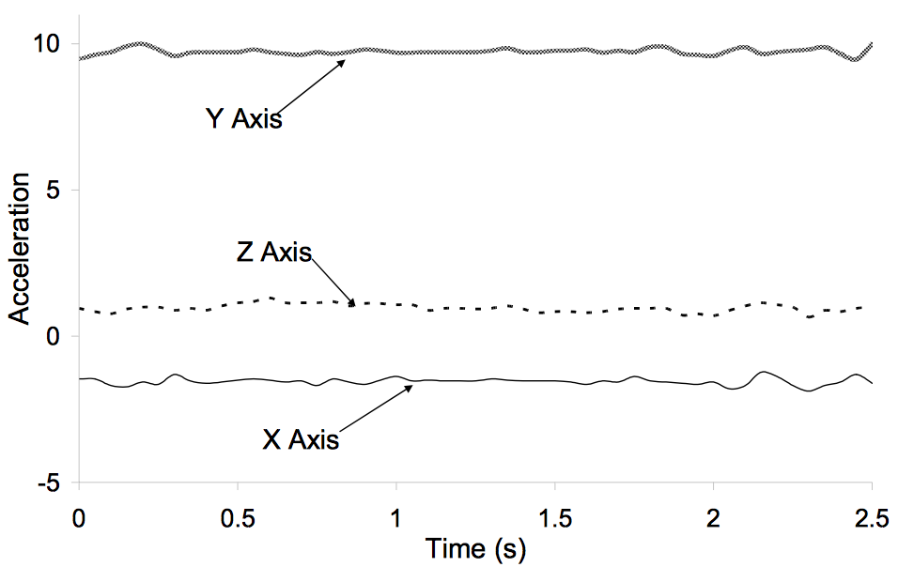
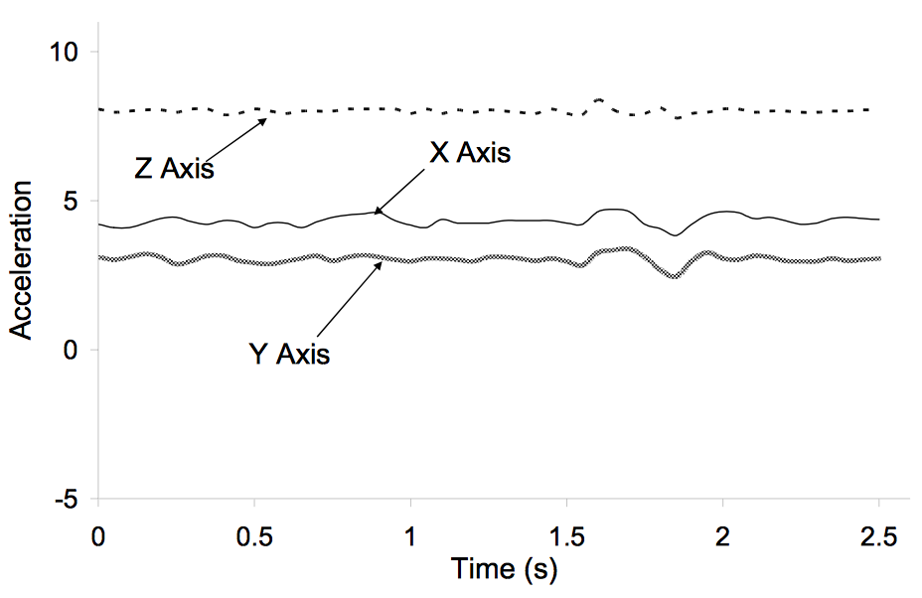
Detection of Activities - Firefly
Activities like sitting and standing do not vary drastically over time.
However, threshold is different for the two due to difference in orientation.
Standing
Sitting

Slide 21
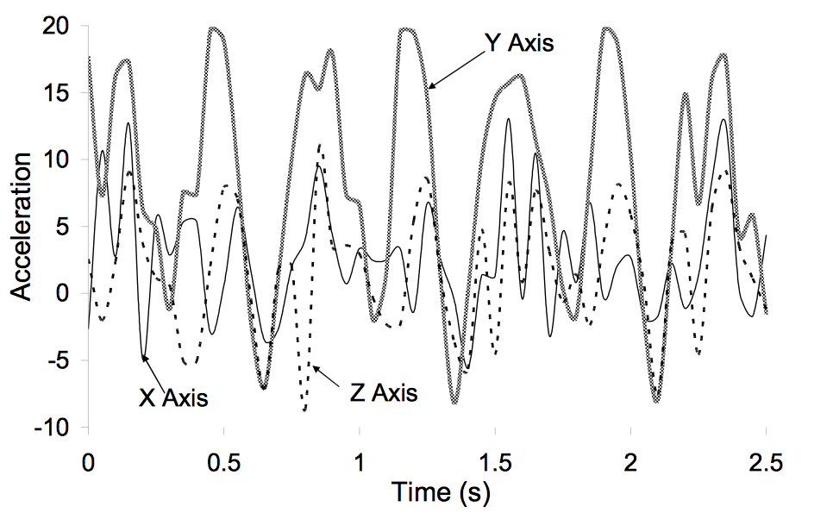
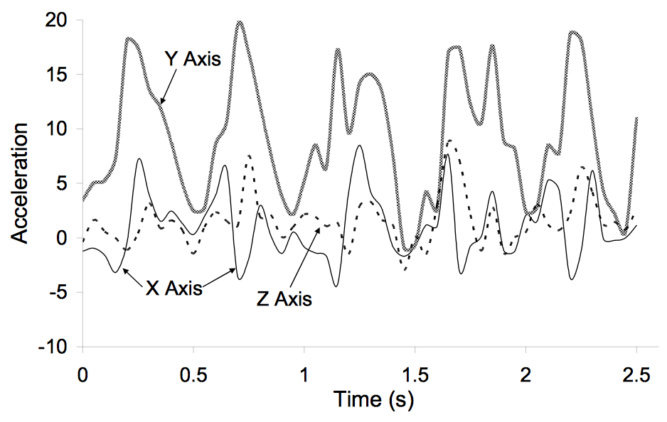
Detection of Activities - Firefly
For walking and running, the value of positive and negative peaks are noted.
Depending on the number of peaks, steps taken can be derived.
Running
Walking

Slide 22
Final Demo Scenario that test all features
Demo Scenario 1:
Two people perform individual activities like biking and running
→Activity detection using android
They meet for a short duration and then leave
→Connection is established and data exchanged
After a while, they meet again
→Version update and difference of activity from previous data transferred.

Slide 23
Final Demo Scenario that test all features
Demo Scenario 2:
Two people perform activities.
→One of them plays basketball at a specific location and other is siting.
They meet for a short duration.
→Location based activity detection and notification from firefly)
After a while, they meet
→Version update and exchange of data .

Slide 24
Final Demo Scenario that test all features
Demo Scenario 3:
Two people perform activities.
→ One of them is walking and other is running.
They meet for a short duration
→Activity detection from firefly using number of steps )
Exchange of contact details and viewing profile
→Contact other person feature.

Slide 25
Final Demo Scenario that test all features
Demo Scenario 4:
Three people perform activities.
Two of them meet for a short duration and are exchanging data
In this duration, a third person walks by
→Data not exchanged

Slide 26
Lessons Learnt
Access to Uart by multiple tasks should be globally controlled.
If one task is reading from UART then other tasks should not print logs
If timing is not so critical then task reserve can be disabled but will starve low priority tasks

Slide 27
Thank you

