Slide 1
RankRelay
An autonomous 8-agent SEO and AEO agency, built on the ai-employees kits
Notes:
RankRelay is an SEO and AEO agency run by eight AI employees. The client is a fictional travel blog built for this assignment.

Slide 2
One command runs the whole agency
8 of 8
3m 26s
9
21
agents finished in the final run
agent run time
URLs crawled, 1 returning 404
failed page checks found
A daily run crawls the live client site, gives seven specialist agents their work orders, and has a Project Manager agent audit the results. Each agent gets a row in a Google Sheet ledger, and a status bulletin goes out by email.
Readiness out of 100
85
41
Nothing leaves as a final action: outreach, ads and replies stay as drafts for a person to approve.
SEO
AEO
Notes:
All figures are from the final live run, 2026-11-04-21-45. The scores use fixed formulas computed from the crawl.

Slide 3

The agency serves a fictional budget travel blog
Agency type: SEO and AEO, because the repo's SEO/AEO kit covers both search and AI-answer visibility.
Client: Shoestring Atlas, a demo site on GitHub Pages. It has 8 live pages.
Test design: 10 known defects were planted on purpose, so the audit has answers to check against.
adwaith11366.github.io/rankrelay
Notes:
The site's budget and price charts use example figures and say so on the page. Photos are from Unsplash.

Slide 4
Eight employees, one kit from the repo each
Project Manager
Lead Researcher
Content Writer
Performance Analyst
chief-of-staff
seo-employee
social-media-employee
gtm-engineer
Audits 7 agents, logs the ledger, writes the brief
Maps traveller questions to pages and gaps
Drafts an answer-first article with FAQ schema
Scores readiness and names bottlenecks
Campaign Builder
Technical Auditor
Support Triage
Outbound Strategist
ad-manager-employee
web-dev-employee
customer-satisfaction-employee
sales-employee
Builds a 7-day promotion schedule
Audits the crawl and proposes exact fixes
Sorts sample reader mail and drafts replies
Lists link targets and drafts outreach
Notes:
Each kit was installed with npx ai-employees hire, which wrote its .installed.json receipt. Agents use the kit's ROLE.md as their charter.

Slide 5
Four stages of work, then out to Google and GitHub
Stage 1, parallel
Researcher, Auditor, Analyst, Triage
Crawler
Live site to crawl.json
Stage 2
Content Writer
Stage 3
Campaign Builder, Outbound
Stage 4
Project Manager audit
Agents can write only inside their run folder. Later stages read earlier stages' files.
Google Sheet
One row per agent
Email bulletin
8:00 AM daily
GitHub
Outputs and dashboard
Notes:
Claude Code runs each agent headlessly. Code checks exit status and file output before the Project Manager reads the work.

Slide 6
Setup took six steps
1
Install the tools
2
Hire the kits
3
Publish the client site
Node, Git, GitHub CLI and Claude Code
npx ai-employees hire, once per employee
GitHub Pages from the docs folder
4
Write the work orders
5
Deploy the bridge
6
Schedule it
A prompt and a task for each agent
Apps Script web app on the ledger Sheet
7:15 AM agents, 8:00 AM email
Notes:
The kits run on a signed-in Claude Code account, so no API key is stored in the project.

Slide 7
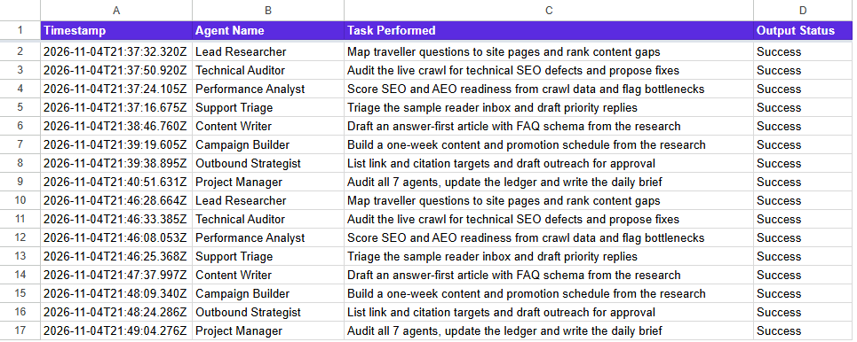
The Project Manager keeps the ledger and bulletin
Ledger columns
Timestamp, Agent Name, Task Performed, Output Status
Daily bulletin
An Apps Script trigger sends it at 8:00 AM, so it goes out with the PC off. If no agent ran in 24 hours, the subject line says so.
Status comes from code checks, so an agent can't mark its own work as done.
Notes:
Show the live Sheet here. The Sheet is public to anyone with the link.

Slide 8
Scripts connect the agents to the outside world
agency/run-all.mjs | Runs every stage, audits outputs, posts results, pushes to GitHub
agency/bridge/bridge.mjs | Posts ledger rows and the brief to the web app with a secret key
agency/bridge/Code.template.gs | Apps Script: appends rows, sends email, owns the 8:00 AM trigger
employees/*/.installed.json | Receipt from each hired kit: slug, version and file hashes
{
"schema": "ai-employee-receipt/1",
"slug": "seo-employee",
"version": "1.10.0",
"standard": "1.5",
"installed_on": "2026-11-04",
"files": { ... }
}
github.com/adwaith11366/rankrelay
Notes:
The secret key and the recipient address stay in a local file that git ignores.

Slide 9
The longest agent took 65 seconds
4
stages, some running agents in parallel
3m 26s
run time, for 362s of agent work in total
Notes:
Durations are from the kits' own run logs. Stage 1 agents run at the same time, which saves time.

Slide 10
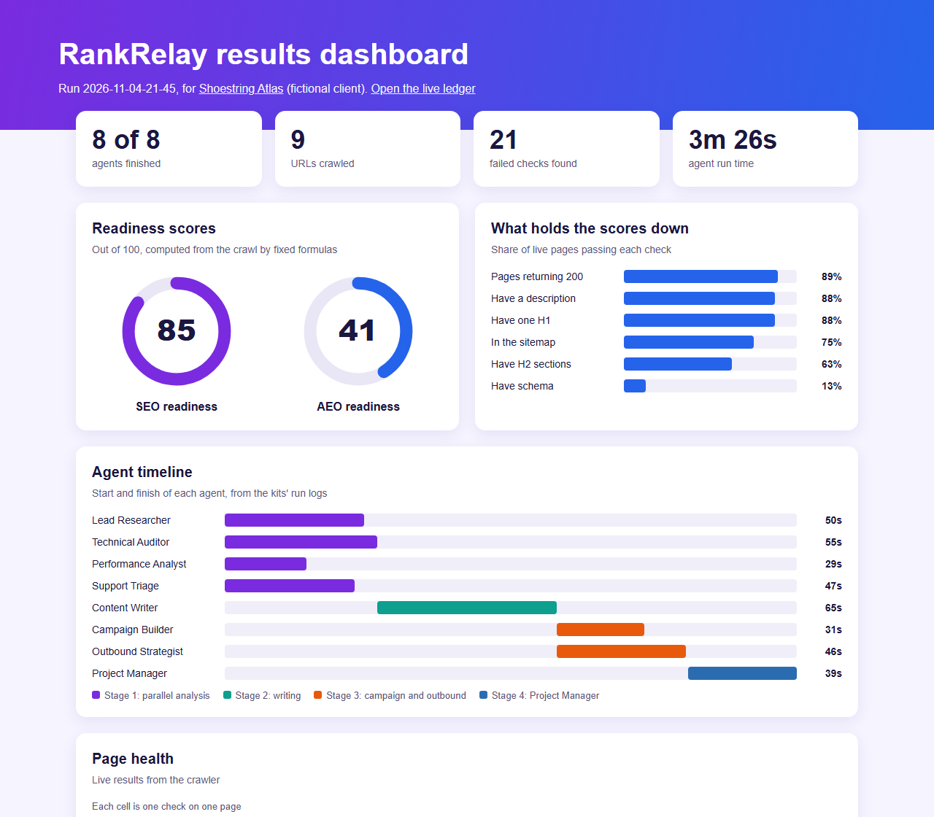
The dashboard shows what is holding the site back
SEO 85, AEO 41
Basic SEO is mostly in place. AEO is weak: 1 of 8 live pages has schema, and the site has no llms.txt.
The Technical Auditor's report covered all 10 planted defect types. The agents also proposed an llms.txt and FAQ schema.
Notes:
Traffic and rankings are n/a because the demo site has no analytics. Open the live dashboard at /rankrelay/dashboard/.

Slide 11
Reviewing the runs led to real fixes
Agents ran in the wrong order
Scores drifted between runs
Audit couldn't trace the 404
In rehearsal the Campaign Builder ran before the article existed, and the Project Manager flagged it.
SEO was 85, then 72, because the analyst picked its own formula each time.
The crawl didn't record which page held the broken link.
Writer now runs first
Fixed formulas in code
Crawler records the source
Notes:
The Project Manager also flags weak spots each run, for example when the article draft cites no sources.

Slide 12
What this demo does not prove
Sample data
Quality checks
The client and reader inbox are made up. No real traffic or ranking figures exist.
Success means a clean exit and a real file. The Project Manager's review of quality is a judgement.
Unverified targets
Kit routines
Outbound URLs came from search results, and the agent didn't open the pages.
Agents use each kit's charter and run log. The full routines need real accounts, so they weren't run.
Notes:
Outward-facing work stays as drafts. A person approves anything sent, posted or spent.

Slide 13
See it running
Code: github.com/adwaith11366/rankrelay
Dashboard: adwaith11366.github.io/rankrelay/dashboard/
Notes:
Run the live demo now, or play the recording. The ledger link is in the submission and in each email.

