Slide 1

Module2
Text Book

Slide 2
Installing GIT
For Ubuntu provides Git via its apt-get tool, so a few commands from the terminal are enough to get you going.
Download the latest tarball from the Git website.
Prompt>tar –xjf git-YOUR-VERSION.tar.bz2
prompt> cd git-YOUR-VERSION
prompt> make
Prompt>make install

Slide 3
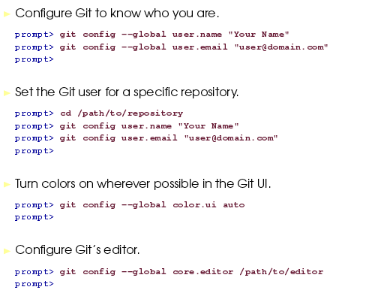
Configuring GIT

Slide 4
Creating a Repository in Git
Repositories in Git are stored on your local file system right along side the code they track.
Y o u create a repository
by typing git init in the directory that you want to start tracking files in.
Y o u use two repositories in Git to collaborate
with others: a private one and a public one. Y o u r private repository—the one we’re creating here—is where you do all your work

Slide 5
git init creates a .git directory in your current directory and initializes the Git repository inside that.
Once you’ve initialized a repository,you still need to add and commit the files using git add
And git commit

Slide 6
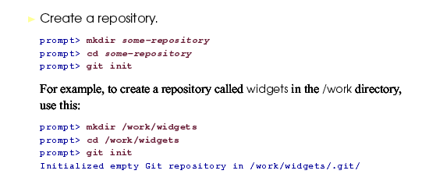
Creating an empty Git Repository

Slide 7
Shared repositories should always be created with the --bare flag (see discussion below). Conventionally, repositories initialized with the --bare flag end in .git.
For example, the bare version of a repository called my-project should be stored in a directory called my-project.git.

Slide 8
The --bare flag creates a repository that doesn’t have a working directory, making it impossible to edit files and commit changes in that repository. Central repositories should always be created as bare repositories because pushing branches to a non-bare repository has the potential to overwrite changes.
Think of --bare as a way to mark a repository as a storage facility, opposed to a development environment. This means that for virtually all Git workflows, the central repository is bare, and developers local repositories are non-bare.

Slide 9
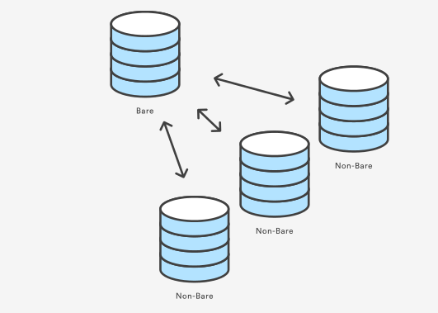

Slide 10
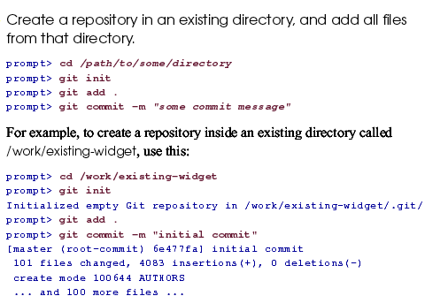
Adding files to the repository

Slide 11
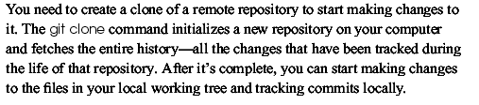
Creating a local copy of an existing Repository

Slide 12


Slide 13
gitclone
The git clone command copies an existing Git repository.
Git repository—it has its own history, manages its own files, and is a completely isolated environment from the original repository.

Slide 14


Slide 15


Slide 16
Seeing what has changed
Y o u r local repository tracks changes. Before you start committing
Just anything, you need to see what changes exist between your working tree and your repository and what changes are staged and ready to commit.
git status is the tool for the job. git status has several different outputs, depending on what’s in your working tree. The example on the next page is from one of my repositories, and it contains all three types of outputs: staged changes, changes to known files, and untracked
files.

Slide 17
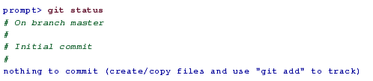

Slide 18
Staging changes to commit
Git uses a two-step process to get changes into the repository.
The first step is staging changes through git add Staging a change adds it to the Index ,or staging area. This sits between the working tree—your view of the repository—and the actual repository.
Through the staging area, you can control what is staged from the most coarse-grained—adding everything within the repository—down
to editing the changes, line by line.

Slide 19
Another quick way to add all files is
git add –A
you can add files that have changed using
The –u parameter.
It doesn’t add any new files, though, only files that have already been tracked

Slide 20
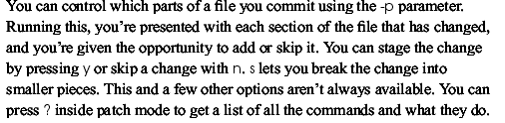

Slide 21
Ignoring files
If you don’t want to commit some of the files , then you can make use of gitignore

Slide 22
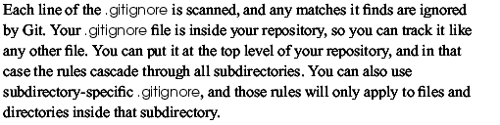

Slide 23
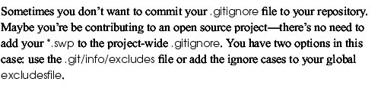

Slide 24


Slide 25
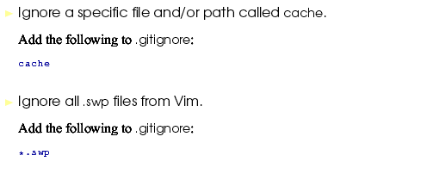

Slide 26
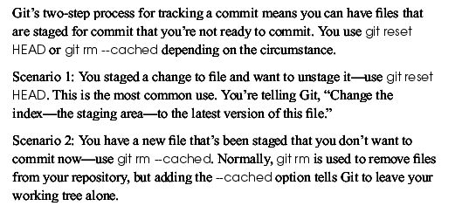
Undoing uncommitted changes

Slide 27


Slide 28
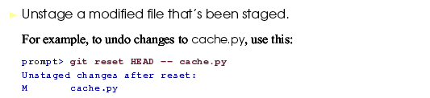

Slide 29


Slide 30
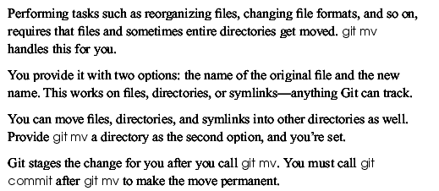
Moving files in Git

Slide 32
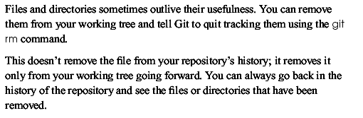

Slide 33
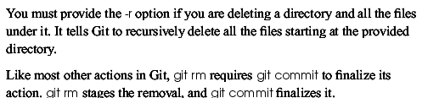

Slide 34
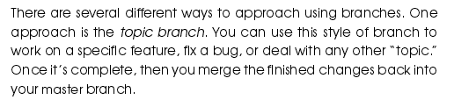
Categorizing branches

Slide 35
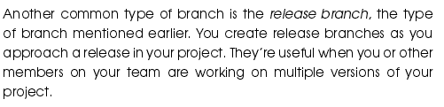

Slide 36


Slide 37
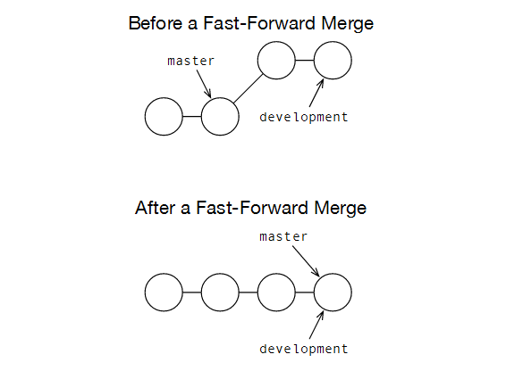

Slide 38
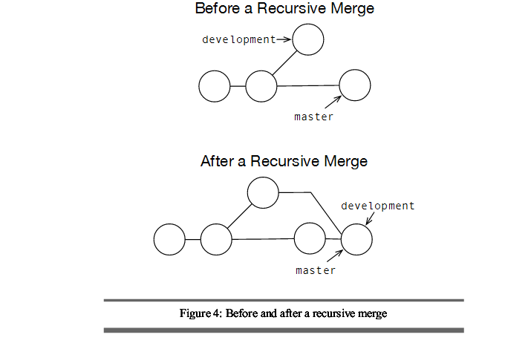

Slide 39

Creating branches

Slide 40

Moving to the branch

Slide 41
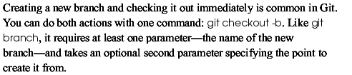
Creating and moving to branch in one step with –b option

Slide 42
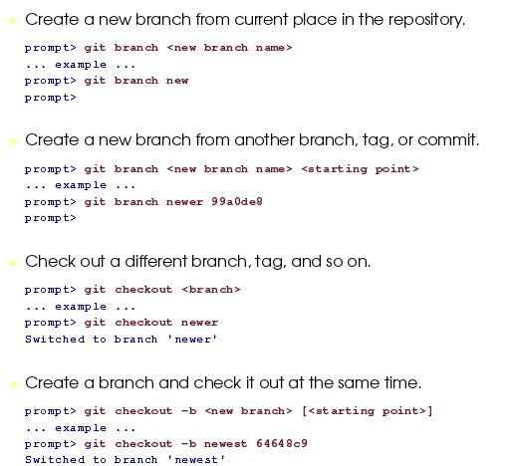

Slide 43
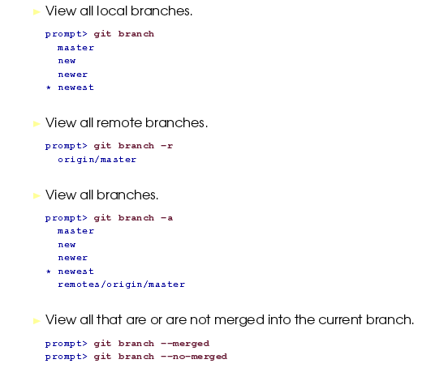
Viewing branches

Slide 44
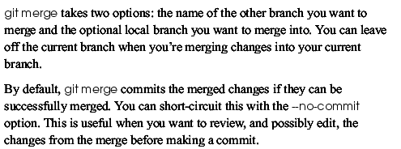
Merging commits between branches

Slide 45
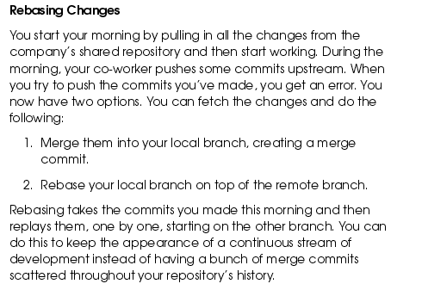

Slide 46
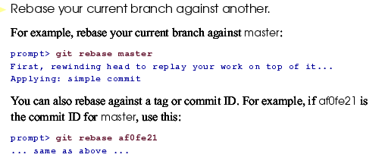

Slide 47
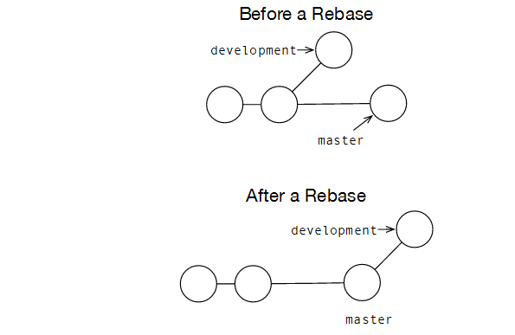

Slide 48

Deleting a branch

Slide 49
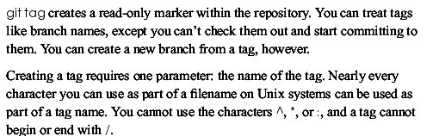
Creating tags in Git

Slide 50

Listing tags

Slide 51
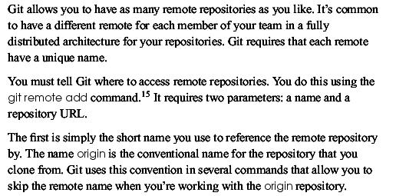
Creating remote repositories

Slide 52
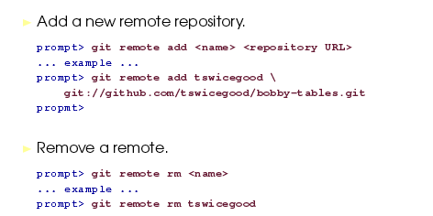

Slide 53
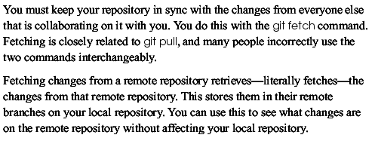
Git Fetch

Slide 54


Slide 55
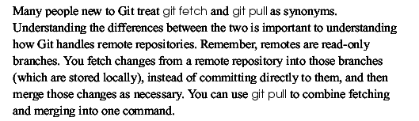
Retrieving changes

Slide 56
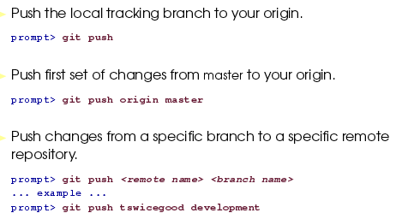

Slide 57
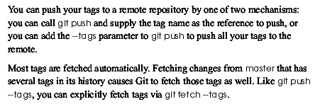
Handling remote tags and branches

Slide 58
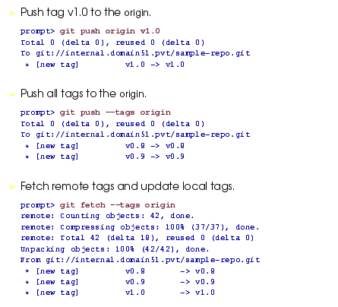

Slide 59
Handling conflicts in git
Git was nice enough to mark the problematic area in the file by enclosing it in "<<<<<<< HEAD" and ">>>>>>> [other/branch/name]".

Slide 60


Slide 61
The contents after the first marker originate from your current working branch. After the angle brackets, Git tells us where (from which branch) the changes came from. A line with "=======" separates the two conflicting changes.
Our job is now to clean up these lines

Slide 62
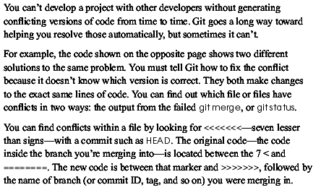
Resolving conflicts

Slide 63


Slide 64
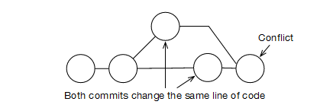

Slide 65
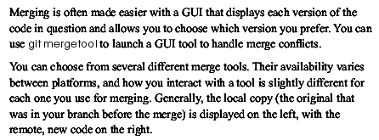
Handling conflicts with GUI

Slide 66
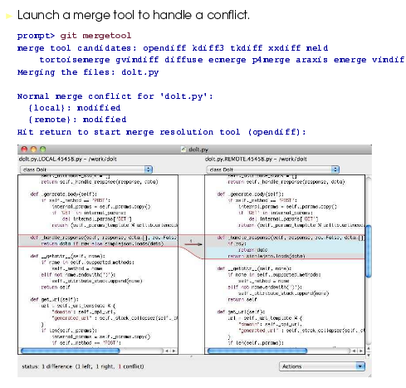

Slide 67
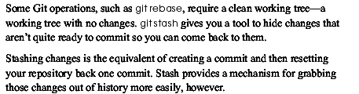
Temporarily Hiding changes with git stash

Slide 68
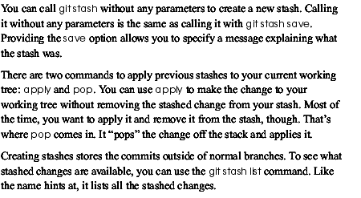

Slide 69
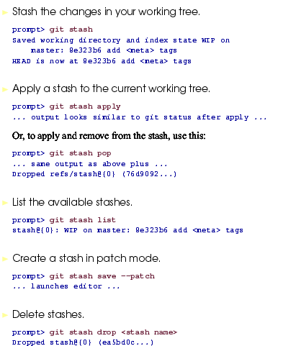

Slide 70
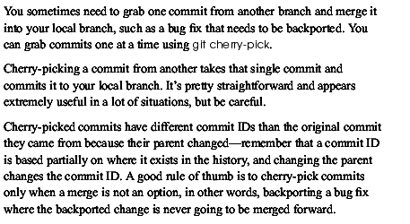
Git cherry pick

Slide 71
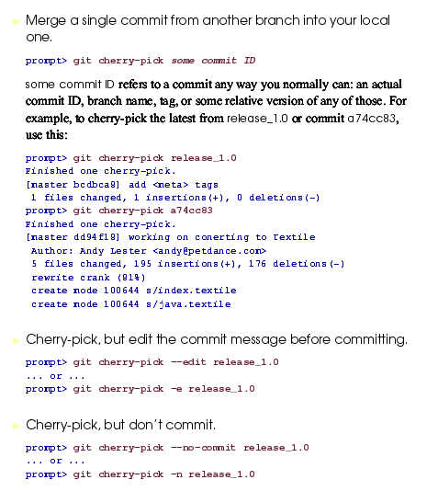

Slide 72
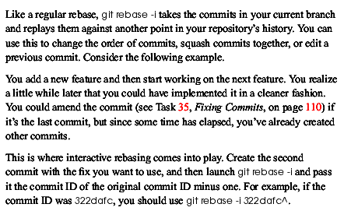
Controlling how to replay commits

Slide 73
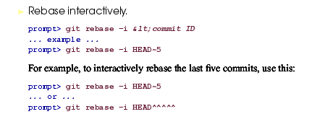

Slide 74
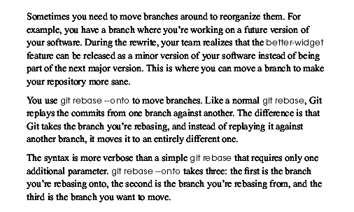
Moving branches

Slide 75
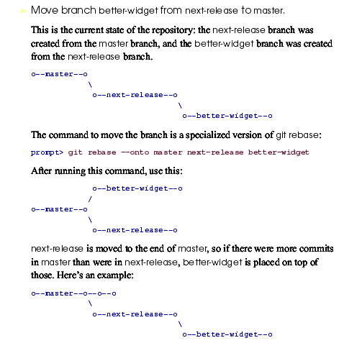

Slide 76
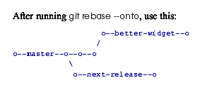

Slide 77
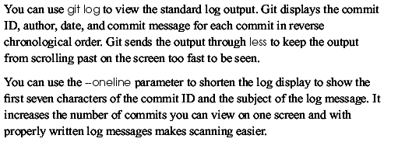
Git log with oneline option

Slide 78
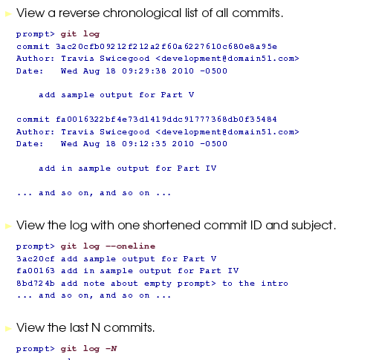

Slide 79

More options with Git log

Slide 80


Slide 81

Git diff

Slide 82


Slide 83

Git blame

Slide 84


Slide 85

Git revert

Slide 86


Slide 87

Resetting staged changes and commits

Slide 88


Slide 89

Erasing commits

Slide 90


Slide 91

Git bisect

Slide 92

Retrieving lost commits with Git reflog

Slide 93


