Slide 1
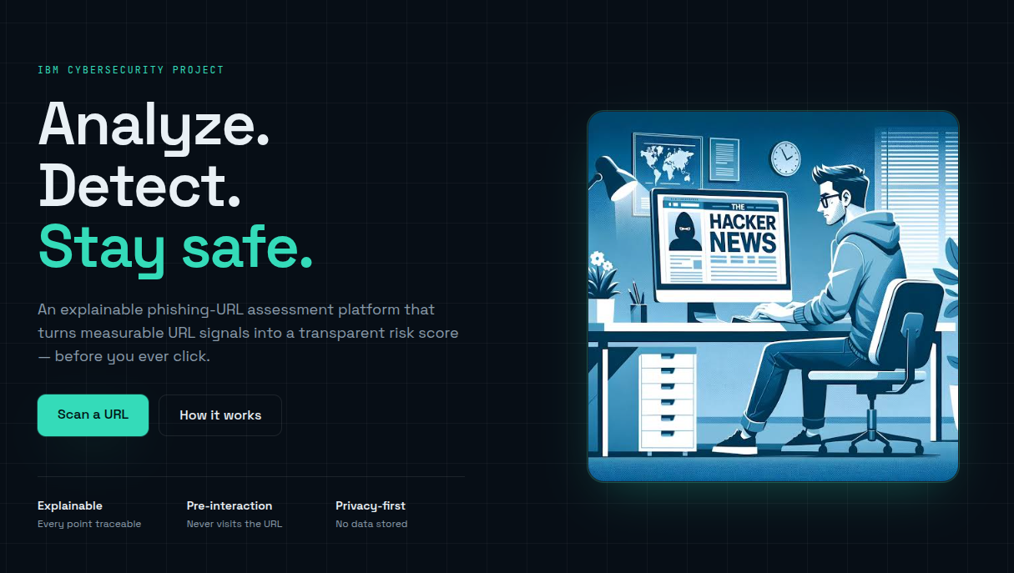
CYBER SAFETY • PROJECT PRESENTATION
URL SENTINEL
A simple way to pause, check a link, and make a safer decision online.
Presented by: ADWAITH VENUGOPAL
Class / Department: CSE B

Slide 2
01 • INTRODUCTION
Why link checking matters
A link can look familiar while leading to an unexpected or deceptive destination.
PHISHING
UNEXPECTED LINKS
USER AWARENESS
Fake pages may imitate trusted brands and try to collect passwords.
Messages can pressure users to click quickly without checking the address.
A quick pause and independent verification can reduce avoidable risk.
Key message: do not trust a link only because its message or appearance seems familiar.
URL SENTINEL • PROJECT PRESENTATION
02

Slide 3
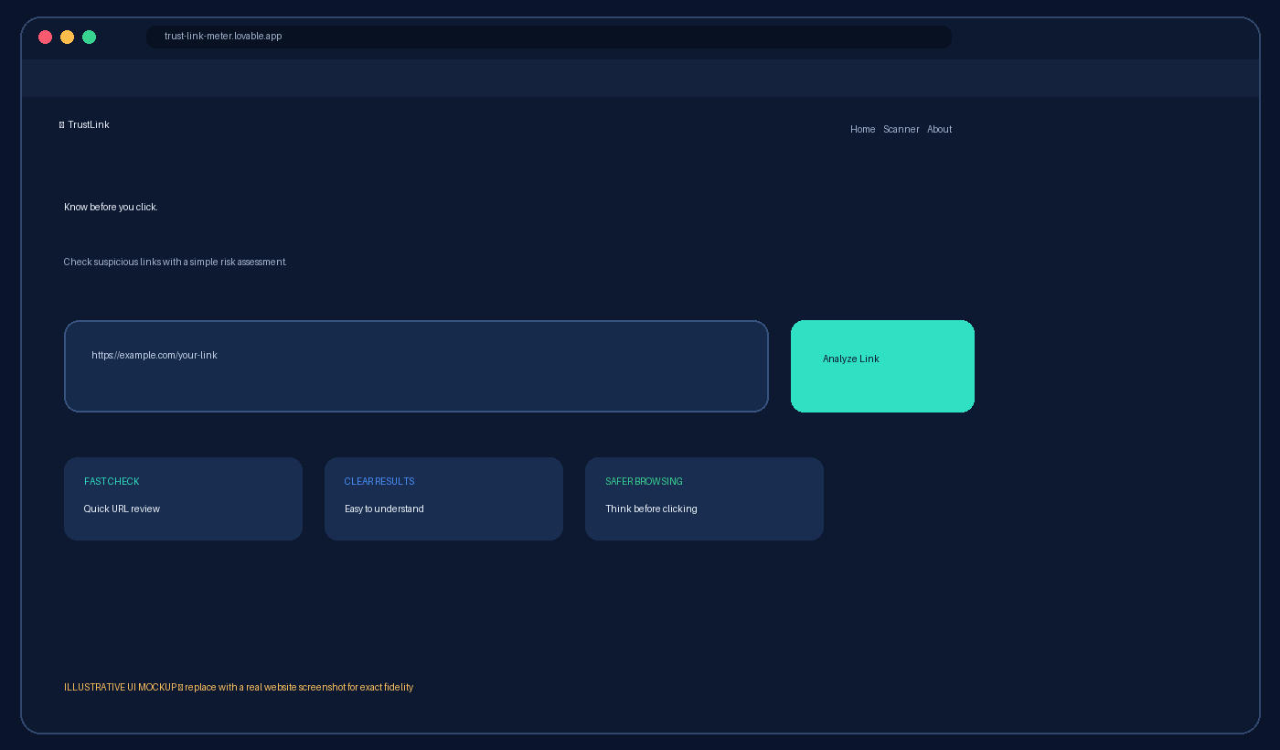
02 • THE IDEA
What is URL Sentinel?
A web-based concept for checking a URL and helping users think before they click.
PROJECT GOAL
Make link safety easier to understand for everyday users.
The website link provided is the source for this presentation. The exact features and results should be demonstrated live.
URL SENTINEL • PROJECT PRESENTATION
03

Slide 4
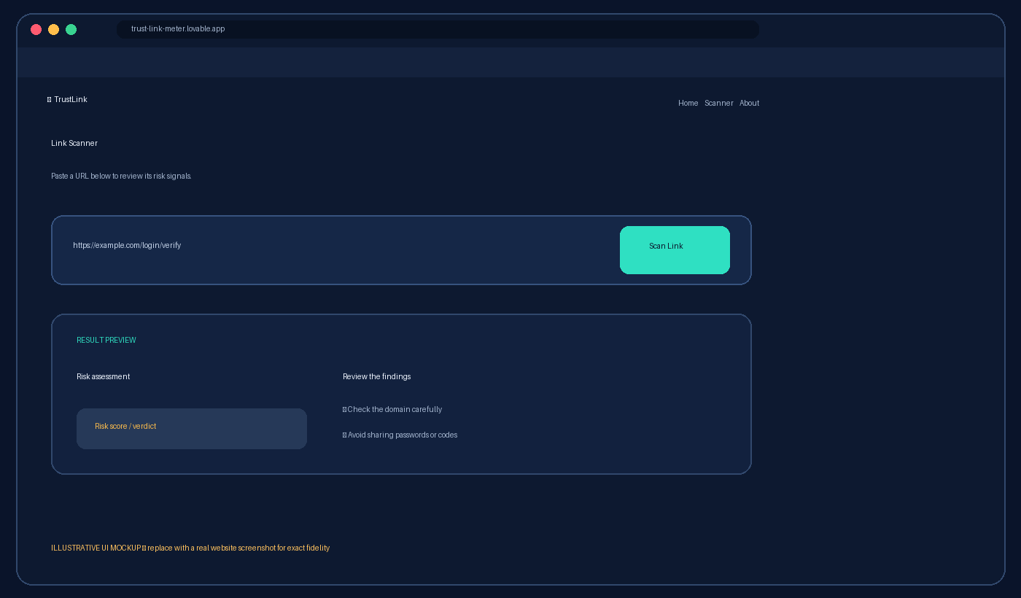
03 • WEBSITE WALKTHROUGH
Scanner page
Demonstrate the scanner by opening the website and entering a link you are authorised to test.
LIVE DEMO STEPS
1. Open the website URL.
2. Navigate to the scanner section.
3. Enter a public test URL.
4. Select the scan/analyze control.
5. Read the result and any explanation.
URL SENTINEL • PROJECT PRESENTATION
04

Slide 5
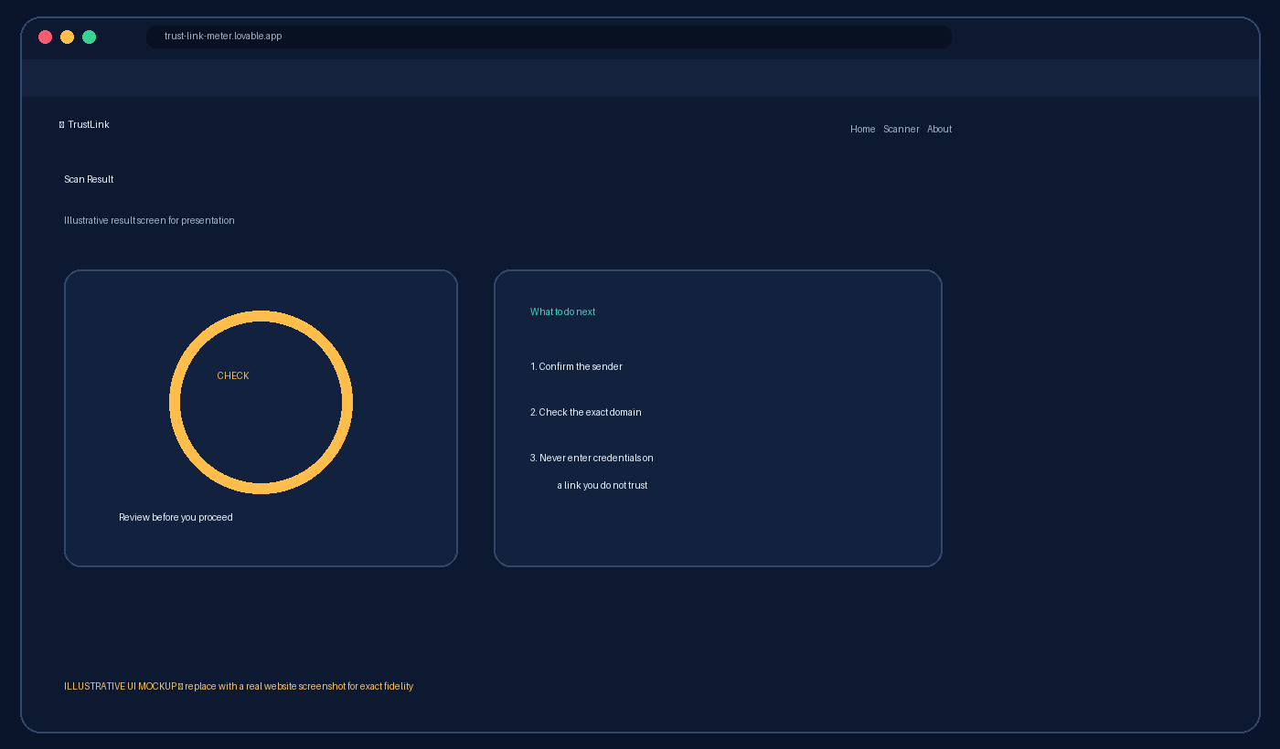
04 • UNDERSTANDING RESULTS
How to interpret a link check
Use the real website's displayed result during the presentation; do not assume a verdict in advance.
SAFE HABITS
• Check the spelling of the domain.
• Be cautious of urgency or threats.
• Never share passwords or one-time codes from an unexpected link.
• If unsure, visit the official site directly.
URL SENTINEL • PROJECT PRESENTATION
05

Slide 6
05 • BENEFITS
Why this project is useful
A clear, accessible link-checking flow can support safer online decisions.
Simple workflow
Awareness
Enter a URL and review the response.
Encourages users to question unfamiliar links.
Practical demonstration
Room to grow
Can be shown live in a browser during a project presentation.
Potential future additions include clearer explanations, scan history, and accessibility improvements.
URL SENTINEL • PROJECT PRESENTATION
06

Slide 7
06 • LIMITATIONS & NEXT STEPS
Responsible use
A link checker is a decision aid—not a guarantee that a website is safe.
IMPORTANT LIMITATIONS
FUTURE IMPROVEMENTS
• A low-risk result does not prove a link is harmless.
• Results depend on what the tool actually checks.
• Avoid entering private, personal, or authenticated URLs into public scanners.
• Explain each warning in plain language.
• Improve mobile accessibility and contrast.
• Add clear guidance for suspicious results.
• Test against safe, known examples.
URL SENTINEL • PROJECT PRESENTATION
07

Slide 8
CONCLUSION
Pause. Check. Then click.
URL Sentinel presents an opportunity to make link awareness more approachable and practical.
Thank you — any questions?
URL SENTINEL • PROJECT PRESENTATION
08

