Slide 1
Deepfake Detection Model
using MobileNetV2

Slide 2
Problem Statement
Deepfake technology manipulates videos and images,
leading to misinformation and security threats.
This project builds a CNN model to classify real and fake images.

Slide 3
Problem Statement
Deepfake technology manipulates videos and images,
leading to misinformation and security threats.
This project builds a CNN model to classify real and fake images.

Slide 4
Literature Survey
- Early methods: handcrafted features (blinking, landmarks)
- Now: Deep learning (CNNs, RNNs, Capsule Networks)
- CNNs automatically learn deep features from pixels.

Slide 5
Dataset Explanation
Source: detection.zip containing real and fake images.
Structure after unzip:
detection_data/real/detection_data/fake/
Splitting:
80% Training,20% Testing
Classes:Real (Label 0)Fake (Label 1)

Slide 6
Data Preprocessing
Rescaling pixel values (1./255 normalization).
Image resizing to (224x224).
Batching with size 32.
Binary classification mode.

Slide 7
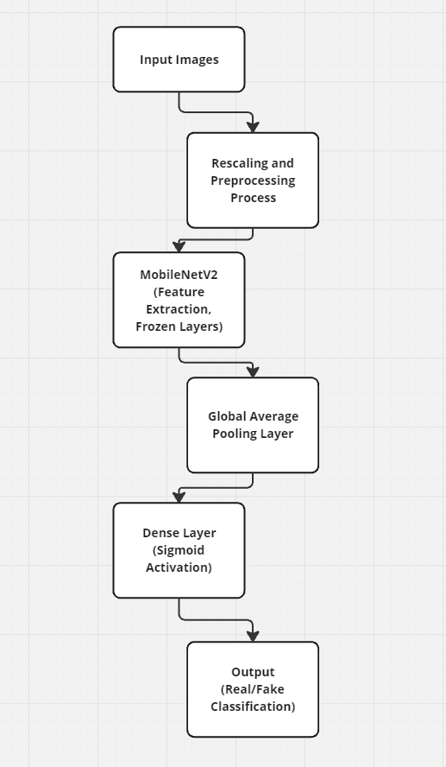
Model Architecture
Base Model: MobileNetV2 (pretrained, ImageNet weights, frozen).
Added Layers: Global Average Pooling, Dense layer (1 neuron, sigmoid activation)
Optimizer: Adam
Loss Function: Binary Crossentropy

Slide 8
Model Training Summary
Epochs: 5
Train Accuracy: ~82%
Final Test Accuracy: ~79.74%

Slide 9
Thank you!! :D

