Slide 1


Accelerating DNN Architecture Search at Scale Using Selective Weight Transfer
Hongyuan Liu†, Bogdan Nicolae∗, Sheng Di∗, Franck Cappello∗, Adwait Jog†
Session 2 @ CLUSTER 2021
†
∗
Notes:
My name is Hongyuan Liu. In this video, I will present our work Accelerating DNN Architecture Search at Scale Using Selective Weight Transfer.
This work was jointly performed with my advisor Adwait Jog at William & Mary and our collaborators Bogdan Nicolae, Sheng Di, and Franck Cappello at Argonne National Lab.

Slide 2

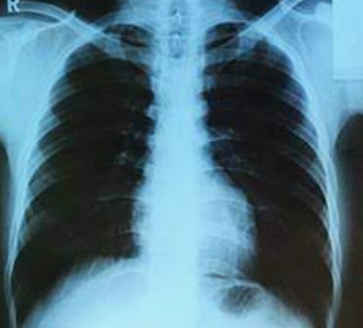
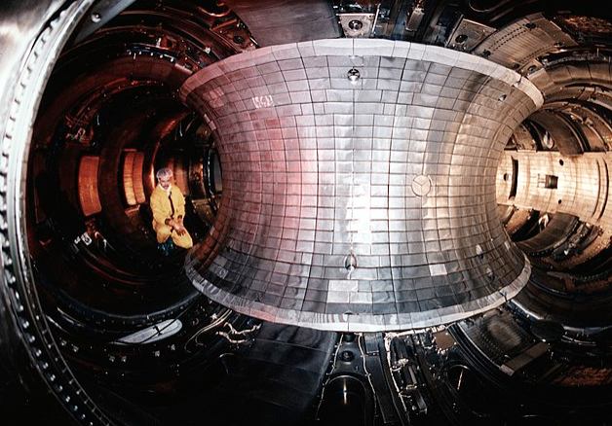

Deep Neural Networks (DNNs)
Cat!
Image Classification
Medical Research
Financial Technology
Fusion Energy Science
Images from https://www.instagram.com/lume_miao/ and Wikipedia
Notes:
Deep neural networks have succeeded in many domains, such as
1
Image classification
2
Medical research
3
Financial technology
4
Fusion energy science

Slide 3




Deep Neural Networks (DNNs)
DNN Model
Cat!
How do we design the black box?
Notes:
We show a typical usage of a deep neural network. Suppose we have a cat image as the input.
1
We simply feed the image into the trained DNN.
2
The DNN model classifies the input and give the answer to the user.
In the entire process, the user just need to treat the DNN as a black box.
3.
How do we design the black box?
One way is to design the black box manually. However, this way requires both domain knowledge and machine learning knowledge.
Can we design the black box automatically?

Slide 4
Neural Architecture Search at Scale
Stages:
Challenge
Expensive in Computation & Resources
Search Models
Top-K Promising Models (Candidates)
Full Training
Fully Trained Model(s)
Notes:
Neural architecture search is an approach to design the DNN model automatically for a certain task.
Neural architecture search has two stages.
1.
The first stage explores the search space and evaluate potential models,
2
and then generate top-K promising models (or candidates).
3.
The second stage fully trains the top-K promising models. After the full training, the user can select the models they want to deploy in the real use cases.
4
However, the entire process requires significant amount of computation resources and time.

Slide 5
Given a limited budget of node hours, how can we find the best models?
Notes:
Given a limited budget of node hours, how can we find the best models?
In this work, our techniques focus on optimizing this problem.
To start with, we will analyze the problems in the neural architecture search process.

Slide 6





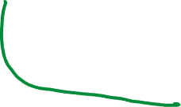

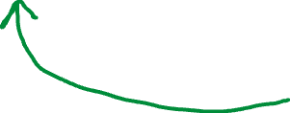


Neural Architecture Search (NAS)
Search Strategy
Evaluator
Model A
Model A
Model B
Model B
Model C
Model C
Notes:
Before the first stage, the user define a search space. The search space contains many models, here we show them as model A, B, C.
In the first stage
1
The NAS framework uses a search strategy to explore the search space.
2
The search strategy generates the next model to be evaluated.
3
Then, the evaluator evaluates the model,
4
and feedback the score of the model to the search strategy. The score shows how promising a model is.
5
based on the score of each model, the search strategy determines which model to search next.
6.
This process continues until the search space is exhausted or the process reaches the time budget.

Slide 7

How Does the Evaluator Score Models?
One simple way (low-fidelity training):
Train the model with small number of epoch(s)
Model 1
Accuracy = 0.6
➔ Score = 0.6
Converged
Accuracy = 0.9
Model 2
Accuracy = 0.7
➔ Score = 0.7
Converged
Accuracy = 0.8
Model 1 and model 2, which one is better?
Notes:
How does the evaluator score the models?
1
There are multiple ways to roughly estimate a score for a model. One category is to use low-fidelity training. In this work, we focus on one approach of low-fidelity training. It trains the model with small number of epochs rather than a lot of epochs.
In this work, we evaluate the candidate using one epoch.
2
Consider we have model 1. We can train it using only one epoch.
The trained accuracy on the validation set is 0.6. So we give model 1 a score 0.6.
3.
When model 1 is fully trained to converge, it may require 50 epochs.
Let's suppose the converged accuracy is 0.9.
5.
Consider we also have a model 2 with score = 0.7. When model 2is fully trained, the accuracy is 0.8.
6
Model 1 and model 2, which one is better?
--- Here we know although model 1 has lower score, when being fully trained, it is better than model 2.

Slide 8
Problems
Slow convergence of the candidates
It affects searched model quality
Slow full training of the top-K models
K may be large.
Notes:
In this work, we focus on addressing two problems.
First,
Due to the slow convergence, as we show in the previous slide, the score may not reflect the performance of the full training model. This may affect the final model quality.
2
Second,
in the second stage of the NAS, it fully trains the top-K candidates. The user may want multiple models to deploy to different platforms. It also requires a lot of time because K may be large and each needs a lot of epochs.

Slide 9
Our Insights
The models generated from the same search space are similar:
Functionality
Structure
How do we leverage the model similarity to address the two problems?
Notes:
To address the two problems, our insight is that the models in the same search space are similar in two aspects.
First, all the models try to solve the same task, and are trained by the same dataset.
Second, the models may have tensors of the same shape. We simply call this case as structurally similar. We confirmed this case in our paper.
Next, we discuss how do we leverage the model similarity to address the two problems.

Slide 10

Leverage the model similarity to address the two problems Basic Idea: Weight Transfer from Previous Evaluated Models
Evaluator
Challenge:
Weight transfer from a different model
Model A
Checkpoint A
Weights of A
Model B
Expectation:
Score will be closer to the converged obj. metric of B
Better candidates
Notes:
Here, we show the basic idea of our approach that partially transfers weights from previous evaluated models.
1
After the the evaluator evaluates a model A, it writes a checkpoint for A for future full training.
2
We reads the weights of A from the checkpoint A.
3
And then we use the weights of A to initialize the next model.
3
The circled area shows our proposal.
4.
We expect the score of model B initialized with weights transferred from model A is closer to the converged objective metric of B.
5
However, the challenge is, it is not clear how can we transfer weights from a model with a different structure.

Slide 11







Weight Transfer Mechanisms
If two tensors of the same shape, it is easy to assign one to the other.
A model can be treated as a tensor shape sequence
Weight Transfer Mechanisms:
Longest Prefix (LP)
Longest Common Subsequence (LCS)
Notes:
In this slides, we propose weight transfer mechanisms in this scenarios.
1
We consider the simplest case to transfer a tensor. If two tensors are in the same shape, it is easy to assign one to the other.
2
A model, can be treated as a tensor shape sequence following an order in which the layers are defined.
3
Here we show a simple CNN model. It uses a convolution layer, a pooling layer, a convolution layer, and two dense layers. There are 4 weighted layers.
4
Therefore, we can treat the model as a tensor shape sequence. Here, the sequence looks like this.
5
Based on the tensor shape sequences, we propose two weight transfer mechanisms
First, longest prefix.
Second, longest common subsequence.

Slide 12


Weight Transfer Mechanisms
Example of LP:
Provider Sequence : (6 x 3 x 3), Pooling, (16 x 3 x 3), (120 x 84), (84 x 10)
Receiver Sequence : (6 x 3 x 3), (16 x 3 x 3), Pooling, (60 x 84), (84 x 10)
Example of LCS:
Provider Sequence : (6 x 3 x 3), Pooling, (16 x 3 x 3), (120 x 84), (84 x 10)
Receiver Sequence : (6 x 3 x 3), (16 x 3 x 3), Pooling, (60 x 84), (84 x 10)
Notes:
We show examples of the two mechanisms.
1
First, for example, the longest prefix of the two sequences are shown in here.
2
They will transfer the two beginning convolution layers.
2
Second, suppose we use LCS, since the longest common subsequence does not require the sequence to be contiguous, the last tensor is also transferred.

Slide 13
Research Questions
From which model do we transfer weights to initialize the current model is beneficial?
How do we integrate the weight transfer mechanisms with existing NAS framework?
Notes:
After we have the weight transfer mechanisms, we have two research questions.
First, for a certain model to be evaluated, we do not know from which model do we want to transfer weights from to initialize it. We also don’t know whether weight transfer is beneficial to the receiver model.
Second, we need to have a way to integrate the mechanisms to existing NAS frameworks.

Slide 14
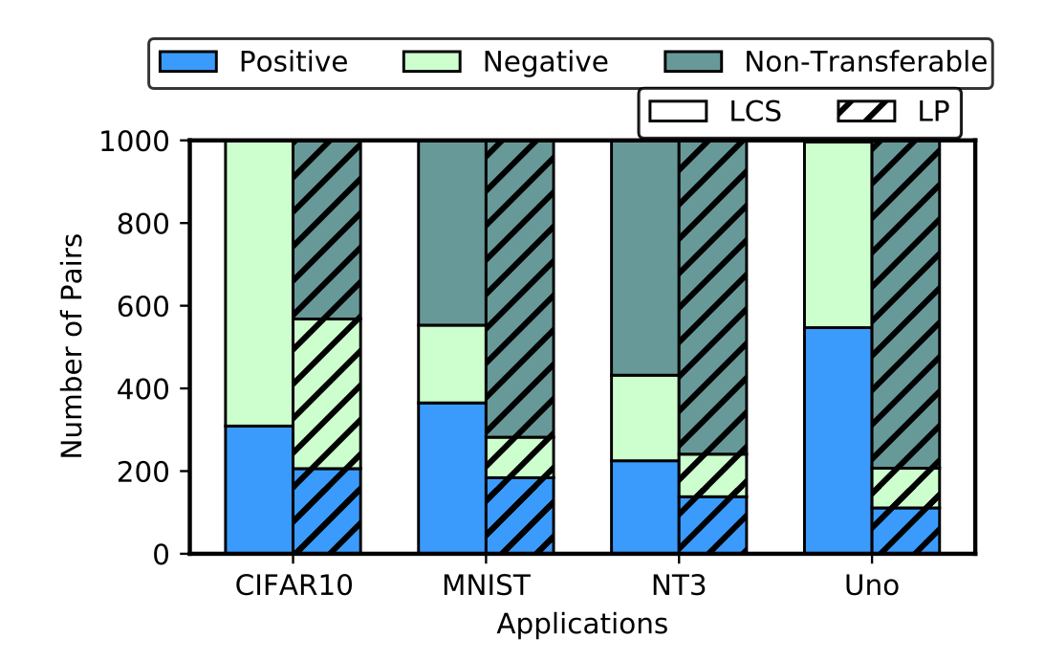
How about select a provider model randomly?
NAS Trace
Model 1
Model 2
Model 3
Model 4
…
Generate Pairs (provider, receiver)
(Model 1, Model 2)
(Model 3, Model 4)
(Model 2, Model 4)
(Model 4, Model 3)
…
Positive Pair
Negative Pair
Non-Transferable Pair
By randomly selecting a provider model, the receiver model does not converge faster!
Notes:
First, we try to answer the first research question--- From which model do we transfer weights to initialize the current model is beneficial.
1
To this end, we collect NAS traces for four different applications. Each line of the trace is an explored model.
2
We generate pairs of provider model and receiver model randomly from the NAS traces. Then, we classify the pairs to three categories. Positive pair, negative pair, non-transferrable pair.
The pair is positive when the receiver model, when trained from the weights transferred from the provider model, converges faster than being trained from random weights. In other words, weight transfer benefits it.
3
Here, we check if randomly pick a provider model can benefit the receiver model.
In this figure, we found the positive pairs, in all cases, are not majority.
4
As a result, we conclude that randomly selecting a provider model to transfer weights from cannot make the receiver model converge faster.

Slide 15
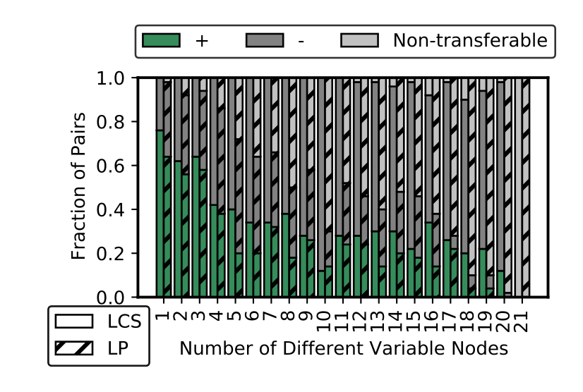
Leverage the Similarity
The search space contains many variable nodes. The user defines what operators (e.g., Conv2D, Dense, Skip-connection, etc. ) can be in different variable nodes.
We use number of different variable nodes to measure how similar the provider and the receiver is.
Positive
Negative
Observation:
Transferring weights from a similar model will be likely to accelerate the convergence of training current candidate.
CIFAR-10
Notes:
We leverage the similarity of the models in the search space.
1
The search space contains many variable nodes. The user defines what operators (e.g., Conv2D, Dense, Skip-connection, etc. ) can be in different variable nodes. When the NAS instantiate a model, it needs to select operators for each variable node.
2.
We use number of different variable nodes to measure how similar the provider model and the receiver model is. The more different options the provider, receiver pair have taken, the less similarity they are.
3.
Like the experiment in the previous slides, we classify pairs into positive, negative and non-transferrable, but we breakdown the results by the number of different variable nodes.
We show the results of one application. The results of other evaluated applications are similar.
4
In this figure, we observe the downward tread of the positive pairs. Also, we observe that transferring weights from a similar model will be likely to accelerate the convergence of training current candidate.

Slide 16





Integrating Weight Transfer Mechanisms
Challenge:
How do we select a similar model fast?
Notes:
Next, we discuss our second research question: how do we integrate the weight transfer mechanisms with existing NAS framework.
1
Now suppose we are evaluating model n. Previously, n-1 models were evaluated.
2.
To do the weight transfer, we need to find a proper “similar” model from the previous n-1 models. Since read checkpoints and recover the checkpoints to models also take much time, we need to select a similar model very fast!

Slide 17
Integrating Weight Transfer Mechanisms
How do we select a similar model faster?
We notice the genetic algorithm (RegEvo [1]) always generate similar new model by mutating previous (i.e. parent) models.
Simple Solution:
Integrating weight transfer mechanism with RegEvo.
[1] Real et al., Regularized Evolution for Image Classifier Architecture Search, AAAI 2019
Notes:
To address the challenge, we revisit the existing search strategies. We notice a set of search strategies use genetic algorithm. A typical work is regularized evolution.
Such genetic algorithm always generates a new model by mutating one option of the variable nodes in an old model. This means that the newly generated model has one different variable node compared to the parent model.
1
In this work, we use the simple solution that integrates our weights transfer mechanisms with the regularized evolution search strategy.
It is also important to note that our weight transfer mechanisms are not limited to it, if we have a fast way to select a similar provider model.

Slide 18

Accelerating the Full Training
Stages:
Search Models
Top-K Promising Models (Candidates)
Checkpoint 0
Checkpoint 0
Full Training
Checkpoint K
Fully Trained Model(s)
Notes:
After the first stage, since the top-K models’ checkpoints are closer to the converged objective metrics.
1
When we fully train them, we use the checkpoints of K models. The checkpoints, which were started training with transferred weights, are closer to the fully trained models.
Consequently, we expect they will converge faster in the full training. We will evaluate it later.

Slide 19
Implementation & Evaluation
Implementation
We build our schemes on top of DeepHyper [2]
Experiment Configuration
On “ThetaGPU” cluster
We use up to four DGX A100 nodes, each has 8 NVIDIA A100 GPUs
More details are in the paper.
[2] Balaprakash et al.,
Scalable Reinforcement-Learning-Based Neural Architecture Search for Cancer Research, SC 2019
Notes:
In this slide, we discuss our implementation and the evaluation configurations.
We implement our schemes on top of DeepHyper, a neural architecture framework.
We run our experiment on Argonne ThetaGPU cluster. We use up to four DGX A100 nodes, each has 8 NVIDIA A100 GPUs.
We train each model on one GPU.
More details of the implementation and evaluation configuration are introduced in the paper.

Slide 20
Datasets & Search Space
Dataset | Task | Search Space
CIFAR-10 | Image Classification | VGG variants
MNIST | Image Classification | LeNet variants
Uno | A part of ECP-CANDLE Drug response regression model | Defined in [2]
NT3 | A part of ECP-CANDLE, RNA classifcation | Defined in [2]
[2] Balaprakash et al.,
Scalable Reinforcement-Learning-Based Neural Architecture Search for Cancer Research, SC 2019
Notes:
We discuss the datasets and the search space used in our paper.
We focus on four datasets of the image classification and the cancer research domain.
CIFAR-10 classifies images to 10 categories. We define our own search space inspired by VGG network variants.
MNIST classifies handwritten digits. We define our own search space inspired by LeNet.
Next, Uno and NT3 are a part of ECP CANDLE project. Uno builds a regression model for drug response. NT3 builds an RNA classification model. For these two datasets, we use the same search space defined in the previous DeepHyper paper.

Slide 21
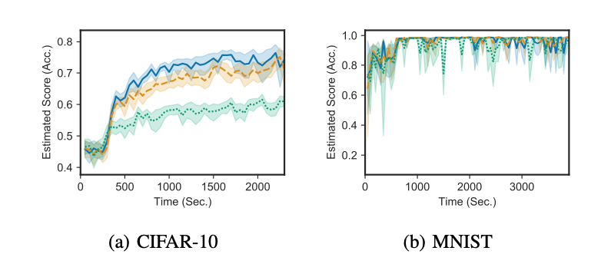
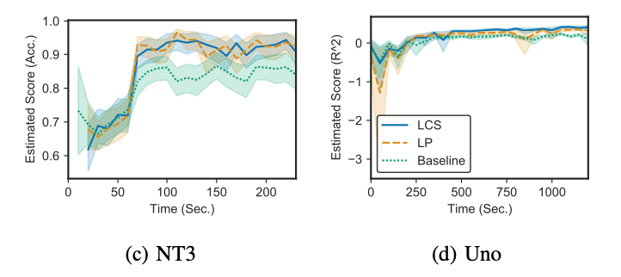
Q1: The convergence of the candidate models
All cases, our schemes have comparable results.
In most cases, our schemes accelerate the convergence, bringing the scores closer to the fully-trained models.
Notes:
Can weight transfer accelerate the convergence of the candidate models?
We run neural architecture search on each application for five times and average them together. We search 400 candidate models for each experiment.
The x-axis shows the time, and the y axis shows the averaged objective metrics (such as accuracy and R^2 in our cases).
The blue line and the orange line show our approaches. The green line shows the baseline case without weight transfer.
1
We observe that first, in all cases, our schemes achieve comparable results to the baseline case.
2
Second, in all cases except MNIST, our schemes show better metrics at the same time compared to the baseline.
Since we do not change the search space and search strategy, this indicates that our schemes accelerate the convergence, bringing the scores closer to the objective metrics of the fully-trained models.

Slide 22
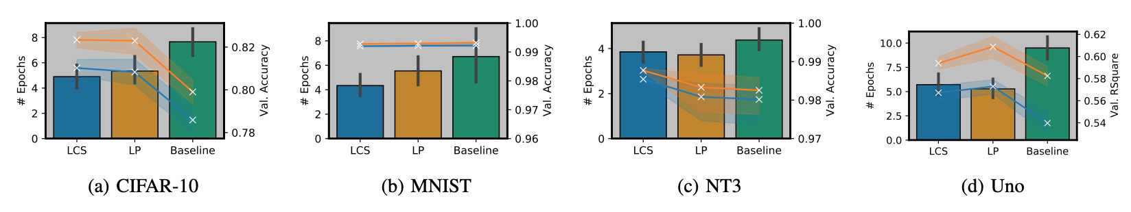
Q2: Full training for the top-K candidate models
Shorter the bars are, faster the top-K models are trained. 1.5X / 1.4X Speedup
Notes:
Can we speed up the full training for the top-K candidate models?
To answer question 2, we use the checkpoints written by the first stage of NAS.
We train the models for at maximum 20 epochs to get the fully trained models. We adopt early stopping to them. Specifically, if the objective metrics do not change by more than a given threshold for two epochs, the training stops.
The bars in the figures show the number of epochs needed to reach the convergence. The lower the bars are, the faster the training is.
We observe that, with early stopping, our approaches accelerates the full training by 1.5 times and 1.4 times, respectively.
We also compare the objective metrics. We found that in all cases except MNIST, with our approaches, the objective metrics are significantly better than the baseline case, regardless applying early stopping or not.

Slide 23
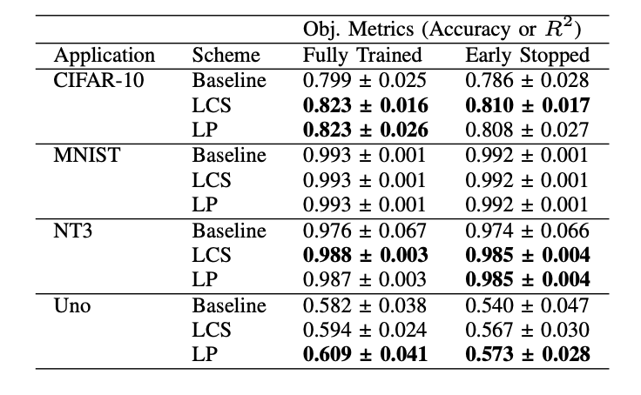
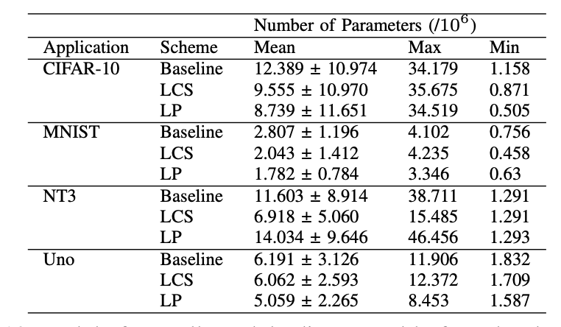
Q3: Model Quality & Complexity
With weight transfer, we discover better, or at least comparable models compared to training from scratch approach. (Reason analysis is in the paper)
Our schemes have a similar range of parameters as the baseline does.
Notes:
How do the models discovered using weight transfer compare with those discovered by training from scratch?
We check the models found by the NAS process.
In the first table, we show the statistic results of the top-10 models.
In MNIST, all approaches achieve similar accuracy because MNIST is easy to achieve good results and converges very fast.
In all other applications, our approaches achieve better results, regardless applying early stopping or not. It is not obvious whether LCS or LP can always win, because it also depends on the search space of the application and operators in the variable nodes.
The reason that our approach increases the model quality is that our approaches make the scores of the candidates more accurate by let them converge faster. The detailed analysis is in the paper.
1
Second, to have better metrics, the user may not want at the cost of a huge increase of the model complexity.
To know the model complexity, we use the number of parameters as a proxy for the model complexity.
We observe that for most cases, our schemes have a similar range of parameters as the baseline does. Sometimes, our approaches have fewer number of parameters than the baseline. To conclude, our approaches lead to statistically better models than the baseline without a negative impact on the model complexity characteristics.

Slide 24
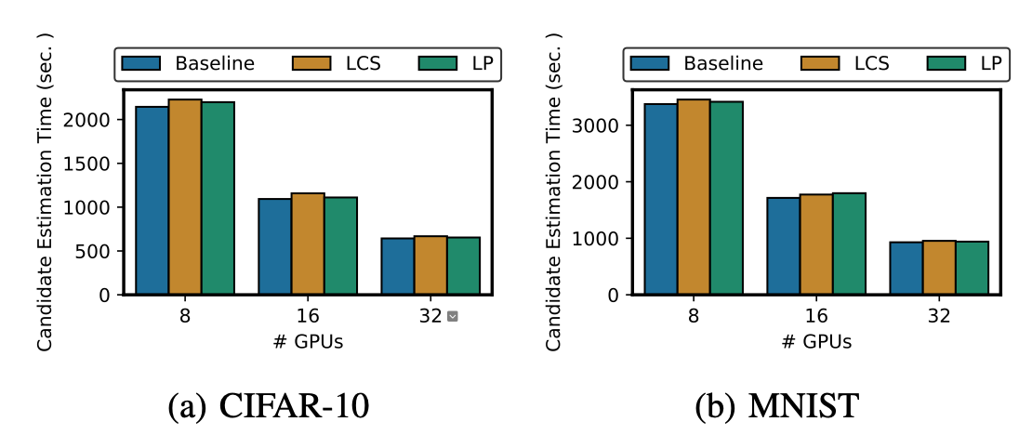
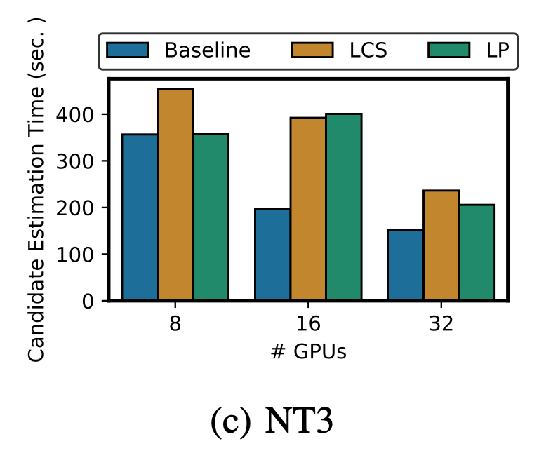
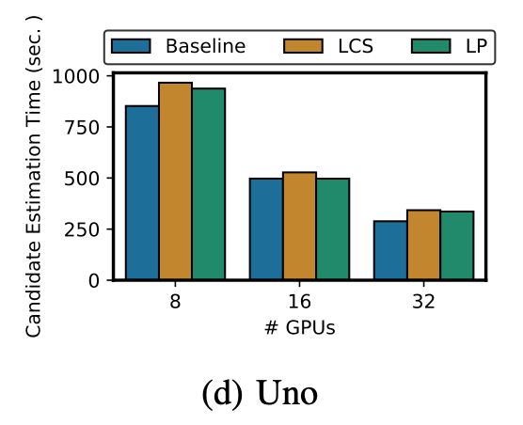
Q4: Scalability Analysis
Scales linearly with the increasing number of GPUs in most evaluated applications.
Not scale perfectly for NT3, as it has too few observations.
Notes:
Are the proposed weight transfer techniques scalable?
We further check what is the overhead of our approaches and whether they are scalable in a cluster.
We vary the number of GPUs we use, from 8, 16, to 32. We found that our schemes incur small amount of overhead because of loading checkpoints and recover checkpoints to models.
1
First, we found that our schemes scale linearly for most of the applications.
2.
Second, as NT3 only has around 1 thousand training samples and it only takes 6 second to train, compared to the training time, our schemes have comparable large overhead in NT3.
Also, the task scheduler also incurs large overhead in the small tasks.
To conclude, our approach is scalable and incurs a low overhead for most of the evaluated applications.

Slide 25
Contributions
Weight transfer mechanisms
Study the beneficial cases of weight transfer, and establish criteria for provider model selection
Lightweight and scalable integration to an existing NAS approach
Accelerated convergence and full training
Notes:
Weight transfer mechanisms
Study the beneficial cases of weight transfer, and establish criteria for provider model selection
Lightweight and scalable integration to an existing NAS approach
Accelerated convergence and full training

Slide 26
Thank You!
This material is based upon work supported by the U.S. Department of Energy (DOE), Office of Science, Office of Advanced Scientific Computing Research, under Contract DE- AC02-06CH11357. We acknowledge the computing resources provided on Theta and JLSE (operated by Argonne Leadership Computing Facility).
Notes:
Thank you very much for coming to this talk!

