Slide 1




Fault Site Pruning for Practical Reliability Analysis of GPGPU Applications
Bin Nie, Lishan Yang, Adwait Jog, and Evgenia Smirni
College of William & Mary
Notes:
HPC DL VR.

Slide 2

Soft Errors
Soft errors: most commonly observed errors
Single bit flips
Masked output
Correct answer.
Silent Data Corruption (SDC) output
Wrong answer.
Other output
Crash, hang, …
Notes:
Soft errors 过度 most common observed error
字还是黑的
Intro是怎么写的

Slide 3

Reliability Research: Fault Injection
Fault injection method
Injecting single-bit errors into different locations (fault sites) in applications
Ground truth: huge unreachable exhaustive fault sites!
Closest to ground truth (Baseline):
Random sampling based on statistics
GEMM:
$16384 threads×1305 insns/thd×29.6bits/insn=6.23×{10}^{8}$ fault sites!
Confidence Interval: 99.8%, Error Margin: 1.26%
→ 60K fault sites
Notes:
GPU: parallel Typically. GEMM: matrix mul. GEMM: 16Kthd x #insn x #bit

Slide 4



GPU Architecture
GPU Application
Kernel 1
Kernel 2
…
Kernel $n$
Kernel
CTA 1
CTA 2
CTA $n$
…
…
…
…
CTA
Warp 1
Warp 2
Warp$n$
…
…
…
…
Notes:
4 & 5 连在一起

Slide 5
GPU Architecture → Progressive Fault Sites Pruning
....
Thread-wise pruning
GPU Application
Kernel 1
Kernel 2
…
Kernel $n$
Instruction-wise pruning
Kernel
....
CTA 1
CTA 2
CTA $n$
Loop-wise pruning
…
…
…
…
....
CTA
Warp 1
Warp 2
Warp$n$
Bit-wise pruning
…
…
…
…
....
Notes:
2 million exps

Slide 6
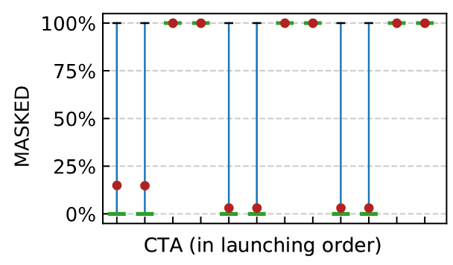
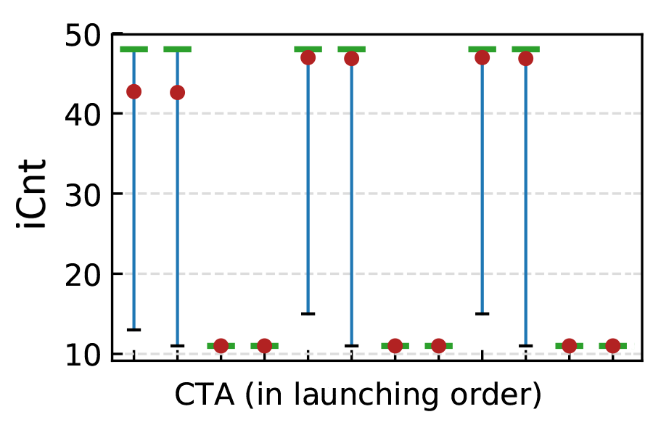
Progressive Fault Sites Pruning
....
Thread-wise pruning
CTA-level
Instruction-wise pruning
....
Loop-wise pruning
....
2DCONV K1
Bit-wise pruning
A few CTAs are enough; the rest are pruned
proxy
....
Notes:
颜色 备选方案。 Pdf & ppt; U pan
圈出来，不同线框
Group 1,2,3 加文字
Icnt -> insn cnt
Check CTA, highlight

Slide 7
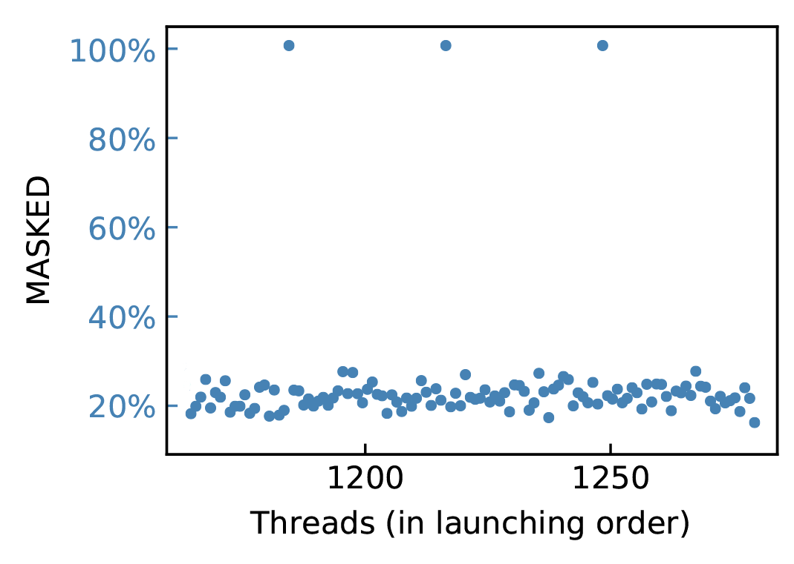
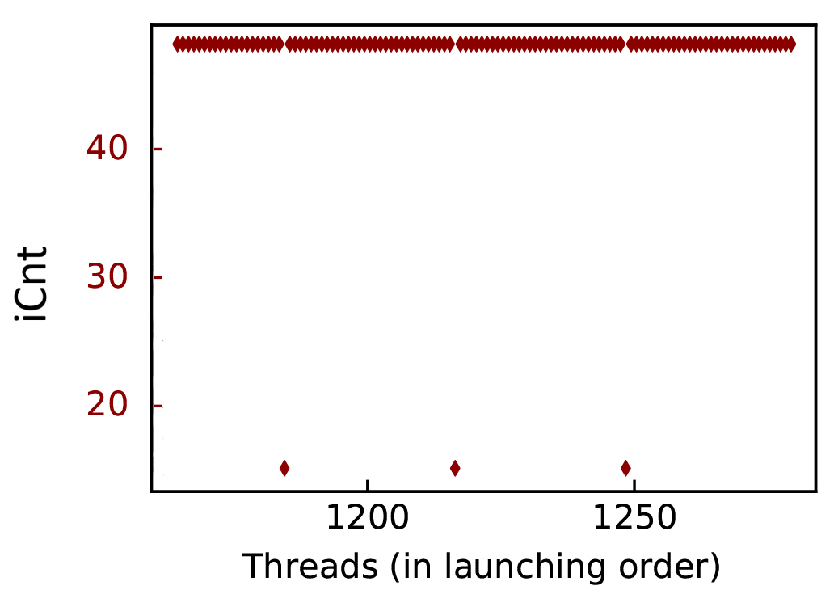
Progressive Fault Sites Pruning
....
Thread-wise pruning
CTA-level → Thread-level
Instruction-wise pruning
....
Loop-wise pruning
....
Bit-wise pruning
A few threads are enough; the rest are pruned
2DCONV K1, CTA(0-1-0)
....
proxy
Notes:
加线太乱。
用不同颜色,

Slide 8
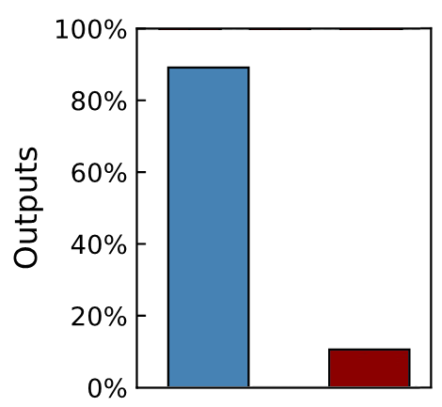
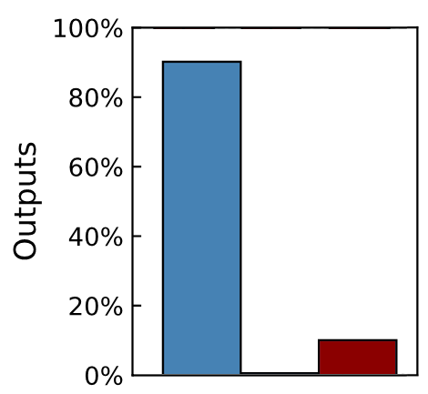
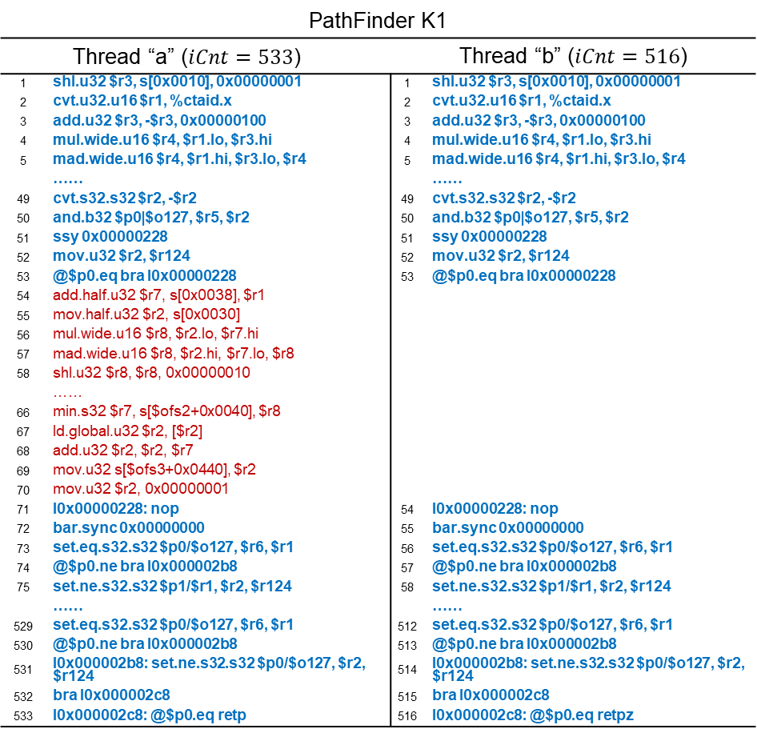
Progressive Fault Sites Pruning
PathFinder K1
Thread “a” ($iCnt=533$) |  |  | Thread “b” ($iCnt=516$)
1 | shl.u32 $r3, s[0x0010], 0x00000001 |  | 1 | shl.u32 $r3, s[0x0010], 0x00000001
2 | cvt.u32.u16 $r1, %ctaid.x |  | 2 | cvt.u32.u16 $r1, %ctaid.x
3 | add.u32 $r3, -$r3, 0x00000100 |  | 3 | add.u32 $r3, -$r3, 0x00000100
4 | mul.wide.u16 $r4, $r1.lo, $r3.hi |  | 4 | mul.wide.u16 $r4, $r1.lo, $r3.hi
5 | mad.wide.u16 $r4, $r1.hi, $r3.lo, $r4 |  | 5 | mad.wide.u16 $r4, $r1.hi, $r3.lo, $r4
 | …… |  |  | ……
49 | cvt.s32.s32 $r2, -$r2 |  | 49 | cvt.s32.s32 $r2, -$r2
50 | and.b32 $p0|$o127, $r5, $r2 |  | 50 | and.b32 $p0|$o127, $r5, $r2
51 | ssy 0x00000228 |  | 51 | ssy 0x00000228
52 | mov.u32 $r2, $r124 |  | 52 | mov.u32 $r2, $r124
53 | @$p0.eq bra l0x00000228 |  | 53 | @$p0.eq bra l0x00000228
54 | add.half.u32 $r7, s[0x0038], $r1
55 | mov.half.u32 $r2, s[0x0030]
56 | mul.wide.u16 $r8, $r2.lo, $r7.hi
57 | mad.wide.u16 $r8, $r2.hi, $r7.lo, $r8
58 | shl.u32 $r8, $r8, 0x00000010
 | ……
66 | min.s32 $r7, s[$ofs2+0x0040], $r8
67 | ld.global.u32 $r2, [$r2]
68 | add.u32 $r2, $r2, $r7
69 | mov.u32 s[$ofs3+0x0440], $r2
70 | mov.u32 $r2, 0x00000001
71 | l0x00000228: nop |  | 54 | l0x00000228: nop
72 | bar.sync 0x00000000 |  | 55 | bar.sync 0x00000000
73 | set.eq.s32.s32 $p0/$o127, $r6, $r1 |  | 56 | set.eq.s32.s32 $p0/$o127, $r6, $r1
74 | @$p0.ne bra l0x000002b8 |  | 57 | @$p0.ne bra l0x000002b8
75 | set.ne.s32.s32 $p1/$r1, $r2, $r124 |  | 58 | set.ne.s32.s32 $p1/$r1, $r2, $r124
 | …… |  |  | ……
529 | set.eq.s32.s32 $p0/$o127, $r6, $r1 |  | 512 | set.eq.s32.s32 $p0/$o127, $r6, $r1
530 | @$p0.ne bra l0x000002b8 |  | 513 | @$p0.ne bra l0x000002b8
531 | l0x000002b8: set.ne.s32.s32 $p0/$o127, $r2, $r124 |  | 514 | l0x000002b8: set.ne.s32.s32 $p0/$o127, $r2, $r124
532 | bra l0x000002c8 |  | 515 | bra l0x000002c8
533 | l0x000002c8: @$p0.eq retp |  | 516 | l0x000002c8: @$p0.eq retpz
....
Thread-wise pruning
Instruction-wise pruning
Extrapolate
....
Loop-wise pruning
....
Bit-wise pruning
....
MSK SDC OTR
MSK SDC OTR
Notes:
Use b to represent a. we ve done evertyh

Slide 9
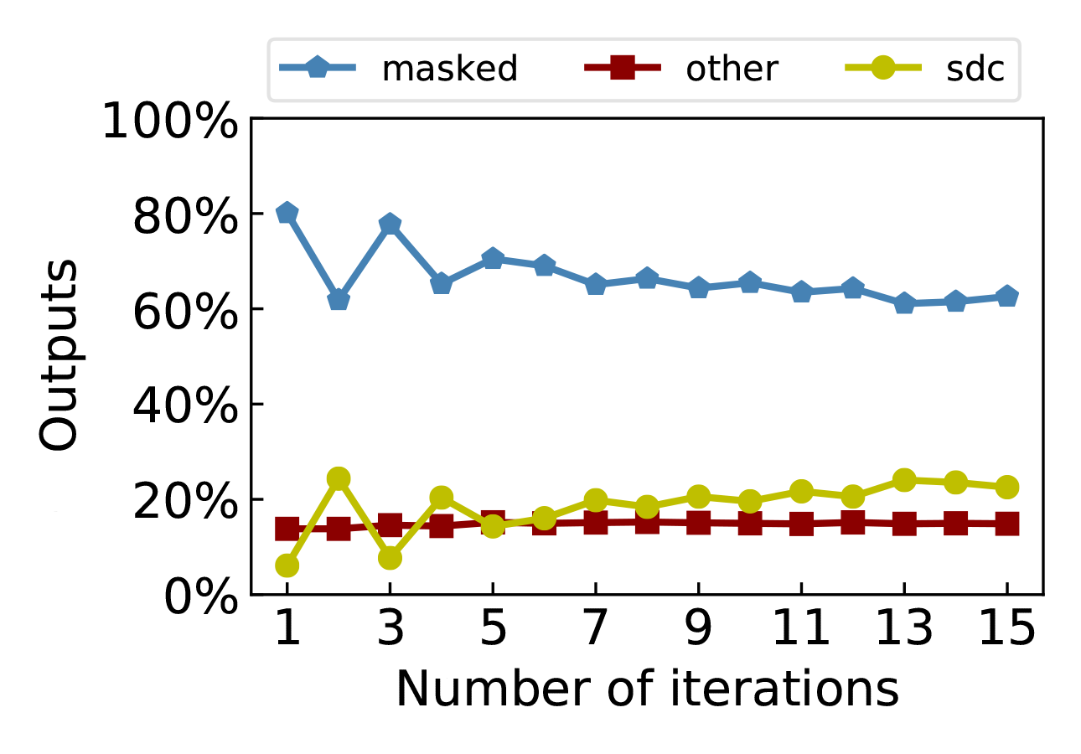
Progressive Fault Sites Pruning
....
Thread-wise pruning
Instruction-wise pruning
....
Loop-wise pruning
....
Bit-wise pruning
K-Means K1
34 loop iterations
....
Notes:
No data dependency

Slide 10
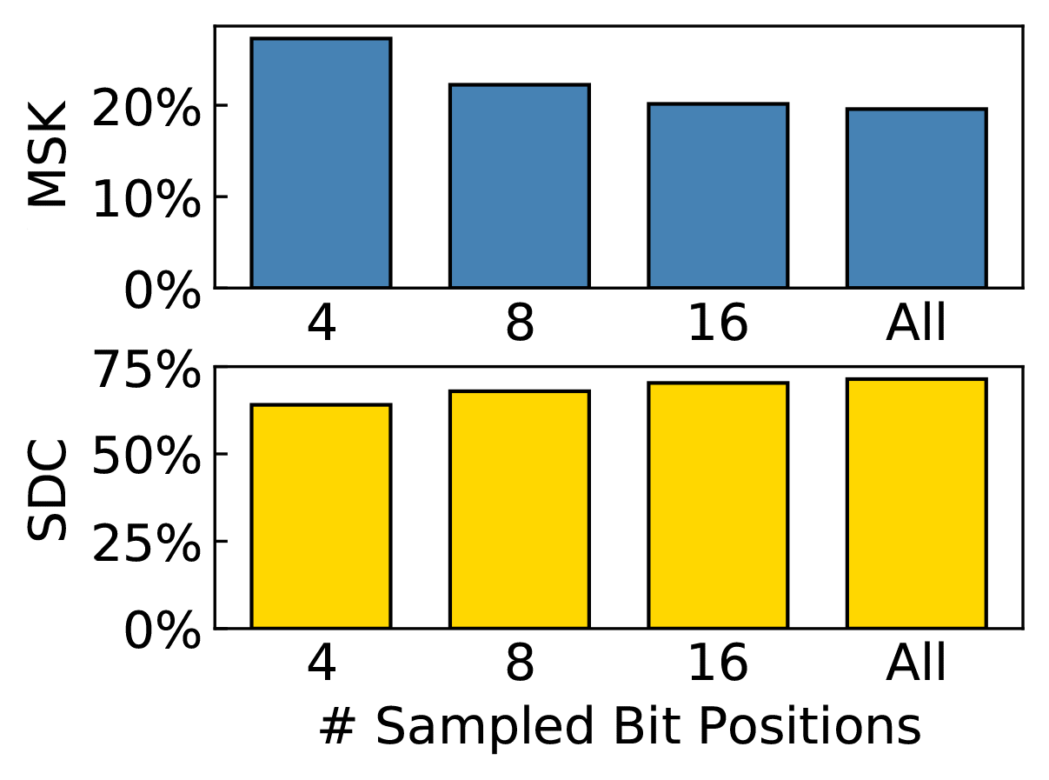
Progressive Fault Sites Pruning
....
Thread-wise pruning
Instruction-wise pruning
....
Loop-wise pruning
....
Bit-wise pruning
MVT K1
....
Notes:
图示 怎么选。等间距

Slide 11
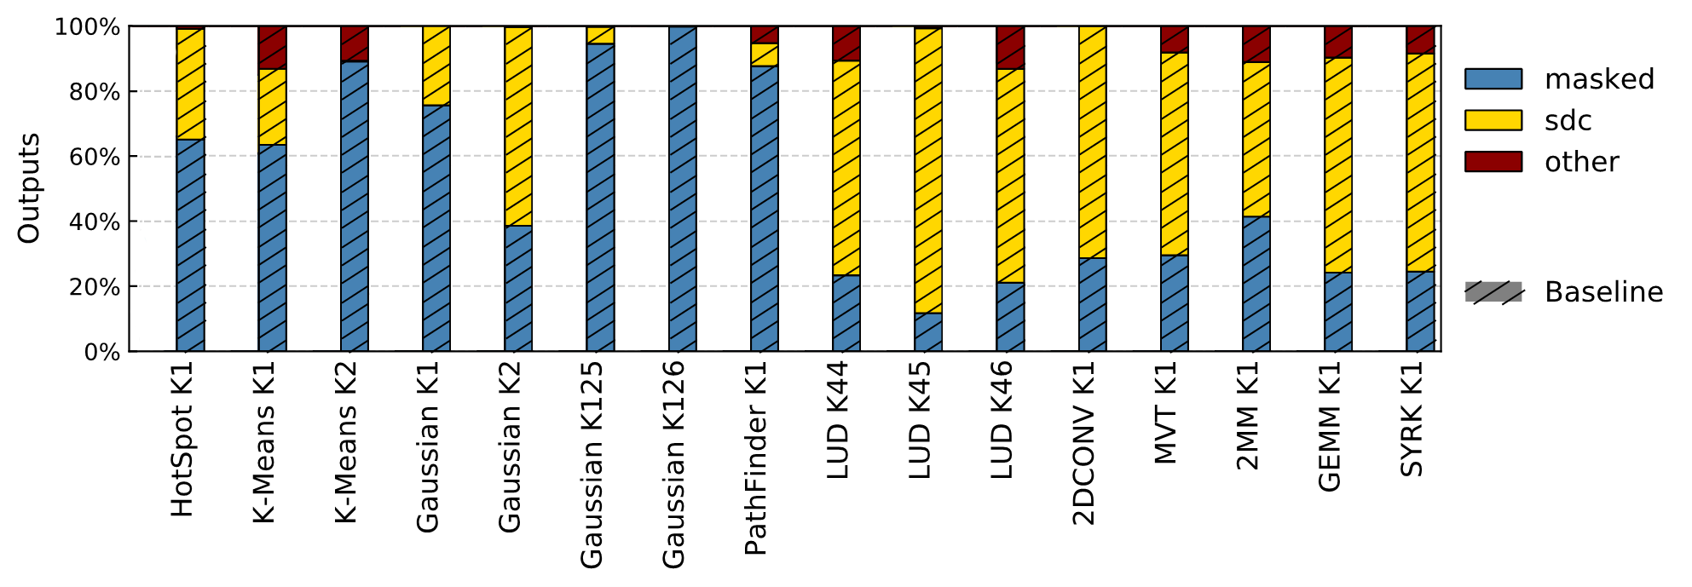
Evaluation
Fault Site Pruning vs. Baseline
Baseline: 60K fault sites (confidence interval=99.8%, error margin=1.26%)
Closest to ground truth
Notes:
16 benchmarks from rodinia and polybench

Slide 12
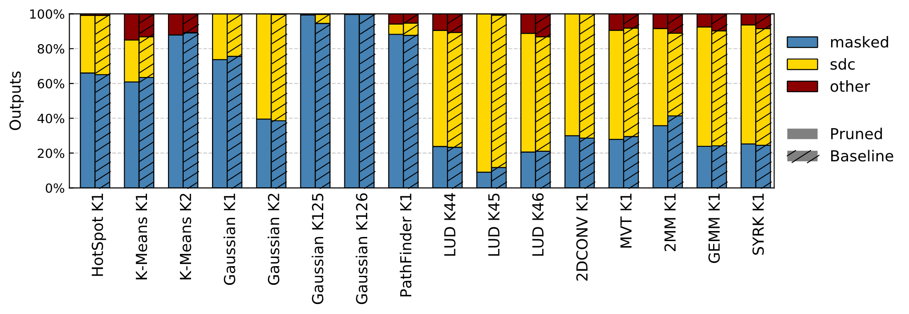
Evaluation
Fault Site Pruning vs. Baseline (closest to ground truth)
Baseline: 60K fault sites (confidence interval=99.8%, error margin=1.26%)
Notes:
16 benchmarks from rodinia and polybench

Slide 13
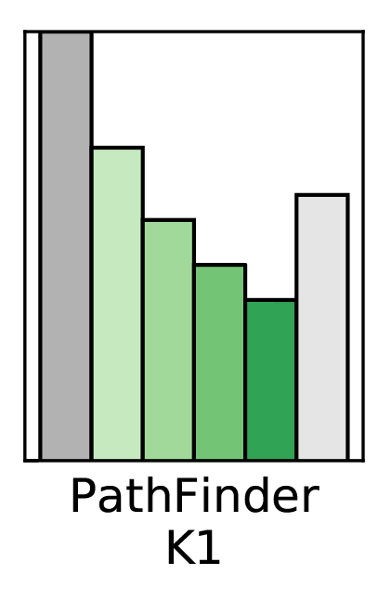
Evaluation
Effectiveness
27M
354K
60K
23K
4K
1K
Notes:
Log scale

Slide 14
Evaluation
Effectiveness
27M
354K
60K
23K
4K
1K
Notes:
先放60K

Slide 15
Evaluation
Effectiveness
27M
354K
60K
23K
4K
1K
Notes:
先放60K

Slide 16
Evaluation
Effectiveness
27M
354K
60K
23K
4K
1K
Notes:
先放60K

Slide 17
Evaluation
Effectiveness
27M
354K
60K
23K
4K
1K
Notes:
先放60K

Slide 18
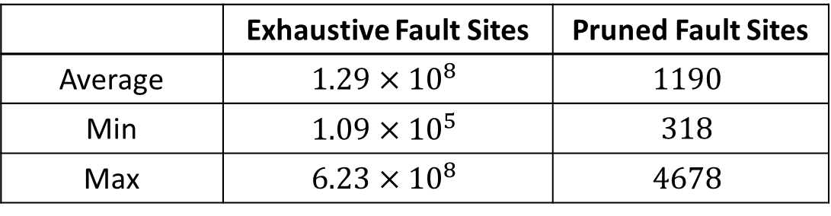
Evaluation
Effectiveness
27M
354K
 | Exhaustive Fault Sites | Pruned Fault Sites
Average | $$1.29×{10}^{8}$$ | $$1190$$
Min | $$1.09×{10}^{5}$$ | $$318$$
Max | $$6.23×{10}^{8}$$ | $$4678$$
60K
23K
4K
1K
108,403x Reduction!
Notes:
Original ; 32x / 1000x reduction.

Slide 19
Conclusion
GPGPU applications: huge unreachable exhaustive fault sites
Progressive Fault Site Pruning
GPGPU-specific features
Accurate GPU reliability assessment
Significant reduction:
Up to 7 orders of magnitude
108,403x on average
Notes:
Original ; 32x / 1000x reduction.

Slide 20
Fault Site Pruning for Practical Reliability Analysis of GPGPU Applications
Thank you :)
Bin Nie, Lishan Yang, Adwait Jog, and Evgenia Smirni
College of William & Mary
This work is supported by NSF grants CCF-17175332 (CRII) and CCF-1750667 (CORE Small)717532
Notes:
Thanks for the NSF grants, and thank you for listening. research Internship and other opportunities. I am glad to take any questions.
Good question!

Slide 21
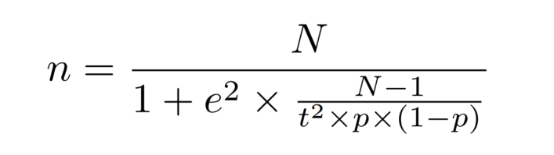
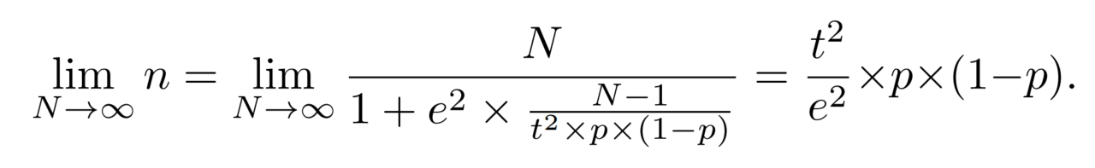
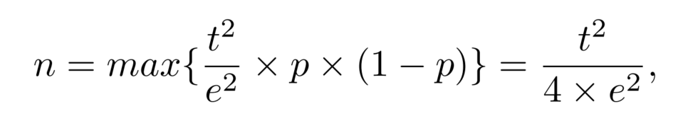
# Exhaustive fault sites
# samples
Error margin
t-statistic
(confidence interval)
Program vulnerability factor (PVF)
Unknown
Notes:
Backup: why 60K? Fomular. Not necessary

Slide 22
Progressive Fault Sites Pruning
....
Thread-wise pruning
Destination Register
31
0
Instruction-wise pruning
....
Loop-wise pruning
....
Bit-wise pruning
....
Notes:
图示 怎么选。等间距

Slide 23
Progressive Fault Sites Pruning
....
Thread-wise pruning
Destination Register
31
0
Instruction-wise pruning
....
Loop-wise pruning
....
Bit-wise pruning
....
Notes:
图示 怎么选。等间距

Slide 24
Progressive Fault Sites Pruning
....
Thread-wise pruning
Destination Register
31
0
Instruction-wise pruning
....
Loop-wise pruning
....
Bit-wise pruning
....
Notes:
图示 怎么选。等间距

Slide 25
Progressive Fault Sites Pruning
....
Thread-wise pruning
Destination Register
31
0
Instruction-wise pruning
....
Loop-wise pruning
....
Bit-wise pruning
....
Notes:
图示 怎么选。等间距

Slide 26
Progressive Fault Sites Pruning
....
Thread-wise pruning
Destination Register
31
0
Instruction-wise pruning
....
Loop-wise pruning
....
Bit-wise pruning
....
MVT K1
Notes:
图示 怎么选。等间距

