Slide 1


Efficient and Fair Multi-programming in GPUs via Effective Bandwidth Management
Haonan Wang, Fan Luo, Mohamed Ibrahim
(College of William and Mary), Onur Kayiran (AMD),
Adwait Jog (College of William and Mary)
Notes:
Hi, my name is Mohamed Assem Ibrahim. Today, I will present our work “Efficient and Fair Multi-programming in GPUs via Effective Bandwidth Management”. This work was jointly performed with my advisor and colleagues at The Collage of William and Mary and our collaborators at AMD.
+++++++++++++++++++++++++++++++++++++
Don’t use
-----------
OK
Right?
Sort of

Slide 2



Single-Application Execution on GPUs
GPU
Kernel-1 (K1)
Core 1
Core N
C
C
C
C
C
C
Underutilized
On-Chip Network
DRAM
DRAM
DRAM
Single Kernel Execution
Notes:
GPUs are a crucial part of most computing systems as they provide orders of magnitude faster and energy-efficient execution for many general-purpose applications. With each new generation of GPUs, number of cores, as well as peak memory bandwidth and throughput are growing at a steady pace.
Running a single kernel can lead to underutilization of resources on GPUs.
+++++++++++++++++++++++++++++++++++++

Slide 3
Multi-Application Execution on GPUs
GPU
K1
K2
KX
Core 1
Core N
C
C
C
C
C
C
On-Chip Network
DRAM
DRAM
DRAM
Multiple Kernels Execution
Notes:
To keep these growing compute and memory resources highly utilized, GPU multi-programming was proposed as a solution.
The idea of co-locating two or more kernels (originating from the same or different applications) has been shown to be beneficial in terms of both GPU resource utilization and throughput.
+++++++++++++++++++++++++++++++++++++

Slide 4
Executive Summary
Multi-application execution on GPUs
Difficult management of BW resources in GPUs
Goal: Address the BW interference problem via Thread-level Parallelism (TLP) modulation
Contributions:
Observe that prior single-application TLP modulation schemes do not provide optimal throughput (WS) and fairness (FI) in a multi-application environment
Propose a new metric Effective Bandwidth (EB) to quantify the effects of TLP modulation
Design new application-aware TLP management techniques (PBS) for a better throughput/fairness
PBS improves Throughput (up to 20%) and Fairness (up to 2x) over using single-application TLP modulation schemes in a multi-application environment
Notes:
As a quick overview of our work, we investigate multi-application execution on GPUs. It can increase the resource utilization and overall throughput. Also, it enables sharing GPUs in the cloud. However, it is difficult to efficiently manage the shared BW resources in such environment.
Our goal is to address the BW interference problem using Thread-level Parallelism modulation.
Our contribution is three-fold. First, we studied the prior single-application TLP modulation schemes in a multi-application environment, and found that they don’t provide optimal system throughput and fairness. Second, we propose Effective Bandwidth (EB), a new metric to understand performance in single- and multi-application execution context. Finally, we develop a new application-aware scheme, PBS, that utilizes EB to achieve better throughput and fairness.
PBS improves system throughput up to 20% and achieves up to 2x fairness compared to using single-application TLP modulation schemes in a multi-application environment.
+++++++++++++++++++++++++++++++++++++
Onur: EB is not only for quantifying the effects of TLP modulation. Don't downplay its importance. It is for understanding performance in general, but it is specifically more useful in the context of multi-application execution.
PBS is within 3% and 6% of optWS and optFI
Our proposed pattern-based TLP management mechanisms improve the system throughput and fairness by 20% and 2x, respectively, over a baseline where each application executes with a TLP configuration that provides the best performance when it executes alone.

Slide 5
Outline
Introduction
Motivation
Effective Bandwidth Metric
Pattern-based Searching Schemes
Evaluation
Conclusion
Notes:
This is our talk outline. We start by a quick introduction and motivation. Then, we discuss our proposed metric, Effective Bandwidth. After that, we present our EB-based searching schemes to find the optimal system throughput and fairness. Finally, we evaluate our schemes and conclude our work.
+++++++++++++++++++++++++++++++++++++

Slide 6

Managing TLP for Single-Application
Thread-level Parallelism
TLP
Number of Wavefronts/Warps
Change
Cache Hit/Miss Behavior
Cache
DRAM Bandwidth Behavior
DRAM
Notes:
TLP can be used as a knob to manage resources utilization. We start by showing how TLP modulation can be used in a single-application scenario.
As we see in the figure, TLP directly affects the number of wavefronts running, which affects the number of concurrent threads.
As a result, it affects the cache behavior in terms of hit and miss requests.
TLP also affect the DRAM BW behavior.
Now if we increase the TLP value, then we can see a change in both the cache and BW behavior.
+++++++++++++++++++++++++++++++++++++
Onur: The blue arrows in DRAM are not very visible. Maybe red will be better. Or you can make them wider.
Show the DRAM utilization in a better/clear way
Number of Warps = Number of Wavefronts
In particular, the techniques that find the optimal thread-level parallelism (TLP) of a GPGPU application were found to be very effective in improving the GPU performance both for cache and memory-intensive applications [30], [50]. The key idea behind these techniques is to exploit the observation that executing a GPGPU application with the maximum possible TLP does not necessarily result in the highest performance. This is because as the number of concurrently executing threads increases, the contention for cache space and memory bandwidth also increases, which can lead to sub-optimal performance. Therefore, many of the TLP management techniques proposed to limit the TLP via limiting the number of concurrently executing warps (or wavefronts2) to a particular value.

Slide 7
Managing TLP for Single-Application
A single application is executed with
bestTLP | the best-performing TLP configuration
maxTLP | the maximum possible value of TLP
bestTLP
maxTLP
Notes:
For example, this figure shows how changing the TLP can affect the performance of an application. On the x-axis is the different TLP values, and on the y-axis in the normalized IPC.
We first identify two points. “bestTLP” is the TLP configuration with the best IPC, and “maxTLP” is the configuration with the maximum possible TLP value.
We point out two observations. First, using “maxTLP” doesn’t lead to the best IPC. This is because as the number of concurrently executing threads increases, the contention for cache and memory bandwidth also increases, which may lead to sub-optimal performance. Second, as the TLP value increases, the IPC increases till we reach “bestTLP”. After that IPC drops. This is because the increase in BW utilization cannot compensate the increase in cache miss rate.
+++++++++++++++++++++++++++++++++++++
Application = CUDA-BFS2

Slide 8
Challenges of Managing TLP for Multi-Application
Two or more applications are executed concurrently with
++bestTLP | their own respective bestTLP configurations
++maxTLP | their own respective maxTLP configurations
optWS/optFI | their own TLP configurations such that WS/FI is maximized
++bestTLP
++bestTLP
Why?
Notes:
To understand the scope of TLP modulation in the context of two-application execution, we analyzed three different scenarios.
First, both applications executes with their respective “bestTLP” referred to as “++bestTLP”. Second, both applications executes with their respective “maxTLP” referred to as ”++maxTLP”. Finally, both applications executes with TLP configuration such that system throughput or fairness is maximized.
From the figure, we can see that there is a significant gap in WS between optWS and ++bestTLP/++maxTLP combinations running BFS2_FFT workload. The same applies for fairness (FI).
Thus, blindly using the single-application TLP modulation schemes in the context of multi-application execution is sub-optimal. But why?
+++++++++++++++++++++++++++++++++++++
Workload = BFS2_FFT

Slide 9
Why?
L2 Cache
Some applications consume less/more resources compared to co-running application(s)
Difficult management of BW resources in GPUs
Application#1
TLP
Application#2
TLP
How to manage the application interference in the shared caches and main memory to achieve the maximum benefits of multi-application execution?
DRAM
BW Interference Problem
Notes:
This figure shows two co-running applications. Each is given half of the shared resources. We can see that application#1 is consuming its half of the resources as shown in blue, while application#2 is not as shown in green.
This underutilization of resources is because applications have different resources requirement. That is what makes managing the shared BW resources a challenging problem.
Specifically, the BW interference problem is how to manage the applications interference in the shared resources to achieve maximum benefits from multi-application execution.
+++++++++++++++++++++++++++++++++++++
Onur: Why is the negative point about "being unfair"? It might cause people to think about "fairness".
Should we explicitly mention that such configurations consider local information only?

Slide 10

Proposal
Goal
Address the BW interference problem in multi-application execution environment
Contribution
Design new TLP management techniques that can bridge the gap in System Throughput and Fairness
Optimizing performance by considering core-level metrics locally
Application-aware TLP management that make good and judicious use of all the shared resources available
Notes:
In this work, we address the BW interference problem in a multi-application environment.
We develop new TLP management schemes to bridge the gap in system throughput and fairness.
We don’t rely ONLY on local per-core metrics.
But we consider the shared resources as well.
+++++++++++++++++++++++++++++++++++++
TLP technique focusing on BW interference problem.
Although previously proposed TLP modulation techniques (e.g., DynCTA and CCWS) have been shown to be effective in optimizing TLP for single-application execution scenarios, they rely only on different kinds of per-core heuristics (e.g., latency tolerance, IPC, cache/memory contention) and do not consider the shared resource consumption of co-scheduled applications. In other words, each application under such TLP configurations (including bestTLP) attempts to maximize its own effective bandwidth, ultimately taking disproportionate amount of shared resources. This causes too much contention in caches and memory, ultimately hampering the system-wide metrics such as system throughput and fairness.

Slide 11
Outline
Introduction
Motivation
Effective Bandwidth Metric
Pattern-based Searching Schemes
Evaluation
Conclusion
Notes:
Now, we present our new metric, Effective Bandwidth.
+++++++++++++++++++++++++++++++++++++

Slide 12
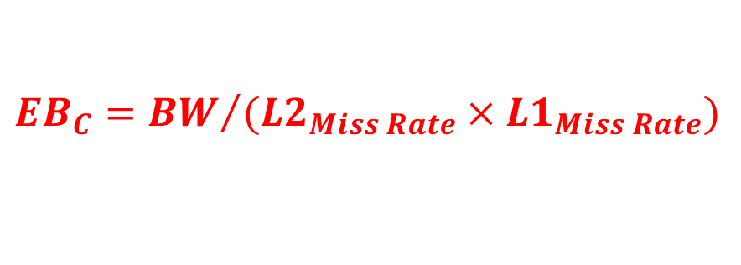
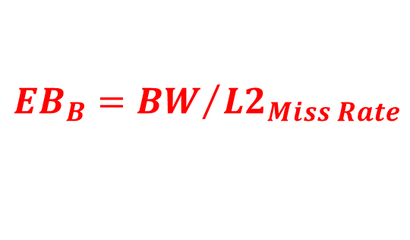

Effective Bandwidth: A New Metric to Quantify the Effects of TLP
An application-level utility metric defined as the ratio of attained DRAM bandwidth to the cache miss rate (based on current level of hierarchy)
Core
L1
L2
DRAM
$$EB={BW}/{Cache Miss Rate}$$
C
B
A
$${EB}_{B}={BW}/{{L2}_{Miss Rate}}$$
$${EB}_{C}={BW}/{({L2}_{Miss Rate}×{L1}_{Miss Rate})}$$
$${EB}_{A}=BW$$
Notes:
Effective Bandwidth, EB, is an application-level utility metric, defined as the ratio between the DRAM bandwidth and the cache miss rate based on level of hierarchy under consideration.
For example, in this figure, EB @ point A is the same as the DRAM BW. However, @ point B, EB is the ratio between DRAM BW and L2 miss rate. Finally, @ point C, @ the core, EB is ratio between DRAM BW and the combined miss rate. CMR is the product of L1 and L2 cache miss rates.
+++++++++++++++++++++++++++++++++++++
- Metric concerning BW as BW interference is the main problem.

Slide 13

Effective Bandwidth: A New Metric to Quantify the Effects of TLP
Measures how well the DRAM bandwidth is utilized
Considers the usefulness of the caches in amplifying the performance
$IPC∝\frac{BW}{{r_{m}×L2}_{Miss Rate}×{L1}_{Miss Rate}}$ $∝\frac{EB}{r_{m}}$
Why EB?
Combined Miss Rate (CMR)
Notes:
But why EB?
EB measures both the DRAM BW utilization and the usefulness of the caches in amplifying the performance. Let us look at EB benefit analytically and experimentally.
Analytically, performance, in terms of IPC, is the ratio between DRAM BW and the product of rm (which is related to the compute to memory ratio) and the combined cache miss rate.
Then, IPC is directly proportional to EB.
This can be shown by monitoring the IPC and the EB. We can see that both IPC and EB follow the same trend when TLP changes. Also, we can see that up to TLP=4 both IPC and EB increases as the increase in BW is more that the increase in CMR. However, after TLP=4, EB drops as the increase in BW is not enough to compensate the increase in CMR. IPC also drops as the contention for cache and memory bandwidth increases.
This shows that EB is a good metric to optimize for performance in a single-application scenario, but what about multi-application?
+++++++++++++++++++++++++++++++++++++
Application = CUDA-BFS2

Slide 14
EB in Multi-Application Environment
optFI
optWS
optIT
A mechanism that attempts to maximize IT may not be optimal to improve system throughput and fairness
Balance Individual SDs
Balance Individual EBs
Highest Sum of IPC
Not always Highest WS or FI
Highest Sum of SD
Highest Sum of EB
Notes:
The figure studies four two-application workloads under different TLP configurations. The LHS figure shows the sum of slowdowns (which is the weighted speedup) on the y-axis. The RHS figure reports the sum of EB on the y-axis.
Three observations are in order. First, the TLP configuration “optWS” leads to the highest sum of slowdowns and also the highest sum of EBs, as shown by the red circles. Second, the TLP configuration “optFI” leads to a fair balance between the individual SDs and between individual EBs as well, as shown by the red arrows. We can see that sum of EBs can be used to optimize for system throughput, and individual EBs to optimize for fairness.
Finally, the TLP configuration optIT, which maximizes the sum of the co-running applications IPC, doesn’t lead to the highest WS as shown by the blue arrow and does not achieve the optimal balance between the slowdowns as shown by the red arrows.
This means that a schemes that tries to maximize instruction throughput is not optimal for system throughput and fairness.
+++++++++++++++++++++++++++++++++++++
Onur: I think it might be a good idea to include the answer to why EB is better than IPC; because of alone-ratios.
Instruction throughput (IT) = sum of IPCs across all the concurrent applications
Choose better workloads?
The TLP combination (optIT) that provides the highest sum of IPCs does not always provide the highest WS and FI. It implies that a mechanism that attempts to maximize IT may not be optimal to improve system throughput.

Slide 15
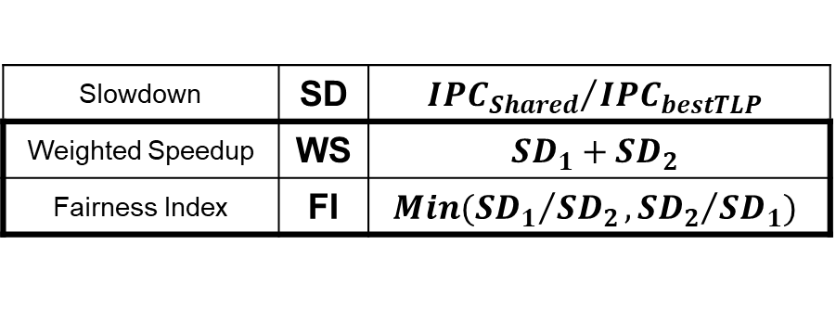
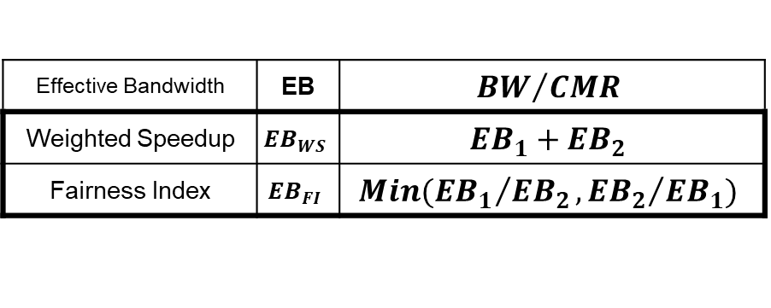
EB in Multi-Application Environment
A TLP management scheme that optimizes for EB-based metrics is useful in improving system throughput and fairness
SD-based Metrics
EB-based Metrics
Slowdown | SD | $${{IPC}_{Shared}}/{{IPC}_{bestTLP}}$$
Weighted Speedup | WS | $${SD}_{1}+{SD}_{2}$$
Fairness Index | FI | $$Min({{SD}_{1}}/{{SD}_{2}},{{SD}_{2}}/{{SD}_{1}})$$
Effective Bandwidth | EB | $${BW}/{CMR}$$
Weighted Speedup | $${EB}_{WS}$$ | $${EB}_{1}+{EB}_{2}$$
Fairness Index | $${EB}_{FI}$$ | $$Min({{EB}_{1}}/{{EB}_{2}},{{EB}_{2}}/{{EB}_{1}})$$
Easier to calculate in shared environment
Details in paper
Challenge?
Notes:
However, a management scheme that optimizes for EB-based metrics is useful in improving system throughput and fairness.
Thus, we introduce our version of the SD-based metrics for system throughput and fairness and utilize EB instead of slowdowns. For example, EB-WS is the sum of EBs instead of using the sum of slowdowns. Another, crucial factor here is that EB-based metrics don’t incorporate any alone-execution information. This makes EB-based metrics easier to calculate in a multi-application environment.
But what is the challenge in using EB?
+++++++++++++++++++++++++++++++++++++
Mention the alone information in SD-based metrics vs. EB-based metrics.
EB-WS (EB-based) metric does not incorporate any alone-application information making it easier to calculate directly in a multi-application environment.
Note: In the latter case, each application uses the value of EB when it executes alone and uses bestTLP. As we cannot get this information unless we halt the other co-running applications, we approximate it by executing the co-runners with the least amount of TLP (i.e., 1) so that they induce the least amount of interference possible.

Slide 16

Challenge? Search Space
Finding the TLP combination is difficult
Huge search space
Assume $n$ applications with $TLP= \left\{1, 2, 4, 8, 12, 16, 20, 24\right\}$
$Search Space=8^{n}$
Sampling period to collect $BW$ and $CMR$
Solution?
Notes:
Finding the optimal TLP configuration is difficult. This is due to the huge search space. For example, using n co-running applications, while selecting from 8 TLP values per application, leads to 8^n search space.
Add the sampling period required, per configuration, to collect BW and CMR, this shows how bad a naïve searching technique can fail.
So, what is the solution?
+++++++++++++++++++++++++++++++++++++
We need an intelligent way to find the required TLP

Slide 17
Outline
Introduction
Motivation
Effective Bandwidth Metric
Pattern-based Searching Schemes
Evaluation
Conclusion
Notes:
We now propose Pattern-based Searching (PBS) to quickly find the near-optimal TLP configuration.
+++++++++++++++++++++++++++++++++++++
Pattern-Based Searching (PBS) to quickly locate the optimal TLP combination

Slide 18
Pattern-Based Searching (PBS)
Guideline-1
To reach optimal system throughput
Choose a TLP configuration that does not underutilize the shared resources
Guideline-2
To avoid sharp drops in one (or all) applications’ EB, hence inferior throughput and fairness
Choose a TLP configuration which would not overwhelm the DRAM BW
Pattern?
Notes:
We start by emphasizing two guidelines. First, EB-based metrics are sub-optimal if a TLP configuration leads to resources underutilization. Thus, to reach optimal system throughput, choose a TLP configuration that does not underutilize the shared resources.
Similarly, we should choose a TLP configuration that does not overwhelm the shared resources. This is because EB-based metrics start to drop when the increase in BW can no longer compensate the increase in CMR.
Now, we define the pattern used in the searching scheme.
+++++++++++++++++++++++++++++++++++++
Total EB can be sub-optimal when a particular TLP configuration leads to under-utilization of resources (DRAM and BW)
Guideline-1. The EB-based metrics are sub-optimal when a particular TLP combination leads to under-utilization of resources (e.g., DRAM bandwidth). Therefore, for obtaining the optimal system throughput, it is important to choose a TLP combination that does not under-utilize the shared resources.
EB of an application starts to drop only when its BW can no longer compensate for the increase in its CMR
Guideline-2. When increasing an application’s TLP level, its EB starts to drop only when the increase in its BW can no longer compensate for the increase in its CMR (i.e., EB at its inflection point). Therefore, it is important to choose a TLP combination that would not overwhelm resources as it is likely to cause sharp drops in one or all applications’ EB, leading to inferior system throughput and fairness.

Slide 19
Pattern-Based Searching (PBS)
Pattern
Significant drop in EB-based metric happens at a fixed TLP of a particular application, when the resources in the system are sufficiently utilized, regardless of TLP of other co-running application(s)
Notes:
The figure show the execution of BLK_TRD workload, with EB-WS on the y-axis. We vary the TLP values of BLK on the x-axis, and show the different TLP values of TRD as colored/dashed lines.
The pattern:
- is a significant drop in the EB-based metric
- that happens at a fixed TLP of a particular application
- when the resources are sufficiently utilized
- regardless of the TLP of the other co-running application
For example, we see that EB-WS drops @ TLP-BLK = 2 regardless the TLP value of TRD. We refer to this as the pattern for BLK.
+++++++++++++++++++++++++++++++++++++
at the DRAM BW saturation point? How to show that?
Significant drop in EB happens at a fixed TLP of a particular application at the DRAM BW saturation point (regardless of TLP of other co-running applications)

Slide 20
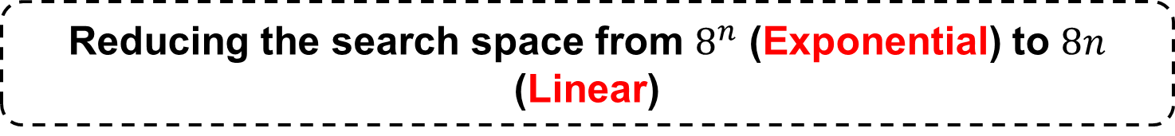
PBS – High-level Searching Process
1- Find the Critical Application
Sequentially check each application for the pattern while maintaining full resource utilization
2- Tune the Co-running Application(s)
Tune the co-running application TLP to optimize the EB-based metric
The sharpest drop in EB-based metrics is attributed to the critical application
Reducing the search space from $8^{n}$ (Exponential) to $8n$ (Linear)
Notes:
Now, we give a high-level overview for our searching scheme.
First, we search for what we refer to as the critical application. We do that by sequentially checking each of the co-running applications for the pattern.
The application with the sharpest drop in the EB-based metric is the critical application.
Second, we fix the TLP of the critical application @ its inflection point and sequentially tune the co-running application(s) to optimize the EB-based metric.
This process reduces the exponential search space to a linear one.
+++++++++++++++++++++++++++++++++++++

Slide 21
Optimizing Throughput via PBS-WS
1- Find the Critical Application
Use TLP = 24 → Ensure that the resources in the system are sufficiently utilized
Critical Application = BLK @ TLP=2
Notes:
We show here how PBS can be used to optimize system throughput via maximizing the total effective bandwidth.
First, we find the critical application.
We vary the TLP of one application while fixing the TLP of the co-running application @ 24. This is to ensure that the resources are not underutilized.
We can see that the drop in BLK is more than in TRD. Thus BLK is the critical application, and we fix its TLP @ 2.
+++++++++++++++++++++++++++++++++++++
FI and HS → In the paper

Slide 22
Optimizing Throughput via PBS-WS
2- Tune the Co-running Application(s)
Fix BLK-TLP = 2 → Tune TRD to improve EB-WS
Fairness optimization can be found in paper
Searching process leads to the TLP combination (BLK, TRD) = (2,8) = optWS
Notes:
Now, we tune the TLP of the co-running application, while TLP-BLK is fixed @ 2, to optimize EB-WS.
The figure shows the EB-WS on the y-axis, while varying the TLP-TRD on the x-axis.
We sequentially vary the TRD TLP till we find a drop in EB-WS @ TLP=8.
Then, the searching schemes leads to TLP combination (2,8) which is equal to optWS.
Searching scheme for improving the fairness can be found in the paper.
+++++++++++++++++++++++++++++++++++++

Slide 23
Outline
Introduction
Motivation
Effective Bandwidth Metric
Pattern-based Searching Schemes
Evaluation
Conclusion
Notes:
Now, we evaluate our searching schemes.
+++++++++++++++++++++++++++++++++++++

Slide 24
Evaluation Methodology
Evaluated on MAFIA
A GPGPU-Sim based framework that can execute two or more applications concurrently
Baseline Configuration
30 SMs, 32-SIMT Lanes, 32 Threads/Wavefront, 48 Wavefronts
16KB L1 (4-way, 128B Cache Block) + 32KB Shared Memory per SM
256KB L2 (16-way, 128B Cache Block) per Memory Partition
6 Memory Partitions
1 Crossbar/Direction
Workloads
26 Single Applications
From Rodinia, Parboil, CUDA SDK, and SHOC
50 Two-application Workloads
20 Three-application Workloads
Notes:
We evaluate PBS on MAFIA, a GPGPU-Sim based framework that executes two (or more) applications concurrently.
We use 30 cores equally divided between the co-running applications. For example, in case of two-application scenario, each application is statically assigned 15 cores. However, the L2 cache and DRAM BW are shared.
We use 26 applications from different benchmarks suites to evaluate 50 two-application workloads, and 20 three-application workloads.
+++++++++++++++++++++++++++++++++++++
Extended GPGPU-Sim v3.x (Simulator) and developed GPU concurrent application framework (GCA) to enable multi-programming in GPUs.
The memory performance model is validated across several GPGPU workloads on an NVIDIA K20m GPU.
To understand how these applications interfere in the shared memory system, each application is mapped to an exclusive set of cores and allowed to use resources beyond the cores (e.g., L2, DRAM). We allocate an equal number of cores to each concurrently executing application. Sensitivity to different core and L2 cache partitioning techniques is discussed later.

Slide 25
Evaluation – Throughput
[Kayiran+, PACT2013]
[Li+, DATE2016]
++bestTLP
++DynCTA
Mod+Bypass
optWS
+19.6%
+11.2%
+9.7%
-3%
Notes:
We start with system throughput. This figure shows the normalized WS on the y-axis normalized to ++bestTLP.
Our scheme, PBS-WS, achieves 19.6% improvement over ++bestTLP.
Also, PBS-WS achieves 11.2% improvement over a scheme that uses DynCTA, which is a single-application TLP modulation scheme, to determine the TLP for each co-running application.
PBS-WS achieves 9.7% improvement over a recently proposed TLP management mechanism Mod+Bypass, that use CTA modulation and cache bypassing to enhance the system throughput in multi-application scenario.
Finally, our scheme is within 3% from the optimal WS.
+++++++++++++++++++++++++++++++++++++
This is because in “++bestTLP” or “++maxTLP” scenarios, each application assumes that no other application is co-scheduled. That leads to high cache and memory contention.
Explain FWT_TRD?
Impact of our schemes on Weighted Speedup. Results are normalized to ++bestTLP.
We compare the PBS mechanisms against the recently proposed TLP management mechanism Mod+Bypass for multi-application scenario. They use both CTA modulation and cache bypassing mechanism to enhance the system throughput.

Slide 26
Evaluation – Throughput
TLP configuration (2,2) is the preferred TLP combination for BLK_BFS2 and is chosen for the longest duration of time
Other TLP combinations are chosen during other time intervals to boost the WS further
Sampling Period
Notes:
This figure shows how our scheme dynamically changes TLP during the execution time.
The shaded areas represent the sampling period.
We observe that the most chosen TLP configuration for BLK_BFS2 is (2,2) which is the optWS (from our analysis).
Also, note that the runtime tuning of TLP configuration provides benefits. Other TLP combinations are chosen during other intervals to boost the WS further.
+++++++++++++++++++++++++++++++++++++
Figure shows the dynamic changes in TLP (TLP-BLK above and TLP-BFS2 below) over the course of BLK_BFS2 execution. The shaded areas represent the sampling period including the time during which the decision cannot be taken because the execution time of the kernel is too short.
As expected and discussed before in Section III, (2,2) is the most preferred TLP combination for BLK_BFS2 and is chosen for the longest duration of time. Other TLP combinations are chosen during other time intervals to boost the WS further.

Slide 27
Evaluation – Fairness
[Kayiran+, PACT2013]
[Li+, DATE2016]
++bestTLP
++DynCTA
Mod+Bypass
optFI
2X
+83.1%
+44.3%
-6%
Notes:
We move to fairness. This figure shows the normalized fairness index (FI) on the y-axis normalized to ++bestTLP.
Our scheme, PBS-FI, improves fairness by 2x compared to ++bestTLP.
Also, PBS-FI achieves 83.1% improvement over a scheme that uses DynCTA.
PBS-FI achieves 44.3% improvement over using Mod+Bypass.
Finally, our scheme is within 6% from the optimal FI.
+++++++++++++++++++++++++++++++++++++
PBS-FI is better than optFI?
Impact of our schemes on Fairness. Results are normalized to ++bestTLP.

Slide 28
Evaluation – Case Studies
Application Scalability
PBS benefits are stable as the number of applications scales
For a k-application workload with N is the number of TLP choices, the overall complexity is linear to the number of applications O(N × k)
Notes:
Finally, we show the scalability of our searching schemes using three-application workloads. We evaluate 20 three-application workloads and report the average in this figure.
We observe that system throughput and fairness are stable as the number of applications increases.
Our searching scheme complexity for a k-application workload, with N TLP values to choose from, is linear with the number of applications.
+++++++++++++++++++++++++++++++++++++
For a k-application workload, we first rank the criticality of each application in the workload based on the magnitude of the EB drop. While determining the ranking, the TLP of other applications is fixed at 24 (same as discussed before in Section V). If N is the number of TLP choices, the procedure for deciding the criticality takes less than N × k steps. Subsequently, the tuning of TLP of each application would take N × (k−1) steps. Therefore, the associated overall search complexity is linear to the number of applications (O(N × k)). In this case study, we evaluate PBS on three-application workloads by performing some straightforward extensions to the PBS. Therefore, we find the critical application one by one under the interference of the other two remaining applications, keeping other steps the same. We choose 20 representative three-application workloads to compare the average benefits to that of workloads with two applications (Figure). We observe that the benefits of PBS are reasonably stable as the number of applications scales. We conclude that our techniques are not limited to workloads that consist of only two applications.

Slide 29
Conclusion
Observe an ample scope for TLP management techniques to improve WS and FI in GPUs running multiple applications
Propose a new metric EB to quantify the effects of TLP modulation
Design PBS, EB-based application-aware TLP management techniques for a better WS/FI in a multi-application environment
PBS is within 3% and 6% of optWS and optFI
Notes:
To conclude, we observed a large scope a TLP management scheme to improve system throughput and fairness in a multi-application environment.
We proposed a new metric called Effective Bandwidth to model the performance in a single- and multi-application scenarios.
Also, we designed PBS, EB-based application aware TLP management schemes to enhance WS and fairness. Our results are within 3% and 6% of optimal WS and fairness.
+++++++++++++++++++++++++++++++++++++
Should I add “PBS improves WS (up to 20%) and FI (up to 2x)”?

Slide 30
Thank You! Questions?
We acknowledge the support of the National Science Foundation (NSF) grants (#1657336 and #1717532)
Notes:
This work is jointly performed with our collaborators at AMD.

Slide 31
Efficient and Fair Multi-programming in GPUs via Effective Bandwidth Management
Haonan Wang, Fan Luo, Mohamed Ibrahim
(College of William and Mary), Onur Kayiran (AMD),
Adwait Jog (College of William and Mary)
Notes:
This work is jointly performed with our collaborators at AMD.

Slide 32
Backup
Why not IPC?
Implementation Details and Overheads
Case Studies – Core Partitioning
Case Studies – Cache Partitioning

Slide 33
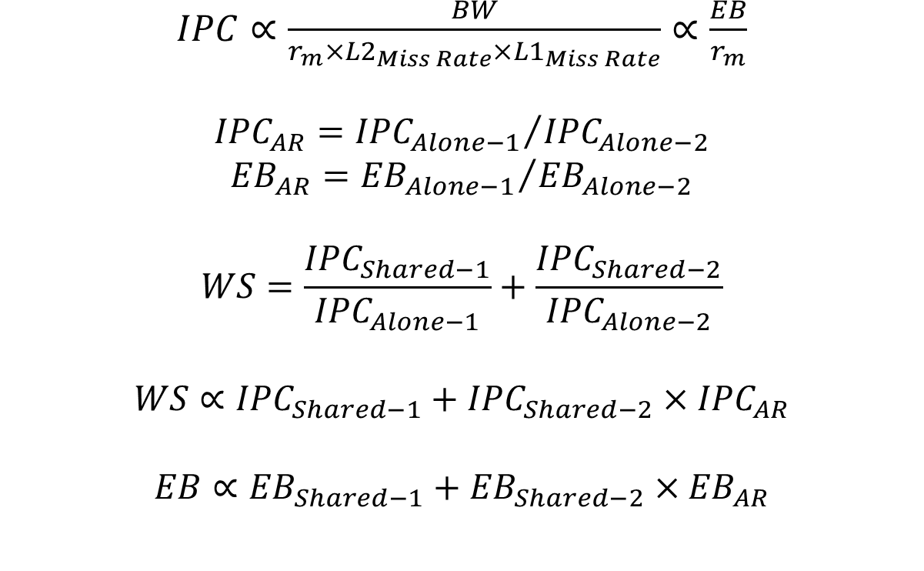
Why not IPC?
$IPC∝\frac{BW}{{r_{m}×L2}_{Miss Rate}×{L1}_{Miss Rate}}$ $∝\frac{EB}{r_{m}}$
$${IPC}_{AR}={{IPC}_{Alone−1}}/{{IPC}_{Alone−2}}$$
$${EB}_{AR}={{EB}_{Alone−1}}/{{EB}_{Alone−2}}$$
$$WS=\frac{{IPC}_{Shared−1}}{{IPC}_{Alone−1}}+\frac{{IPC}_{Shared−2}}{{IPC}_{Alone−2}}$$
$$WS∝{IPC}_{Shared−1}+{IPC}_{Shared−2}×{IPC}_{AR}$$
$$EB∝{EB}_{Shared−1}+{EB}_{Shared−2}×{EB}_{AR}$$

Slide 34
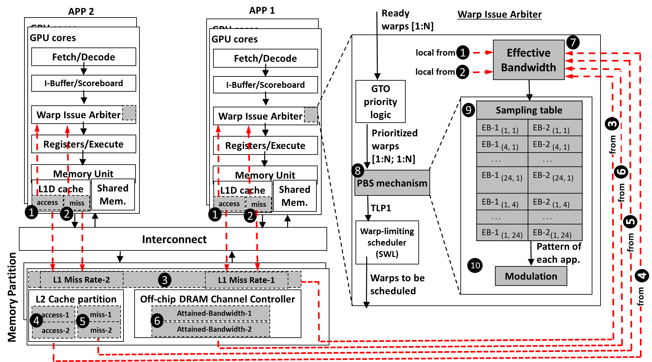
Implementation & Overhead

Slide 35
Evaluation – Case Studies
Core Partitioning
PBS enhances WS and FI under both equal and unequal core partitioning scenarios
PBS benefits reduce with unequal partitioning because with different core partitioning each application executes with a different amount of TLP
Core partitioning techniques do not completely solve the interference problem and PBS can provide additional benefits
Notes:
Explain Unequal partitioning?
We test PBS under two different core partitioning scenarios: 2:1 and 1:2 partitioning (e.g., in 2:1, the first and the second applications are assigned 20 and 10 cores, respectively) and compare it to our baseline that allocates 15 cores to each application. Figure shows the benefits of PBS over ++bestTLP observed in WS and FI averaged across all our 50 workloads. The bar denoted by Equal represents the average improvement of PBS with equal partitioning, and the bar denoted by Unequal represents the average improvement of PBS with the best performing partitioning scheme among 2:1 and 1:2 (found separately for each workload and then averaged). PBS enhances WS, FI, and HS under both equal and unequal core partitioning scenarios, compared to ++bestTLP. However, the benefits of PBS reduce with unequal partitioning because with different core partitioning each application executes with a different amount of TLP. As we choose the best (among 2:1 and 1:2) core partitioning configuration, the interference is also alleviated because of core partitioning itself in addition to our TLP management schemes. As the design of core partitioning is itself an interesting and non-trivial research problem, we conclude that these techniques still do not completely solve the interference problem and TLP management techniques like PBS can provide additional benefits.

Slide 36
Evaluation – Case Studies
Cache Partitioning
PBS improves WS and FI under both Shared and Equal scenarios
Cache partitioning can alleviate the interference at L2
Cache partitioning might be suboptimal (underutilization) when different applications utilize the caches differently
Notes:
Explain Shared vs. Equal?
Figure shows the benefits of PBS when the L2 is way-partitioned equally (denoted by Equal) across two applications, and compare it to our baseline where the L2 cache is shared (denoted by Shared). We observe that PBS improves all three metrics (WS, FI, and HS) under both the scenarios. Cache partitioning can alleviate the interference at L2, but it might be suboptimal in scenarios where different applications in the same workload utilize the caches differently. This might lead to a portion of the cache to be not utilized well. On the other hand, PBS changes the cache demand of each application by TLP modulation.

