Slide 1


Why GPUs are Slow at Executing NFAs and How to Make them Faster
Hongyuan Liu (William & Mary),
Sreepathi Pai (University of Rochester),
and Adwait Jog (William & Mary)
Notes:
My name is Hongyuan Liu. In this video, I will present our work Why GPUs are Slow at Executing NFAs and How to Make them Faster.
This work was jointly performed with my advisor Prof. Adwait Jog and our collaborator Prof. Sreepathi Pai.

Slide 2



Automata (Finite State Machines) Processing
Larger Applications
Efficient Automata Processing
Notes:
Automata are widely used in different domains such as bioinformatics, machine learning, network intrusion detection, and anti-virus software. They are used for searching patterns across input streams.
Animation 5
In these years, the applications are getting larger, where they match a lot of finite state machines on many input streams.
Animation 6
And hence, efficient automata processing becomes more challenging.

Slide 3
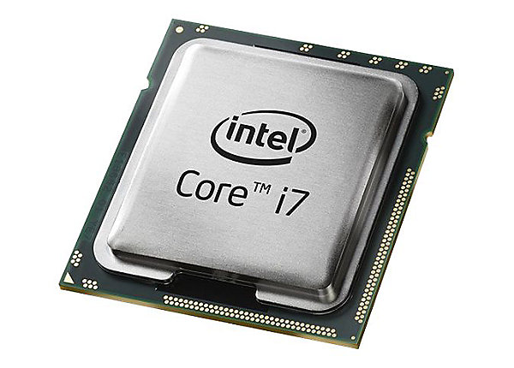
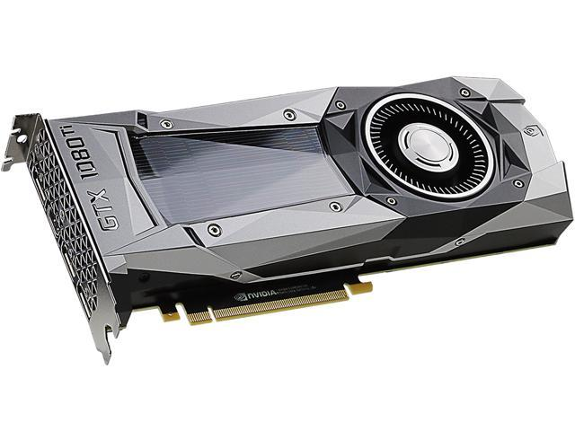

Architectures for automata processing…
✔️
Many Options
Unavailable
Parallelism
Notes:
There are many architectures to choose from for automata processing.
Animation 1
CPU is traditionally used.
Animation 2
However, CPU does not have enough parallelism, especially if there are too many finite state machines and many input streams,
Animation 3
Many accelerators are also proposed to support large-scale automata processing.
Animation 4
Although there are many to choose from, almost all of them are still not available on the market.
Animation 5
GPU, on the other hand, is massively parallel, general-purpose and available almost everywhere.
In this work, we focus on accelerating automata processing on the GPU.

Slide 4
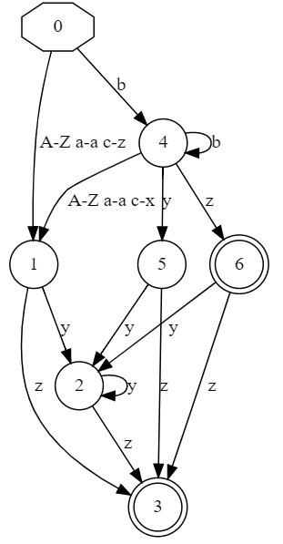
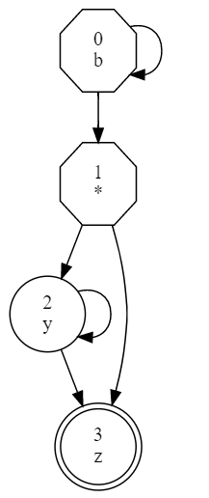
Simple
Not compact
More Parallelism
Compact
Deterministic Finite Automata
(DFA)
Nondeterministic Finite Automata
(NFA)
✔️
Notes:
Deterministic finite automata (DFA) and nondeterministic finite automata (NFA) are two common representations of finite state machines.
Animation 1
DFA is simple in transition. Only one state is active at a time. However, DFA is not compact because we need more states and more state transitions to represent the same pattern.
Animation 2:
On the other hand, NFA can have multiple states active at a time, which shows an additional source of parallelism. It is also compact in terms of size, especially for complicated patterns.
Animation 3
In this paper, we specifically focus on NFAs.

Slide 5
Efficiently Processing Large-scale NFAs on GPU
Notes:
The goal of this paper is to support more efficient large-scale NFA processing on GPU.
In this talk, we will show the bottlenecks on GPU that limit the speed of processing NFAs.
We propose schemes to overcomes these bottlenecks and make NFA processing on GPU much faster.

Slide 6
Outline
Introduction
Motivation
Addressing the Data Movement Problem
Addressing the Utilization Problem
Evaluation
Contributions
Notes:
We will start by discussing the bottlenecks of NFA processing on GPU.

Slide 7
S2
y
Starting State
b
*
z
Reporting State
S0
S1
S3
Accepting Pattern
b*.y*z
Notes:
Here, we show an NFA that identifies a pattern.
An NFA can have multiple starting states and multiple reporting states.
The starting states S0 and S1 in this NFA are shown in hexagons and the reporting state S3 is shown in double-circle.
Each state has a matchset that contains the symbols it can accept.
For example, state S0 can accept a symbol b.

Slide 8
S2
y
Starting State
b
*
z
Reporting State
S0
S1
S3
 | S0 | S1 | S2 | S3
… |  | S2, S3
b | S1 | S2, S3
… |  | S2, S3
x |  | S2, S3
y |  | S2, S3 | S2, S3
z |  | S2, S3 |  | report
 | S0 | S1 | S2 | S3
… |  | S2, S3
b | S1 | S2, S3
… |  | S2, S3
x |  | S2, S3
y |  | S2, S3 | S2, S3
z |  | S2, S3 |  | report
 | S0 | S1 | S2 | S3
… |  | S2, S3
b | S1 | S2, S3
… |  | S2, S3
x |  | S2, S3
y |  | S2, S3 | S2, S3
z |  | S2, S3 |  | report
 | S0 | S1 | S2 | S3
… |  | S2, S3
b | S1 | S2, S3
… |  | S2, S3
x |  | S2, S3
y |  | S2, S3 | S2, S3
z |  | S2, S3 |  | report
Transition table is sparse and redundant!
Alphabet-oriented Transition Table in GPU Global Memory
Problem #1: Data Movement
Notes:
Prior works use alphabet-oriented transition table, or its variants, to store the NFAs. The transition table is in the GPU global memory.
Each row in the transition table is indexed by a symbol. Hence, if the size of the alphabet is 256, there are 256 rows in the table.
Each column in the transition table is indexed by a state.
Each cell in the table shows the next states to be active according to an incoming symbol and an active state.
[Animation 1]
For example. If the incoming symbol is b, and the active state is S0, then S1 is active in the next step.
[Animation 2]
However, the table is sparse. For example in the first column, only one cell is filled.
-----
[Animation 3]
Also, the table stores the same values multiple times. For example, the second column stores S2, S3 for all rows.
[Animation 4]
Overall, the alphabet-oriented transition table may be sparse and redundant, and hence too big to fit into GPU on-chip resources.
This causes the data movement problem.

Slide 9
T1
T3
T0
T1
T3
T0
T2
T2
GPU Threads
S2
y
GPU Threads
b
*
z
 | S0 | S1 | S2 | S3
… |  | S2, S3
b | S1 | S2, S3
… |  | S2, S3
x |  | S2, S3
y |  | S2, S3 | S2, S3
z |  | S2, S3 |  | report
S0
S1
S3
* Starting states are always active.
Starting State
Reporting State
Not all states are active all the time.
Active State
Matched State
Average = 0.39%, Maximum = 3.05%
Problem #2: Thread Utilization
Notes:
At the beginning of the execution, the starting states are active. The green states are the active states.
[Animation 1]
A common way in prior work to parallelize the matching process is done by mapping the GPU threads to the states.
[Animation 2]
Because S0 and S1 are active, only threads T0 and T1 are active.
[Animation 3]
Since not all states are active all the time, some threads might be idle in a lot of steps of processing the input stream.
We investigate this for all applications.
We found in all applications, only 0.39% of states are active on average, and at maximum 3.05% of states are active.
Although this small percentage still includes many states, the one to one mapping between thread and state leads to
[Show Problem 2]
underutilization of GPU threads.

Slide 10
Input Stream: xyz
S2
S2
S2
y
y
y
z
z
b
*
z
b
*
b
*
 | S0 | S1 | S2 | S3
… |  | S2, S3
b | S1 | S2, S3
… |  | S2, S3
x |  | S2, S3
y |  | S2, S3 | S2, S3
z |  | S2, S3 |  | report
S0
S0
S0
S1
S1
S1
S3
S3
S3
Starting State
Reporting State
Active State
Threads must access the
transition table for every symbol.
Matched State
Problem #1: Data Movement
Notes:
Now, we will process the input stream on this NFA.
When the incoming symbol is x, S1 can match with x but S0 cannot.
So S1 becomes a matched state.
When S1 is matched, it is going to activate its successors, [Animation 1] S2 and S3.
[Animation 2] In the transition table, two cells were fetched and S2 and S3 are activated.
[Animation 3] For each symbol, the threads must access the transition table to know which states are going to be activated.
[Problem]
Since the transition table is in the global memory of GPU, these accesses lead to suboptimal performance due to the excessive data movement.

Slide 11
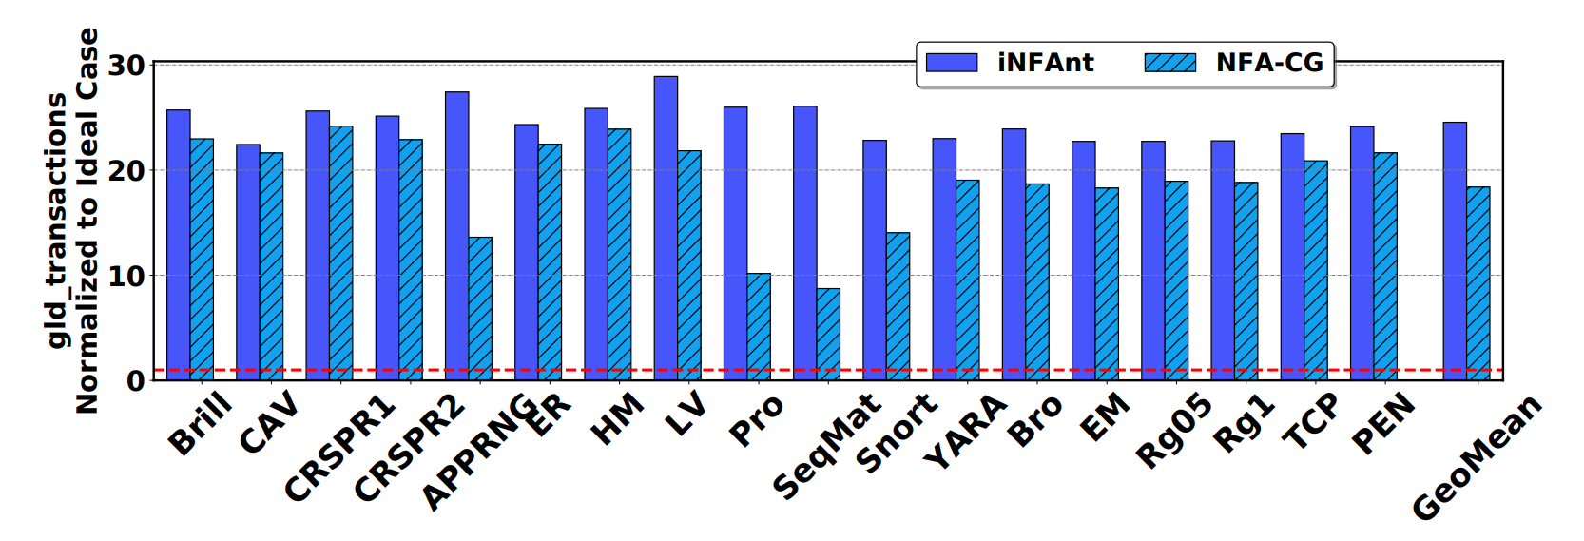
25X
18X
Ideal Case:
Threads only load input symbols
Notes:
To measure the data movement in the prior work, we use global load transactions from nvprof as a metric and compare it with an ideal case where threads only load input symbols.
We found that iNFAnt uses 25X more data movement and NFA-CG uses 18X more data movement.

Slide 12
Outline
Introduction
Motivation
Addressing the Data Movement Problem
Addressing the Utilization Problem
Evaluation
Contributions
Notes:
Now, we will show how we address the data movement problem.

Slide 13
New Transition Table
Idea:
Put transition table to GPU registers as much as possible.
T0
Alphabet-oriented
Transition Table
Registers
New Transition Table
 | S0
…
b | S1
…
x
y
z
outedges | S1
matchset | …00010000…
Local
Memory
98th is 1
(ASCII of ‘b’)
Notes:
We propose a new transition table, which is compact and tries to use GPU on-chip resources as much as possible.
Animation 1
We consider the alphabet-oriented transition table for S0 in here.
Animation 2:
We convert it to our new transition table. We use a 64-bit variable ``outedges’’ to store the successors, which is stored in GPU register.
Animation 3.
S0 is mapped to a thread T0, so the thread can access the topology of NFA via registers.
Animation 3:
We use a 256-bit array to hold the matchset. It is a bit set where the accepted symbol is marked as 1.
Animation 5:
However, the GPU registers cannot be indexed and hence the matchset array is stored in the local memory, which may be ultimately in global memory.

Slide 14
Matchset Compression (MaC)
Idea: Convert memory accesses to compute.
b
….000010000…..
256 bit
Start = 98 End = 99
16 bit
complete
^b
….111101111…..
256 bit
Start = 98 End = 99
16 bit
complement
Notes:
To mitigate the local memory accesses, We propose matchset compression.
The basic idea of matchset compression is to convert memory accesses to compute.
Animation 1
Consider a state accepting b. We found the 0s and 1s are continuous in its matchset.
Animation 2
the 256-bit bitset could be represented as two 8-bit variables: start, and end. We call these states as complete states.
Animation 3
Accordingly, if a state accepts any symbol except b, the bitset is negated.
Animation 4:
In this case, we can also represent it as two 8-bit variables. We call these states are complement states.

Slide 15
Matchset Compression (MaC)
Bit Checking
Range Checking
New Transition Table with MaC
outedges | S1
start | 98
end | 99
Notes:
Therefore, the matchset checking is converted from bitset checking to a range checking.
Animation 1
Finally, the transition table structure of S0 is like this, where the bitset is replaced by two 8-bit variables.
This further reduces data movement and enables putting the transition table to registers.

Slide 16
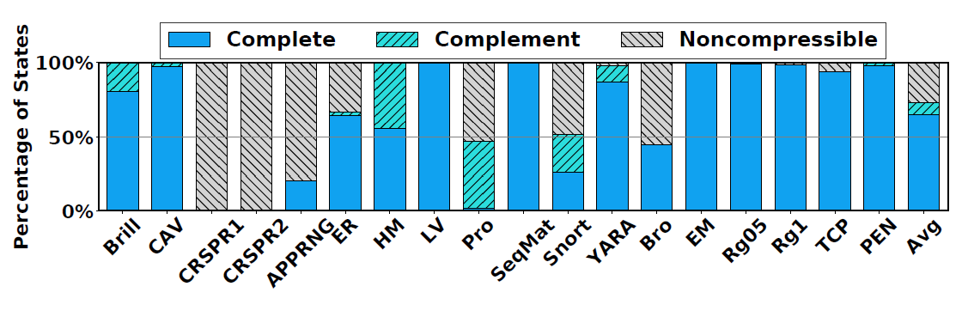
Scope of Matchset Compression (MaC)
70%
Notes:
We then study the scope of matchset compression.
We found among all the states in the applications, 70% of them can be compressed.

Slide 17
Outline
Introduction
Background and Motivation
Addressing the Data Movement Problem
Addressing the Utilization Problem
Evaluation
Contributions
Notes:
Next, we show how do we address the poor compute utilization caused by the one to one mapping between state to thread.

Slide 18
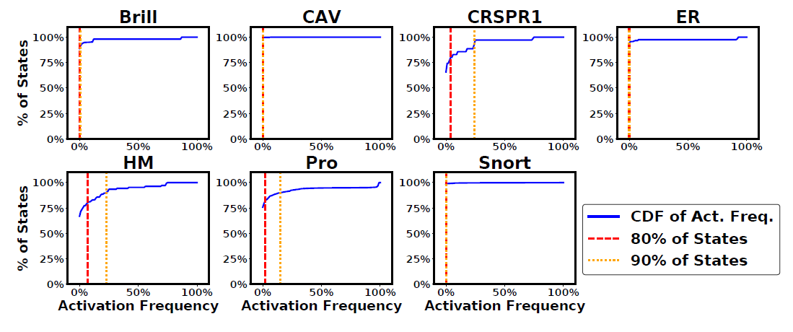
Activity of States
Notes:
We study the activity of states in the evaluated applications.
In this figure, x-axis is the activation frequency. The y-axis is the CDF of percentage of non-starting states.
Animation 1
From the red vertical line, we found that 80% of non-starting states are activated for only less than 1% of the processed symbols.
This implies that many states were infrequently activated but mapped to threads, leading to inefficient thread utilization.

Slide 19

Activity-based Processing
Idea: Hot States Vs. Cold States
Hot States
Threads
Cold States
Worklists
Notes:
To address this issue, we propose activity-based processing to solve the utilization problem.
We classify the states to hot states and cold states, where the hot states are activated frequently, and the cold states are activated infrequently. The details are in the paper.
We map the hot states to threads.
And we use a worklist to process the cold states, where the elements in worklists are dynamically mapped to threads.

Slide 20
S2
y
S1
b
*
z
xyz
S0
S3
Thread Block
S1 → S2
S1 → S3
Hot Mode
Next Cold Worklist
S2, S3
Cold Worklist
Cold Mode
Cold Worklist = Next Cold Worklist and Zero Next Cold Worklist
Sync threads
Notes:
Here is an example of the activity-based processing. The red states are classified as hot states.
Animation 1
They are mapped to two threads in the thread block.
Animation 2:
Suppose the current incoming symbol is x.
Animation 3:
First, the threads are in hot mode. S0 and S1 check if they can match with x.
Animation 4:
S1 can match with x, and hence its successors S2 and S3 are active.
Since S2 and S3 are cold states, two hot to cold transitions are generated.
Animation 5:
They are pushed to the next cold worklist, which is going to be processed in the next symbol.
Animation 6
Then the thread turns to cold mode.
Animation 7
Each thread is hence mapped to an element in the cold worklist.
Since this is the first symbol, no element is in the cold worklist.
Animation 8:
So the cold mode ends.
Finally, we assign the next cold worklist to the cold worklist and zero the next worklist.

Slide 21
S2
y
S1
b
*
z
xyz
S0
S3
Thread Block
S1 → S2
S1 → S3
Hot Mode
Next Cold Worklist
S2, S3
Duplicated
Cold Worklist
Cold Mode
S2, S3
S2 → S2
S2 → S3
Cold Worklist = Next Cold Worklist and Zero Next Cold Worklist
Sync threads
Notes:
Then we process the next symbol.
Animation 1:
First, S1 match with incoming symbol y and then S2 and S3 are pushed to the next cold worklist.
Animation 2.
Then we come to the cold mode. The cold worklist was the next cold worklist we generated in the previous step.
Two threads are processing S2 and S3 in the cold worklist.
Animation 3:
Two cold to cold transitions are generated.
Animation 4:
They will be pushed to the next cold worklist.
Animation 5:
We check if they are already in the next cold worklist. In this case, we found they are already in and hence will not be pushed to it again.
Animation 6:
Finally, we do some cleaning up as we did in the previous step before the end of this symbol step.

Slide 22
Outline
Introduction
Motivation
Addressing the Data Movement Problem
Addressing the Utilization Problem
Evaluation
Contributions
Notes:
Now, we evaluate out schemes.

Slide 23
Evaluation
Baselines
iNFAnt [CCR’10]
NFA-CG [PPoPP’12]
AP Chip
NVIDIA Quadro P6000
Sixteen Applications
Notes:
We compare our schemes with iNFAnt and NFA-CG, which are prior works on GPU.
We also compare our schemes with a Micron AP chip, where we use a performance model to estimate the performance of an AP chip.
We evaluate our implementations on an NVIDIA Quadro P6000 GPU, which is Pascal architecture.
We evaluate 16 applications from different benchmark suites.

Slide 24
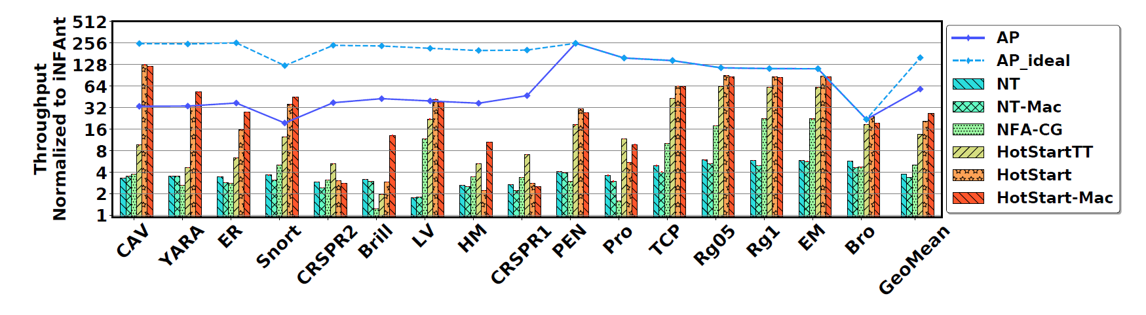
Evaluation
Our artifact is available in
https://github.com/bigwater/gpunfa-artifact
Notes:
In this figure, we show the performance results normalized to iNFAnt.
The y-axis is on the log-scale showing the normalized throughput.
Animation 1
The bars shown in the green boxes are our schemes.
Animation 2
Our best scheme outperforms an AP chip. For example in ClamAV.
Animation 4:
Our best scheme outperforms prior work iNFAnt by 26.5 X on average for the 16 applications.
And also outperforms NFA-CG by 5.3 X on average.

Slide 25
Contributions
Two Performance Bottlenecks
Excessive Data Movement
Poor Compute Utilization
Our Proposals
Use on-chip resources when possible
Converting memory accesses to compute
Mapping only active states to threads
Performance Improvement
26.5X / 5.3X over prior work
Reduced the gap towards an AP chip
We acknowledge the support of the National Science Foundation (NSF) grants (#1657336, #1750667)
Notes:
We conclude our contributions in this slide.
We found two performance bottlenecks when we process NFAs on GPU---excessive data movement caused by the alphabet transition table and poor data utilization is caused by the inactive states.
We proposes three optimizations to solve the two bottlenecks.
We achieved significant performance improvement.
Thank you for attending this online talk.
Stay healthy.
I am happy to take questions over emails.

