Slide 1
ACACES 2018 Summer School GPU Architectures: Basic to Advanced Concepts
Adwait Jog, Assistant Professor
College of William & Mary (http://adwaitjog.github.io/)
Slide Credits: NVIDIA Teaching Kit, Tor Aamodt (UBC)

Slide 2
Course Outline
Lectures 1 and 2: Basics Concepts
Basics of GPU Programming
Basics of GPU Architecture
Lecture 3: GPU Performance Bottlenecks
Memory Bottlenecks
Compute Bottlenecks
Possible Software and Hardware Solutions
Lecture 4: GPU Security Concerns
Timing channels
Possible Software and Hardware Solutions

Slide 3
GPU Architecture Overview
Single-Instruction, Multiple-Threads
GPU
SM Cluster
SM Cluster
SM Cluster
SM
SM
SM
SM
SM
SM
Interconnection Network
Memory
Partition
Memory
Partition
Memory
Partition
GDDR5/HBM
GDDR5/HBM
Off-chip DRAM
GDDR5/HBM

Slide 4
GPU Instruction Set Architecture (ISA)
NVIDIA defines a virtual ISA, called “PTX” (Parallel Thread eXecution)
More recently, Heterogeneous System Architecture (HSA) Foundation (AMD, ARM, Imagination, Mediatek, Samsung, Qualcomm, TI) defined the HSAIL virtual ISA.
PTX is Reduced Instruction Set Architecture (e.g., load/store architecture)
Virtual: infinite set of registers (much like a compiler intermediate representation)
PTX translated to hardware ISA by backend compiler (“ptxas”). Either at compile time (nvcc) or at runtime (GPU driver).

Slide 5
Some Example PTX Syntax
Registers declared with a type:
.reg .pred p, q, r;
.reg .u16 r1, r2;
.reg .f64 f1, f2;
ALU operations
add.u32 x, y, z; // x = y + z
mad.lo.s32 d, a, b, c; // d = a*b + c
Memory operations:
ld.global.f32 f, [a];
ld.shared.u32 g, [b];
st.local.f64 [c], h
Compare and branch operations:
setp.eq.f32 p, y, 0; // is y equal to zero?
@p bra L1 // branch to L1 if y equal to zero

Slide 6
GPU Microarchitecture
Companies tight lipped about details of GPU microarchitecture.
Several reasons:
Competitive advantage
Fear of being sued by “non-practicing entities”
The people that know the details too busy building the next chip
Model described next, embodied in GPGPU-Sim, developed from: white papers, programming manuals, IEEE Micro articles, patents.

Slide 7
GPGPU-Sim from UBC – A Cycle-level Simulator
Correlation
~0.976
12

Slide 8
Inside an SM
Done (Warp ID)
SIMT
Front End
Reg
File
SIMD Datapath
Fetch
Decode
Memory Subsystem
Icnt.
Network
Schedule
Branch
SMem
L1 D$
Tex $
Const$
Fine-grained multithreading
Interleave warp execution to hide latency
Register values of all threads stays in core

Slide 9
Inside an SM (2.0)
Schedule
+ Fetch
Decode
Register
Read
Execute
Memory
Writeback
SIMT Front End
SIMD Datapath
Branch Target PC
Fetch
SIMT-Stack
Scheduler 1
Scheduler 3
ALU
Valid[1:N]
Active
ALU
I-Buffer
Pred.
ALU
Mask
ALU
I-Cache
Decode
Issue
Operand
Scheduler 2
Collector
Score
MEM
Board
Done (WID)
Three decoupled warp schedulers
Scoreboard
Large register file
Multiple SIMD functional units
Notes:
As we learn more about the GPU design, we tried to add more detail to this model. At some point, we feel that we need to redesign from scratch.

Slide 10
Fetch + Decode
Arbitrate the I-cache among warps
Cache miss handled by fetching again later
Fetched instruction is decoded and then stored in the I-Buffer
1 or more entries / warp
Only warp with vacant entries are considered in fetch
Score-
PC
Decode
Board
A
1
PC
v
Inst. W1
r
R
2
e
B
PC
3
v
Inst. W2
r
h
c
v
Inst. W3
r
a
C
-
I
o
Selection
T
To
Fetch
Issue
Valid[1:N]
Issue
ARB
Fetch
Valid[1:N]
I-Buffer
I-Cache
Decode

Slide 11
Instruction Issue
Select a warp and issue an instruction from its I-Buffer for execution
Scheduling: Greedy-Then-Oldest (GTO)
GT200/later Fermi/Kepler: Allow dual issue (superscalar)
Fermi: Odd/Even scheduler
To avoid stalling pipeline might
keep instruction in I-buffer until
know it can complete (replay)

Slide 12
Scoreboard
Checks for RAW and WAW dependency hazard
Flag instructions with hazards as not ready in I-Buffer (masking them out from the scheduler)
Instructions reserves registers at issue
Release them at writeback

Slide 13
Review: In-order Scoreboard
Scoreboard: a bit-array, 1-bit for each register
If the bit is not set: the register has valid data
If the bit is set: the register has stale data
i.e., some outstanding instruction is going to change it
Issue in-order: RD ← Fn (RS, RT)
If SB[RS] or SB[RT] is set → RAW, stall
If SB[RD] is set → WAW, stall
Else, dispatch to FU (Fn) and set SB[RD]
Complete out-of-order
Update GPR[RD], clear SB[RD]
Scoreboard
Register File
0
Regs[R1]
1
Regs[R2]
0
Regs[R3]
0
Regs[R31]
[Gabriel Loh]
Notes:
H&P-style notation

Slide 14
In-Order Scoreboard for GPUs?
Problem 1: 32 warps, each with up to 128 (vector) registers per warp means scoreboard is 4096 bits.
Problem 2: Warps waiting in I-buffer needs to have dependency updated every cycle.
Solution?
Flag instructions with hazards as not ready in I-Buffer so not considered by scheduler
Track up to 6 registers per warp (out of 128)
I-buffer 6-entry bitvector: 1b per register dependency
Lookup source operands, set bitvector in I-buffer. As results written per warp, clear corresponding bit

Slide 15
Example
Code
ld r7, [r0]
mul r6, r2, r5
add r8, r6, r7
Scoreboard
Instruction Buffer
Index 0
Index 1
Index 2
Index 3
i0 i1 i2 i3
Warp 0
r7 | - | - | -
- | - | - | -
r7 | r6 | - | -
- | - | - | -
r7 | r6 | r8 | -
- | - | - | -
r7 | r6 | r8 | -
- | - | - | -
r7 | - | r8 | -
- | - | - | -
r7 | - | r8 | -
- | - | - | -
- | - | r8 | -
- | - | - | -
Warp 0
- | - | - | -
- | - | - | -
ld r7, [r0] | 0 | 0 | 0 | 0
ld r7, [r0] | 0 | 0 | 0 | 0
mul r6, r2, r5 | 0 | 0 | 0 | 0
ld r7, [r0] | 0 | 0 | 0 | 0
mul r6, r2, r5 | 0 | 0 | 0 | 0
add r8, r6, r7 | 1 | 1 | 0 | 0
ld r7, [r0] | 0 | 0 | 0 | 0
mul r6, r2, r5 | 0 | 0 | 0 | 0
add r8, r6, r7 | 1 | 1 | 0 | 0
ld r7, [r0] | 0 | 0 | 0 | 0
add r8, r6, r7 | 1 | 0 | 0 | 0
ld r7, [r0] | 0 | 0 | 0 | 0
add r8, r6, r7 | 1 | 0 | 0 | 0
add r8, r6, r7 | 0 | 0 | 0 | 0
Warp 1
Warp 1

Slide 16
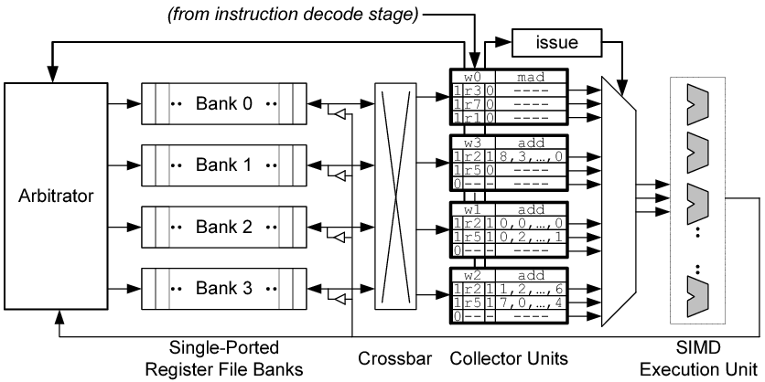
Operand Collector
(from instruction issue stage)
dispatch

Slide 17
ALU Pipelines
SIMD Execution Unit
Fully Pipelined
Each pipe may execute a subset of instructions
Configurable bandwidth and latency (depending on the instruction)
Default: SP + SFU pipes

Slide 18
Writeback
Each pipeline has a result bus for writeback
Exception:
SP and SFU pipe shares a result bus
Time slots on the shared bus is pre-allocated

Slide 19
Memory Unit
Model timing for memory instructions
Support half-warp (16 threads)
Double clock the unit
Each cycle service half the warp
Has a private writeback path

Slide 20
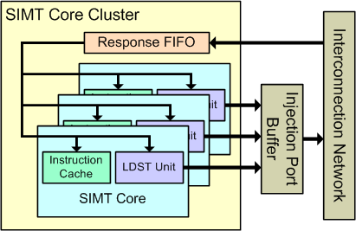
SM Cluster
Collection of SIMT cores

Slide 21
GPU Architecture Overview
Single-Instruction, Multiple-Threads
GPU
SM Cluster
SM Cluster
SM Cluster
SM
SM
SM
SM
SM
SM
Interconnection Network
Memory
Partition
Memory
Partition
Memory
Partition
GDDR5/HBM
GDDR5/HBM
Off-chip DRAM
GDDR5/HBM

Slide 22
Interconnection Network Model
Intersim (Booksim) a flit level simulator
Topologies (Mesh, Torus, Butterfly, …)
Routing (Dimension Order, Adaptive, etc. )
Flow Control (Virtual Channels, Credits)
Two separate networks
From SIMT cores to memory partitions
Read Requests, Write Requests
From memory partitions to SIMT cores
Read Replies, Write Acks
Notes:
22

Slide 23
Topology Examples
Notes:
There are a diverse range of topologies that can be used to transfer memory requests in a many-core architecture.
In Nvidia’s GPUs, it looks something like a crossbar except multiple SIMT cores share input ports.
Intel’s Larrabee looks like a ring.
In our ISPASS paper we found that a mesh was viable as well.
23

Slide 24
GPU Architecture Overview
Single-Instruction, Multiple-Threads
GPU
SM Cluster
SM Cluster
SM Cluster
SM
SM
SM
SM
SM
SM
Interconnection Network
Memory
Partition
Memory
Partition
Memory
Partition
GDDR3/GDDR5
GDDR3/GDDR5
Off-chip DRAM
GDDR3/GDDR5

Slide 25
Memory Partition
Memory Partition
Off-Chip DRAM Channel
L2→ICNT Queue
DRAM→L2 Queue
Atomic
Operation
Execution
L2
Cache
Bank
DRAM
Access
Scheduler
DRAM
Timing
Model
Interconnection Network
ICNT→L2 Queue
L2→DRAM Queue
DRAM Latency Queue
ROP Queue

Slide 26
DRAM Access
Row access
Activate a row or page of a DRAM bank
Load it to row buffer
Column access
Select and return a block of data in row buffer
Precharge
Write back the opened row into DRAM
Otherwise it will be lost!
DRAM
Column Decoder
Column Decoder
Column Decoder
Row Buffer
Row Buffer
Row Buffer
Row Buffer
Memory
Controller
Memory
Array
Row Decoder
Row Decoder
Notes:
Accessing data in DRAM consists of three steps: precharge, row access, and column access. A row access activates a page of data in the core and transfers it to the row buffer. After that, the column access selects the desired block and transfers it to the processor through the data bus.
26

Slide 27
DRAM Row Access Locality
t_{RC} = row cycle time
t_{RP} = row precharge time
t_{RCD} = row activate time
Notes:
row access locality of a memory request stream is crucial to performance.
Within a bank, you have thousands of rows of data.
Before you can access a particular row, you have to load the row into the row buffer.
The time to close the previous row and open the new row is governed by the DRAM spec, and it can be a dominating factor in performance when there are few accesses per row, or low row access locality
27

Slide 28
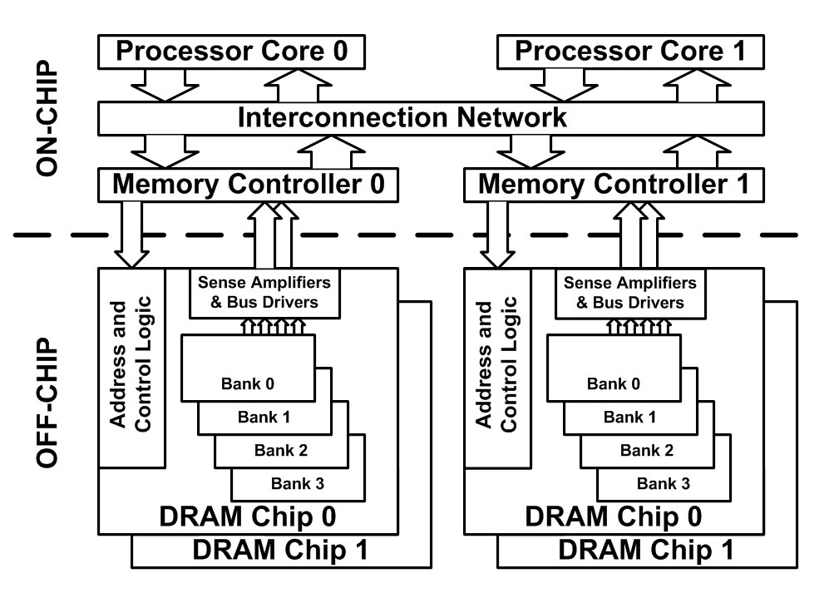
DRAM Bank-level Parallelism
To increase DRAM performance and utilization
Multiple banks per DRAM chip
To increase bus width
Multiple chips per Memory Controller
Notes:
28
You may have several chips connected in parallel to a controller to increase the bus width and the peak throughput.
Within a chip, you also have multiple banks to exploit bank-level parallelism. What this means is having multiple banks share the data bus to maximize utilization. If one bank is in the middle of switching rows, another bank can transfer data.
The BLP of memory request stream of an application is crucial to performance.
If you only use a single bank in a chip, any time it’s busy switching rows, that’s wasted data bus cycles.

Slide 29
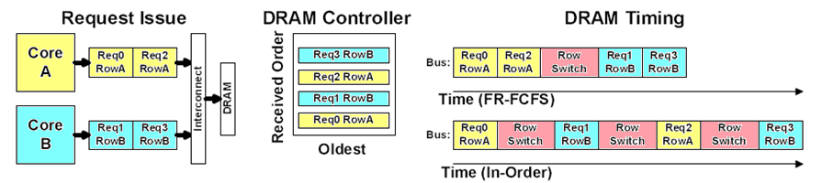
Scheduling DRAM Requests
Scheduling policies supported
First in first out (FIFO)
In-order scheduling
First Ready First Come First Serve (FR-FCFS)
Out of order scheduling
Requires associative search

Slide 30
Key GPU Performance Concerns

Slide 31
Key GPU Performance Concerns
I) Data transfers between CPU and GPU are one of the major performance bottlenecks.
II) Data transfers between SMs and global memory is costly. Can on-chip memory help?
Control
ALU
ALU
ALU
ALU
Cache
Bottleneck!
CPU Memory
GPU Memory
SM
Scratchpad
Registers and
Local Memory
??
Bottleneck!
SM
GPU (Device)
GPU Global Memory
SM
SM
Notes:
WARP_SIZE

Slide 32
CUDA Streams
CUDA (and OpenCL) provide the capability to overlap computation on GPU with memory transfers using “Streams” (Command Queues)
A Stream orders a sequence of kernels and memory copy “operations”.
Operations in one stream can overlap with operations in a different stream.

Slide 33
How Can Streams Help?
Serial:
Streams:
GPU idle
GPU busy
GPU idle
cudaMemcpy(H2D)
kernel<<<>>>
cudaMemcpy(D2H)
cudaMemcpy(H2D)
K0
DH0
K1
DH1
Savings
K2
DH2
Time

Slide 34
CUDA Streams
cudaStream_t streams[3];
for(i=0; i<3; i++)
cudaStreamCreate(&streams[i]); // initialize streams
for(i=0; i<3; i++) {
cudaMemcpyAsync(pD+i*size,pH+i*size,size,
cudaMemcpyHostToDevice,stream[i]); // H2D
MyKernel<<<grid,block,0,stream[i]>>>(pD+i,size); // compute
cudaMemcpyAsync(pD+i*size,pH+i*size,size,
cudaMemcpyDeviceToHost,stream[i]); // D2H
}

Slide 35
Manual CPU ⬄ GPU Data Movement
Problem #1: Programmer needs to identify data needed in a kernel and insert calls to move it to GPU
Problem #2: Pointer on CPU does not work on GPU since different address spaces
Problem #3: Bandwidth connecting CPU and GPU is order of magnitude smaller than GPU off-chip
Problem #4: Latency to transfer data from CPU to GPU is order of magnitude higher than GPU off-chip
Problem #5: Size of GPU DRAM memory much smaller than size of CPU main memory

Slide 36
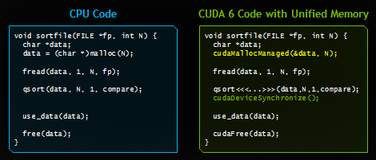
Additional Features in CUDA
Dynamic Parallelism (CUDA 5 onwards): Launch kernels from within a kernel. Reduce work for e.g., adaptive mesh refinement.
Unified Memory (CUDA 6 onwards): Avoid need for explicit memory copies between CPU and GPU
http://devblogs.nvidia.com/parallelforall/unified-memory-in-cuda-6/
See also, Gelado, et al. ASPLOS 2010.

Slide 37
Key GPU Performance Concerns
I) Data transfers between CPU and GPU are one of the major performance bottlenecks.
II) Data transfers between SMs and global memory are costly. Can on-chip memory help?
Control
ALU
ALU
ALU
ALU
Cache
Bottleneck!
CPU Memory
GPU Memory
SM
Scratchpad
Registers and
Local Memory
??
Bottleneck!
SM
GPU (Device)
GPU Global Memory
SM
SM
Notes:
WARP_SIZE

Slide 38
Let’s consider some software approaches first..
before moving on to hardware approaches
Notes:
WARP_SIZE

Slide 39
GPU Memory Address Spaces
GPU has three address spaces to support increasing visibility of data between threads: local, shared, global
In addition two more (read-only) address spaces: Constant and texture.

Slide 40
Partial Overview of CUDA Memories
SM
Block (0, 0)
Block (0, 1)
Thread (0, 0)
Thread (0, 1)
Thread (0, 0)
Thread (0, 1)
Registers
Registers
Registers
Registers
Host
GPU Global Memory
Device code can:
R/W per-thread registers
R/W all-shared global memory
Host code can
Transfer data to/from per grid global memory
Notes:
Global, constant, and texture memory spaces are persistent across kernels called by the same application.

Slide 41
CUDA Device Memory Management API functions
SM
Block (0, 0)
Block (0, 1)
Thread (0, 0)
Thread (0, 1)
Thread (0, 0)
Thread (0, 1)
Registers
Registers
Registers
Registers
Host
GPU Global Memory
cudaMalloc()
Allocates an object in the device global memory
Two parameters
Address of a pointer to the allocated object
Size of allocated object in terms of bytes
cudaFree()
Frees object from device global memory
One parameter
Pointer to freed object

Slide 42
Host-Device Data Transfer API functions
SM
Block (0, 0)
Block (0, 1)
Thread (0, 0)
Thread (0, 1)
Thread (0, 0)
Thread (0, 1)
Registers
Registers
Registers
Registers
Host
GPU Global Memory
Relatively new Features:
Transfer to device can be asynchronous
Explicit mention of memcpy by the users can be avoided by new CUDA Unified Memory
https://devblogs.nvidia.com/unified-memory-cuda-beginners/
cudaMemcpy()
memory data transfer
Requires four parameters
Pointer to destination
Pointer to source
Number of bytes copied
Type/Direction of transfer

Slide 43
Local address Space
Each thread has own “local memory”
0x42
Example: Location at address 100 for thread 0 is different from location at address 100 for thread 1.
Contains local variables private to a thread.

Slide 44
Global Address Spaces
Each thread in the different thread blocks (even from different kernels) can access a region called “global memory”.
Commonly in GPGPU workloads threads write their own portion of global memory. Avoids need for synchronization—slow; also unpredictable thread block scheduling.
thread block X
thread block Y
0x42

Slide 45
Blocks are partitioned after linearization
Linearized thread blocks are partitioned
Thread indices within a warp are consecutive and increasing
Warp 0 starts with Thread 0
Partitioning scheme is consistent across devices
Thus you can use this knowledge in control flow
However, the exact size of warps may change from generation to generation
DO NOT rely on any ordering within or between warps
If there are any dependencies between threads, you must __syncthreads() to get correct results.

Slide 46
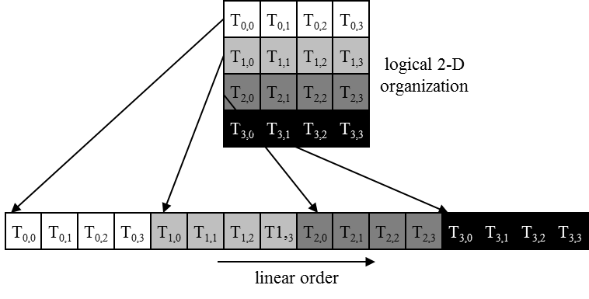
Warps in Multi-dimensional Thread Blocks
The thread blocks are first linearized into 1D in row major order
In x-dimension first, y-dimension next, and z-dimension last

Slide 47
Example: Transpose (CUDA SDK)
__global__ void transposeNaive(float *odata, float* idata, int width, int height)
{
int xIndex = blockIdx.x * TILE_DIM + threadIdx.x; // TILE_DIM = 16
int yIndex = blockIdx.y * TILE_DIM + threadIdx.y;
int index_in = xIndex + width * yIndex;
int index_out = yIndex + height * xIndex;
for (int i=0; i<TILE_DIM; i+=BLOCK_ROWS) { // BLOCK_ROWS = 16
odata[index_out+i] = idata[index_in+i*width];
}
}
1 | 2
3 | 4
1 | 3
2 | 4
NOTE: “xIndex”, “yIndex”, “index_in”, “index_out”, and “i” are in local memory
(local variables are register allocated but stack lives in local memory)
“odata” and “idata” are pointers to global memory
(both allocated using calls to cudaMalloc -- not shown above)

Slide 48
Scratchpad Memory
Each thread in the same thread block (work group) can access a memory region called scratchpad (or shared memory)
Shared memory address space is limited in size (16 to 48 KB).
Used as a software managed “cache” to avoid off-chip memory accesses.
Synchronize threads in a thread block using __syncthreads();
thread block
0x42

Slide 49
Use of Scratchpad
__global__ void transposescratchpad (float *odata, float *idata, int width, int height)
{
__shared__ float tile[TILE_DIM][TILE_DIM];
int xIndex = blockIdx.x * TILE_DIM + threadIdx.x;
int yIndex = blockIdx.y * TILE_DIM + threadIdx.y;
int index_in = xIndex + (yIndex)*width;
xIndex = blockIdx.y * TILE_DIM + threadIdx.x;
yIndex = blockIdx.x * TILE_DIM + threadIdx.y;
int index_out = xIndex + (yIndex)*height;
for (int i=0; i<TILE_DIM; i+=BLOCK_ROWS) {
tile[threadIdx.y+i][threadIdx.x] = idata[index_in+i*width];
}
__syncthreads();
for (int i=0; i<TILE_DIM; i+=BLOCK_ROWS) {
odata[index_out+i*height] = tile[threadIdx.x][threadIdx.y+i];
}
}

Slide 50
Bank Conflicts
To increase bandwidth common to organize memory into multiple banks.
Independent accesses to different banks can proceed in parallel
Bank 0
Bank 1
Bank 0
Bank 1
Bank 0
Bank 1
0
2
4
6
1
3
5
7
0
2
4
6
1
3
5
7
0
2
4
6
1
3
5
7
Example 1: Read 0, Read 1
(can proceed in parallel)
Example 2: Read 0, Read 3
(can proceed in parallel)
Example 3: Read 0, Read 2
(bank conflict)

Slide 51
Shared Memory Bank Conflicts
__shared__ int A[BSIZE];
…
A[threadIdx.x] = … // no conflicts
0
32
64
96
1
33
65
97
2
34
66
98
31
63
95
127

Slide 52
Shared Memory Bank Conflicts
__shared__ int A[BSIZE];
…
A[2*threadIdx.x] = // 2-way conflict
0
32
64
96
1
33
65
97
2
34
66
98
31
63
95
127

Slide 53
Eliminate Bank Conflicts
__global__ void transposeNoBankConflicts (float *odata, float *idata, int width, int height)
{
__shared__ float tile[TILE_DIM][TILE_DIM+1];
int xIndex = blockIdx.x * TILE_DIM + threadIdx.x;
int yIndex = blockIdx.y * TILE_DIM + threadIdx.y;
int index_in = xIndex + (yIndex)*width;
xIndex = blockIdx.y * TILE_DIM + threadIdx.x;
yIndex = blockIdx.x * TILE_DIM + threadIdx.y;
int index_out = xIndex + (yIndex)*height;
for (int i=0; i<TILE_DIM; i+=BLOCK_ROWS) {
tile[threadIdx.y+i][threadIdx.x] = idata[index_in+i*width];
}
__syncthreads();
for (int i=0; i<TILE_DIM; i+=BLOCK_ROWS) {
odata[index_out+i*height] = tile[threadIdx.x][threadIdx.y+i];
}
}

