Slide 1
ACACES 2018 Summer School GPU Architectures: Basic to Advanced Concepts
Adwait Jog, Assistant Professor
College of William & Mary (http://adwaitjog.github.io/)
Slide Credits: NVIDIA Teaching Kit, Tor Aamodt (UBC), Daniel Wong (UCR), Mary Jane Irwin, and Chita Das (Penn State)

Slide 2
Course Outline
Lectures 1 and 2: Basics Concepts
Basics of GPU Programming
Basics of GPU Architecture
Lecture 3: GPU Performance Bottlenecks
Memory Bottlenecks
Compute Bottlenecks
Possible Software and Hardware Solutions
Lecture 4: GPU Security Concerns
Timing channels
Possible Software and Hardware Solutions

Slide 3
Key GPU Performance Concerns
Memory Concerns: Data transfers
between SMs and global memory
are costly.
SM
Scratchpad
Registers and
Local Memory
Bottleneck!
SM
GPU (Device)
GPU Global Memory
SM
SM
A
T1
T2
T3
T4
Compute Concerns: Threads that
do not take the same control path
lead to serialization in the GPU
compute pipeline.
B
T1
T2
T3
T4
C
Time
T1
T2
D
T3
T4
E
T1
T2
T3
T4
Notes:
WARP_SIZE

Slide 4
We need intelligent hardware solutions!
Reducing Off-Chip Access
Re-writing software to use “shared memory” and avoid un-coalesced global accesses is difficult for the GPU programmer.
Recent GPUs introduce hardware-managed caches (L1/L2), but large number of threads lead to thrashing.
General purpose code, now being ported to GPUs, has branches and irregular accesses. Not always possible to fix them in the code.

Slide 5
I) Alleviating the Memory Bottlenecks
Memory concerns: Thousands of threads running on SMs need data from DRAM, however, DRAM bandwidth is limited. Increasing it is very costly
Bottleneck!
Bottleneck!
SM
L1
L2 Cache
SM
L1
GPU (Device)
GPU Global Memory
SM
L1
SM
L1
Q1. How can we use caches effectively to reduce the bandwidth demand?
Q2. Can we effectively data compression and reduce the data consumption?
Q3. How can we effectively/fairly allocate memory bandwidth across concurrent streams/apps?
Notes:
WARP_SIZE

Slide 6
Quantifying Memory Bottlenecks
AVG: 32%
55%
HPC Applications
Percentage of total execution cycles wasted waiting for the data to come back from memory.
[Jog et al., ASPLOS 2013]
Notes:
Bandwidth problem
KMN → limited TLP
FFT → limted TLP

Slide 7
Strategies
Cache-Aware Warp Scheduling Techniques
Effective caching → Less Pressure on Memory
Employing Assist Warps for Helping Data Compression
Bandwidth Preserved
Bandwidth Allocation Strategies for Multi-Application execution on GPUs
Better System Throughput and Fairness
Notes:
Cache as bandwidth filter
Unable to extract max parallelism

Slide 8

Application-Architecture Co-Design
Architecture: GPUs typically employ smaller caches compared to CPUs
Scheduler: Many warps concurrently access the small caches in a round-robin manner leading to thrashing.

Slide 9
Cache Aware Scheduling
Philosophy: "One work at a time"
Working
Select a "group" (work) of warps
Always prioritizes it over other groups
Group switch is not round-robin
Benefits:
Preserve locality
Fewer Cache Misses

Slide 10
Improve L1 Cache Hit Rates
Data for Grp.1 arrives.
No prioritization.
Round-Robin Order
Grp.1
Grp.2
Grp.3
Grp.4
Grp.1
Grp.2
Grp.3
Grp.4
W
W
W
W
W
W
W
W
W
W
W
W
W
W
W
W
Data for Grp.1 arrives.
Cache Aware Order
Prioritize Grp.1
Grp.1
Grp.2
G3
Grp.1
G3
Grp.4
Grp.2
Grp.3
Grp.4
Round-Robin: 4 groups in Time T
T
Prioritization: 3 groups in Time T
Fewer warp groups access the cache concurrently → Less cache contention
Time
Notes:
Round-robin (size = N/num_groups)

Slide 11
Reduction in L1 Miss Rates
Round-Robin Scheduler
Cache Aware
Scheduler
34%
25% improvement in IPC across 19 applications
Limited benefits for cache insensitive applications
Software Support (e.g., specify data-structures that should be "uncacheable”)
[Jog et al., ASPLOS 2013]
Notes:
Round-robin (size = N)

Slide 12
Other Sophisticated Mechanisms
Rogers et al., Cache Conscious Wavefront Scheduling, MICRO’12
Kayiran et al., Neither more Nor Less: Optimizing Thread-level Parallelism for GPGPUs, PACT’13
Chen et al., Adaptive cache management for energy-efficient GPU computing, MICRO’14
Lee et al., CAWS: criticality-aware warp scheduling for GPGPU workloads
Notes:
Cache as bandwidth filter
Unable to extract max parallelism

Slide 13
Strategies
Cache-Aware Warp Scheduling Techniques
Effective caching → Less Pressure on Memory
Employing Assist Warps for Helping Data Compression
Bandwidth Preserved
Bandwidth Allocation Strategies for Multi-Application execution on GPUs
Better System Throughput and Fairness
Notes:
Cache as bandwidth filter
Unable to extract max parallelism

Slide 14


Challenges in GPU Efficiency
Threads
Full!
Register File
Cores
Memory
Hierarchy
Thread
3
Idle!
Thread
2
Idle!
Full!
Thread
1
Thread
0
GPU Streaming Multiprocessor
The memory bandwidth bottleneck leads to idle cores
Thread limits lead to an underutilized register file
Notes:
However there are some challenges that introduce some inefficiency in execution.
GPU support a fixed number of threads and the GPU register files is partitioned among the threads running at any given time, there’s a fixed number compute units to execute these threads and of course, off-chip memory. A key challenge is maximizing utilization of different resources in the GPU to enable better efficiency in execution. However, this is difficult to achieve in practice because different applications may utilize different resources to varying extents, leaving some of them underutilized. A single GPU architecture cannot fit all applications with differing characteristics.
Let’s take an example where the GPU can run just four threads and each thread requires less than a quarter of the register file, there is going to some amount of the register file that is going to be underutilized.
Similarly, in memory bound workloads, the available memory bandwidth can quickly become the execution bottleneck, leaving the cores idle while the threads are waiting for data to come back from memory.

Slide 15
Motivation: Unutilized On-chip Memory
24% of the register file is unallocated on average
Similar trends for on-chip scratchpad memory
Notes:
We ran some experiments to analyze the impact of these balances and bottlenecks.
First, we look at the register file utilization for a representative set of workloads. On the Y-axis we plot the fraction of the register than remain unallocated. We find that in some applications more than 60% of the register file is unallocated and on average as much as 24% of the register file remains unutilized. We also see a similar trend in the utilization of on-chip shared memory.

Slide 16
Motivation: Idle Pipelines
Memory Bound
67% of cycles idle
Compute Bound
35% of cycles idle
Notes:
Second, we analyze a breakdown of idle time in the GPU pipeline. We first take a look at memory bound applications. The Y axis depicts the percentage of total issue cycles.
Compute stalls are due backed up pipelines when one of the hardware structures in the compute pipeline is unavailable . Memory stalls occur as a result of saturation in the memory hierarchy preventing further requests from being serviced. Waiting is the time spent waiting for data to come back from memory or a long latency computation or synchronization to complete. And active cycles include those cycles where instructions were actually issued into the pipelines to perform useful work. We find that in the case of memory bound workloads, as much of the 67% of the cycles are wasted. In the case of compute bound workloads, we see a similar trend where the primary cause of idleness comes from compute stalls and data dependencies leading to 35% of total issue cycles being idle.
TODO: Add banner with results on the graphs

Slide 17
Motivation: Summary
Heterogeneous application requirements lead to:
Bottlenecks in execution
Idle resources
Notes:
In summary, because there is a multitude of resources different resources become bottlenecks at different times and this leads to underutilization and idling of other resources.
We’ve seen that a) there are bottlenecks in execution and b) these bottlenecks tend to leave other resources underutilized.

Slide 18
Our Goal
Use idle resources to do something useful: accelerate bottlenecks using helper threads
Cores
Register File
Memory
Hierarchy
Helper
threads
A flexible framework to enable helper threading in GPUs: Core-Assisted Bottleneck Acceleration (CABA)
Notes:
Our goal in this work is to use these underutilized resources to alleviate the bottleneck in execution.
For example we can use the idle cores and register file to help alleviate the bandwidth bottleneck by using enabling an optimization like data compression using these idle resources.
In order to do this we develop a flexible framework in GPUs to enable helper threads to perform different optimizations which we refer to as CABA.
In order to do this we can use light-weight hardware generated threads to employ available resources to perform different optimizations which we use in this case to attack the memory bandwidth bottleneck. Some optimizations that can be performed with these helper threads include data compression, prefetching, etc.
In this work our goal is to develop a flexible framework to do this in GPUs which we refer to as CABA.
TODO: Should we swap the last two points?

Slide 19
Helper threads in GPUs
Large body of work in CPUs …
[Chappell+ ISCA ’99, MICRO ’02], [Yang+ USC TR ’98], [Dubois+ CF ’04], [Zilles+ ISCA ’01], [Collins+ ISCA ’01, MICRO ’01], [Aamodt+ HPCA ’04], [Lu+ MICRO ’05], [Luk+ ISCA ’01], [Moshovos+ ICS ’01], [Kamruzzaman+ ASPLOS ’11], etc.
However, there are new challenges with GPUs…
Notes:
There’s been a large body of work that targets different helper threading mechanisms in CPUs. However there are some new challenges with GPUs which leads us to the question of how do we manage and use helper threads in GPUs.

Slide 20
Challenge
How do you efficiently
manage and use helper threads
in a throughput-oriented architecture?

Slide 21
Managing Helper Threads in GPUs
Thread
Warp
Hardware
Block
Software
Where do we add helper threads?
Notes:
GPUs however execute thousands of threads in parallel. These threads are grouped at different levels of abstractions into threads, warps, blocks and grids. Programmers and software reason about threads at the granularity of a block which consists of hundreds of threads but hardware cannot execute all these hundreds of threads at the same time. So, threads are managed in hardware at the granularity of a warp which is a set of a few tens of threads. Software does not control the execution of warps. That leads us to the question of where do we add helper threads?
We could envision a software only approach where we enable helper threads entirely in software.

Slide 22

Approach #1: Software-only
No hardware changes
Coarse grained
Regular threads
Synchronization is difficult
Not aware of runtime program behavior
Helper threads
Notes:
We could create helper threads entirely in software, essentially at the granularity of a block, with special kernels just for helper threads and this would be great because now we don’t need any modifications to hardware. However, there are some drawbacks. The SW cannot control the scheduling and execution of threads at a finer granularities than a block. This means that we cannot control threads at a fine granularity. Since these threads are run independently of each other, synchronizing the execution of the helper threads and regular threads. Not aware of architectural events as well as the runtime behavior of the program.
A hardware only approach at the granularity of a warp could potentially provide fine-grained control over the management of helper threads however, providing contexts for execution would be tricky and enabling data communication and synchronization would be difficult and I’ll talk about why in a minute.

Slide 23
Where Do We Add Helper Threads?
Thread
Warp
Hardware
Block
Software

Slide 24
Other functionality
In the paper:
More details on the hardware structures
Data communication and synchronization
Enforcing priorities

Slide 25
CABA: Applications
Data compression
Memoization
Prefetching
…
Notes:
Now that we’ve seen how CABA is implemented, how can we use it?
Some of the applications that could be enabled with CABA include….

Slide 26
A Case for CABA: Data Compression
Data compression can help alleviate the memory bandwidth bottleneck - transmits data in a more condensed form
Memory
Hierarchy
Uncompressed
Compressed
Idle!
CABA employs idle compute pipelines to perform compression
Notes:
Recall that one of the source of inefficiency In utilizing resources is the memory bandwidth bottleneck.
Data compression is a technique that can help alleviate this bottleneck by transmitting data in a more condensed form.
In bandwidth-constrained workloads, idle compute pipelines offer an opportunity to enable data compression with CABA.

Slide 27
Data Compression with CABA
Use assist warps to:
Compress cache blocks before writing to memory
Decompress cache blocks before placing into the cache
CABA flexibly enables various compression algorithms
Example: BDI Compression _{[Pekhimenko+ PACT ’12]}
Parallelizable across SIMT width
Low latency
Others: FPC _{[Alameldeen+ TR ’04],} C-Pack _{[Chen+ VLSI ’10]}
Notes:
In order to perform data compression with CABA we use assist.
One of the nice things about using assist warps is that unlike a hardware based mechanism, we are tied down to using only one compression algorithm, CABA enables flexibility in algorithm choice. We actually studied three different compression algorithms which we detail in the paper, but an example of a compression algorithm that is amenable with CABA is BDI, because it easily:
We use BDI for this reason for our primary evaluations.

Slide 28
Walkthrough of Decompression
Assist Warp
Store
Assist Warp
Controller
Trigger
L2 + Memory
L1D
Miss!
Hit!
Scheduler
Compressed
Uncompressed
Cores

Slide 29
Walkthrough of Compression
Assist Warp
Store
Assist Warp
Controller
Trigger
L2 + Memory
L1D
Scheduler
Cores

Slide 30
Effect on Performance
41.7%
CABA provides a 41.7% performance improvement
CABA achieves performance close to that of designs with no overhead for compression
Notes:
Here we show the impact on performance of using CABA to perform data compression. The Y-axis depicts the performance normalized to a baseline system with no compression.
CABA provides a performance improvement of as much as 2.7X and on average a 41% improvement in performance.
We also study a no-overhead design where we retain the benefits of compression while incurring none of the overheads of actually perfrming the compression and decompression.
We find that CABA loses only 3% on average in comparison to the no-overhead design, because of the existence of idle cycles to perform the compression/decompression..
We see in some cases that …….
For all of our memory bound compressible applications we see that the performance benefits from CABA always outweigh the assist warp overhead.
CABA- BDI refers to the design with CABA using the BDI. We find the CABA-BDI provides a 41% improvement in performance over baseline
We then evaluate an ideal design with none of the overheads of compression. We find that CABA loses only 3% in performance in comparison to the ideal case.
We also compare with a previously proposed hardware-based memory bandwidth compression design that involves compressing only for memory bandwidth. We find that CABA performs 9% better and this is because of significant benefits from compressing the on-chip interconnect traffic as well
Finally we compare with a dedicated hardware design that compresses both at the interconnect as well as at the memory and find that on average CABA only performs about 2% worse than the hardware based design. This is because of the existence of sufficient idle time in most case to effectively execute assist warps to perform the compression.
CABA-BDI provides a 41.7% average improvement
Only 2.8% less than the ideal case (Ideal-BDI) with none of the overheads associated with CABA
CABA-BDI’s performance
3. 9.9% better than the previous hardware-based memory bandwidth compression design (HW-BDI-Mem)
4. 1.6% worse than the purely hardware-based design (HW-BDI) that
performs both interconnect and memory bandwidth compression.

Slide 31
Effect on Bandwidth Consumption
Data compression with CABA alleviates the memory bandwidth bottleneck
Notes:
Now, let’s look at why we are able to achieve this speedup in performance. Here we show the memory bandwidth utilization for our different designs. We see that in most workloads the performance benefits correlate with reduction in the utilization of memory bandwidth. Data compression reduces the traffic and hence the contention in the DRAM channels and hence reduces the overall utilization. We see a drop in utilization from on average form 53% to 35% and this helps alleviate the memory bandwidth bottleneck.
REMOVE NO-OVERHEAD

Slide 32
Conclusion
Observation: Imbalances in execution leave GPU resources underutilized
Our Goal: Employ underutilized GPU resources to do something useful – accelerate bottlenecks using helper threads
Challenge: How do you efficiently manage and use helper threads in a throughput-oriented architecture?
Our Solution: CABA (Core-Assisted Bottleneck Acceleration)
A new framework to enable helper threading in GPUs
Enables flexible data compression to alleviate the memory bandwidth bottleneck
A wide set of use cases (e.g., prefetching, memoization)
Notes:
Now let me conclude:
We make the observation that bottlenecks in executions and imbalances in resource requirements leave different resources in the GPU idle.
For example the memory bandwidth bottleneck leaves the cores idle while the threads are waiting for data to return from memory.
Our goal is to employ underutilized GPU resources to accelerate different bottlenecks in execution.
To this end, we introduce a new flexible framework to enable helper threading in GPUs that we call CABA.
We then apply this framework to enable flexible data compression to the memory bandwidth bottleneck.
However, CABA is a general framework that we believe can have many other uses like prefetching and memoization.
We find that CABA is provides a 42% performance improvement when used to implement data compression.

Slide 33
Other Sophisticated Mechanisms
Notes:
Cache as bandwidth filter
Unable to extract max parallelism

Slide 34
Strategies
Cache-Aware Warp Scheduling Techniques
Effective caching → Less Pressure on Memory
Employing Assist Warps for Helping Data Compression
Bandwidth Preserved
Bandwidth Allocation Strategies for Multi-Application execution on GPUs
Better System Throughput and Fairness
Notes:
Cache as bandwidth filter
Unable to extract max parallelism

Slide 35
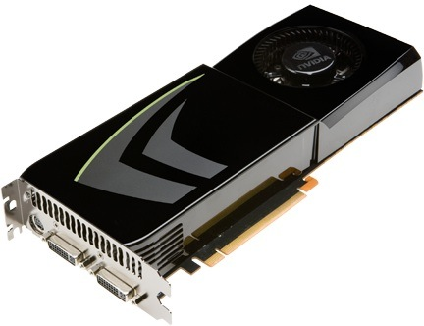

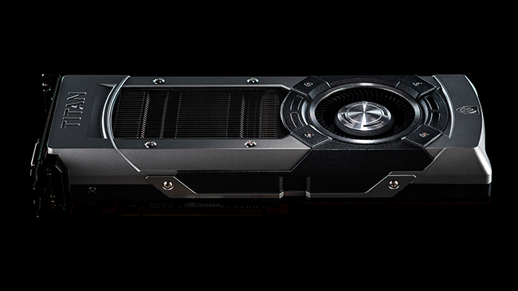
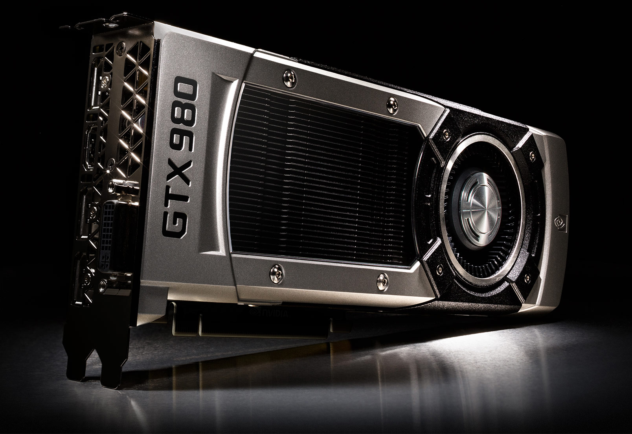
Discrete GPU Cards --- Scaling Trends
2008 2010 2012 2014 2016 2018
GTX 275
(Tesla)
240
CUDA
Cores
(127
GB/sec)
GTX 480
(Fermi)
448
CUDA
Cores
(139
GB/sec)
GTX 680
(Kepler)
1536
CUDA
Cores
(192
GB/sec)
GTX 980
(Maxwell)
2048
CUDA
Cores
(224
GB/sec)
GP 100
(Pascal)
3584
CUDA
Cores
(720
GB/sec)
GV 100
(Volta)
5120
CUDA
Cores
(900
GB/sec)
Notes:
As we know GPU are scaling both in terms of number of CUDA cores as well peak DRAM
Bandwidth. For example, the latest NVIDIA GPU GTX 980 has more than 2000 cores.
Given such powerful GPUs, the question is -- Are we “still” using them efficiently?

Slide 36
Multi-Application Execution
Not all applications have enough parallelism
GPU resources can be under-utilized
Multiple CPUs send requests to GPUs
Multiple players concurrently play games on the cloud
CPU-1
CPU-2
CPU-3
CPU-N

Slide 37
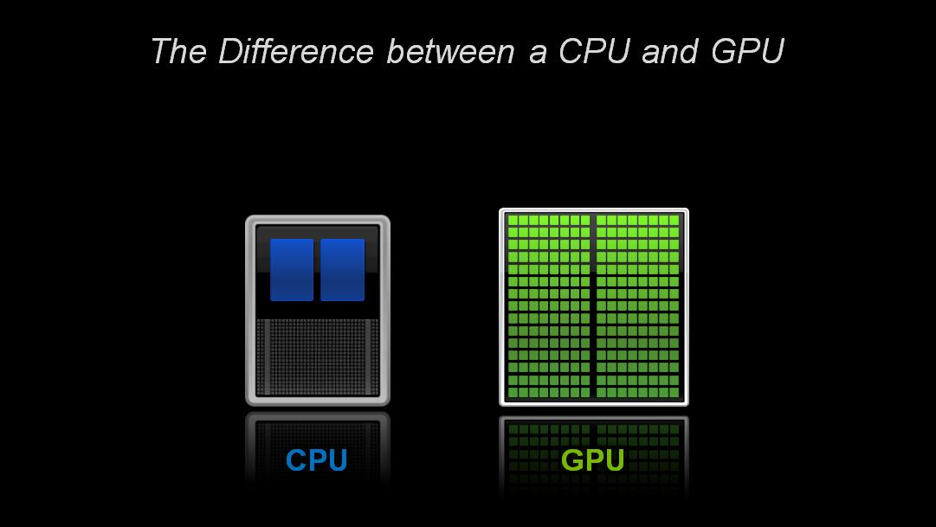
System Throughput (Jobs/sec)
HIST
DGEMM
HIST+DGEMM: 40% improvement in
System throughput, over running alone
[Jog et al., GPGPU 2014]

Slide 38
System Throughput (Jobs/sec)
GUPS
GAUSS
GAUSS+GUPS: Only 2% improvement in
System throughput, over running alone
[Jog et al., GPGPU 2014]

Slide 39
Memory Bandwidth Allocation
GUPS (Heavy Application) hurts other light applications
[Jog et al., GPGPU 2014]

Slide 40
Fairness
GUPS
HIST
DGEMM
What is the best way to allocate bandwidth to different applications?
Unpredictable performance impact
Fairness problems in the system
Unequal performance impact
[Jog et al., GPGPU 2014]
Notes:
GUPS degradation is less

Slide 41
1. Infrastructure Development
Many existing CUDA applications do not employ “CUDAStreams” to enable multi-programmed execution
Developed GPU concurrent application framework to enable multi-programming in GPUs
Available at https://github.com/adwaitjog/mafia
[Jog et al., MEMSYS 2015]

Slide 42

2. Application Performance Modeling
Attained Bandwidth (BW)
Performance
Misses Per Instruction (MPI)
How can we utilize this
model to develop better
memory scheduler?
Also, on real hardware (NVIDIA K20), absolute relative error is less than 10% averaged across 22 applications
[Jog et al., MEMSYS 2015]

Slide 43
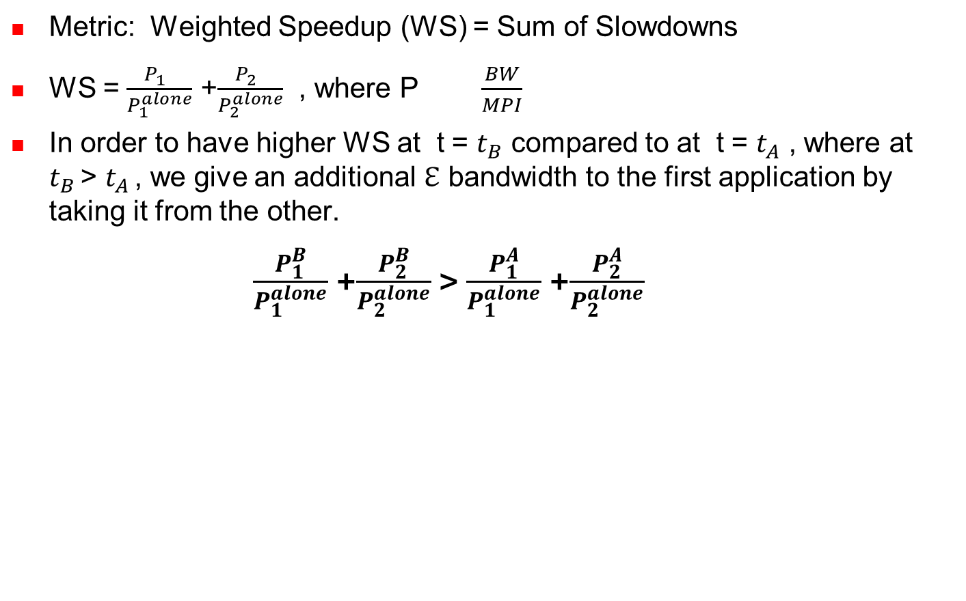




Bandwidth Sharing Mechanisms
$$\frac{\frac{{BW}_{1 }+\text{ℇ}}{{MPI}_{1}}}{\frac{{BW}_{1}^{alone}}{{MPI}_{1}}}$$
$$\frac{\frac{{BW}_{2 }\text{− }\text{ℇ}}{{MPI}_{2}}}{\frac{{BW}_{2}^{alone}}{{MPI}_{2}}}$$
$$\frac{\frac{{BW}_{1 }}{{MPI}_{1}}}{\frac{{BW}_{1}^{alone}}{{MPI}_{1}}}$$
$$\frac{\frac{{BW}_{2 }}{{MPI}_{2}}}{\frac{{BW}_{2}^{alone}}{{MPI}_{2}}}$$
+
>
+
Prioritize the application with the least BW (alone) to optimize for weighted speedup
In the paper, we show that prioritizing the application with the least attained bandwidth can improve weighted speedup
[Jog et al., MEMSYS 2015]
Notes:
Consistent with that fact that priortizing a job with least attained service would lead to a schedule that also prefers jobs with shortest
Processing Remaining time, which is the best way to improve system throughput (jobs/sec)

Slide 44
Results
Misses Per Instruction (MPI) Metric is not a good proxy for GPU performance
Attained Bandwidth (BW) and Misses Per Instruction (MPI) metrics can drive memory scheduling decisions for better throughput and fairness.
10% improvement in weighted speedup and fairness over 25 representative 2-app workloads
More results: Scalability; Application to Core Mapping Mechanisms.
[Jog et al., MEMSYS 2015]
Notes:
Consistent with that fact that priortizing a job with least attained service would lead to a schedule that also prefers jobs with shortest
Processing Remaining time, which is the best way to improve system throughput (jobs/sec)

Slide 45
Conclusions
Data Movement and Bandwidth are Major Bottlenecks.
Three issues we discussed today:
High cache miss-rates → warp scheduling!
Bandwidth is critical → data compression!
Sub-optimal memory bandwidth allocation → memory scheduling!
Other avenues and directions?
Processing Near/In Memory (PIM)
Value Prediction and Approximations

Slide 46
Other Sophisticated Mechanisms
Notes:
Cache as bandwidth filter
Unable to extract max parallelism

Slide 47
Key GPU Performance Concerns
Memory Concerns: Data transfers
between SMs and global memory
are costly.
SM
Scratchpad
Registers and
Local Memory
Bottleneck!
SM
GPU (Device)
GPU Global Memory
SM
SM
A
T1
T2
T3
T4
Compute Concerns: Threads that
do not take the same control path
lead to serialization in the GPU
compute pipeline.
B
T1
T2
T3
T4
C
Time
T1
T2
D
T3
T4
E
T1
T2
T3
T4
Notes:
WARP_SIZE

Slide 48
Compute Concerns
Challenge: How to handle branch operations when different threads in a warp follow a different path through program?
Solution: Serialize different paths.
foo[] = {4,8,12,16};
A
T1
T2
T3
T4
A: v = foo[threadIdx.x];
B: if (v < 10)
C: v = 0;
else
D: v = 10;
E: w = bar[threadIdx.x]+v;
B
T1
T2
T3
T4
C
Time
T1
T2
D
T3
T4
E
T1
T2
T3
T4

Slide 49
Control Divergence
Control divergence occurs when threads in a warp take different control flow paths by making different control decisions
Some take the then-path and others take the else-path of an if-statement
Some threads take different number of loop iterations than others
The execution of threads taking different paths are serialized in current GPUs
The control paths taken by the threads in a warp are traversed one at a time until there is no more.
During the execution of each path, all threads taking that path will be executed in parallel
The number of different paths can be large when considering nested control flow statements
Notes:
WARP_SIZE

Slide 50
Control Divergence Examples
Divergence can arise when branch or loop condition is a function of thread indices
Example kernel statement with divergence:
if (threadIdx.x > 2) { }
This creates two different control paths for threads in a block
Decision granularity < warp size; threads 0, 1 and 2 follow different path than the rest of the threads in the first warp
Example without divergence:
If (blockIdx.x > 2) { }
Decision granularity is a multiple of blocks size; all threads in any given warp follow the same path

Slide 51
Recall: SIMT Hardware Stack
Stack
A
A/1111
Reconv. PC
Next PC
Active Mask
TOS
TOS
TOS
TOS
-
-
-
-
-
-
-
G
A
E
E
B
E
E
1111
1111
1111
1111
1111
1111
1111
E
E
D
D
0110
TOS
E
D
0110
0110
B
B/1111
TOS
TOS
E
E
C
E
1001
1001
C/1001
D/0110
C
D
F
Thread Warp
Common PC
E
E/1111
Thread
1
Thread
2
Thread
3
Thread
4
G
G/1111
A
B
C
D
E
G
A
Time
Potential for significant loss of throughput when control flow diverged!

Slide 52
Performance vs. Warp Size
165 Applications
Convergent Applications
Warp-Size Insensitive Applications
Divergent Applications

Slide 53
Dynamic Warp Formation (Fung MICRO’07)
Warp 0
Warp 1
Warp 2
A
1 2 3 4
Reissue/Memory
Latency
A
5 6 7 8
A
9 10 11 12
B
1 2 3 4
B
5 6 7 8
B
9 10 11 12
SIMD Efficiency → 88%
C
1 2 -- --
Pack
C
1 2 7 8
Time
C
5 -- 7 8
C
5 -- 11 12
C
-- -- 11 12
D
-- -- 3 4
How to pick threads to pack into warps?
D
-- 6 -- --
D
9 10 -- --
E
1 2 3 4
E
5 6 7 8
E
9 10 11 12
Notes:
Multiple warps interleave execution in core to hide pipeline/memory latency
Breaks up the “static warps”, pack the threads running this instruction into fewer warps to improve efficiency
How should we decide which threads to pack together?

Slide 54
Dynamic Warp Formation: Hardware Implementation
A: BEQ R2, B
C: …
Thread Scheduler
PC-Warp LUT
Warp Pool
I
s
Warp Update Register T
B
s
B
0110
0010
0
2
A
B
B
1
5
2
2
2
3
3
3
4
PC
OCC
IDX
PC
TID x N
8
Prio
u
TID x N
e
5
2
7
3
8
1011
0110
B
REQ
B
PC A
H
C
C
1001
1101
1
1
A
C
PC
OCC
IDX
C
PC
TID x N
Prio
5
1
6
6
7
8
4
L
Warp Update Register NT
B
o
PC
TID x N
Prio
g
7
i
1
6
4
0100
c
1001
C
TID x N
REQ
C
PC B
H
X
Warp Allocator
Y
X
Y
X
Y
Z
X
Y
Z
X
Y
Z
1
5
1
5
1
5
5
1
5
5
1
5
5
2
6
2
6
2
6
2
2
6
2
2
6
2
3
7
3
7
3
7
3
3
7
3
3
7
3
4
8
4
8
4
8
8
4
8
8
4
8
8
No Lane Conflict

Slide 55
DWF Pathologies: Starvation
B: if (K > 10)
C: K = 10;
else
D: K = 0;
E: B = C[tid.x] + K;
Majority Scheduling
Best Performing
Prioritize largest group of threads with same PC
Starvation
LOWER SIMD Efficiency!
Other Warp Scheduler?
Tricky: Variable Memory Latency
C
1 2 7 8
C
5 -- 11 12
D
E
9 6 3 4
1 2 7 8
D
E
-- 10 -- --
5 -- 11 12
E
1 2 3 4
1000s cycles
E
5 6 7 8
D
9 6 3 4
E
9 10 11 12
D
-- 10 -- --
Time
E
9 6 3 4
E
-- 10 -- --
Notes:
12:17 – 13:00 – 14:23

Slide 56
DWF Pathologies: Extra Uncoalesced Accesses
Coalesced Memory Access = Memory SIMD
1st Order CUDA Programmer Optimization
Not preserved by DWF
E: B = C[tid.x] + K;
#Acc = 3
Memory
No DWF
E
1 2 3 4
0x100
E
5 6 7 8
0x140
E
9 10 11 12
0x180
L1 Cache Absorbs
Redundant
Memory Traffic
#Acc = 9
Memory
With DWF
E
1 2 7 12
0x100
E
9 6 3 8
0x140
L1$ Port Conflict
E
5 10 11 4
0x180
Notes:
14:23 – 16:15
Coalesced Memory Access = Grouping individual word accesses from threads inside a warp into a wide access to a chunk of memory
- Serviced by a single wide access

Slide 57
DWF Pathologies: Implicit Warp Sync.
Some CUDA applications depend on the lockstep execution of “static warps”
E.g. Task Queue in Ray Tracing
Warp 0
Thread 0 ... 31
Warp 1
Thread 32 ... 63
Warp 2
Thread 64 ... 95
int wid = tid.x / 32;
if (tid.x % 32 == 0) {
sharedTaskID[wid] = atomicAdd(g_TaskID, 32);
}
my_TaskID = sharedTaskID[wid] + tid.x % 32;
ProcessTask(my_TaskID);
Implicit
Warp
Sync.
Notes:
16:15 – 17:22
A single thread in each warp branches off to fetch task for the rest of the warp.

Slide 58
Observation
Compute kernels usually contain divergent and non-divergent (coherent) code segments
Coalesced memory access usually in coherent code segments
DWF no benefit there
Coherent
Static
Warp
Divergence
Divergent
Dynamic
Warp
Recvg
Pt.
Reset Warps
Coherent
Static
Warp
Coales. LD/ST
Notes:
17:22 – 18:37

Slide 59
Thread Block Compaction
Run a thread block like a warp
Whole block move between coherent/divergent code
Block-wide stack to track exec. paths reconvg.
Barrier @ Branch/reconverge pt.
All avail. threads arrive at branch
Insensitive to warp scheduling
Warp compaction
Regrouping with all avail. threads
If no divergence, gives static warp arrangement
Implicit
Warp Sync.
Starvation
Extra Uncoalesced
Memory Access
Notes:
18:37 – 20:03

Slide 60
Thread Block Compaction
PC
RPC
Active Threads
A
1 2 3 4
A
1 2 3 4
A
E
-
-
1
1
2
2
3
3
4
4
5
5
6
6
7
7
8
8
9
9
10
10
11
11
12
12
A
5 6 7 8
A
5 6 7 8
D
E
--
--
--
--
3
--
4
--
--
--
6
--
--
--
--
--
9
--
10
--
--
--
--
--
A
9 10 11 12
A
9 10 11 12
C
E
1
--
2
--
--
--
--
--
5
--
--
--
7
--
8
--
--
--
--
--
11
--
12
--
A: K = A[tid.x];
B: if (K > 10)
C: K = 10;
else
D: K = 0;
E: B = C[tid.x] + K;
C
1 2 7 8
C
1 2 -- --
C
5 -- 11 12
C
5 -- 7 8
D
9 6 3 4
C
-- -- 11 12
D
-- 10 -- --
D
-- -- 3 4
E
1 2 3 4
D
-- 6 -- --
E
5 6 7 8
D
9 10 -- --
E
9 10 11 12
E
1 2 7 8
E
5 6 7 8
E
9 10 11 12
Time
Notes:
20:03 – 21:45
Here is the same example as before with the block-wide stack.
Clarify that in HW, the active threads are represented as a block-wide active mask.

Slide 61
Thread Compactor
Convert activemask from block-wide stack to thread IDs in warp buffer
Array of Priority-Encoder
C
E
1
2
--
--
5
--
7
8
--
--
11
12
1
5
--
2
--
--
--
7
11
--
8
12
P-Enc
P-Enc
P-Enc
P-Enc
1
5
2
--
7
11
8
12
Warp Buffer
C
1 2 7 8
C
5 -- 11 12

Slide 62
Experimental Results
2 Benchmark Groups:
COHE = Non-Divergent CUDA applications
DIVG = Divergent CUDA applications
COHE
Serious Slowdown from
pathologies
DWF
DIVG
No Penalty for COHE
TBC
22% Speedup on DIVG
0.6
0.7
0.8
0.9
1
1.1
1.2
1.3
IPC Relative to Baseline
Per-Warp Stack
Notes:
26:53 – 27:50
We group our benchmarks according to how much they suffer from branch divergence in the first place.

Slide 63
References
Intel [MICRO 2011]: Thread Frontiers – early reconvergence for unstructured control flow.
UT-Austin/NVIDIA [MICRO 2011]: Large Warps – similar to TBC except decouple size of thread stack from thread block size.
NVIDIA [ISCA 2012]: Simultaneous branch and warp interweaving. Enable SIMD to execute two paths at once.
Intel [ISCA 2013]: Intra-warp compaction – extends Xeon Phi uarch to enable compaction.
NVIDIA: Temporal SIMT [described briefly in IEEE Micro article and in more detail in CGO 2013 paper]
NVIDIA [ISCA 2015]: Variable Warp-Size Architecture – merge small warps (4 threads) into “gangs”.

