Slide 1
Introduction to SimpleScalar
1

Slide 2
Overview
What is an architectural simulator?
– a tool that reproduces the behavior of a computing
device
Device Simulator
Why we use a simulator?
System outputs
System metrics
System inputs
Leverage a faster, more flexible software development cycle
Permit more design space exploration
Facilitates validation before H/W becomes available
Level of abstraction is tailored by design task
Possible to increase/improve system instrumentation
Usually less expensive than building a real system
2

Slide 3
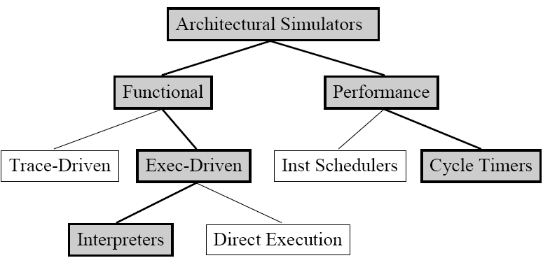
A Taxonomy of Simulation Tools
Shaded tools are included in SimpleScalar Tool Set

Slide 4
Functional vs. Performance
Functional simulators
Model the function of each component
Does not have timing accuracy
Faster
Performance simulators
Model system at finer detail
Timing in addition to functionality
For example:
Branch prediction accuracy vs. memory latency

Slide 5
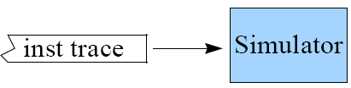
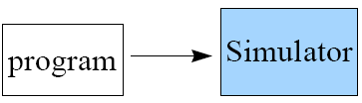
Trace- vs. Execution-Driven
Trace-Driven
Simulator reads a ‘trace’ of the instructions captured during a
previous execution
Easy to implement, no functional components necessary
Execution-Driven
Simulator runs the program (trace-on-the-fly)
Hard to implement
Advantages
No need to store traces
Register and memory values usually are not in trace
Support mis-speculation cost modeling

Slide 6
SimpleScalar Tool Set
Computer system design and analysis infrastructure
– Processor/device (behavioral) models
build modeling applications that simulate real programs running on a range of modern processors and system
Support many ISAs and I/O interfaces
Alpha, PISA, ARM, and x86 instr. sets
Hosted on most any Unix-like machine
Application
Application Input/output
Simplescalar
Simulators
Freely available for academic
non-commercial use with source from
www.simplescalar.com
Performance results
Host
Machine

Slide 7
Advantages of SimpleScalar
Highly flexible
functional simulator + performance simulator
Portable
Host: virtual target runs on most Unix-like systems
Target: simulators can support multiple ISAs
Extensible
Source is included for compiler, libraries, simulators
Easy to write simulators
Performance
Sim-Fast: 10+ MIPS
Sim-OutOrder: 350+ KIPS

Slide 8
Simulator Suite
Sim-Fast
Sim-Safe
Sim-Profile
Sim-Cache
Sim-BPred
Sim-Outorder
-420 lines
-functional
-4+ MIPS
-350 lines
-functional
w/checks
-900 lines
-functional
-Lot of stats
-~1000 lines
-functional
-Cache stats
-3900 lines
-performance
-OoO issue
-Branch pred.
-Mis-spec.
-ALUs
-Cache
-TLB
Performance Detail

Slide 9
Sim-Outorder
Most complicated and detailed simulator
Supports out-of-order issue and execution
Provides reports
branch prediction
cache
external memory
various configuration

Slide 10
Specifying Sim-outorder
Running a program
sim-outorder [sim opts] program [program opts]
e.g.
$SIMPLESIM/simplesim-3.0/sim-outorder
-config cfg_file bzip2_base.i386-m32-gcc42-nn
dryer.jpg

Slide 11
Benchmark
SPEC 2006
– Six benchmarks (4 integer, 2 floating point) bzip2(INT)
equake(FP) hmmer(INT) mcf(INT) milc(FP) sjeng(INT)

Slide 12
Installation of simplescalar
Simplescalar 3.0 is already installed bg machines
Path setup
log on into one of the bg machines
Go to your home directory: cd
>vim .cshrc (or gedit .cshrc)
export SIMPLESIM=/home/scratch/massem/research/Simulators/simplescalar
> source .cshrc
To verify, run
>echo $SIMPLESIM
the return should be /home/scratch/massem/research/Simulators/simplescalar

Slide 13
Installation of simplescalar
Create a local directory
>mkdir simplescalar
>cd simplescalar
>cp -r $SIMPLESIM/simplesim-3.0/ss-benchmark ss-benchmark
>cp -r $SIMPLESIM/simplesim-3.0/config config
>cd ss-benchmark

Slide 14
Running Benchmarks
Run benchmark (bzip2)
>cd bzip2
>$SIMPLESIM/simplesim-3.0/sim-outorder -config ../../config/tmp.cfg bzip2_base.i386-m32-gcc42-nn dryer.jpg
14

Slide 15
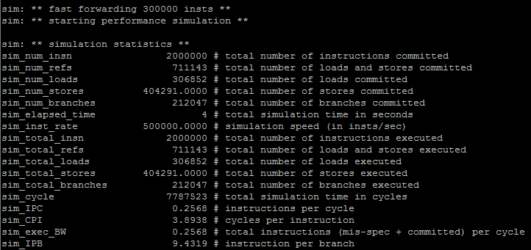
Check results
Check simulation results
– vim sim1.out (or gedit sim1.out)
15

Slide 16
Modify config
Modify a parameter in the config file
>cd ../../config
>vim tmp.cfg (or gedit tmp.cfg)
Increase L2 Data Cache Latency from 4 to 10
-cache:dl2lat 10
Change output file name (-redir:sim sim2.out)
Save and close tmp.cfg

Slide 17
Re-run Benchmark
Run benchmark (bzip2)
>cd ss-benchmark
>cd bzip2
>$SIMPLESIM/simplesim-3.0/sim-outorder
–config ../../config/tmp.cfg
bzip2_base.i386-m32-gcc42-nn dryer.jpg

Slide 18

Check result
Check simulation results
– vim sim2.out (or gedit sim2.out)

Slide 19
Global Simulator Options
Supported on all simulators
-h
-d
-q
-config <file>
-dumpconfig <file>
Configuration files
-print simulator help message
-enable debug message
-quit immediately
-read config parameters from <file>
-save config parameters into <file>
To generate a configuration file: -dumpconfig <file>
Change parameters in <file>
Comments allowed in configuration file, “#”
Reload configuration file using: -config <file>

Slide 20
Log into bg machines using SSH
ssh <username>@bg1.cs.wm.edu
You can use machines from bg1 to bg9

Slide 21
Running rest of benchmarks
mcf
> cd mcf
> $SIMPLESIM/simplesim-3.0/sim-outorder
–config ../../config/tmp.cfg mcf_base.i386-m32-gcc42-nn inp.in

Slide 22
hmmer
> cd hmmer
> $SIMPLESIM/simplesim-3.0/sim-outorder
–config ../../config/tmp.cfg hmmer_base.i386-m32-gcc42-nn bombesin.hmm

Slide 23
sjeng
> cd sjeng
> $SIMPLESIM/simplesim-3.0/sim-outorder
–config ../../config/tmp.cfg sjeng_base.i386-m32-gcc42-nn test.txt

Slide 24
milc
> cd milc
> $SIMPLESIM/simplesim-3.0/sim-outorder
–config ../../config/tmp.cfg milc_base.i386-m32-gcc42-nn < su3imp.in

Slide 25
equake
> cd equake
> $SIMPLESIM/simplesim-3.0/sim-outorder
–config ../../config/tmp.cfg equake_base.pisa_little < inp.in > inp.out

