Slide 1


Name of the School: School of Computer Science and Engineering
Course Code: E1UA307C Course name : Java Programming
Blood Donation Platform
Presented to :
Name : P Rajakumar
Team Details:
Name : Ananya Dwivedi(23SCSE1010115)
Name : Adwait Singh Raghuvanshi(23SCSE1012236)
Name : Jitendra Kumar Sharma (23SCSE1010794)
Name : Om Tripathi(23SCSE1010179)
Section:8

Slide 2
Name of the School: School of Computer Science and Engineering
Course Code: E1UA307C Course Name : Java Programming
INTRODUCTION
A blood donation platform is a digital tool designed to connect volunteer donors with healthcare facilities. It simplifies the donation process by allowing users to register, schedule appointments, and access educational resources. By promoting awareness and facilitating blood drives, these platforms aim to increase donor participation and ensure a reliable blood supply for patients in need.

Slide 3
Name of the School: School of Computer Science and Engineering
Course Code: E1UA307C Course Name: : Java Programming
Objective
Increased Awareness: It educates the public about the importance of blood donation and its life-saving impact.
Connecting Donors and Recipients: It facilitates matching donors with patients in need, ensuring timely access to blood.
Emergency Response: Provides quick access to donors during critical shortages or emergencies.
Streamlined Process: Simplifies the donation process through online scheduling, reminders, and location services for nearby donation centers.

Slide 4
Name of the School: School of Computer Science and Engineering
Course Code: E1UA307C Course Name : Java Programming
Problem Statement
1.Challenges in Blood Donation- Inefficient communication between donors, hospitals, and patients.
2.Limited awareness about blood donation drives and needs- Difficulty in tracking donor history and availability.
3.Inadequate matching of blood types with hospital requests-
Delays in fulfilling urgent blood requests.

Slide 5
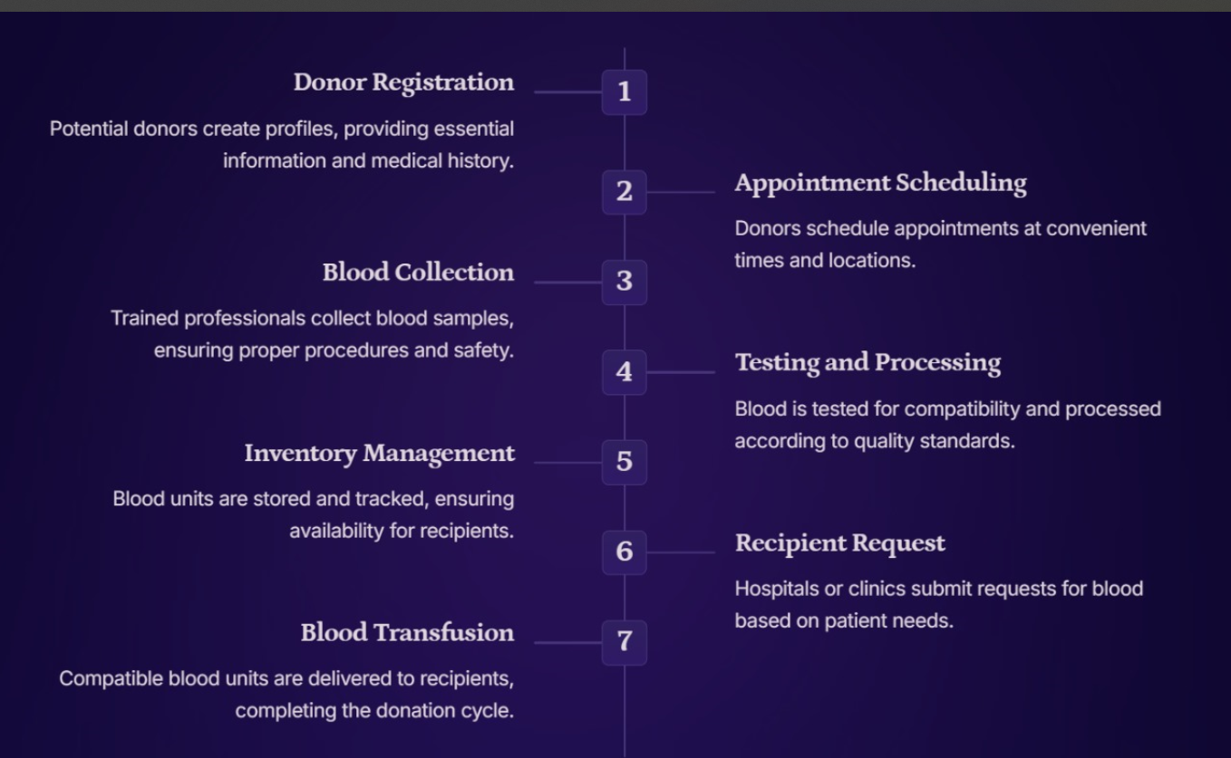
Name of the School: School of Computer Science and Engineering
Course Code: E1UA307C Course Name: Java Programming
Flow Diagram

Slide 6
Name of the School: School of Computer Science and Engineering
Course Code: E1UA307C Course Name: Java Programming
Technical Stacks
1) Front-end: HTML, CSS, JavaScript.
2) Back-end: Java Spring Boot, RESTful API.
3) Database: 2.MySQL/PostgreSQL.
4) Authentication: OAuth/JWT.
5) Notifications: WebSocket/Push API.
6) Deployment: Cloud AWS/Azure/Google Cloud.

Slide 7
Name of the School: School of Computer Science and Engineering
Course Code: E1UA307C Course Name: : Java Programming
Conclusion
A blood donation platform is essential for enhancing the effectiveness and efficiency of blood donation efforts. By raising awareness, connecting donors and recipients, streamlining the donation process, and fostering community engagement, such a platform can significantly improve blood availability and emergency response capabilities. Ultimately, it plays a vital role in saving lives and promoting a culture of giving, making it an invaluable resource for healthcare systems and communities alike.

Slide 8

Name of the School: School of Computer Science and Engineering
Course Code: E1UA307C Course Name: Java Programming

