Slide 1

SMART INDIA HACKATHON 2026
TITLE PAGE
Problem Statement ID – PSS04
Problem Statement Title- AI-Powered Criminal Network Analysis System
Theme- Blockchain and Cybersecurity
PS Category- Software
Team ID-
Team Name- Ctrl Innovate

Slide 2
NETSENTINEL-Mumbai Police Intelligence Platform
Ctrl Innovate
Proposed Solution:-
Unified Intelligence Platform — Fuses FIRs, CDRs, CCTV co-location, and financial data into one Tactical Intelligence Command Center dashboard.
Graph-Powered Network Mapping — Builds a dynamic criminal network graph (Neo4j) to expose syndicates, key connectors, and hidden hierarchies via graph algorithms.
AI-Driven Threat Detection — NLP entity extraction a computed Threat Index flag risks in real time.
How It Addresses the Problem:-
Data Gathering→Analyses Linkages → Compute Threat /Risk→ Displays Organized Data
Innovation:-
Fuses fragmented crime data into a self-explaining, graph-driven threat intelligence engine with an AI reasoning system.

Slide 3
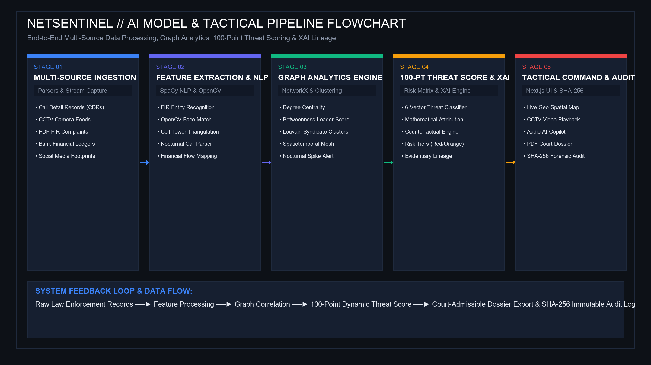
TECHNICAL APPROACH & AI MODEL PIPELINE
Ctrl Innovate
Comprehensive Technology Stack
• Frontend Layer:
Next.js 14, React, TypeScript, Tailwind CSS, Lucide React, Recharts
• Backend & Data Ingestion:
Python (FastAPI / Flask), Regex CDR Parser, OpenCV (Facial Recognition), SpaCy NLP (FIR Parser)
• AI & Graph Mining Engine:
NetworkX (Degree & Betweenness Centrality), Louvain Community Detection, Spatiotemporal Co-Location Engine
• Threat Classifier & XAI:
100-Point Dynamic Threat Indexing System, Feature Attribution Weighting, Counterfactual Engine
• Database & Cryptography:
SQLite / PostgreSQL, Cryptographic SHA-256 Forensic Audit Trail Ledger
Technology Stack:-
Frontend
React + TypeScript
Tailwind CSS
Recharts
Lucide React
Backend
Node.js
Express.js
REST APIs
Database
MySQL
Working Methodology
Data Ingestion
→ FIR / CDR / CCTV Import
→ Multi-Source Aggregation
→ NLP Entity Extraction
Graph Layer
→ Entity-Relationship Mapping
→ Network Construction (Neo4j)
→ Graph Algorithm Analysis
Intelligence Layer
→ Statistical Anomaly Detection
→ Threat Index Computation
→ Explainable AI (XAI) Flagging
Command & Audit
→ RBAC Access Control
→ Forensic Audit Logging
→ Scalability Benchmarking
Core Workflow
Data Ingestion → NLP Extraction → Graph Construction → Anomaly/Threat Detection → XAI Explanation → Command Center Dashboard → Field Action

Slide 4
FEASIBILITY AND VIABILITY
Ctrl Innovate
➢ Built using mature, proven technologies
Neo4j & PostgreSQL
Role-Based Access
Graph & NLP Pipelines
Analytics & Anomaly Detection
Alerts & Reporting
➢ Aligned with established law-enforcement intelligence practices:
Data Ingestion
Entity Extraction
Network Mapping
Threat Scoring
Audit Logging
Expected Outcome:-
Early Threat Detection → Exposed Hidden Networks → Faster, Evidence-Backed Action
Right Entity → Right Connection → Right Pattern → Right Time → Right Response
Risk | Mitigation
Data Accuracy | Validation + Cross-Source Corroboration
Real-Time Processing | Timestamped Updates + Alerts
False Positives** | Explainable AI (XAI) + Human Review
Cybersecurity | Authentication + Role-Based Access
User Adoption | Simple, Investigator-Friendly Dashboards
System Integration | API-Based, Modular Architecture

Slide 5
IMPACT AND BENEFITS
Ctrl Innovate
Investigators
Faster identification of key suspects & links
Reduced manual case-linking effort
Command Center
Government / Policy Makers
Real-time visibility into active syndicates
Prioritized threat alerts, less noise
Data-driven resource allocation
Centralized oversight across units & jurisdictions
Judiciary
Public
Explainable AI evidence trail (XAI)
Stronger, defensible case documentation
Faster crime resolution & safer neighborhoods
Increased trust via transparent, auditable action

Slide 6
RESEARCH AND REFERENCES
Ctrl Innovate
LAW ENFORCEMENT & TECHNICAL REFERENCES
1. NCRB Digital Evidence & CDR Analysis Guidelines
National Crime Records Bureau Standard Operating Procedures for Telecom Log Mining & Evidence Lineage.
2. Statutory Frameworks for Criminal Syndicate Prosecution
Maharashtra Control of Organised Crime Act (MCOCA) & IPC Sec 120B Conspiracy Evidence Requirements.
3. NetworkX & Graph Centrality in Intelligence Mining
IEEE/ACM Research on Degree & Betweenness Centrality Algorithms for Key-Link Identification in Syndicate Graphs.
4. Explainable AI (XAI) Standards for Judicial Admissibility
NIST & Inter-Agency Guidelines for Transparent Algorithmic Scoring and Feature Attribution in Law Enforcement Systems.

