Slide 1

SMART INDIA HACKATHON 2026
TITLE PAGE
Problem Statement ID – PSS04
Problem Statement Title- AI-Powered Criminal Network Analysis System
Theme- Blockchain and Cybersecurity
PS Category- Software
Team ID-
Team Name- Ctrl Innovate

Slide 2
NETSENTINEL-Mumbai Police Intelligence Platform
Ctrl Innovate
Proposed Solution:-
Unified Intelligence Platform — Fuses FIRs, CDRs, CCTV co-location, and financial data into one Tactical Intelligence Command Center dashboard.
Graph-Powered Network Mapping — Builds a dynamic criminal network graph (Neo4j) to expose syndicates, key connectors, and hidden hierarchies via graph algorithms.
AI-Driven Threat Detection — NLP entity extraction a computed Threat Index flag risks in real time.
How It Addresses the Problem:-
Data Gathering→Analyses Linkages → Compute Threat /Risk→ Displays Organized Data
Innovation:-
Fuses fragmented crime data into a self-explaining, graph-driven threat intelligence engine with an AI reasoning system.

Slide 3
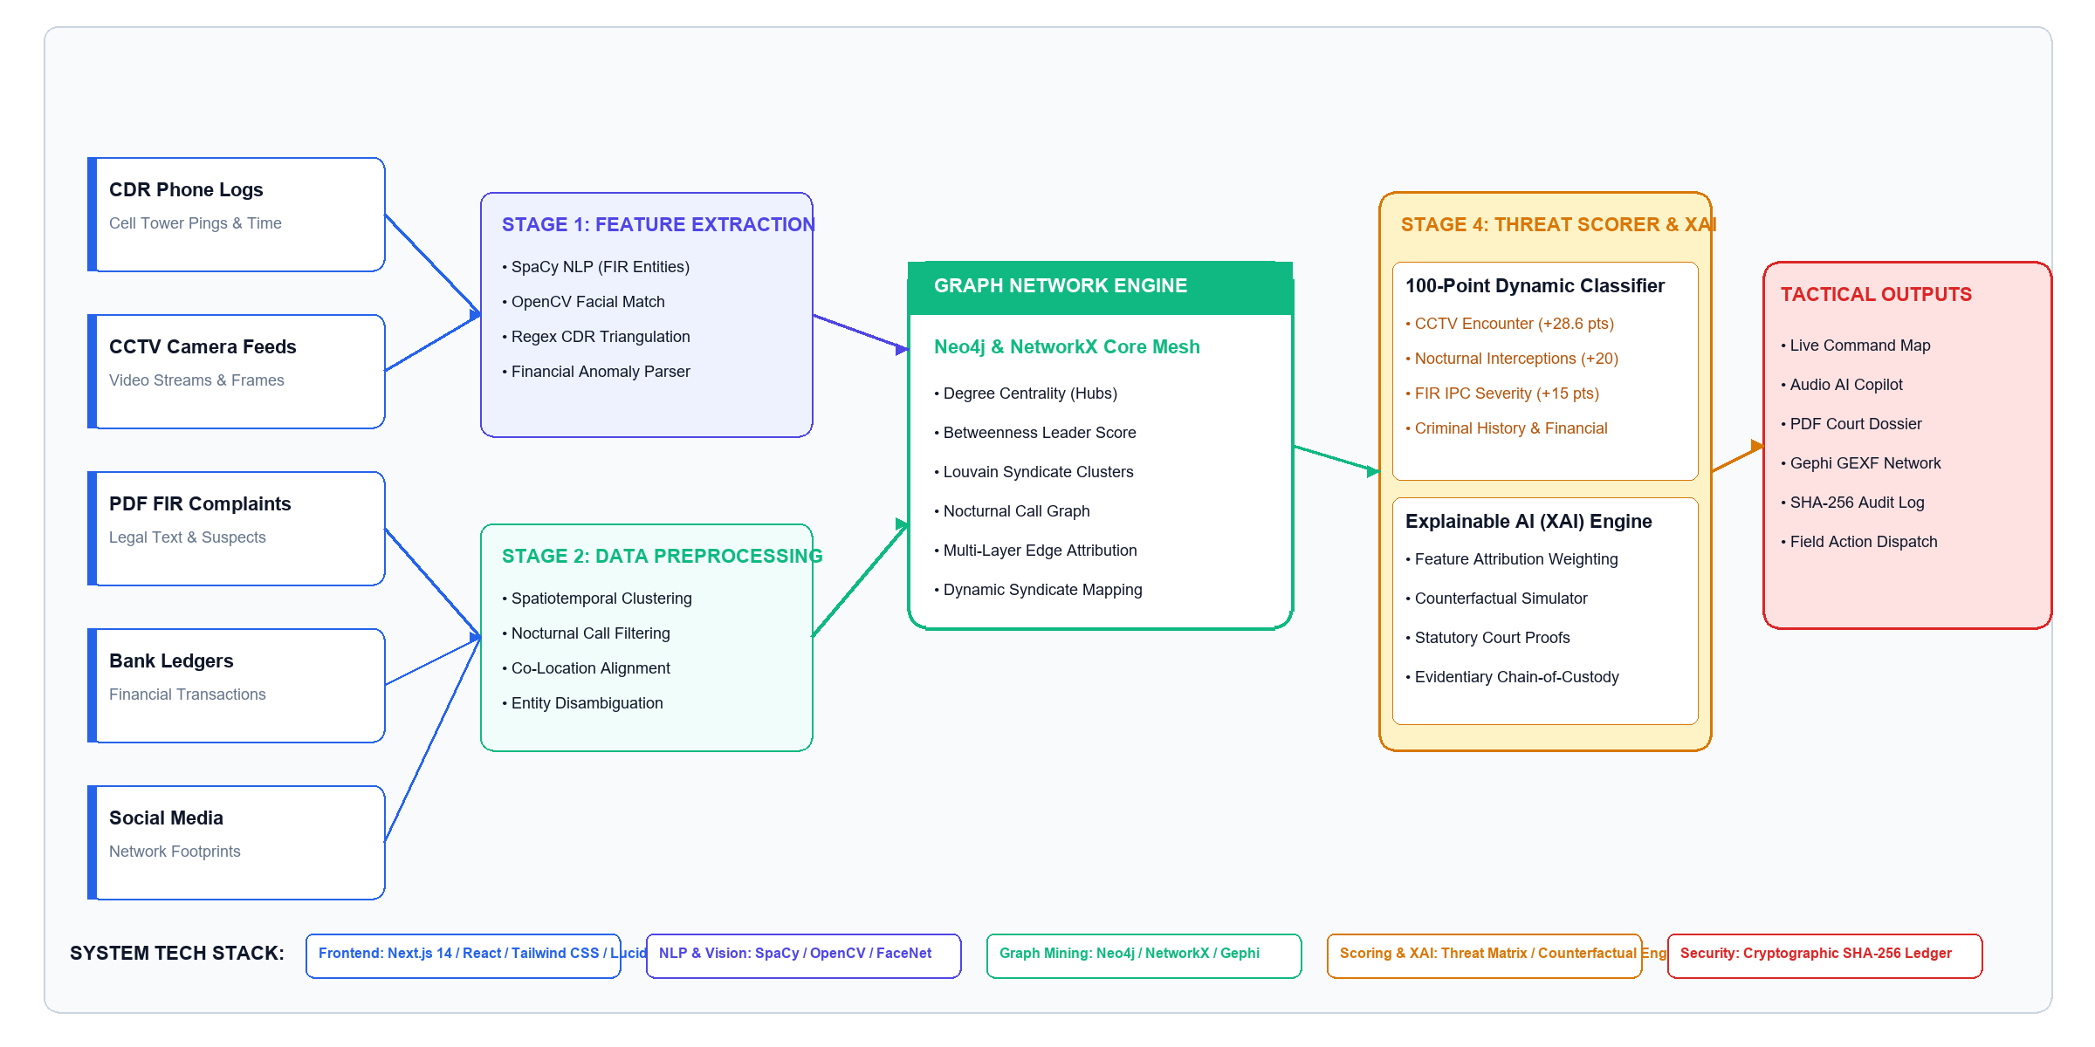
TECHNICAL APPROACH & AI MODEL PIPELINE
Ctrl Innovate
TECHNICAL APPROACH & AI MODEL PIPELINE

Slide 4
FEASIBILITY AND VIABILITY
Ctrl Innovate
➢ Built using mature, proven technologies
Neo4j & PostgreSQL
Role-Based Access
Graph & NLP Pipelines
Analytics & Anomaly Detection
Alerts & Reporting
➢ Aligned with established law-enforcement intelligence practices:
Data Ingestion
Entity Extraction
Network Mapping
Threat Scoring
Audit Logging
Expected Outcome:-
Early Threat Detection → Exposed Hidden Networks → Faster, Evidence-Backed Action
Right Entity → Right Connection → Right Pattern → Right Time → Right Response
Risk | Mitigation
Data Accuracy | Validation + Cross-Source Corroboration
Real-Time Processing | Timestamped Updates + Alerts
False Positives** | Explainable AI (XAI) + Human Review
Cybersecurity | Authentication + Role-Based Access
User Adoption | Simple, Investigator-Friendly Dashboards
System Integration | API-Based, Modular Architecture

Slide 5
IMPACT AND BENEFITS
Ctrl Innovate
Investigators
Faster identification of key suspects & links
Reduced manual case-linking effort
Command Center
Government / Policy Makers
Real-time visibility into active syndicates
Prioritized threat alerts, less noise
Data-driven resource allocation
Centralized oversight across units & jurisdictions
Judiciary
Public
Explainable AI evidence trail (XAI)
Stronger, defensible case documentation
Faster crime resolution & safer neighborhoods
Increased trust via transparent, auditable action

Slide 6
RESEARCH AND REFERENCES
Ctrl Innovate
WHO Digital Transformation Handbook
https://www.who.int/publications/b/76072
WHO Medicines Supply Systems
https://www.who.int/teams/health-product-policy-and-standards/medicines-selection-ip-and-affordability/medicines-policy/medicines-supply
WHO Procurement & Supply Chain Guidelines
https://www.who.int/about/accountability/procurement/principles-and-processes

