Slide 1
Deep Learning for Anomaly Detection in Cybersecurity
AIML339
22/10/2025
By Sahil Adwani

Slide 2
Motivation
Why anomaly detection is important in cybersecurity?
In 2024, cyber threats grew sharply with 31% more reported vulnerabilities and 20% more active attacks. This means it’s getting easier for hackers to find ways in.
Detecting unusual patterns like a sudden spike in traffic or unauthorized access is critical to stopping threats.
Why traditional systems fall short?
Traditional systems often rely on known signatures or manual rules, which fail to catch new or subtle attacks.
The solution: Anomaly detection
learns patterns of normal behavior and flags anything that doesn’t fit, making it well-suited for detecting new or evolving cyber threats.

Slide 3
Motivation
Why use only normal data to train?
In real-world cybersecurity, you have plenty of normal data. But labeled attack data is rare, unlabeled, or unknown.
These models are designed to learn the normal behavior of a system and then detect anything that deviates from it as an anomaly.
This approach is practical and scalable because it doesn't require examples of every possible attack. Hence model can detect unseen attacks.

Slide 4
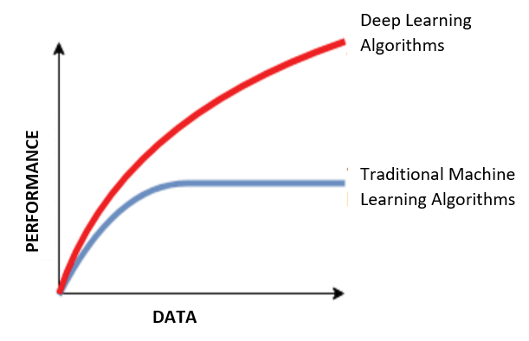
Motivation
Why deep learning methods instead of traditional machine learning methods?
Traditional ML methods require manual feature engineering, struggle with high dimensional or complex data and may miss subtle attacks
Deep Learning methods learn patterns automatically from raw data, handles large, noisy, complex datasets and better at detecting evolving or unknown threats.
Notes:
Traditional machine learning methods like SVMs, decision trees, or K-means were effective in earlier intrusion detection systems
Deep learning methods, in contrast, are more recent and have shown strong performance in tasks involving large-scale, high-dimensional, and noisy data — like network traffic

Slide 5
Research Background and Contribution
Although deep learning-based anomaly detection is a promising approach, its use in cybersecurity applications is still underexplored.
Most existing studies have tested deep learning models on image-based datasets, not on structured cybersecurity data.
This project helps fill that gap by testing and comparing deep learning models on a real-world cybersecurity dataset, and provides practical insights and reproducible steps others can follow.

Slide 6
The Goal
Goal: A fair and systematic comparison of three deep learning approaches on realistic cybersecurity data to identify the most effective one for detecting anomalies in real-world traffic.
Question: Which model is most effective for real-world anomaly detection in cybersecurity?

Slide 7
Selected Models
This study compares three distinct deep learning approaches:
Variational Autoencoder (VAE)
GANomaly
Deep Support Vector Data Description (Deep SVDD)
Notes:
2017,2018,2018

Slide 8
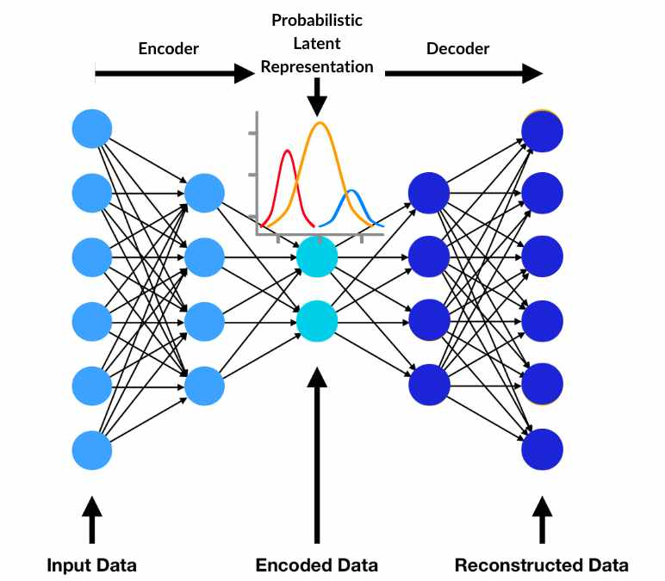
VAE

Slide 9
VAE
Core Idea: Learns a flexible "blueprint" of normal data and flags anything it can't properly reconstruct.
How It Works:
Encoder:
Compresses a normal network flow into a probability distribution in a latent space.
Unlike a standard autoencoder that uses a fixed point, this creates a flexible understanding of normal data.
Latent Space:
The "learned blueprint" of normal traffic, capturing essential patterns.
Decoder:
Samples from this distribution and attempts to reconstruct the original input.
How It Detects Anomalies:
Becomes an expert at reconstructing normal traffic.
When an attack flow passes through:
The encoder can't map it well to the normal blueprint.
The decoder struggles to reconstruct it accurately.
The Anomaly Score is the RECONSTRUCTION ERROR.
A high error means "I've never seen this before" → Flag as an attack.

Slide 10
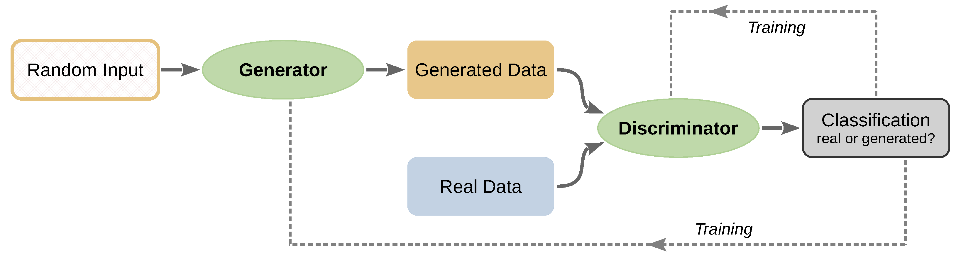
GANomaly

Slide 11
GANomaly
Core Idea: Uses an adversarial game to become hyper-sensitive to subtle anomalies by comparing the "idea" of the original with its reconstruction.
How It Works: Two Networks Compete
Generator (The Forger): Encoder -> Decoder -> Encoder
Takes an input, encodes it (latent_z), decodes it (reconstruction), then re-encodes the reconstruction (latent_ž).
Goal: Make perfect reconstructions that fool the discriminator.
Discriminator (The Critic):
Looks at any latent code and decides: "Is this from a REAL input or a GENERATED reconstruction?"
This adversarial training forces the generator to master normal data.
How It Detects Anomalies:
The anomaly score is a combination of:
Reconstruction Error: How pixel-perfect is the reconstruction?
Latent Space Discrepancy (The Key): How different is the original "idea" (latent_z) from the reconstruction's "idea" (latent_ž)?
Normal Data: The two latent codes are very similar.
Anomalous Data: The generator gets confused; the two latent codes are very different.
Flags inputs that are both hard to reconstruct AND whose core "idea" changes.

Slide 12
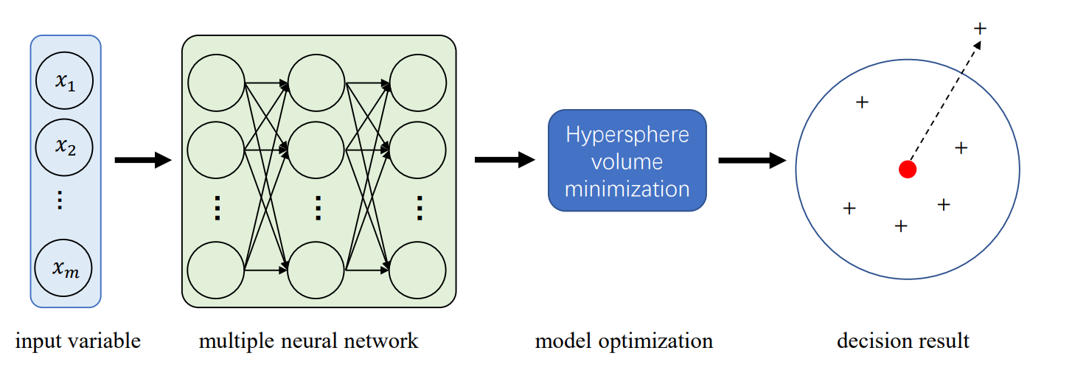
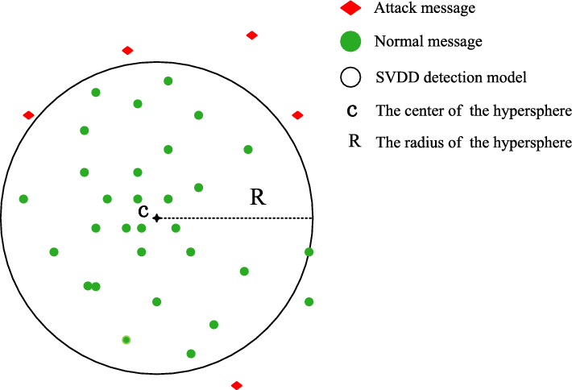
Deep SVDD

Slide 13
Deep SVDD
Core Idea: Learns a simple, compact boundary that surrounds all normal data, ignoring everything else.
How It Works:
Neural Network Projector:
Uses a neural network as a transformation lens to map input data into a new, optimized feature space.
The Hypersphere:
During training, the model learns to pull all normal data points toward a single, pre-defined center point.
The objective is to minimize the distance of all normal points from this center.
The Result:
A tight boundary or "fence" (a hypersphere)—is formed around the condensed cluster of normal data.
How It Detects Anomalies:
For any new data point:
It is mapped through the neural network "lens."
The model calculates its Euclidean distance from the center.
The Anomaly Score is this DISTANCE.
Points inside the fence are normal. Points far outside are anomalies.

Slide 14
Why These Three Models?
I chose these three because they represent distinct and complementary approaches to anomaly detection
VAE:
Modern evolution of autoencoders - uses probability distributions for better generalization
GANomaly:
Cutting-edge approach - uses adversarial training to catch subtle pattern changes
Deep SVDD
Completely different path - learns direct boundaries instead of reconstructing data
Notes:
I started by reviewing several popular deep learning methods used in anomaly detection,
Variational Autoencoder (VAE)
Generative Adversarial Networks (GANs) –including GANomaly and AnoGAN
Recurrent Neural Networks (RNNs) – like LSTM-based models
Convolutional Neural Networks (CNNs) – such as CNN autoencoders
Transformers – like the Anomaly Transformer
Deep Support Vector Data Description (Deep SVDD)

Slide 15
Methodology
Dataset: CIC-IDS2017 - The Realistic Benchmark
Why I chose CIC-IDS2017 as my real-world dataset?
Simulates a real corporate network over 5 days with diverse, modern attacks (DDoS, PortScan, Infiltration, etc.)
What does the data look like?
Format: Tabular data (CSV) - 79 features describing network flows
Each row: A complete bidirectional communication session between two endpoints known as a network flow.
Label: "BENIGN" or specific attack type
Benefit: Provides a higher-level view of network activity compared to raw packet data
Notes:
Scope: 8 days of real enterprise network traffic
Initial Size: 2.8 million network flows, 79 features
Attack Variety: 14 different attack types including DDoS, PortScan, Infiltration

Slide 16
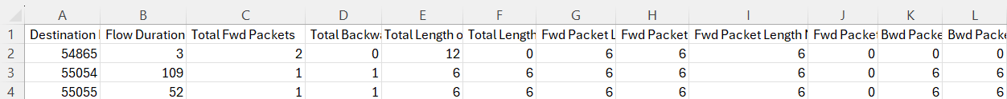


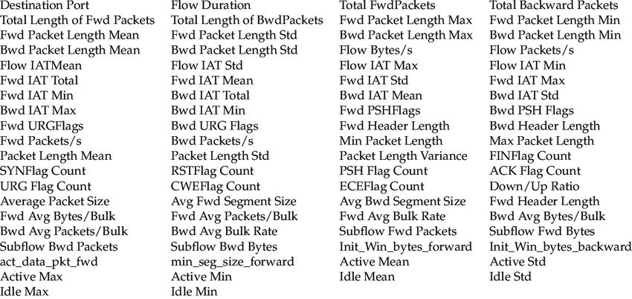
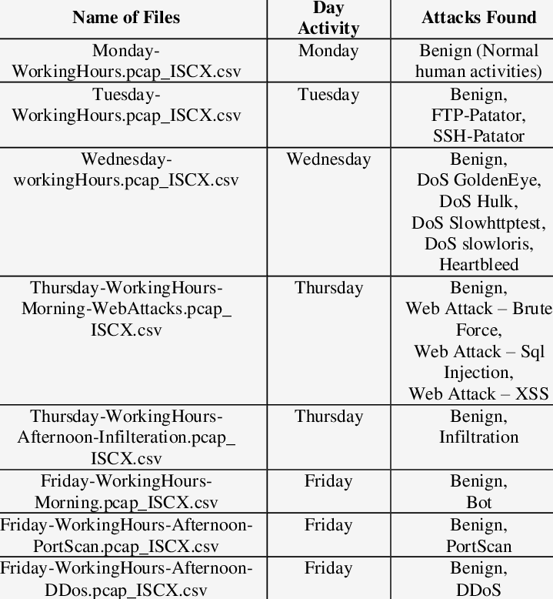
CIC-IDS-2017
Notes:
Here is how it looks on excel
Here are all the different type of attacks
And here all the 8 different files across 5 days. Each file have a different sort of attack found

Slide 17
Methodology
Data Preprocessing Pipeline:
Cleaning: Removed 308,381 duplicate records, handled missing values
Feature Selection: Dropped 8 zero-variance features
Normalization: MinMaxScaler applied using only normal training data
Label Processing: Converted to binary classification (Normal=0, Attack=1)
Final Features: 70 selected network flow characteristics
Train-Test Split: 70% normal traffic for training, 30% mixed traffic for testing
Total After Preprocessing: 2,522,362 network flows
Training (Normal Only): 1,467,538 sample
Test Set: 756,709 samples
Normal in Test: 628,946 (83.1%)
Anomalies in Test: 127,763 (16.9%)
Anomaly Ratio: 16.88%
Notes:
One-Class Training: Used only normal samples for training (1,467,538 samples)
Why 70:30 ? Mimics real-world conditions where attack data is scarce or unknown

Slide 18
Methodology
For fair comparison setup, kept a consistent parameters across all 3 models
Architecture: Same latent dimension (64), hidden layers [256, 128]
Training: Same samples, batch size (256), epochs (50)
Optimization: Same optimizer (Adam), learning rate (0.001)
Randomness: Fixed random seed (42)
Why this matter?:
Ensures performance differences reflect core algorithms, not tuning
Prevents any model from gaining unfair advantages
Provides reproducible and consistent benchmarks
Focuses on inherent strengths of each philosophical approach
Notes:
Why These Specific Parameters?
Balanced for All Three Architectures:
Latent Dimension (64): Large enough to capture complex patterns, small enough to force meaningful compression
Hidden Layers [256, 128]: Standard progression that works well for tabular data without over-parameterization
Batch Size (256): Balances training stability and computational efficiency
50,000 Samples: Sufficient to learn meaningful patterns while maintaining practical training times
Learning Rate (0.001): Default Adam rate - stable for all three very different optimization objectives
Designed for Cross-Architecture Compatibility:
Works for VAE's probabilistic encoding
Suitable for GANomaly's adversarial training
Effective for Deep SVDD's hypersphere learning

Slide 19
Methodology
After, I trained each the model on the training data being only normal

Slide 20
Methodology
Threshold optimisation
Models output anomaly scores, not binary decisions
Hence, we need a threshold to define where to draw the line between normal and attack
Default thresholds are overly conservative - designed to minimize false positives, resulting in high precision but poor recall (missing many attacks).
Why threshold optimisation is essential?
Precision vs. Recall Trade-off:
High threshold: Few false alarms, but miss many attacks
Low threshold: Catch most attacks, but many false alarms
Critical for practical cybersecurity operations where both matter
The models are optimized for practical detection so better balance between catching threats and managing false alarms
Notes:
Why conservative, Default thresholds are conservative because they're designed to be statistically "safe" rather than operationally effective. Defaults like "mean + 2 standard deviations" are designed to minimize false positives

Slide 21

Methodology
My systemic approach:
Tested 5 evenly distributed thresholds
Calculate precision, recall and F1-score for each
Identified the optimal threshold that maximize F1-Score, providing the most practical operational point
Why precisely 5 thresholds?
Computationally efficient and practical for deployment
Covers the full score spectrum without over-engineering
Provides clear precision-recall trade-off analysis
More interpretable and reproducible than complex optimization
Sufficient resolution to find the optimal operational point
Notes:
Threshold Sensitivity Explained
High Threshold (e.g., 0.9)
Harder to trigger - only the most obvious anomalies pass
Fewer detections - misses subtle attacks
Higher precision - when it does alert, it's usually right
Lower recall - misses many real attacks
LESS SENSITIVE
Low Threshold (e.g., 0.1)
Easier to trigger - even slightly unusual behavior sets it off
More detections - catches subtle attacks
Lower precision - more false alarms
Higher recall - catches most real attacks
MORE SENSITIVE

Slide 22
The results
Accuracy can be misleading with imbalanced data (83% normal, 17% attacks)
Hence we need metrics that reveal the true detection capability
Key Metrics:
Precision: When the model flags an attack, how often is it correct? (Low false alarms)
Recall: What percentage of real attacks did the model detect? (Low missed attacks)
F1-Score: Harmonic mean of precision & recall - the balanced metric
ROC-AUC: Model's overall ability to distinguish normal vs attack
The default threshold before optimisation gave high accuracy (0.85 – 0.90) and high precision but poor recall, hence missed attacks
Notes:
Accuracy = Total Correct Predictions ÷ Total Predictions

Slide 23
The results
After threshold optimization : Performance comparison on CIC-IDS-2017
Model | ROC-AUC | F1-Score | Precision | Recall | Accuracy
VAE | 0.853 | 0.629 | 0.655 | 0.605 | 0.880
GANomaly | 0.790 | 0.466 | 0.389 | 0.582 | 0.778
Deep SVDD | 0.862 | 0.591 | 0.639 | 0.549 | 0.867

Slide 24
The result
Model | ROC-AUC | F1-Score | Precision | Recall | Accuracy
VAE | 0.853 | 0.629 | 0.655 | 0.605 | 0.880
GANomaly | 0.790 | 0.466 | 0.389 | 0.582 | 0.778
Deep SVDD | 0.862 | 0.591 | 0.639 | 0.549 | 0.867
1. VAE: The Most Balanced Performer
Highest F1-Score (0.629): It achieves the best overall balance between precision and recall.
Strong Recall (0.605): It successfully detects over 60% of attacks.
Conclusion: The most reliable and practical choice for general use.
2. Deep SVDD: The Best Discriminator
Highest ROC-AUC (0.862): It is the best model at fundamentally separating normal traffic from attacks.
Good Precision (0.639): When it flags an anomaly, it is often correct.
Conclusion: Excellent for environments where computational efficiency and clear separation are key.
3. GANomaly: The High-Sensitivity Model
Significant Recall (0.582): It can detect a wide range of attacks.
Major Trade-Off: This comes at the cost of low precision (0.389), leading to many false alarms.
Conclusion: Useful in high-security settings where missing an attack is worse than investigating false alerts.

Slide 25
The results
Threshold optimisation effects:
Model | Default Recall | Optimized Recall | Improvement
VAE | 0.372 | 0.605 | +63%
GANomaly | 0.221 | 0.582 | +163%
Deep SVDD | 0.338 | 0.549 | +62%

Slide 26
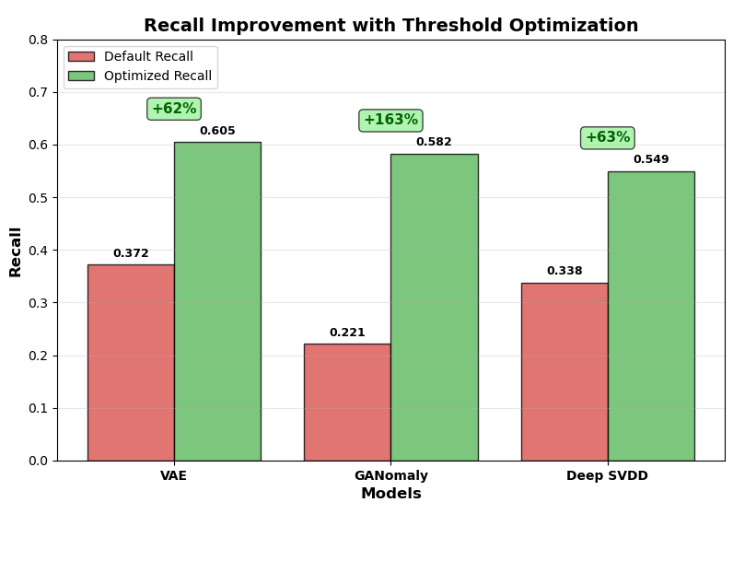
The results
Model | Default Recall | Optimized Recall | Improvement
VAE | 0.372 | 0.605 | +63%
GANomaly | 0.221 | 0.582 | +163%
Deep SVDD | 0.338 | 0.549 | +62%
All models improved by >60% in recall after optimization
GANomaly: The High-Risk, High-Reward Model
+163% recall improvement - the most dramatic gain
But: Major precision trade-off - many more false alarms
Lesson: Extremely sensitive to threshold settings
VAE: The Balanced Champion
+63% recall improvement while maintaining good precision
Most stable and reliable performance
Lesson: Best choice for operational environments
Deep SVDD: The Consistent Performer
+62% improvement with stable performance
Predictable and manageable trade-offs
Lesson: Reliable for resource-constrained deployments
Notes:
The Big Takeaway: Threshold optimization isn't optional - it's what makes these models actually useful for real-world security.

Slide 27
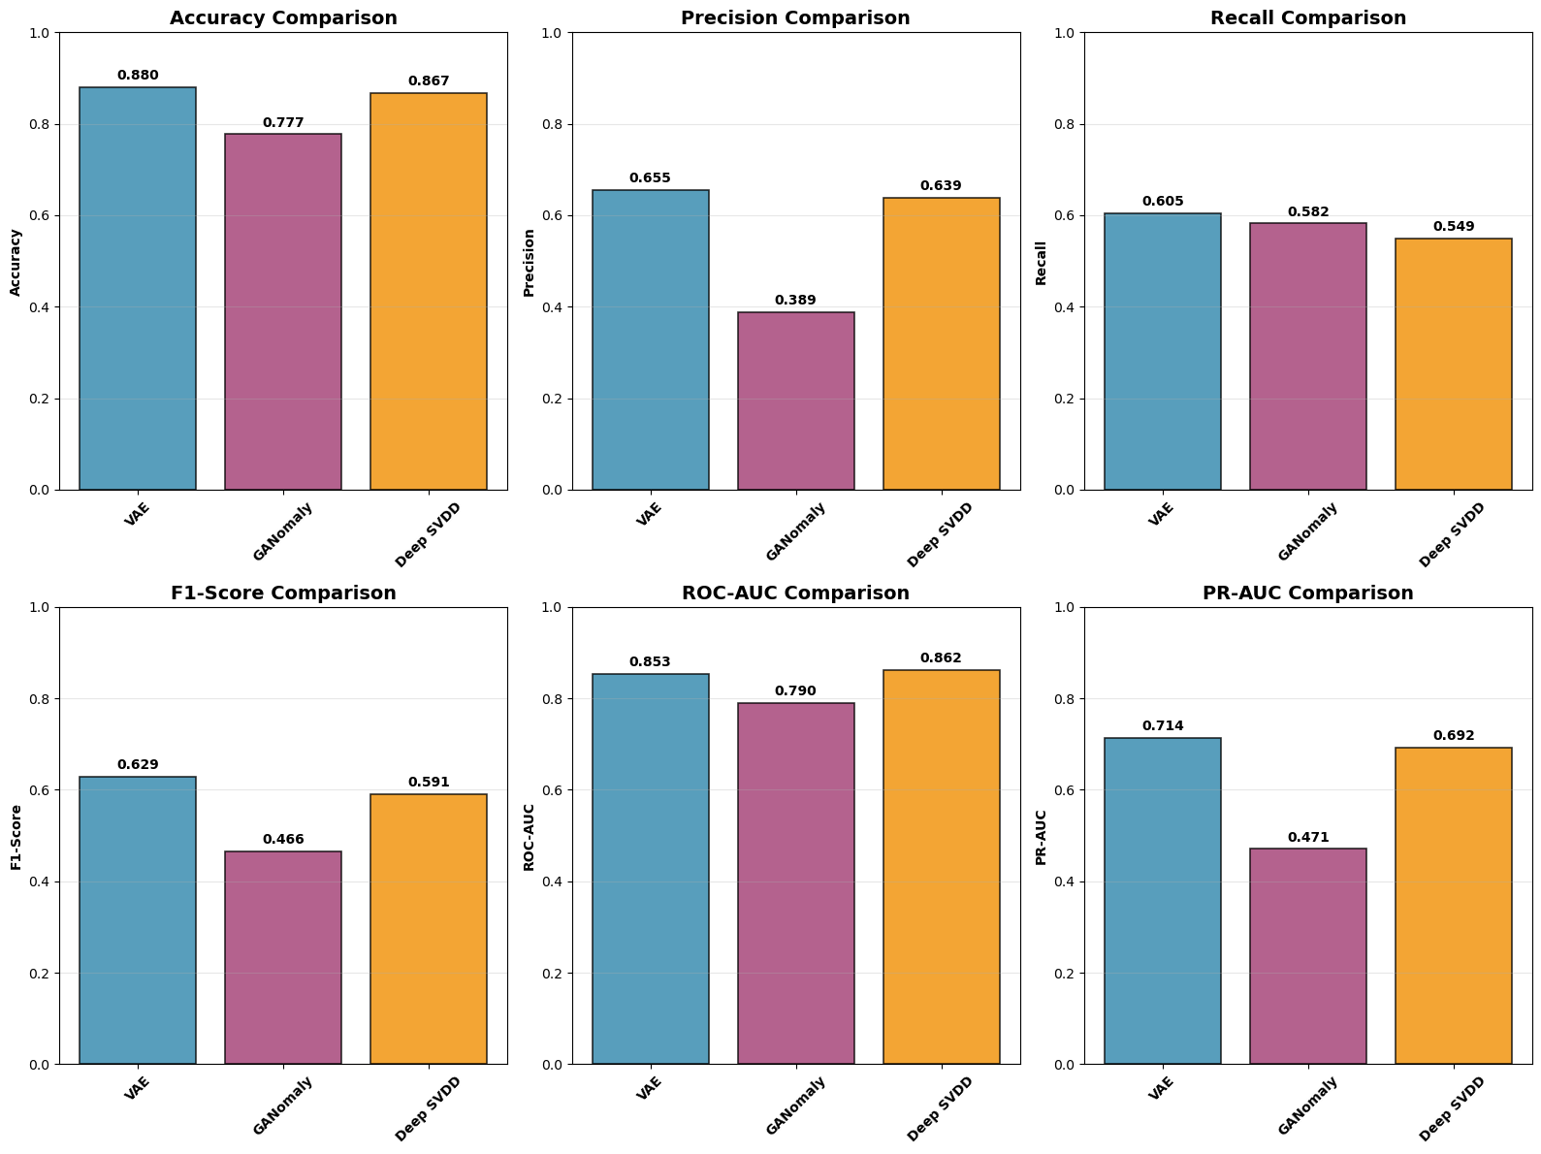

Slide 28
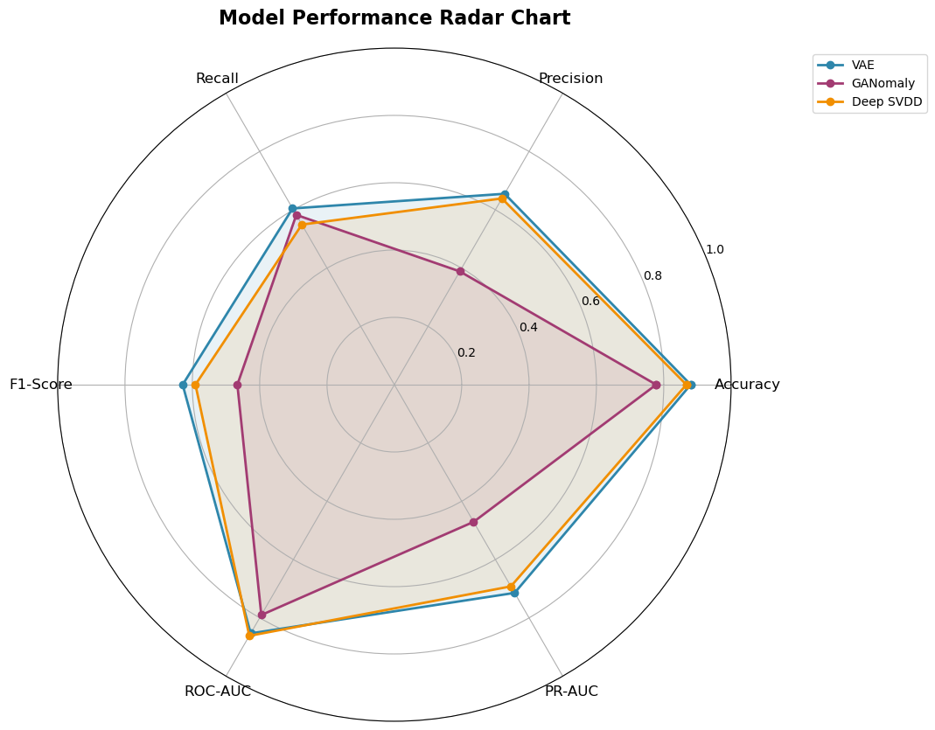

Slide 29
Why we saw these results?
GANomaly's Volatility: The Price of Adversarial Training
Inherent Instability: GAN training is famously unstable - the generator and discriminator are in constant competition
High Sensitivity: This makes the model very sensitive to hyperparameters and thresholds
Result: Dramatic performance swings (+163% recall) but major precision trade-offs
VAE's Stability: The Benefit of Probabilistic Design
Solid Foundation: Probabilistic approach creates a robust, smooth latent space
Better Generalization: Learns the "essence" of normal data rather than memorizing it
Result: Consistent, balanced improvements across all metrics
Deep SVDD's Efficiency: The Power of Focused Learning
Single Objective: Directly minimizes the hypersphere volume - no reconstruction complexity
Computational Stability: More predictable optimization landscape
Result: Stable, reliable improvements without dramatic swings
The Pattern: More complex training (adversarial) → Higher potential but less stability

Slide 30
Recommendations
Actionable Recommendations for Security Teams:
For Most Companies: Use VAE. Its stability and balanced performance prevent alert fatigue and provide reliable detection.
For High-Security, Resource-Rich Environments: Consider GANomaly. If you can afford to investigate many false positives, its high recall can help catch subtle, advanced threats.
For Large-Scale Monitoring with Limited Resources: Use Deep SVDD. Its computational efficiency and fast inference make it ideal for scanning vast amounts of traffic.

Slide 31
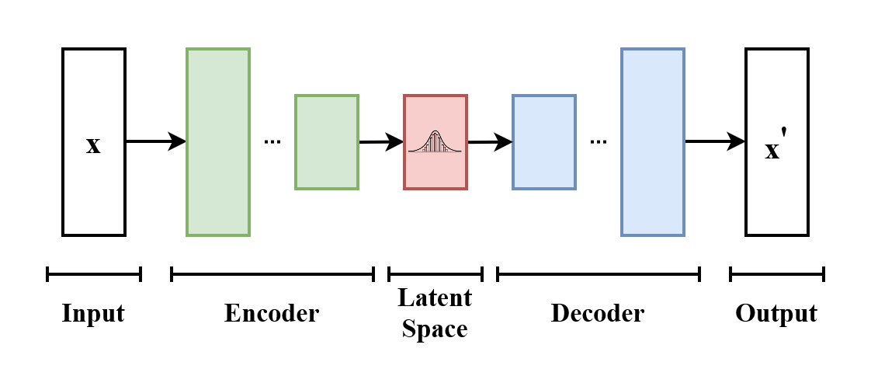
Recommendation
Based on our results, I recommend the Variational Autoencoder (VAE) for most practical deployments, as it provides the most reliable balance between detecting attacks and maintaining a manageable false alarm rate.

Slide 32
Discussion & future
Key Insights:
No Single "Best" Model: The optimal choice depends on the specific network environment, data type, and security priorities. Our results are a practical guide, not a definitive answer for all scenarios.
The Power of Ensembles: The most robust future system might combine these models. For example, using Deep SVDD as a fast first-pass filter and VAE for deeper analysis could yield superior performance.
Future Work:
Expand Evaluation: Test on more diverse datasets from different organizations to ensure broader applicability.
Enhance Explainability: Investigate explainable AI (XAI) to tell security analysts why a flow was flagged, which is critical for trust and effective response.
Towards Continuous Defense: The ultimate goal is a system that runs autonomously in real-time, learning normal behavior and flagging anomalies as they occur on the network.

Slide 33
Limitations
1. Dataset Scope:
Single Benchmark: Our evaluation was conducted on the CIC-IDS2017 dataset. While it's a realistic benchmark, performance may vary across different network environments (e.g., a university network vs. a corporate data center).
2. Operational Overhead:
Computational Cost: This study focused on detection accuracy. A full deployment analysis would require measuring the computational cost, latency, and scalability of each model in a real-time streaming environment.
Concept Drift: Networks evolve over time. Our static evaluation does not address the challenge of continuous retraining to adapt to new "normal" behavior.
3. Architectural Scope:
Focused Comparison: We compared three specific architectures. Other promising deep learning models (e.g., Transformers for sequences, Graph Neural Networks for network connections) were outside the scope of this study including ensemble methods.

Slide 34
Ethics and Social implications
1. Privacy and Anonymization:
We used exclusively public, pre-anonymized datasets. No private user or organizational data was accessed, ensuring compliance with privacy standards.
2. Potential for Misuse:
While our research is for defensive cybersecurity, the same technology could potentially be misused for mass surveillance or invasive monitoring. We strongly advocate for its use only within ethical and legal frameworks.
3. Algorithmic Bias and Fairness:
Models learn from historical data. If this data reflects existing biases (e.g., flagging traffic from certain countries or departments as anomalous), the system could amplify these biases. Continuous monitoring for discriminatory outcomes is essential.
4. Transparency and Accountability:
Deep learning models can be "black boxes." The significant impact of threshold optimization underscores the need for transparent operational parameters. Security analysts need to understand why an alert was generated to make informed decisions.
Notes:
You've probably heard the saying 'know thy enemy.' Well, the reverse is also true. By publishing how our detection models work, we also provide a blueprint for attackers. They can use this information to study the models' weaknesses and craft new attacks that are specifically designed to fly under the radar, effectively making their malware or intrusions more stealthy. This is a fundamental tension in security research that we must acknowledge.

Slide 35
Tools
I implemented the models using Python with TensorFlow/Keras for deep learning, alongside NumPy, pandas, scikit-learn, matplotlib, seaborn, and standard OS libraries for data processing, evaluation, and visualization.
The dataset used was CIC-IDS-2017 obtained from Kaggle: https://www.kaggle.com/datasets/chethuhn/network-intrusion-dataset

Slide 36
Code availability
Code Repository: GitHub: https://github.com/adwanis/AIML339-anomaly-detection

Slide 37
Thank you

