Slide 1
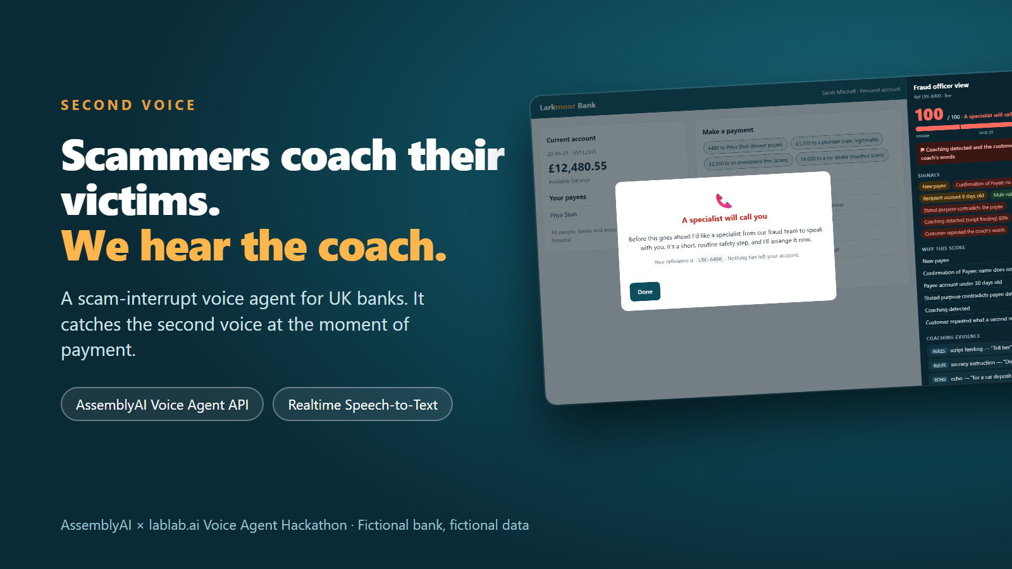

Slide 2
THE PROBLEM
The victim makes the payment — with a scammer coaching them
£576.4m
£85,000
1 voice
lost to authorised push payment fraud by UK banks in 2025 (+19% on 2024)
maximum the sending bank must now reimburse per claim — cost shared 50:50 with the receiving bank
on the phone telling the victim what to say to the bank: "tell her it's for a car deposit — don't mention me"
UK Finance, Annual Fraud Report 2026
Payment Systems Regulator, in force 7 Oct 2024
The gap: no check can hear them
• Scripted in-app warnings get clicked through, and a human intervention call can be coached too.
• Because banks now carry the reimbursement cost, catching the coach at the moment of payment is money, not goodwill.

Slide 3
THE IDEA
Second Voice: a short Voice Check at the moment of payment
1
Risky transfer
New payee, name mismatch or an unusual amount opens an in-app Voice Check
2
The agent talks
What is it for? Who to? How were you contacted? It runs the bank's checks as tools
3
It hears the coach
Scripting, secrecy, rushing, "safe account" — and the customer repeating the coach
4
One gentle question
"Is there someone with you right now? The bank will never ask you to lie."
5
Explainable decision
Release · pause 24 h · escalate to a person. Never a flat refusal. Audit record.

Slide 4
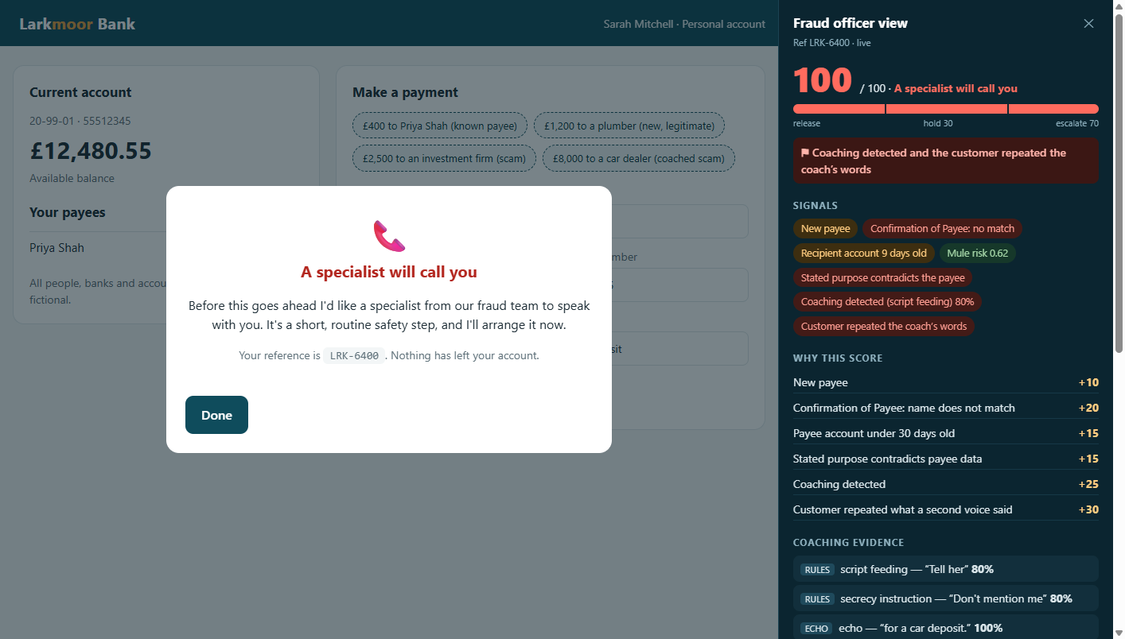
THE DEMO
Two views of the same call
• Left: what the customer sees — kind, never accusing
• Right: the fraud officer — live score, every signal, itemised "why this score"
• Here: bank data alone held the £8,000 payment at 60. The coach pushed it to 100 and a hard trigger escalated it
Fictional bank, customer and accounts. Screenshot from a live run against the AssemblyAI Voice Agent API.

Slide 5
HOW IT WORKS
One microphone, two AssemblyAI streams, one explainable decision
Voice Agent API
conversation · tools
turn-taking · voice
Risk Scorer
points table
hard triggers
Customer's laptop
one shared mic
echo cancel ON
Signal Engine
coaching language
echo · room-only
Realtime STT
speaker labels
per-word loudness
Officer panel
audit record
no audio stored
The LLM never decides:
a transparent points table does.
Agent Injector: a trusted system message makes the agent ask ONE gentle question — at most once every 20 s

Slide 6
APPLICATION OF THE TECHNOLOGY
Built deeply on AssemblyAI — and what we learned
What we used
What building it taught us
• Voice Agent API: stored agent, 6 client-side tools, system-role context, reply.create, session.resume, voice_focus
• Realtime STT (universal-3-6-pro): speaker diarization + per-word loudness from the same mic
• Trusted vs untrusted: only system-role messages are trusted; everything spoken is data
• Optional LLM Gateway second opinion behind the rules
• Two differently-constrained mic streams silently lost echo cancellation — one shared stream fixed it
• tool.result must go back only when reply.done is the latest event
• A loud phone voice passes voice_focus: coaching shows up in the transcript, so content + echo beat source separation
• Stored-agent voice and output.voice are separate fields — set both

Slide 7
SAFETY
Trust by design — and honest about the limits
Built in
Limits we measured
• Deterministic score; every reason is a line in the audit record
• Fail safe: mic denied, connection lost, bank unreachable → hold, never release
• Never a flat refusal; every hold offers a human
• Rules-first detector: a scammer saying "ignore your rules" gains nothing
• No audio stored; account numbers masked; spoken text escaped
• Hears a coach at conversational volume within arm's reach; whispers across a room are not captured
• Speaker labels are a tie-breaker, not proof
• Agent speaks English only (understands 18 languages)
• Rules missed 2 of 10 held-out coaching lines — the case for the optional LLM

Slide 8
EVIDENCE
Tested end to end, against the live API
447
7 / 7
2 / 2
5
automated tests
coached scam runs escalated
honest customer runs released
real bugs found by live runs, all fixed
• The whole flow runs in headless Chrome with a fake microphone: a synthetic customer and coach, the real Voice Agent API, Realtime STT and tools
• Live runs caught bugs unit tests could not: a React crash, an echo window that was too short, sentences split by common words, and an honest customer flagged because of the agent's own paraphrase
• Detector on labelled cases: 16/16 visible, 8/10 held-out, zero false alarms
• Still to do: real human voices and a real phone on speakerphone

Slide 9
BUSINESS VALUE
Why a bank would deploy this
• It acts at the one moment the loss can still be stopped — before the money moves
• Each prevented claim avoids up to £85,000 of reimbursement cost, shared 50:50 with the receiving bank
• Legitimate payments meet no friction: a known payee under £1,000 never sees a check; an honest new payee is released after a short conversation
• Explainable by design: a fraud team and a regulator can read exactly why a payment was held
• Drops into an existing app (web or mobile SDK) or a contact-centre flow — browser today, inbound phone next
• What to measure in a pilot: losses prevented, false-positive rate, time added to a legitimate payment

Slide 10
ROADMAP
What's next
• Real-voice and real-phone validation, plus a range study (30 / 60 / 100 cm)
• Inbound phone channel through a SIP trunk (supported by the Voice Agent API)
• Multilingual customers: the agent already understands 18 languages; native-accent replies are on AssemblyAI's roadmap
• LLM second opinion on a paid tier for paraphrased coaching the rules miss
• A pilot with a real bank's fraud team
Scammers coach their victims.
Second Voice hears the coach.
github.com/adwik1401/second-voice

