Slide 1
AI
Presented by Adthya

Slide 2

The Power of AI in the Digital Age
Content:
- AI as the cornerstone of innovation and transformation
- Spectrum of applications: virtual assistants, medical diagnostics, self-driving cars
- AI mimicking human intelligence for autonomous decision-making
Keyword: Artificial Intelligence

Slide 3
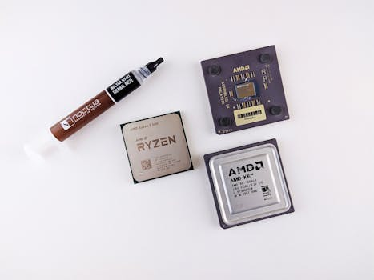
Core Components and Implications of AI
Content:
- Core components: machine learning, deep learning, neural networks
- Fueling AI's ability to analyze data, recognize patterns, predict outcomes
- Revolutionizing industries through productivity, efficiency, and ethical challenges
Keyword: Neural Networks & Implications

Slide 4
Credits
Images provided by Pexels: https://www.pexels.com

