Slide 1
B-Trees

Slide 2
What is a Multi-way tree?
A multi-way (or m-way) search tree of order m is a tree in which
  Each node has at-most m subtrees, where the subtrees may be empty.
  Each node consists of at least 1 and at most m-1 distinct keys
  The keys in each node are sorted.
The keys and subtrees of a non-leaf node are ordered as:
T₀, k₁, T₁, k₂, T₂, . . . , k_{m-1}, T_{m-1} such that:
  All keys in subtree T0 are less than k1.
  All keys in subtree T_{i} , 1 <= i <= m - 2, are greater than k_{i} but less than k_{i+1}.
  All keys in subtree T_{m-1} are greater than k_{m-1}

Slide 3
Multi-way tree
k₁
k₂
k₃
. . .
k_{m-2}
k_{m-1}
T₀
T₁
T₂
T_{m-2}
T_{m-1}
key < k₁
k₁ < key < k₂
k₂ < key < k₃
k_{m-2} < key < k_{m-1}
key > k_{m-1}

Slide 4
What is B-tree?
B-tree of order m (or branching factor m), where m > 2, is either an empty tree or a multiway search tree with the following properties:
  The root is either a leaf or it has at least two non-empty subtrees and at most m non-empty subtrees.
  Each non-leaf node, other than the root, has at least ⎡m/2⎤ non-empty subtrees and at most m non-empty subtrees. (Note: ⎡x⎤ is the lowest integer > x ).
  The number of keys in each non-leaf node is one less than the number of non-empty subtrees for that node.
  All leaf nodes are at the same level; that is the tree is perfectly balanced

Slide 5
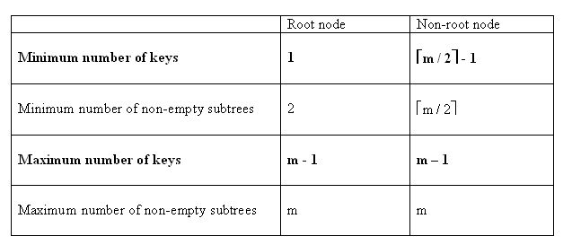
What is a B-tree?
For a non-empty B-tree of order m:

Slide 6
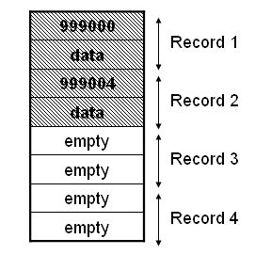
Disk Storage
Data is stored on disk (i.e., secondary memory) in blocks.
A block is the smallest amount of data that can be accessed on a disk.
Each block has a fixed number of bytes – typically 512, 1024, 2048, 4096 or 8192 bytes
Each block may hold many data records.

Slide 7
Motivation
When data is too large to fit in main memory, the data is read from disk in the form of blocks. Disk access time is very high compared to main memory access time. One disk access is worth about 200,000 instructions.
The number of disk accesses will dominate the running time.
The main idea of using B-Trees is to reduce the number of disk accesses.

Slide 8
Motivation (cont.)
Assume that we use an AVL tree to store about 20 million records
We end up with a very deep binary tree with lots of different disk accesses; log₂ 20,000,000 is about 24, so this takes about 0.2 seconds
We know we can’t improve on the logn lower bound on search for a binary tree
But, the solution is to use more branches and thus reduce the height of the tree!
  As branching increases, depth decreases

Slide 9
B-Trees & Efficiency
Allow insertion and deletion into a tree structure, based on log_{m}n property, where m is the order of the tree.
The idea is that you leave some key spaces open. So an insert of a new key is done using available space (most cases).
  Less dynamic than our typical Binary Tree
  Ideal for disk based operations.

Slide 10
Specialization
2-3-4 tree
A B-tree of order 4, that is, internal nodes have two, three, or four children.
B-tree with m=4.
2-3 tree
A B-tree of order 3, that is, internal nodes have two or three children.
B-tree with m=3.

Slide 11
An example B-Tree
26
A B-tree of order 5 containing 26 items
6
12
42
51
62
1
2
4
7
8
13
15
18
25
27
29
45
46
48
53
55
60
64
70
90
Note that all the leaves are at the same level

Slide 12
2-3 Tree
Intuitively, a 2-3 tree is a tree in which each parent node has either 2 or 3 children, and all leaves are at the same level.
According to Donald Knuth, 2-3 trees were invented by John E. Hopcroft.

Slide 13
2-3 Tree: Definition
Formally, T is a 2-3 tree of height h if
a) T is empty (h = 0); OR
b) T consists of a root and 2 subtrees, T_{L} , T_{R} :
  T_{L} and T_{R} are both 2-3 trees, each of height h – 1,
  the root contains one data item with search key S,
  S > each search key in T_{L} ,
  S < each search key in T_{R} ; OR …
T
S
root
T_{L}
T_{R}

Slide 14
2-3 Tree: Definition (Cont’d.)
c) T consists of a root and 3 subtrees, T_{L} , T_{M} , T_{R} :
  T_{L} , T_{M} , T_{R} are all 2-3 trees, each of height h – 1,
  the root contains two data items with search keys S and L,
  each search key in T_{L} < S < each search key in T_{M} ,
  each search key in T_{M} < L < each search key in T_{R} .
T
S L
root
T_{L}
T_{M}
T_{R}

Slide 15
2-3 Tree: Example
50 90
20
70
120 150
10
30 40
60
80
100
130 140
160
Each non-leaf has 2 or 3 children,
All leaves are at the same level, and
At each node, the search keys have the relationships
described on the preceding viewgraphs

Slide 16
2-3 Tree: Efficiency
Insertion and deletion can be defined so that the 2-3 tree remains balanced and its other properties are maintained.
In particular, a 2-3 tree with n nodes never has a height greater than ⎡log₂ (n + 1)⎤ , which is the same as the minimum height of a binary tree with n nodes.
Consequently, finding an item in a 2-3 tree is never worse than O( log n), regardless of the insertions or deletions that were done previously.

Slide 17
2-3 Tree Insertion: Basic Idea
1) Find the leaf where a new item, X, should be inserted and insert it.
2) If the leaf now contains 2 items, you are done.
3) If the leaf now contains 3 items, X, Y, Z, then
  replace the leaf by two new nodes, n1 and n2, with the smallest of X, Y, Z going into n1, the largest going into n2, and the middle value going into the leaf’s parent node, p ;
  make n1 and n2 children of parent p.
4) If parent p now contains 2 items (and has 3 children) you are done.
5) If parent p now contains 3 items (and has 4 children) proceed as in step 3, except that
  p’s two leftmost children are attached to n1, and
  p’s two rightmost children are attached to n2.
6) Repeat steps 3 - 5, until arriving at a parent node containing 2 items.

Slide 18
2-3 Tree Insertion: Example
30 39
10 20
37 38
40
Insert 36
30 39
10 20
36 37 38
40

Slide 19
2-3 Tree Insertion: Example (Cont’d.)
p
30 39
Since the leaf with 36 in it now contains 3 items, replace the leaf by two new nodes containing 36 (the smallest) and 38 (the largest).
Move 37 (the middle value) up to its parent, p.
Make nodes containing 36 and 38 children of parent, p.
10 20
36 37 38
40
p
30 37 39
10 20
36
38
40

Slide 20
2-3 Tree Insertion: Example (Cont’d.)
p
30 37 39
Since node p now contains 3 items, replace p by two new nodes containing 30 (the smallest) and 39 (the largest).
Since p has no parent, create a new node, r, and move 37 (the middle value) into it.
Make nodes containing 30 and 39 children of r.
Finally, p’s leftmost children are attached to the node containing 30; p’s rightmost children are attached to the node containing 39.
10 20
36
38
40
r
37
30
39
10 20
36
38
40

Slide 21
2-3 Tree: Remarks
If a 2-3 tree needs to grow after inserting an item, it grows upwards at the root.
Deletion from a 2-3 tree is a bit more complicated than insertion, involving merging nodes and redistributing items.

Slide 22
Deletion Algorithm
Deleting item I:
1. Locate node n, which contains item I
2. If node n is not a leaf - swap I with inorder successor
-deletion always begins at a leaf
3. If leaf node n contains another item, just delete item I
else
try to redistribute nodes from siblings
if not possible, merge node

Slide 23
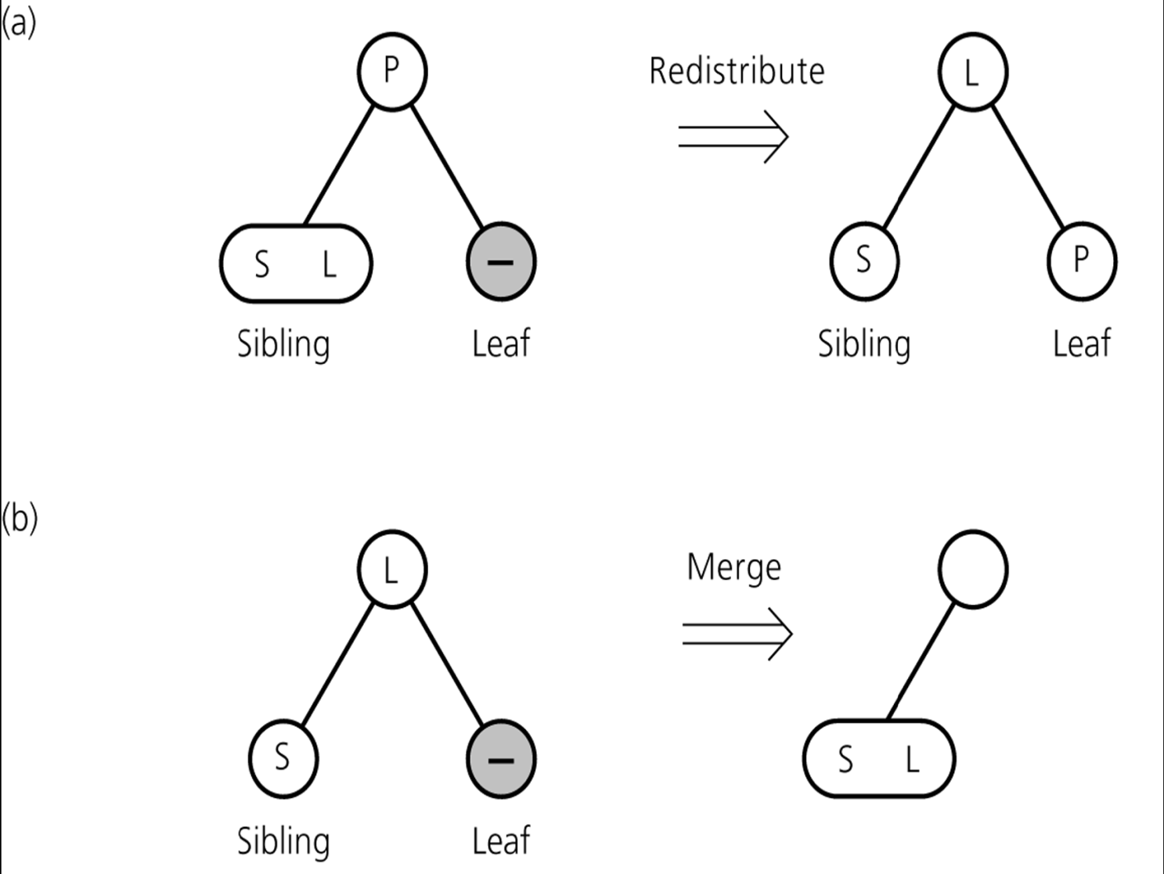
Deletion Algorithm
Redistribution
A sibling has 2 items:
- redistribute item between siblings and parent
Merging
No sibling has 2 items:
- merge node
- move item from parent to sibling

Slide 24
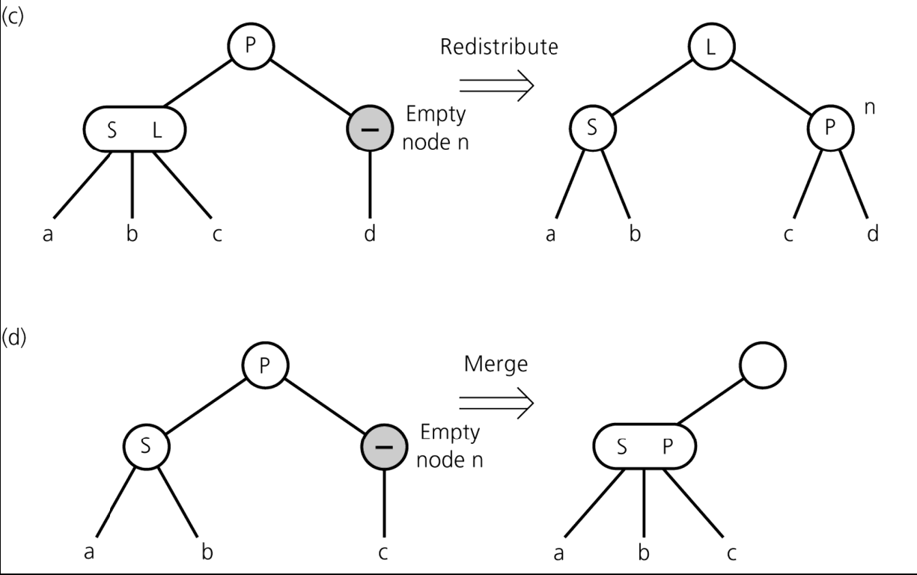
Deletion Algorithm
Redistribution
Internal Node ‘n’ has no item left
- redistribute
Merging
Redistribution not possible:
- merge node
move item from parent to sibling
Adopt child of ‘n’
If n's parent ends up without item, apply process recursively

Slide 25
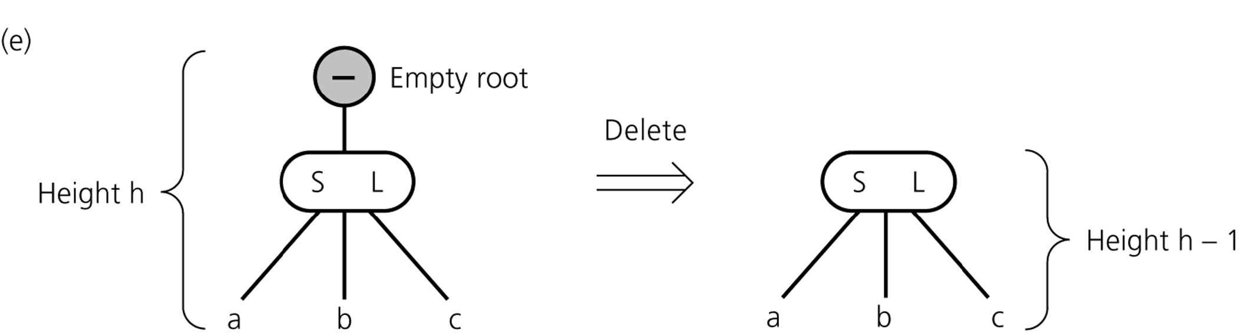
Deletion Algorithm
If merging process reaches the root and root is without item
-delete root

Slide 26
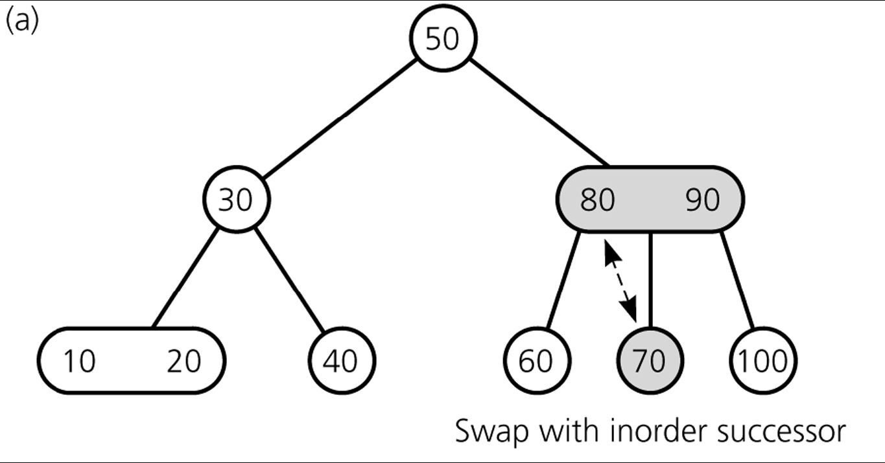
Deleting Items
Delete 70

Slide 27
Deleting Items
Deleting 70: Swap 70 with Inorder Succesor (80)

Slide 28
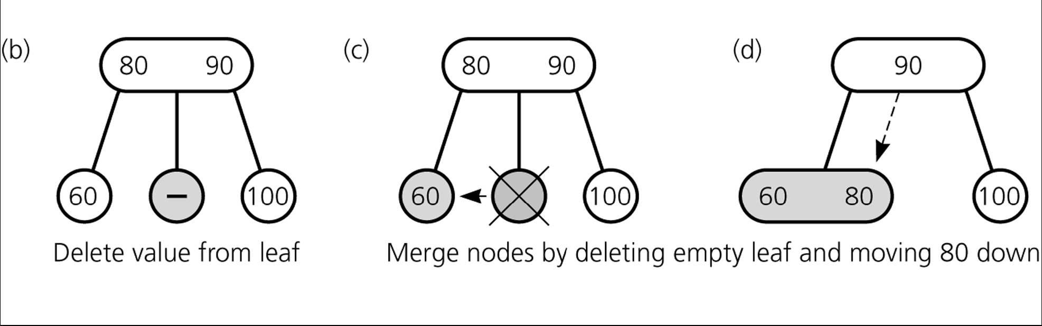
Deleting Items
Deleting 70: Get Rid of 70

Slide 29
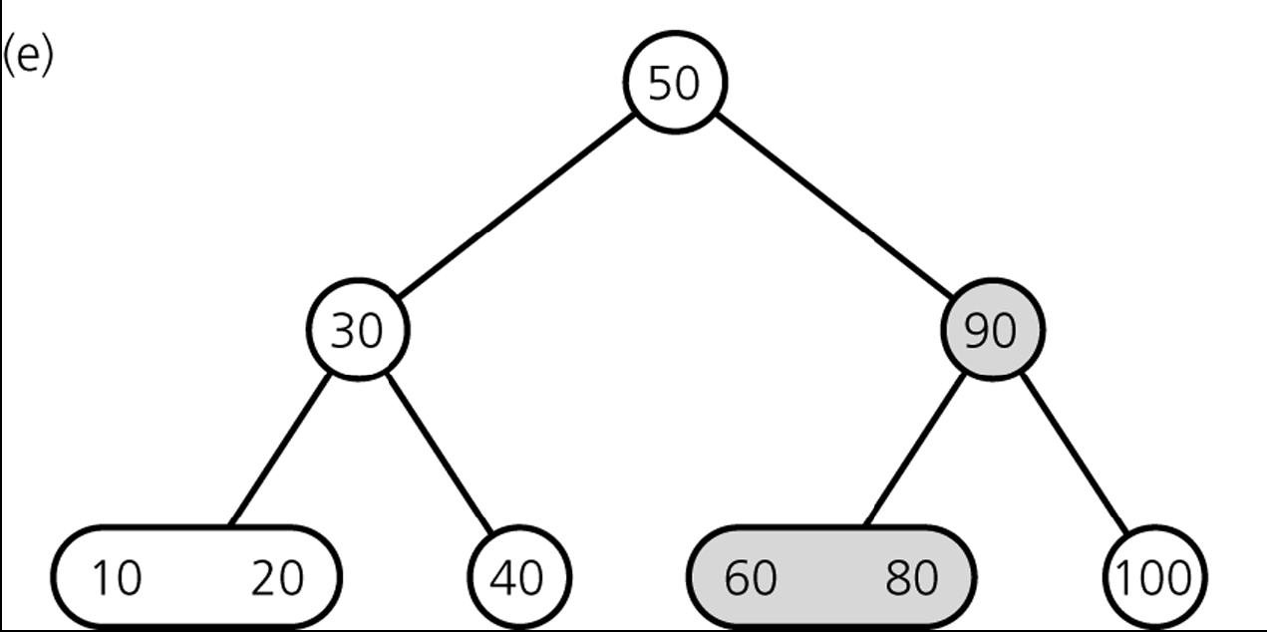
Deleting Items
Result

Slide 30
Deleting Items
Delete 100

Slide 31
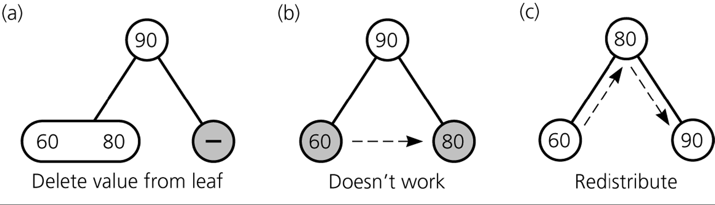
Deleting Items
Deleting 100

Slide 32
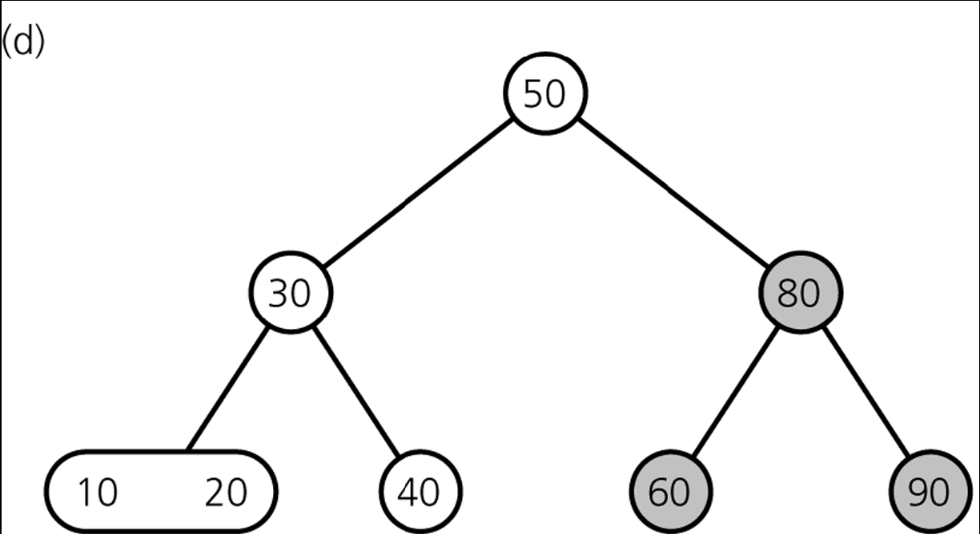
Deleting Items
Result

Slide 33
Deleting Items
Delete 80

Slide 34
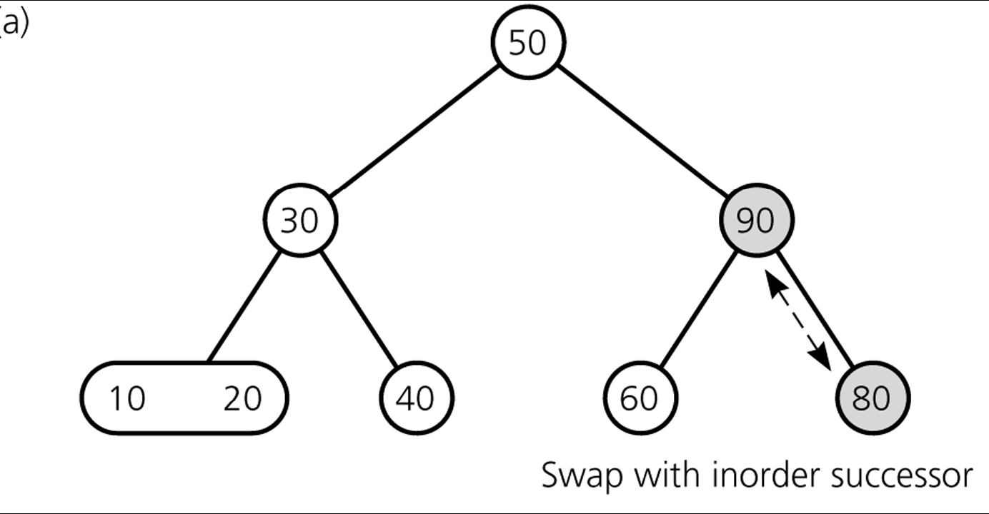
Deleting Items
Deleting 80

Slide 35
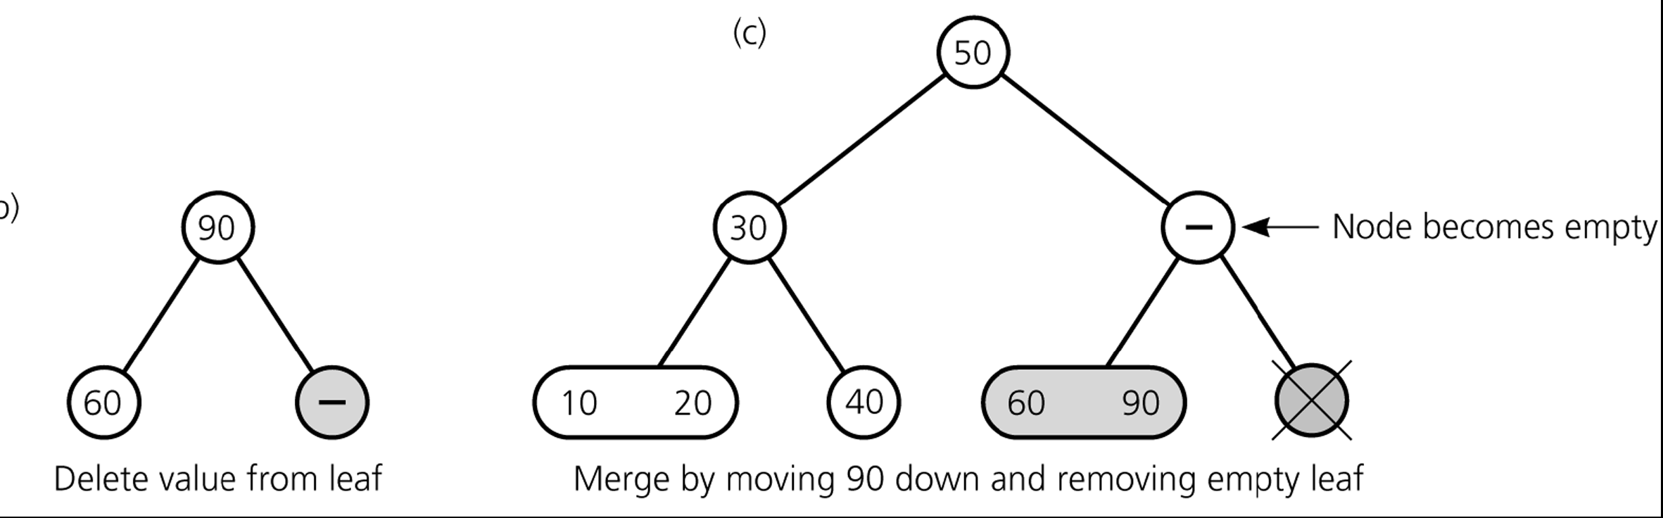
Deleting Items
Deleting 80

Slide 36
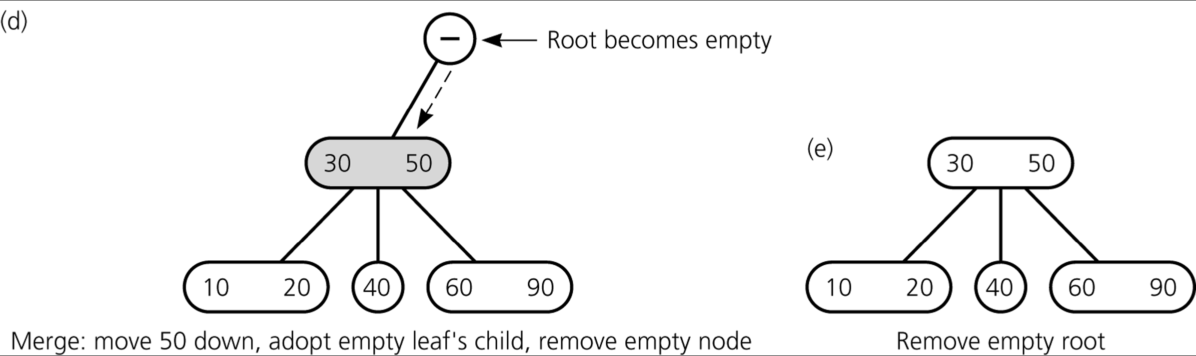
Deleting Items
Deleting 80

Slide 37
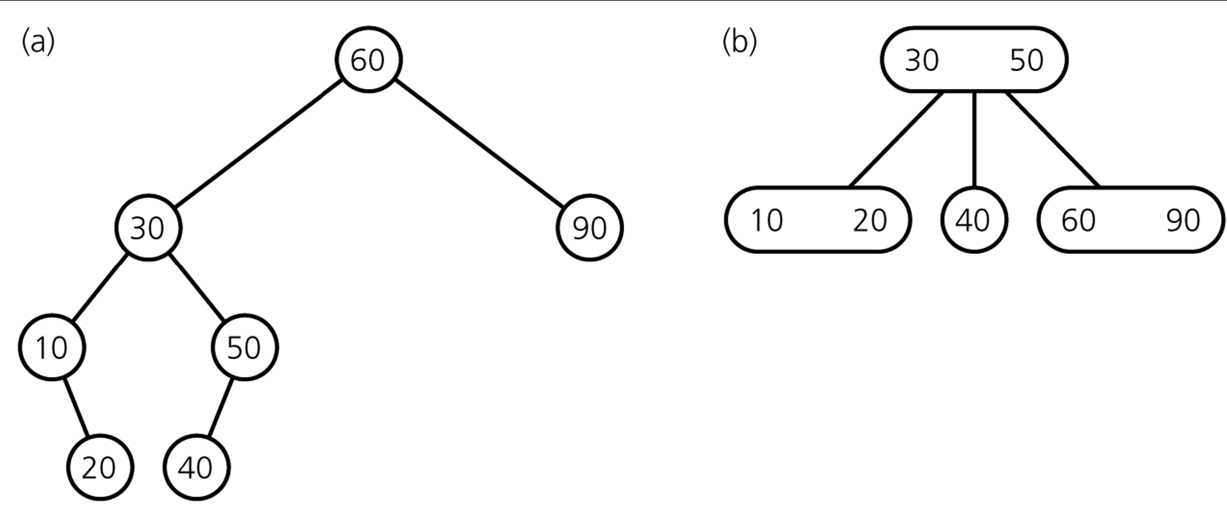
Deleting Items
Final Result

Slide 38
2-3-4 Tree
A 2-3-4 tree is an extension to the concept of a 2-3 tree:
  each parent node has up to 4 children,
  all leaves are at the same level,
  each node can contain up to 3 items.
Insertions and deletions in a 2-3-4 tree require fewer steps than in a 2-3 tree.

Slide 39
2-3-4 Tree: Definition
Formally, T is a 2-3-4 tree of height h if
a) T is empty (h = 0); OR
b) T consists of a root and 2 subtrees, T_{L} , T_{R} :
  T_{L} and T_{R} are both 2-3-4 trees, each of height h – 1,
  the root contains one data item with search key S,
  S > each search key in T_{L} ,
  S < each search key in T_{R} ; OR …
T
S
root
T_{L}
T_{R}

Slide 40
2-3-4 Tree: Definition (Cont’d.)
c) T consists of a root and 3 subtrees, T_{L} , T_{M} , T_{R} :
  T_{L} , T_{M} , T_{R} are all 2-3-4 trees, each of height h – 1,
  the root contains two data items with search keys S and L,
  each search key in T_{L} < S < each search key in T_{M} ,
  each search key in T_{M} < L < each search key in T_{R} ; OR …
T
S L
root
T_{L}
T_{M}
T_{R}

Slide 41
2-3-4 Tree: Definition (Cont’d.)
d) T consists of a root and 4 subtrees, T_{L} , T_{ML} , T_{MR} , T_{R} :
  T_{L} , T_{ML} , T_{MR} , T_{R} are all 2-3-4 trees, each of height h – 1,
  the root contains three data items with search keys S, M and L,
  each search key in T_{L} < S < each search key in T_{ML} ,
  each search key in T_{ML} < M < each search key in T_{MR} ,
  each search key in T_{MR} < L < each search key in T_{R} .
T
S M L
root
T_{L}
T_{ML}
T_{MR}
T_{R}

Slide 42
2-3-4 Tree: Example
30 70
10 20
50
80 90 100
5
15
25
40
60
75
85
95
110
each parent node has up to 4 children
each node contains up to 3 items
all leaves are at the same level
the search keys have the relationships described on the preceding viewgraphs

Slide 43
2-3-4 Tree Insertion: Strategy
When one inserts a new item into a 2-3 tree, the intended destination node is split when it overflows. Steps are then taken, recursively, to determine whether any ancestor of this node also needs to be split.
While searching for the place to insert a new item into a 2-3-4 tree, any node encountered containing 3 items (and 4 children) is immediately split before the destination node is found.
This difference ensures that when the destination node in a 2-3-4 tree is finally found, there will be room in the node for the new item, and ancestor nodes do not need to be revisited.
This difference also simplifies the insertion algorithm for a 2-3-4 tree.

Slide 44
2-3-4 Tree Insertion: Basic Idea
1) Search for the leaf where a new item, W, should be inserted.
2) If a node, n, containing 3 items, X, Y, Z, is encountered, then
  replace n by two new nodes, n1 and n2, with the smallest of X, Y, Z going into n1, the largest going into n2, and the middle value going into n’s parent node, p ;
  if p does not exist (n is also a root), create a new node p ;
  make n1 and n2 children of parent p.
3) If W’s search key < search key of middle( X, Y, Z ), then continue searching with node n1. Otherwise, continue searching with node n2.
4) When the destination leaf is found, it will contain 1 or 2 items. Insert W, and you are done.

Slide 45
Insertion
Insert: 5, 3, 21, 9, 1, 13, 2, 7, 10, 12, 4, 8

Slide 46
Insert 5, 3, 21
* 5 *
a
* 3 * 5 *
a
* 3 * 5 * 21 *
a

Slide 47
After Splitting Node a
* 5 *
a
b
c
* 3 *
* 21 *
Node a splits creating 2 children: b and c

Slide 48
Insert 9
* 5 *
a
b
c
* 3 *
* 9 * 21 *
Node a splits creating 2 children: b and c

Slide 49
Insert 1, 13
* 5 *
a
b
c
* 1 * 3 *
* 9 * 13 * 21 *
Nodes b and c have room to insert more elements
Node c splits creating 2 children: d and c

Slide 50
After Splitting Node c
* 5 * 13 *
a
b
d
c
* 1 * 3 *
* 9 *
* 21 *

Slide 51
Insert 2
* 5 * 13 *
a
b
d
c
* 1 * 2 * 3 *
* 9 *
* 21 *

Slide 52
After Splitting Node b
* 2 * 5 * 13 *
a
b
e
d
c
* 1 *
* 3 *
* 9 *
* 21 *
Node b has no more room, so node b splits into nodes b and e

Slide 53
After Splitting Node a
a
* 5 *
f
g
* 2 *
* 13 *
b
e
d
c
* 1 *
* 3*
* 9 *
* 21 *
Node a must split into 2 nodes. This causes node a to split into 2 nodes and the tree grows a level up.

Slide 54
Insert 7, 10
a
* 5 *
f
g
* 2 *
* 13 *
b
e
d
c
* 1 *
* 3*
* 7 * 9 * 10 *
* 21 *

Slide 55
After Splitting Node d
a
* 5 *
f
g
* 2 *
* 9 * 13 *
b
e
h
d
c
* 1 *
* 3*
* 7 *
* 10 *
* 21 *
Node d must split into 2 nodes. This causes node d to split into 2 nodes h and d

Slide 56
Insert 12
a
* 5 *
f
g
* 2 *
* 9 * 13 *
b
e
h
d
c
* 1 *
* 3*
* 7 *
* 10 * 12 *
* 21 *

Slide 57
Insert 4
a
* 5 *
f
g
* 2 *
* 9 * 13 *
b
e
h
d
c
* 1 *
* 3 * 4*
* 7 *
* 10 * 12 *
* 21 *

Slide 58
Insert 8
a
* 5 *
f
g
* 2 *
* 9 * 13 *
b
e
h
d
c
* 1 *
* 3 * 4*
* 7 * 8 *
* 10 * 12 *
* 21 *

Slide 59
Deletion

Slide 60
Delete 2
a
* 5 *
f
g
* 2 *
* 9 * 13 *
b
e
h
d
c
* 1 *
* 3 * 4*
* 7 * 8 *
* 10 * 12 *
* 21 *

Slide 61
Delete 2
a
* 5 *
f
g
* 3*
* 9 * 13 *
b
e
h
d
c
* 1 *
* 3 * 4*
* 7 * 8 *
* 10 * 12 *
* 21 *

Slide 62
Delete 2
a
* 5 *
f
g
* 3*
* 9 * 13 *
b
e
h
d
c
* 1 *
* 4*
* 7 * 8 *
* 10 * 12 *
* 21 *

Slide 63
Delete 21
a
* 5 *
f
g
* 3*
* 9 * 13 *
b
e
h
d
c
* 1 *
* 4*
* 7 * 8 *
* 10 * 12 *
* 21 *

Slide 64
Delete 21
a
* 5 *
f
g
* 3*
* 9 * 13 *
b
e
h
d
c
* 1 *
* 4*
* 7 * 8 *
* 10 * 12 *
-

Slide 65
After Redistribution
a
* 5 *
f
g
* 3*
* 9 * 12 *
b
e
h
d
c
* 1 *
* 4*
* 7 * 8 *
* 10 *
* 13 *

Slide 66
Delete 10
a
* 5 *
f
g
* 3*
* 9 * 12 *
b
e
h
d
c
* 1 *
* 4*
* 7 * 8 *
* 10 *
* 13 *

Slide 67
Delete 10
a
* 5 *
f
g
* 3*
* 9 * 12 *
b
e
h
d
c
* 1 *
* 4*
* 7 * 8 *
-
* 13 *

Slide 68
After Redistribution from Sibling h
a
* 5 *
f
g
* 3*
* 8 * 12 *
b
e
h
d
c
* 1 *
* 4*
* 7 *
* 9 *
* 13 *

Slide 69
Delete 3
a
* 5 *
f
g
* 3*
* 8 * 12 *
b
e
h
d
c
* 1 *
* 4*
* 7 *
* 9 *
* 13 *

Slide 70
Replace with Inorder Successor
a
* 5 *
f
g
* 4 *
* 8 * 12 *
b
e
h
d
c
* 1 *
* 4*
* 7 *
* 9 *
* 13 *

Slide 71
Delete 3
a
* 5 *
f
g
* 4 *
* 8 * 12 *
b
e
h
d
c
* 1 *
-
* 7 *
* 9 *
* 13 *

Slide 72
After Merging f and b
a
* 5 *
f
g
-
* 8 * 12 *
b
h
d
c
* 1 * 4 *
* 7 *
* 9 *
* 13 *

Slide 73
After Redistribution from Sibling g
a
* 8 *
f
g
* 5 *
* 12 *
b
h
d
c
* 1 * 4 *
* 7 *
* 9 *
* 13 *

Slide 74
Delete 4
a
* 8 *
f
g
* 5 *
* 12 *
b
h
d
c
* 1 * 4 *
* 7 *
* 9 *
* 13 *

Slide 75
Delete 4
a
* 8 *
f
g
* 5 *
* 12 *
b
h
d
c
* 1 *
* 7 *
* 9 *
* 13 *

