Slide 1
Stack ADT
Spring 2025
Data Structures

Slide 2
Stack
Stack is another important concept of data structure.
A stack is a linear list of elements in which an element may be inserted or deleted only at one end, called the top of the stack.
This means that elements are removed from a stack in the reverse order in which they were inserted into the stack.
Spring 2025
Data Structures

Slide 3
A Last-in First-out (LIFO) List
In
Out
C
B
A
B
C
Also called a
STACK
Spring 2025
Data Structures

Slide 4
Primary operations defined on a stack:
  PUSH :
  add an element at the top of the list.
  POP :
  remove the element from the top of the list.
  Also "IsEmpty()" and “IsFull" function, which tests whether a stack is empty or full respectively.
Spring 2025
Data Structures

Slide 5
Examples:
Practical daily life :
a pile of heavy books kept in a vertical box, dishes kept one on top of another
In computer world :
In processing of subroutine calls and returns ; there is an explicit use of stack of return addresses.
Also in evaluation of arithmetic expressions, stack is used.
Spring 2025
Data Structures

Slide 6
Applications of Stack
The simplest application of a stack is to reverse a word. You push a given word to stack - letter by letter - and then pop letters from the stack
Another application is an "undo" mechanism in text editors; this operation is accomplished by keeping all text changes in a stack
Backtracking. This is a process when you need to access the most recent data element in a series of elements
Spring 2025
Data Structures

Slide 7
Example
Suppose that while processing some project A we are required to move on to project B, whose completion is required in order to complete project A. Then we place the folder containing the data of A onto a stack, and begin to process B. However, suppose that while processing B we are led to project C, for the same reason. Then we place B on the stack above A and begin to process C.
On the other hand, suppose after completing the processing of project D, the only project we may continue to process is project C, which is on the top of the stack.
A
B
A
C
B
A
B
A
A
Spring 2025
Data Structures

Slide 8
Abstract Data Types
Spring 2025
Data Structures

Slide 9
Example 1 :: Complex numbers
struct cplx {
float re;
float im;
}
typedef struct cplx complex;
complex *add (complex a, complex b);
complex *sub (complex a, complex b);
complex *mul (complex a, complex b);
complex *div (complex a, complex b);
complex *read();
void print (complex a);
Structure definition
Function prototypes
Spring 2025
Data Structures

Slide 10
add
Complex
Number
sub
mul
div
read
print
Spring 2025
Data Structures

Slide 11
Example 2 :: Set manipulation
struct node {
int element;
struct node *next;
}
typedef struct node set;
set *union (set a, set b);
set *intersect (set a, set b);
set *minus (set a, set b);
void insert (set a, int x);
void delete (set a, int x);
int size (set a);
Structure definition
Function prototypes
Spring 2025
Data Structures

Slide 12
union
Set
intersect
minus
insert
delete
size
Spring 2025
Data Structures

Slide 13
Example 3 :: Last-In-First-Out STACK
Assume:: stack contains integer elements
void push (stack *s, int element);
/* Insert an element in the stack */
int pop (stack *s);
/* Remove and return the top element */
void create (stack *s);
/* Create a new stack */
int isempty (stack *s);
/* Check if stack is empty */
int isfull (stack *s);
/* Check if stack is full */
Spring 2025
Data Structures

Slide 14
push
STACK
pop
create
isempty
isfull
Spring 2025
Data Structures

Slide 15
Contd.
We shall look into two different ways of implementing stack:
  Using arrays
  Using linked list
Spring 2025
Data Structures

Slide 16
Implementation of Stacks
Stacks may be implemented in 2 ways :
Using Arrays
Using Linked Lists
Stack will be maintained by a linear array STACK; a pointer variable TOP, which contains the location of the top element of the stack; and a variable MAXSTK which gives the maximum number of elements that can be held by the stack.
The condition TOP = -1 will indicate that the stack is empty.
STACK
0 1 2 3 4 5 6 7
TOP MAXSTK
XXX | YYY | ZZZ
2
8
Spring 2025
Data Structures

Slide 17
Array implementation of stacks
To implement a stack, items are inserted and removed at the same end (called the top)
To use an array to implement a stack, you need both the array itself and an integer
  The integer tells you either:
    Which location is currently the top of the stack, or
    How many elements are in the stack
Spring 2025
Data Structures

Slide 18
Pushing and Popping
0 1 2 3 4 5 6 7 8 9
stk:
17
23
97
44
top = 3
If the bottom of the stack is at location 0, then an empty stack is represented by top = -1
To add (push) an element
  Increment top and store the element in stk[top]
To remove (pop) an element, either:
  Get the element from stk[top] and decrement top
Spring 2025
Data Structures

Slide 19
After popping
0 1 2 3 4 5 6 7 8 9
stk:
17
23
97
44
top = 2
or count = 3
When you pop an element, do you just leave the “deleted” element sitting in the array?
The surprising answer is, “it depends”
  If this is an array of primitives, or if you are programming in C or C++, then doing anything more is just a waste of time
  If you are programming in Java, and the array contains objects, you should set the “deleted” array element to null
Spring 2025
Data Structures

Slide 20
Stack Implementation with Linked Lists
One disadvantage of using an array to implement a stack is the wasted space---most of the time most of the array is unused. A more elegant and economical implementation of a stack uses a linked list, which is a data structure that links together individual data objects as if they were ``links'' in a ``chain'' of data.
A
B
C
pStack
Spring 2025
Data Structures

Slide 21
Stack Implementation Using Linked List
Spring 2025
Data Structures

Slide 22
Push item 30
L
I
N
K
E
D
L
I
S
T
S
T
A
C
K
top
30
Null
3000
Spring 2025
Data Structures

Slide 23
Push item 20
top
2000
20
3000
3000
30
Null
Spring 2025
Data Structures

Slide 24
Push item 10
top
1000
10
2000
2000
20
3000
3000
30
Null
Spring 2025
Data Structures

Slide 25
POP 10
top
2000
20
3000
3000
30
Null
Spring 2025
Data Structures

Slide 26
POP 20
top
3000
30
Null
Spring 2025
Data Structures

Slide 27
POP 30
STACK EMPTY
Spring 2025
Data Structures

Slide 28
Stack Implementation with Linked Lists
The question here is, where should we consider the top of the stack to be, the beginning or end of the list, and why?
A
B
C
pStack
Spring 2025
Data Structures

Slide 29
Where should the top of the stack be?
Since the Stack ADT uses a LIFO manner to retrieve data, the top of the stack is where all objects are added, and also retrieved from. Therefore, it is necessary that the programmer evaluates the pros and cons on figuring out if the top of the stack should be at the head of the linked list or at the tail.
Spring 2025
Data Structures

Slide 30
Top of the stack at the tail
Imagine the scenario where the top of the stack is at the end of the linked list. Since the Stack ADT uses a LIFO manner to retrieve data, in this case, new objects would have to be added to the end of the linked list, and retrieved from the end of the linked list too.
Spring 2025
Data Structures

Slide 31
When the Top is at the Tail – push()
In order to add a new object, it would be necessary to traverse the linked list and find the end. However, this could be taken care of with the help of a tail pointer (pTail), along with the head pointer (pStack).
A
B
C
pStack
D
pTail
Spring 2025
Data Structures

Slide 32
When the Top is at the Tail – pop()
In order to delete a new object, it would be necessary to traverse the linked list and find the end.
A
B
C
pStack
D
pTail
pPre
delete node
Spring 2025
Data Structures

Slide 33
When the Top is at the Tail – pop()
In order to delete a new object, it would be necessary to traverse the linked list and find the end. Can this be taken care of with the help of a tail pointer (pTail) and another pointer that always points to the previous pointer from the tail (pPre), along with the head pointer (pStack)?
Since there is no way to go backwards with this type of linked list, you will see that you would have to traverse the whole list to get to the previous pointer of pPre. This would result in a algorithm with a big O of n i.e. O(n)
Spring 2025
Data Structures

Slide 34
When the Top is at the Head – push()
In this case, in order to add a new object, it would just add it to the head in this manner.
A
B
C
pStack
D
pNew
Spring 2025
Data Structures

Slide 35
When the Top is at the Head – pop()
In order to delete an object from the beginning, we need to make the head pointer point to the next node and then delete the node that is being previously pointed by the header.
A
B
C
delete node
pStack
D
Spring 2025
Data Structures

Slide 36
Stack Implementation of Linked List
Insert/Delete
At the end of list (O(n))
At the beginning (Constant time operation, O(1))
Spring 2025
Data Structures

Slide 37
Basic Idea
In the array implementation, we would:
  Declare an array of fixed size (which determines the maximum size of the stack).
  Keep a variable which always points to the “top” of the stack.
    Contains the array index of the “top” element.
In the linked list implementation, we would:
  Maintain the stack as a linked list.
  A pointer variable top points to the start of the list.
  The first element of the linked list is considered as the stack top.
Spring 2025
Data Structures

Slide 38
Declaration
#define MAXSIZE 100
struct lifo
{
int st[MAXSIZE];
int top;
};
typedef struct lifo
stack;
stack s;
struct lifo
{
int value;
struct lifo *next;
};
typedef struct lifo
stack;
stack *top;
ARRAY
LINKED LIST
Spring 2025
Data Structures

Slide 39
Stack Creation
void create (stack *s)
{
s->top = -1;
/* s->top points to
last element
pushed in;
initially -1 */
}
void create (stack **top)
{
*top = NULL;
/* top points to NULL,
indicating empty
stack */
}
LINKED LIST
ARRAY
Spring 2025
Data Structures

Slide 40
Pushing an element into the stack
void push (stack *s, int element)
{
if (s->top == (MAXSIZE-1))
{
printf (“\n Stack overflow”);
exit(-1);
}
else
{
s->top ++;
s->st[s->top] = element;
}
}
ARRAY
Spring 2025
Data Structures

Slide 41
void push (stack **top, int element)
{
stack *new;
new = (stack *) malloc(sizeof(stack));
if (new == NULL)
{
printf (“\n Stack is full”);
exit(-1);
}
new->value = element;
new->next = *top;
*top = new;
}
LINKED LIST
Spring 2025
Data Structures

Slide 42
Popping an element from the stack
int pop (stack *s)
{
if (s->top == -1)
{
printf (“\n Stack underflow”);
exit(-1);
}
else
{
return (s->st[s->top--]);
}
}
ARRAY
Spring 2025
Data Structures

Slide 43
int pop (stack **top)
{
int t;
stack *p;
if (*top == NULL)
{
printf (“\n Stack is empty”);
exit(-1);
}
else
{
t = (*top)->value;
p = *top;
*top = (*top)->next;
free (p);
return t;
}
}
LINKED LIST
Spring 2025
Data Structures

Slide 44
Checking for stack empty
int isempty (stack *s)
{
if (s->top == -1)
return 1;
else
return (0);
}
int isempty (stack *top)
{
if (top == NULL)
return (1);
else
return (0);
}
ARRAY
LINKED LIST
Spring 2025
Data Structures

Slide 45
Checking for stack full
int isfull (stack *s)
{
if (s->top ==
(MAXSIZE–1))
return 1;
else
return (0);
}
Not required for linked list implementation.
In the push() function, we can check the return value of malloc().
  If -1, then memory cannot be allocated.
ARRAY
LINKED LIST
Spring 2025
Data Structures

Slide 46
Example main function :: array
#include <stdio.h>
#define MAXSIZE 100
struct lifo
{
int st[MAXSIZE];
int top;
};
typedef struct lifo stack;
main()
{
stack A, B;
create(&A); create(&B);
push(&A,10);
push(&A,20);
push(&A,30);
push(&B,100); push(&B,5);
printf (“%d %d”, pop(&A),
pop(&B));
push (&A, pop(&B));
if (isempty(&B))
printf (“\n B is empty”);
}
Spring 2025
Data Structures

Slide 47
Example main function :: linked list
#include <stdio.h>
struct lifo
{
int value;
struct lifo *next;
};
typedef struct lifo stack;
main()
{
stack *A, *B;
create(&A); create(&B);
push(&A,10);
push(&A,20);
push(&A,30);
push(&B,100); push(&B,5);
printf (“%d %d”,
pop(&A), pop(&B));
push (&A, pop(&B));
if (isempty(B))
printf (“\n B is empty”);
}
Spring 2025
Data Structures

Slide 48
Arithmetic Expressions; Polish Notation
Arithmetic expressions are expressed as combinations of:
1. Operands
2. Operators (arithmetic, Boolean, relational operators)
Various rules have been formulated to specify the order of evaluation of combination of operators in any expression.
Spring 2025
Data Structures

Slide 49
Arithmetic Expressions; Polish Notation
The arithmetic expressions are expressed in 3 different notations:
Infix
    In this, if the operator is binary; the operator is between the 2 operands.
    And if the operator is unary, it precedes the operand.
2. Prefix
    In this notation for the case of binary operators, the operator precedes both the operands.
    Simple algorithm using stack can be used to evaluate the final answer.
Spring 2025
Data Structures

Slide 50
Arithmetic Expressions; Polish Notation
3. Postfix
    In this notation for the case of binary operators, the operator is after both the corresponding operands.
    Simple algorithm using stack can be used to evaluate the final answer.
    Always remember that the order of appearance of operands does not change in any Notation. What changes is the position of operators working on those operands.
Spring 2025
Data Structures

Slide 51
Polish Notation
Polish Notation refers to the notation in which the operator symbol is placed before its 2 operands. For example,
+AB -CD *EF /GH
Reverse Polish Notation refers to the analogous notation in which the operator symbol is placed after its 2 operands.
AB+ CD- EF* GH/
Spring 2025
Data Structures

Slide 52
Suppose we want to evaluate the following parenthesis-free arithmetic expression:
2 ^ 3 + 5 * 2 ^ 2 – 12 / 6
So, we assume the following three levels of precedence for solving the arithmetic expression
Highest : Exponentiation (^)
Next Highest : Multiplication (*) and Division (/)
Lowest : Addition (+) and Subtraction (-)
Spring 2025
Data Structures

Slide 53
The computer usually evaluates an arithmetic expression written in infix notation in 2 steps. First, it converts the expression to postfix notation, and then it evaluates the postfix expression. In each step, the stack is the main tool that is used to accomplish the given task.
Spring 2025
Data Structures

Slide 54
Transforming Infix Expressions into Postfix Expressions
POLISH(Q, P)
Suppose Q is an arithmetic expression written in infix notation. This algorithm finds the equivalent postfix expression P.
Push “(” onto STACK, and add “)” to the end of Q.
Scan Q from left to right and repeat steps 3 to 6 for each element of Q until the stack is empty:
If an operand is encountered, add it to P.
If a left parenthesis is encountered, push it onto STACK.
If an operator © is encountered, then:
  (a) Repeatedly pop from STACK and add to P each operator (on the top of STACK) which has the same precedence as or higher precedence than ©.
  (b) Add © to STACK.
If a right parenthesis is encountered, then :
  (a) Repeatedly pop from STACK and add to P each operator (on the top of STACK) until a left parenthesis is encountered.
  (b) Remove the left parenthesis.
Exit.
Spring 2025
Data Structures

Slide 55
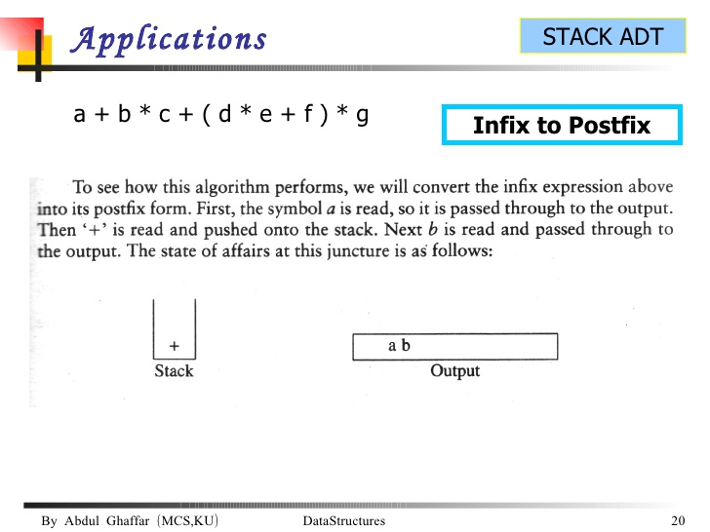
Spring 2025
Data Structures

Slide 56
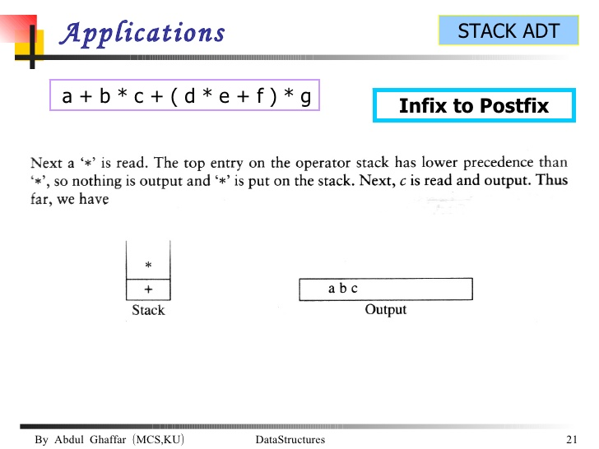
Spring 2025
Data Structures

Slide 57
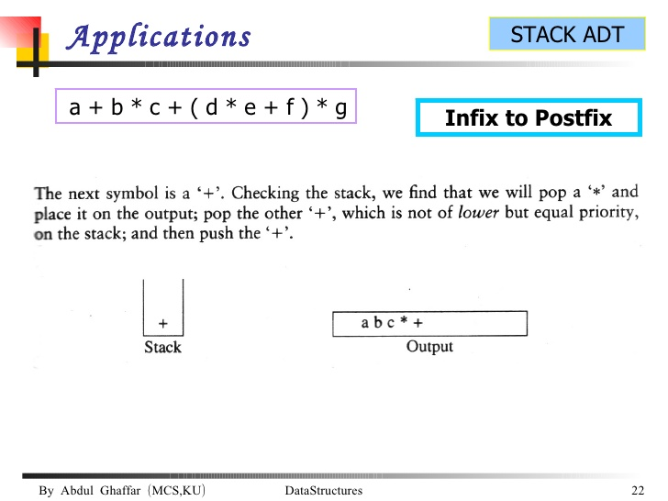
Spring 2025
Data Structures

Slide 58
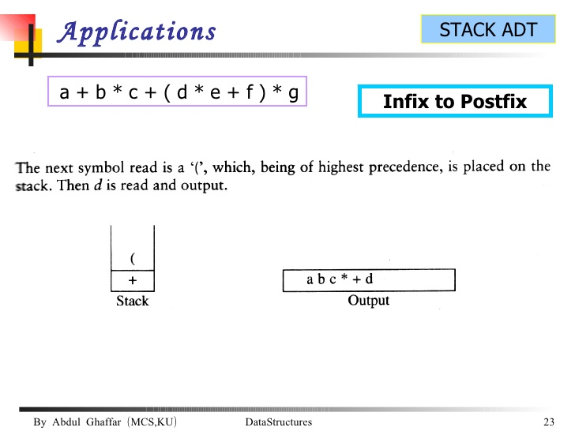
Spring 2025
Data Structures

Slide 59
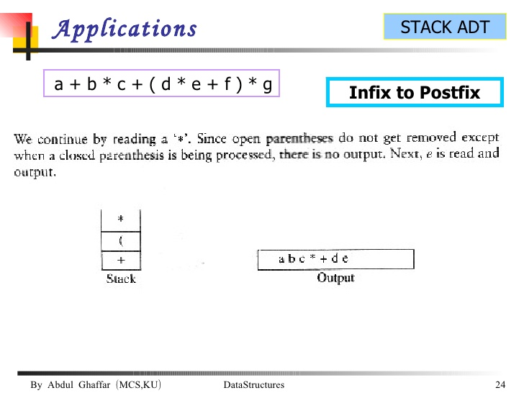
Spring 2025
Data Structures

Slide 60
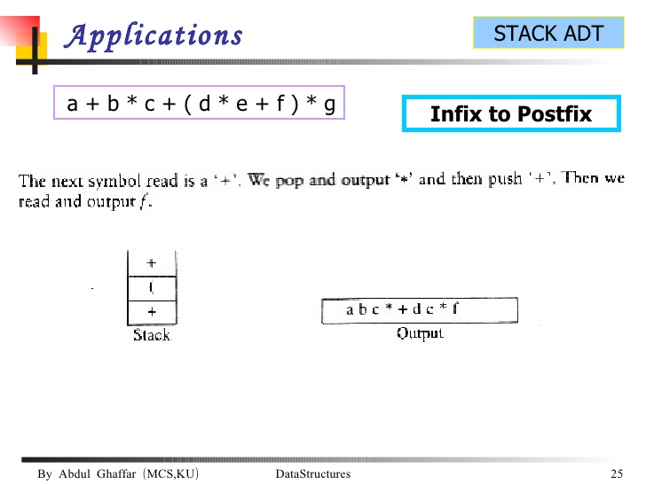
Spring 2025
Data Structures

Slide 61
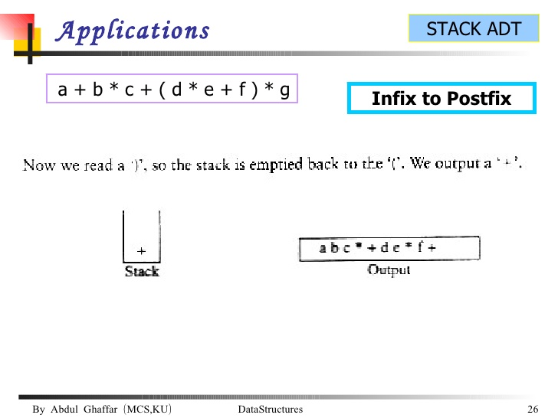
Spring 2025
Data Structures

Slide 62
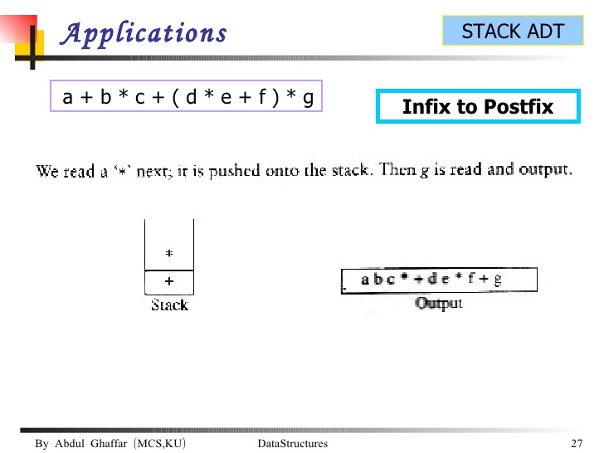
Spring 2025
Data Structures

Slide 63
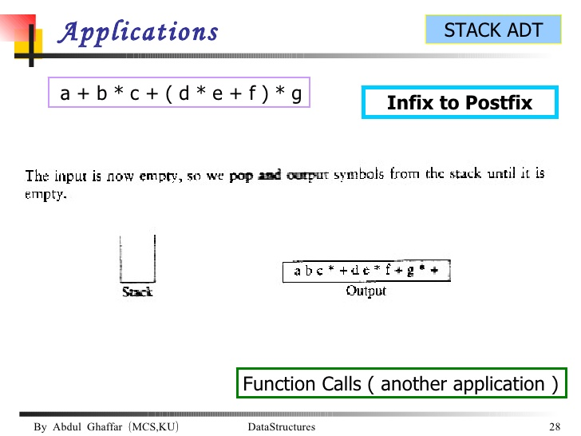
Spring 2025
Data Structures

Slide 64
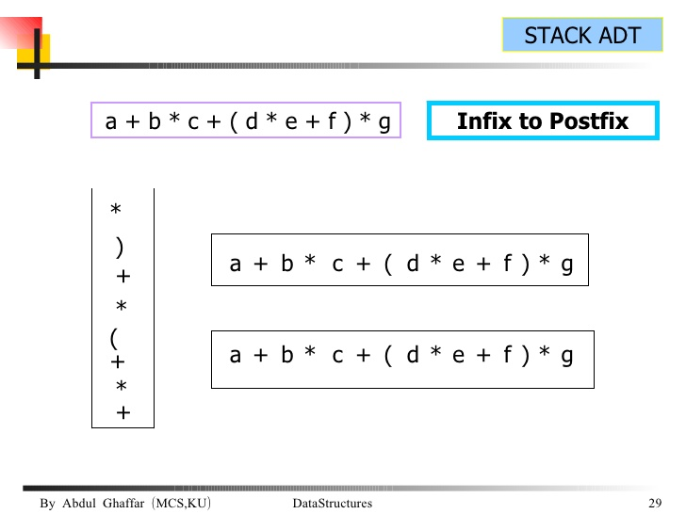
Spring 2025
Data Structures

Slide 65
Evaluation of a Postfix Expression
This algorithm finds the VALUE of an arithmetic expression P written in postfix notation.
Add a right parenthesis “)” at the end of P.
Scan P from left to right and repeat steps 3 and 4 for each element of P until the sentinel “)” is encountered.
If an operand is encountered, push it onto STACK.
If an operator © is encountered, then:
  (a) Remove the 2 top elements of STACK, where A is the top element and B is the next-to-top element.
  (b) Evaluate B © A.
  (c) Place the result of (b) back on STACK.
Set VALUE equal to the top element on STACK.
Exit.
Spring 2025
Data Structures

Slide 66
Consider the following arithmetic expression P written in Postfix notation.
5, 6, 2, +, *, 12, 4, /, -
After putting a right parenthesis
5, 6, 2, +, *, 12, 4, /, -, )
Symbol Scanned | STACK
5 | 5
6 | 5, 6
2 | 5, 6, 2
+ | 5, 8
* | 40
12 | 40, 12
4 | 40, 12, 4
/ | 40, 3
- | 37
)
Spring 2025
Data Structures

