Slide 1
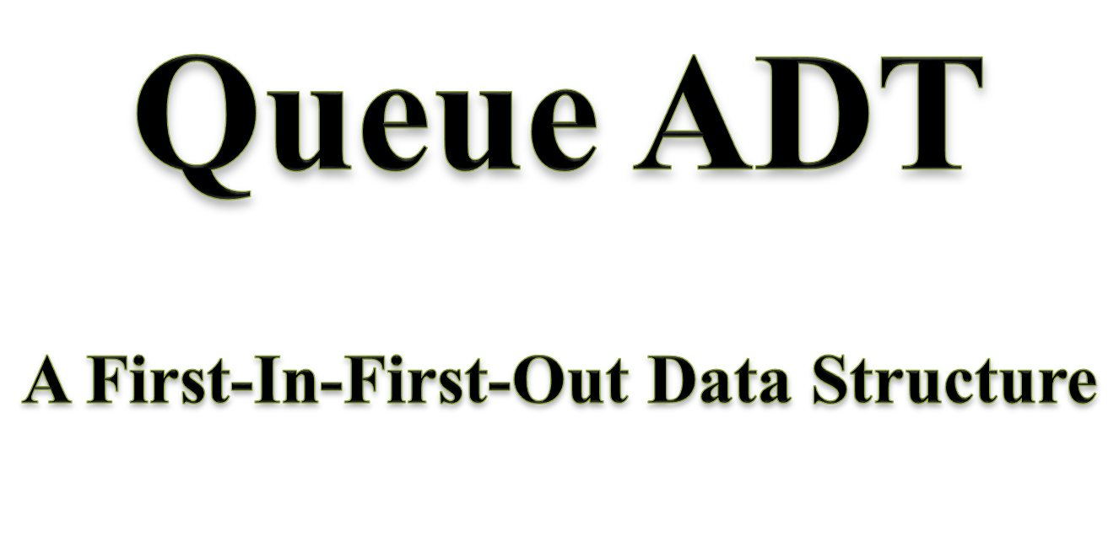
Spring 2025
Data Structures

Slide 2
Lecture Overview
Queue
  Introduction
  Specification
  Implementations
    Array-Based
    Linked List Based
  Application
    Palindrome Checking
Spring 2025
Data Structures

Slide 3

Out
In
A
B
C
B
A
Also called a QUEUE
Spring 2025
Data Structures

Slide 4
QUEUE
Real Life Examples
  A queue for Movie Tickets, Airline Reservation Queue, etc.
  First item added will be the first item to be removed
    Has the First In First Out (FIFO) property
    Major Operations
      Enqueue: Items are added to the back of the queue
      Dequeue: Items are removed from the front of the queue
      IsEmpty: To check Queue is empty or not
      IsFull: To check Queue is full or not
Spring 2025
Data Structures

Slide 5
enqueue
QUEUE
dequeue
create
isempty
isfull
Spring 2025
Data Structures

Slide 6
Array implementation of queues
A queue is a first in, first out (FIFO) data structure
This is accomplished by inserting at one end (the rear) and deleting from the other (the front)
0 1 2 3 4 5 6 7
Queue:
17
23
97
44
front = 0
rear = 3
For an empty queue: front = -1 and rear = -1
To insert: put new element in location 4, and set rear to 4
To delete: take element from location 0, and set front to 1
Spring 2025
Data Structures

Slide 7
Array implementation of queues
front = 0
rear = 3
Initial queue:
17
23
97
44
After insertion:
17
23
97
44
333
After deletion:
23
97
44
333
front = 1
rear = 4
Notice how the array contents “crawl” to the right as elements are inserted and deleted.
Spring 2025
Data Structures

Slide 8
Different Types of Queue
Linear Queue
Circular Queue
Doubly Ended Queue (DEQUE)
Priority Queue.
Spring 2025
Data Structures

Slide 9
Linear Queue
In this queue, elements will be inserted only from REAR side and if the position of REAR is equal to 1 less than the size of queue, then queue is full.
Spring 2025
Data Structures

Slide 10
Array implementation of queues
front = 0
rear = 7
Full queue:
17
23
97
44
99
87
94
89
front = 7
rear = 7
After some deletions:
89
Spring 2025
Data Structures

Slide 11
Drawbacks of Linear Queues
One of the major limitation with the linear queues is that even if there is space for some new elements but still we can not be able to insert because the position of rear is equal to the maximum size of array.
Solution
As the solution to this problem, we assume that our array is circular.
Spring 2025
Data Structures

Slide 12
Circular arrays
We can treat the array holding the queue elements as circular (joined at the ends)
0 1 2 3 4 5 6 7
myQueue:
44
55
11
22
33
rear = 1
front = 5
Elements were added to this queue in the order 11, 22, 33, 44, 55, and will be removed in the same order.
Spring 2025
Data Structures

Slide 13
Array implementation of queues
front = 0
rear = 7
Full queue:
17
23
97
44
99
87
94
89
After deletion:
89
After some insertions & deletions:
25
15
10
12
333
29
37
89
rear = 6
front = 7
Spring 2025
Data Structures

Slide 14
Array Declaration of Queue
#define MAXSIZE 100
struct fifo
{
int Q[MAXSIZE];
int front;
int rear;
};
typedef struct fifo Queue;
Spring 2025
Data Structures

Slide 15
Main function
void main()
{
Queue q;
create(&q);
enqueue(&q,10);
enqueue(&q,20);
enqueue(&q,30);
enqueue(&q,100);
enqueue(&q,5);
printf (“%d”, dequeue(&q));
if (isempty(&q))
printf (“\n Queue is empty”);
}
Spring 2025
Data Structures

Slide 16
Queue Creation
void create (Queue *q)
{
q -> front = -1;
q -> rear = -1;
}
Spring 2025
Data Structures

Slide 17
Enquing an element into the queue
void enqueue (Queue *q, int element)
{
if ((q->front == 0) && (q -> rear ==(MAXSIZE-1)) || q->front == (q->rear +1))
{
printf (“\n Overflow”);
exit(-1);
}
else if(q->front==-1)
q->front=q->rear=0;
else if(q->rear == (MAXSIZE-1))
q->rear=0;
else
q->rear++;
q->Q[q->rear]= element;
}
Spring 2025
Data Structures

Slide 18
Dequing an element from the Queue
int dequeue (Queue *q)
{
if (q->front == -1)
{
printf (“\n Underflow”);
exit(-1);
}
int item = q->Q[q->front];
if(q->front == q->rear)
q->front= q->rear=-1;
else if(q->front==(MAXSIZE-1))
q->front=0;
else
q->front++;
return item;
Spring 2025
Data Structures

Slide 19
Checking for queue empty
int isempty (Queue *q)
{
if (q->front == -1)
return 1;
else
return 0;
}
Spring 2025
Data Structures

Slide 20

Spring 2025
Data Structures

Slide 21
Basic Idea
  Create a linked list to which items would be added to one end and deleted from the other end.
  Two pointers will be maintained:
    One pointing to the beginning of the list (point from where elements will be deleted).
    Another pointing to the end of the list (point where new elements will be inserted).
Rear
Front
DELETION
INSERTION
Spring 2025
Data Structures

Slide 22
QUEUE: LINKED LIST STRUCTURE
ENQUEUE
front
rear
Spring 2025
Data Structures

Slide 23
QUEUE: LINKED LIST STRUCTURE
DEQUEUE
front
rear
Spring 2025
Data Structures

Slide 24
Linked List Declaration of Queue
struct fifo
{
int data;
struct fifo *next;
};
typedef struct fifo Queue;
Spring 2025
Data Structures

Slide 25
Main function
void main()
{
Queue *front,*rear;
create(&front,&rear);
enqueue(&front,&rear,10);
enqueue(&front,&rear,20);
enqueue(&front,&rear,30);
enqueue(&front,&rear,100);
enqueue(&front,&rear,5);
printf (“%d”, dequeue(&front, &rear));
if (isempty(&front))
printf (“\n Queue is empty”);
}
Spring 2025
Data Structures

Slide 26
Queue Creation
void create (Queue **front, Queue **rear)
{
*front = NULL;
*rear = NULL;
}
Spring 2025
Data Structures

Slide 27
Enquing an element into the queue
void enqueue (Queue **front, Queue **rear, int element)
{
Queue *new=(Queue *)malloc(sizeof(Queue));
new->data=element;
new->next=NULL;
if(*front==NULL)
*front=*rear=new;
else
{
(*rear)->next=new;
*rear=new;
}
}
Spring 2025
Data Structures

Slide 28
Dequing an element from the Queue
int dequeue (Queue **front, Queue **rear)
{
if (*front == NULL)
{
printf (“\n Underflow”);
exit(-1);
}
int item = *front->data;
Queue *tmp=*front;
if(*front == *rear)
*front=*rear=NULL;
else
*front=(*front)->next;
free(tmp);
return item;
}
Spring 2025
Data Structures

Slide 29
Checking for queue empty
int isempty (Queue **front)
{
if (*front == NULL)
return 1;
else
return 0;
}
Spring 2025
Data Structures

Slide 30
Deques
A deque is a double-ended queue
Insertions and deletions can occur at either end but not in the middle.
Implementation is similar to that for queues
Deques are not heavily used
You should know what a deque is, but we won’t explore them much further
Spring 2025
Data Structures

Slide 31
Types of Deques
Input-Restricted Deque
which allows insertions only at only one end of the list but allows deletions at both ends of the list.
2. Output Restricted Deque
which allows deletions only at only one end of the list but allows insertions at both ends of the list.
Spring 2025
Data Structures

Slide 32
Operations on Deques
Insertion from REAR
Insertion from FRONT
Deletion from REAR
Deletion from FRONT
Spring 2025
Data Structures

Slide 33
Priority Queues
Priority Queue is an extension of queue with following properties.
1) Every item has a priority associated with it.
2) An element with high priority is dequeued before an element with low priority.
3) If two elements have the same priority, they are served according to their order in the queue.
Spring 2025
Data Structures

Slide 34
Priority Queues
A typical priority queue supports following operations.
insert(item, priority): Inserts an item with given priority.
getHighestPriority(): Returns the highest priority item.
deleteHighestPriority(): Removes the highest priority item.
Spring 2025
Data Structures

Slide 35
How to implement Priority Queues?
Using Array: A simple implementation is to use array of following structure.
typedef struct item{
int item;
int priority;
} item;
typedef struct queue{
item queue[MAXQ];
int front, rear;
}queue;
Spring 2025
Data Structures

Slide 36
How to implement Priority Queues?
insert() operation can be implemented by adding an item at end of array in O(1) time.
Spring 2025
Data Structures

Slide 37
How to implement Priority Queues?
getHighestPriority() operation can be implemented by linearly searching the highest priority item in array. This operation takes O(n) time.
deleteHighestPriority() operation can be implemented by first linearly searching an item, then removing the item by moving all subsequent items one position back.
We can also use Linked List, time complexity of all operations with linked list remains same as array. The advantage with linked list is deleteHighestPriority() can be more efficient as we don’t have to move items.
Spring 2025
Data Structures

Slide 38
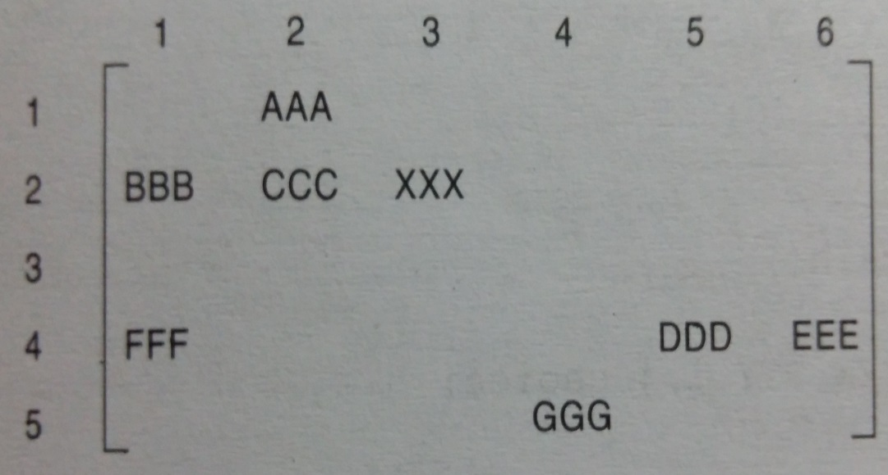
2-D Array Representation of a Priority Queue
Another way to maintain a priority queue in memory is to use a separate queue for each level of priority. Each such queue will appear in its own circular array and must have its own pair of pointers, FRONT and REAR. In fact, if each queue is allocated the same amount of space, a 2-D array QUEUE can be used instead of the linear arrays.
FRONT
REAR
1
2
1
0
5
4
2
3
0
1
4
2
3
4
5
Spring 2025
Data Structures

Slide 39
This Algorithm deletes and processes the first element in a priority queue maintained by a two-dimensional array QUEUE.
[Find the first non empty queue.]
Find the smallest K such that FRONT[K] ≠ NULL.
Delete and process the front element in row K of QUEUE.
Exit.
Spring 2025
Data Structures

Slide 40
This Algorithm adds an ITEM with priority number M to a priority QUEUE maintained by a two-dimensional array QUEUE.
Insert ITEM as the rear element in row M of QUEUE.
Exit.
Spring 2025
Data Structures

