Slide 1

Pointers

Slide 2
Content
Recap
What is Pointers?
Declaration
Types of Pointers
Pointers Arithmetic

Slide 3
Recap
Types of Recursion with Example
Recursion Vs iteration
Advantages & Disadvantages of Recursion
Recursion in Arrays
Exercises

Slide 4
Pointer Definition
C pointer is the derived data type that is used to store the address of another variable.
Efficient manipulation: It can access and manipulate the variable's data stored at that location.
You can pass the data efficiently between the functions, and create dynamic data structures like linked lists, trees, and graphs.

Slide 5
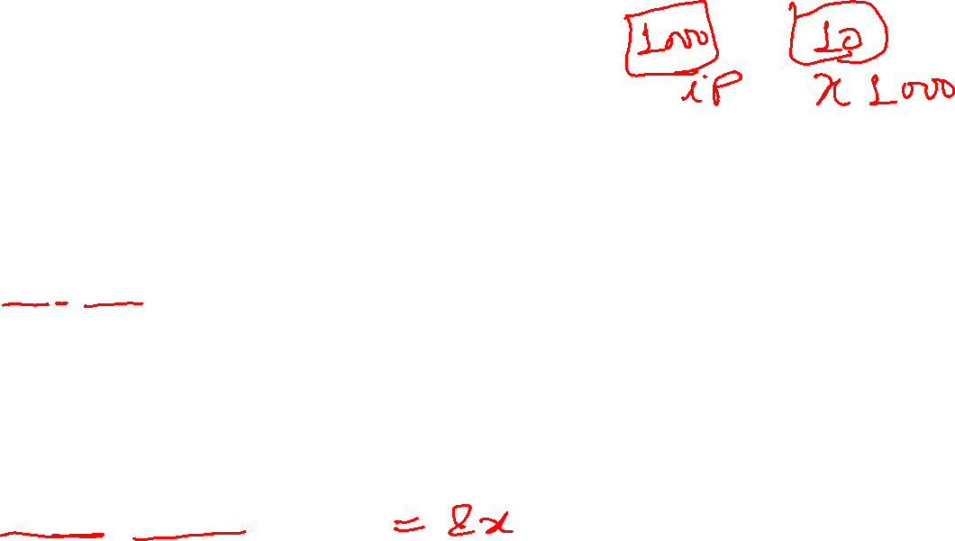
Pointer Declaration
We use dereferencing operator (*) followed by the data type.
Syntax
type *var-name;
Here, type is the pointer's base type and var-name is the name of the pointer variable.
The asterisk * is being used to designate a variable as a pointer.
Example:
int *ip; /* pointer to an integer */
double *dp; /* pointer to a double */

Slide 6
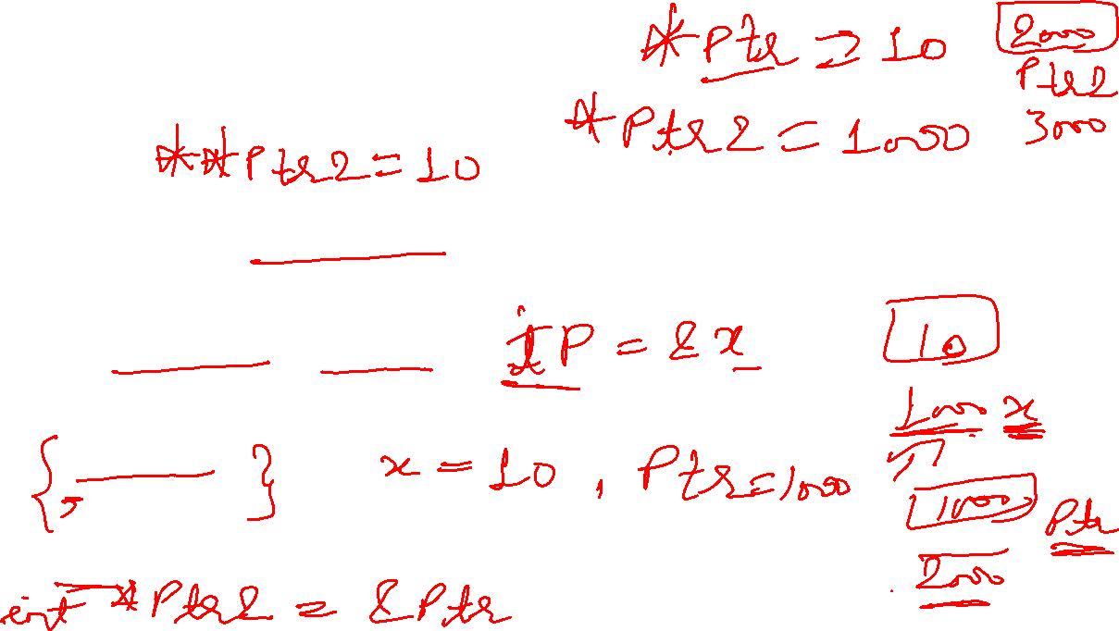
Pointer Initialization
After declaring a pointer variable, you need to initialize it with the address of another variable using the address of (&) operator. This process is known as referencing a pointer.
Syntax
pointer_variable = &variable;
Example
int x = 10;
int *ptr = &x;
Here, x is an integer variable, ptr is an integer pointer. The pointer ptr is being initialized with x.

Slide 7


Referencing and Dereferencing Pointers
Obtaining the value stored at that location is known as dereferencing the pointer.
Purpose of the following two operators:
The & Operator − "Address-of operator“ or “Referencing operator”. Taking the address of an existing variable (using &) to set a pointer variable.
The * Operator - "dereference operator". Dereferencing a pointer is used to get the value from the memory address that is pointed by the pointer.

Slide 8
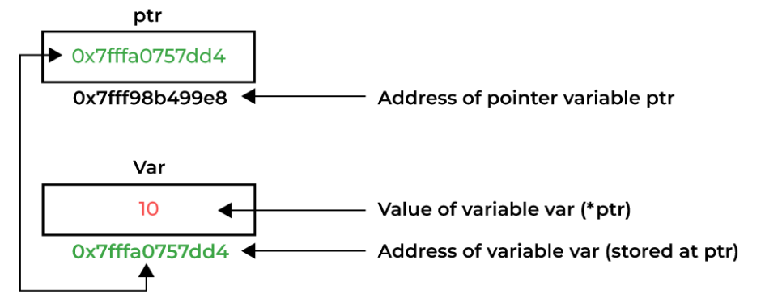

Referencing and Dereferencing Pointers
Pointers are used to pass parameters by reference.
This is useful if a programmer wants a function's modifications to a parameter to be visible to the function's caller.
This is also useful for returning multiple values from a function.

Slide 9
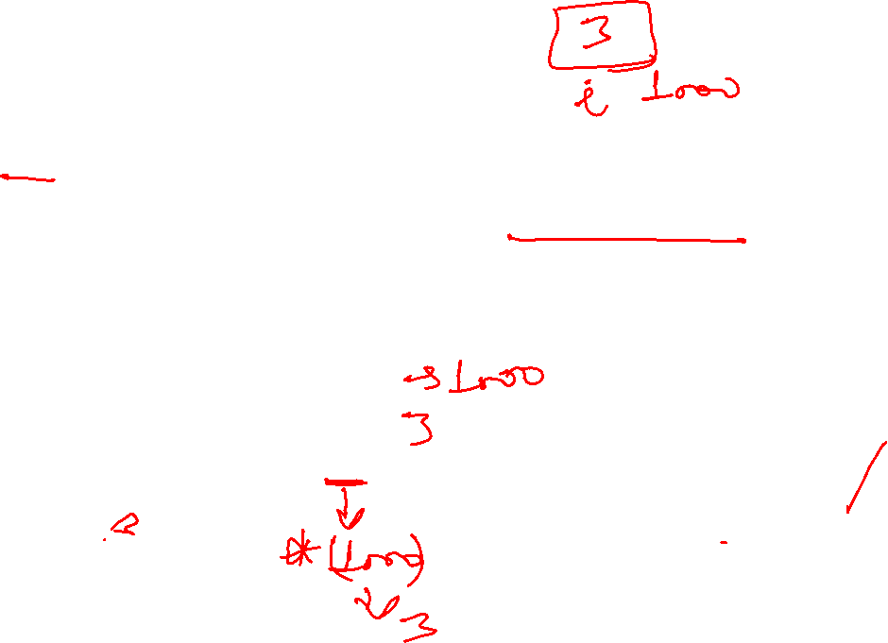
Example
‘*’ is called ‘value at address’ operator. It gives the value stored at a particular address.
The ‘value at address’ operator is also called ‘indirection’operator.
main( )
{
int i = 3 ;
printf ( "\nAddress of i = %u", &i ) ;
printf ( "\nValue of i = %d", i ) ;
printf ( "\nValue of i = %d", *( &i ) ) ;
}
The output of the above program would be:
Address of i = 65524
Value of i = 3
Value of i = 3
Notes:
Let us C

Slide 10
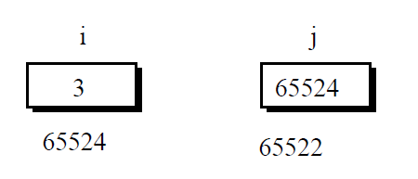

Example
main( )
{
int i = 3 ;
int *j ;
j = &i ;
printf ( "\nAddress of i = %u", &i ) ;
printf ( "\nAddress of i = %u", j ) ;
printf ( "\nAddress of j = %u", &j ) ;
printf ( "\nValue of j = %u", j ) ;
printf ( "\nValue of i = %d", i ) ;
printf ( "\nValue of i = %d", *( &i ) ) ;
printf ( "\nValue of i = %d", *j ) ;
}
The output of the above program would be:
Address of i = 65524
Address of i = 65524
Address of j = 65522
Value of j = 65524
Value of i = 3
Value of i = 3
Value of i = 3

Slide 11
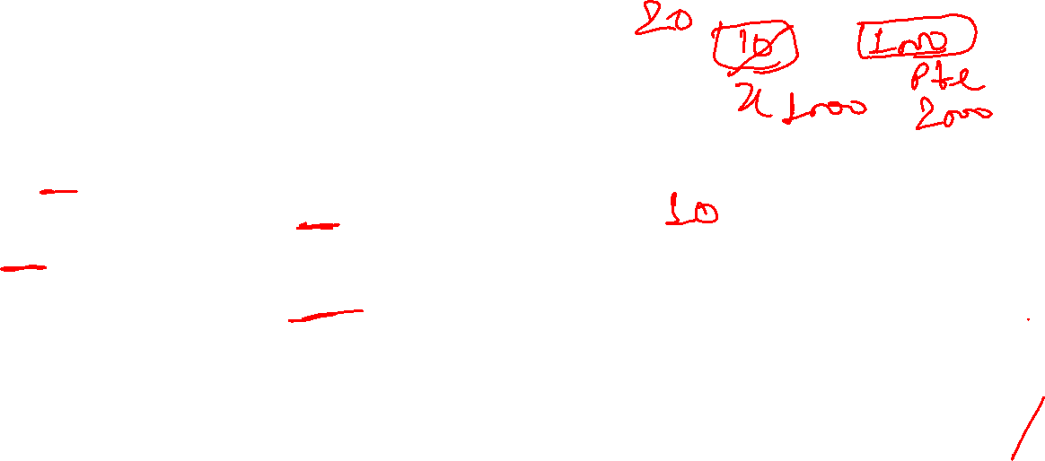
Access and Manipulate Values using Pointer
The value of the variable which is pointed by a pointer can be accessed and manipulated by using the pointer variable.
#include <stdio.h>
int main() {
int x = 10;
int * ptr = & x; // Pointer declaration and initialization
printf("Value of x = %d\n", * ptr); // Printing the current value
* ptr = 20; // Changing the value
printf("Value of x = %d\n", * ptr); // Printing the updated value
return 0;
}
Output:
Value of x = 10
Value of x = 20

Slide 12

Types of pointers
Type | Description | Example
Integer pointer | pointers that point to the integer values. | int *ptr;
Character pointer | pointers that point to the character values. | char* ptr_char = &c;
Float pointer | pointers that point to the float values. | float *fp;
Array pointer | pointer to an array | char *ptr = &array_name;
Structure pointer | pointer pointing to the structure type | struct struct_name *ptr;
Void pointer | generic pointers, can point to any type and can be typecasted to any type | void * pointer_name;

Slide 13

Types of pointers
Type | Description | Example
Null pointer | Do not point to any memory location. Can be created by assigning a NULL value. A pointer of any type can be assigned the NULL value. | data_type *pointer_name = NULL;
Constant Pointer | the memory address is constant and cannot be modified once it is defined | data_type * const pointer_name;
Double pointer or pointers to pointer | a pointer that stores the memory address of another pointer. | datatype ** pointer_name;
Pointer to Constant | pointers pointing to a constant value | const data_type * pointer_name;
Wild pointer | Have not been initialized with something | int *ptr; char *str;

Slide 14

Size of a pointer
Reason
The size of the pointers in C is equal for every pointer type.
The size of the pointer does not depend on the type it is pointing to.
The pointers store the memory addresses, no matter what type they are.
It only depends on the operating system and CPU architecture.
The size of pointers is
8 bytes for a 64-bit System
4 bytes for a 32-bit System

Slide 15
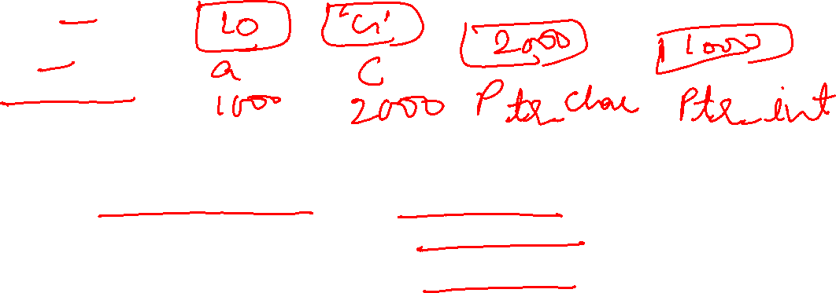
Example
#include<stdio.h>
int main()
{
int a = 10;
char c = 'G’;
int* ptr_int = &a;
char* ptr_char = &c;
void* ptr_vn = NULL;
printf("Size of Integer Pointer \t:\t%d bytes\n", sizeof(ptr_int));
printf("Size of Character Pointer\t:\t%d bytes\n", sizeof(ptr_char));
printf("Size of NULL Void Pointer\t:\t%d bytes", sizeof(ptr_vn));
return 0;
}
Output:
Size of Integer Pointer : 8 bytes
Size of Character Pointer : 8 bytes
Size of NULL Void Pointer : 8 bytes

Slide 16
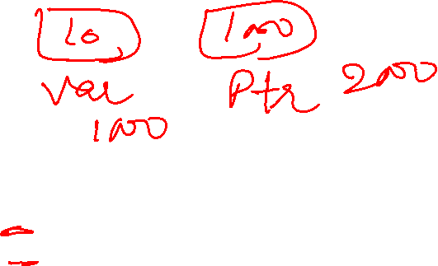
Example of Pointer: Using Pointers
#include <stdio.h>
int main()
{
int var = 10;
int* ptr; // declare pointer variable
ptr = &var; // note that data type of ptr and var must be same
printf("Value at ptr = %p \n", ptr); // assign the address of a variable to a pointer
printf("Value at var = %d \n", var);
printf("Value at *ptr = %d \n", *ptr);
return 0;
}
Output:
Value at ptr = 0x7fff8feb5884
Value at var = 10
Value at *ptr = 10

Slide 17
Examples of pointer: Print Value and Address of an Integer
#include <stdio.h>
int main(){
int var = 100;
printf("Variable: %d \t Address: %p", var, &var);
return 0;
}
Output
Variable: 100 Address: 0x7ffff60b54ac

Slide 18
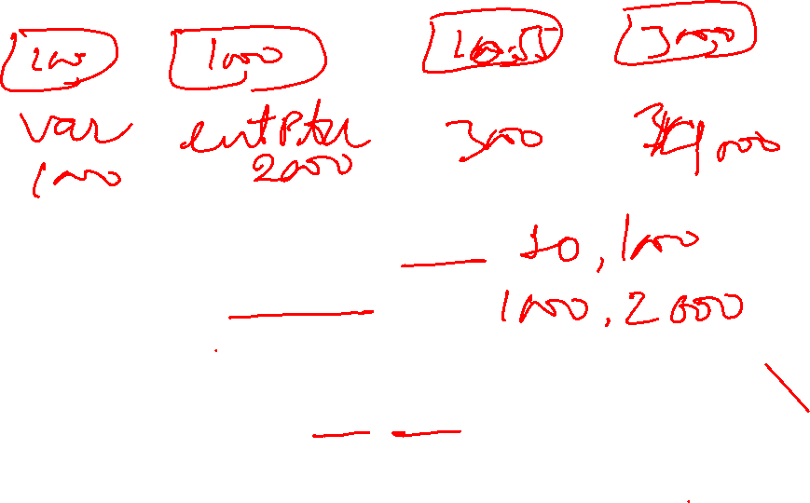
Examples of pointer: Address of integer and float pointer
#include <stdio.h>
int main(){
int var = 100;
int *intptr = &var;
printf("Integer Variable: %d \tAddress of integer: %p \n", var, &var);
printf("intptr: %p \tAddress of intptr: %p \n", intptr, &intptr);
float var1 = 10.55;
float *floatptr = &var1;
printf(" Float Variable: %f \tAddress of float: %p \n", var1, &var1);
printf("floatptr: %p \tAddress of floatptr: %p \n", floatptr, &floatptr);
return 0;}
Output:
Integer Variable: 100 Address of integer: 0x7fffb1740cdc
intptr: 0x7fffb1740cdc Address of intptr: 0x7fffb1740cd0
Float Variable: 10.550000 Address of float: 0x7fffb1740ccc
floatptr: 0x7fffb1740ccc Address of floatptr: 0x7fffb1740cc0

Slide 19
Example of pointers: Null pointer
#include <stdio.h>
int main(){
int *ptr = NULL;
printf("The value of ptr is : %x\n", ptr);
return 0;
}
Output:
The value of ptr is 0

Slide 20
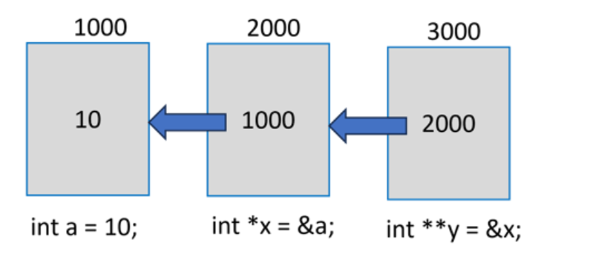
Pointer to pointer
"a" is a normal "int" variable, whose pointer is "x". In turn, the variable stores the address of "x".
"y" is declared as "int **" to indicate that it is a pointer to another pointer variable. Obviously, "y" will return the address of "x" and "*y" is the value in "x" (which is the address of "a").
To obtain the value of "a" from "y", we need to use the expression "**y". Usually, "y" will be called as the pointer to a pointer.

Slide 21
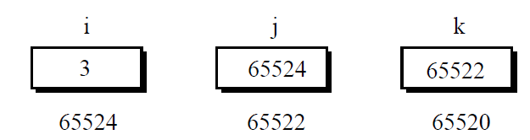
Example: Pointer to pointer
#include<stdio.h>
int main( )
{
int i = 3, *j, **k ;
j = &i ;
k = &j ;
printf ( "\nAddress of i = %u, i = %u, i = %u ", &i, j, *k ) ;
printf ( "\nAddress of j = %u, j = %u, j = %u", &j, k, &k ) ;
printf ( "\nValue of j = %u", j ) ;
printf ( "\nValue of k = %u", k ) ;
printf ( "\nValue of i = %d, i = %d, i = %d, i = %d", i, * ( &i ), *j, **k) ;
}
Output:
Address of i = 201259388, i = 201259388, i = 201259388
Address of j = 201259376, j = 201259376, j = 201259368
Value of j = 201259388
Value of k = 201259376
Value of i = 3, i = 3, i = 3, i = 3

Slide 22
Example: Pointer to pointer
Output:
var: 10 Address of var: 2030583852
inttptr: 2030583852 Address of inttptr: 2030583840
var: 10 Value at intptr: 10
ptrptr: 2030583840 Address of ptrtptr: 2030583832
intptr: 2030583852 Value at ptrptr: 2030583852
var: 10 *intptr: 10 **ptrptr: 10
#include <stdio.h>
int main(){
int var = 10;
int *intptr = &var;
int **ptrptr = &intptr;
printf("var: %d \tAddress of var: %d \n",var, &var);
printf("inttptr: %d \tAddress of inttptr: %d \n", intptr, &intptr);
printf("var: %d \tValue at intptr: %d \n", var, *intptr);
printf("ptrptr: %d \tAddress of ptrtptr: %d \n", ptrptr, &ptrptr);
printf("intptr: %d \tValue at ptrptr: %d \n\n", intptr, *ptrptr);
printf("var: %d \t*intptr: %d \t**ptrptr: %d", var, *intptr, **ptrptr);
return 0;}

Slide 23
Announcement
Viewing your Mid-sem answer script today from 12:30 to 4:00 in D313.
Quiz 2 is on 24th Oct (Thursday)- from 12:30pm onwards.
Syllabus will be including Pointers. (Conditional statements, Loops, arrays, functions, recursion, pointers)

Slide 24

Upcoming Slides
Array Pointers
Function Pointers

