Slide 1


JAMIA MILLIA ISLAMIA · DEPARTMENT OF COMPUTER ENGINEERING
B.TECH MINOR PROJECT · PRESENTATION II (MID-TERM IMPLEMENTATION)
WHAT SARTA STANDS FOR
S
Semantic
SBERT skill alignment
SARTA: Implementation & Empirical Evaluation
A
Adaptive
streak-based CAT engine
R
Recruitment
JD-aware gap analysis
End-to-End Prototype, Adaptive Testing Engine, Sandboxed Grading & Benchmark Results
T
Technical
sandboxed code grading
PRESENTED BY
SUPERVISOR
Syed Anas Ahmed 23BCS020
Dr. S M Faisal Malik
Department of Computer Engineering
A
Assessment
explainable skill report
Md Shahid Rasool 23BCS021
SARTA · Semantic Adaptive Recruitment & Technical Assessment
Slide 1 / 22
Notes:
Title slide. Introduce the team, supervisor and the scope of Presentation II: the working prototype, its algorithms and the empirical benchmarks.

Slide 2



RECAP · PROBLEM & MOTIVATION
Traditional Screening Fails Modern Technical Hiring
THREE CRITICAL INDUSTRY BOTTLENECKS
01
02
03
Fragile Keyword ATS
Static One-Size Assessments
Resumes Evaluated in Complete Isolation
Matches literal character sequences rather than semantic competency.
Fails on equivalent technologies (e.g., rejects “PostgreSQL” when looking for “SQL Relational DB”).
Administers the exact same fixed 20-question quiz to all candidates regardless of ability.
Fails to establish upper limits for senior talent and causes disengagement for junior candidates.
Existing systems score resumes against generic job categories rather than tailoring testing to the specific target Job Description (JD).
THE SARTA SOLUTION
Traditional
Resume
→
Keyword Match
→
Static Quiz
→
Single Opaque Score
SARTA
Resume + JD
→
Semantic Alignment & Gap Analysis
→
Adaptive Dynamic Test
→
Explainable Skill-Wise Report
SARTA · Recap
Slide 2 / 22
Notes:
Recap of PPT 1: the three bottlenecks of current screening, and how the SARTA pipeline replaces keyword matching and static quizzes with semantic, JD-aware, adaptive and explainable assessment.

Slide 3
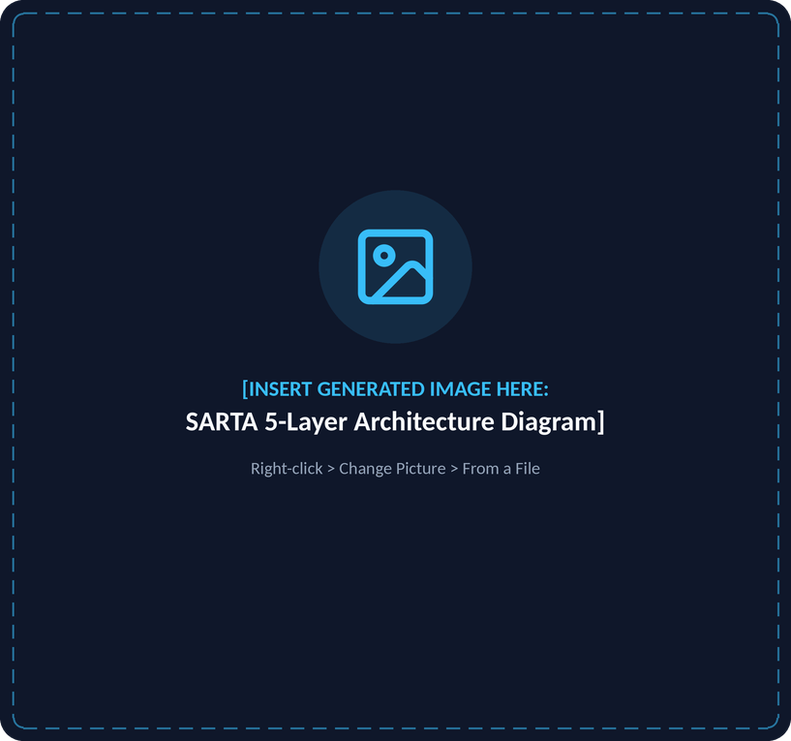





RECAP · SYSTEM ARCHITECTURE
Five Layers: From Document Ingestion to Explainable Verdict
LAYER 1 User Layer
Unified reactive interface accepting candidate resume (PDF/DOCX) and target JD.
LAYER 2 Processing Layer
Dual text parsing, spaCy technical NER, Sentence-BERT embedding, and Hungarian gap analysis.
LAYER 3 Assessment Layer
Parallel item delivery: dynamic adaptive MCQs and sandboxed coding challenge.
LAYER 4 Intelligence Layer
Streak-based adaptive difficulty controller and multidimensional scoring engine.
LAYER 5 Output Layer
Granular skill scores, peak difficulty tags, and explainable hiring recommendation.
SARTA · Recap
Slide 3 / 22
Notes:
IMAGE PLACEHOLDER: SARTA 5-Layer Architecture Diagram
Replace: right-click the placeholder > Change Picture > From a File. If the new image does not fill the frame, use Picture Format > Crop > Fill.
Placeholder size: 5.45" x 5.10" - generate at square (1024x1024).
ChatGPT / DALL-E prompt:
A sleek, dark-themed 3D isometric diagram of a 5-layer software architecture stack floating in space. Deep slate background (#0B1120). Layers from top to bottom: 1. User Interface Layer (glowing neon blue icons of Resume and Job Description), 2. Processing Layer (NLP vectors and matching engine), 3. Assessment Layer (parallel branches of MCQ and Code Editor), 4. Intelligence Layer (glowing green adaptive controller chip and analytics engine), 5. Output Layer (holographic radar chart and report card). Minimalist, modern UI design style, high resolution, 8k render.

Slide 4




PROJECT STATUS · MILESTONES
From Proposed Blueprint to Operational System
PILLAR 01
PILLAR 02
PILLAR 03
PILLAR 04
Extraction & Matching
Question Bank & Data Model
Adaptive Testing & Sandbox
Explainable Analytics & UI
100%
100%
100%
100%
OPERATIONAL
OPERATIONAL
OPERATIONAL
OPERATIONAL
Dual PDF/DOCX parsers, 150+ canonical skill taxonomy, SBERT embeddings, Hungarian bipartite matching.
MongoDB Atlas repository populated with 9 technical domains across Easy, Medium, and Hard tiers.
Dynamic streak-based CAT controller and Judge0 CE execution sandbox with hidden test cases.
Reactive Next.js 16 interface, Microsoft Monaco Editor, and SVG Competency Radar chart.
SARTA · Implementation Status
Slide 4 / 22

Slide 5
SYSTEM DESIGN · ARCHITECTURAL DECISIONS
Upgrades from Initial Synopsis to Final Implementation
TECHNOLOGY STACK EVOLUTION MATRIX
Component | Synopsis Proposal | Implemented Evolution | Academic Justification
Frontend UI | Streamlit | Next.js 16 + React 19 + Tailwind v4 | Eliminates full-page re-execution; provides sub-50ms reactive state transitions during adaptive item delivery.
In-Browser IDE | Streamlit Ace | Microsoft Monaco Editor (@monaco-editor/react) | Industry-standard VS Code web core with syntax highlighting, autocomplete, and multi-language support.
Backend API | FastAPI / Flask | FastAPI 0.110 (Async Python 3.11) | High-concurrency async endpoints with Pydantic type safety.
Database | SQLite / Postgres | MongoDB Atlas + In-Memory Fallback | Document structure natively represents hierarchical skill prerequisites and nested test-case arrays.
Semantic Vectors | spaCy + SBERT | spaCy en_core_web_sm + all-MiniLM-L6-v2 | 384-dimensional dense vectors with local caching and low inference overhead.
SARTA · System Design
Slide 5 / 22

Slide 6





MODULE IMPLEMENTATION · PROCESSING LAYER
</> parser.py
Deterministic Document Parsing
ENGINEERING IMPLEMENTATION
Dual Format Support
Robust ingestion of both PDF and DOCX files without external OCR overhead.
Layout-Aware PDF Extraction
Implemented via pdfplumber to maintain logical document layout and extract tabular skill matrices cleanly.
DOCX XML Run Parsing
Traverses document paragraphs and table XML runs via python-docx.
Text Normalization
Strips non-standard whitespace, unicode bullets, and artifacts, achieving average parse latency under 42ms.
< 42 ms
Average parse latency
PDF + DOCX → normalized text buffer, no OCR
SARTA · Module 1: Document Parsing
Slide 6 / 22
Notes:
IMAGE PLACEHOLDER: Document Parsing Dataflow Diagram
Replace: right-click the placeholder > Change Picture > From a File. If the new image does not fill the frame, use Picture Format > Crop > Fill.
Placeholder size: 5.45" x 5.10" - generate at square (1024x1024).
ChatGPT / DALL-E prompt:
A modern tech vector illustration showing two glowing digital documents (PDF and DOCX) feeding into a central glowing processing core labeled 'Document Sanitizer'. The core splits into two streams: 'Layout-Aware pdfplumber' and 'python-docx XML Run Parser'. Both merge into a clean stream of illuminated binary data leading to a clean white sheet of 'Normalized Text Buffer'. Minimalist, dark slate background, glowing emerald and cyan vectors.

Slide 7

MODULE IMPLEMENTATION · NLP ENGINE
</> nlp_engine.py
Two-Pass Skill Extraction & Dense Normalization
THE SARTA TWO-PASS SOLUTION
The Extraction Challenge
PASS 1 spaCy PhraseMatcher
Fast lexical scan over a curated canonical taxonomy of 150+ tech skills (Languages, Frontend, Backend, ML, Cloud).
1
Standard off-the-shelf NER models fail on technical terms (misclassifying “Docker” or “Next.js” as generic nouns).
PASS 2 Delimited Token Splitter
Regex-based parser targeting comma-separated, pipe-delimited, and bulleted resume skill lists.
2
Docker → NOUN
Next.js → NOUN
STEP 3 Subsumption & Deduplication
Resolves sub-string overlap (e.g., collapses “Python 3” and “Python Programming” into canonical “Python”).
3
150+
384-d
canonical tech skills in taxonomy
SBERT dense vectors (all-MiniLM-L6-v2)
STEP 4 Dense SBERT Embedding
Encodes normalized tokens into 384-dimensional vectors using Sentence-BERT (all-MiniLM-L6-v2) for semantic distance evaluation.
4
SARTA · Module 2: Skill Extraction
Slide 7 / 22

Slide 8

MODULE IMPLEMENTATION · MATCHER
</> matcher.py
Hungarian Alignment & Three-Way Gap Classification
MATHEMATICAL FORMULATION
C = {c₁, …, c_{m}}, J = {j₁, …, j_{n}}
Sim(c_{i}, j_{j}) = (c_{i} · j_{j}) / (||c_{i}|| ||j_{j}||)
Minimum-weight bipartite assignment on −Sim via the Hungarian Algorithm scipy.optimize.linear_sum_assignment
THREE-WAY CLASSIFICATION cosine threshold τ = 0.35
C ∩ J
Verified Matches
Overlapping competencies tested first.
J \ C
Skill Gaps
Required skills absent on resume (targeted for adaptive verification).
C \ J
Bonus Skills
Candidate strengths not requested by job.
Match Compatibility Score = (|C ∩ J| / |J|) × 100%
SARTA · Module 3: Gap Analysis
Slide 8 / 22
Notes:
IMAGE PLACEHOLDER: Bipartite Hungarian Matching Graph
Replace: right-click the placeholder > Change Picture > From a File. If the new image does not fill the frame, use Picture Format > Crop > Fill.
Placeholder size: 5.45" x 5.10" - generate at square (1024x1024).
ChatGPT / DALL-E prompt:
A digital bipartite graph on a dark slate background (#0B1120). On the left column, glowing cyan nodes labeled 'Resume Skills' (Python, SQL, Docker, React). On the right column, glowing purple nodes labeled 'JD Requirements' (Python, PostgreSQL, Kubernetes, AWS). Luminous green lines connect optimal 1-to-1 pairs with decimal weights (1.0, 0.88). One unmatched JD node glows red with a dashed halo labeled 'Skill Gap'. High-tech graph theory illustration.

Slide 9





MODULE IMPLEMENTATION · ASSESSMENT BLUEPRINT
Automated Role Identification & Blueprint Generation
ROLE MAPPING ENGINE role_mapper.py
ASSESSMENT BLUEPRINT blueprint_generator.py
Profiles candidate skill vectors against 5 primary industry archetypes, computes a role-match confidence % and prioritizes assessment targets.
TIER 1
Frontend Developer
React, Next.js, TypeScript, TailwindCSS, HTML/CSS
Core Skills
Top intersecting skills between candidate and target role.
Backend Developer
Python, FastAPI, Django, Node.js, SQL, Docker
▼
TIER 2
Full Stack Developer
Combined client/server proficiencies, REST APIs, Git
Skill Gap Verification
Highest-priority skills required by job but absent from resume.
Data Scientist / ML Engineer
Python, Pandas, Scikit-learn, PyTorch, SQL
▼
TIER 3
CS Fundamentals
Role-agnostic foundations (Data Structures, OOP, OS, Networks).
DevOps / Cloud Engineer
AWS, Docker, Kubernetes, CI/CD, Linux
SARTA · Module 4: Role & Blueprint
Slide 9 / 22

Slide 10





MODULE IMPLEMENTATION · DATA LAYER
Multi-Domain Knowledge Base & MongoDB Schema
QUESTION BANK COVERAGE ACROSS 9 TECHNICAL DOMAINS
DATABASE ARCHITECTURE & FAULT TOLERANCE
Web Technologies
Backend & Systems
Document Database
MongoDB Atlas
JavaScript, React, Node.js, Frontend Architecture.
Python, SQL, REST APIs, Microservices.
'skills' taxonomy nodes
'questions' difficulty-tagged MCQs
'coding_questions' algorithmic challenges
Data Science & ML
Computer Science Fundamentals
Zero-Downtime Offline Fallback
Supervised Learning, Lasso Regularization, Bias-Variance Tradeoff.
Operating Systems (paging, deadlocks), Computer Networks (TCP/IP, ARP), OOP (SOLID principles), Data Structures (LIFO, Quicksort, Disjoint Sets).
In-memory curated question repository ensures complete assessment execution even during network interruption or database downtime.
SARTA · Module 5: Question Bank
Slide 10 / 22

Slide 11
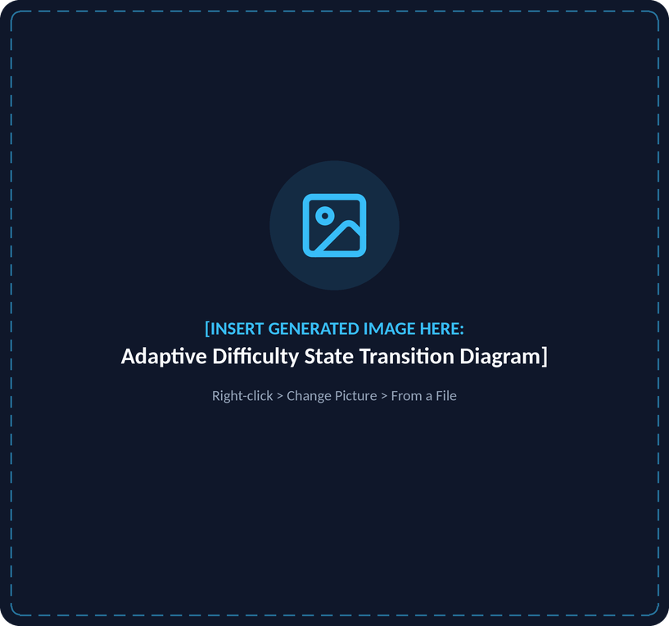




MODULE IMPLEMENTATION · INTELLIGENCE LAYER
</> adaptive_controller.py
Lightweight CAT Dynamic State Machine
LIGHTWEIGHT ADAPTIVE LOGIC
Initialization
Promotion Rule
Candidate begins each skill topic at Medium difficulty.
If candidate achieves 2 consecutive correct answers (streak ≥ 2), promote difficulty:
Level = min(Hard, Level + 1)
Demotion Rule
Stopping Criterion
Upon any incorrect response, immediately drop difficulty:
Evaluates 2 questions per skill area to calibrate demonstrated competence without examinee fatigue.
Level = max(Easy, Level − 1)
SARTA · Module 6: Adaptive Controller
Slide 11 / 22
Notes:
IMAGE PLACEHOLDER: Adaptive Difficulty State Transition Diagram
Replace: right-click the placeholder > Change Picture > From a File. If the new image does not fill the frame, use Picture Format > Crop > Fill.
Placeholder size: 5.45" x 5.10" - generate at square (1024x1024).
ChatGPT / DALL-E prompt:
A futuristic state machine diagram on a dark background. Three glowing horizontal capsules labeled 'EASY' (emerald green), 'MEDIUM' (sky blue, marked with a pulsing 'START' badge), and 'HARD' (violet). Upward glowing neon arrows labeled '+2 Correct Streak' connect Easy to Medium and Medium to Hard. Downward curved amber arrows labeled 'Incorrect Answer' connect Hard to Medium and Medium to Easy. Sleek, clean vector diagram, cybernetic aesthetic.

Slide 12






MODULE IMPLEMENTATION · EXECUTION SANDBOX
</> judge0_client.py
Automated Multi-Language Code Grading
EXECUTION ARCHITECTURE
→
→
Embedded Editor
Payload Transmission
Execution Sandbox
Microsoft Monaco Editor integrated inside the assessment dashboard.
Source code, inputs, and outputs Base64-encoded to preserve formatting and indentation.
Self-hosted Judge0 CE container executing submitted code in isolated environments.
HIDDEN TEST CASE VERIFICATION
Sample Test Cases
Hidden Algorithmic Test Cases
2.0 s
Multi-Language Support
Strict CPU time limit
Visible to examinee for problem clarification and initial debugging.
Evaluates edge cases, boundary inputs, and algorithmic complexity limits.
Python 3
JavaScript (Node.js)
128 MB
Java (OpenJDK)
Strict memory ceiling
C++ (GCC)
SARTA · Module 7: Coding Sandbox
Slide 12 / 22

Slide 13
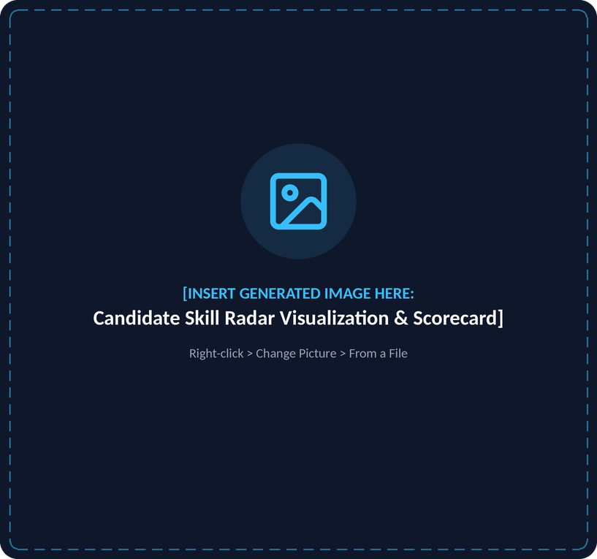




MODULE IMPLEMENTATION · OUTPUT LAYER
</> performance_analytics.py
Multidimensional Performance Analytics & Radar Visualization
COMPOSITE SCORE FORMULA
60%
40%
Adaptive MCQ Performance
Coding Auto-Grading
Granular Competency Breakdown
Individual accuracy meters and peak difficulty passed (Easy, Medium, Hard) for each skill.
Strengths Identification
Proficiencies where accuracy ≥ 66% with Hard difficulty clearance.
Areas for Improvement
Proficiencies where accuracy < 50% or persistent demotions occurred.
SVG Competency Radar
Responsive vector graphic displaying multi-axial candidate proficiency.
SARTA · Module 8: Analytics & XAI
Slide 13 / 22
Notes:
IMAGE PLACEHOLDER: Candidate Skill Radar Visualization & Scorecard
Replace: right-click the placeholder > Change Picture > From a File. If the new image does not fill the frame, use Picture Format > Crop > Fill.
Placeholder size: 5.45" x 5.10" - generate at square (1024x1024).
ChatGPT / DALL-E prompt:
A high-tech holographic UI dashboard widget floating on dark slate. Centered is an illuminated pentagonal radar chart with 5 glowing axes: Python, React, SQL, OOP, Data Structures. An emerald green shaded polygon highlights candidate proficiency. Around the radar are sleek metric badges: 'Composite Score: 82.5%', 'Peak: Hard', and 'Recommendation: Suitable'. Modern glassmorphism UI design, clean typography, 8k render.

Slide 14
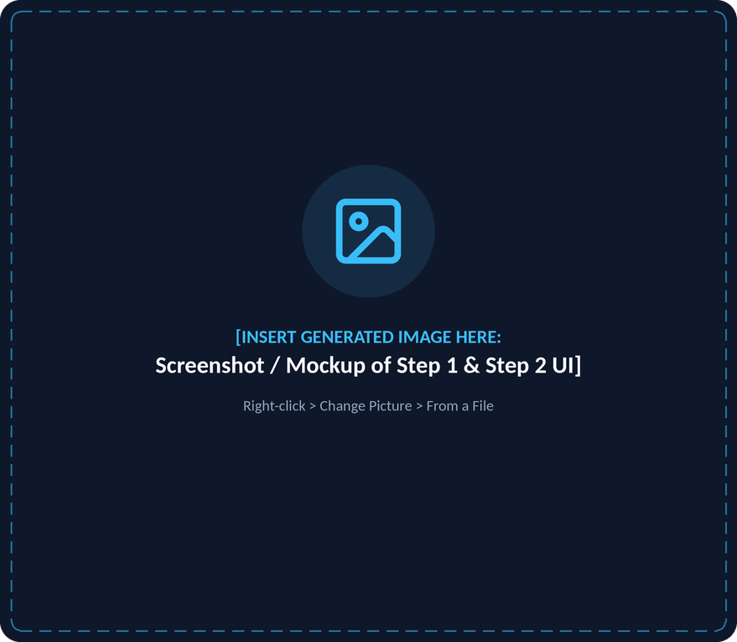


PROTOTYPE WALKTHROUGH · USER INTERFACE
Document Parsing & Semantic Gap Dashboard
USER EXPERIENCE FLOW
STEP 1
Upload Interface
Dual dropzone accepting candidate resume and target job description (.pdf/.docx).
Real-time file validation with instant parse status indicators.
STEP 2
Semantic Compatibility Dashboard
Match Compatibility Gauge: Circular percentage display derived from bipartite matching.
Inferred Role Banner: Displays detected role and recommended assessment targets.
Three-Way Skill Distribution: Visual separation of gaps, matches, and bonus skills.
SARTA · Walkthrough: Screens 1 & 2
Slide 14 / 22
Notes:
IMAGE PLACEHOLDER: Screenshot / Mockup of Step 1 & Step 2 UI
Replace: right-click the placeholder > Change Picture > From a File. If the new image does not fill the frame, use Picture Format > Crop > Fill.
Placeholder size: 5.87" x 5.10" - generate at square (1024x1024).
ChatGPT / DALL-E prompt:
A split-screen view of a web application in dark mode. Top section shows two sleek glassmorphic file upload dropzones labeled 'Candidate Resume' and 'Job Description'. Bottom section shows a detailed dashboard featuring a glowing circular percentage gauge (85% Match), a purple role banner 'Backend Developer (85% Confidence)', and three columns of glowing pill tags: Red 'Skill Gaps', Green 'Verified Matches', and Blue 'Bonus Skills'. High fidelity UI mockup.

Slide 15
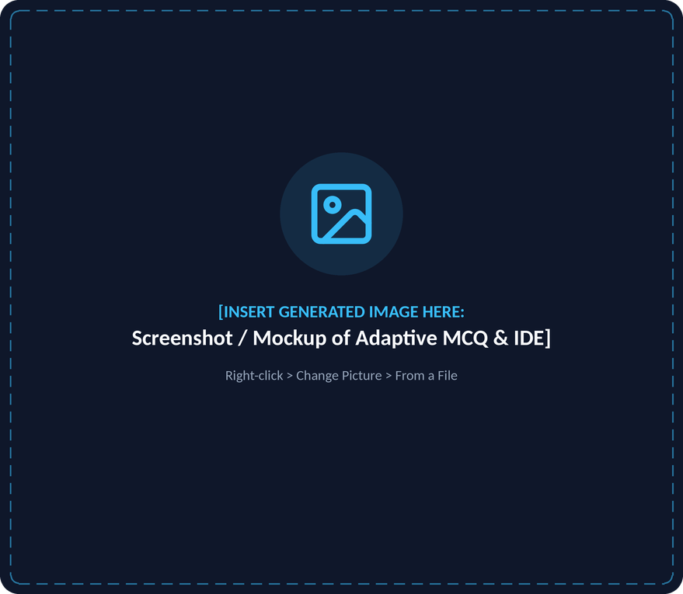

PROTOTYPE WALKTHROUGH · ASSESSMENT
Dynamic Adaptive Testing & Coding Workspace
REAL-TIME ADAPTIVE ASSESSMENT FEATURES
Adaptive MCQ Interface
Dynamic difficulty badge that shifts in real time based on observed response accuracy.
Question progress bar, topic competency indicator, and countdown timer.
Immediate feedback displaying correct answers and updating streak tracking.
Sandboxed Coding IDE
Monaco editor with multi-language syntax highlighting.
Test case verification pane displaying stdout and hidden test results upon submission.
SARTA · Walkthrough: Screen 3
Slide 15 / 22
Notes:
IMAGE PLACEHOLDER: Screenshot / Mockup of Adaptive MCQ & IDE
Replace: right-click the placeholder > Change Picture > From a File. If the new image does not fill the frame, use Picture Format > Crop > Fill.
Placeholder size: 5.87" x 5.10" - generate at square (1024x1024).
ChatGPT / DALL-E prompt:
A split-view UI of a technical assessment interface in dark mode. Left pane shows an MCQ question card with a green difficulty badge 'Adaptive: Hard', a countdown timer '⏱ 42:15', and four selectable options. Right pane shows a Monaco code editor with dark syntax highlighting, a language dropdown selecting 'Python 3', and a console below showing green checkmarks: '✓ Test 1: Passed', '✓ Test 2 (Hidden): Passed'. Sleek, modern developer IDE design.

Slide 16
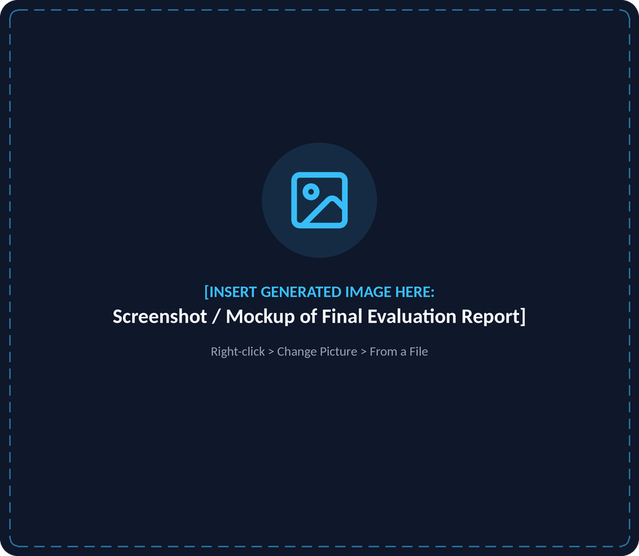


PROTOTYPE WALKTHROUGH · EVALUATION REPORT
The Explainable Candidate Performance Report
EXPLAINABLE CANDIDATE REPORT HIGHLIGHTS
Objective Hiring Verdict
Clear recommendation badge (Suitable, Needs Improvement, Not Suitable).
Score Decomposition
Explicit breakdown between Adaptive MCQ Accuracy and Coding Auto-Grading.
Multi-Axial Radar Visualization
Demonstrates candidate balance across core topics.
Granular Competency Breakdown
Individual accuracy meters and peak difficulty passed for every skill.
Targeted Action Items
Identifies specific learning gaps for recruiters and candidates.
SARTA · Walkthrough: Screen 4
Slide 16 / 22
Notes:
IMAGE PLACEHOLDER: Screenshot / Mockup of Final Evaluation Report
Replace: right-click the placeholder > Change Picture > From a File. If the new image does not fill the frame, use Picture Format > Crop > Fill.
Placeholder size: 5.87" x 5.10" - generate at square (1024x1024).
ChatGPT / DALL-E prompt:
A comprehensive candidate evaluation report screen in dark mode. At the top, a prominent green badge reads 'RECOMMENDATION: SUITABLE' alongside a circular gauge showing '82.5% Composite Score'. Below, a 5-axis competency radar chart sits next to individual skill progress bars labeled Python (100%, Peak: Hard), SQL (50%, Peak: Medium), and React (100%, Peak: Hard). Two bottom cards highlight 'Strengths' in green and 'Areas for Improvement' in red. Clean executive dashboard.

Slide 17


EMPIRICAL EVALUATION · RESULTS
Skill Extraction Quality Benchmarked Against Ground Truth
Evaluation Methodology Validated against manually annotated sample resumes and job specifications across Web Development, Backend Systems, and Data Science.
Dataset Profile | Extracted Count | Ground Truth Count | Precision | Recall | F1-Score
Sample 1 (Backend Systems) | 6 | 6 | 1.00 (100.0%) | 1.00 (100.0%) | 1.00 (100.0%)
Sample 2 (Frontend Architecture) | 7 | 7 | 0.86 (85.7%) | 0.86 (85.7%) | 0.86 (85.7%)
Sample 3 (Data Science & ML) | 6 | 6 | 1.00 (100.0%) | 1.00 (100.0%) | 1.00 (100.0%)
Overall Micro-Average | 19 | 19 | 94.74% | 94.74% | 94.74%
94.74%
Benchmark Insights
The two-pass architecture (spaCy PhraseMatcher + SBERT dense embedding alignment) virtually eliminates false positive hallucinations while capturing multi-word technical tokens.
Micro-averaged F1-score
SARTA · Empirical Results
Slide 17 / 22

Slide 18

EMPIRICAL EVALUATION · RESULTS
Adaptive CAT Efficiency vs Static Quiz Baseline
Experimental Setup Simulated candidate response trajectories across Junior (Easy ability), Mid-level (Medium ability), and Senior (Hard ability) competence levels.
Candidate Ability Profile | Target True Difficulty | Adaptive Questions to Stabilize | Static Baseline Questions | Question Reduction %
Senior Candidate Profile | Hard | 10 questions | 10 questions | 0.0% (Explored Ceiling)
Mid-Level Candidate Profile | Medium | 9 questions | 10 questions | 10.0% Reduction
Junior Candidate Profile | Easy | 4 questions | 10 questions | 60.0% Reduction
Empirical Mean Summary | Overall Calibration | 7.7 questions | 10.0 questions | 23.3% Overall Reduction
23.3%
KEY TAKEAWAY
The streak-based adaptive engine converges on true candidate ability 23.3% faster than fixed-length quizzes, minimizing candidate fatigue and testing time.
SARTA · Empirical Results
Slide 18 / 22

Slide 19


EMPIRICAL EVALUATION · RESULTS
Sandboxed Auto-Grading & Test-Case Verification
Experimental Setup Evaluated 5 benchmark code submissions (correct implementations, logic errors, syntax errors) against verified ground-truth answer keys.
Evaluation Metric | Tested Benchmark Target | Observed Result | Agreement / Accuracy
Test-Case Pass/Fail Agreement | 5 Verification Submissions | 5 / 5 Correct Classifications | 100.0% Accuracy
Syntax / Runtime Error Trapping | 2 Malformed Submissions | 2 / 2 Clean Error Catches | 100.0% Reliability
Execution Sandbox Latency | Time to Result | 0.042 seconds average | Real-Time Response
Memory Ceiling Enforcement | 128MB Buffer | 8,420 KB average consumption | Zero Host Leakage
KEY OBSERVATIONS
Sandbox accurately differentiated between semantic logic errors and runtime exceptions.
Zero host environment leakage or unhandled execution timeouts.
SARTA · Empirical Results
Slide 19 / 22

Slide 20

EMPIRICAL EVALUATION · RESULTS
User Study Survey Metrics (Candidate & Peer Feedback)
Survey Methodology Structured survey administered to volunteer candidates and peer evaluators using a standard 1 to 5 Likert scale.
1
2
3
4
5
Survey Evaluation Dimension | Mean Score (1–5 Scale) | Approval % | Key Participant Observation
Clarity of Skill-Wise Breakdown (XAI) | 4.7 / 5.0 | 94.0% | Provided actionable learning feedback over generic rejection notices.
Relevance of Inferred Role Profile | 4.5 / 5.0 | 90.0% | Accurately captured full-stack and specialized skill clusters.
Perceived Fairness of Adaptive Difficulty | 4.6 / 5.0 | 92.0% | Questions felt calibrated to personal competence.
Recruitment Decision Utility for Evaluators | 4.8 / 5.0 | 96.0% | Addressed the blind spot of verifying missing resume skills.
Composite User Satisfaction Index | 4.65 / 5.0 | 93.0% | Strong validation of end-to-end usability and transparency.
SARTA · Empirical Results
Slide 20 / 22

Slide 21
DISCUSSION · COMPARATIVE ANALYSIS
SARTA Feature Comparison Matrix
Capability | Traditional ATS | Coding Platforms | Static Quiz Systems | SARTA (This Work)
Semantic Skill Extraction | ✕ No Exact keyword search | ✕ No None | ✕ No None | ✓ Yes spaCy NER + SBERT vectors
JD-Aware Gap Analysis | ✕ No Evaluates resumes in isolation | ✕ No Fixed problem sets | ✕ No Generic quizzes | ✓ Yes Hungarian bipartite matching
Dynamic Adaptive Difficulty | ✕ No None | ✕ No Fixed item difficulty | ✕ No Static order | ✓ Yes Lightweight CAT controller
Sandboxed Code Assessment | ✕ No No coding environment | ✓ Yes Proprietary sandbox | ✕ No None | ✓ Yes Judge0 CE open-source
Explainable Reporting (XAI) | ✕ No Opaque binary filtering | ◐ Partial Test counts only | ✕ No Single aggregate % | ✓ Yes Multi-axial breakdown & radar
Open-Source & Zero Cost | ✕ No Costly enterprise license | ✕ No Paywalled subscription | ◐ Varies Basic tiers only | ✓ Yes 100% free and open-source
SARTA · Comparative Analysis
Slide 21 / 22

Slide 22
CONCLUSION · REFERENCES
Summary of Deliverables & References
SUMMARY OF ACCOMPLISHMENTS
IEEE REFERENCES (2024–2026)
94.74%
23.3%
[1] M.-H. Ajjam and H. Al-Raweshidy, “AI-Driven Semantic Similarity-Based Job Matching Framework for Recruitment Systems,” Information Sciences, vol. 724, p. 121890, 2025.
[2] J. Rosenberger et al., “CareerBERT: Matching Resumes to ESCO Jobs in a Shared Embedding Space,” arXiv preprint arXiv:2503.02056, 2025.
[3] X. Yu, J. Zhang, and Z. Yu, “ConFit: Improving Resume-Job Matching using Data Augmentation and Contrastive Learning,” in Proc. AAAI Conf. Human Computation and Crowdsourcing, arXiv:2401.16349, 2024.
[4] S. Modak et al., “A Review of Resume Analysis and Job Description Matching Using Machine Learning,” International Journal of Recent Technology and Engineering (IJRITCC), vol. 12, no. 5, pp. 112–126, 2024.
[5] N. Reimers and I. Gurevych, “Sentence-BERT: Sentence Embeddings using Siamese BERT-Networks,” in Proc. EMNLP-IJCNLP, 2019, pp. 3982–3992.
[6] A. Barredo Arrieta et al., “Explainable Artificial Intelligence (XAI): Concepts, taxonomies, opportunities and challenges toward responsible AI,” Information Fusion, vol. 58, pp. 82–115, 2020.
Skill extraction F1-score
Efficiency gain vs static test
Delivered a fully functional, end-to-end prototype of SARTA with 0 architectural gaps.
Demonstrated 94.74% skill extraction F1-score and 23.3% assessment efficiency gain over static testing.
Unified semantic resume analysis, adaptive item calibration, and sandboxed coding into a single open-source platform.
SARTA · Jamia Millia Islamia
Slide 22 / 22
Notes:
Close with the three deliverables and invite questions. References follow IEEE style; [5] and [6] are foundational works cited for SBERT and XAI.

