Slide 1
.NET CORE & VISUAL STUDIO CODE ON LINUX (UBUNTU)
Adrian Gabor http://adriangabor.com https://github.com/adyle5
Yes! You can develop ASP.NET websites on Linux and deploy them to the cloud.
Notes:
Hello, my name is Adrian Gabor.
I am a Lead Software developer for a company headquartered in Detroit, Michigan.
I am literally the least interesting thing in this presentation, so let’s get started.
Quick question, how many of you are coming from Linux and are just interesting in .Net.

Slide 2
Why Open Source?
Cheaper - Lower barriers to entry
Safer
Better – flexibility & freedom
By developers & for developers
Give back to the community
Notes:
1. If you are starting a new business you can get up and running quickly and inexpensively using open source software.
2. lots of eyeballs looking at the code and patches released quicker.

Slide 3
Why Linux?
Free
Less resource intensive
More control
Step out of comfort zone.
However, if you want to develop XAML desktop apps or use SSIS, SSRS, WF, or other MS specific technologies, still better to use Windows.
View this as a supplement, not a replacement.
Notes:
A great choice for senior citizen computers.

Slide 4
Setup
.NET is supported on many flavors of Linux – both Debian and Fedora based
.NET is also supported on Mac
We are using Ubuntu
  Most popular desktop Linux distro
  Some relationship between Microsoft and Canonical (Bash support)
  Technology evolving. I recommend a VM.
    VMWare
Notes:
.Net is not truly cross platform.
On March 7th they release Visual Studio 2017 and the first full release (non-RC) version of .net core, which is very exciting.
.Net has evolved so much that just in the past couple of weeks I’ve had to update this presentation several times.

Slide 5
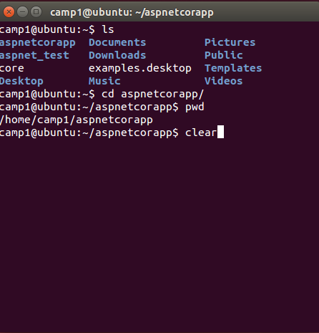
Getting Started
We will be doing most our work in BASH – Bourne Again Shell AKA the Terminal
The Terminal
Commands
  sudo
  ls/cd
  pwd
  clear

Slide 6
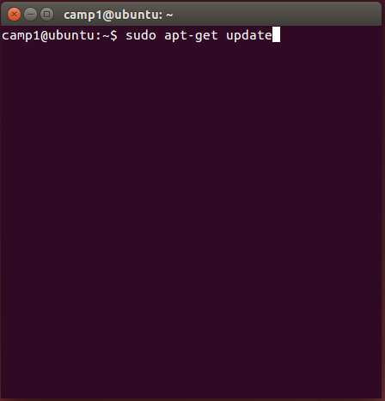
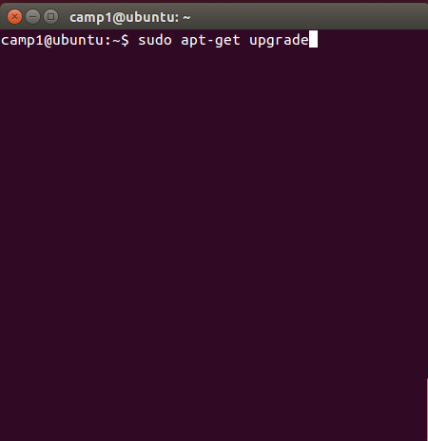
Getting Started
Update Apt Repo
Upgrade Package
Notes:
Apt – advanced package tool is the application repository for debian based distros, of which ubuntu is one.
Here is where you will get most of your packages from. Pretty much, if you get packages from apt maintained by canonical, you can be sure that it’s safe.
These are the 2 most important commands.

Slide 7

Getting Started
Update Apt Repo
Upgrade Package

Slide 8
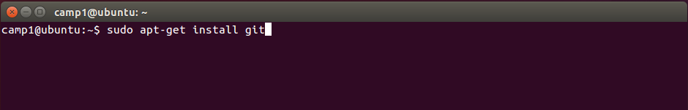
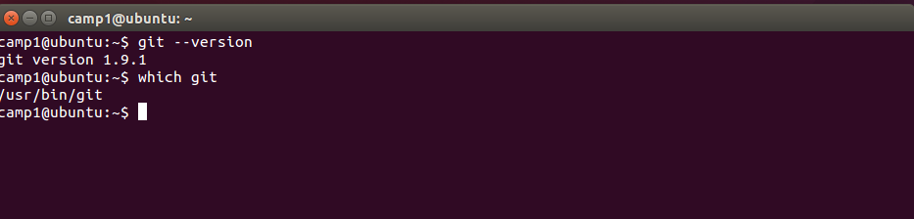
Step 1 – Install git

Slide 9
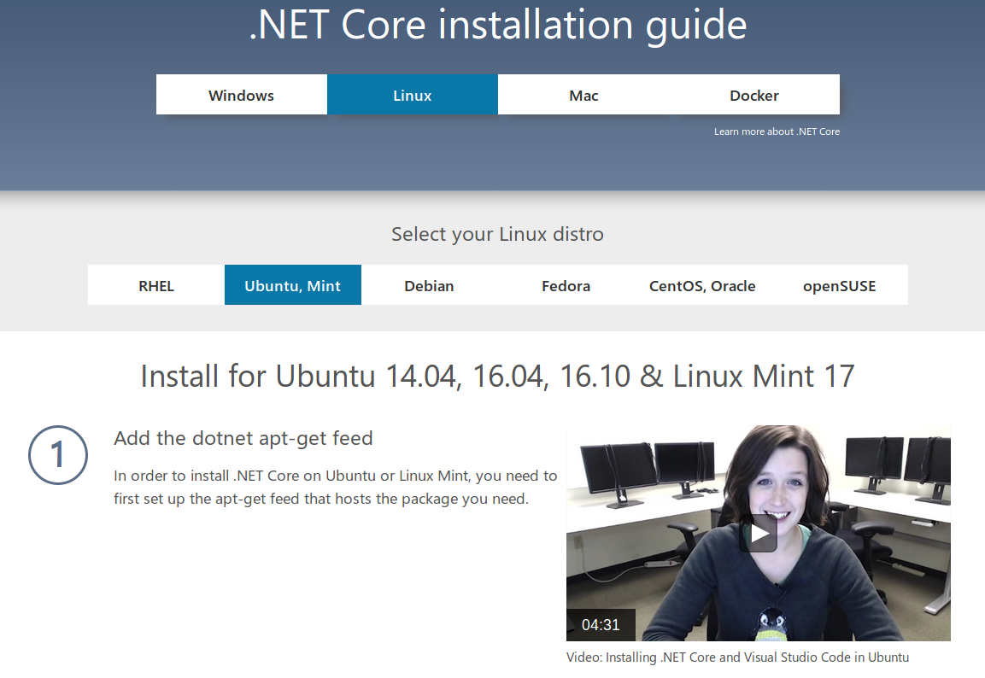
Step 2 – Install .NET CORE 1.X
https://www.microsoft.com/net/core#linuxubuntu

Slide 10
Step 2 – Install .NET CORE 1.X
$ sudo sh -c 'echo "deb [arch=amd64] https://apt-mo.trafficmanager.net/repos/
dotnet-release/ xenial main" > /etc/apt/sources.list.d/dotnetdev.list'
$ sudo apt-key adv --keyserver hkp://keyserver.ubuntu.com:80 --recv-keys 417A0893
$ sudo apt-get update
$ sudo apt-get install dotnet-dev-1.0.1

Slide 11
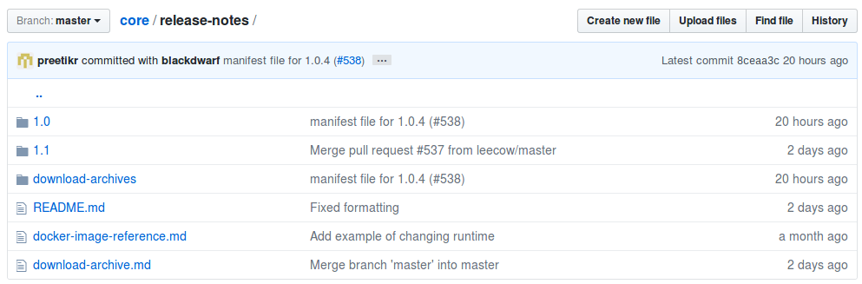
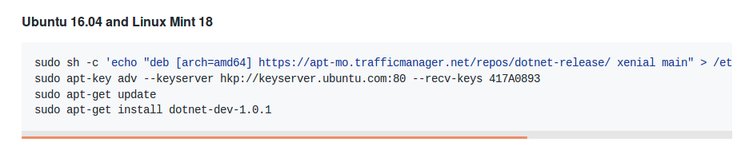
Github Releases
https://github.com/dotnet/core/tree/master/release-notes

Slide 12
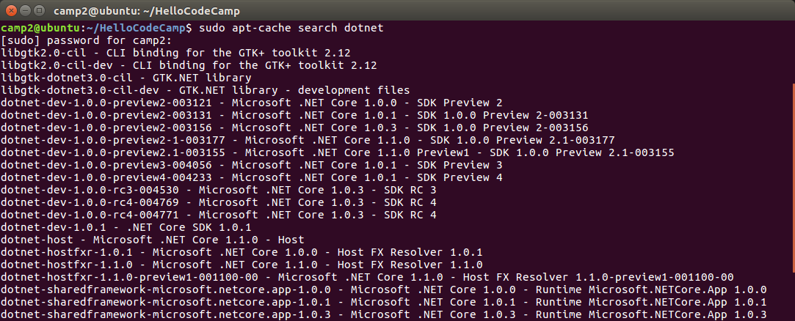
Step 2 - Install .NET Core 1.X
Search the Apt repository for the latest version of the .NET SDK

Slide 13

Step 3 – Create a Hello World App
# Create a directory in home
$ mkdir HelloWorldApp
$ cd HelloWorldApp
$ dotnet new console
Created new C# project in /home/camp1/HelloWorldApp.
$ ls
$ Program.cs HelloWorldApp.csproj
$ sudo nano Program.cs

Slide 14
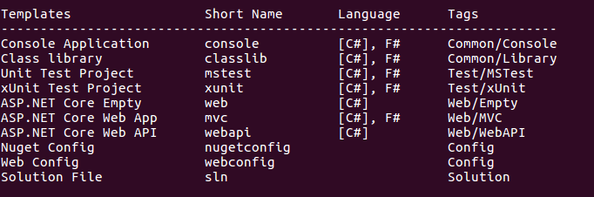
Step 4 – Run the App
$ dotnet restore # restores the packages in project.json
$ dotnet run # runs the app
Hello World!
$ dotnet help # dotnet documentation
$ dotnet new -all # lists all available templates

Slide 15
ASP.NET Application
https://docs.microsoft.com/en-us/aspnet/core/getting-started
$ mkdir HelloAspNet
$ cd HelloAspNet
$ dotnet new mvc
Content generation time 726.3014 ms
The template “MVC ASP.NET Core Web Application” created successfully.
$ dotnet restore
$dotnet run
…
…
Now listening on: http://localhost:5000
Application started. Press Ctrl+C to shut down.

Slide 16
Moving Beyond dotnet new
What if you wanted to move beyond the basic scaffolding provided by MS/dotnet new?
  OmniSharp
  Github
We need to install NVM/Node/NPM
  Node Version Manager (like RVM)
  Node (JS on the server)
  Node Package Manager (like gems, nuget, apt)

Slide 17
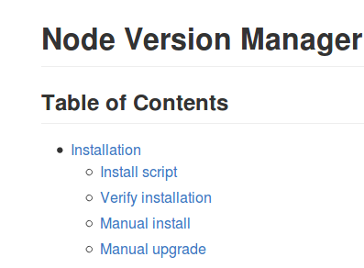
Install NVM ~ Node ~ NPM
$ sudo apt-get update # if you haven’t already
$ sudo apt-get install build-essential libssl-dev curl
Go to: https://github.com/creationix/nvm
Scroll down and click on Install script
Copy the CURL command and paste Into the Terminal.
Restart the Terminal:
To install node & npm we can now use nvm:
$ curl -o- https://raw.githubusercontent.com/creationix/nvm/v0.33.0/install.sh | bash
# close and reopen the terminal
$ command -v nvm
nvm
$ nvm install stable

Slide 18
Install Yoeman and Bower
Yoeman: Scaffolding for the Web
  Like VS File>New>Project
Bower
  The Package Manager for the Web
Install Yoeman, Bower, and OmniSharp
  OmniSharp automatically bundled in VS Code
$ npm install -g yo
$ npm install -g bower
$ npm install -g generator-aspnet # This is OmniSharp Templates

Slide 19
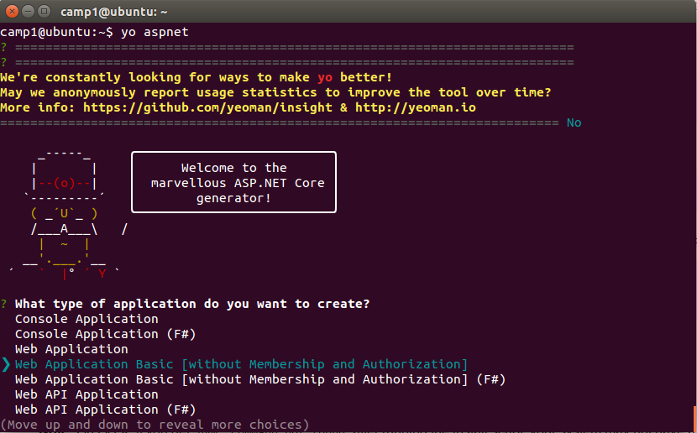
Create an ASP.NET site with yo

Slide 20
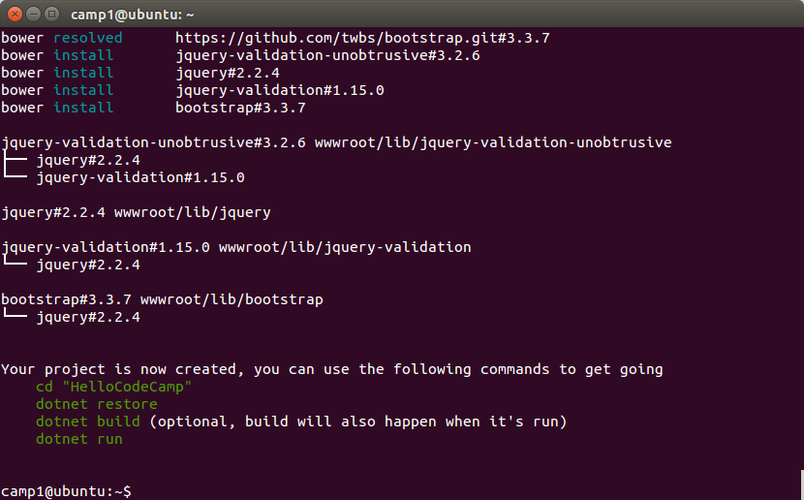
Create an ASP.NET site with yo

Slide 21
Create a new asp.net site with git
You can also pull down a template from git and use that as a starting point.
$ git clone https://github.com/adyle5/code_camp_template.git/
$ cd code_camp_template
$ dotnet restore
$dotnet run
…
...
Now listening on: http://localhost:5000
Application started. Press Ctrl+C to shut down.

Slide 22
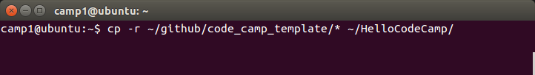
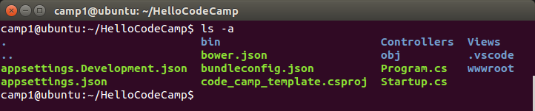
Copy Files to New folder
cd into the new folder and look at the files.
It shouldn’t have copied the hidden .git folder, but if it did,
run $ rm -rf .git to remove it.

Slide 23
Visual Studio Code
Visual Studio Code is a code editor (on steroids)
  Half way between a full IDE like VS or Netbeans and a text editor like textmate or Sublime Text
  Very similar to Atom (Github)
  Supports intellisense
  Built in Git
  VS Style debugging
  Very extensible
  No Resharper
Cross Platform
Not just for .NET

Slide 24
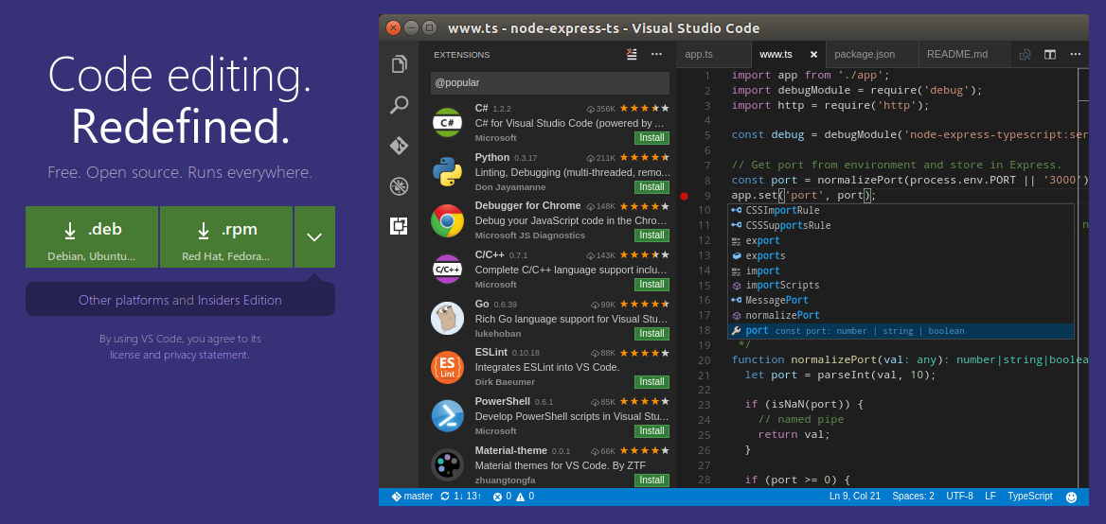
Installing Visual Studio Code
Go to https://code.visualstudio.com/ and download the .deb file.

Slide 25
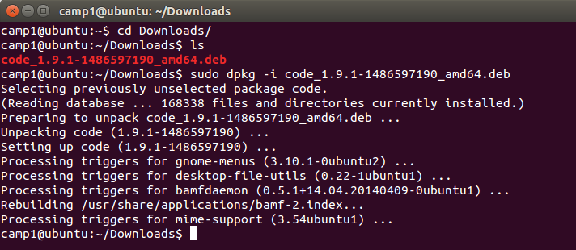
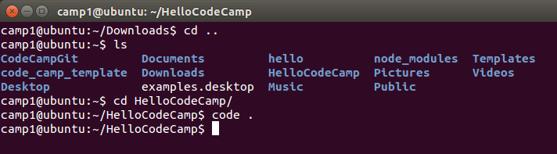
Installing Visual Studio Code

Slide 26
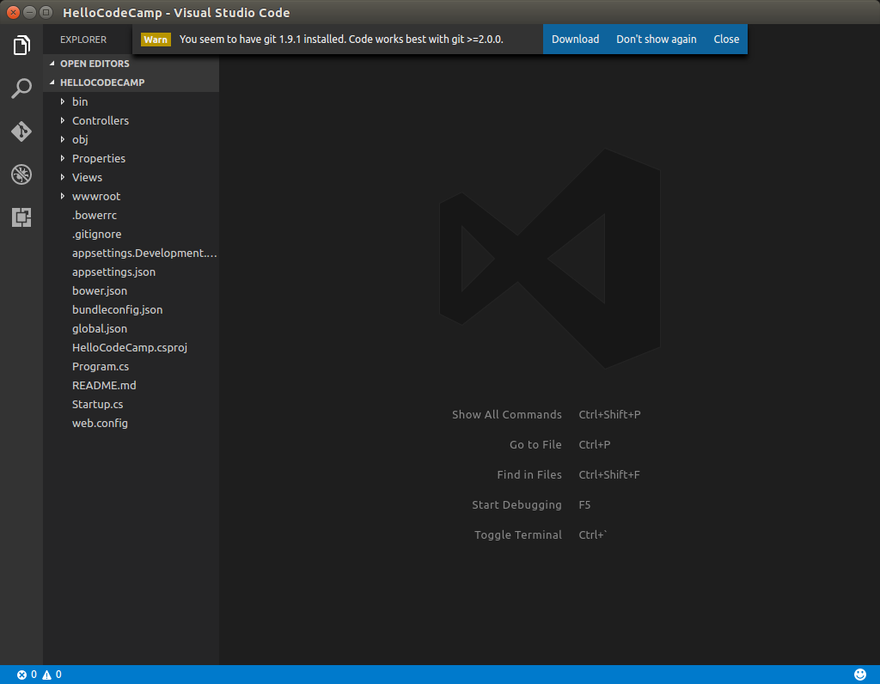
The Visual Studio Code IDE

Slide 27

The View Bar
Display and hide files & folders
Search for text in files, like VS
Built in Git support
Debugging support (not just .NET)
Install and manage extensions

Slide 28
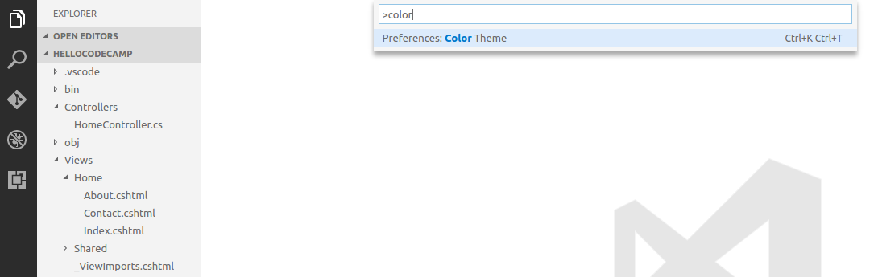
Command Palette (ctrl+shift+p)
Run command commands and commonly used tasks from within VS Code.
Shift + ctrl + p
Type color and then click preferences: Color Theme.

Slide 29
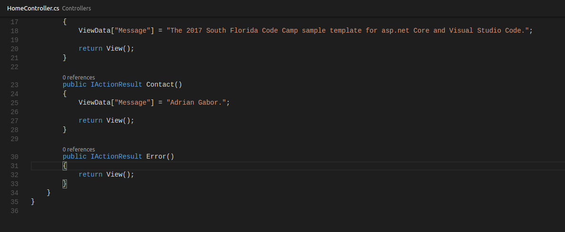
Zen Mode
Hide everything except the code editor
Ctrl + K, Z - Double click esc to exit.

Slide 30
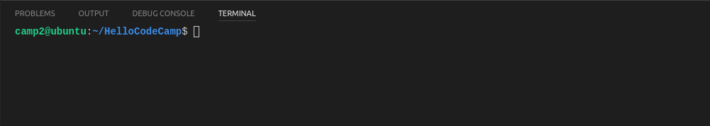
The Panels
Output is similar to Visual Studio’s output window.
Terminal support built into Code makes much better work flow!

Slide 31
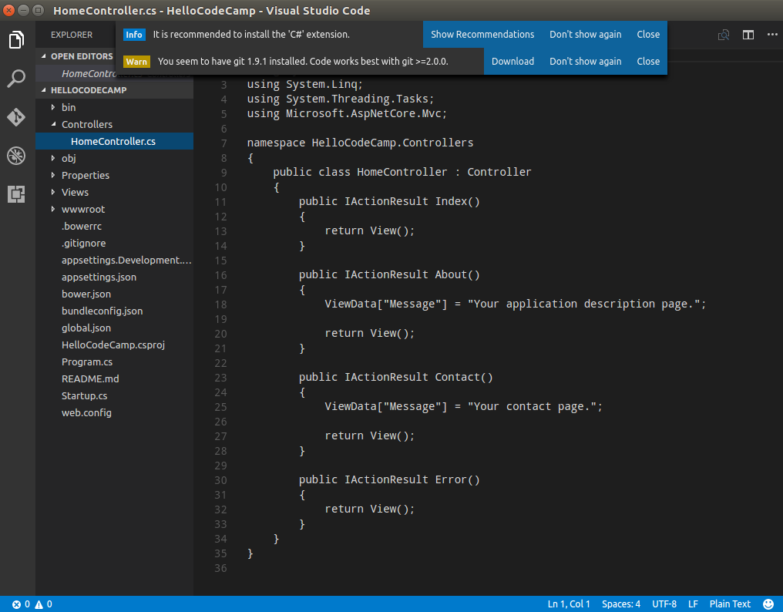
Install the C# Extension
Expand Controllers
And click on
HomeController.cs
You will be prompted
To install the C#
Extension for VS Code.
C# language support
Does not come
Installed by default.
Click Recommendation
And then Install.

Slide 32
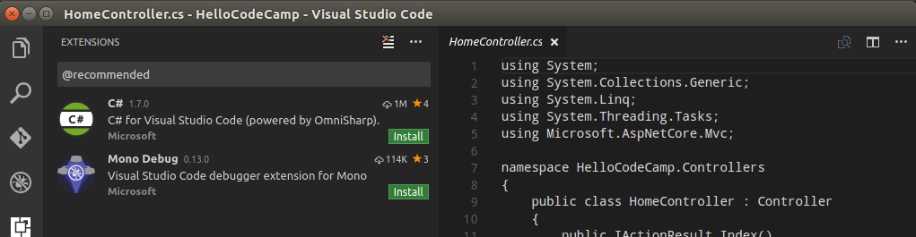
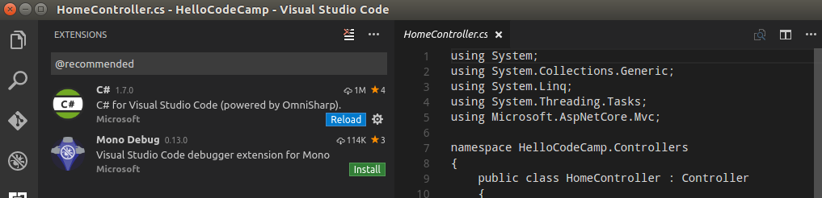
Install the C# Extension

Slide 33
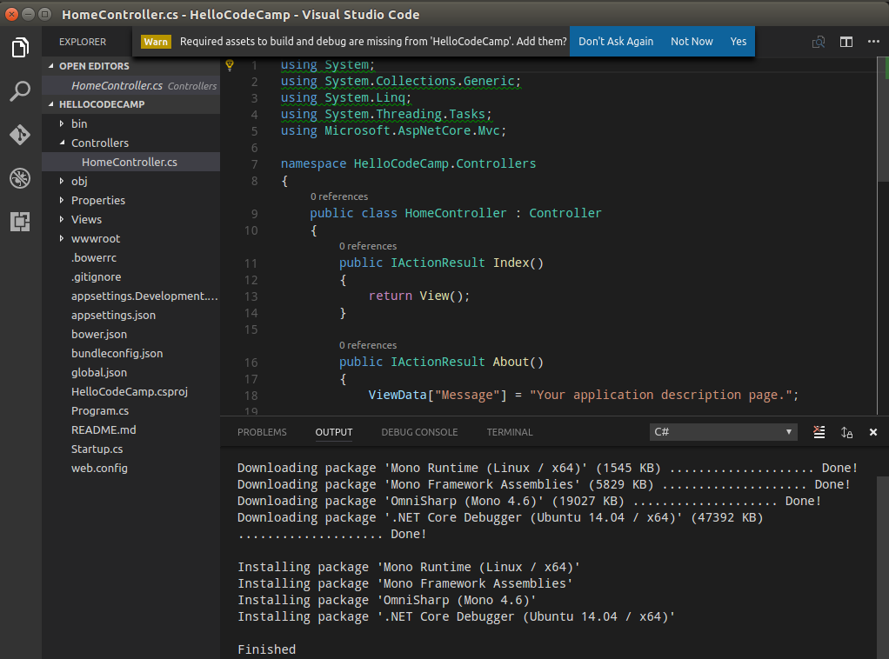
Install the C# Extension
Install
Required assets.

Slide 34
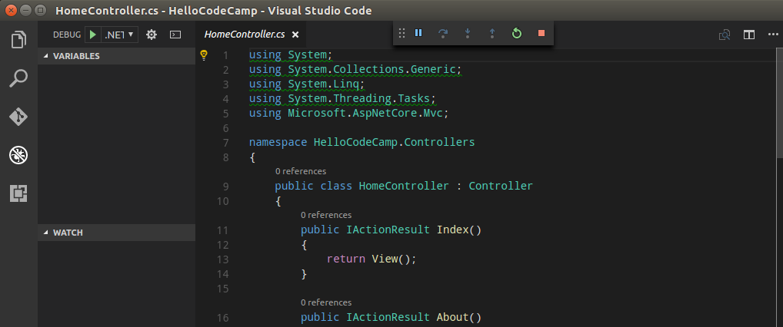
Running the Website
Click the debug tab, and then the green arrow on the upper left. This will launch
The browser.

Slide 35
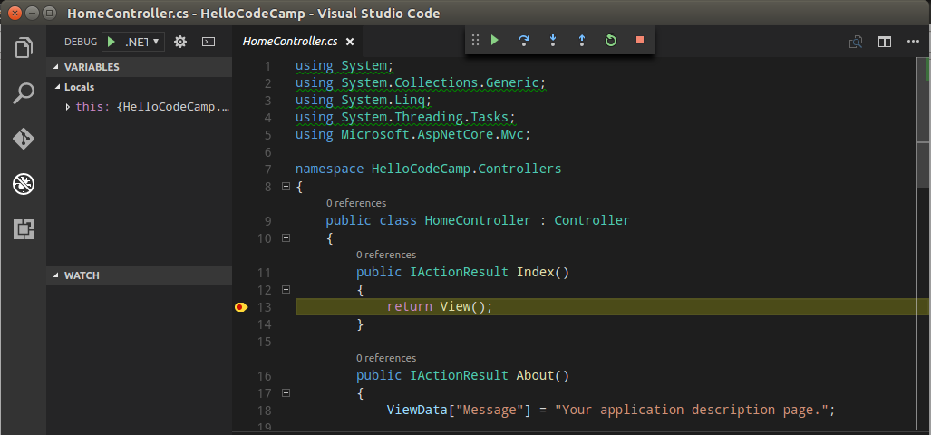
Debugging
Put a breakpoint in the Index method of the HomeController and then run.

Slide 36
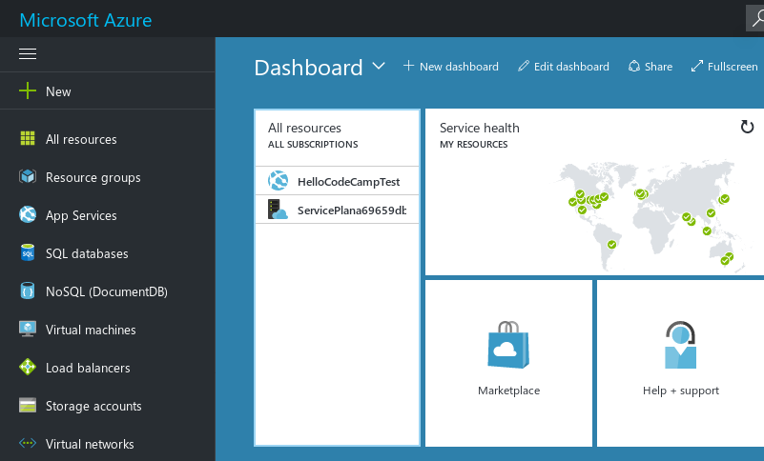
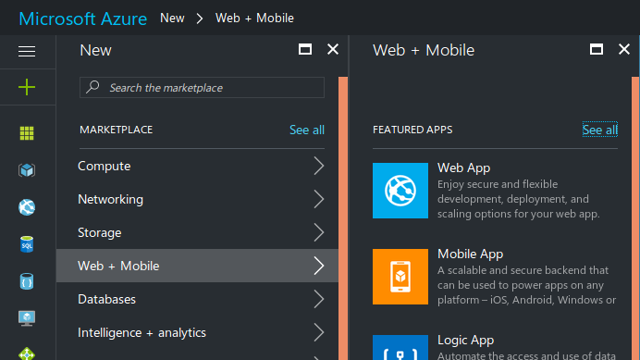
Moving code to the cloud
You can push your ASP.NET application from Code directly to Azure using Git
  Create a new Azure website
  Setup Azure to deploy via Git

Slide 37
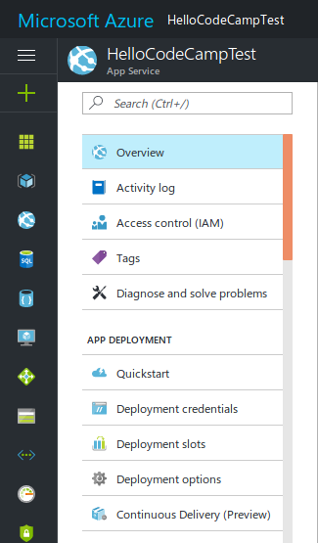
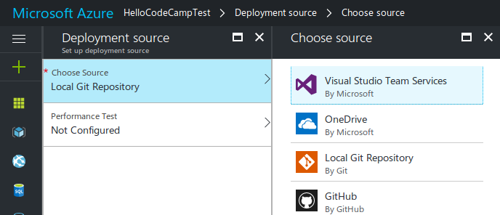
Moving code to the cloud
When the app is created on Azure, it is setup to deploy via FTP. We need to change the the deployment settings to deploy from a local git repository.

Slide 38
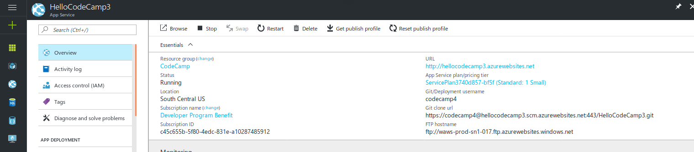
Moving code to the cloud
It will generate a URL for a Git remote source. You will need to copy that value.

Slide 39
Add Deployment Creds
Add credentials specific to this deployment.
When you add the origin, make sure to add the
correct credentials

Slide 40
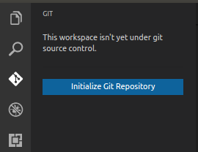
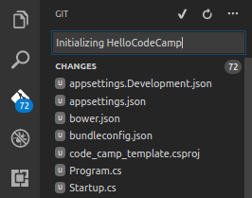
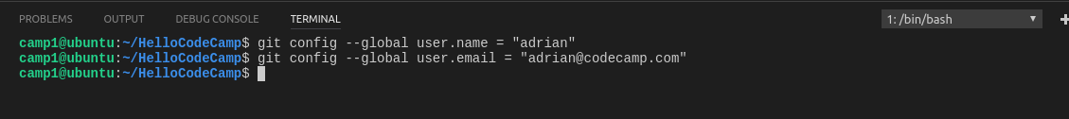
Moving code to the cloud
Now setup Git locally.
  Click the “Initialize Git Repository” button.
Enter a message and then click the check mark
  You can see the Git folder by typing ls -a in the terminal.

Slide 41
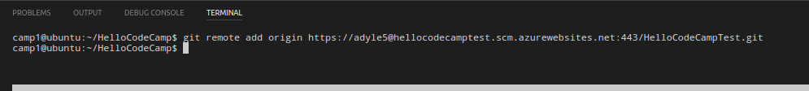
Moving code to the cloud
Add the remote origin (to Azure)
  Use the URL we generated from Azure
Push the code to Azure

Slide 42
