Slide 1
.NET CORE & VISUAL STUDIO CODE ON LINUX (UBUNTU) Adrian Gabor http://adriangabor.com https://github.com/adyle5
Yes! You can develop ASP.NET websites on Linux and deploy them to the cloud.

Slide 2
Why Open Source?
Cheaper - Lower barriers to entry
Safer
Better – flexibility & freedom
By developers & for developers
Give back to the community

Slide 3
Why Linux?
Free
Less resource intensive
More control
Step out of comfort zone. Polyglot. Tunnel vision.
However, if you want to develop XAML desktop apps or use SSIS, SSRS, WF, or other MS specific technologies, still better to use Windows.
View this as a supplement, not a replacement.

Slide 4
Setup
.NET is supported on many flavors of Linux – both Debian and Fedora based
.NET is also supported on Mac
We are using Ubuntu
Most popular desktop Linux distro
Some relationship between Microsoft and Canonical (Bash support)
Technology evolving. I recommend a VM.
VMWare

Slide 5
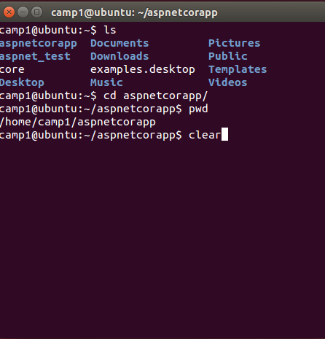
Getting Started
We will be doing most our work in BASH – Bourne Again Shell AKA the Terminal
The Terminal
Commands
sudo
ls/cd
pwd
clear

Slide 6
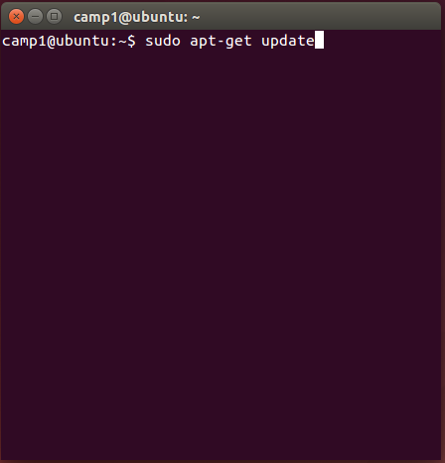
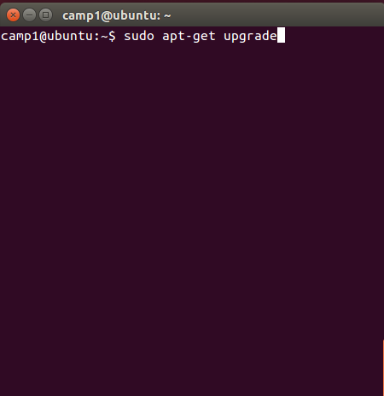
Getting Started
Update Apt Repo
Upgrade Package

Slide 7

Getting Started
Update Apt Repo
Upgrade Package

Slide 8
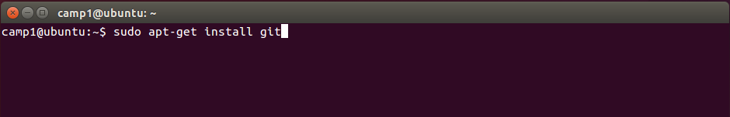
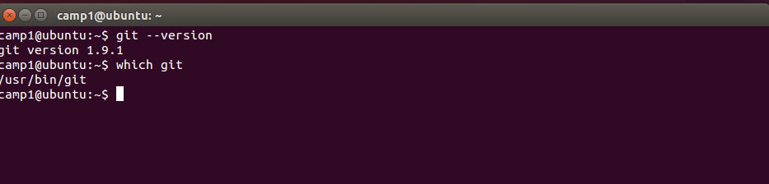
Step 1 – Install git

Slide 9
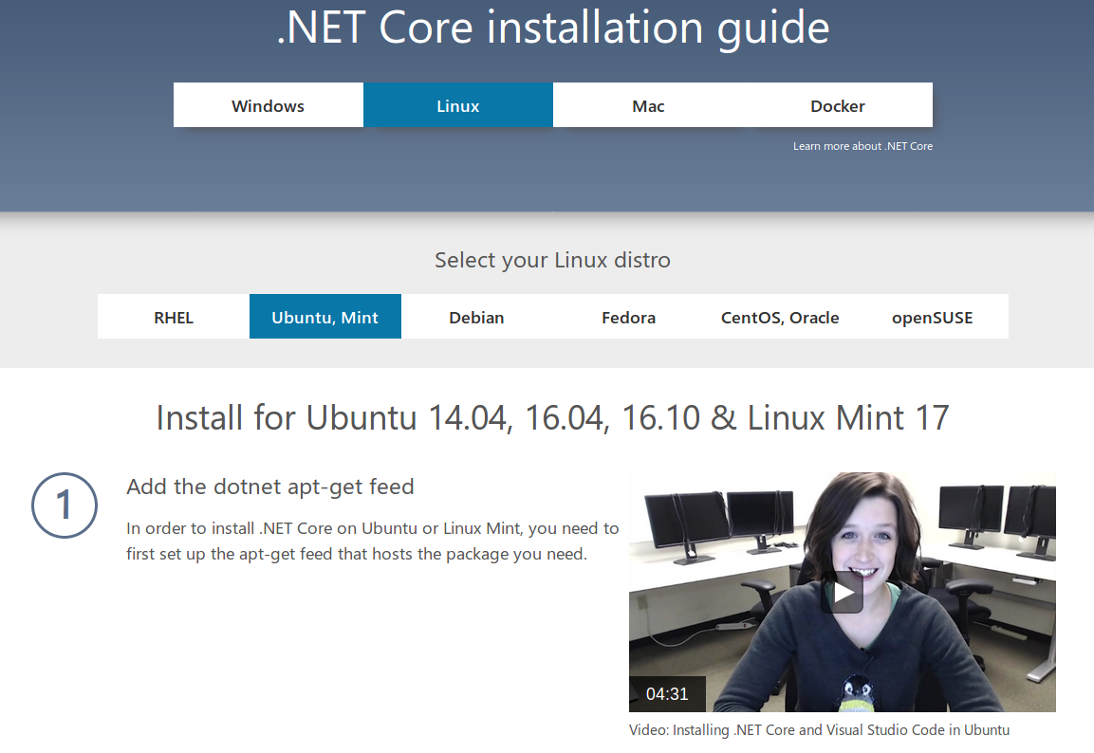
Step 2 – Install .NET CORE 1.X
https://www.microsoft.com/net/core#linuxubuntu

Slide 10
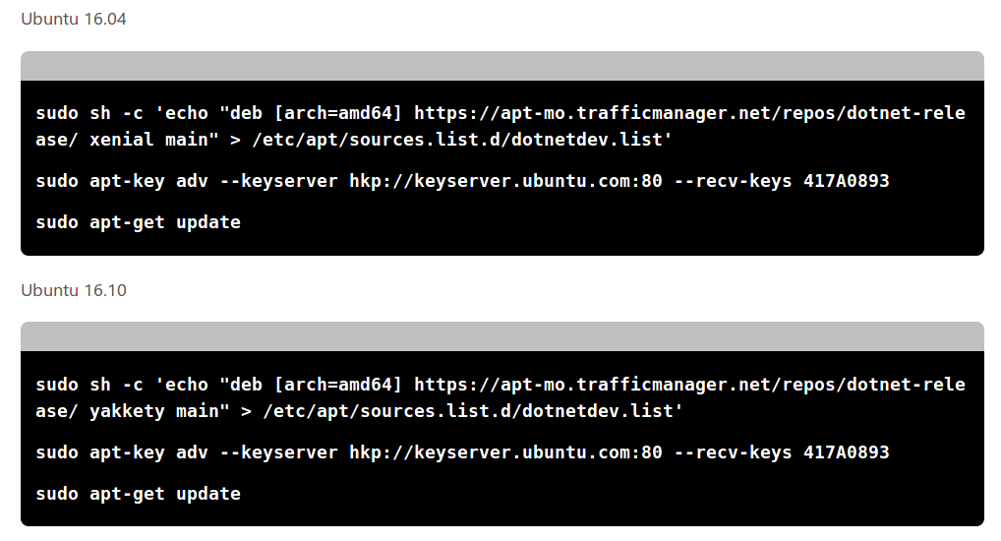
Step 2 – Install .NET CORE 1.X

Slide 11
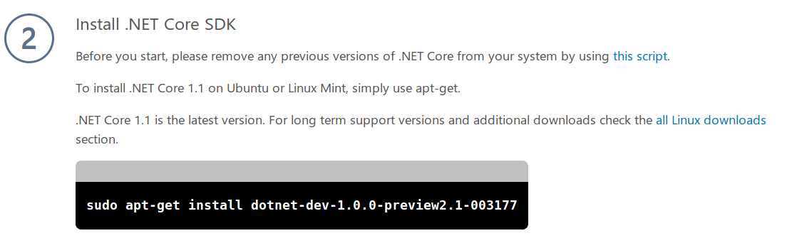
Step 2 – Install .NET CORE 1.X
The one they want you to install is the “stable” version, but it lacks many features that are being adapted going forward, such as support for MSBuild and csproj files.
Skip this part

Slide 12
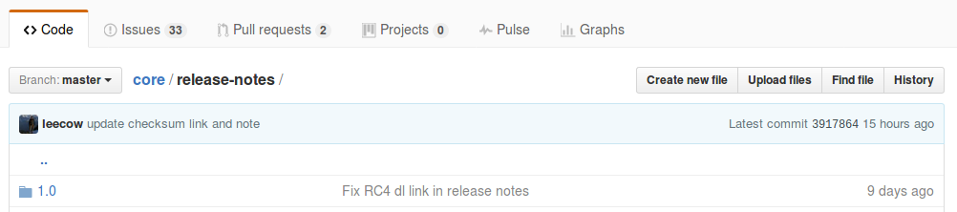

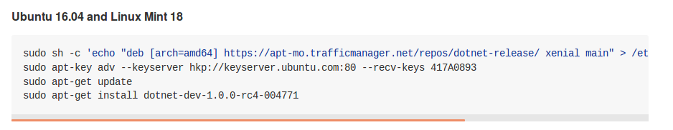
The Secret Stash
https://github.com/dotnet/core/tree/master/release-notes

Slide 13
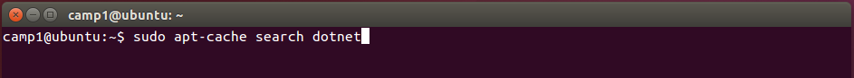
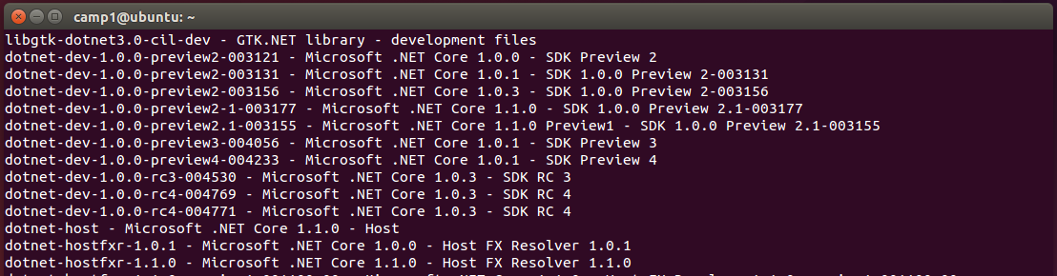
Step 2 - Install .NET Core 1.X
Search the Apt repository for the latest version of the .NET SDK
***https://github.com/dotnet/core

Slide 14

Step 3 – Create a Hello World App
# Create a directory in home
$ mkdir HelloWorldApp
$ cd HelloWorldApp
$ dotnet new
Created new C# project in /home/camp1/HelloWorldApp.
$ ls
$ Program.cs HelloWorldApp.csproj
$ sudo nano Program.cs

Slide 15
Step 4 – Run the App
$ dotnet restore # restores the packages in project.json
$ dotnet run # runs the app
Hello World!
$ dotnet help # dotnet documentation
$ dotnet new mvc # creates a mvc application
# console
# classlib
# mstest
# xunit
# web
# mvc
# webapi
# sln

Slide 16
ASP.NET Application
https://docs.microsoft.com/en-us/aspnet/core/getting-started
$ mkdir HelloAspNet
$ cd HelloAspNet
$ dotnet new mvc
Content generation time 726.3014 ms
The template “MVC ASP.NET Core Web Application” created successfully.
$ dotnet restore
$dotnet run
…
…
Now listening on: http://localhost:5000
Application started. Press Ctrl+C to shut down.

Slide 17
Moving Beyond dotnet new
What if you wanted to move beyond the basic scaffolding provided by MS/dotnet new?
OmniSharp
Github
We need to install NVM/Node/NPM
Node Version Manager (like RVM)
Node (JS on the server)
Node Package Manager (like gems, nuget, apt)

Slide 18
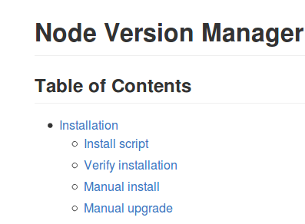
Install NVM ~ Node ~ NPM
$ sudo apt-get update # if you haven’t already
$ sudo apt-get install build-essential libssl-dev curl
Go to: https://github.com/creationix/nvm
Scroll down and click on Install script
Copy the CURL command and paste Into the Terminal.
Restart the Terminal:
To install node & npm we can now use nvm:
$ curl -o- https://raw.githubusercontent.com/creationix/nvm/v0.33.0/install.sh | bash
# close and reopen the terminal
$ command -v nvm
nvm
$ nvm install stable

Slide 19
Install Yoeman and Bower
Yoeman: Scaffolding for the Web
Like VS File>New>Project
Bower
The Package Manager for the Web
Install Yoeman, Bower, and OmniSharp
OmniSharp automatically bundled in VS Code
$ npm install -g yo
$ npm install -g bower
$ npm install generator-aspnet # This is OmniSharp Templates

Slide 20
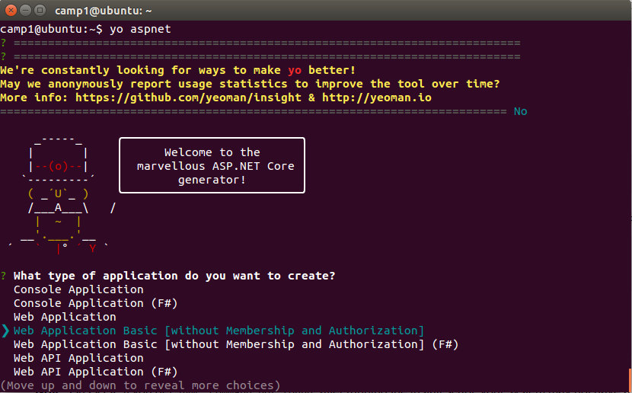
Create an ASP.NET site with yo

Slide 21
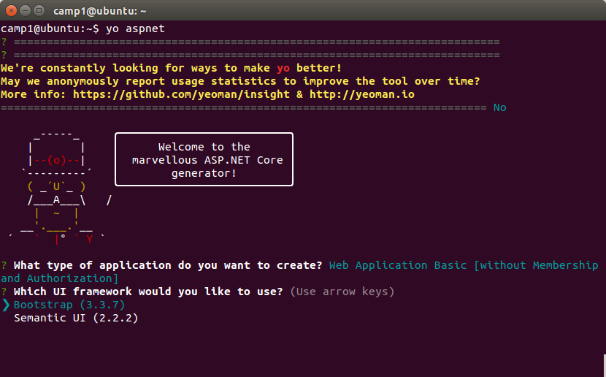
Create an ASP.NET site with yo

Slide 22
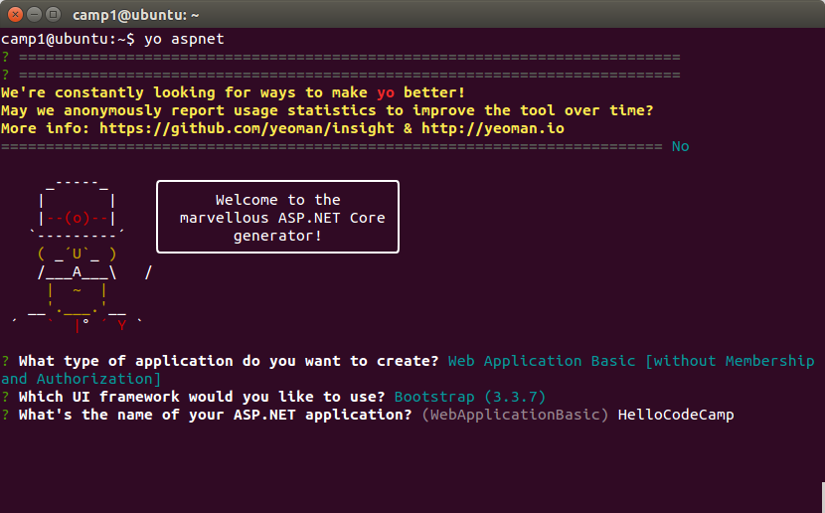
Create an ASP.NET site with yo

Slide 23
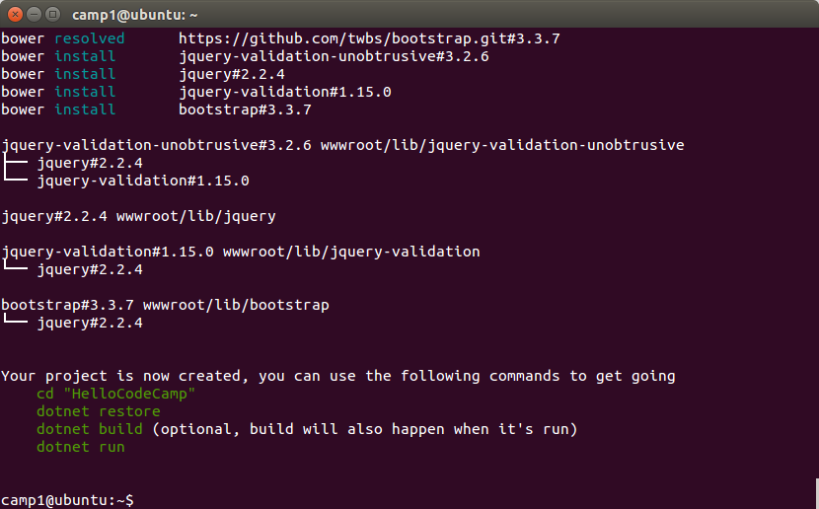
Create an ASP.NET site with yo

Slide 24
Create a new asp.net site with git
$ git clone https://github.com/adyle5/code_camp_template.git/
$ cd code_camp_template
$ dotnet restore
$dotnet run
…
...
Now listening on: http://localhost:5000
Application started. Press Ctrl+C to shut down.
You can also pull down a template from git and use that as a starting point.

Slide 25
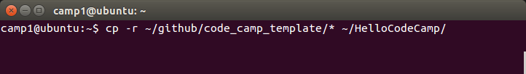
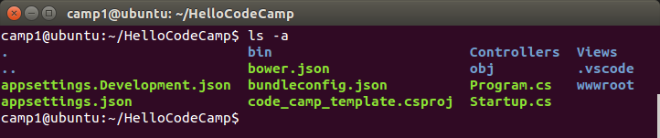
Copy Files to New folder
cd into the new folder and look at the files.
It shouldn’t have copied the hidden .git folder, but if it did,
run $ rm -rf .git to remove it.

Slide 26
Visual Studio Code
Visual Studio Code is a code editor (on steroids)
Half way between a full IDE like VS or Netbeans and a text editor like textmate or Sublime Text
Very similar to Atom (Github)
Supports intellisense
Built in Git
VS Style debugging
Very extensible
No Resharper
Cross Platform
Not just for .NET

Slide 27
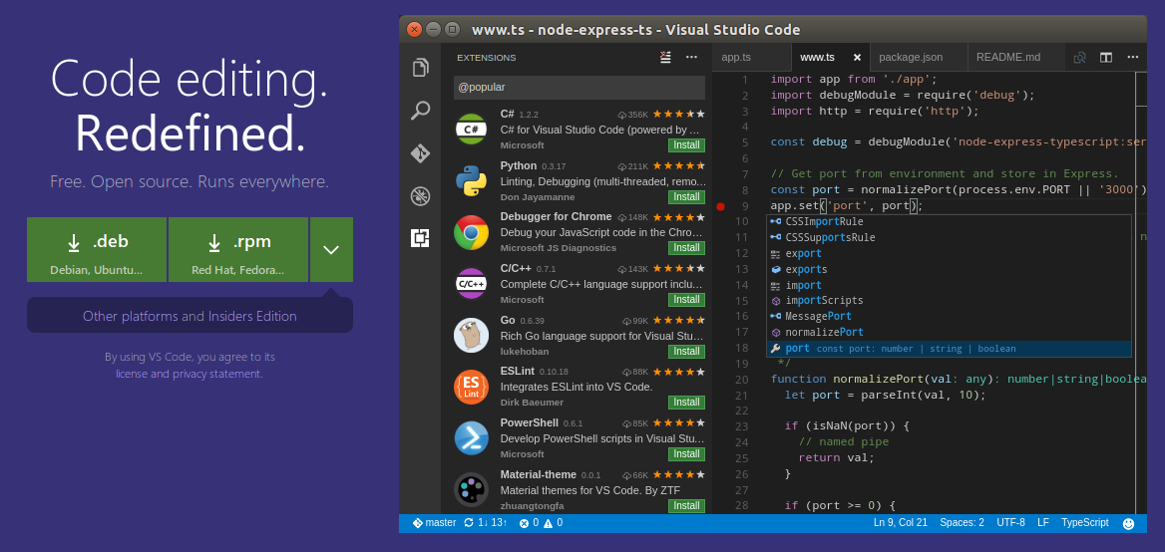
Installing Visual Studio Code
Go to https://code.visualstudio.com/ and download the .deb file.

Slide 28
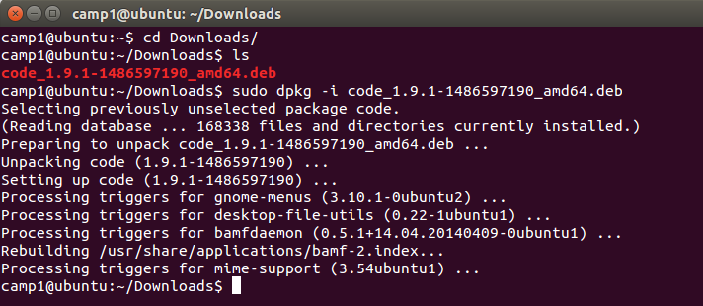
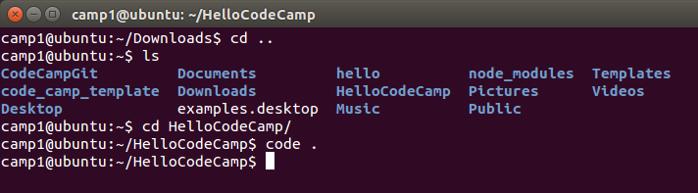
Installing Visual Studio Code

Slide 29
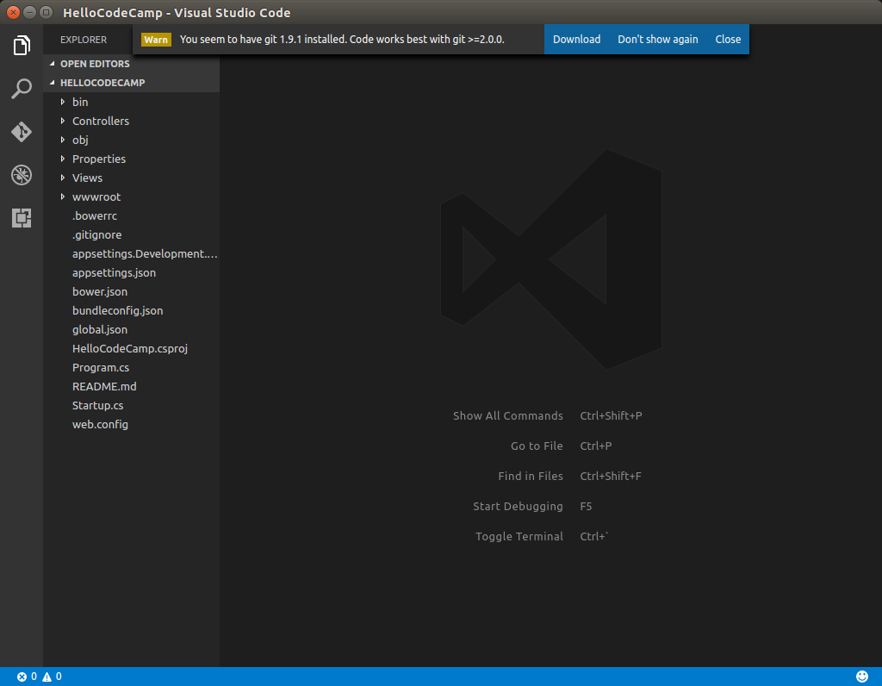
The Visual Studio Code IDE

Slide 30

The View Bar
Display and hide files & folders
Search for text in files, like VS
Built in Git support
Debugging support (not just .NET)
Install and manage extensions

Slide 31
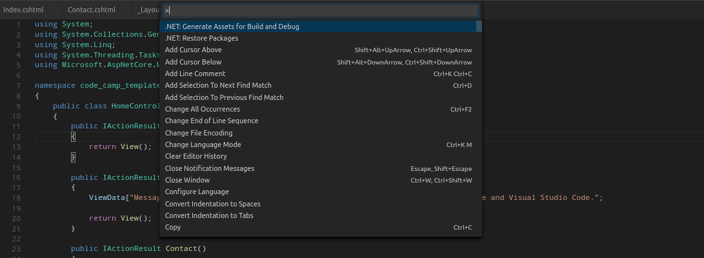
Command Palette (ctrl+shift+p)
Run command commands and commonly used tasks from within VS Code.
Shift + ctrl + p
Restore packages by typing: .NET and then click “.NET Restore Packages”

Slide 32
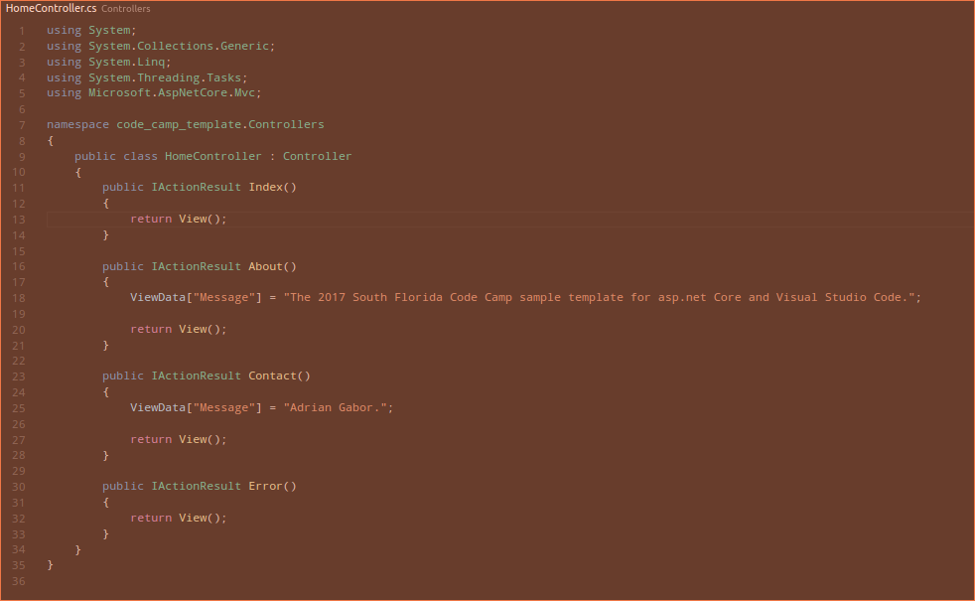
Zen Mode
Hide everything except the code editor
Ctrl + K, Z
Double click esc to exit.

Slide 33
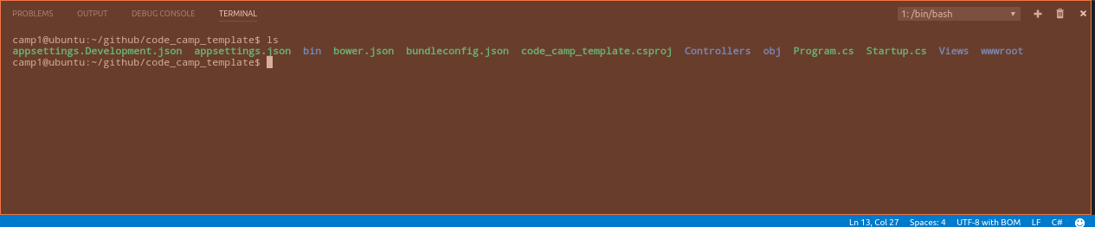
The Panels
Output is similar to Visual Studio’s output window.
Terminal support built into Code makes much better work flow!

Slide 34
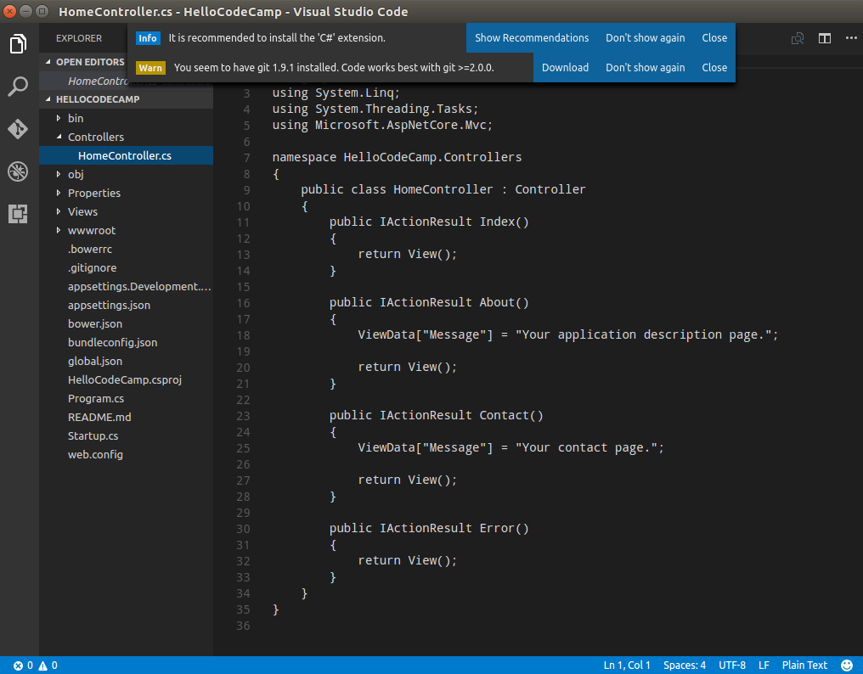
Install the C# Extension
Expand Controllers
And click on
HomeController.cs
You will be prompted
To install the C#
Extension for VS Code.
C# language support
Does not come
Installed by default.
Click Recommendation
And then Install.

Slide 35
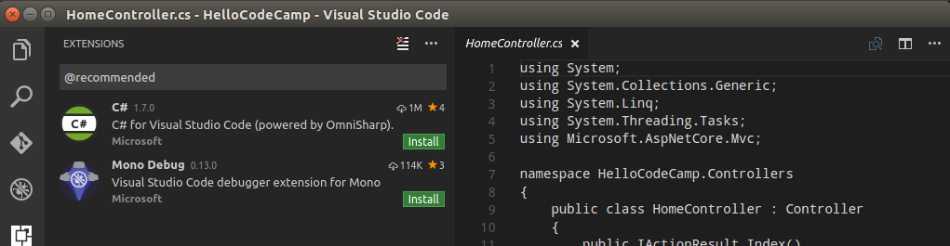
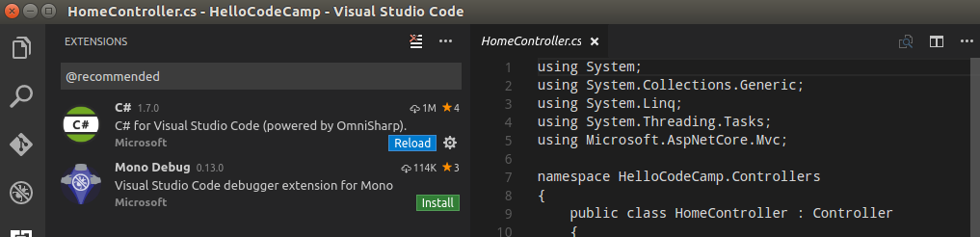
Install the C# Extension

Slide 36
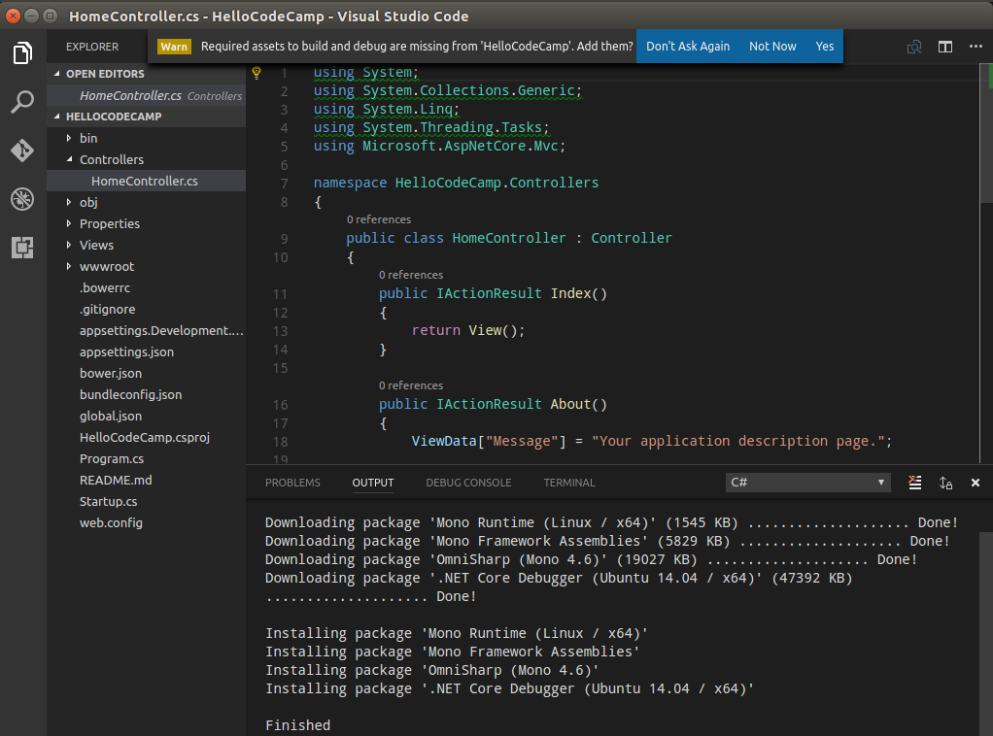
Install the C# Extension
Install
Required assets.

Slide 37
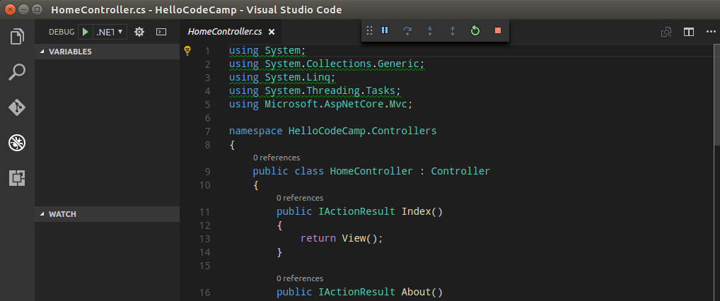
Running the Website
Click the debug tab, and then the green arrow on the upper left. This will launch
The browser.

Slide 38
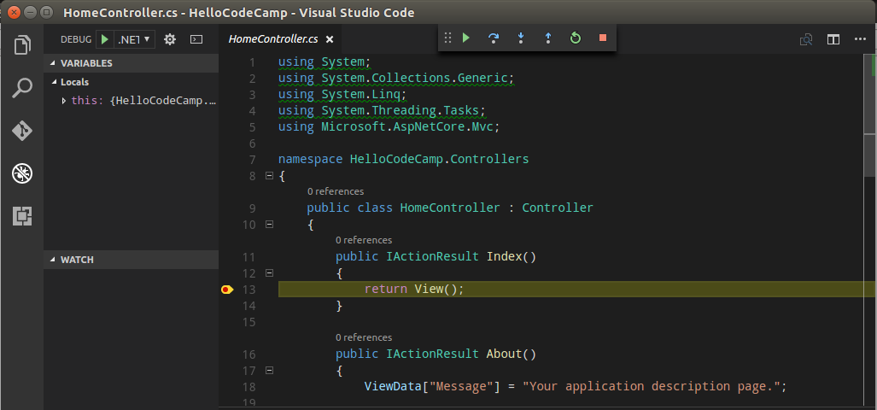
Debugging
Put a breakpoint in the Index method of the HomeController and then run.

Slide 39
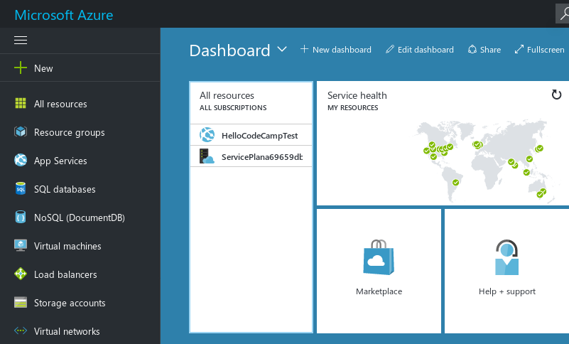
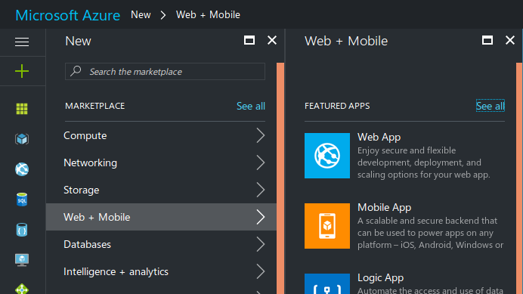
Moving code to the cloud
You can push your ASP.NET application from Code directly to Azure using Git
Create a new Azure website
Setup Azure to deploy via Git

Slide 40
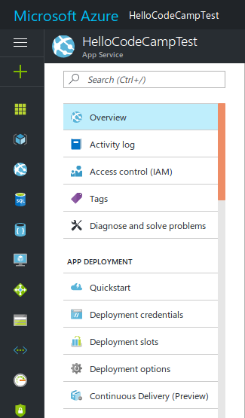
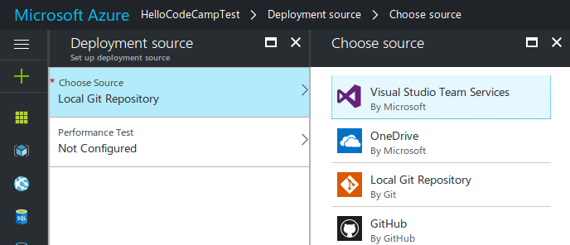
Moving code to the cloud
When the app is created on Azure, it is setup to deploy via FTP. We need to change the the deployment settings to deploy from a local git repository.

Slide 41
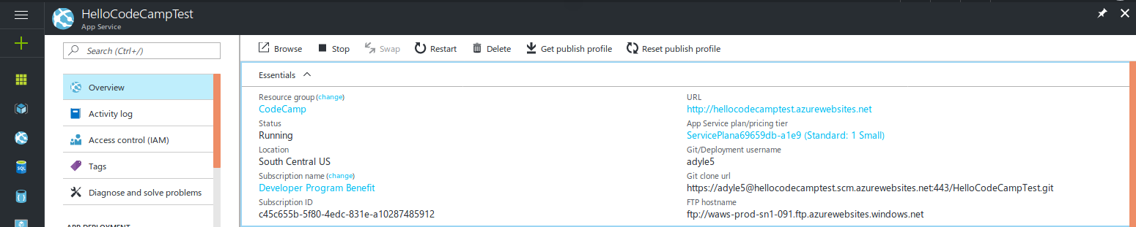
Moving code to the cloud
It will generate a URL for a Git remote source. You will need to copy that value.

Slide 42
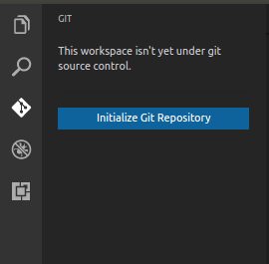
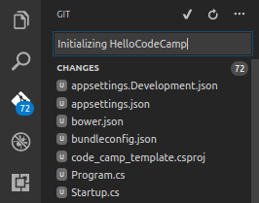
Moving code to the cloud
Now setup Git locally.
Click the “Initialize Git Repository” button.
Enter a message and then click the check mark
You can see the Git folder by typing ls -a in the terminal.

Slide 43
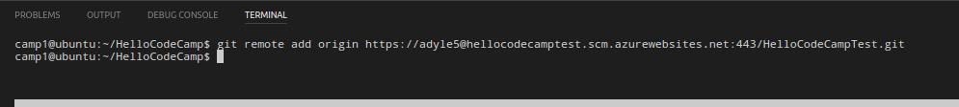
Moving code to the cloud
Add the remote origin (to Azure)
Use the URL we generated from Azure
Push the code to Azure

