Slide 1
Combining Quantum with Physics-Inspired AI Models for Accelerating CFD Simulations
A Seshaditya
Quasi

Slide 2
Outline
Introduction to Use Cases
Silicon Crystal Growth Simulations
Cryogenic Vessels Design
Approaches
Classical AI - PINN/PI-GANO/GAOT
Hybrid-Quantum - QPINNs
Outlook
Notes:
Collaborate with Leading Aerospace Companies: Secure pilot projects with industry leaders like SpaceX, Blue Origin, and NASA to validate and refine the technology.
Government Contracts: Pursue contracts with government space agencies (NASA, ESA) for exclusive use of simulation tools.
Academic Collaborations: Partner with top aerospace research universities for co-development and validation, building credibility and refining the technology.

Slide 3
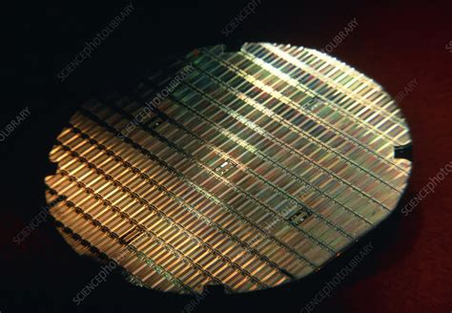
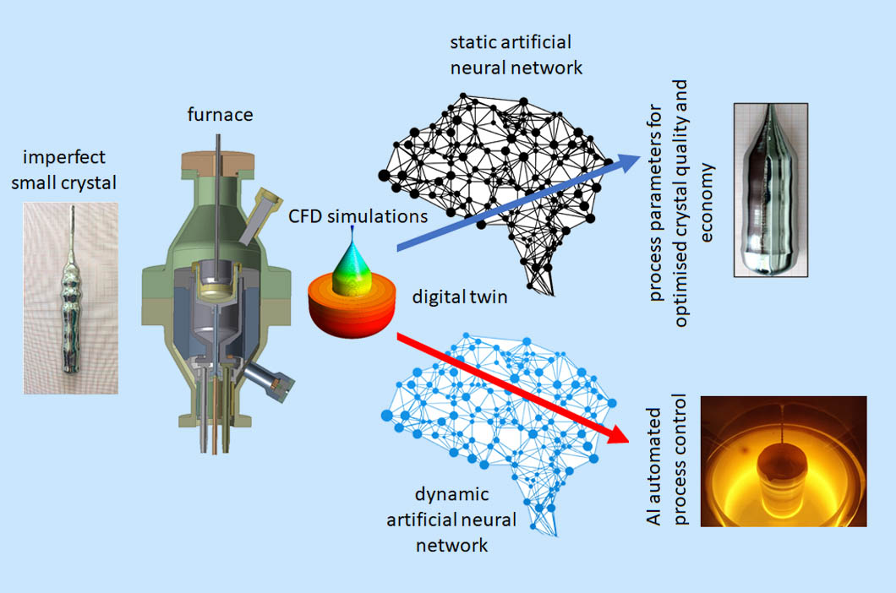
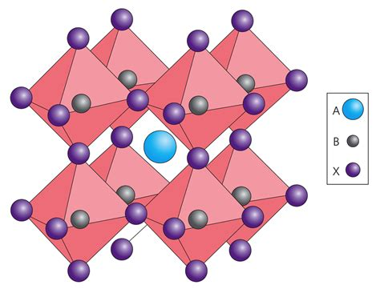
{:format :pointed-dict, :data [{#uuid "44ea032a-76b6-419e-bb07-e2b6786c7596" {:entity-type :block, :coords {:y-start 0.13655769816811772, :x-start 0.44545579108342953, :x-end 0.5539836687824496, :y-end 0.3383207750269106}, :original-aspect-ratio? true, :media-asset-ids #{#uuid "d4550b4b-b18b-4767-b6eb-50e059e92f31"}, :image-aspect-ratio 0.9562624254473161, :url "https://pitch-assets-ccb95893-de3f-4266-973c-20049231b248.s3.eu-west-1.amazonaws.com/d4550b4b-b18b-4767-b6eb-50e059e92f31?pitch-bytes=237512&pitch-content-type=image%2Fpng", :block-type :image, :image-scale-x 1, :locked-aspect-ratio? false, :created-at 1747681534919}} [#uuid "44ea032a-76b6-419e-bb07-e2b6786c7596"]]}
Silicon Crystal Growth
Accelerating CFD Simulations
Real-Time Digital Twins
SDG 9
Ind, Inno infra
SDG 12
Cons & Prod
Silicon Wafers
Bringing Quantum Advantage through AI
(Hybrid Approaches on QPU/GPUs Hardware)
Perovskites

Slide 4
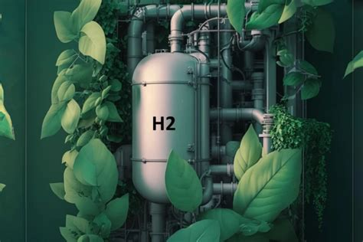
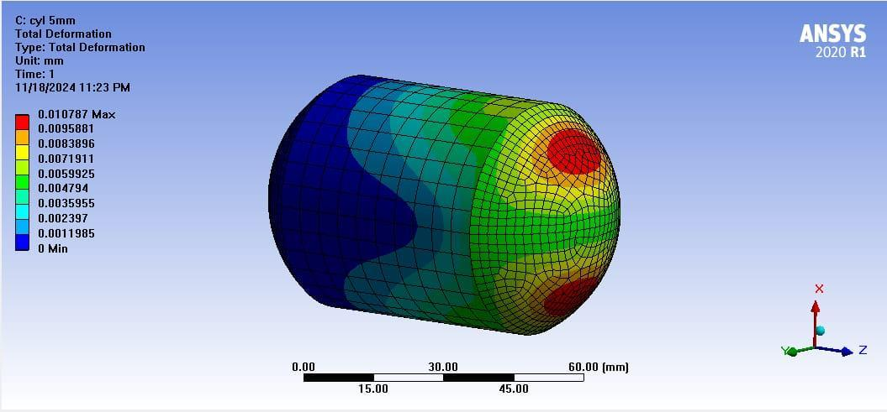
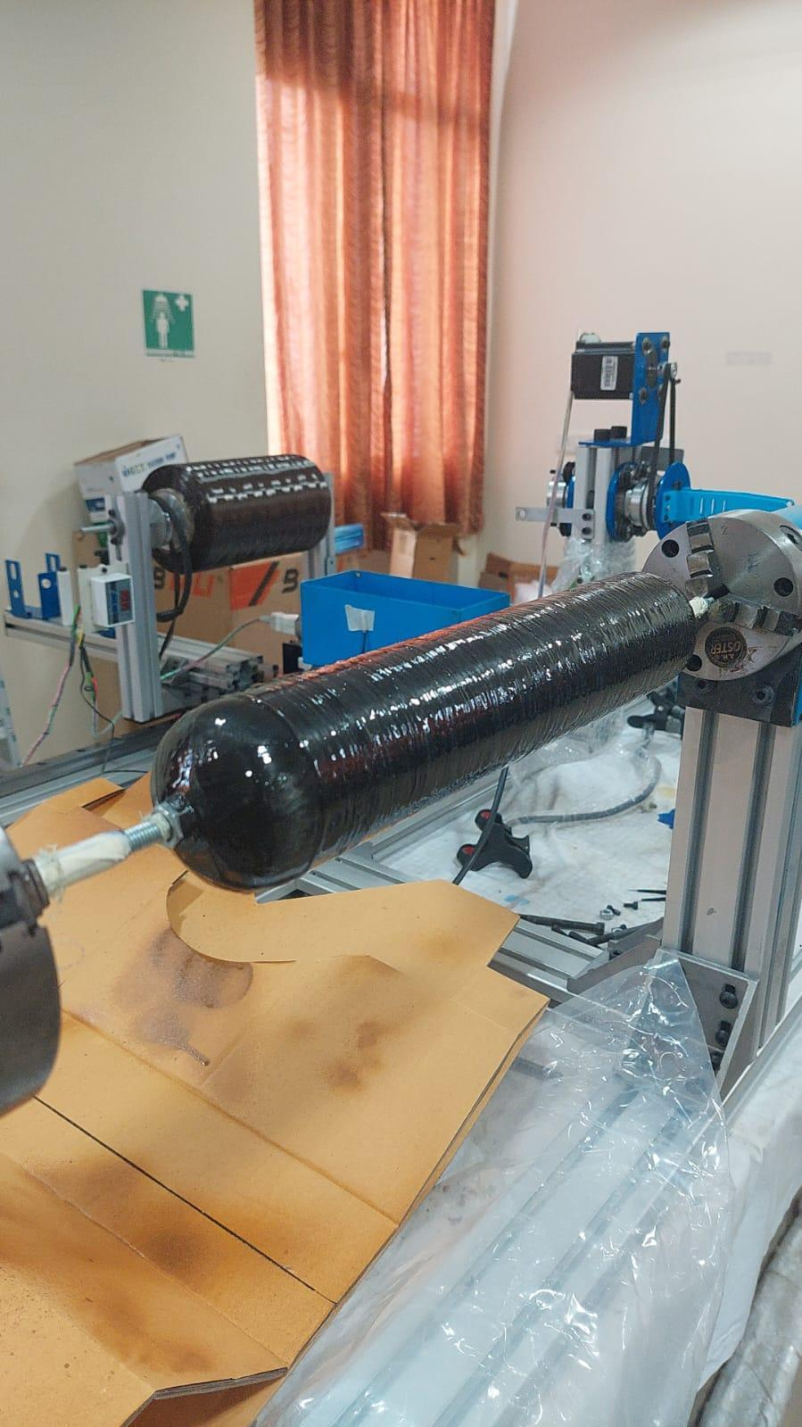
QML Quantum
Designing Cryogenic Vessels
Accelerating CFD Reduces Design to Production Time
Green Hydrogen
Economy
Collaboration with Indo-Australian Startup

Slide 5
Classical Physics-Inspired AI models

Slide 6
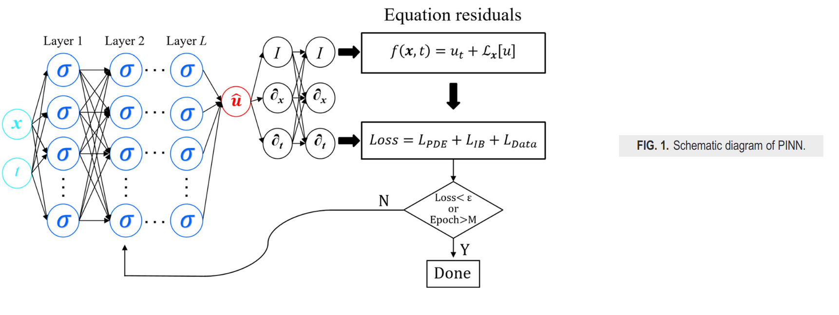
PINNs: Combining Physics
Multi-Physics Capability with Less Data or Conditions
Source: https://doi.org/10.1063/5.0226232

Slide 7
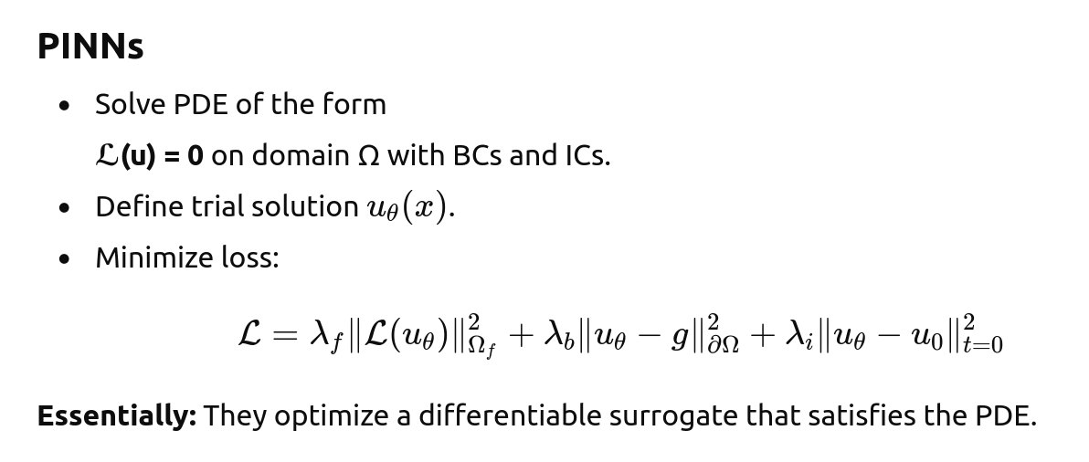
PINNs: Combining Physics
Multi-Physics Capability with Less Data or Conditions
Source: https://doi.org/10.1063/5.0226232

Slide 8
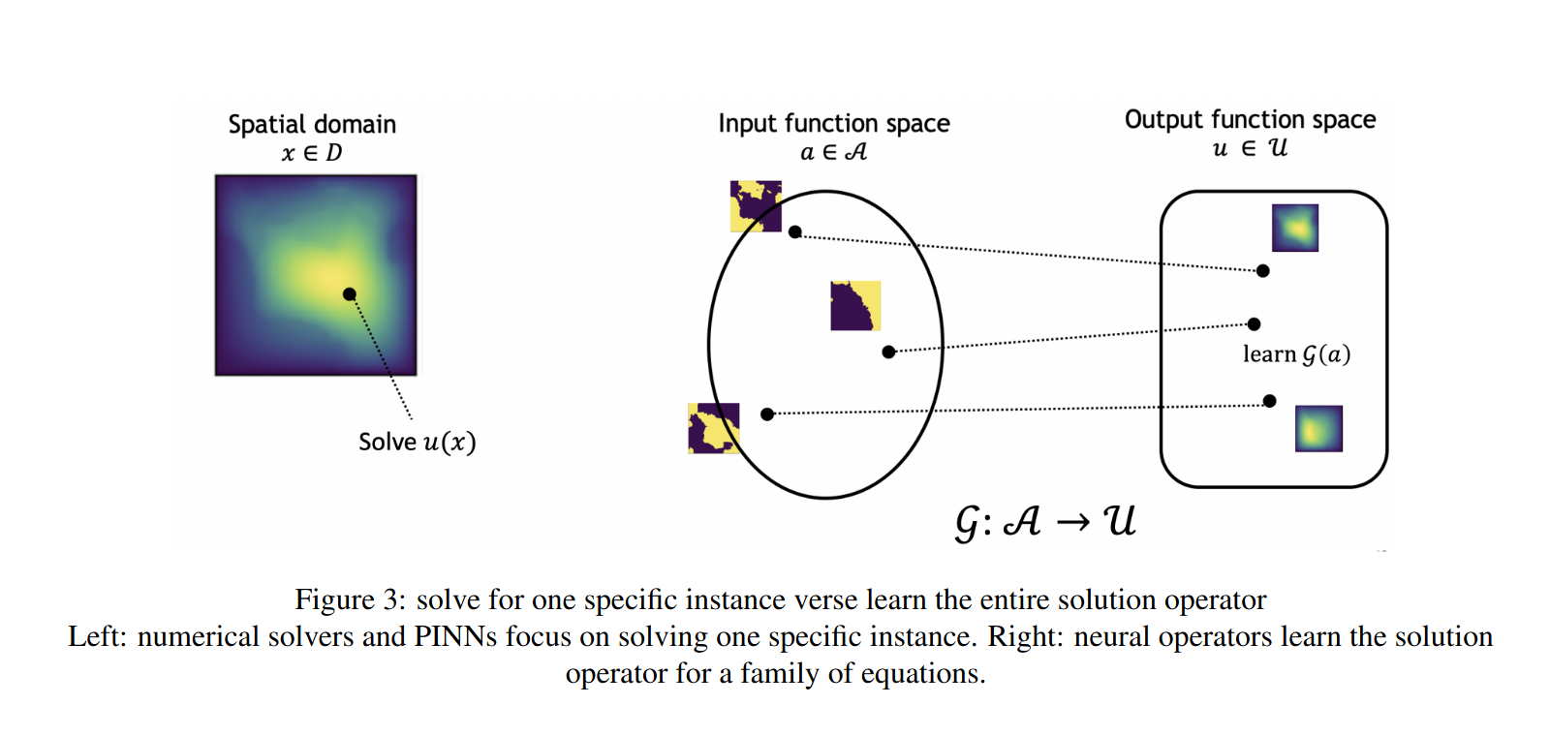
PINO: Physics Inspired Neural Operators
Higher Accuracy & Multi-Physics Capability with Less Data
Notes:
Highly Accurate Simulations: Integrate fundamental physics laws with neural networks to provide more accurate predictions of CFRP behavior under various conditions.
Significantly Faster Processing: Reduce simulation times from weeks to days or hours, enabling rapid design iterations.
Multi-Physics Capability: Simultaneously simulate structural, thermal, and fluid dynamics within a unified framework.
Customizable Interface: Tailor simulations to specific design requirements of different space missions.

Slide 9
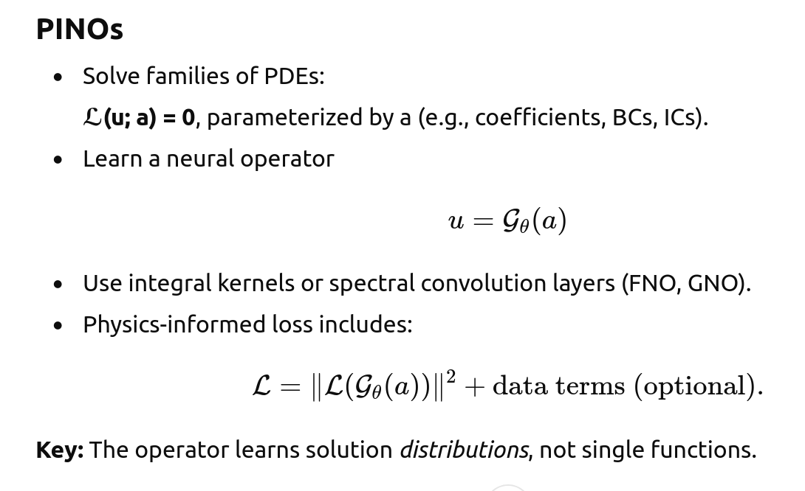
PINO: Physics Inspired Neural Operators
Higher Generalisability Data
Notes:
Highly Accurate Simulations: Integrate fundamental physics laws with neural networks to provide more accurate predictions of CFRP behavior under various conditions.
Significantly Faster Processing: Reduce simulation times from weeks to days or hours, enabling rapid design iterations.
Multi-Physics Capability: Simultaneously simulate structural, thermal, and fluid dynamics within a unified framework.
Customizable Interface: Tailor simulations to specific design requirements of different space missions.

Slide 10
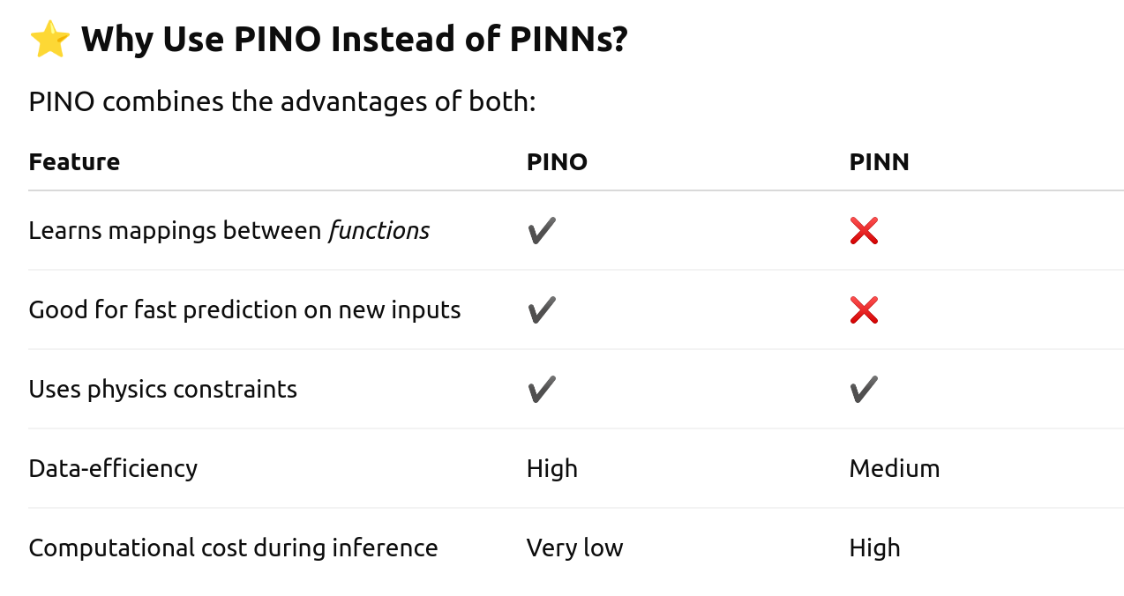
Comparison
Notes:
Highly Accurate Simulations: Integrate fundamental physics laws with neural networks to provide more accurate predictions of CFRP behavior under various conditions.
Significantly Faster Processing: Reduce simulation times from weeks to days or hours, enabling rapid design iterations.
Multi-Physics Capability: Simultaneously simulate structural, thermal, and fluid dynamics within a unified framework.
Customizable Interface: Tailor simulations to specific design requirements of different space missions.

Slide 11
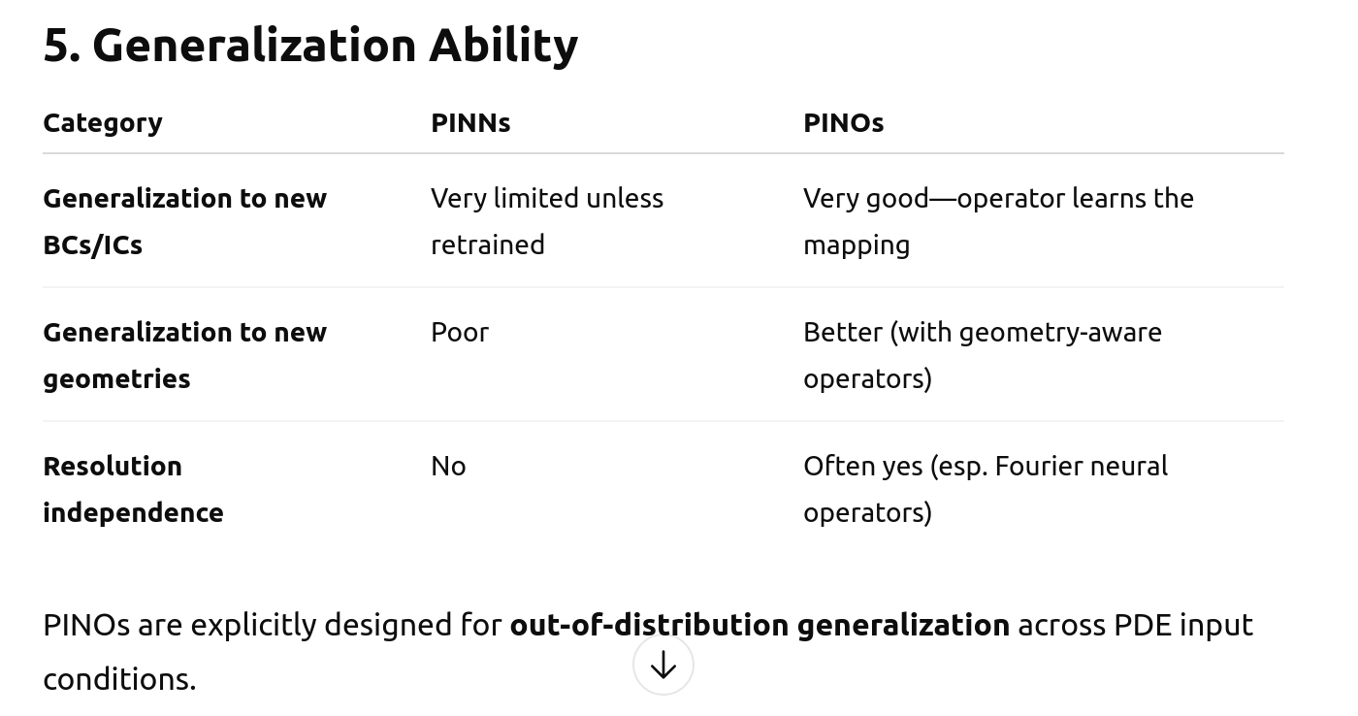
Comparison
Notes:
Highly Accurate Simulations: Integrate fundamental physics laws with neural networks to provide more accurate predictions of CFRP behavior under various conditions.
Significantly Faster Processing: Reduce simulation times from weeks to days or hours, enabling rapid design iterations.
Multi-Physics Capability: Simultaneously simulate structural, thermal, and fluid dynamics within a unified framework.
Customizable Interface: Tailor simulations to specific design requirements of different space missions.

Slide 12
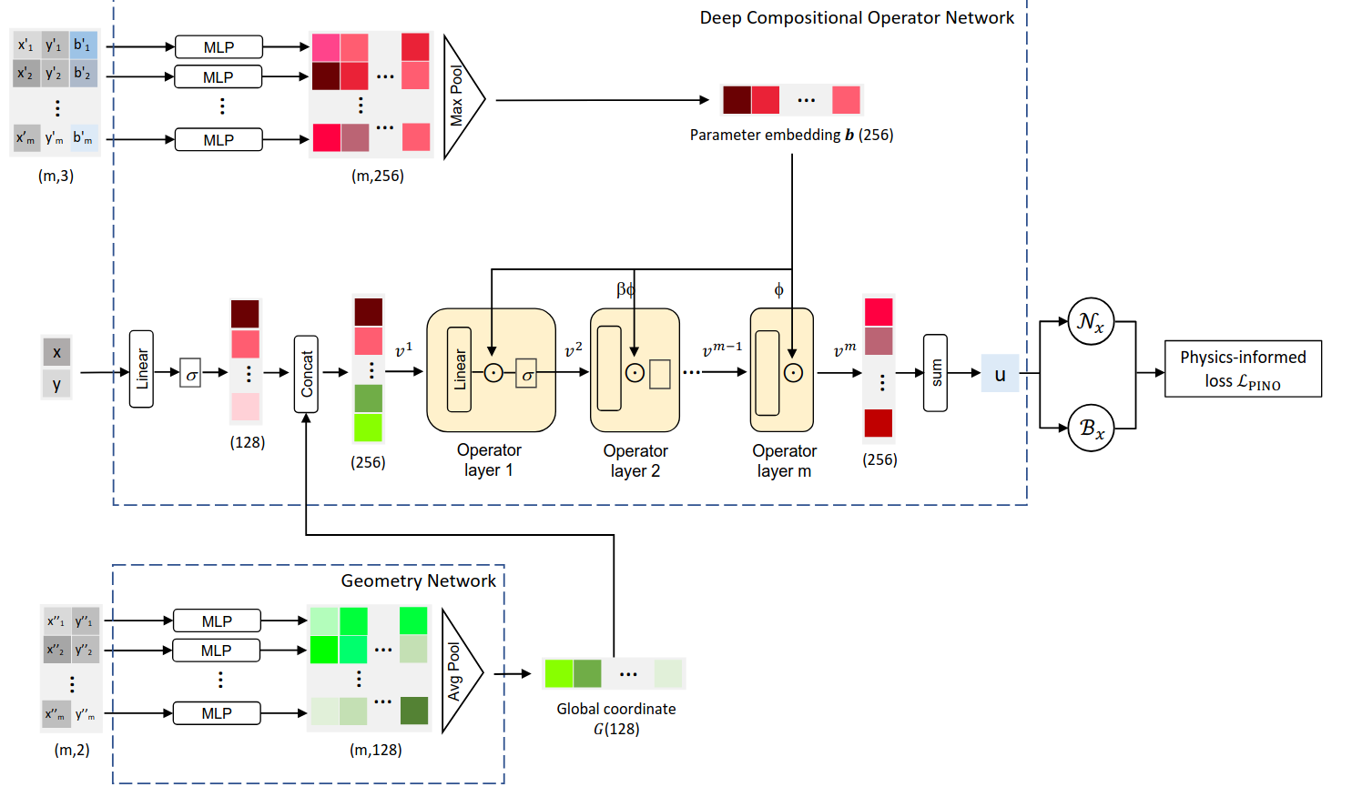
PI- GANO: Geometry Aware Neural Operator
Generalize across PDE parameter representations and geometries
Source: arXiv:2408.01600v1
Notes:
Highly Accurate Simulations: Integrate fundamental physics laws with neural networks to provide more accurate predictions of CFRP behavior under various conditions.
Significantly Faster Processing: Reduce simulation times from weeks to days or hours, enabling rapid design iterations.
Multi-Physics Capability: Simultaneously simulate structural, thermal, and fluid dynamics within a unified framework.
Customizable Interface: Tailor simulations to specific design requirements of different space missions.

Slide 13
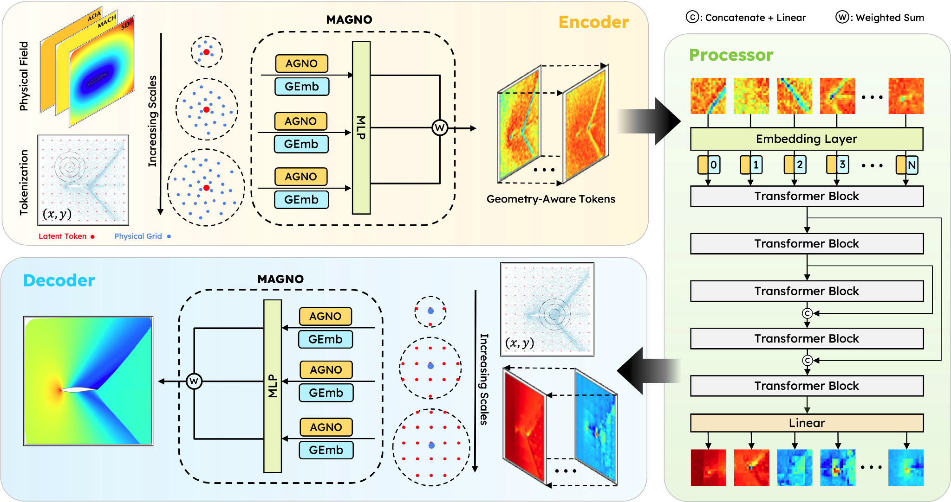
GAOT: Geometry Aware Operator Transformers
Multiscale Attentional Graph Neural Operator (MAGNO)
Source: arXiv:2505.18781v2 https://camlab-ethz.github.io/GAOT/

Slide 14
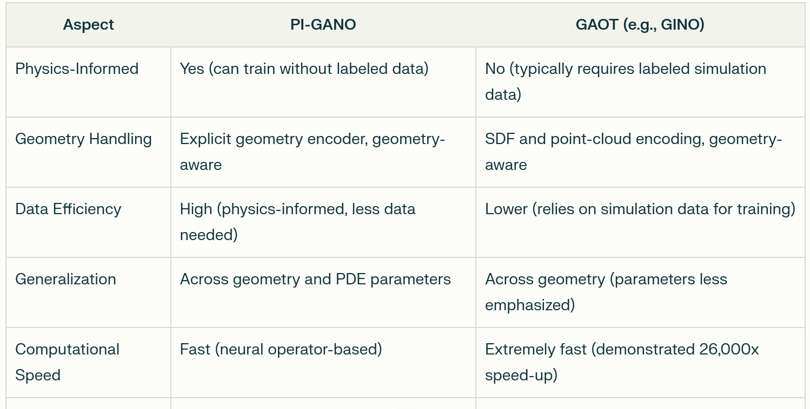
Comparison
Notes:
Highly Accurate Simulations: Integrate fundamental physics laws with neural networks to provide more accurate predictions of CFRP behavior under various conditions.
Significantly Faster Processing: Reduce simulation times from weeks to days or hours, enabling rapid design iterations.
Multi-Physics Capability: Simultaneously simulate structural, thermal, and fluid dynamics within a unified framework.
Customizable Interface: Tailor simulations to specific design requirements of different space missions.

Slide 15
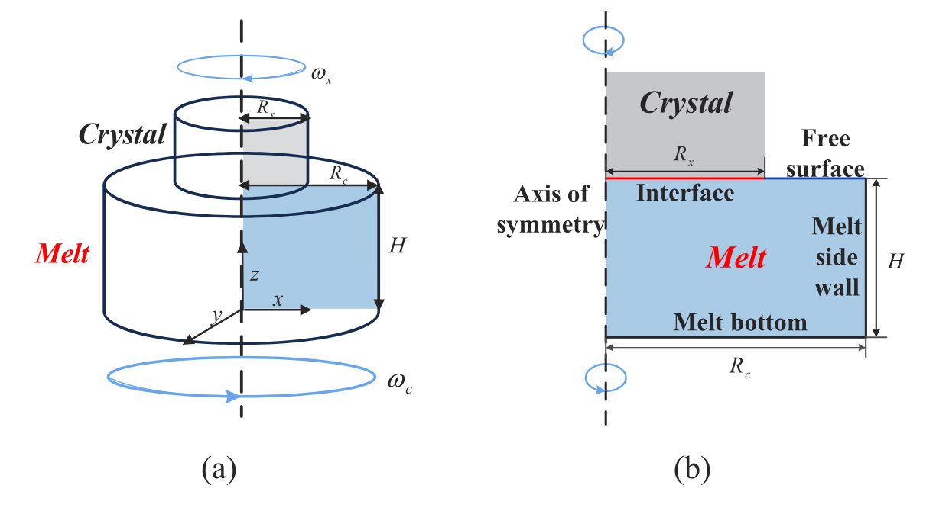
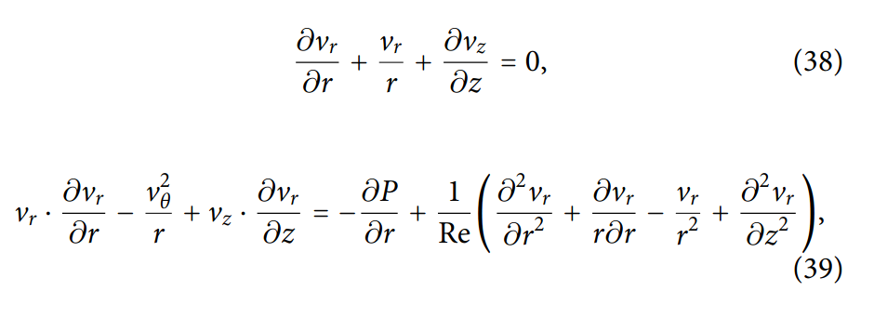
Silicon Crystal Growth (CZ process)
Navier–Stokes(NS), Particle Transport, and Heat Transfer equation
Source: doi: 10.1063/5.0271778

Slide 16
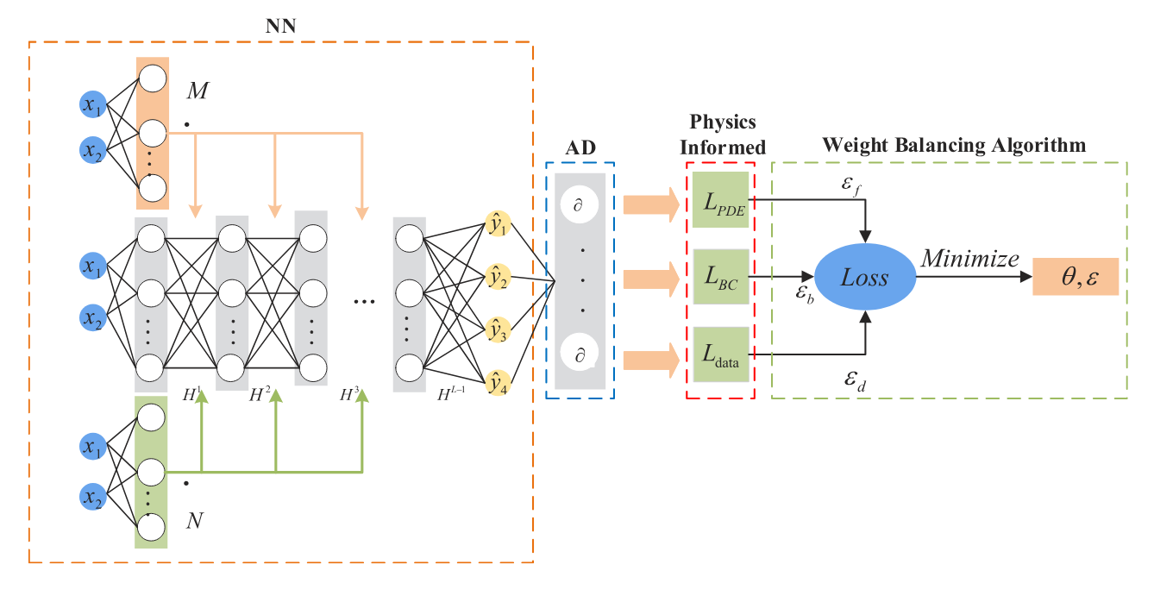
Spatial Information & Adaptive Loss Balance PINN
Optimizes the thermal-fluid coupling and Improves training stability
Source: doi: 10.1063/5.0271778

Slide 17
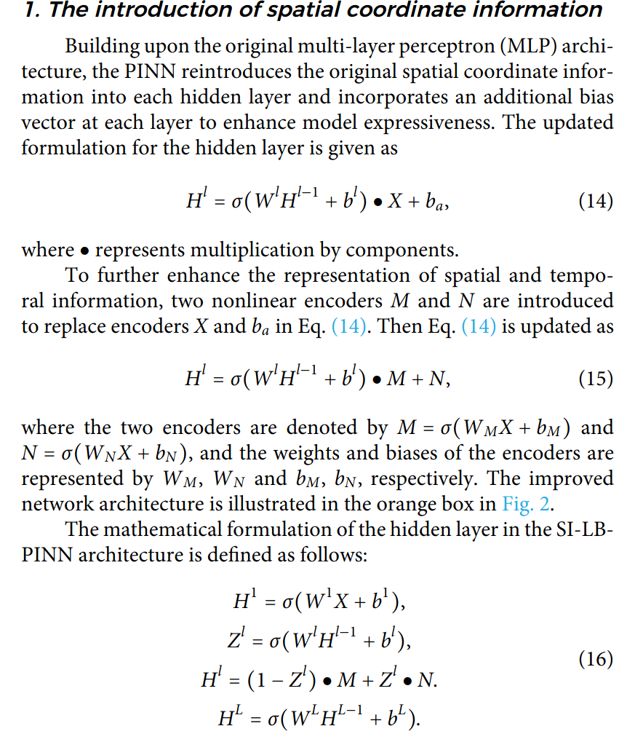
Spatial Information & Adaptive Loss Balance PINN
Optimizes the thermal-fluid coupling and Improves training stability
Source: doi: 10.1063/5.0271778

Slide 18
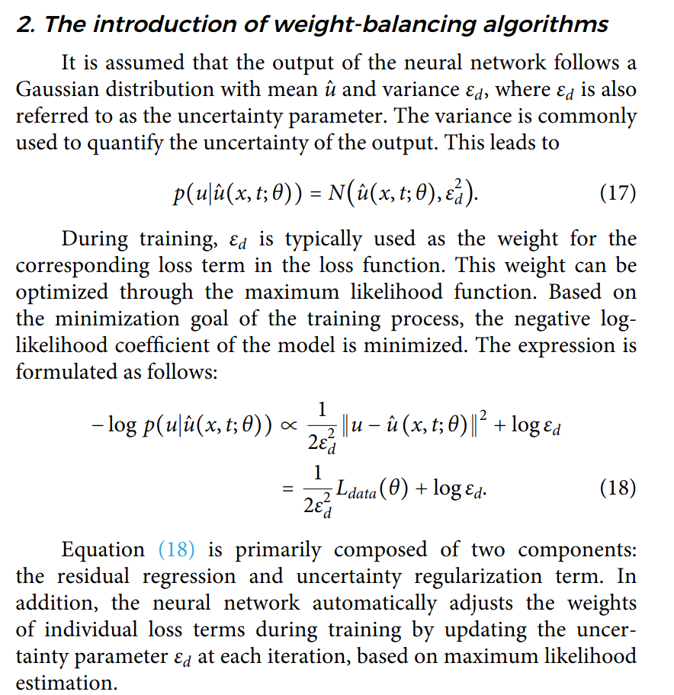
Spatial Information & Adaptive Loss Balance PINN
Optimizes the thermal-fluid coupling and Improves training stability
Source: doi: 10.1063/5.0271778

Slide 19
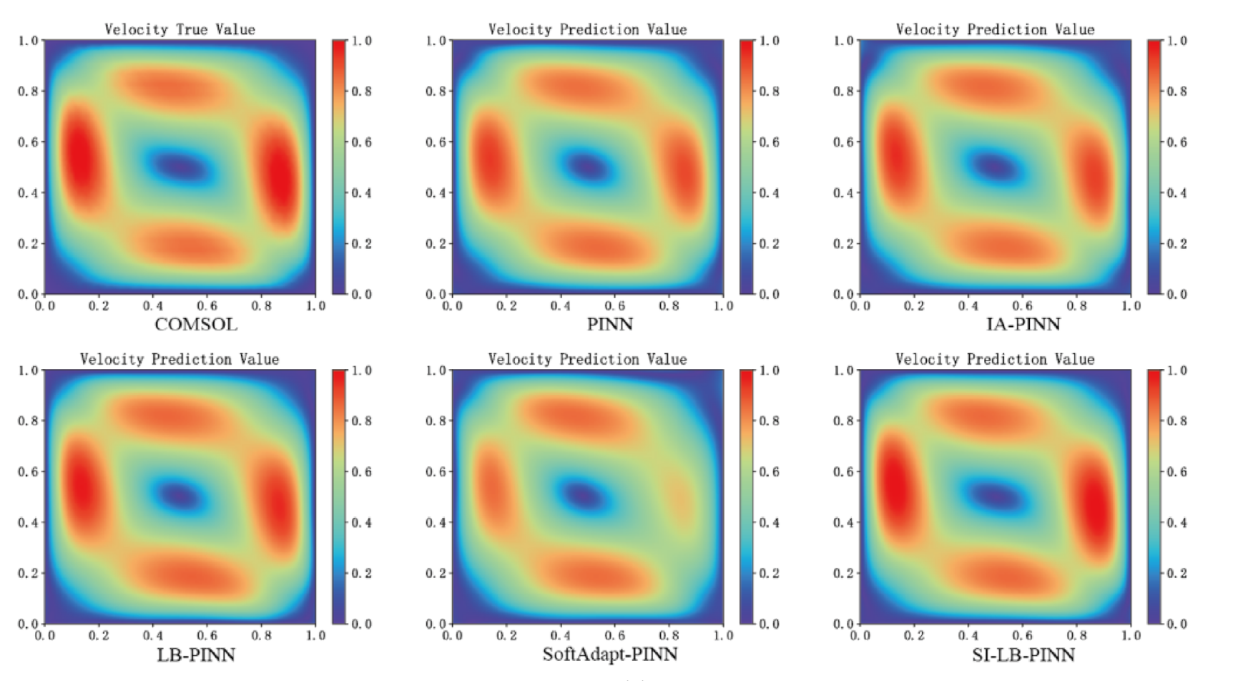
Spatial Information & Adaptive Loss Balance PINN
Source: doi: 10.1063/5.0271778

Slide 20
Hybrid Quantum-Classical Physics-Inspired AI Models

Slide 21
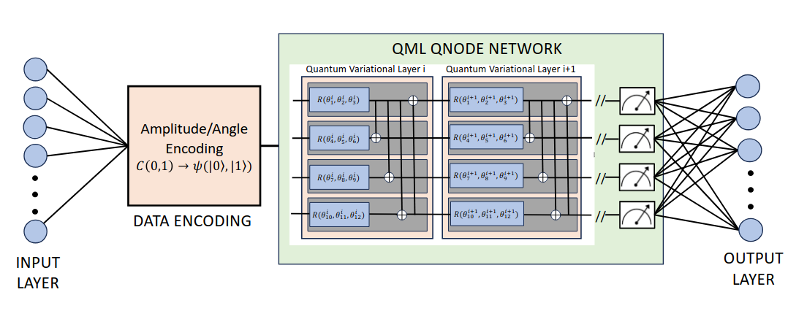
Quantum Physics Informed Neural Networks
Multi-variational layer quantum network
Source: https://www.mdpi.com/1099-4300/26/8/649

Slide 22
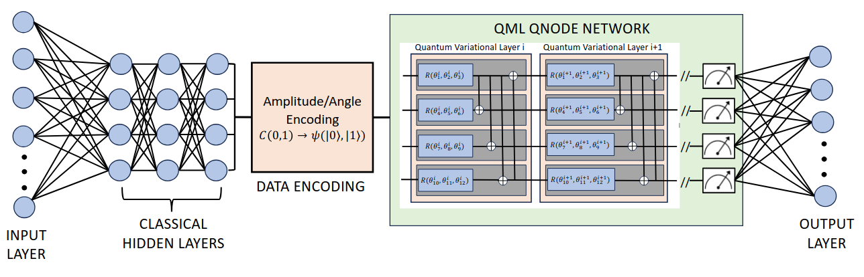
Quantum Physics Informed Neural Networks
Quantum node layer combined with classical layers
Source: https://www.mdpi.com/1099-4300/26/8/649

Slide 23
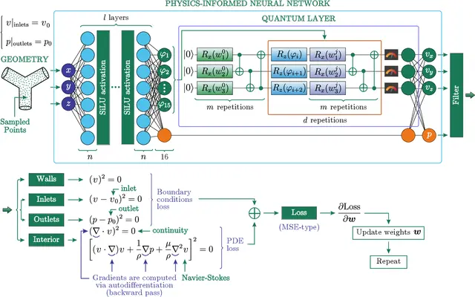
Hybrid Quantum Physics Informed Neural Networks
Variational Quantum Circuit (VQC) with focus on Geometry
Source: https://arxiv.org/html/2304.11247v3

Slide 24
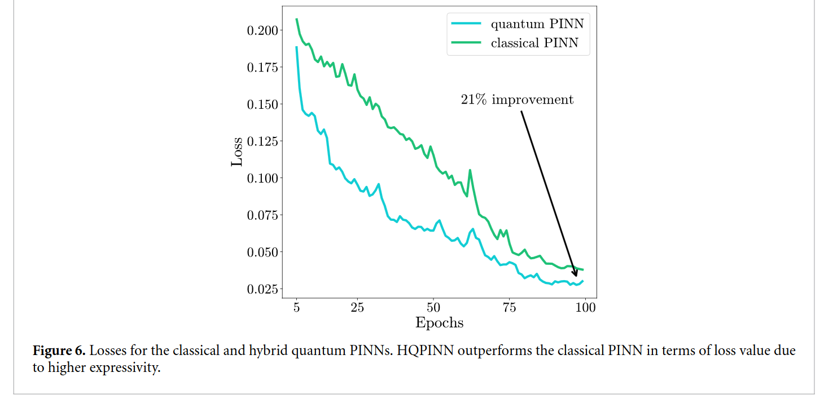
QML Quantum Node Layers
Classical PINN
Turbulent Flows
CRFP Vessels
Simulation Results
Source: https://arxiv.org/html/2304.11247v3

Slide 25
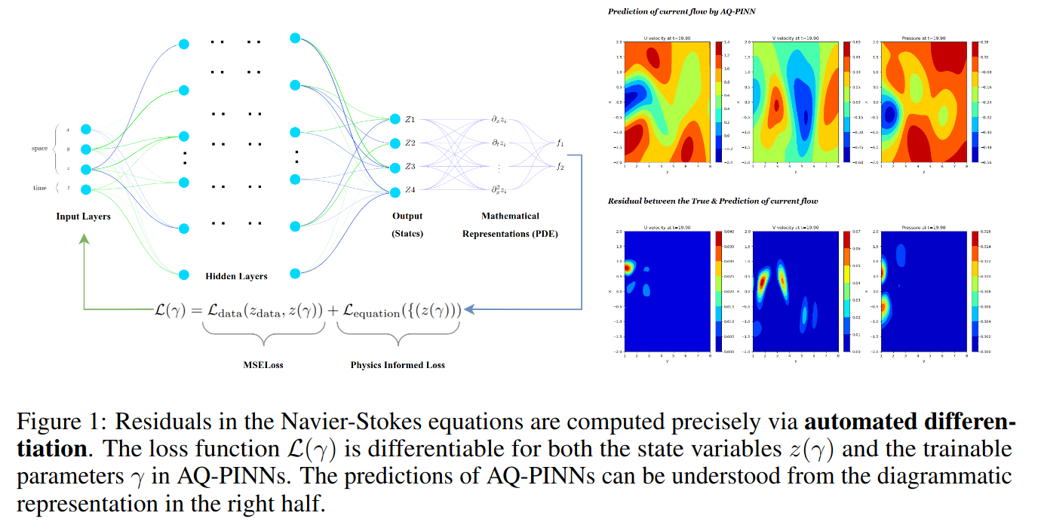
Attention Enhanced Quantum PINNs
Source: https://arxiv.org/html/2304.11247v3

Slide 26
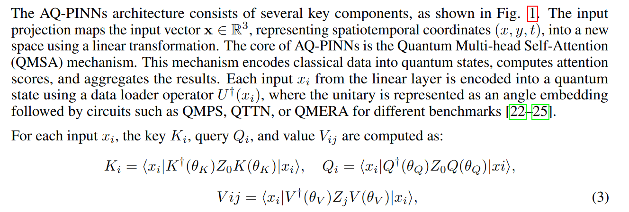
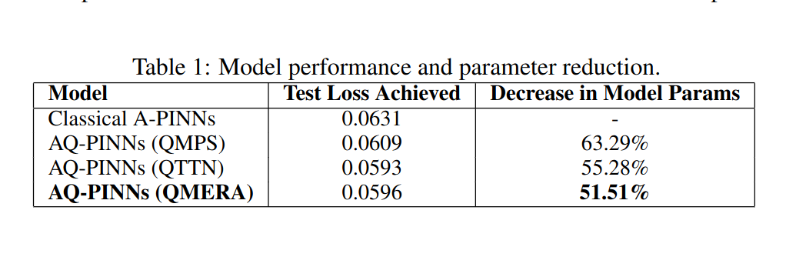
QML Quantum Node Layers
Classical PINN
Turbulent Flows
CRFP Vessels
Simulation Results
Matrix Product States (QMPS), Tree Tensor Networks (QTTN),
Multiscale Entanglement Renormalization Ansatz (QMERA)
Source: https://arxiv.org/html/2304.11247v3

Slide 27
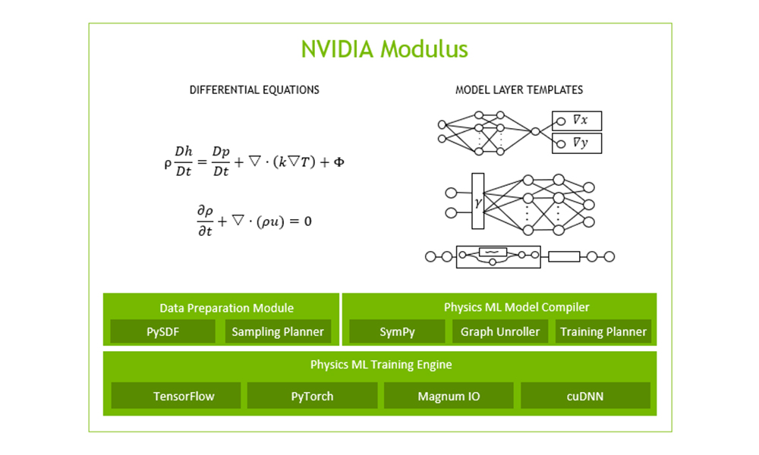
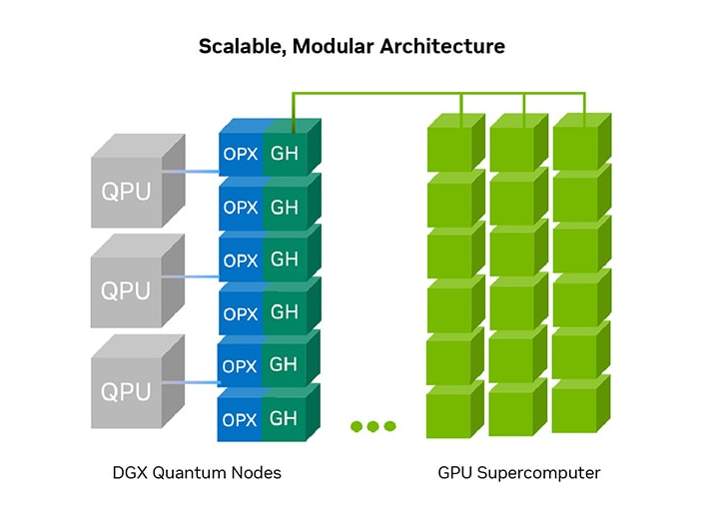
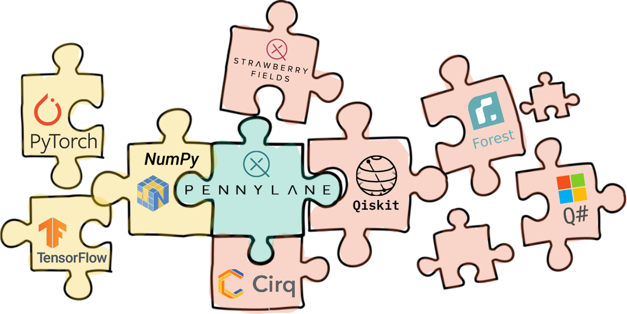

Frameworks & Resources
Pennylane, Nvidia Modulus, DGX Quantum, IBM Qantm Credits
Source: https://pennylane.ai/ developer.nvidia.com

Slide 28
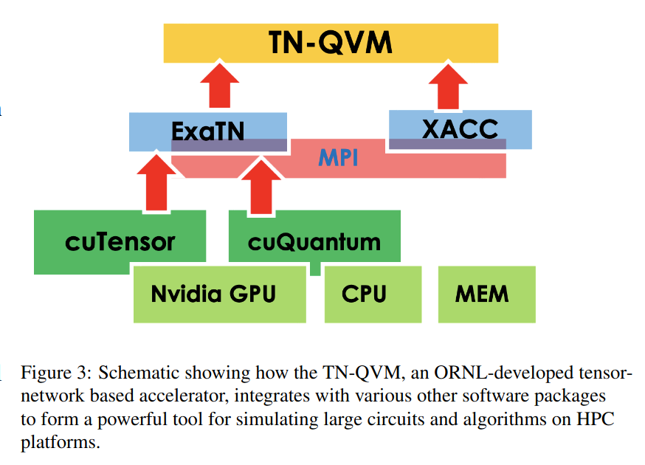
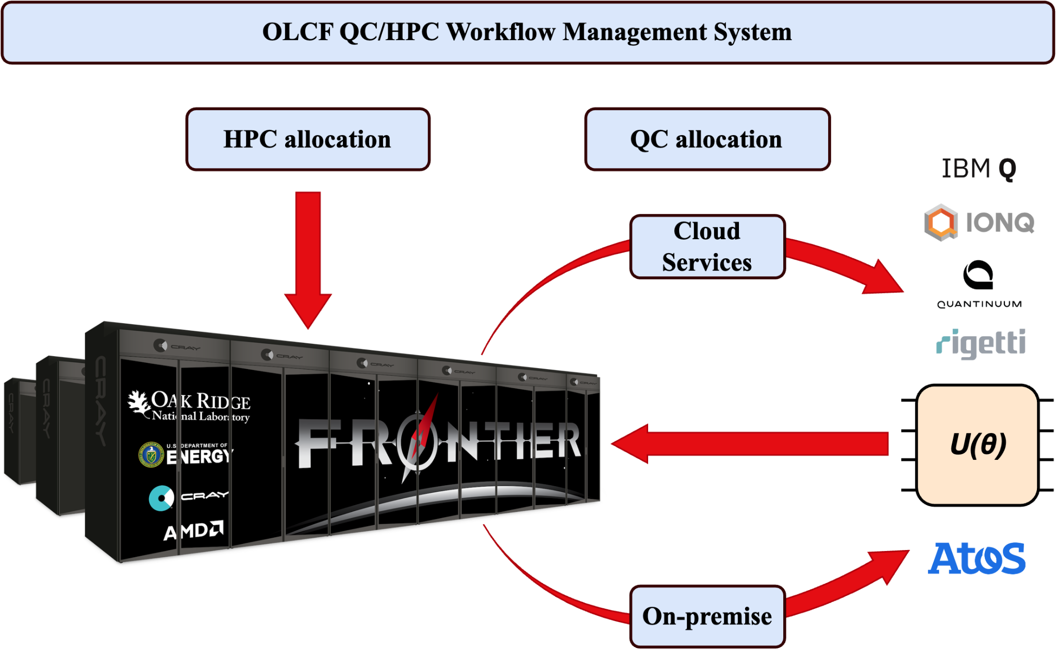
QC-HPC integration
Source: https://arxiv.org/html/2408.16159v1

Slide 29
Outlook
Benchmark studies with advanced AI models
(Physics and Geometry Aware)
Hybrid approaches for Quantum advantage
Collaborations with academia and industries
Notes:
Partnerships:
Collaborate with Leading Aerospace Companies: Secure pilot projects with industry leaders like SpaceX, Blue Origin, and NASA to validate and refine the technology.
Government Contracts: Pursue contracts with government space agencies (NASA, ESA) for exclusive use of simulation tools.
Academic Collaborations: Partner with top aerospace research universities for co-development and validation, building credibility and refining the technology.

Slide 30
References
Quantum and Physics-Informed Neural Networks
Afrah Farea, Saiful Khan, & Mustafa Serdar Celebi. (2025). QCPINN: Quantum-Classical Physics-Informed Neural Networks for Solving PDEs. arXiv:2503.16678 [quant-ph]. https://arxiv.org/abs/2503.16678
Hybrid Quantum PINNs for Computational Fluid Dynamics. (2025). IOP Science. https://doi.org/10.1088/2632-2153/ad43b2
Quantum Physics-Informed Machine Learning for Multiscale Simulations. (2024). arXiv:2403.08954 [quant-ph]. https://arxiv.org/abs/2403.08954
PINNSFORMER: A Transformer-Based Framework for Physics-Informed Neural Networks. (2023). arXiv:2307.11833v3 [cs.LG].
Pengpeng Xiao, Muqing Zheng, Anran Jiao, Xiu Yang, & Lu Lu. (2024). Quantum DeepONet: Neural Operators Accelerated by Quantum Computing. [Manuscript].
Siddhant Dutta, Nouhaila Innan, Sadok Ben Yahia, & Muhammad Shafique. (2024). AQ-PINNs: Attention-Enhanced Quantum Physics-Informed Neural Networks for Carbon-Efficient Climate Modeling. arXiv:2409.01626v1 [cs.LG].
Physics-Informed Neural Networks in Crystal Growth Simulations
D. Kolberg, C. Anders, & S. Reke. (2023). Fast Prediction of Transport Structures in the Melt by Physics-Informed Neural Networks during ‘VMCz’ Crystal Growth of Silicon. Journal of the Institute of Metals, https://doi.org/10.1080/00219592.2023.2236656
J. Ling, Y. Zhang, & D. Chen. (2023). Simulation of Thermal‑Fluid Coupling in Silicon Single Crystal Growth Based on Gradient Normalized Physics‑Informed Neural Network. Physics of Fluids. https://doi.org/10.1063/5.0123811
(Code repository: https://github.com/callmedrcom/SIPINN)
Z. Wang, F. Chen, & M. Li. (2024). RF-PINNs: Reactive Flow Physics-Informed Neural Networks for Field Reconstruction of Laminar and Turbulent Flames. Journal of Computational Physics, 113698. https://doi.org/10.1016/j.jcp.2024.113698
Y. Zhao, H. Liu, & J. Xu. (2025). Research on the Thermal‑Fluid Coupling in the Growth Process of Czochralski Silicon Single Crystals Based on an Improved Physics‑Informed Neural Network. AIP Advances, 15(10), 105202. https://doi.org/10.1063/5.0271778
Notes:
Partnerships:
Collaborate with Leading Aerospace Companies: Secure pilot projects with industry leaders like SpaceX, Blue Origin, and NASA to validate and refine the technology.
Government Contracts: Pursue contracts with government space agencies (NASA, ESA) for exclusive use of simulation tools.
Academic Collaborations: Partner with top aerospace research universities for co-development and validation, building credibility and refining the technology.

Slide 31

Thank You
Name: A Seshaditya
Email: aditya@quasi.digital
Websites: https://quasi.digital
https://github.com/adytiaa/quasi.ai
https://adytiaa.github.io/quasi.ai/
Notes:
Partnerships:
Collaborate with Leading Aerospace Companies: Secure pilot projects with industry leaders like SpaceX, Blue Origin, and NASA to validate and refine the technology.
Government Contracts: Pursue contracts with government space agencies (NASA, ESA) for exclusive use of simulation tools.
Academic Collaborations: Partner with top aerospace research universities for co-development and validation, building credibility and refining the technology.

Slide 32
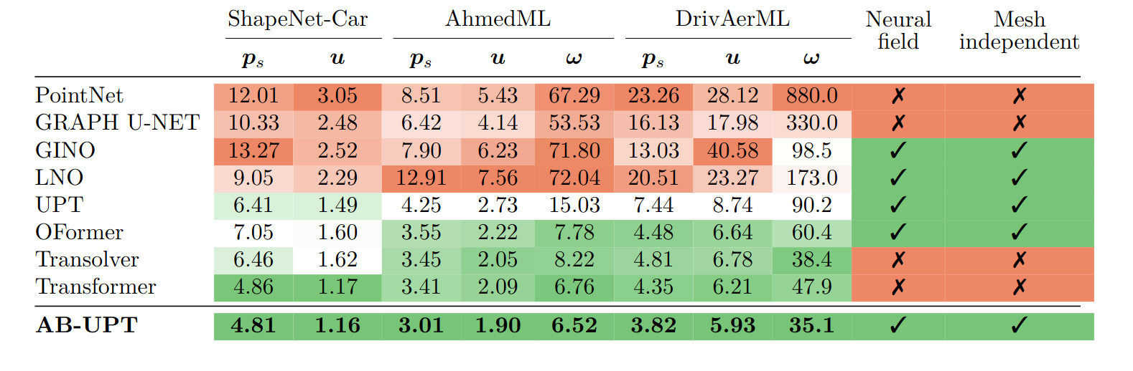
Classical Benchmarks
PINNs, Neural Operators, NeuralDEM, Universal Physics Transformer Models
Source: https://arxiv.org/pdf/2502.09692

Slide 33
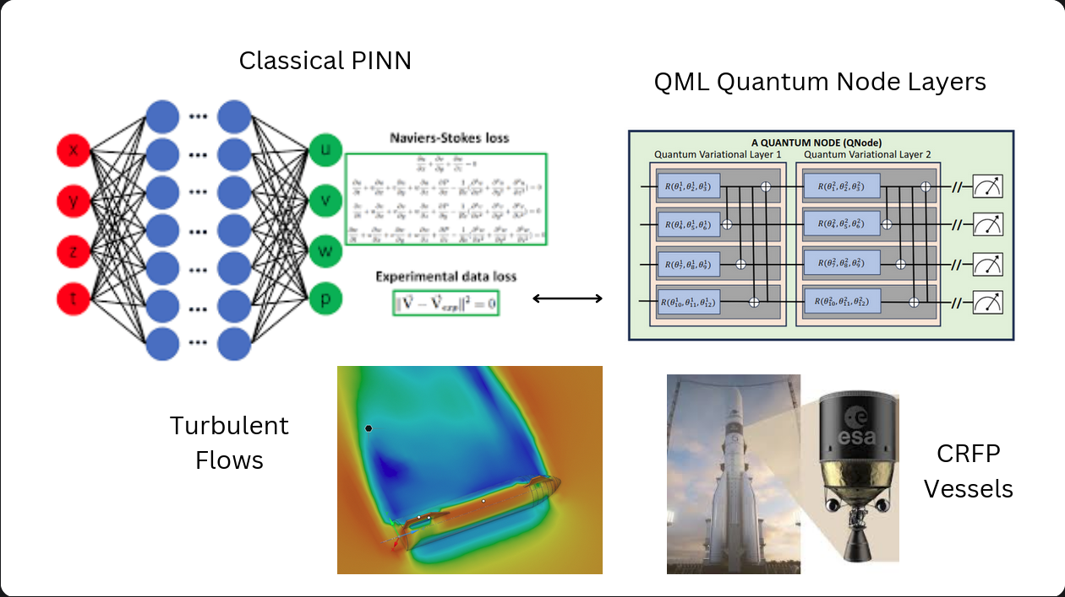
QML Quantum Node Layers
Classical PINN
Turbulent Flows
CRFP Vessels
Overview
Quantum advantage to Classical PINNs

Slide 34
Role of PINNs
Perform Parameter Sensitivity Analysis
Temperature gradients
Precursor pressure concentrations
Flow rates
Substrate properties
Notes:
Highly Accurate Simulations: Integrate fundamental physics laws with neural networks to provide more accurate predictions of CFRP behavior under various conditions.
Significantly Faster Processing: Reduce simulation times from weeks to days or hours, enabling rapid design iterations.
Multi-Physics Capability: Simultaneously simulate structural, thermal, and fluid dynamics within a unified framework.
Customizable Interface: Tailor simulations to specific design requirements of different space missions.

Slide 35
Role of PINNs
PINN methodology
  Modified Loss Function:
  L_total = L_PDE + L_BC + L_IC + λ L_SAL
    $L_{PDE}$ is the physics-informed loss
    $L_{BC}$ and $L_{IC}$ are boundary and initial condition losses
    $L_{SA}$ is the sensitivity analysis term
    λ is a weighting factor
Computation done with automated differentiation
Notes:
Highly Accurate Simulations: Integrate fundamental physics laws with neural networks to provide more accurate predictions of CFRP behavior under various conditions.
Significantly Faster Processing: Reduce simulation times from weeks to days or hours, enabling rapid design iterations.
Multi-Physics Capability: Simultaneously simulate structural, thermal, and fluid dynamics within a unified framework.
Customizable Interface: Tailor simulations to specific design requirements of different space missions.

Slide 36
Overview
Combining Quantum with Physics-Inspired AI models for accelerating Computational Fluid Dynamic (CFD) Simulations
Addressing the problems associated with CFD
● High Computational Cost
● Expensive High Fidelity Simulations

Slide 37
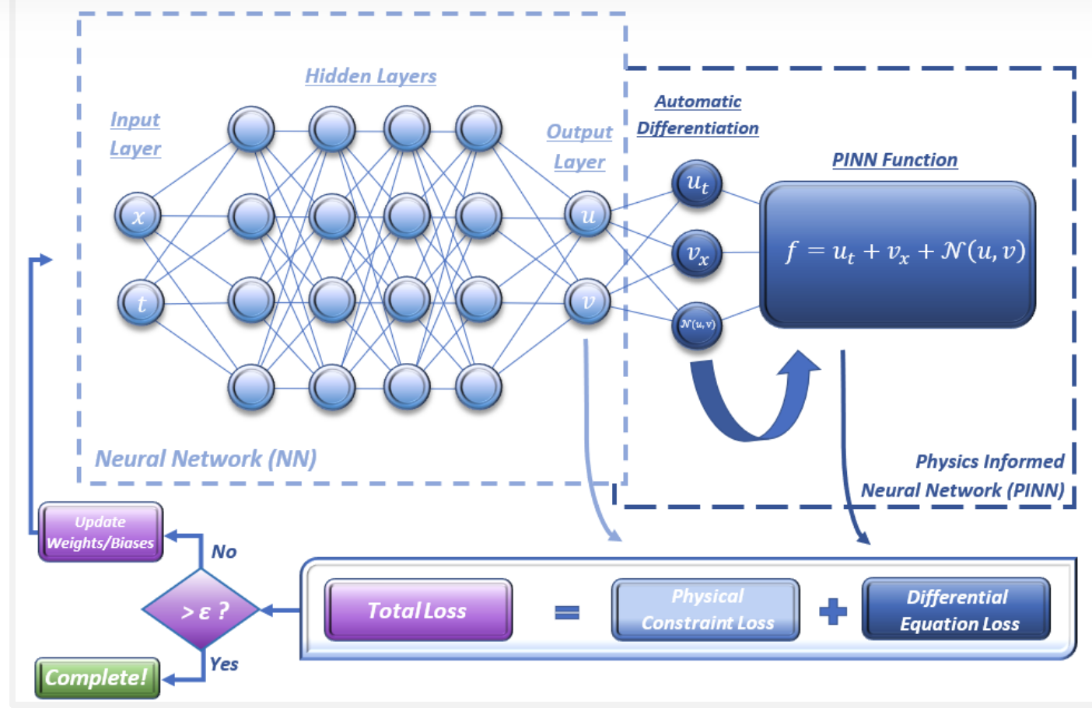
PINNs: combining NN with Physics
Higher Accuracy & Multi-Physics Capability with Less Data
Notes:
Highly Accurate Simulations: Integrate fundamental physics laws with neural networks to provide more accurate predictions of CFRP behavior under various conditions.
Significantly Faster Processing: Reduce simulation times from weeks to days or hours, enabling rapid design iterations.
Multi-Physics Capability: Simultaneously simulate structural, thermal, and fluid dynamics within a unified framework.
Customizable Interface: Tailor simulations to specific design requirements of different space missions.

Slide 38
PINNs: combining NN with Physics
Higher Accuracy & Multi-Physics Capability with Less Data
Notes:
Highly Accurate Simulations: Integrate fundamental physics laws with neural networks to provide more accurate predictions of CFRP behavior under various conditions.
Significantly Faster Processing: Reduce simulation times from weeks to days or hours, enabling rapid design iterations.
Multi-Physics Capability: Simultaneously simulate structural, thermal, and fluid dynamics within a unified framework.
Customizable Interface: Tailor simulations to specific design requirements of different space missions.

Slide 39
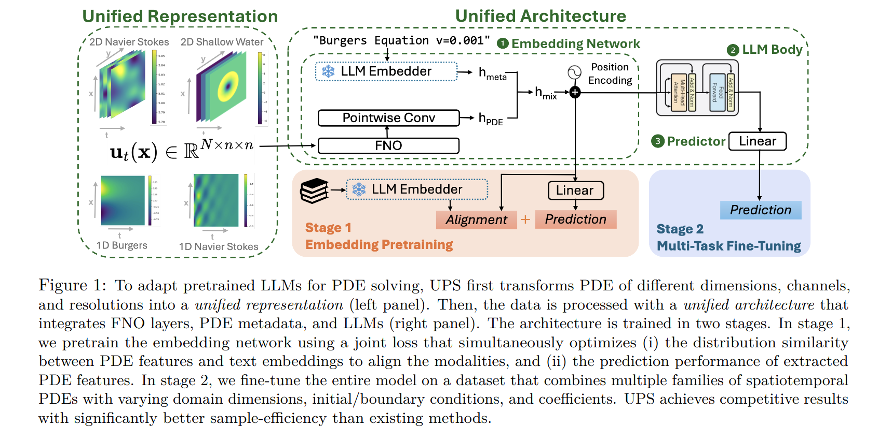
QML Quantum Node Layers
Classical PINN
Turbulent Flows
CRFP Vessels
Unified PDE Solver (UPS)
Source:

Slide 40
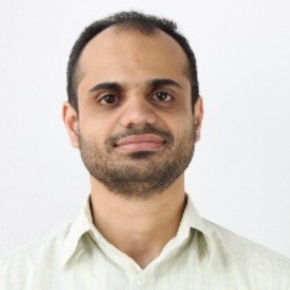


Introduction
Academic Experience:
Doctoral Thesis in Density Functional Theory
(TU Berlin)
Dimensionality Behaviour of Kinetic Functionals (FU Berlin)
Industry Experience:
Data Science and Machine Learning
BMBF Projects KILIDAR, KIKOSA
(Ancud IT)
A Seshaditya

Slide 41
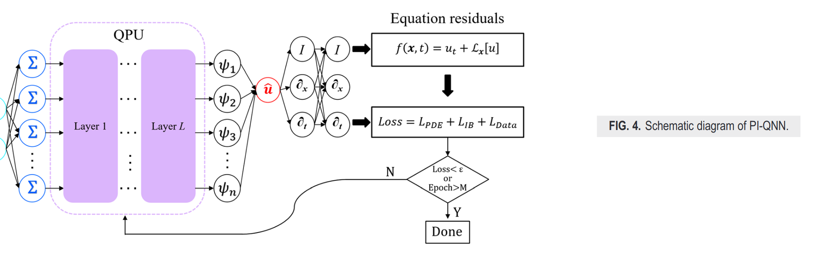
Theory
Physics Informed Quantum Neural Networks
Source: https://doi.org/10.1063/5.0226232

Slide 42
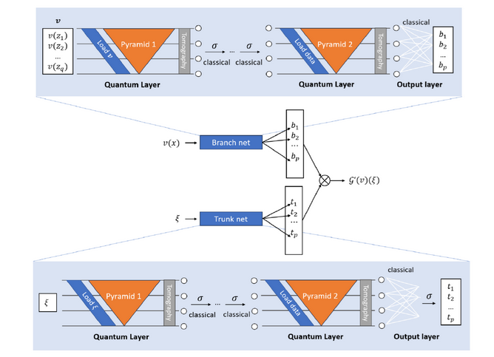
Theory
Quantum DeepONets
Variational Quantum Circuit (VQC) with focus on Geometry
Source: https://arxiv.org/pdf/2409.15683

Slide 43
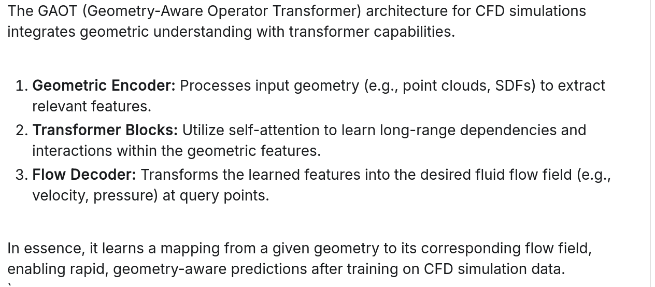
GAOT: Geometry Aware Operator Transformers
Source: arXiv:2505.18781v2

Slide 44
GAOT: Geometry Aware Operator Transformers
Source: arXiv:2505.18781v2

Slide 45
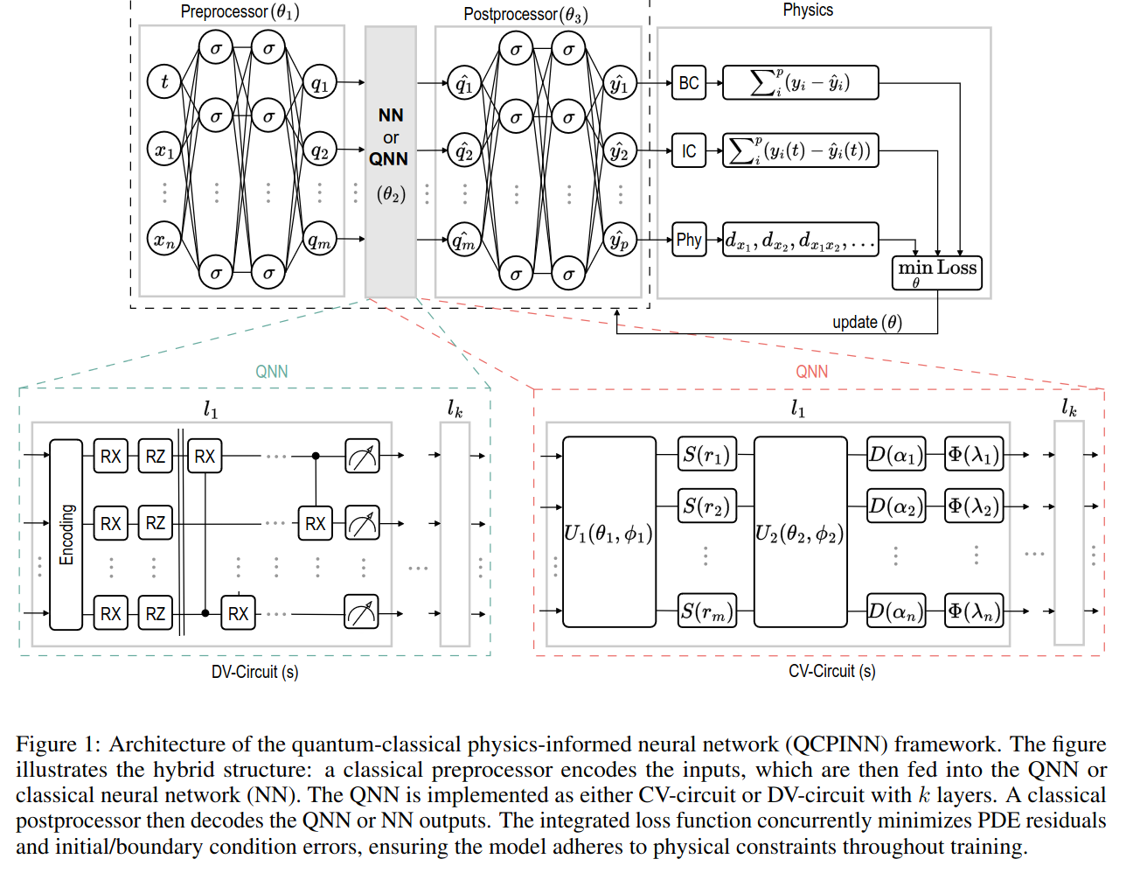
Theory
Hybrid Quantum Physics Informed Neural Networks
Variational quantum circuit (VQC) with focus on Geometry
Source: https://arxiv.org/html/2304.11247v3

Slide 46
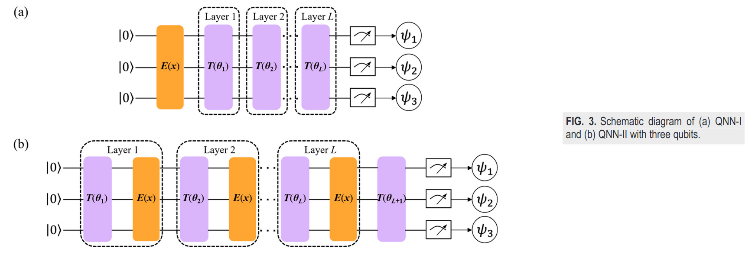
Theory
Physics Informed Quantum Neural Networks
Source: https://doi.org/10.1063/5.0226232

Slide 47
Theory
Advanced Quantum PINNs-Attention Enhanced
Source: https://arxiv.org/html/2304.11247v3

Slide 48
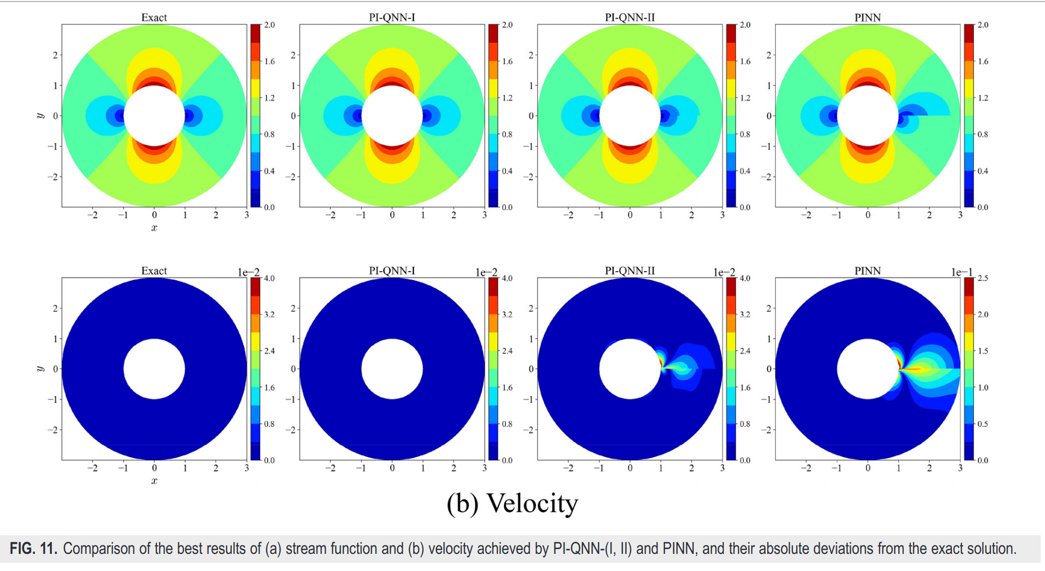
QML Quantum Node Layers
Classical PINN
Turbulent Flows
CRFP Vessels
Simulations Results
Source: https://doi.org/10.1063/5.0226232

Slide 49
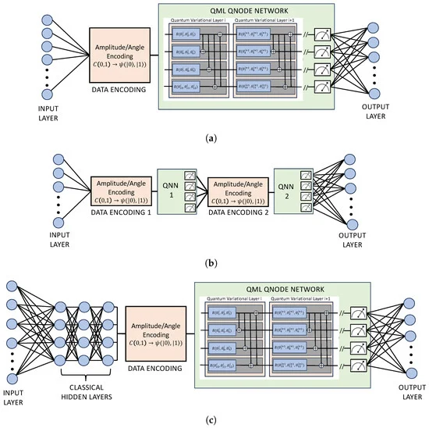
Theory
Quantum Physics Informed Neural Networks
Quantum node layer combined with classical layers
Source: https://www.mdpi.com/1099-4300/26/8/649

Slide 50
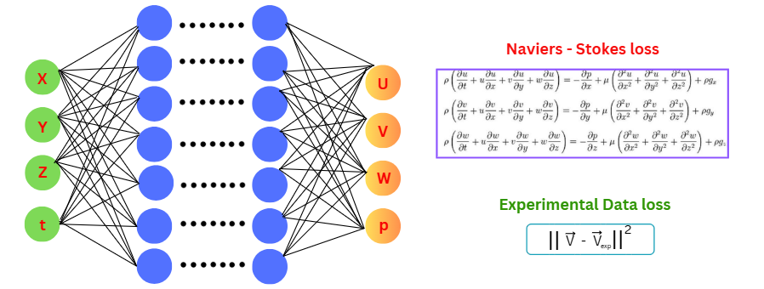
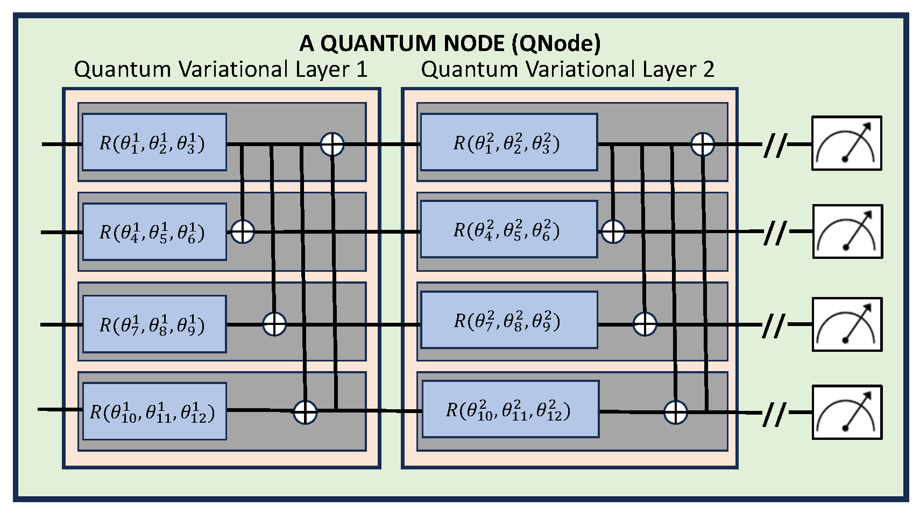
Aim
Combining Quantum with Physics-Informed Neural Networks Neural Operators, Geometry Aware Operator Transformers
Bringing Quantum Advantage through AI
(Hybrid Approaches on QPU/GPUs Hardware)

Slide 51
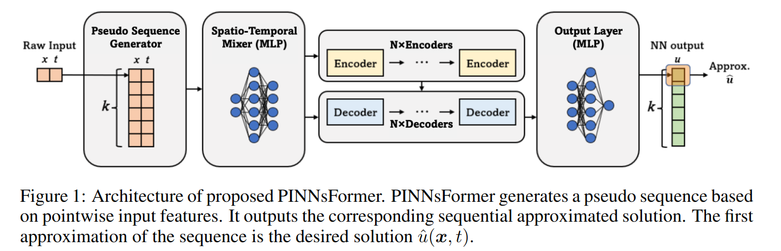
QML Quantum Node Layers
Classical PINN
Turbulent Flows
CRFP Vessels
Variants of PINNs
Source:

Slide 52
QML Quantum Node Layers
Classical PINN
Turbulent Flows
CRFP Vessels
UPS
Source:

Slide 53
QML Quantum Node Layers
Classical PINN
Turbulent Flows
CRFP Vessels
Variants of PINNs
Source:

Slide 54
Theory
Quantum Physics Informed Neural Networks
Quantum node layer combined with classical layers
Source: https://www.mdpi.com/1099-4300/26/8/649

Slide 55
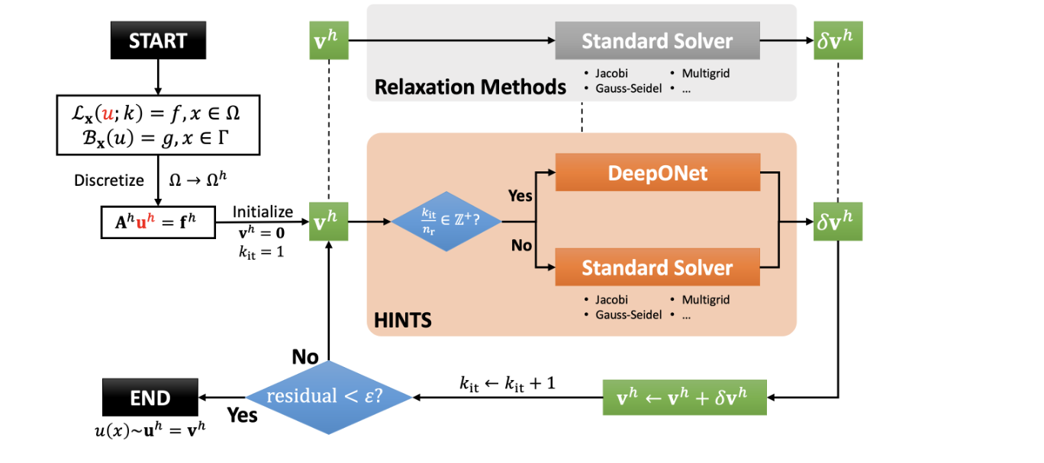
QML Quantum Node Layers
Classical PINN
Turbulent Flows
CRFP Vessels
HINTS
Source:

Slide 56
Advantages of PINNs
Multi-physics Integration: Fluid Dynamics, heat transfer, and chemical kinetics
Data Efficiency: By incorporating physical laws, accurate predictions even with limited experimental data
Interpretability: physics-informed nature of PINNs allows for better interpretability of results
Adaptability: different processes and configurations by adjusting equations and boundary conditions
Notes:
Highly Accurate Simulations: Integrate fundamental physics laws with neural networks to provide more accurate predictions of CFRP behavior under various conditions.
Significantly Faster Processing: Reduce simulation times from weeks to days or hours, enabling rapid design iterations.
Multi-Physics Capability: Simultaneously simulate structural, thermal, and fluid dynamics within a unified framework.
Customizable Interface: Tailor simulations to specific design requirements of different space missions.

Slide 57
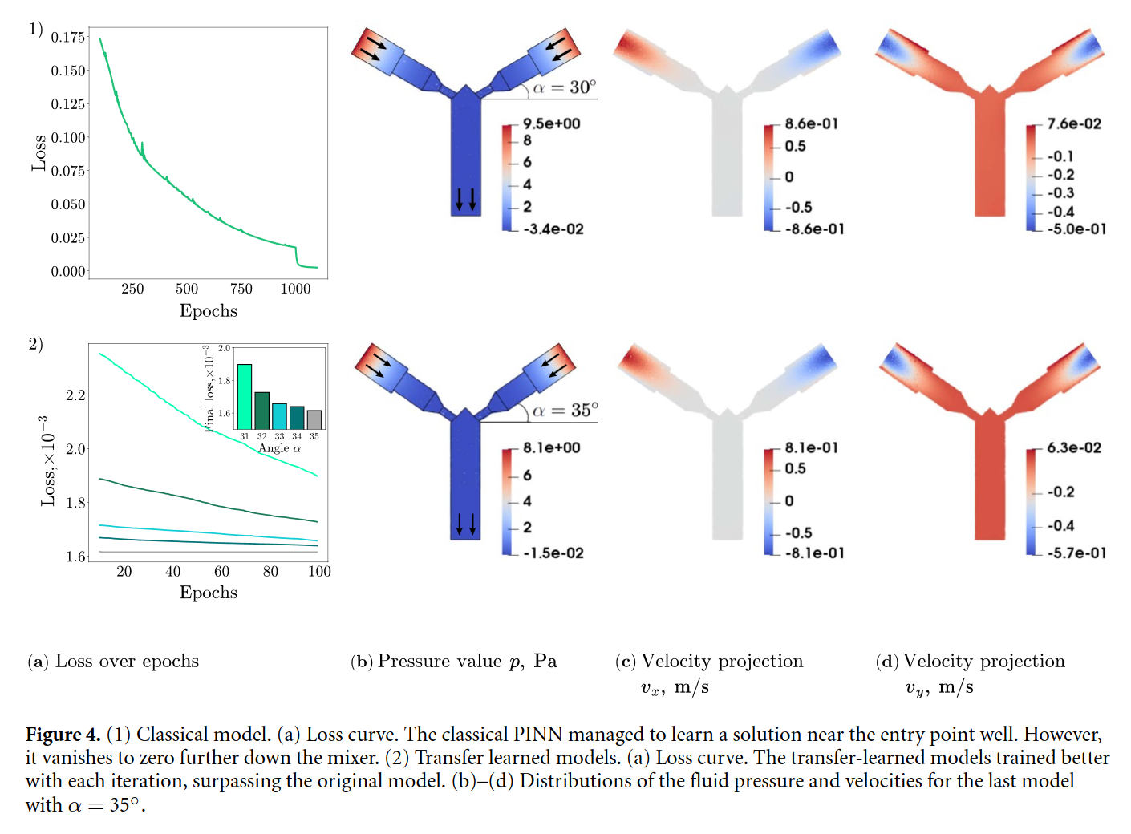
QML Quantum Node Layers
Classical PINN
Turbulent Flows
CRFP Vessels
Simulation Results
Source: https://arxiv.org/html/2304.11247v3

Slide 58

QML Quantum Node Layers
Classical PINN
Turbulent Flows
CRFP Vessels
Simulations Results

Slide 59
QML Quantum Node Layers
Classical PINN
Turbulent Flows
CRFP Vessels
HINTS
Source:

Slide 60

A practical case study. Higher generalization.
Continuous variable (CV) quantum neural network can emulate a classical non-linear affine transformation – a neuron.
This is not always granted. Topic under study also inside QuaSi.
Key advantage : 80-90% reduction of the training volume data, same solution quality.
QCPINN: Quantum-Classical Physics-Informed Neural Networks for Solving PDEs, AfraFareah et al., https://arxiv.org/pdf/2503.16678

