Slide 1
Machine Learning Algorithms Using Scikit-learn
Introduction

Slide 2
Machine Learning
- Machine learning: the science and art of programming computers so they can learn from data.
- In classical programming humans input rules (a program) and data to be processed according to these rules, and the outputs are answers.
- In machine learning, humans input data and the expected answers, and the outputs are the rules.
Classical programming
Rules
Answers
Data
Machine learning
Data
Rules
Answers
Adapted from ‘Deep Learning with Python’ by Francois Chollet.

Slide 3
Machine Learning
What do you need for machine learning?
- Input data points: e.g. text, pictures, sound files.
- Examples of the expected output (answers): e.g. tags such as ‘dogs’, ‘cats’; human-generated transcripts of sound files.
- A way to measure whether the algorithm is doing a good job: to determine the distance between the algorithm’s output and the expected output.
This is a feedback signal to adjust the way the algorithm works.
Performance
Machine learning
Data
Rules
Answers
Adapted from ‘Deep Learning with Python’ by Francois Chollet.

Slide 4






Machine Learning Lifecycle
Data Acquisition
Preprocessing
Processing
Measurement
Improvement

Slide 5
Machine Learning
Data Acquisition
- Understand the problem.
- Identify the data sources.
- Spot possible problems with the data.

Slide 6
Machine Learning
Data Types
Data
Numerical
Categorical
Discrete
Continuous
Nominal
Ordinal
Measurements are integers:
- age
- n° of students
Measurements can take on any value, usually within a range:
- temperature
- weight
No natural order between categories:
- gender
- states / districts
- color names
An order between categories:
- T-shirt size (S, M, L)
- grades (A, B, C)
- time of the day (morning, afternoon, evening)

Slide 7
Machine Learning
Data Types
Data
Strings
Sequence data
Location data
- time series (time order)
- sequences of strings (text data)

Slide 8
Machine Learning
Preprocessing: Data
- Separate relevant data from noise.
- Establish the data types available and the missing data.
- Handling missing values.
- Redundancy problems.
- Data transformation.
- Data reduction: e.g. aggregation.
- Numerical data: rounding, binning (put values in bin categories), scaling.
- Categorical data: encodings (e.g. one-hot: 0-1 vector with 1 identifying class).

Slide 9
Machine Learning
Preprocessing: Missing Values
- Ignore / remove that particular data row.
- Use a global constant to fill in the values.
- Use mean / median to fill in values.
- Use mean of all samples belonging to the same class.
- Use ML algorithm to predict the values.
- Categorical data: difficult to fill in missing values, predict values from other features or set an ‘unknown category’.

Slide 10
Machine Learning
Preprocessing: Train a Model
- Build a machine learning model of data to solve problems such as classification and regression.
- The different parameters of this model can then be tweaked.

Slide 11

Machine Learning

Slide 12
Machine Learning
Types of Machine Learning Systems
Are they trained with human supervision?
- Supervised
- Unsupervised
- Semisupervised
- Reinforcement Learning
Can they learn incrementally on the fly?
- Online
- Batch Learning
Do they compare new input data to known data points or do they detect patterns?
- Instance-based
- Model-based
These criteria can be combined

Slide 13
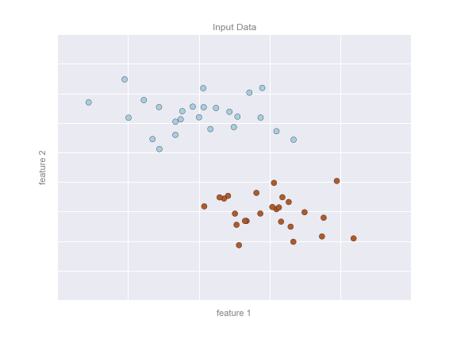
Machine Learning
Supervised Learning
The training data fed to the algorithm includes the desired solutions, called labels.
In classification, the labels are discrete categories e.g. spam detection.
In regression, the labels are continuous quantities e.g predicting the price of a car given the brand, mileage, etc.
Algorithms
- Linear Regression
- Logistic Regression
- Support Vector Machines (SVMs)
- Decision Trees and Random Forest
- Neural Networks
From ‘Python Data Science Handbook’ by Jake Vander Plas.

Slide 14
Machine Learning
Unsupervised Learning
The training data is unlabeled.
Clustering: grouping similar entities together.
Visualization: output 2D or 3D representation of complex and data that can be easily plotted.
Algorithms
Clustering
- k-Means.
- Hierarchical Cluster Analysis
Visualization
- Principal Component Analysis (PCA)
- t-distributed Stochastic Neighbor Embedding (t-SNE)

Slide 15
Machine Learning
Semisupervised Learning
The training data is partially labeled: a lot of unlabeled data with only a little of labeled data.
Labeling massive amounts of data for supervised learning is - time-consuming
- expensive.
- introduces human biases on the model.
Example: webpage classification, labeled data is used to identify specific groups of webpage types, then the algorithm is trained on unlabeled data to define the boundaries of those webpage types and may even identify new types of webpages that were unspecified in the existing human-inputted label.
Algorithms
(most are combinations of unsupervised and supervised learning algorithms)
- Deep Belief Networks (DBNs).

Slide 16

Machine Learning
Reinforcement Learning
The learning system (agent) observes the environment, selects and performs actions, and gets rewards or penalties in return.
It learns by itself what is the best strategy (policy) to maximize the rewards over time.
Algorithms
- Monte Carlo
- Q-learning
- Proximal Policy Optimation (PPO)
https://pixabay.com/en/robot-machine-technology-science-312566/

Slide 17
Machine Learning
Model Evaluation
The performance of a model must be evaluate according to the learning problem, that is, a unsupervised learning problems have different metrics from supervised learning ones.
- Supervised learning metrics
Accuracy
Confusion matrix
ROC Curve
- Unsupervised learning metrics
Adjusted Rand Silhouette Score
Jaccard index

Slide 18
Machine Learning
Challenges of Machine Learning
- Insufficient quantity of training data.
- Non-representative training data: if sample is too small, there is sample noise as a result of chance; if the sample is large the it could be non-representative if the method is flawed, called sample bias.
- Poor quality of data: if training data is full of outliers, errors and noise.
- Irrelevant features.
- Overfitting the training data: the model performs well on training data but does not generalize well.
- Underfitting the training data: the model is too simple to learn the underlying structure of the data.

Slide 19
Machine Learning
Examples from Industry
Finance
- Fraud detection.
- Credit analytics: who should get a loan?
- Sentiment analysis for stock selection.
Manufacturing
- Robots and automation.
- Predictive maintenance minimizes the risk of unexpected failures.
Medicine
- Drug discovery.
- Diagnostics.
- Recommend best medicines, predict readmissions and identify high-risk patients.
Entertainment
- Recommendation systems: YouTube, Netflix.

