Slide 1
Machine Learning Algorithms Using Scikit-learn
Classification

Slide 2
Classification
Supervised learning task, predicting classes.
Supervised Learning: the training data fed to the algorithm includes the desired solutions, called labels.
The goal of classification is, after being trained, to predict a class for a new sample whose features are provided as input.
The output is a discrete label.
Examples: yes/no, class 1 to class 5, true/false, etc.

Slide 3
Classification
Binary Classification
A binary classifier is capable of distinguishing between 2 classes e.g. cats and dogs.
Algorithms that are strictly binary classifiers are Support Vector Machines (SVM), Linear classifiers.
Algorithms that handle multiple classes are Random Forests (RF), naive Bayes classifiers.

Slide 4
Classification
Binary Classification
Performance Measures
Confusion Matrix
Count the number of times instances of class A (cats) are classified as class B (dogs).
To compute the matrix we need a set of predictions to compare with the actual targets.
Each row represents an actual class and each column a predicted class.
The perfect classifier would have only true positives and true negatives.
predicted
P
N
P
TP
FN
actual
N
FP
TN

Slide 5
Classification
Binary Classification
Performance Measures: Accuracy
Accuracy (ratio of correct predictions) = TP + TN
TP + TN + FP + FN
Accuracy sometimes not the best performance measure for classification for classifiers when dealing with skewed datasets (some classes are much more frequent than others).
For example, if there were 95 cats and only 5 dogs in the data, a particular classifier might classify all the observations as cats. The overall accuracy would be 95%, but in more detail the classifier would have a 100% recognition rate for the cat class but a 0% recognition rate for the dog class.

Slide 6
Classification
Binary Classification
Performance Measures: Precision and Recall
Precision (positive predictive value) = TP
TP + FP
Recall, sensitivity or true positive rate: ratio of positive instances correctly detected by the classifier.
Recall = TP
TP + FN
F1 score combines precision and recall, it’s the harmonic mean of precision and recall.
F1 = 2 x precision x recall = TP
precision + recall TP + (FN + FP)
2
F1 favors classifiers that have similar precision and recall. Sometimes you care more about precision and sometimes more about recall i.e. detect videos that are safe for kids you prefer to reject many good videos (low recall) but keeps only safe ones (high precision).

Slide 7
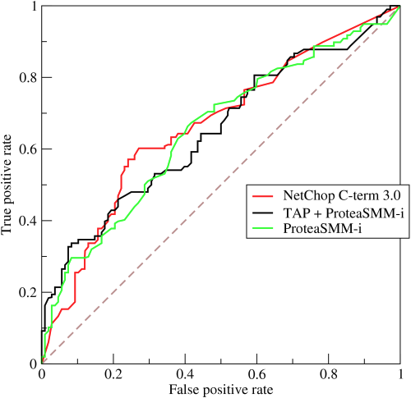
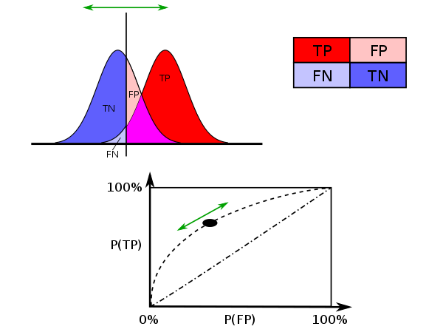
Classification
Binary Classification
Performance Measures: The ROC Curve
Receiver operating characteristic (ROC) curve plots the true positive rate (recall, sensitivity) against the false positive rate. The FPR is equal to 1 – TNR (specificity).
ROC curve plots sensitivity (recall) vs 1 – specificity.
ROC curve plots true positive rate against false positive rate at various threshold settings.
ROC curve illustrates the diagnostic ability of a binary classifier as its discrimination threshold is varied: given a threshold parameter T, the instance is classified as "positive" if X>T, and "negative" otherwise.
By BOR at the English language Wikipedia, CC BY-SA 3.0, https://commons.wikimedia.org/w/index.php?curid=10714489
By Sharpr - Own work, CC BY-SA 3.0, https://commons.wikimedia.org/w/index.php?curid=44059691

Slide 8
Classification
Binary Classification
Performance Measures: The ROC Curve
http://www.navan.name/roc/

Slide 9
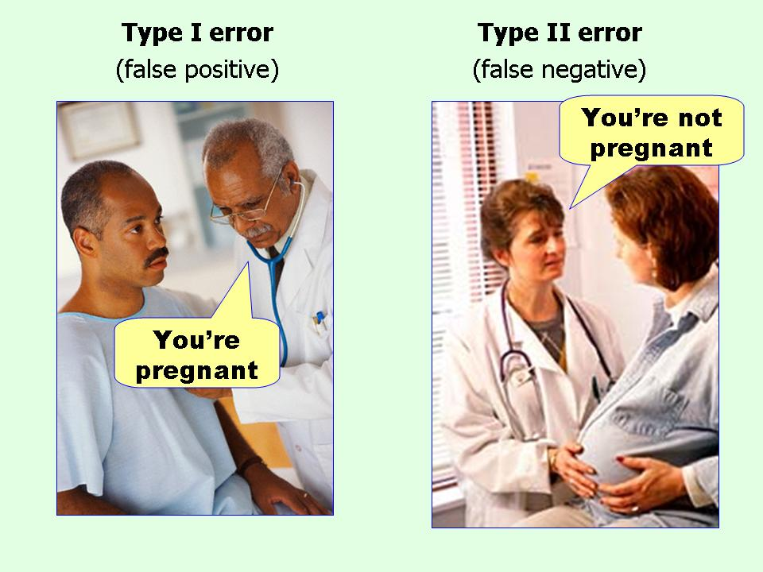
Classification
Binary Classification
Type I error – False Positive Rate
Type I error = FP
FP + TN
Type II error – False Negative Rate
Type II error = FN
FN + TP
https://effectsizefaq.files.wordpress.com/2010/05/type-i-and-type-ii-errors.jpg

Slide 10
Classification
Multiclass Classification
Multiclass classifier: can distinguish between more than two classes, also known as multinomial classifier.
Multilabel classifier: output multiple classes for each instance.
i.e. face recognition classifier that attaches the name (label) per person that recognizes.

Slide 11
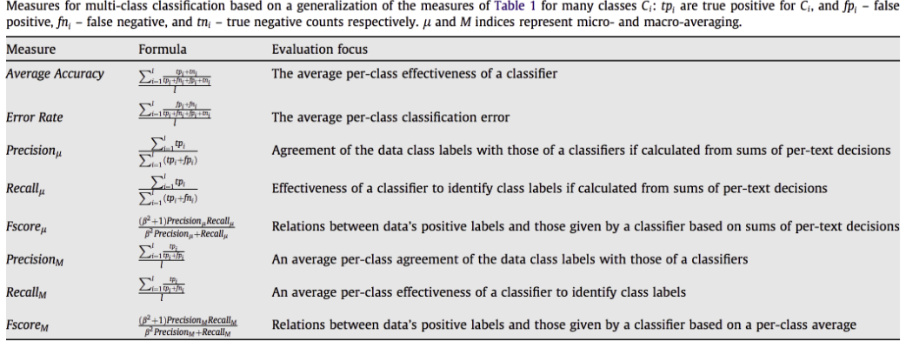
Classification
Multiclass Classification
Performance Measures
https://www.sciencedirect.com/science/article/abs/pii/S0306457309000259

Slide 12
Classification
Multiclass Classification
Performance Measures
Micro-average method: - sum of counts to obtainl TP, FP, TN, and FN and then calculate a performance measure
- it favors the bigger classes
Macro-average method: - takes the average of the measures calculated for class 1 to n
- treats all classes equally
Micro-average is preferable if there is a class imbalance problem.

Slide 13
Classification
Multiclass Classification
Performance Measures
Pycm: multi-class confusion matrix library in Python
https://github.com/sepandhaghighi/pycm

Slide 14
Classification
Classifiers
- Logistic Regression.
- Support Vector Machines (SVM).
- Decision Trees / Random Forest.

